Slide 1
Welcome to
Inclusive Leadership
Topical Action Group (TAG)
Thursday, Dec 5th 2024
3:00-4:00 Eastern Time
Welcome to our TAG!
Participants: please change your Zoom name to
your state and name
Ex: Florida, Agatha Trunchbull
CEEDAR staff: please change your Zoom name to
CEEDAR, Your name
Notes:
Abby: Make everyone co-hosts
Speaker: Nichole
3:00-3:01

Slide 2
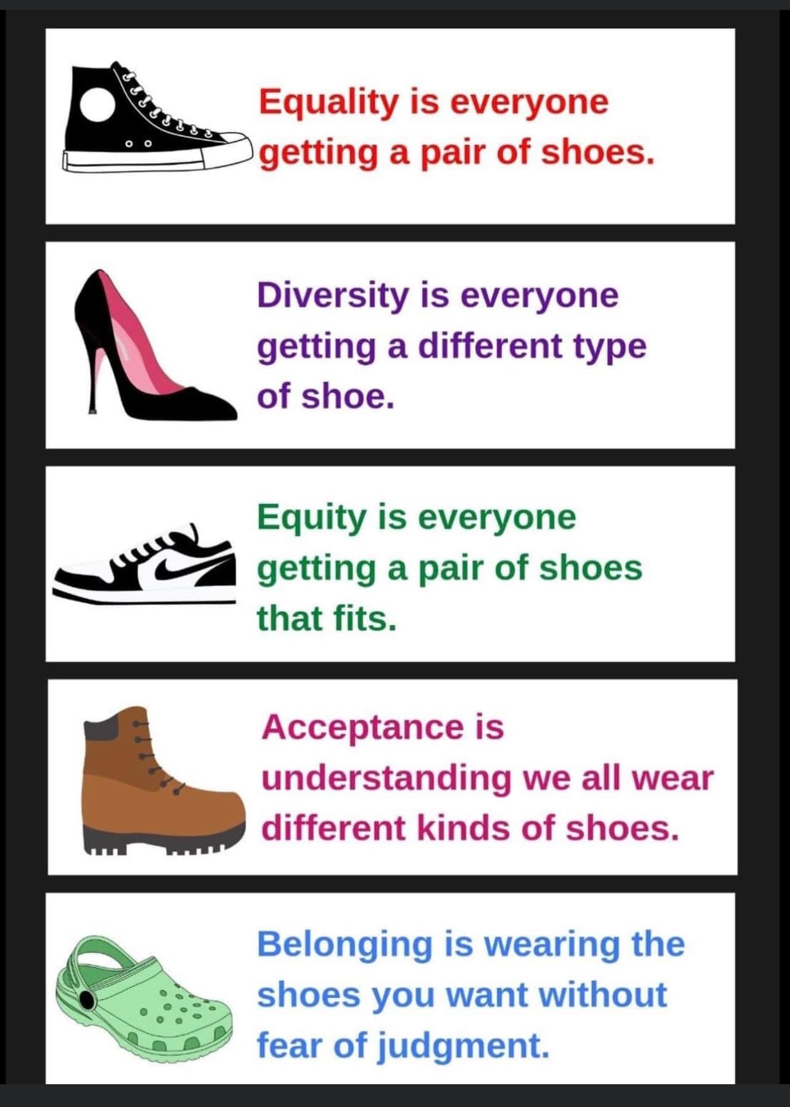
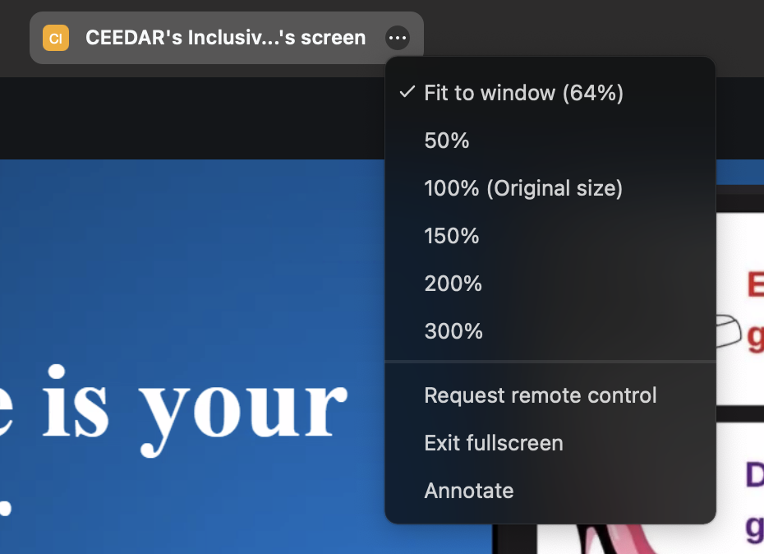
Check in:
Which shoe is your program or organization currently wearing?
Notes:
Speaker: Nichole Please change your name to Your state abbreviation and your first and last name
3:00-3:02
Nichole circle the annotate word on slide show

Slide 3
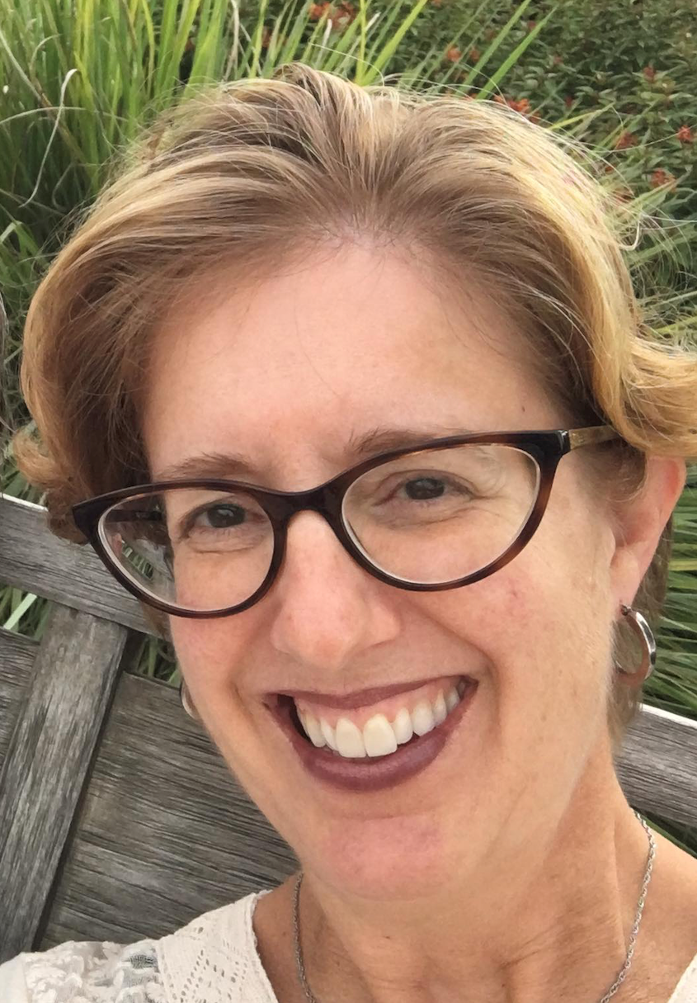
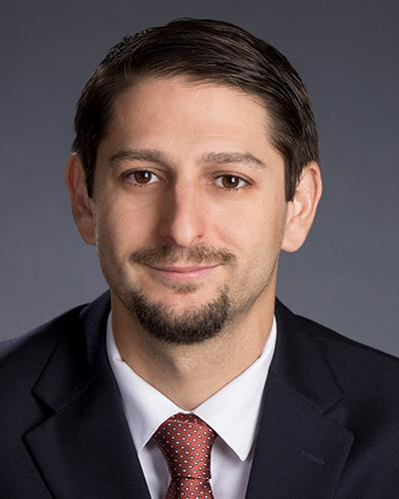
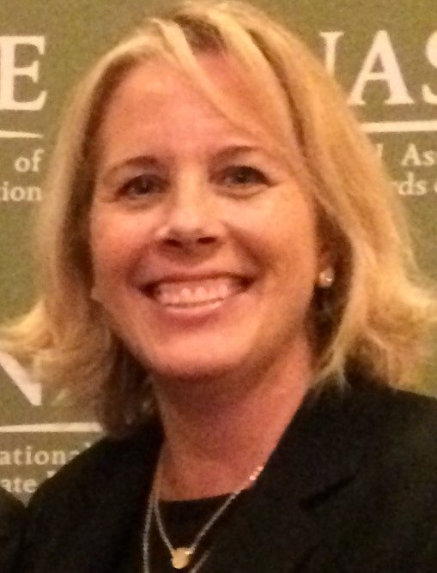
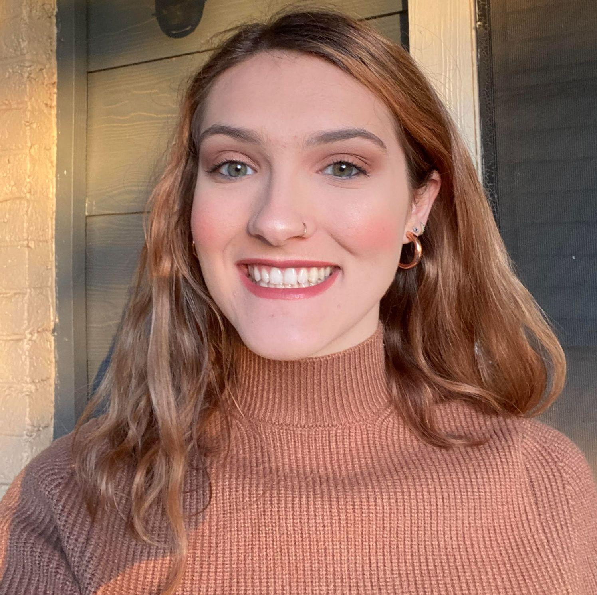
Welcome & Introductions 1
Welcome & Introductions
Dr. David DeMatthews
Professor, Department of Education Leadership and Policy,
The University of Texas at Austin
Nichole Spalding
Technical Assistance Specialist,
CEEDAR, University of Florida
Abby Berner
Engagement Specialist, CEEDAR, Research Assistant, American Institute for Research (AIR)
Dr. Bobbi Newman
State Lead for CEEDAR Center, Principal Researcher, American Institute for Research (AIR)
Notes:
Speaker: Bobbi
3:02-3:03

Slide 4





Our Partners
Notes:
Speaker: Bobbi
A warm thank you to our partners
Our partners are Lead IDEA, NASSP, and CCSSO- they are our liaisons and will share resources, they can provide additional perspectives. If you are here from one of these partner organizations, please share who you are in the chat and feel free to share your expertise!
3:02-3:03

Slide 5
The purpose of the IL TAG is to…
elevate the importance of inclusive leadership in our work,
focus on inclusive practices in our programs, coursework, clinical experiences, and policies,
engage in authentic conversations on their inclusive leadership efforts,
and share expertise, successes and challenges, and discuss how to use resources to support scaling and sustainability.
Notes:
Speaker: Bobbi
Recognize that we have different roles as members of our TAG (SEA, IHE, associations, local) we want to be mindful of these roles as we talk in cross state and state team time
3:02-3:03

Slide 6
Inclusive Leadership
Potential Topics for Discussion
Date | Topic
October 3 | TAG Overview - Spotlight on Georgia
November 7 | Mission, Vision and Core Values; Ethics and Professional Norms
December 5 | Equity and Cultural Responsiveness
January 9 | Curriculum, Instruction and Assessment
February 6 | Communities of Student Care and Support
March 6 | Professional Capacity and School Personnel; Professional Community for Teachers and Staff
April 3 | Meaningful Engagement of Families and Community
May 1 | Operations and Management, School Improvement
Notes:
speaker: Bobbi
3:03-3:04

Slide 7
Today’s Agenda
Welcome and Introductions
Resource Sharing - Standards 3
Cross State Breakout Groups
Spotlight on Colorado
State Breakout Groups
Final Thoughts and Action Items
Notes:
Speaker: Bobbi
Nichole put meeting norms in chat
Meeting norms:
Be present and prepared
Respect in the shared space and keep what is shared in confidence. We are creating a community.
We will record guest speakers and resources sharing, but nothing else. What happens in the TAG, stays in the TAG!
Breakout rooms could be mixed cross state or state specific depending on the work.
Group members should “believe the best” and lead with positive intentionality.
3:04-3:05

Slide 8
Standard 3: Equity and Cultural Responsiveness
“Principals should recognize that students have multiple identities... As opposed to viewing students as part of one subgroup… Principals often must educate and advocate within their schools and communities… [They] cannot wait to enact efforts until the ‘hearts and minds’ of others are changed…” (p. 24-25).
Standard Components | Program/ Faculty | Courses | Clinical | Policy
3.1: Ensure the academic success and well-being of each student, including SWDs, through equitable access to effective teachers, contextually focused learning opportunities and supports, and necessary resources. |  |  | X
3.2: Hold asset-based rather than deficit-based perspectives of students and recognize relationships among disability, cultural differences, and social inequities. |  | X
Notes:
speaker: David
3:05-3:15

Slide 9
Using the IC!!!
Essential Components | Implementation Levels
Instructions: Place an X under the implementation for each course syllabus that meets the criteria level from 0-3. Score and rate each item separately. | Level 0: No evidence that the component is included in the syllabus, or the syllabus only mentions the component. | Level 1: Instruction Must contain at least one item of the following: reading, lecture/presentation, discussion, modeling/demonstration, or assessment. | Level 2: Observation Must contain at least one item from Level 1, plus at least one of the following: observation, project/activity, case study, or lesson plan study. | Level 3: Application Must contain at least one item from Level 1 and at least one item at Level 2, plus at least one of the following: tutoring, small-group student teaching, or whole group internship.
3.1 Ensure the academic success and well-being of each student, including students w/ disabilities, through equitable access to effective teachers, contextually focused learning opportunities and supports, and necessary resources
Using the IC!!!
Notes:
speaker: David
3:05-3:15

Slide 10
Interconnected: Mission/Vision, Ethics/Norms, and Cultural Responsiveness
Standard 1 Mission/Vision
Standard 2
Ethics/Norms
Standard 3
Cultural Responsiveness
Notes:
speaker: David
3:05-3:15

Slide 11
Cross State Breakout Room Guiding Question
Share an example of how your SEA/EPP is strengthening program implementation of equity and cultural responsiveness for aspiring and current school leaders. We will stay in these breakout rooms until 3:30.
CEEDAR facilitators, be prepared to come back from breakouts and share 1-2 sentences that summarize the discussion.
Notes:
Speaker: Bobbi
10 minute groups
Mix of state and CEEDAR facilitators
Abby will put in chat: breakout norms screenshot and “Share an example of how your SEA/EPP is strengthening program implementation of equity and cultural responsiveness for aspiring and current school leaders. CEEDAR facilitators, be prepared to come back from breakouts and share 1-2 sentences that summarize the discussion.”
3:15-3:16

Slide 12
Takeaways from Cross State Discussion
Welcome back! CEEDAR facilitators, share 1-2 sentences in the chat that summarize your group’s discussion.
Notes:
Speaker: David
intro WKU people or Shelby
3:27-3:30

Slide 13
Welcome & Introductions
Western Kentucky University
Dr. Stacy Leggett
Dr. Margie DeSander
Dr. Ellen Casale
Illustration of:
Program/ Collective Faculty (Collective Improvement of Equity Across Programs)
Notes:
speaker: David - give time reminder: it’s 3:30…. for the next 10 minutes, we will hear… at 3:40…
David will msg in chat with time reminder

Slide 14
Prior State (2011-2018):
Weaker Program Treatment of
Issues of Equity
After reviewing syllabi, assessments, and student work products, we realized that we explicitly addressed equity weakly and often unintentionally. Faculty could share how equity guided their thinking on presenting course content and even feedback to aspiring principals, but they could identify only a limited number of learning experiences explicitly designed to develop student understanding of equity in leadership. Comparing the current and emergent standards for school leader development further supported the need to focus more intentionally on equitable leadership and diversity within the program (Leggett et al., 2022, p. 411).
Notes:
Margie
Abby: send PDF of their paper

Slide 15
Prior Program Treatment of Equity
Course | Treatment
Culture and community | A combination of survey instruments (Richardson, 2010; Wagner, 2006) and collaborative field-based activities (Peterson & Deal, 2009)
School law | Legal issues related to student rights and students with disabilities
Introduction | Historical achievement trends with attention to the deficit-oriented language
School improvement | Goals: achievement gaps, student achievement, student growth, transitions, and graduation rates where applicable
Instructional leadership | Multi-tiered systems of support (MTSS) audit
Leggett et al., 2022
Notes:
Margie?

Slide 16
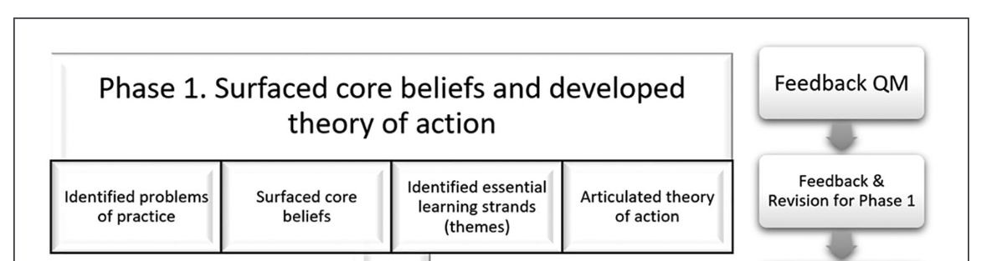
Key Work for Stronger Program Treatment (Coherence Across Program) of Issues of Equity
Leggett et al., 2022
Notes:
Margie?

Slide 17
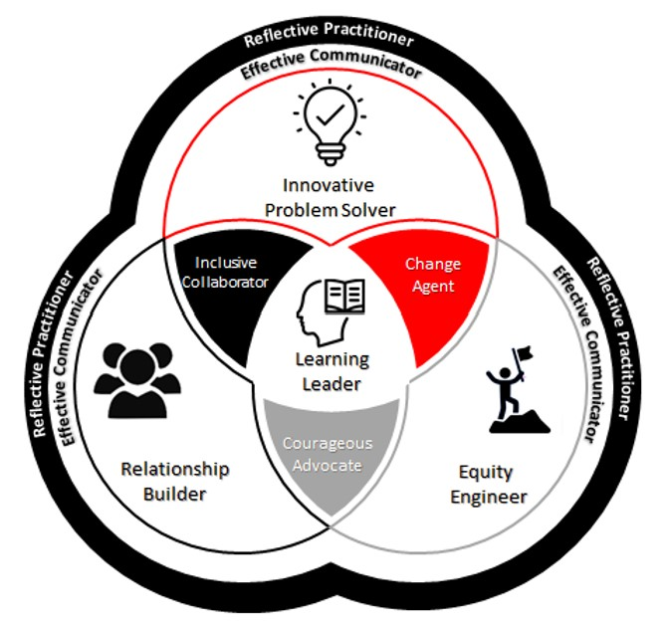
Themes
Learning Leader
Innovative Problem Solver
Effective Communicator
Equity Engineer-design solutions for problems related to equity
Leggett et al., 2022
Notes:
Margie?

Slide 18
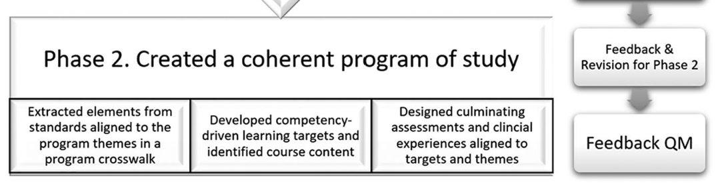
Phase 2
Leggett et al., 2022
Notes:
Stacy

Slide 19
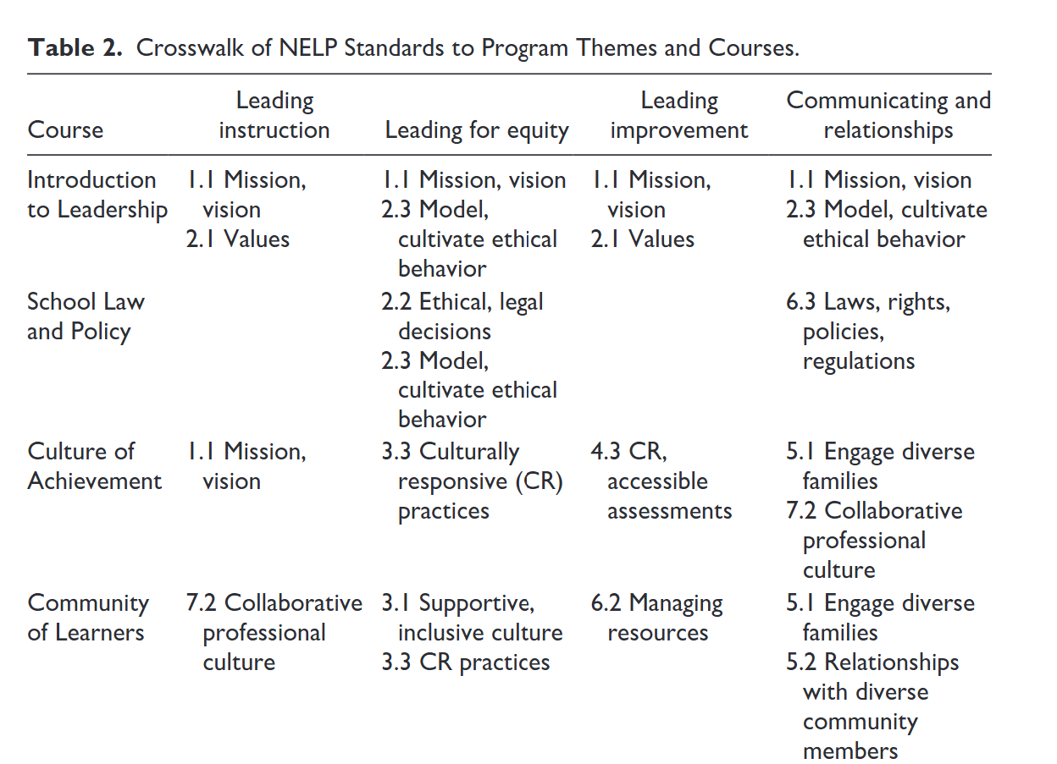
Crosswalk
Leggett et al., 2022
Notes:
Stacy

Slide 20
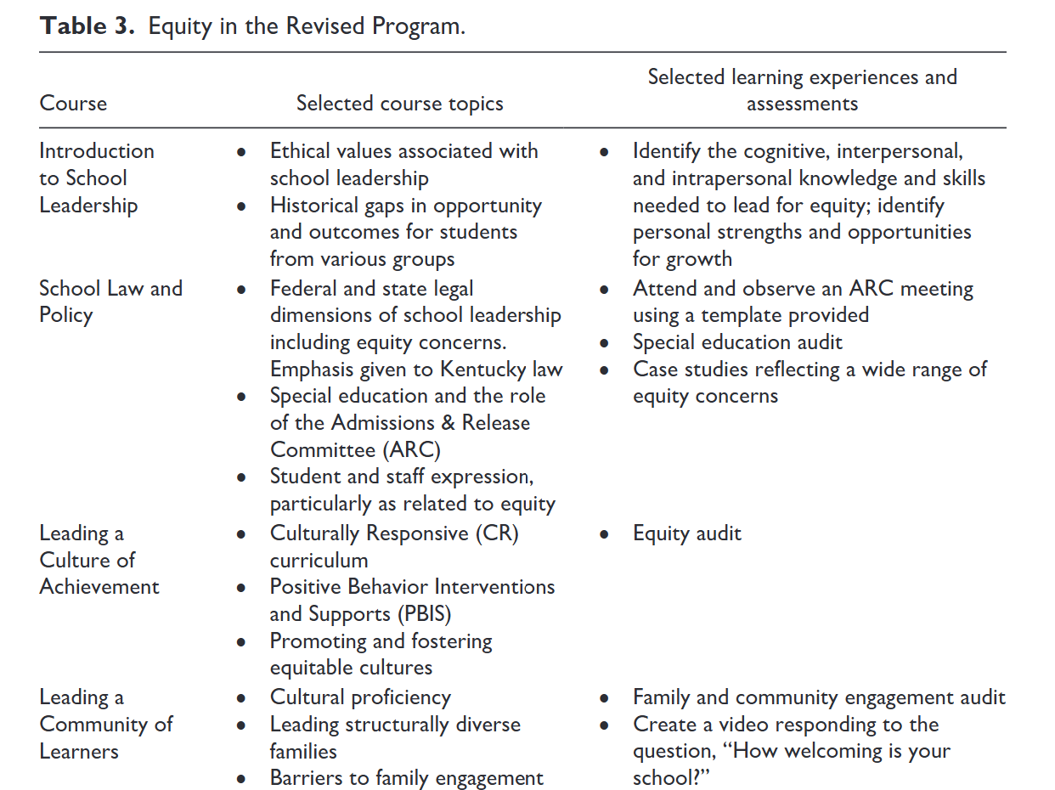
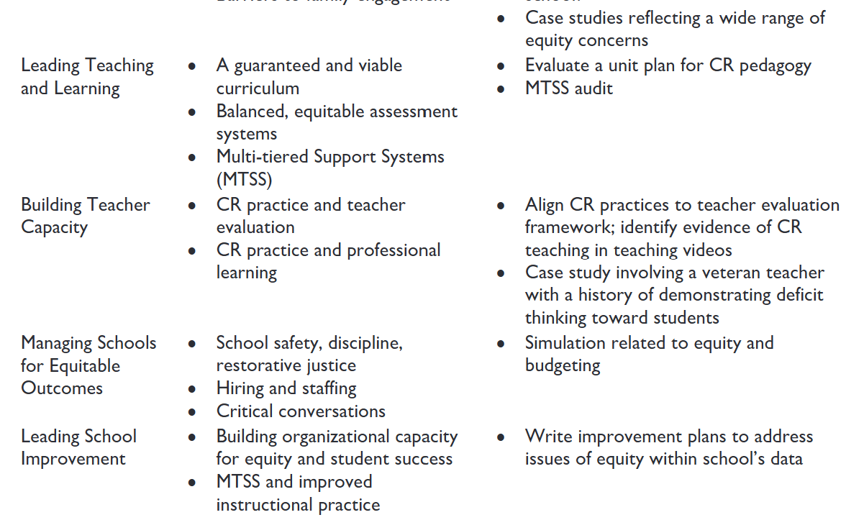
Coherent Treatment of Equity
Leggett et al., 2022
Notes:
Stacy

Slide 21
Doing better as we learn more
Special Education/Educational Administration
Continued revisions focused on equitable outcomes for students with disabilities through Kentucky Excellence in Educator Preparation (KEEP) mini-grants and WKU Center for Innovative Teaching and Learning (CITL)
Started by aligning program with CEEDAR Center Inclusive Practices Innovation Configuration (IC; Billingsley et al., 2017) and prioritizing courses for revision
Added learning modules to EDAD 606, 607, and 597 and will address 605 in the spring
Notes:
Ellen

Slide 22
State Team Reflection
Please access your blueprint from your state notes page to help with these questions. This also provides you a space to record your thinking during discussion.
  What ideas did you hear today that resonated with you?
  How might what you learned today impact your state plan or the work in your organization?
Notes:
speaker: Abby
Thank you to the faculty from WKU for sharing their program redesign process. Be sure to check out the paper I sent earlier in the chat as that describes even more about this fantastic work. Now with your state team in breakout rooms, please reflect on WKU’s presentation and how it relates to your state’s work.
go over slide info. each breakout room will have a CEEDAR staff member or partner to help guide your conversations, you will have 15 minutes. Do we have any questions?
Nichole sends questions in the chat and state notes page
What ideas did you hear today that resonated with you?
How might what you learned today impact your state plan or the work in your organization?

Slide 23
Final Thoughts
Notes:
speaker: Bobbi
3:56-3:58

Slide 24
Invitations
Our next TAG meeting January 9th
  Curriculum, Instruction, and Assessment (IC Standard 4).
    Please review pages 25-34 in the IC document to help orient you to our next meeting topic.
  We are looking for state to highlight in this January meeting.
    If you have a connection within your state work that connects to IC Standard 4, please reach out to aberner@air.org
  Please join the monthly IC Trainings
    January 23rd 4-5:30 pm ET, Sign-up form
Notes:
speaker: Bobbi
thank the presenters again
Abby send IC document and Sign-up form
3:58-4:00

