Slide 1
Welcome to
Inclusive Leadership
Topical Action Group (TAG)
Thursday, Nov 7th 2024
3:00-4:00 Eastern Time
Welcome to our TAG!
Participants: please change your Zoom name to
your state and name
Ex: Florida, Agatha Trunchbull
CEEDAR staff: please change your Zoom name to
CEEDAR, Your name
Notes:
Abby: Make everyone co-hosts
Speaker: Nichole
3:00-3:01

Slide 2
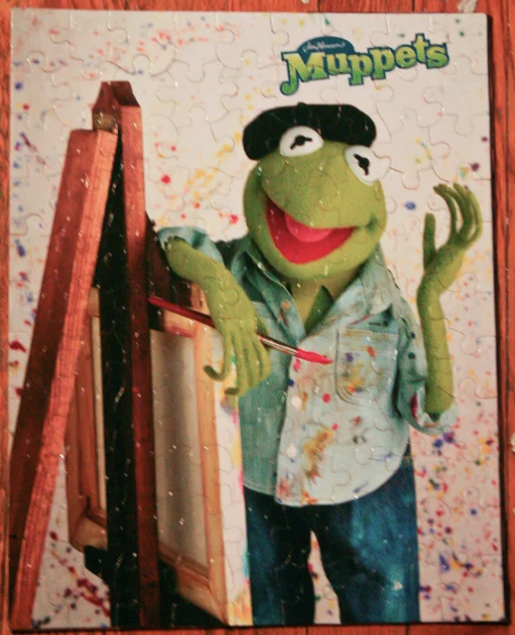
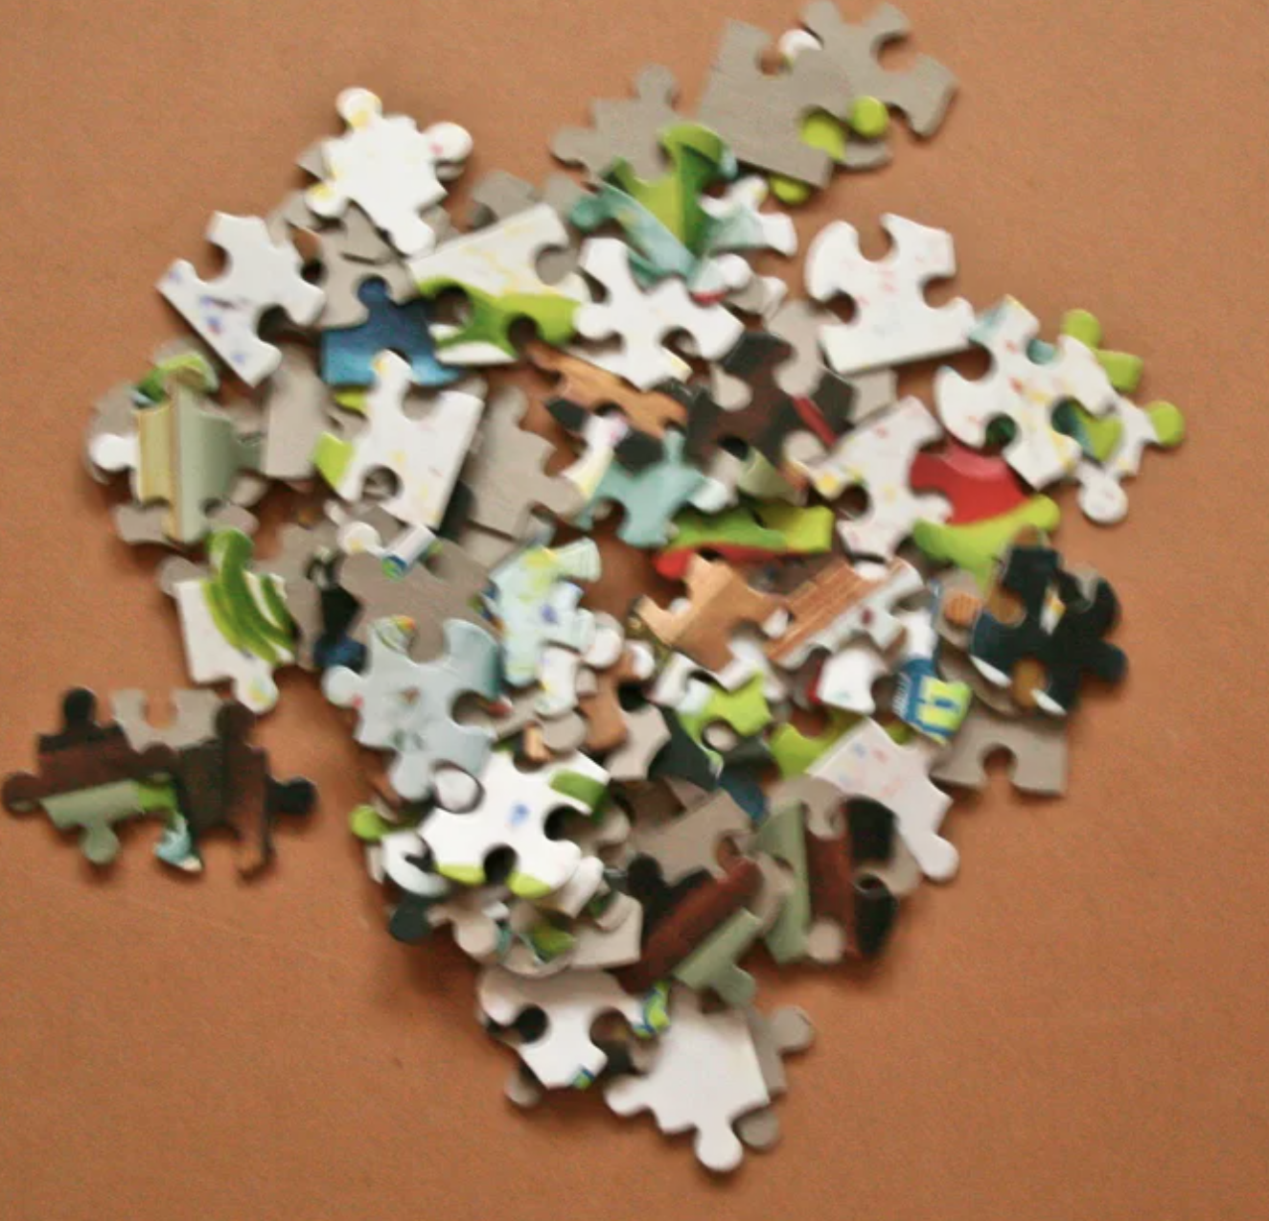
Check in:
Check in:
Today’s TAG is about having a shared vision. What is your vision of the puzzle?
Notes:
Speaker: Nichole Please change your name to Your state abbreviation and your first and last name
3:00-3:02

Slide 3
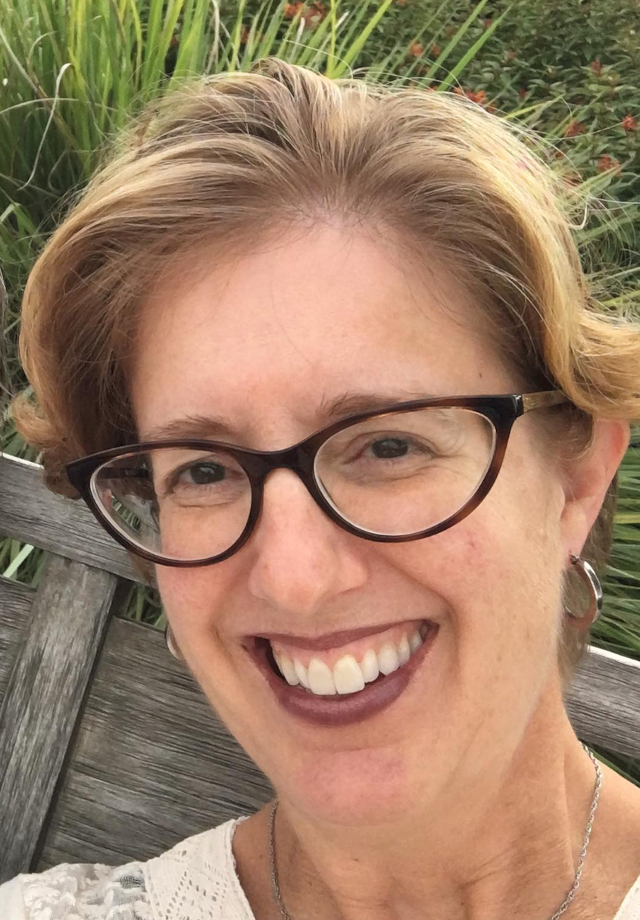
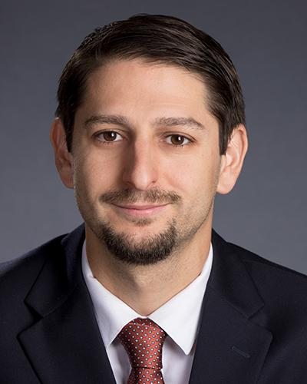
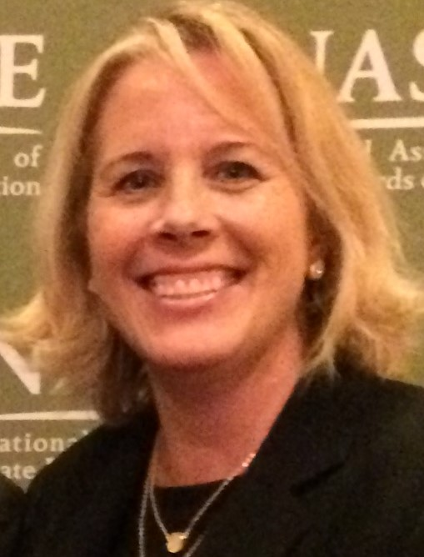
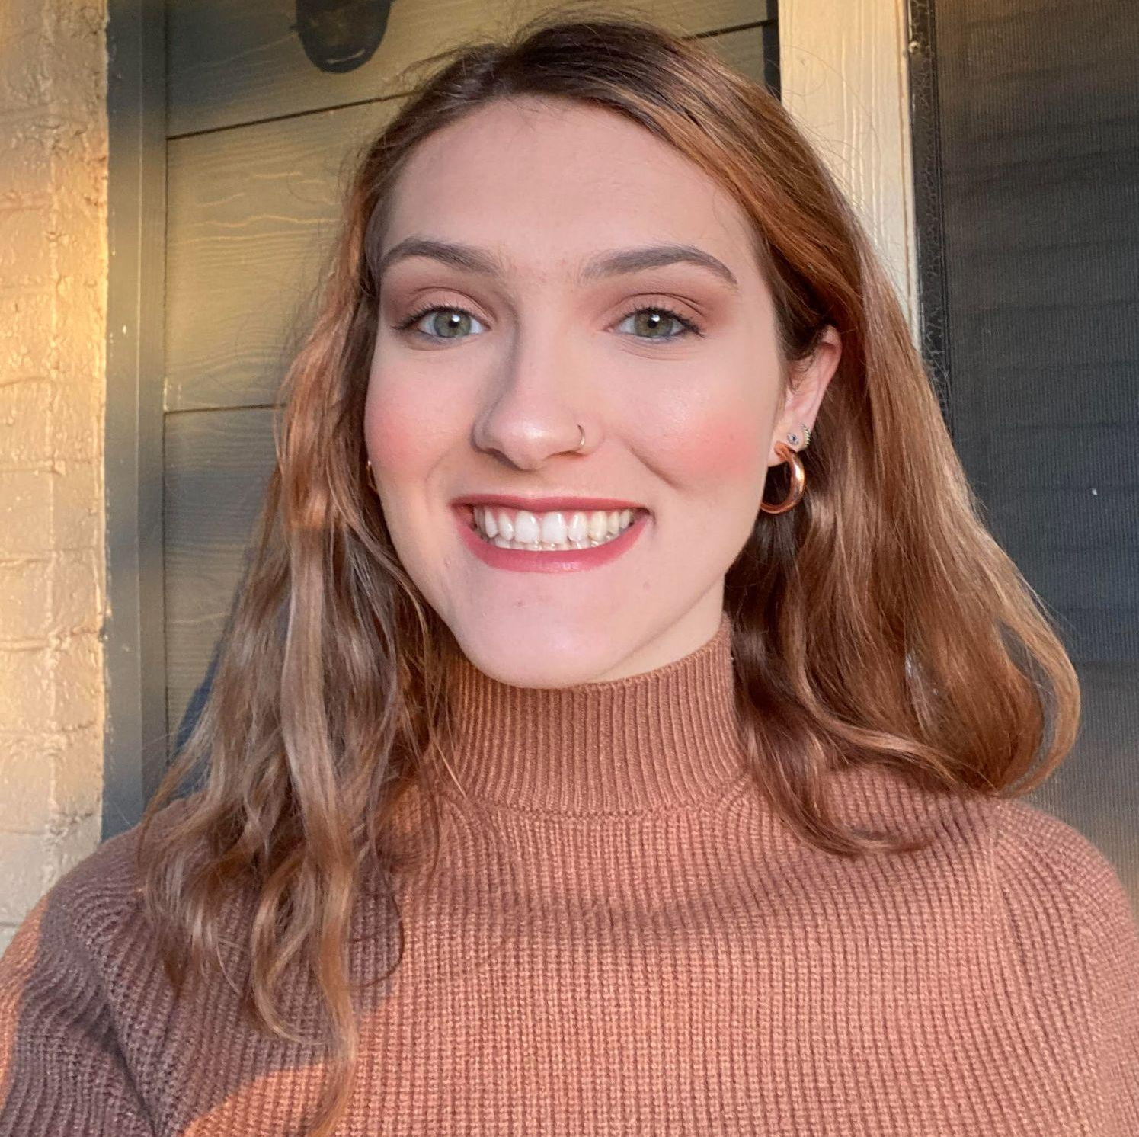
Welcome and Introductions
Welcome & Introductions
Dr. David DeMatthews
Professor, Department of Education Leadership and Policy,
The University of Texas at Austin
Nichole Spalding
Technical Assistance Specialist,
CEEDAR, University of Florida
Abby Berner
Engagement Specialist, CEEDAR, Research Assistant, American Institute for Research (AIR)
Dr. Bobbi Newman
State Lead for CEEDAR Center, Principal Researcher, American Institute for Research (AIR)
Notes:
Speaker: Bobbi
3:02-3:03

Slide 4





Our Partners
Notes:
Speaker: Bobbi
A warm thank you to our partners
Our partners are Lead IDEA, NASSP, and CCSSO- they are our liaisons and will share resources, they can provide additional perspectives. If you are here from one of these partner organizations, please share who you are in the chat and feel free to share your expertise!
3:02-3:03

Slide 5
The purpose of the IL TAG is to…
elevate the importance of inclusive leadership in our work,
focus on inclusive practices in our programs, coursework, clinical experiences, and policies,
engage in authentic conversations on their inclusive leadership efforts,
and share expertise, successes and challenges, and discuss how to use resources to support scaling and sustainability.
Notes:
Speaker: Bobbi
Recognize that we have different roles as members of our TAG (SEA, IHE, associations, local) we want to be mindful of these roles as we talk in cross state and state team time
3:02-3:03

Slide 6
Inclusive Leadership
Potential Topics for Discussion
Date | Topic
October 3 | TAG Overview - Spotlight on Georgia
November 7 | Mission, Vision and Core Values; Ethics and Professional Norms
December 5 | Equity and Cultural Responsiveness
January 9 | Curriculum, Instruction and Assessment
February 6 | Communities of Student Care and Support
March 6 | Professional Capacity and School Personnel; Professional Community for Teachers and Staff
April 3 | Meaningful Engagement of Families and Community
May 1 | Operations and Management, School Improvement
Notes:
speaker: Bobbi
segue into David presenting
3:04-3:05

Slide 7
Today’s Agenda
Welcome and Introductions
Resource Sharing - Standards 1 & 2
Cross State Breakout Groups
Spotlight on Colorado
State Breakout Groups
Final Thoughts and Action Items
Notes:
Speaker: Bobbi
Nichole put meeting norms in chat
Meeting norms:
Be present and prepared
Respect in the shared space and keep what is shared in confidence. We are creating a community.
We will record guest speakers and resources sharing, but nothing else. What happens in the TAG, stays in the TAG!
Breakout rooms could be mixed cross state or state specific depending on the work.
Group members should “believe the best” and lead with positive intentionality.
Speaker Bobbi:
3:03-3:04

Slide 8
Meeting Norms
Be present and prepared
Respect in the shared space and keep what is shared in confidence. We are creating a community.
We will record guest speakers and resources sharing, but nothing else. What happens in the TAG, stays in the TAG!
Breakout rooms could be mixed cross state or state specific depending on the work.
Group members should “believe the best” and lead with positive intentionality.
Notes:
Nichole post norms in chat

Slide 9
Resource
Notes:
Speaker David

Slide 10
Standard 1: Mission, Vision, and Core Values
“Principals work with teams of teachers, parents, and others … as they considered how to initiate inclusion in the school… Inclusive principal leadership includes a continued focus on being responsive to resistance and maintaining the school’s vision amid resistance” (p. 15-17).
Standard Components | Program/ Faculty | Courses | Clinical | Policy
1.1: Work collaboratively to develop a mission and vision for their inclusive school that supports the success of all students, including SWDs. | X
1.2: Ensure a shared understanding of and mutual commitment to this inclusive mission and vision among faculty and staff that shape practice.
1.3: Involve parents, including parents of students with disabilities and other external stakeholders in the visioning process and consistently engage them as partners in their work.
Notes:
Speaker: David
3:05-3:15

Slide 11
Standard 2: Ethics and Professional Norms
“Adhering to ethical norms, addressing inequities, managing ever-evolving challenges and dilemmas, and cultivating trust among diverse stakeholders are vital components to inclusive principal leadership” (p. 22)
Standard Components | Program/ Faculty | Courses | Clinical | Policy
2.1: Adhere to ethical and professional norms and uphold the moral imperative to acknowledge inequities.
2.2: Possess an ethical mindset to identify, interpret, and manage the ethical dilemmas for students with disabilities.
2.3: Lead with interpersonal competence and develop productive relationships with all populations… by communicating effectively, cultivating interpersonal awareness, and building trust. |  |  | X
Notes:
Speaker: David
3:05-3:15

Slide 12
Interconnected: Mission/Vision, Ethics/Norms, and Cultural Responsiveness
Standard 1 Mission/Vision
Standard 2
Ethics/Norms
Standard 3
Cultural Responsiveness
Notes:
Speaker: David
3:05-3:15

Slide 13
Cross State Break Out Room Directions
Notes:
Speaker: Abby
thank david for 1 and 2 as well as forward connecting to 3 which will be december’s topic
confirm with thumbs up
Nichole will build 10 rooms with CEEDAR staff in each
3:15-3:16

Slide 14
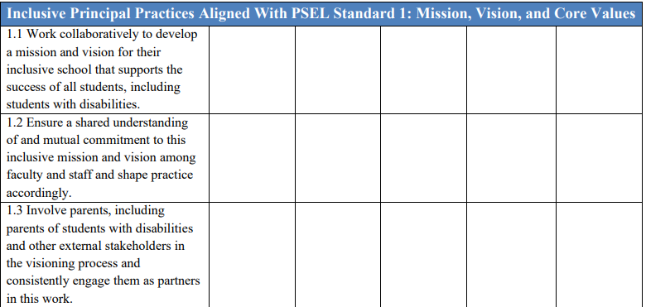
Mission and Vision Break Out Rooms
Share an example of how your SEA/EPP is strengthening implementation of mission and vision for aspiring and current school leaders.
Notes:
Speaker: Bobbi
10 minute groups
Mix of state and CEEDAR facilitators
Abby will put in chat: “Share an example of how your SEA/EPP is strengthening implementation of mission and vision for aspiring and current school leaders.” will also send screenshot of picture table
David: after cross state breakouts, have people share takeaway in chat
3:16-3:27

Slide 15
Takeaways from Cross State Discussion
We hope your break out room conversations were productive and informative. Feel free to share a take away from your discussion surrounding mission and vision implementation in the chat.
Notes:
Speaker: David
intro CO people
3:27-3:30

Slide 16
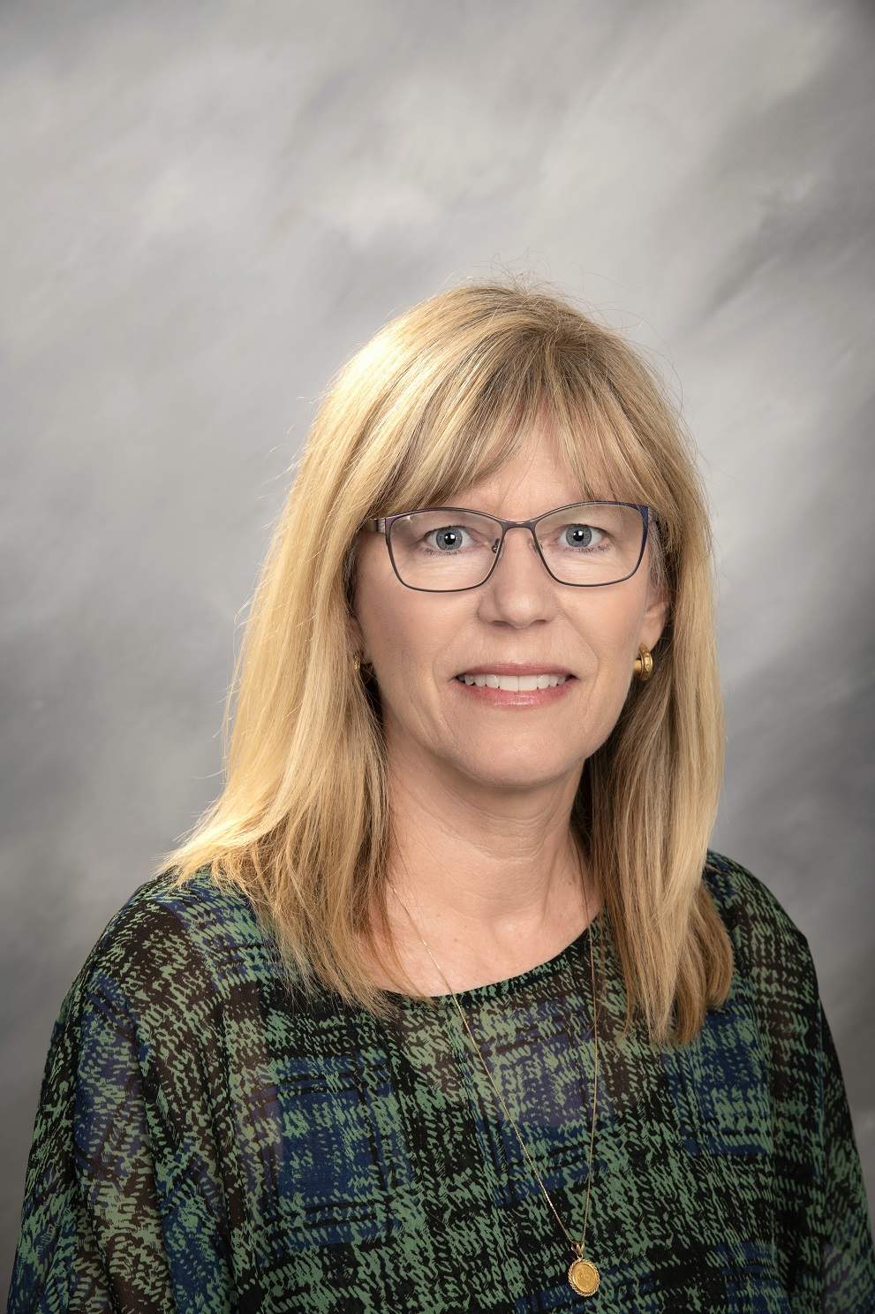
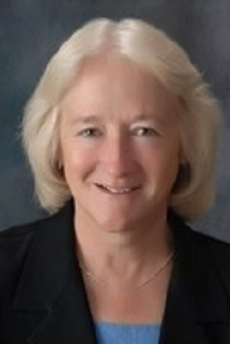
Welcome & Introductions
Karin Reynolds
Assistant Teaching Professor, Educational Leadership Program Coordinator
Leadership, Research, & Foundations, UCCS
Margaret Scott
Associate Teaching Professor
Leadership, Research, and Foundations, UCCS
Notes:
speaker: David - give time reminder: it’s 3:30…. for the next 10 minutes, we will hear… at 3:40…
David will msg in chat with time reminder

Slide 17



UCCS Successes
Helped identify our strengths and areas for more intentional inclusion of the practices
We identified one class with little documented inclusive principal practices (taught by adjunct)
We identified one standard that was light on explicit language and opportunities in our courses (S8)
Notes:
3:30-3:40

Slide 18
UCCS Challenges
Doing this work while attending to other initiatives
How to make the work seamless in our coursework
How to add without compromising something else
Notes:
3:30-3:40

Slide 19
Discussion Questions
What would you most like for us to share about our experience that we haven’t mentioned?
Where are you in the work?
What has been successful?
What has challenged you?
What else?
Notes:
3:30-3:40

Slide 20
State Team Reflection
Please access your blueprint from your state notes page to help with these questions. This also provides you a space to record your thinking during discussion.
Is there something you are already working on in your state to create a shared vision for Inclusive Leadership?
What ideas did you hear today that resonated with you?
How might what you learned today impact your state blueprint or the work in your program / organization?
Notes:
speaker: Abby
thank you Margaret and Karin for sharing with us their impactful work, Now with your state team in breakout rooms, please reflect on Colorado’s presentation and how it relates to your state’s work. go over slide info. each breakout room will have a CEEDAr staff member or partner to help guide your conversations, you will have 15 minutes
Please give us a thumbs up if you understand.
Nichole put state notes page and questions in chat before moving to breakout rooms
Is there something you are already working on in your state to create a shared vision for Inclusive Leadership?
What ideas did you hear today that resonated with you?
How might what you learned today impact your state blueprint or the work in your program / organization?
3:40-3:56

Slide 21
Final Thoughts
Share in the chat, “What is something you are feeling optimistic about in your state or organization related to your Inclusive Leadership work?”
Notes:
speaker: Bobbi
3:56-3:58

Slide 22
Invitations
Our next TAG meeting December 5th
  Equity and Cultural Responsiveness (IC Standard 3).
    Please review pages 22-24 in the IC document to help orient you to our next meeting topic.
  We are looking for state to highlight in this December meeting.
    If you have a connection within your state work that connects to IC Standard 3, please reach out to aberner@air.org
  Please join the monthly IC Trainings
    November 19th 12-1:30 pm ET, Sign-up form
Notes:
speaker: Bobbi
thank CO again
Abby send IC document and Sign-up form
3:58-4:00

