Slide 1


COACHED 2.0: A Multimedia
Option for Observing and
Coaching Educators
www.coached.education.virginia.edu
Notes:
75 mins

Slide 2



CEEDAR GA and Dr. Michael Kennedy
CEEDAR TA Partner since 2014
Jennifer Sears
University of North Georgia

Slide 3

Coached

Slide 4
www.coached.education.virginia.edu
Quick live whip around tour

Slide 5
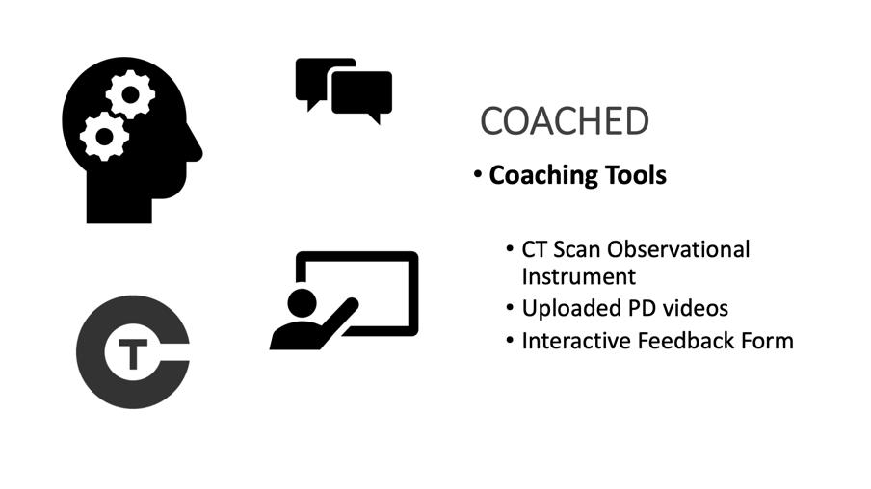
Tools

Slide 6
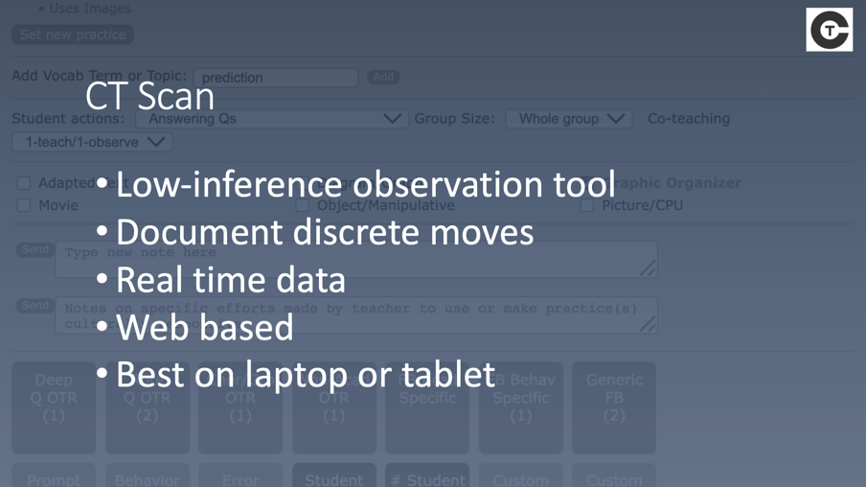
CT Scan

Slide 7
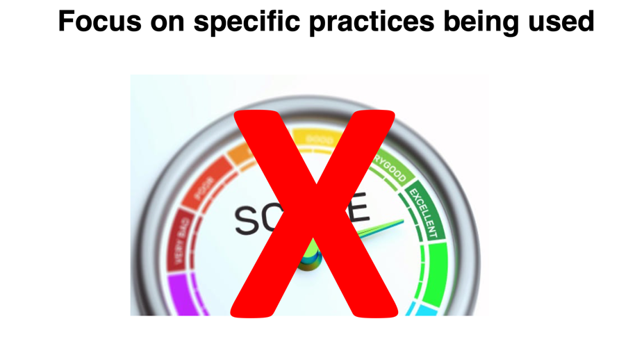
Focus on specific practices

Slide 8
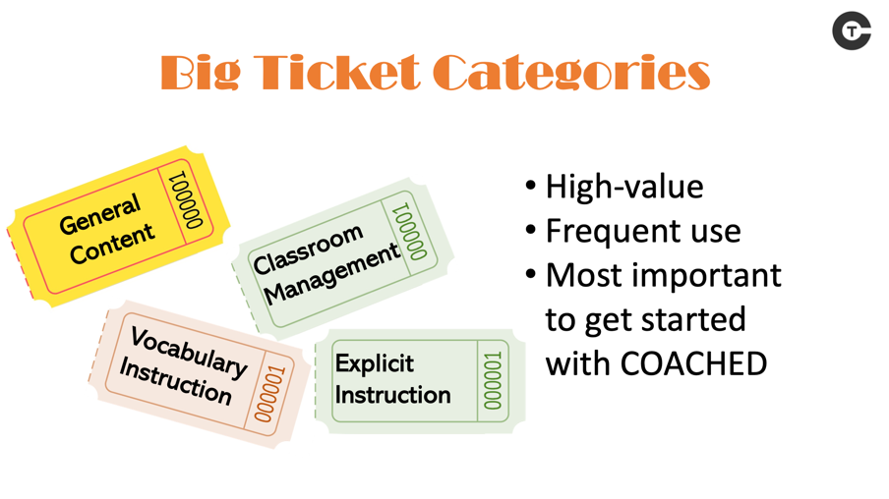
Big ticket

Slide 9



Real time
Notes:
When will we use it?
Up to you! You can use it in virtual observations where students upload a video - you can use it in real time - you can use it in Face to Face

Slide 10

HLPs

Slide 11

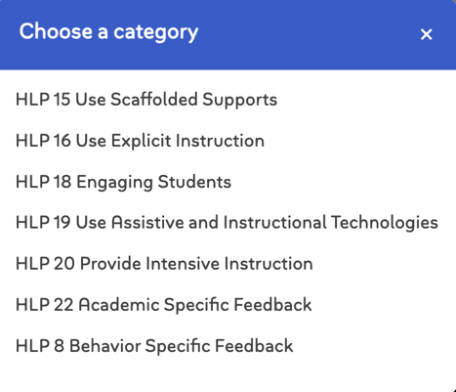
High Leverage Practices in

Slide 12
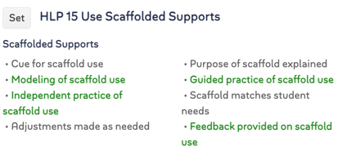
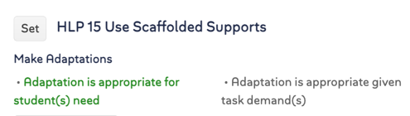
HLP 15 Using Scaffolded Supports
Two practices:
Scaffolded Supports
Make Adaptations
Individual Implementation Markers “Look-fors” for each practice

Slide 13
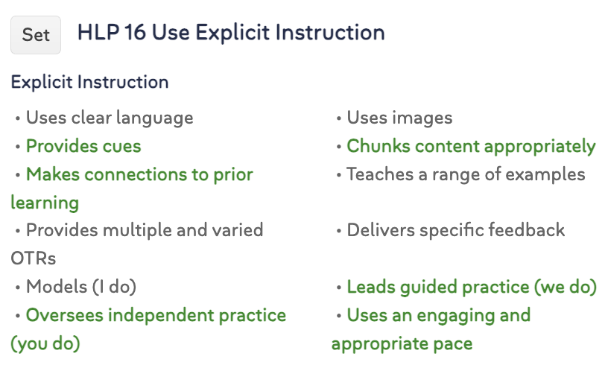
HLP 16 Use Explicit Instruction

Slide 14
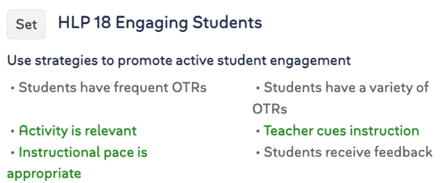
HLP 18 Engaging Students
Each HLP in COACHED has a unique set of Implementation Markers or “Look-fors” for each practice

Slide 15
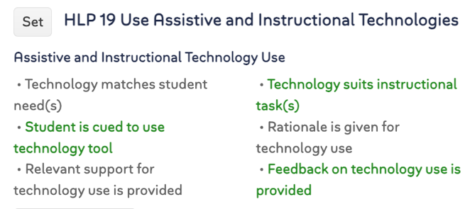
HLP 19 Use Assistive and Instructional Technologies

Slide 16
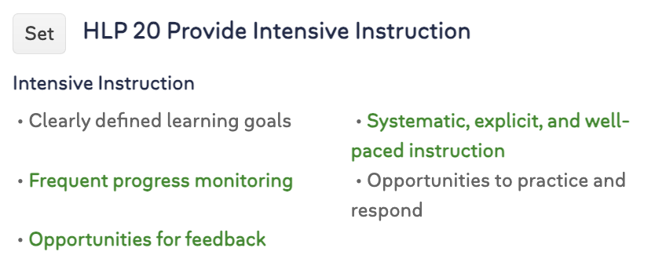
HLP 20 Provide Intensive Instruction

Slide 17
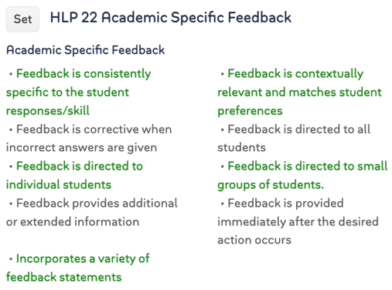
HLP 22 Academic Specific Feedback

Slide 18
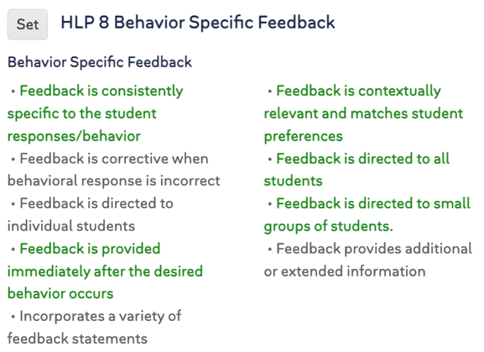
HLP 8 Behavior Specific Feedback

Slide 19
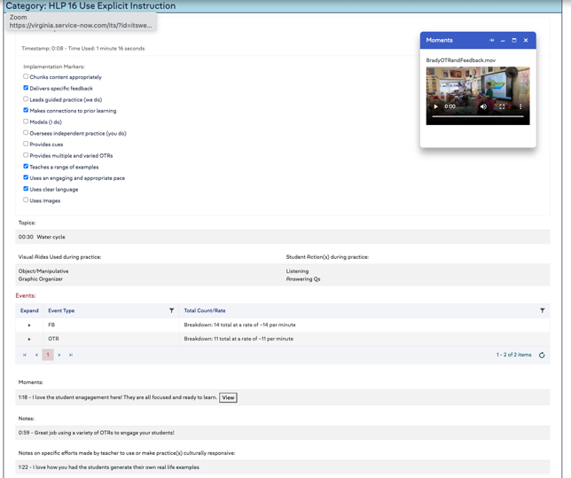
HLP Automatically Generated Feedback

Slide 20
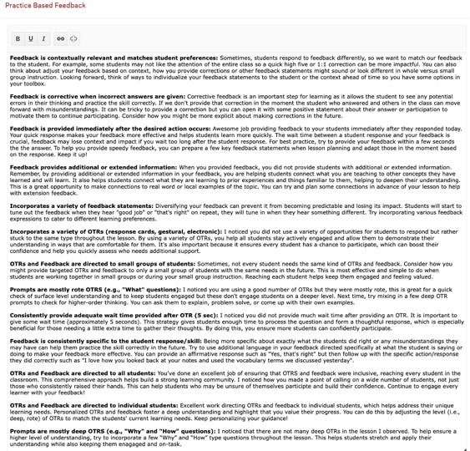
HLP Automatically Generated Feedback

Slide 21
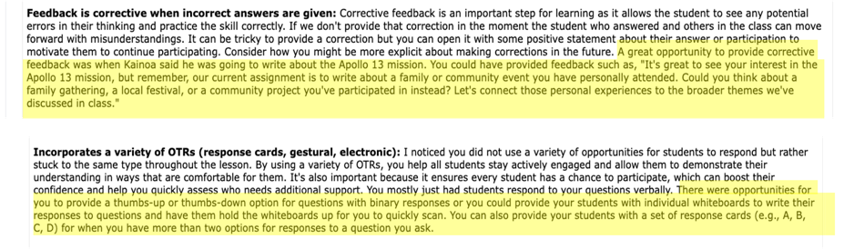
Automatically Generated Feedback with Edits

Slide 22
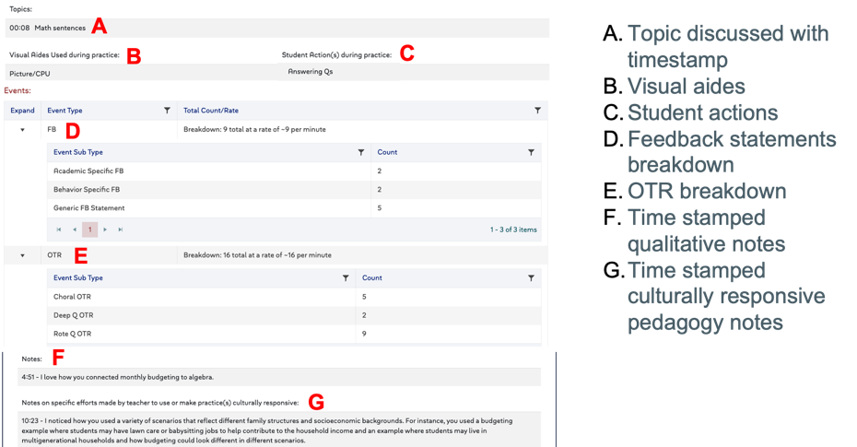
Topics

Slide 23
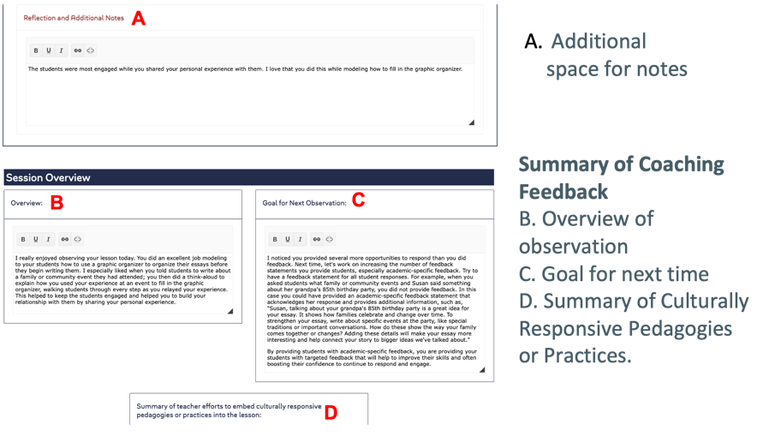
Summary

Slide 24

COACHED 2.0 Using Multimedia to Observe and Coach Pre and In-Service Teachers
Jennifer A. Sears, PhD
Assistant Professor
University of North Georgia

Slide 25
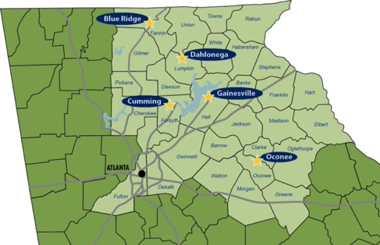
University of North Georgia
College of Education
- ELE/SPED – appx 400
- MG/SSE – appx 150
- MAT/Post Bac – appx 45
Notes:
Primarily a face to face observation
Supervisors all over the state
Only able to supervise in schools where we had actually supervisors present – so if we didn’t have a supervisor for that area – we couldn’t use that area

Slide 26
Needs
Supporting students in multiple counties
Flip to Online Learning
Introducing new technology to faculty/supervisors/students
Training

Slide 27
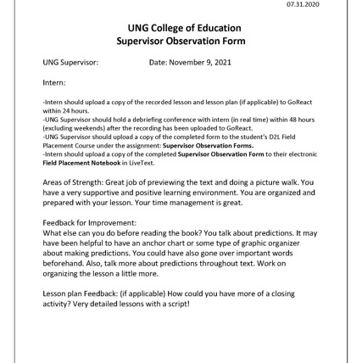
Example
Junior in college
First observation
You’ve planned your lesson
You are nervous and excited
You get your camera set up to video
You record it perfectly
You send it to your professor

Slide 28
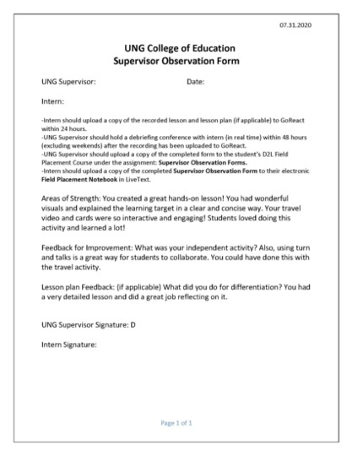
Supervisor Observation Form

Slide 29
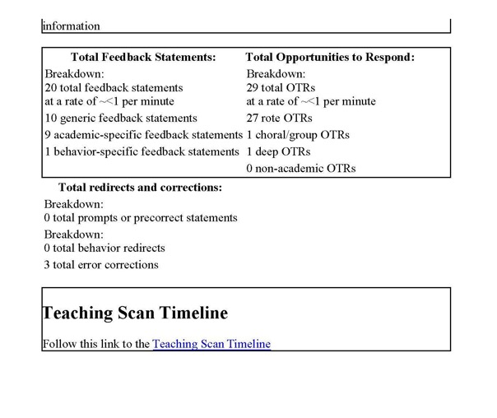
Breakdown section

Slide 30
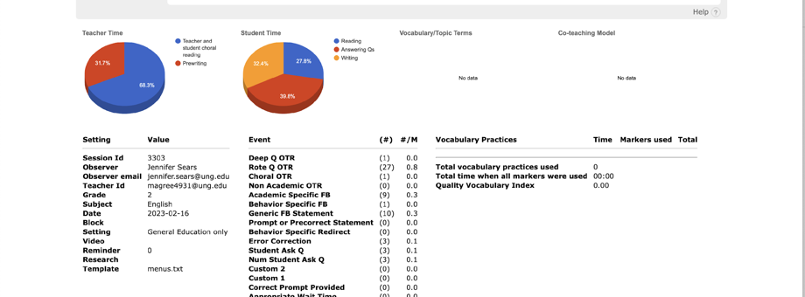
Data

Slide 31
What do our students have to say about it?
COACHED has really helped me in the feedback process with lesson planning. Being able to look back over notes and having a graph showing the data is a great visual for me. This has served as a great reference for me to go back and reflect so that I know what I should work on and try to include more of for future lessons. I really like it! - 2023 UNG Graduate

Slide 32


Supervisor Needs…

Slide 33
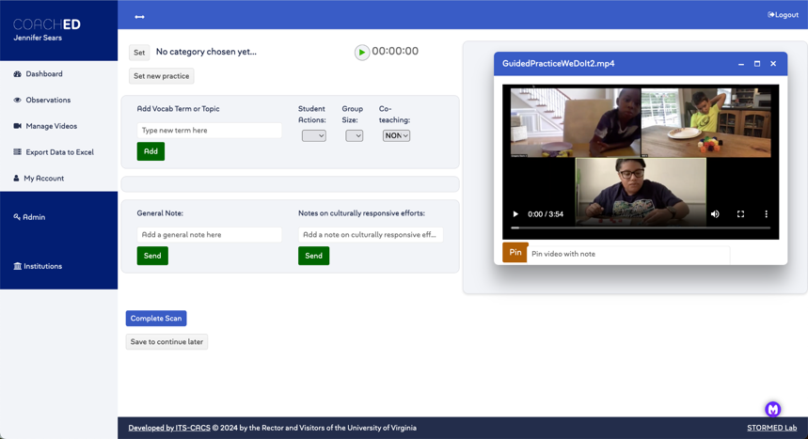
Pin notes

Slide 34
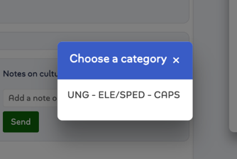
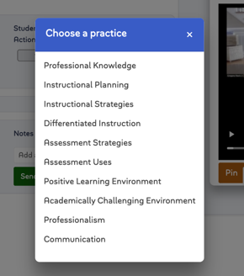
Choose a category

Slide 35
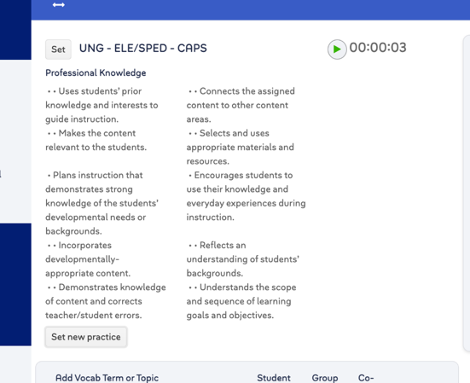
Time stamped comment

Slide 36
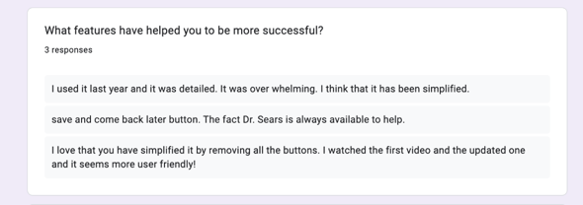
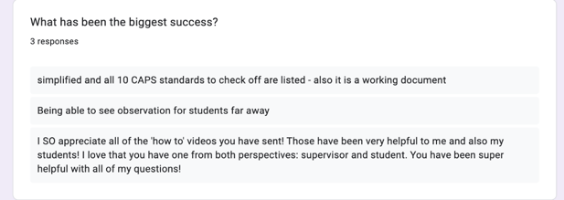
Feedback

Slide 37
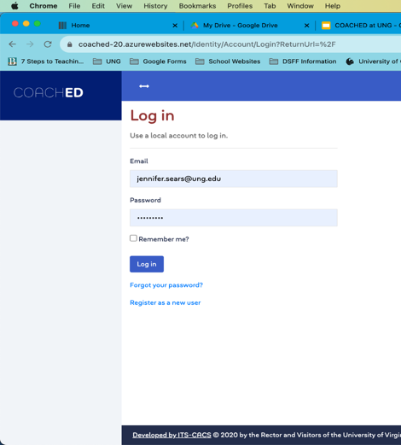
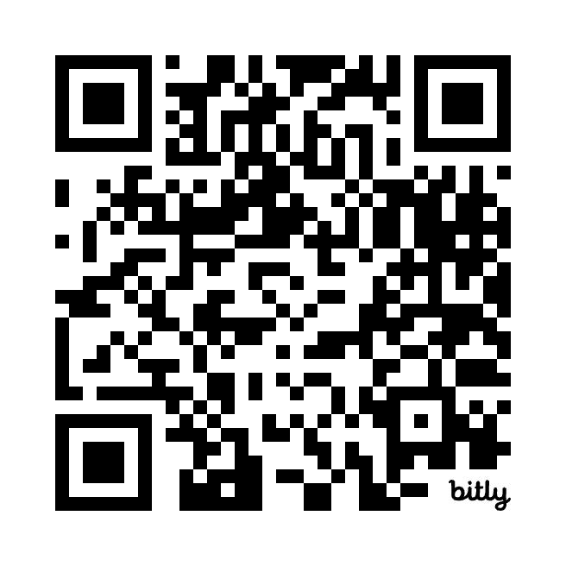
Where is it located
https://bit.ly/COACHED2
Notes:
Show them a quick overview of COACHED and what it can do

Slide 38
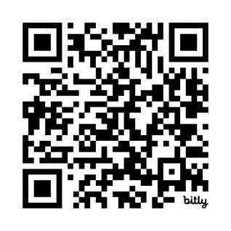
COACHED Resources
https://bit.ly/COACHEDCEEDAR

Slide 39



Practice/Discussion
Notes:
Group 1: COACHED practice
Group 2: Alternative ways to observe/coach teachers (supporting teacher educators who can’t use COACHED or must use another platform)

Slide 40
Whole group discussion
What kind of training and support do you think you will need to effectively use an online observation and coaching tool?
How can we ensure that the feedback provided through online tools is actionable and leads to measurable improvements in teaching practices?
How can online observation tools be aligned with state standards and evaluation frameworks for special education teachers?

Slide 41


Questions?

Slide 42

Thank you

Slide 43

Disclaimer

Slide 44

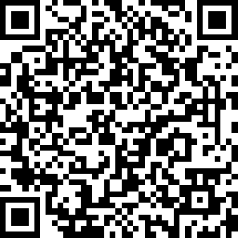
Survey
https://www.research.net/r/CEEDAR_Webinar_10-24

