Slide 1
Welcome to
Inclusive Leadership
Topical Action Group (TAG)
Thursday, October 3rd 2024
3:00-4:00 Eastern Time
Welcome to our TAG!
Participants: please change your Zoom name to
your state abbreviation and name
Ex: FL, Agatha Trunchbull
CEEDAR staff: please change your Zoom name to
CEEDAR, Your name
Notes:
Abby will hit record
Nichole please change your zoom name
Abby will be letting people in from waiting room
Abby will make 10 breakout rooms - auto assigned

Slide 2

Check In
Check in :
Did you ever get sent to the principal’s office as a kid? Share your experience in the chat!
Notes:
Nichole: Please change your name to Your state abbreviation and your first and last name

Slide 3
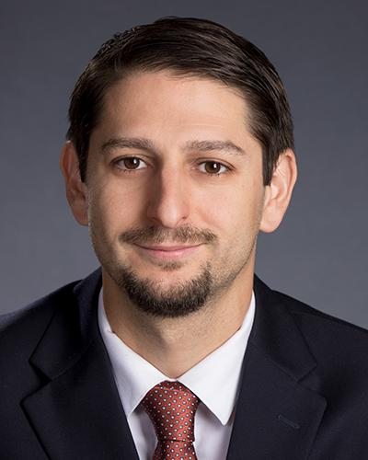
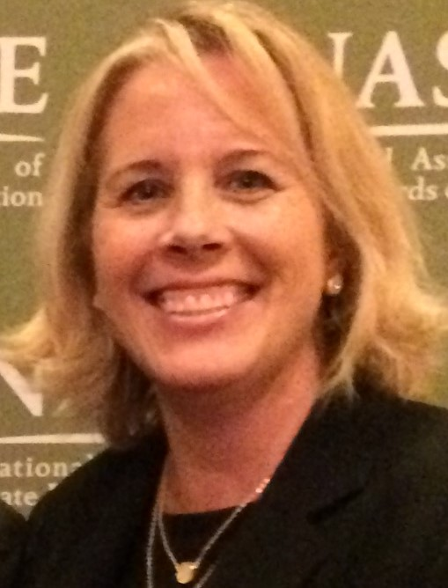
Welcome & Introductions 1
Welcome & Introductions
Dr. David DeMatthews
Professor, Department of Education Leadership and Policy,
The University of Texas at Austin
Dr. Bobbi Newman
State Lead for CEEDAR Center, Principal Researcher, American Institute for Research (AIR)
Notes:
Dave and Bobbi

Slide 4
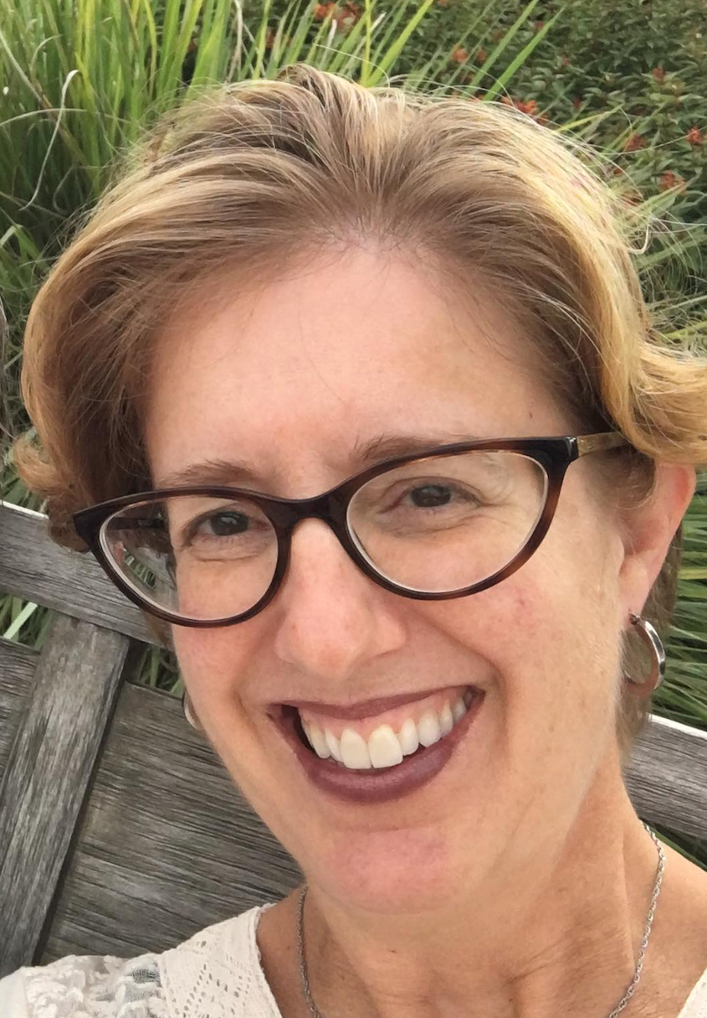
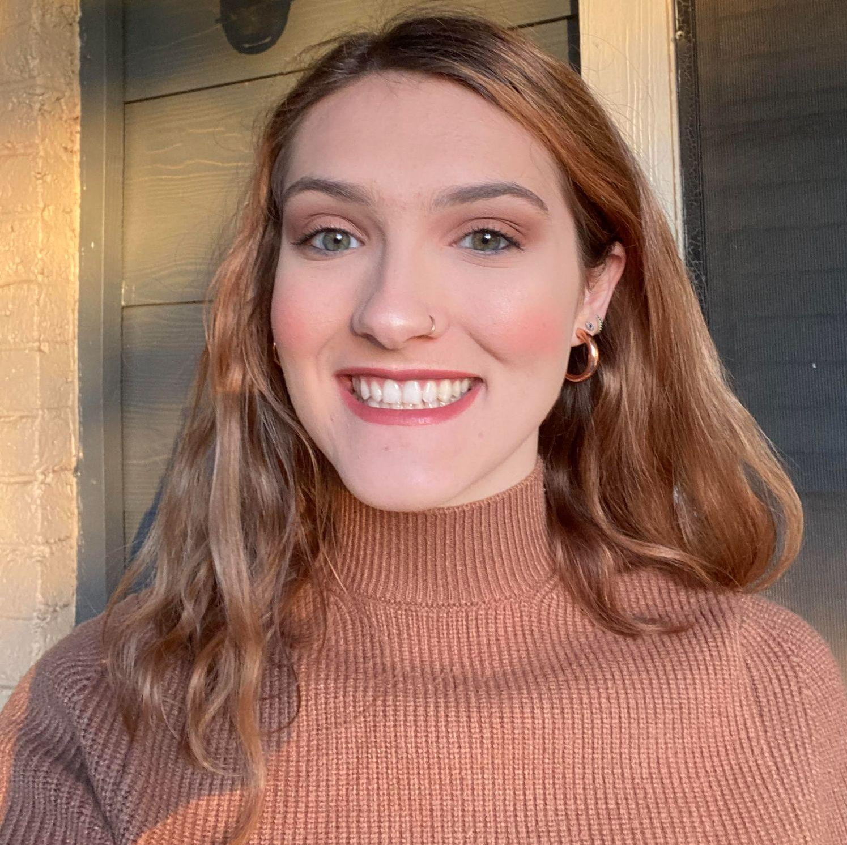
Welcome & Introductions 2
Welcome & Introductions
Nichole Spalding
Technical Assistance Specialist,
CEEDAR, University of Florida
Abby Berner
Engagement Specialist, CEEDAR, Research Assistant, American Institute for Research (AIR)

Slide 5





Our Partners
Notes:
Nichole - Our partners are Lead IDEA, NASSP, CCSSO, NAESP and UCEA - they are our liaisons and will share resources, they can provide additional perspectives. If you are here from one of these partner organizations, please share who you are in the chat and feel free to share your expertise!

Slide 6
Today’s Agenda
Today’s Agenda
Welcome and Introductions
TAG Overview
Cross State Breakout Groups
Inclusive Principal Leadership
Spotlight on Georgia
State Breakout Groups
Final Thoughts and Action Items
Notes:
Nichole
Welcome and Introductions- 5 min
TAG Overview and Logistics - 5 min
Breakout Groups for Padlet Q1 and 2- XX min
David talk about IC - XX min
Spotlight on GA: Columbus State U - XX min
Padlet 3 4 and 5 - XX min
Final Thoughts and Action Items – 5 min

Slide 7
Inclusive Leadership
Potential Topics for Discussion
Date | Topic
October 3 | TAG Overview - Spotlight on Georgia
November 7 | Mission, Vision and Core Values; Ethics and Professional Norms
December 5 | Equity and Cultural Responsiveness
January 9 | Curriculum, Instruction and Assessment
February 6 | Communities of Student Care and Support
March 6 | Professional Capacity and School Personnel; Professional Community for Teachers and Staff
April 3 | Meaningful Engagement of Families and Community
May 1 | Operations and Management, School Improvement
Notes:
Nichole
These Potential topics are aligned with the IC you're about to see, but based on your feedback and needs, we make some adjustments.
If one of these topics speaks to the work you are doing in your org, and you have expertise to share, please let us know! We do want to highlight examples from around our TAG network so we can learn from one another.

Slide 8
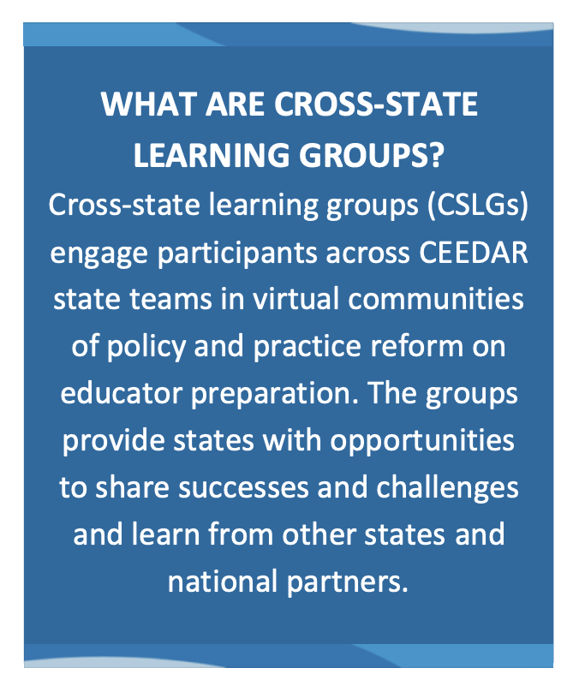
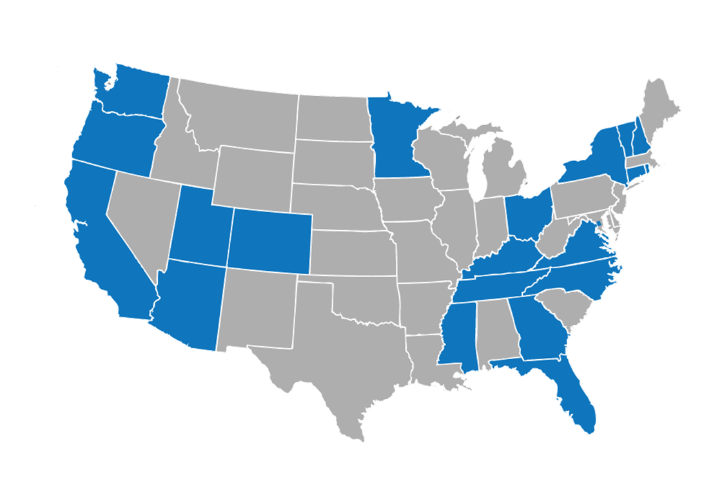
What is a Cross State Learning Group (CSLG)?
2 Types of CSLG
Affinity Groups (AGs)
Topical Action Groups (TAGs)
Notes:
Nichole- 12 states in TAG

Slide 9
What is the purpose of this TAG and
what will I get out of it?
Topical Action Groups
Much of our time
will be dedicated to:
engaging discussion
sharing successes
and problem solving challenges.
We will frequently work
in breakout rooms
(Cross State and within State) to facilitate deeper dives and action plans.
Everyone is working on similar issues.
We are creating an IL community.
Together we can work smarter.
Everyone is at a different point in their work.
Opportunity to learn from others and share your knowledge.
Highlight every state.
Notes:
Nichole- TAGs are different bc we spend time in the ACTION… And you’ll have the opportunity to really talk with other states about inclusive leadership efforts…problem solve … plan while sharing successes and challenges.

Slide 10
Meeting Norms
Meeting Norms
Be present and prepared
Respect in the shared space and keep what is shared in confidence. We are creating a community.
We will record guest speakers and resources sharing, but nothing else. What happens in the TAG, stays in the TAG!
Breakout rooms could be mixed cross state or state specific depending on the work.
Group members should “believe the best” and lead with positive intentionality.
Notes:
Abby- Invite them to review as well as suggest others in the chat.

Slide 11

TAG Logistics
We want to show you the space we have created for your ongoing work in these meetings.
State folders
Notes:
Nichole to put the link in the chat and Abby share your screen with the Google drive view; Nichole to provide an overview
link: https://drive.google.com/drive/u/4/folders/1CW8GKw9fwG73IsnMK6pQFKcDzfahMjhQ

Slide 12
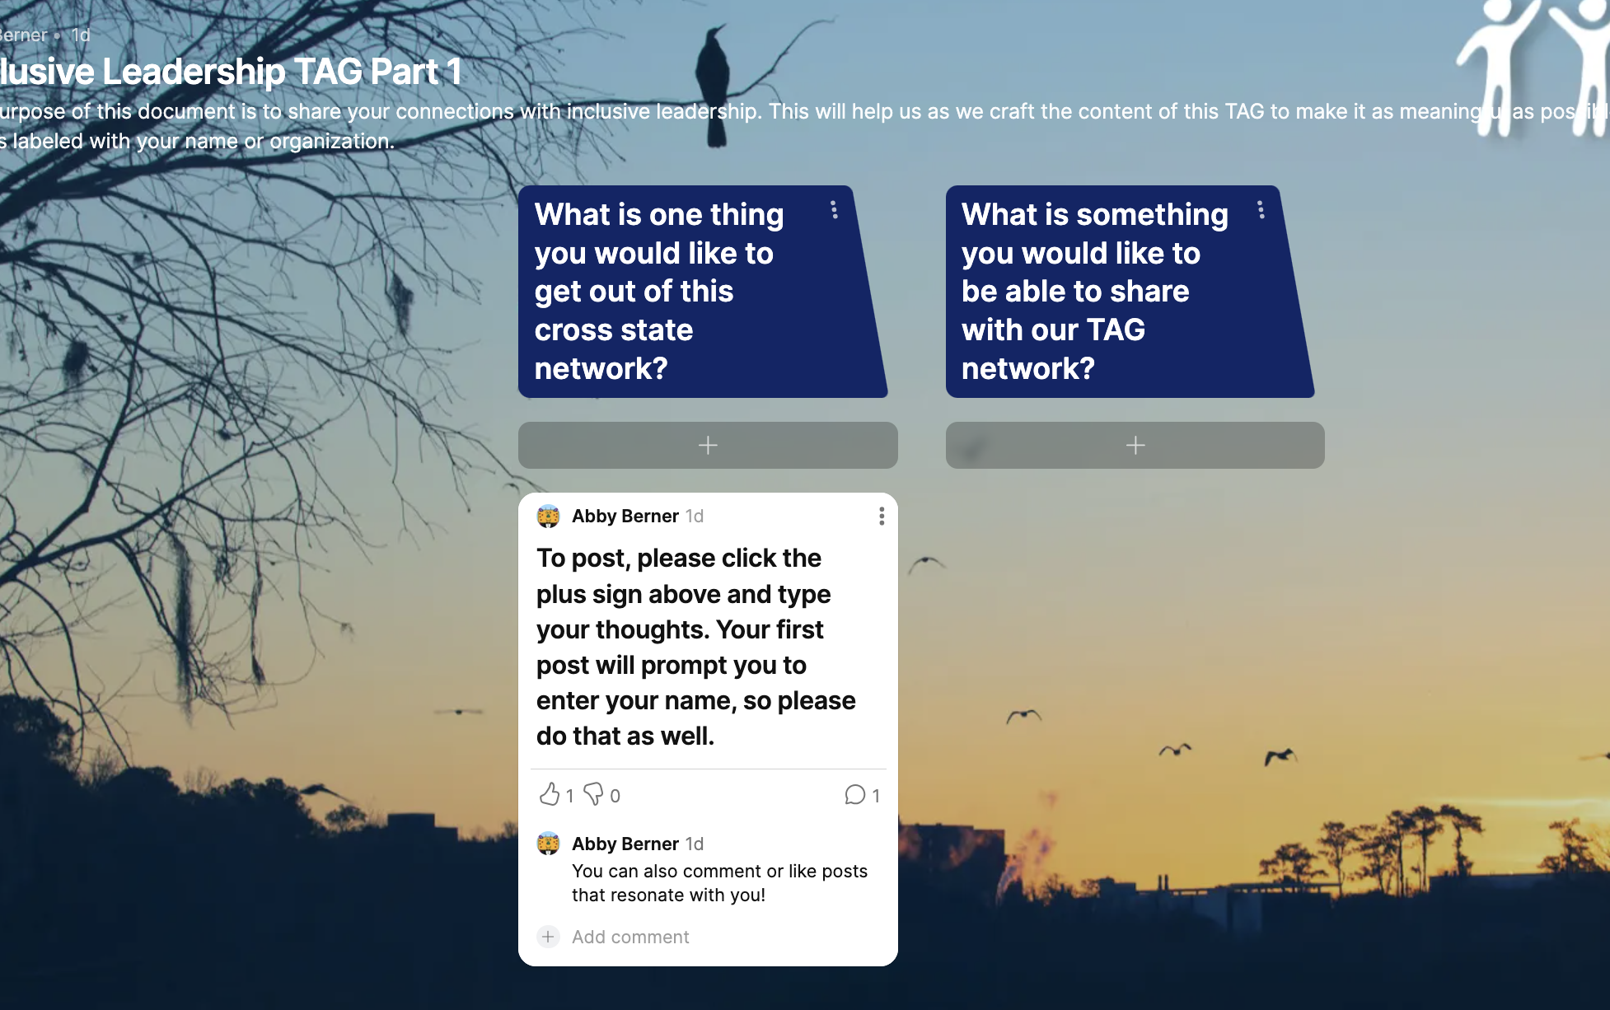
Cross State Breakout Rooms
Padlet link
In cross state breakout rooms, please
introduce yourself to your group
use our Padlet to guide and record your conversation
Your feedback will help us as we plan our scope and sequence for this TAG!
Notes:
Nichole - opportunity for members to connect with each other and share what they hope to get out of participating in this TAG
What is one thing you would like to get out of this cross state network?
What is something you would like to be able to share with our TAG network?
Nichole - After breakout rooms, David DeMatthews what are some themes you see in the padlet?
is going to connect your posts to our guiding document, the Inclusive Principal Leadership IC
10 minute groups, auto assign, should we have them end after 10 minutes?
Mix of state and CEEDAR facilitators

Slide 13

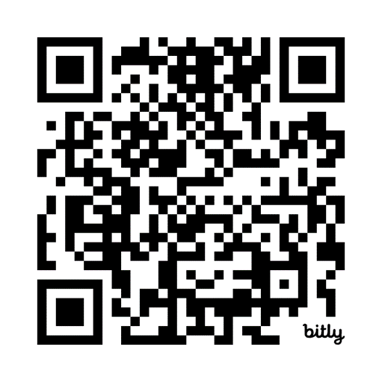
Innovation Configuration
•The Innovation Configuration includes a comprehensive review of evidence on effective inclusive principal leadership practice AND a matrix to guide principals and principal preparation programs.
•The IC can also be used as a reflective and planning tool to consider priorities and progress toward creating a pipeline of inclusive principal leaders.
Notes:
David discuss
Nichole put link in chat https://ceedar.education.ufl.edu/wp-content/uploads/2023/11/Inclusive-Principal-Leadership-IC.pdf

Slide 14
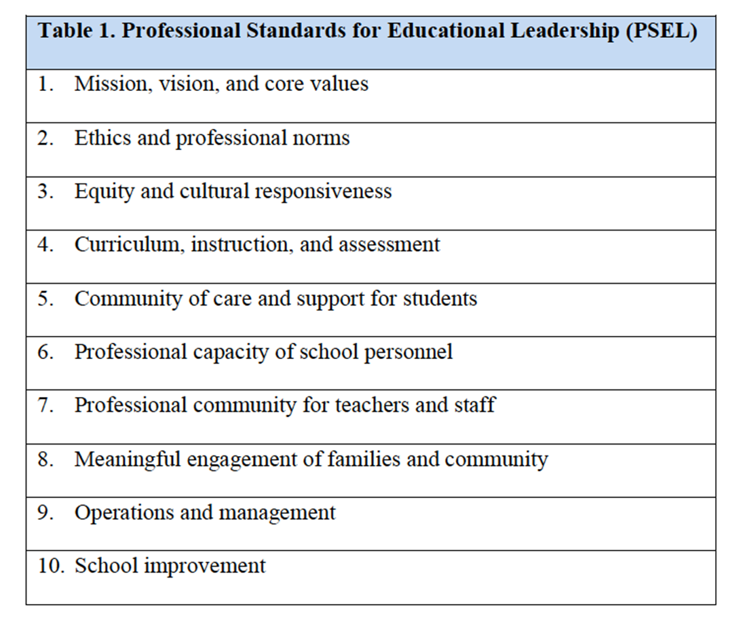
PSEL and NELP
•Aligned to PSEL Standards or “Guideposts” to help school leaders.
•NELP Standards are aligned to PSEL but oriented toward performance expectations for beginning leaders.
•We will focus on 1-2 standards per TAG meeting.
•Highlighting work of states in each area.
Notes:
David

Slide 15
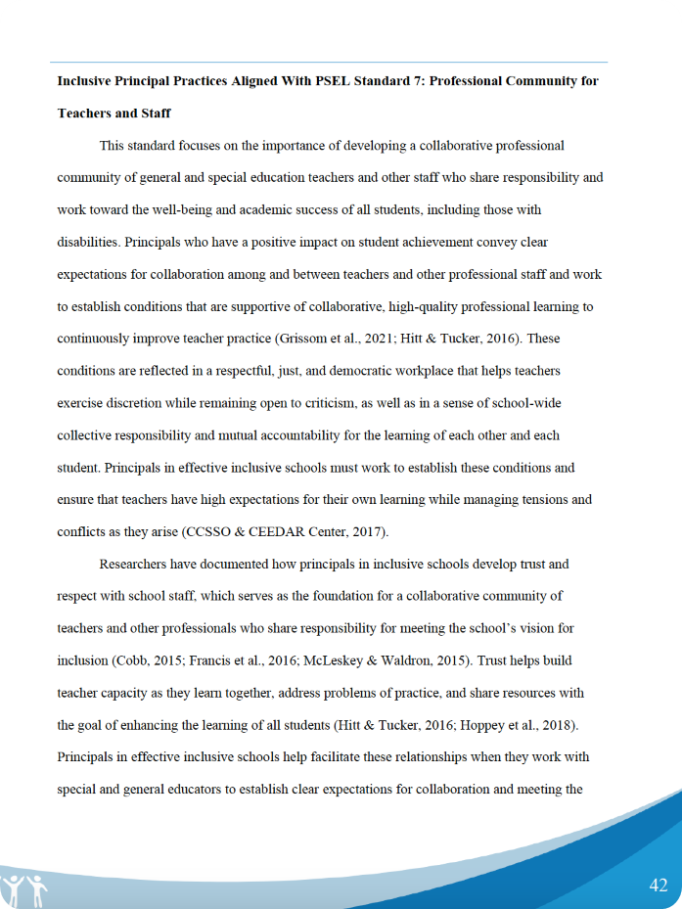
Example Standard
•Each standard has a description of the practices aligned to research.
•Standard 4: Curriculum, Instruction, and Assessment
•Added emphasis on IEP meetings, high-leverage teaching practices, and evidenced based interventions
Notes:
David

Slide 16
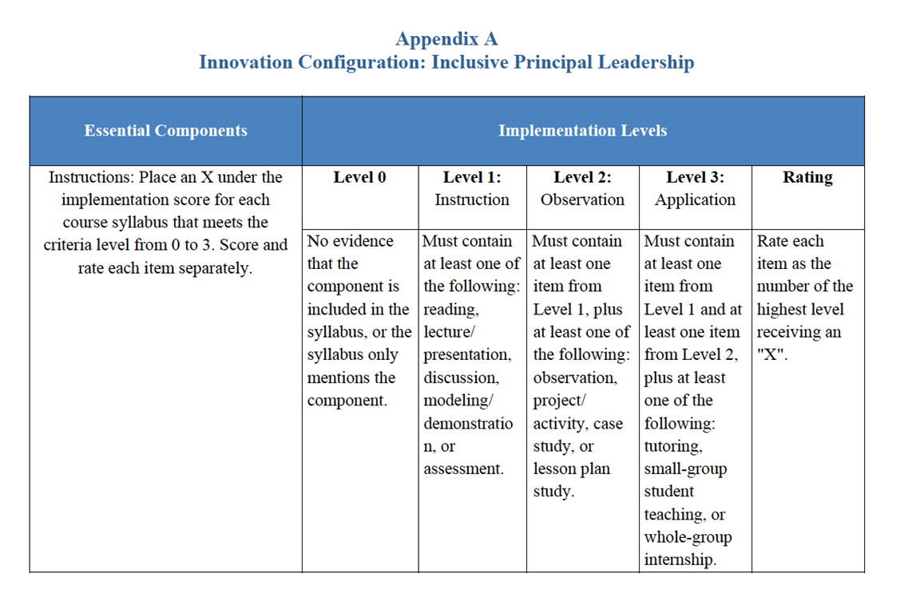
IC Matrix
•Potential Uses:
•Can be used for syllabus review
•Identify key practices to prioritize
•Engage in reflection and curriculum planning processes

Slide 17
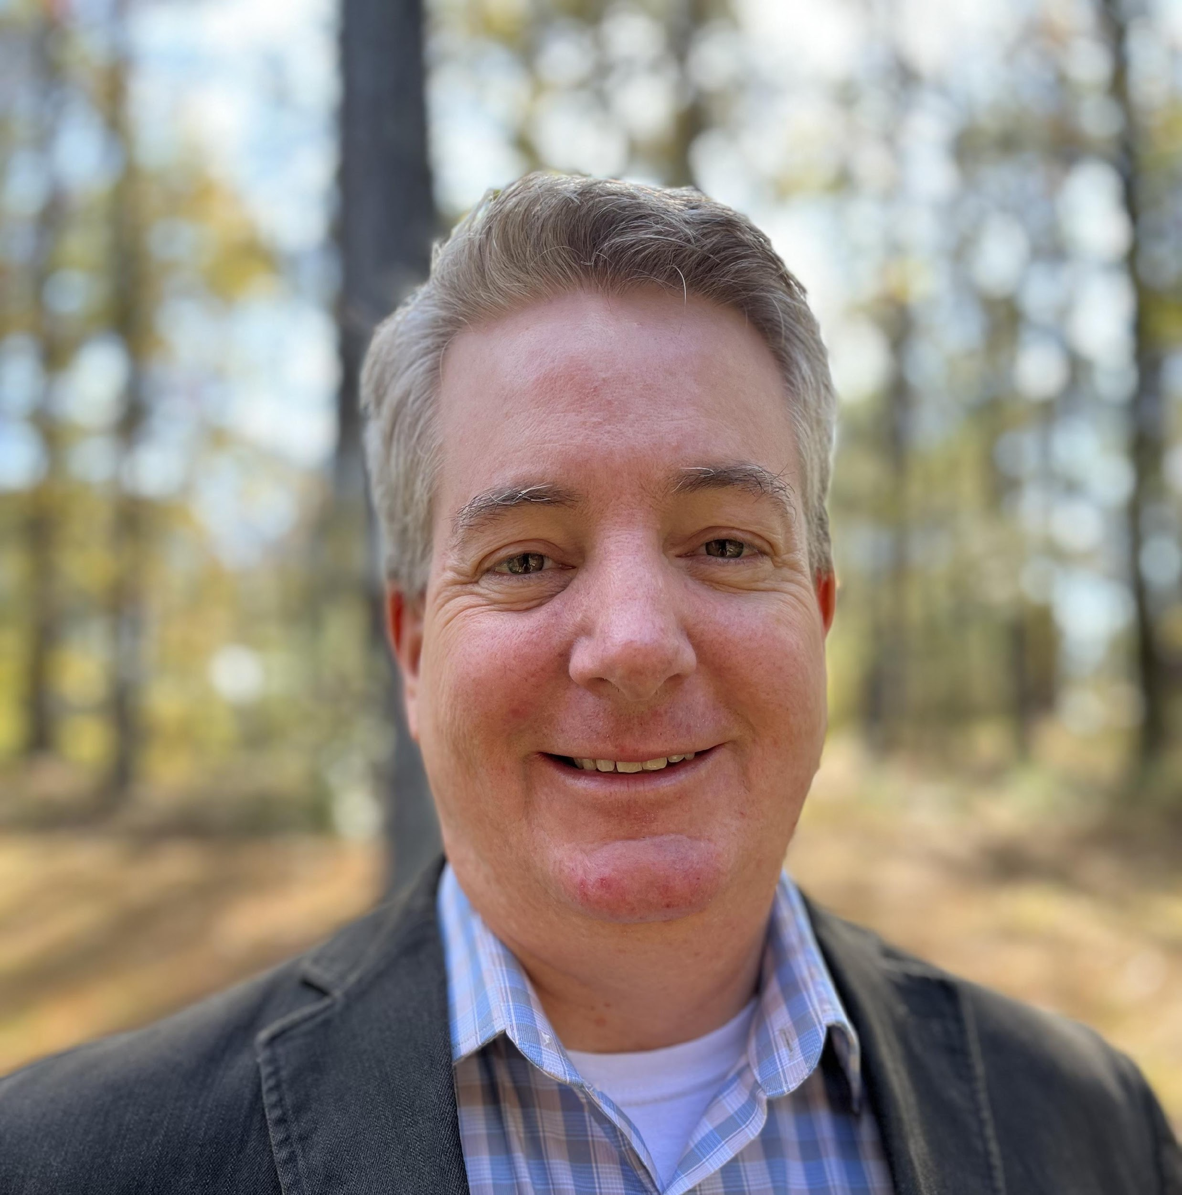
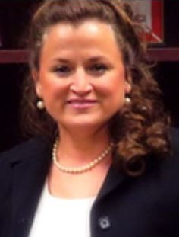

Special Education & Principal Preparation Partnership
Dr. Gregory Blalock, Special Education
(blalock_gregory@columbusstate.edu)
Dr. Dana Griggs, Educational Leadership
(griggs_dana@columbusstate.edu)

Slide 18

Collaborators
Our Why
Educational Leadership Faculty and Related (MEd, Tier I) Students in Principalship Course
Special Education Faculty and Related (MAT) Students in Methods Course
Lack of experience with special education, students, and teachers
Special education teachers typically not chosen for class observations
Offer more observations within the MAT program
Provide collaboration & safety in the observation process
Instructional Observation and Feedback
Principal Preparation and Special Education

Slide 19

Our Process
Our Outcomes
Video tape lesson
Submit to shared folders
Watch lessons individually
Meet with team to debrief, record
Record feedback for each teacher
Submit feedback videos to shared folders, or virtual meeting between team and each teacher
Experience brings higher comfort level
Growth in teaching through two observations
More confidence in self and evaluation process
Learned to see more through the debriefing team process
Instructional Observation and Feedback
Principal Preparation and Special Education

Slide 20

Our Challenges
Our Questions
Scheduling
Building folders, sharing folders
All the moving parts
Solidifying the partnership within each program
Who might be a good partner in helping you move forward within the EPP?
Within the context, what are some challenges to collaboration?
Ultimately, how does the collaboration support inclusive leadership?
Instructional Observation and Feedback
Principal Preparation and Special Education

Slide 21
State
Breakout Rooms
Notes:
think about your work where you are right now that may strengthen your work

Slide 22
State Team Reflection
Within your context, what are some challenges to collaboration?
Ultimately, how does the collaboration support inclusive leadership?
What is something you are already working on in Inclusive Leadership and who could you collaborate with to help you with next steps?
In state breakout rooms reflect on Georgia’s presentation and how it relates to your state’s work.
Use these questions to guide your discussion and record any action items, notes or questions on your state notes page
Notes:
how much time on these?
Nichole put question in chat before moving to breakout rooms
Abby will paste q’s in here
Within your context, what are some challenges to collaboration?
Ultimately, how does the collaboration support inclusive leadership?
What is something you are already working on in Inclusive Leadership and who could you collaborate with to help you with next steps?

Slide 23
Final Thoughts and Action Items
In the chat, please share a takeaway you have from our conversations today that relates to your Inclusive Leadership work.
Our next TAG will be focusing on Mission, Vision and Core Values (IC Standard 1) and Ethics and Professional Norms (IC Standard 2)
Please review pages 12-21 in the CEEDAR IC document to help orient you to our next meeting topic.
Notes:
Nichole put in chat
https://ceedar.education.ufl.edu/wp-content/uploads/2023/11/Inclusive-Principal-Leadership-IC.pdf

Slide 24
Feedback and Next Steps
If you have questions or feedback, please contact aberner@air.org
Also, be on the lookout for a follow up email with all the resources and links shared today as well as the slides.
Next Meeting: November 7th 3-4 EST
Thank you for joining us today!

Slide 25

Our Mission
Our Mission
To support students with disabilities (SWDs) in achieving college- and career-ready standards by building the capacity of state personnel preparation systems to prepare teachers and leaders to implement evidence-based practices (EBPs) within multi-tiered systems of support (MTSS).

Slide 26
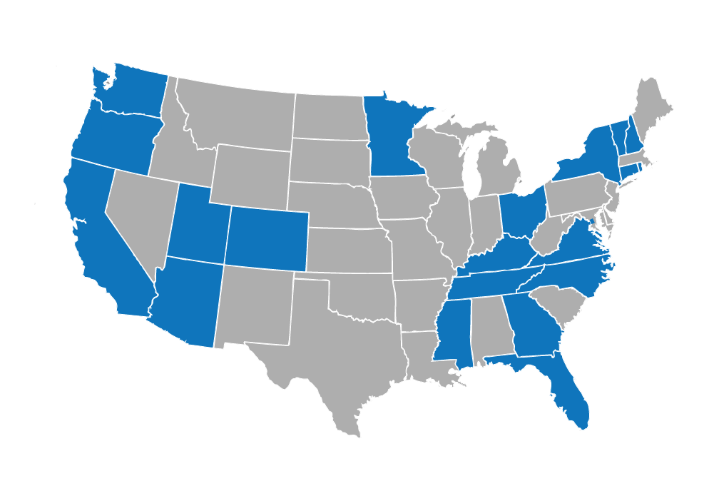
CEEDAR States

Slide 27

Disclaimer
This content was produced under U.S. Department of Education, Office of Special Education Programs, Award No. H325A220002. David Guardino serves as the project officer. The views expressed herein do not necessarily represent the positions or policies of the U.S. Department of Education. No official endorsement by the U.S. Department of Education of any product, commodity, service, or enterprise mentioned in this website is intended or should be inferred.

Slide 28





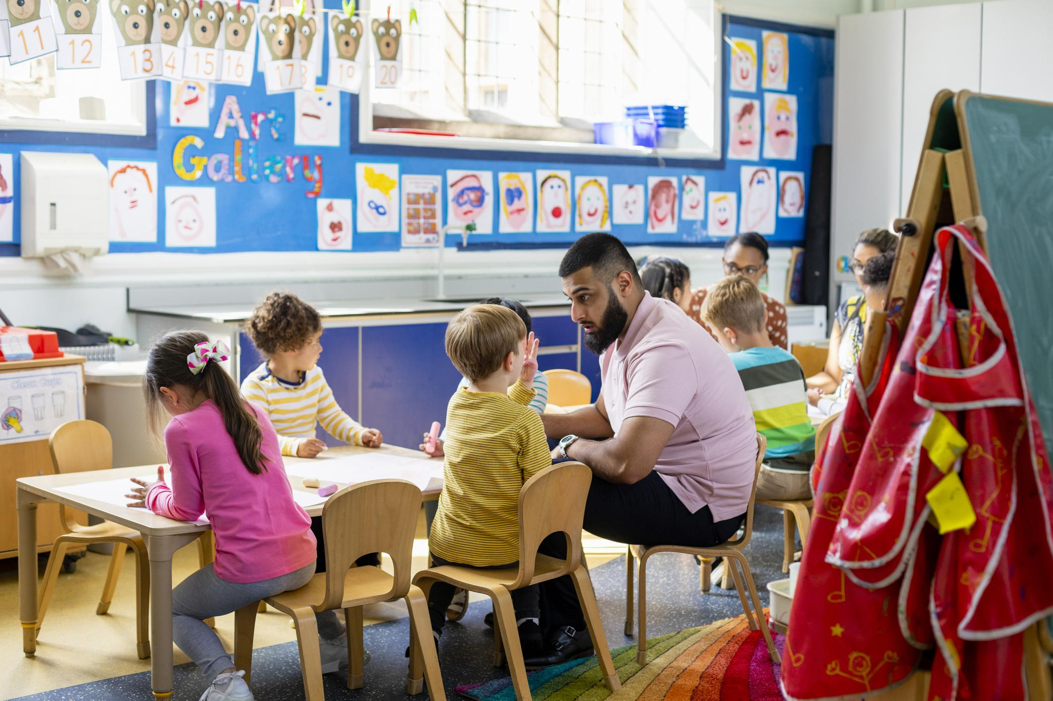


Sample Photos
*Feel free to use these images anywhere throughout the presentation

