Slide 1
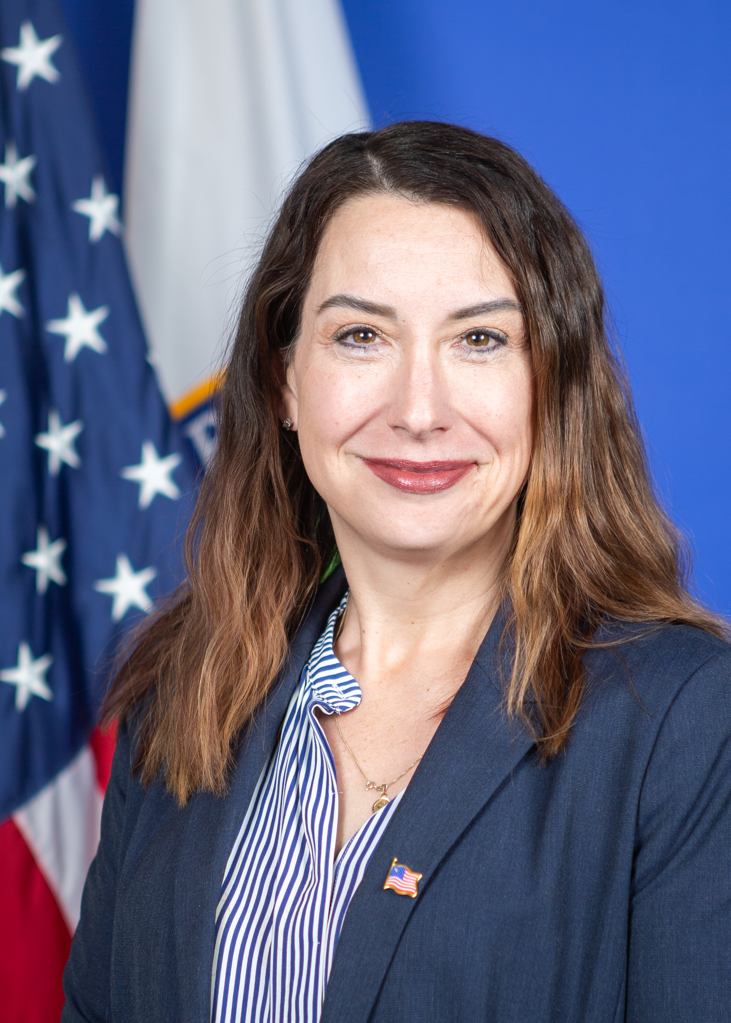
Glenna Wright-Gallo
Leading with Purpose with a Winning T.E.A.M:
Designing Systems Resulting in Improved Outcomes for Children with Disabilities
Assistant Secretary
Office of Special Education and Rehabilitative Services (OSERS)

Slide 2
Raise the Bar: Lead the World
ACHIEVE
ACADEMIC EXCELLENCE
BOLDLY IMPROVE LEARNING CONDITIONS
CREATE PATHWAYS FOR GLOBAL ENGAGEMENT
Accelerate learning for every student
Deliver a comprehensive and rigorous education for every student
Eliminate the educator shortage for every school
Invest in every student’s mental health and well being
Ensure every student has a pathway to college and a career
Provide every student with a pathway to multilingualism
Raise the Bar Booklet

Slide 3

Identifying and Refining Purpose
Student (with a disability)
Parent
Special educator
School leader
State Education Agency
  Monitoring and Dispute Resolution
  State Director of Special Education
  Assistant Superintendent of Special Education
United States Department of Education
  Assistant Secretary, OSERS

Slide 4
OSERS Mission and Priorities
To Improve Early Childhood, Education, and Employment Outcomes and Raise Expectations For All People With Disabilities, Their Families, Their Communities, and The Nation
Leading for Equitable outcomes
Prepared workforce
Remedy immediate staffing shortages and effectively deploy diverse and equipped educators, providers, and support personnel
Evidence-Based practices
Amplify, promote, and actively drive effective learning experiences, instruction, intervention, services, and support
Accessible technology
Accelerate usage of inclusive materials and technology for in-person and remote learning and employment
Stakeholders
Engage families, individuals with disabilities, educators, providers, policy makers, advocates, and communities to identify successes, barriers, and needs
Strategic RESOURCEs
Invest in data-aligned coordinated activities that advance Competitive Integrated Employment (CIE)

Slide 5
Intersecting Laws/Regulations
IDEA
ESSA
WIOA
Section 504
Rehab Act
ESSA/ ESEA
Section 504/
Rehab
Act
IDEA
WIOA
ADA
Federal requirements impacting
children, youth, and adults with disabilities
(and their families)

Slide 6
The Purpose of IDEA
To ensure that all children with disabilities have available to them a free appropriate public education (FAPE) that emphasizes special education and related services designed to meet their unique needs and prepare them for further education, employment, and independent living;
To ensure that the rights of children with disabilities and parents of such children are protected;
To ensure that educators and parents have the necessary tools to improve educational results for children with disabilities by supporting system improvement activities; coordinated research and personnel preparation; coordinated technical assistance, dissemination, and support; and technology development and media services; and
To assess, and ensure the effectiveness of, efforts to educate children with disabilities.

Slide 7
Identify Non-Negotiables
Presumed competence
Sense of urgency and understanding of time limitations
Identifying and addressing ableism and discrimination in everyday actions
Understanding and using data to identify successes and needs
Comprehensive use of universal design in planning and provision of services
  Access and progress in grade-level state standards
  Ensuring accessibility and seamless provision of materials, technology, and accommodations
  Instruction is vital for learning!
  Special education services are supplemental, not a replacement for general education
Accountability for actions and messaging (verbal and nonverbal)

Slide 8
Our Story
In 2021, there were:
  741,510 children with disabilities ages 3-5
  6,611,306 children and youth with disabilities ages 6-21
  State Assessments
    67.8% - 75.9% of students served under IDEA in each of grades 3 through 8 and high school participated in a math assessment (24.1% - 32.2% did not participate)
    65.2% - 75.4% of students served under IDEA in each of grades 3 through 8 and high school participated in a reading assessment (24.6% - 34.8% did not participate)
  75.4% of youth with disabilities exited by graduating with a regular high school diploma, while 14.7% dropped out
45th Annual Report to Congress on the IDEA

Slide 9
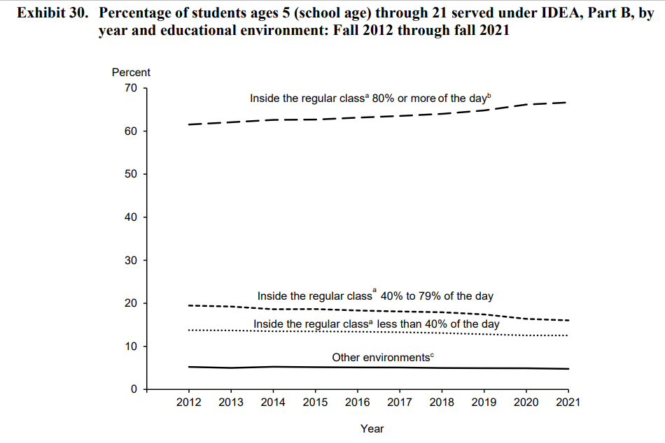
Educational Environment Trends
45th Annual Report to Congress on the IDEA

Slide 10
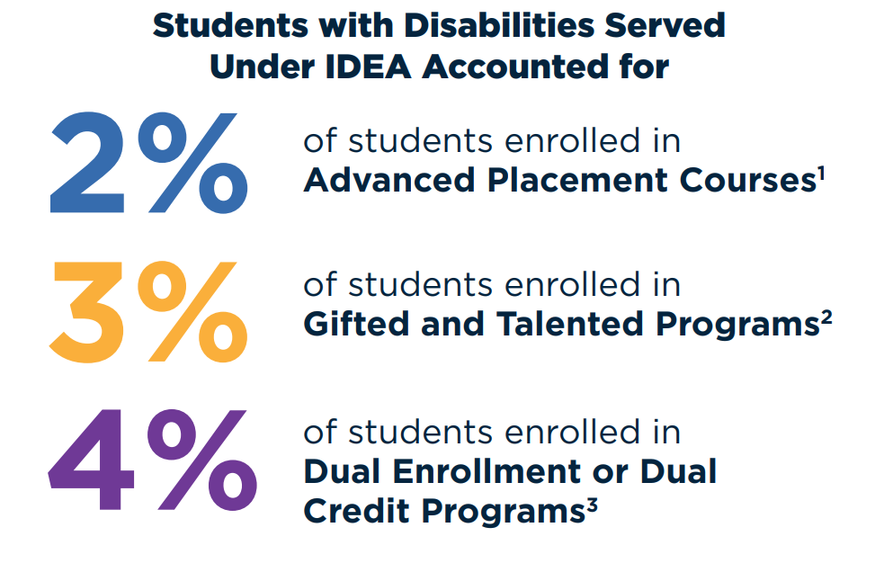
Course Taking by Students with Disabilities
Source: CRDC Profile of Students with Disabilities in U.S. Public Schools During the 2020-21 School Year (ed.gov)

Slide 11
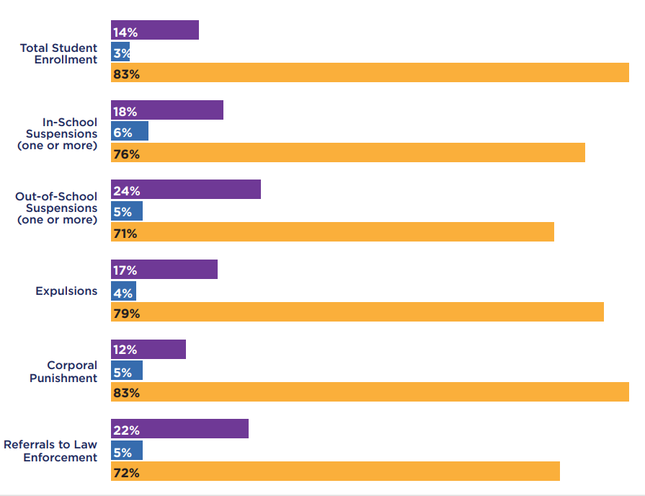



SWDs Subjected to Disciplinary Actions
Source: CRDC Profile of Students with Disabilities in U.S. Public Schools During the 2020-21 School Year (ed.gov)

Slide 12
SWDs Subjected to Disciplinary Actions
Source: CRDC Profile of Students with Disabilities in U.S. Public Schools During the 2020-21 School Year (ed.gov)

Slide 13
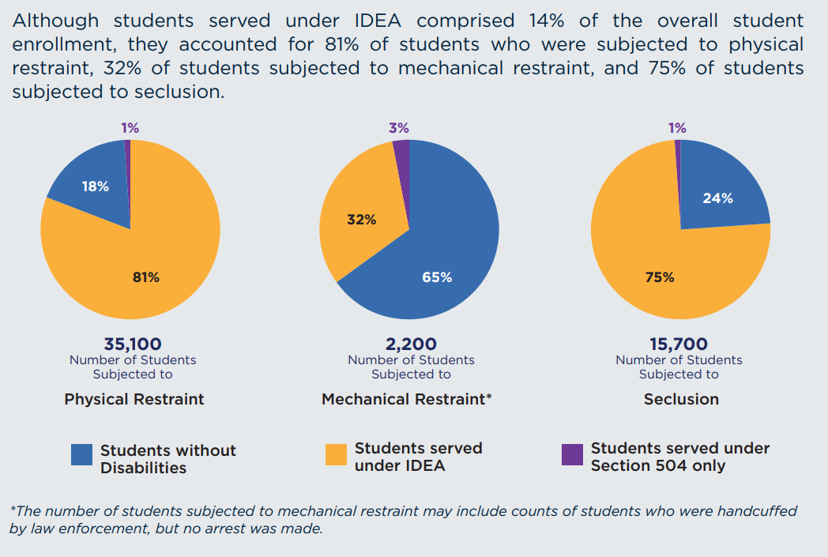
SWDs Subjected to Restraint or Seclusion
Source: CRDC Profile of Students with Disabilities in U.S. Public Schools During the 2020-21 School Year (ed.gov)

Slide 14
What is Your Story?
Inputs:
Resources
Outcomes:
?

Slide 15
Persistent Disparities & Inequities
System
Lack of diverse and prepared personnel in schools
Less access to services, including mental health
Lower expectations
Evaluation/eligibility delays and outcomes
Restrictive placements
Use of restraint and seclusion
Use of discipline
Impact to Children
Reduced access to rigorous curriculum and instruction
Lower graduation rates
Lower post-school outcomes

Slide 16
Improve Outcomes & Raise Expectations
Our commitment
and
sense of urgency
to improve outcomes
and raise expectations?
How
do our
current actions demonstrate…

Slide 17
Persistent Equities Disparities & Inequities
System
Diverse and prepared personnel
Access to services, including mental health
High expectations supported by evidence-based instruction and intervention
Timely and responsive evaluation/eligibility decisions and educational plans
Family engagement used to celebrate success and be responsive to student need
Inclusive placements, with supports that proactively address positive behavior, communication, and learning together
Impact to Children
Access to rigorous curriculum and instruction
Increased graduation rates
Increased post-school outcomes

Slide 18
Designing a System for Improved Outcomes
Students graduate prepared for college and career
Specially Designed Instruction
School to Post-School Planning and Services
EB Instruction in Rigorous Grade-Level Standards
*Reinforced by families, communities, and employers

Slide 19
Levers for Change
Vision – Identification of the Desired Change(s)
Stakeholder Engagement
  Platform of influence (e.g., bully pulpit and public advocacy)
  Agreements (informal and formal)
Monitoring and Accountability
Funding and Grants
Professional Development and Training (pre- and in-service)
Technical Assistance and “Dear Colleague Letters”
Legislation and Regulatory Changes (federal, state, local)
Judicial Decisions
Executive Actions
Intra-Agency and Inter-Agency Collaboration

Slide 20
Purposeful Stakeholder Engagement
Nothing about us without us! (But it can’t only be us)
  Broad identification of challenges, potential and actual root causes, and diversity of solutions
  Responsive and timely improvements/changes
  Collective influence changes decisional outcomes and allows multiple change leaders working together
  Interactive efforts support consensus building and planning
  Shared expectations and multiple opportunities for feedback and course correction and/or amplification of success
  Combination of expertise, influence, and practical application, as well as measurement of intended and actual impact
  Shared accountability to drive change and demand improved outcomes with measurable data
  Build a community of multiple pathways to post-school success

Slide 21
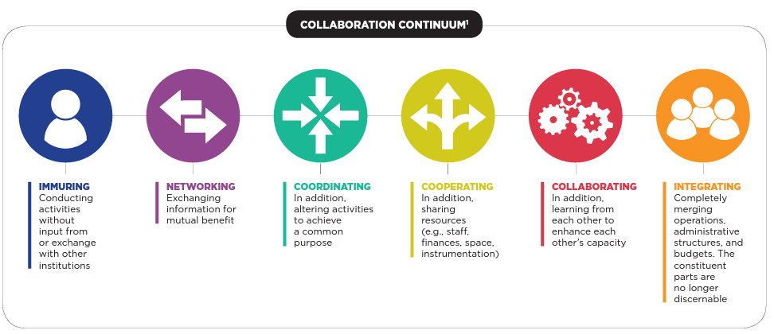
Collaboration Continuum
¹ Mashek,D. (June, 2015). Capacities and Institutional Supported Needed along the Collaboration Continuum.
A presentation to the Academic Deans Committee of The Claremont Colleges, Claremont. CA

Slide 22
Levers for Change (Part 2)
Vision
Stakeholder Engagement
Monitoring and Accountability
Funding and Grants
PD and Training
Technical Assistance
Legislation and Regulatory Changes
Judicial Decisions
Executive Actions
Intra-Agency and Inter-Agency Collaboration
What is Missing?
Which are the Most Effective?

Slide 23
Working Together to Shift Policies and Practices
Our Current Story
Our Desired Story

Slide 24
Instruction is Critical To Outcomes!
Students with disabilities are entitled to
evidence-based instruction provided by content experts in grade-level core standards and the supplemental special education and related services needed for them to access and make
progress in those standards
Principal
Educator

Slide 25
What Will It Really Take to Change Outcomes?
True high expectations reflected in our actions (commitment and priority-focused)
Leadership focused on improving outcomes (instruction-driven and supported by strategic investments and compliance/accountability)
Acknowledgement of the interconnecting supports that can be leveraged differently
Engage partners, support expansion on who is considered “an expert” on neurodiversity and children, youth, and adults needing additional supports, and expect contributions
Accountability and a cycle of continuous improvement with a sense of urgency
Telling our story, along with sharing data that demonstrate impact

Slide 26
Invest in Improved Outcomes
Activities/investments aligned with priorities that deliver improved outcomes
Braiding of IDEA funds with other federal/state funds, where allowable, to reduce duplication of services, and accessing all available resources (e.g., Medicaid, general education funds)
Staffing investments and decisions to address immediate needs and long-term plans
Coordination across agencies and departments:
  Aligned PD (to support priorities) with general educators and
  school/district leaders, as well as special educators
  Leverage Vocational Rehabilitation (VR) for Pre-ETS, technology, and
  post-school planning
  Engage partners in planning and delivery (e.g., families, labor organizations, advocates, and professional associations)
Are current investments improving outcomes?

Slide 27
Focusing on Instruction
Student Learning
Federal Govt Leadership
SEA Leadership
LEA Leadership
School Leadership
Teacher
What do educators need to know/do for students to learn (and demonstrate learning)?
  What do families need to know and do?
  What do school leaders need to know/do to set up the conditions for educators to perform?
  What needs to happen across the district to set up the conditions for school leaders to perform?
  How are preparation programs and licensing systems reinforcing these needed skills?

Slide 28
Our Role, Our Work, Our Children
“Do the best you can until you know better. Then when you know better, do better.”
Maya Angelou
How will we, together, build upon those change levers and amplify or accelerate the improvement efforts needed to ensure that every student with a disability not only has equitable access to high quality instruction and learning, but that they leave the preK-12+ education system fully prepared for further education, training, and independent living (that aligns with their goals and dreams)?

