Slide 1


Collectively Moving from Constrained to Empowered in Educating Students with Disabilities
Kristin Wright, Executive Director
Sacramento County Office of Education
May 14, 2024

Slide 2
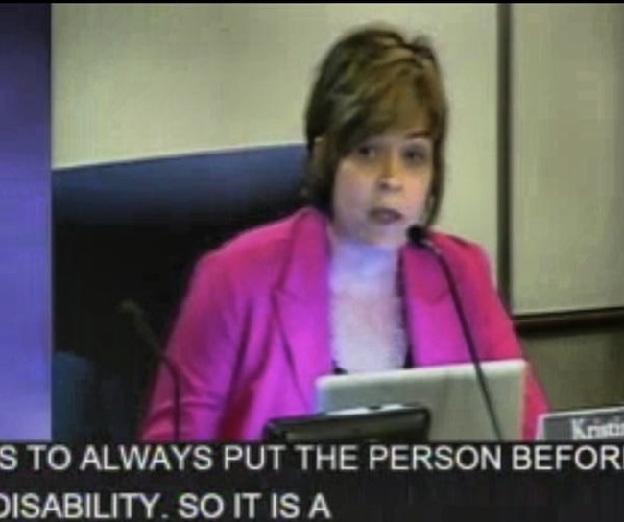
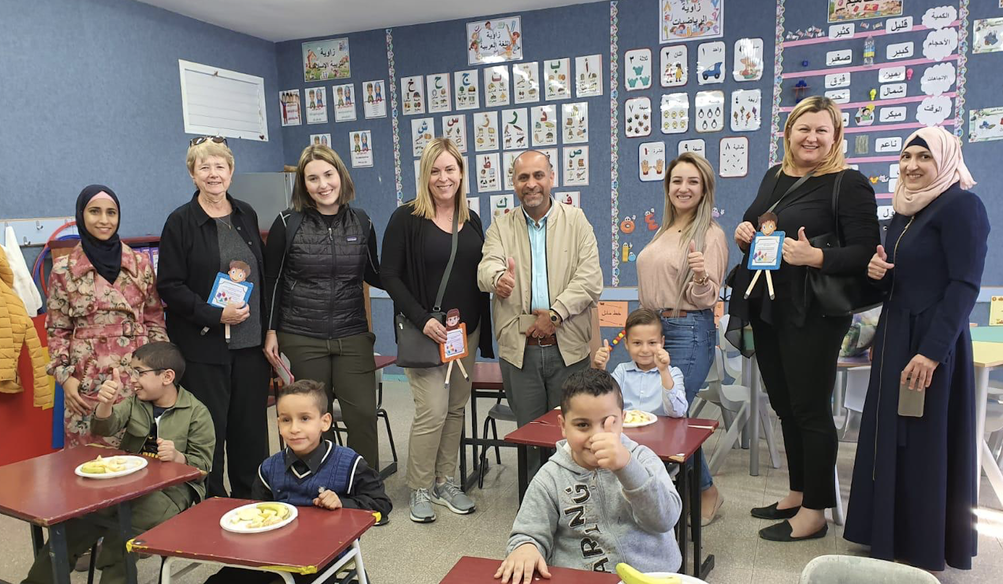
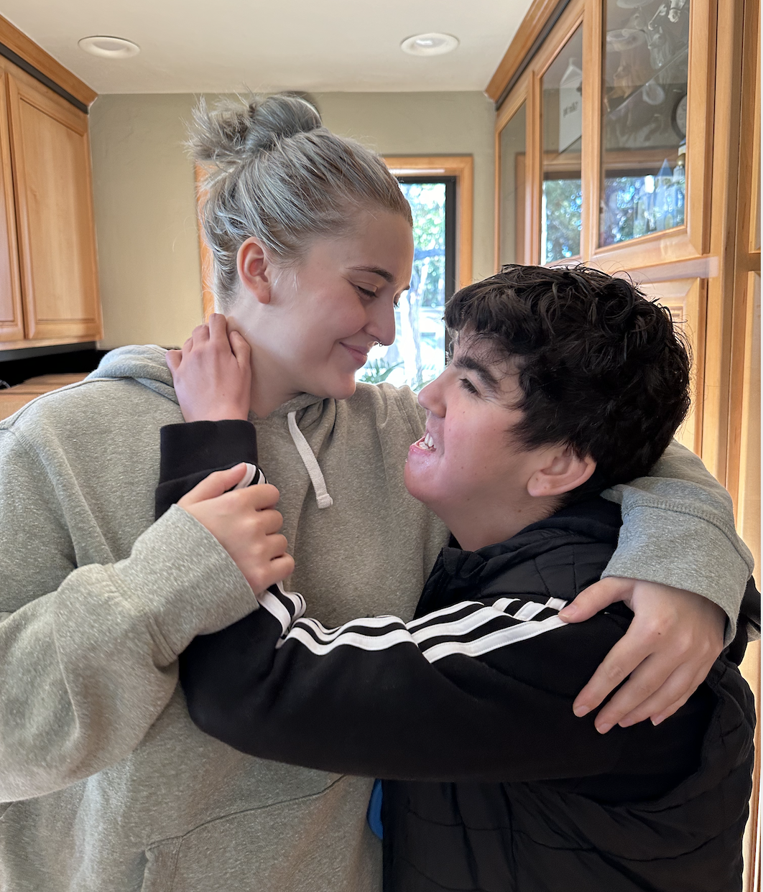
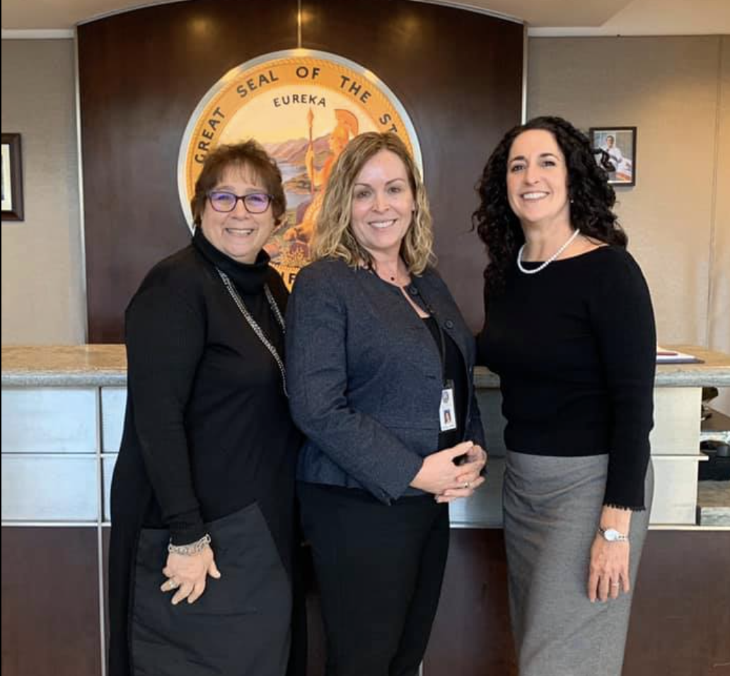

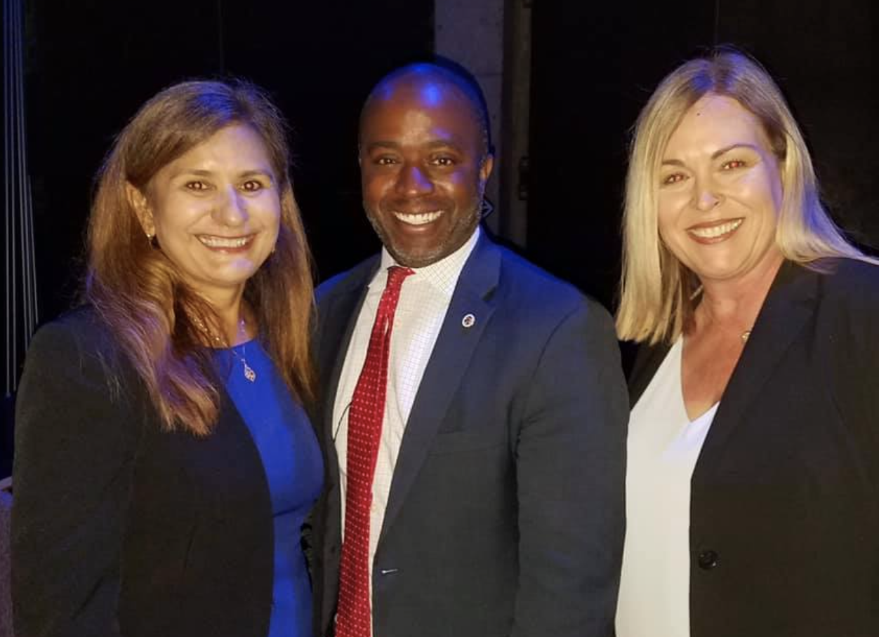
Disclaimer: These vantage points have influenced my personal opinions, biases, and evolution of thinking.
Educator/Researcher/Traveler
Parent Advocate/Commission Chair
Mom of Children
with Disabilities
State Board Policy Consultant
State Director of Special Education
County Office of Education Administrator
Notes:
The photos represent both the myriad of elevations and positionality that are the patchwork pieces of the quilt that makes up my current thinking. Some of my thinking has evolved as recent as two weeks ago. Today I want to share with you some of my latest ah ha’s and what I see as some our biggest collective opportunities.

Slide 3
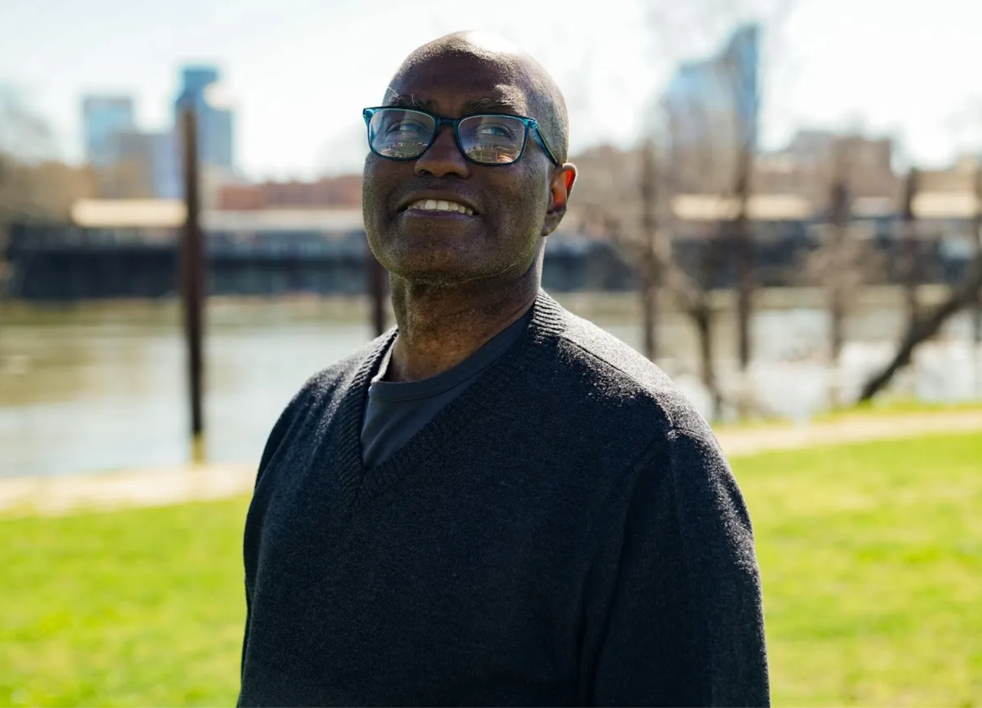
Theodore

Slide 4
Historical Timeline
Americans with Disabilities Act (ADA) is signed into law.
Individuals with Disabilities Education Act (IDEA) Reauthorized: The Education for All Handicapped Children Act is reauthorized and renamed the Individuals with Disabilities Education Act (IDEA)
Brown v. Board of Education
School segregation is abolished and public schools are given permission to educate children with significant intellectual disabilities.
Civil Rights Act signed in to law and bypasses persons with disabilities.
1962
1975*
1954
1964
1990
THEODORE IS BORN
Education for Handicapped Children Act of 1975 signed in to law
*In 1977 California passed the Lanterman Act

Slide 5
Constraint
“Any limitation, restriction, or barrier that impedes the effective implementation of either a law's provision(s) or the spirit of the law.”

Slide 6
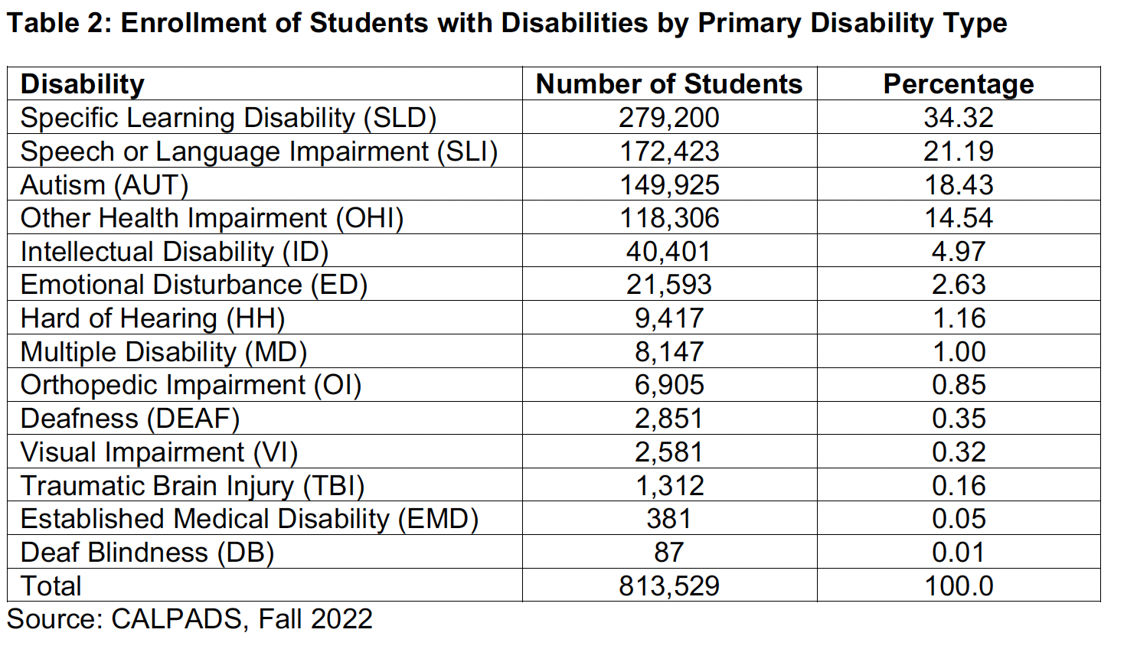
Students with Disabilities by IDEA Category in CA

Slide 7
Constraints in Using Disability Categories for IDEA Eligibility
Reinforcement of the medical model of disability perpetuating a deficit-based ableist mindset, labeling, and sorting
Perpetuation of stereotypes of certain disabilities resulting in preconceptions and predetermined pathways/tracks, lowered expectations, and increased segregation
Over reliance on research-based interventions resulting in both prescribed treatments for certain disabilities (i.e., ABA for Autism and lack of specific, appropriate interventions for others)
Indicators | Targets | Results | Met Target | Change from Prior Year
1 Graduation | 76% | 82.98% | Yes | +5.62%
2 Drop Out | 9% | 10.04% | No | -2.83%
3 Statewide Assessment | N/A | N/A | N/A | N/A
3A Participation | 95% ELA/Math | Various | Yes/No | Various
3B Grade Level Assessments Proficiency | Various | Various | Yes/No | Various
3C Alternate Assessment Proficiency | Various | Various | Yes/No | Various
3D Achievement Gap | Various | Various | Yes | Various
4 Suspension/Expulsion | N/A | N/A | N/A | N/A
4A Suspension and Expulsion Rate Overall | 2.6% | 0.67% | Yes | +0.67%
4B Suspension and Expulsion Rate by Race/Ethnicity | 0% | 0% | Yes | No Change
5 Education Environments | N/A | N/A | N/A | N/A
5A Regular Class 80 Percent or More | 63% | 61.3% | No | +0.48%
5B Regular Class Less than 40 Percent | 16.5% | 18.38% | No | -0.22%
5C Separate Schools, Residential Facilitates, or Homebound/Hospital Placements | 3% | 2.54% | Yes | -0.03%
6 Preschool Least Restrictive Environments | N/A | N/A | N/A | N/A
6A Regular Preschool | 43% | 19.86% | No | +1.0%
6B Separate Schools or Classes | 29% | 47.48% | No | -0.39%
6C Home | 3.5% | 5.64% | No | -2.33
7 Preschool Assessment | N/A | N/A | N/A | N/A
7A Positive Social-Emotional Skills | 78%/78% | 69.0%/80.4% | No/Yes | -0.5%/+12.7%
7B Use of Knowledge and Skills | 78%/78% | 70.4%/84.7% | No/Yes | +1.4%/+19.5%
7C Use of Appropriate Behaviors | 78%/78% | 68.3%/85.3% | No/Yes | -3.2%/+13.1%
8 Parent Involvement | 96% | 99.67% | Yes | +0.04%
9 Disproportionate Representation | 0% | 0.33% | No | -0.14%
10 Disproportional Representation by Disability Category | 0% | 2.98% | No | -1.45 %
11 Child Find | 100% | 94.03% | No | +0.04%
12 Early Childhood Transition | 100% | 76.09% | No | -2.06%
13 Secondary Transition | 100% | 95.25% | No | +0.36%
14 Post-school Outcomes | N/A | N/A | N/A | N/A
14A Enrolled in Higher Education | 57% | 50.81% | No | +2.88%
14B Enrolled in Higher Education or Competitively Employed within a Year | 78% | 75.06% | No | +0.53%
14C Enrolled in Higher Education, Postsecondary Education or Training or Competitively Employed | 88% | 90.46% | Yes | -0.66%
15 Resolution Sessions | 42% | 5.38% | No | -2.8%
16 Mediation | 67% | 9.15% | No | -7.77%
17 State Systemic Improvement Plan | 15% | 14.57% | No | 0.50%

Slide 8
Wondering:
Aside from being used to qualify a student for services, how does being labeled in a specific disability category help a student learn or inform a teacher about the student?
Notes:
And, is this a system designed to get people the help they need, or keep out those we don’t believe can prove they are disabled enough?

Slide 9
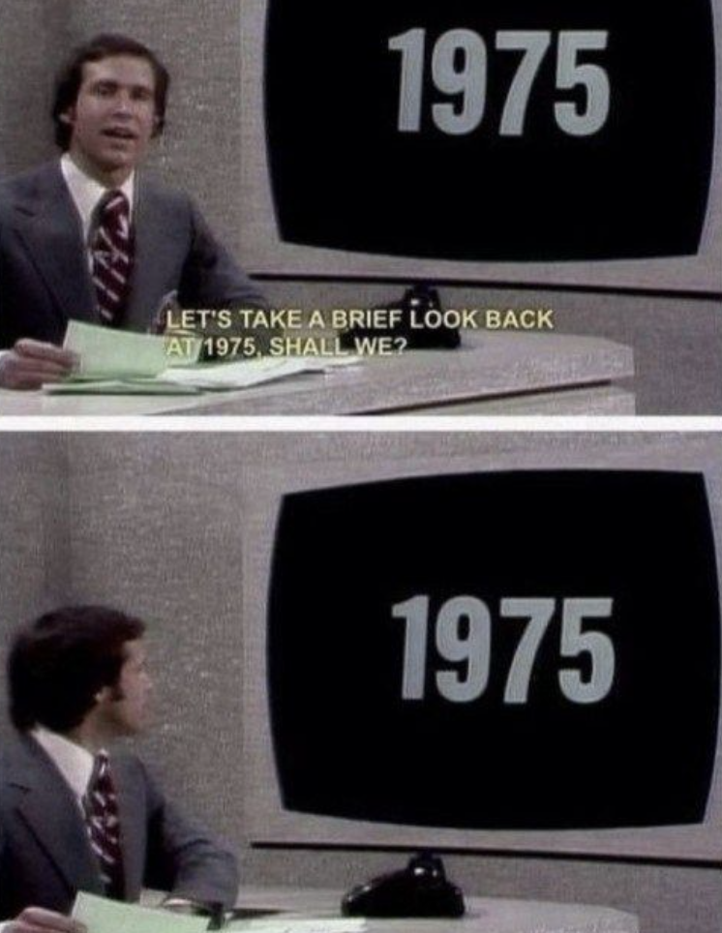
The Individuals with Disabilities Education Act (IDEA) was signed into law almost 50 years ago.*
*On November 29, 1975, President Gerald Ford signed into law the Education for All Handicapped Children Act (Public Law 94-142), now known as the Individuals with Disabilities Education Act (IDEA).

Slide 10
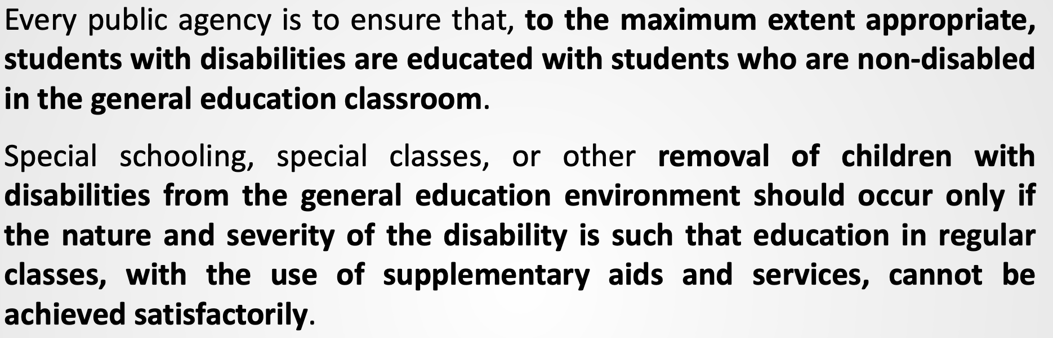
Least Restrictive Environment (LRE)
Notes:
CONSTRAINTS
Overly dependent on assumption of high quality, engaging, differentiated general education
Room for subjectivity based on educator/administrator/community biases and fear especially with words like “to extent appropriate”
“Continuum of placements” is prominent and used as a menu to choose further disabling students rather than fixing a disabling environment
Misunderstandings about “qualifications” or “criteria” for a student to be included in general education

Slide 11
Constraints of LRE Provision
Overly dependent on assumption of high quality, engaging, universally designed, and differentiated general education classrooms
Room for subjectivity based on educator/administrator/community biases and fear especially with words like “to the extent appropriate”
“Continuum of placements” is prominent and used as permission to segregate rather than fixing a disabling environment
Misunderstandings about “qualifications” or “criteria” to determine whether a student can be included in “general” education

Slide 12
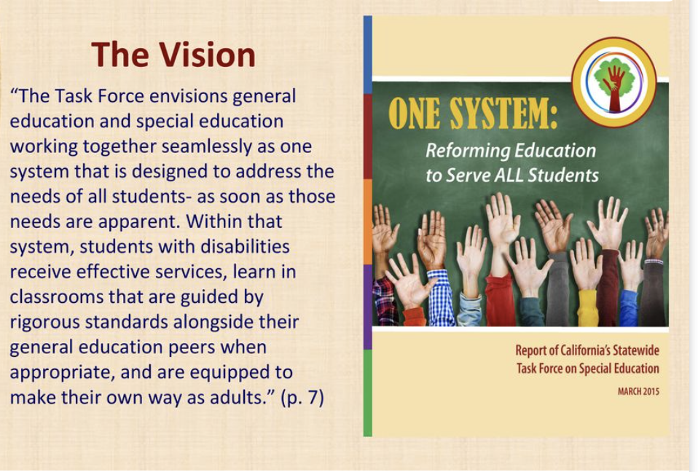
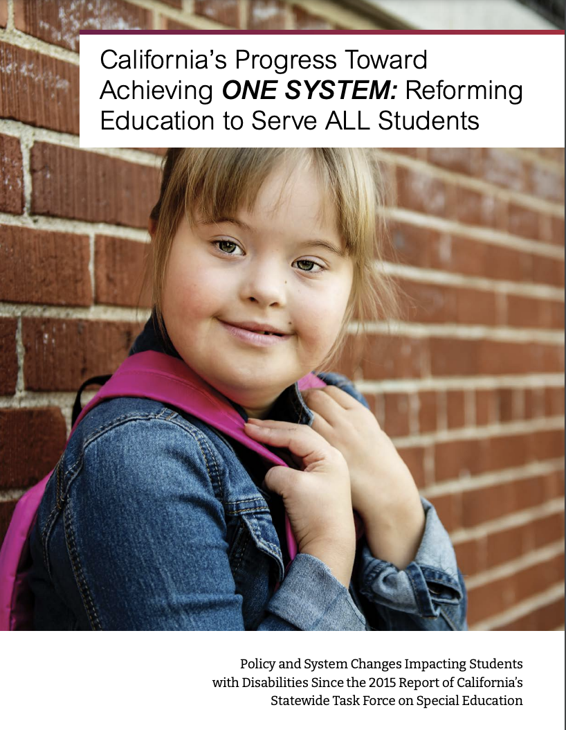
https://www.cde.ca.gov/sp/se/sr/taskforce2015-intro.asp
https://www.cde.ca.gov/sp/se/sr/documents/onesystemreport2021.pdf
Notes:
While the state has specific monitoring responsibilities under IDEA, it also is responsible for continuous improvement. California’s Special Education Task Force convened in 2015 came to some conclusions and suggested ways the education system could better serve students with disabilities.

Slide 13
California Senate Bill 692 - Chaptered 2022
Section 56049 is added to the Education Code, immediately following Section 56048
The Legislature finds and declares all of the following:
(a) All pupils are general education pupils first, including pupils with disabilities.
(b) Comprehensive local educational agency and school-level fiscal and programmatic planning…must reflect the needs of all pupils, including pupils with disabilities…
(c) Inclusion in general education classrooms and programs should be considered the first setting for all pupils…
(d) …local educational agencies should use all available data sources on pupils with disabilities, ..with a focus on least restrictive environment data, to inform continuous improvement efforts.
Notes:
SECTION 1. Section 56049 is added to the Education Code, immediately following Section 56048, to read:
56049. https://leginfo.legislature.ca.gov/faces/billTextClient.xhtml?bill_id=202120220SB692#93CHP

Slide 14
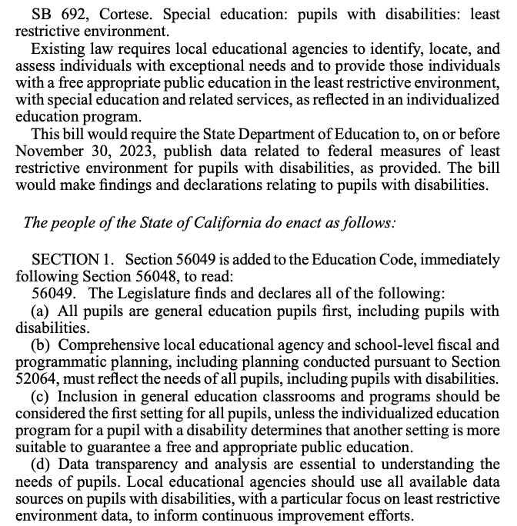

California

Slide 15
OTHERING
Othering is a process whereby individuals and groups are treated and marked as different and inferior from the dominant social group
Source: Oxford Dictionary

Slide 16
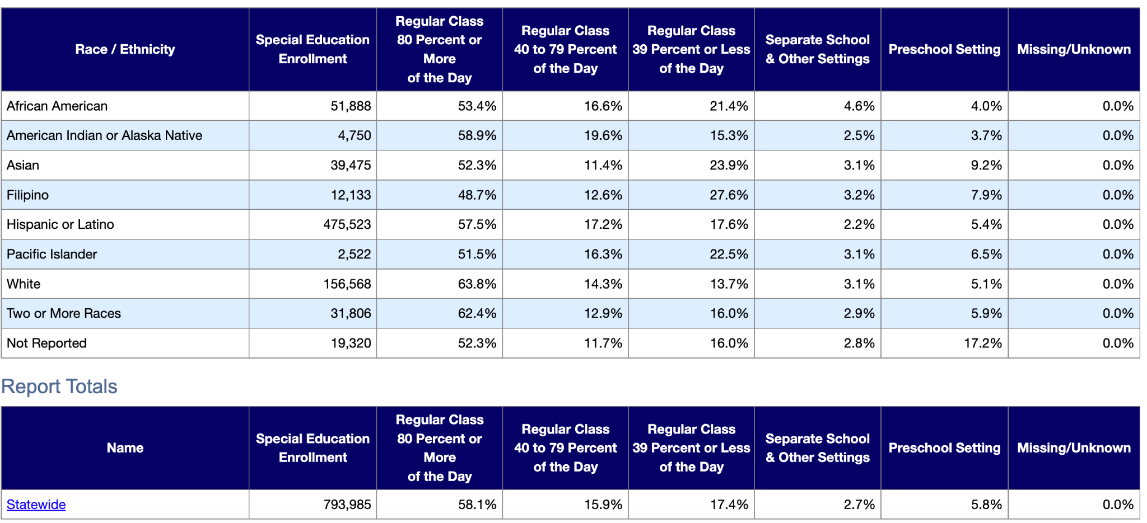
NEW DATA AVAILABLE: LRE of CA Students with Disabilities by Race/Ethnicity
Source: CDE Dataquest 2022-23
Notes:
SB 692 also called for transparency of data related to LRE to understand how the intersectionality of race/ethnicity and disability could play a role in placement decisions

Slide 17
How do we talk about students with disabilities and the people who educate them?

Slide 18
This is how we talk about students with disabilities:
Special education student/sped student/sped kiddo
Special education teacher/sped teacher
Special education/sped/sdc/ED/autism classroom
“Inclusion” in reference to a student with disabilities, a placement, program, school, district, or teacher
Notes:
And I’d argue our teacher preparation system is built around these sentiments.

Slide 19
Instead we could instead use terms like:
Special education student/sped student/sped kiddo? Learner, student, or if a student identifies with disability identity first language (i.e., Autistic student)
Special education/sped teacher?
Teacher/Education Specialist
Special education/sped/sdc/ED/autism classroom?
Room 4, 3rd grade, etc.
“Inclusion” when referring to student with disabilities, a placement, program, school, district, or teacher?
Inclusive practices, accessible and universally designed instruction, classrooms and learning environments

Slide 20
What can we collectively do across our agencies? What should we be paying attention to?

Slide 21

From Inclusion Belonging
and Justice Through Rightful Presence
…Inclusion efforts alone cannot bring about substantial change because they adhere to the same guest/host power dynamic that serves to normalize the existence of a group who is “invited” and a group with the power to invite.
Swift Center on Inclusion Toward Rightful Presence

Slide 22
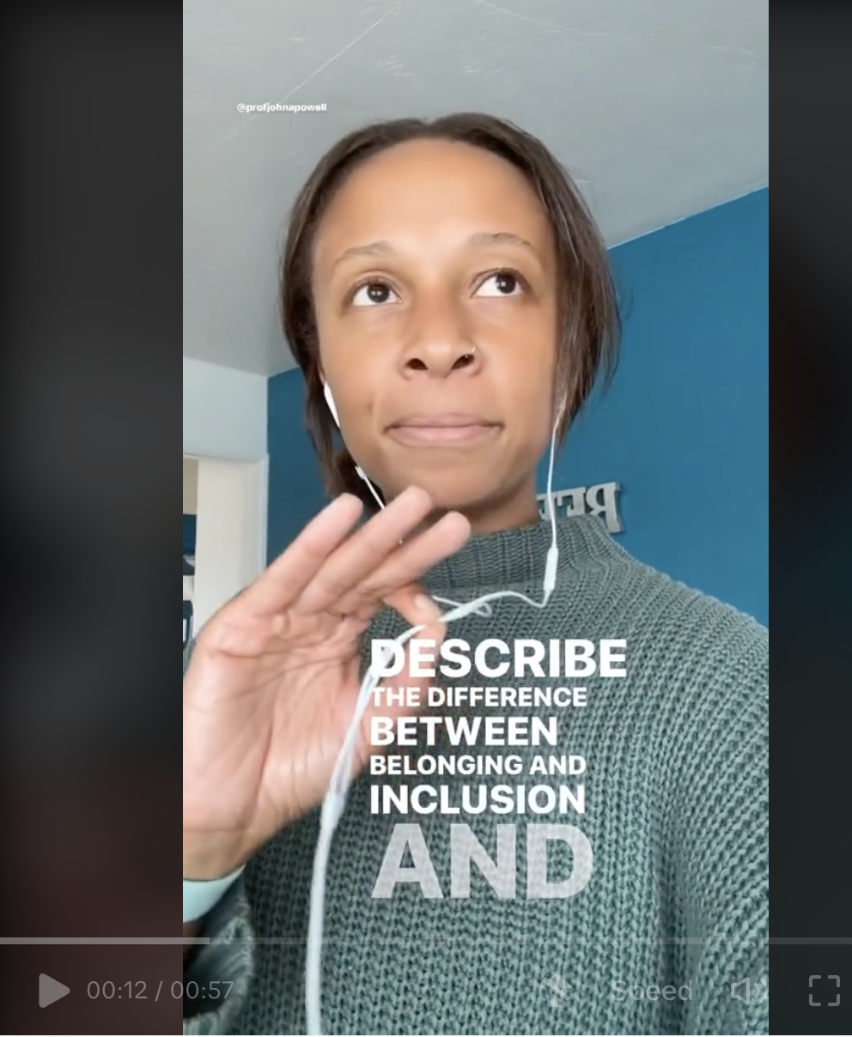
Othering and Belonging Institute
At UC Berkeley - Dr. John Powell
Notes:
https://belonging.berkeley.edu/john-powell

Slide 23
Current (but not new) Obsessions and Favs:
UC Berkeley Othering and Belonging Institute: Targeted Universalism
Doing a (dis)service: Reimagining special education from a disability studies perspective Beth Ferri, Syracuse University (2008)
OSEP Dear Colleague Letter 2015
Diana Pastora Carson: https://www.dianapastoracarson.com/
Redwood SEEDS Scholars at UC Davis
https://redwoodseed.ucdavis.edu/

Slide 24
Thank you! Please reach out!
Kristin Wright
kwright@scoe.net

