Slide 1
HIGH-LEVERAGE PRACTICES
JUNE 28, 2018
SELMA POWELL
CARLY ROBERTS
Please make sure to sign-in and provide your email address so you can be added to the shared google drive for today!
Notes:
Selma

Slide 2

Notes:
Selma

Slide 3

How many of you are in elementary schools?
How many of you are in middle schools?
How many of you are in high schools?
How many of you have taught special ed?
Notes:
Selma
We want to get a better sense of our crowd…

Slide 4

About Me: Selma
Learner-educator
Mom
Immigrant
Loves the PNW
Notes:
Selma

Slide 5

CARLY BIO
Teacher educator
Researcher
Born and raised in WA
Notes:
(Carly)
-Teacher educator at UW preparing preservice special education teachers
-Researcher focusing on instruction for students with intellectual disability and promoting inclusion for students with disabilities
-Born and raised in Stanwood, WA, spent several years out of state and returned back a few years ago. Very happy to be back.

Slide 6

Agenda
Orientation to materials
Background of HLPs
Introduction to the HLPs
Example application scenarios
Group work time
Sharing
Closing
Notes:
(Carly)
Today we will be referencing several documents and folders, all of which are on the USB that was provided to you. We will also invite you to a google folder where you can access our Pp.

Slide 7
Purpose
“The primary purpose of High-Leverage Practices in Special Education is to provide those involved in special education teacher preparation and professional development with a set of HLPs that were identified through consensus among special educators. These HLPs may be used to design a cohesive set of practice based opportunities to support teacher candidates and practicing teachers in learning to put this know-how to use on behalf of the complex learners they teach.”
Notes:
(Carly)
-Teaching is complex and prioritizing what practices to focus on has been a consistent problem in teacher preparation and development
-The goal of identifying High Leverage Practices was to help teacher educators and school leaders support pre- and inservice teachers by identifying a set of critical practices to focus on
-A work group through the Council for Exceptional Children and the CEEDAR Center (a collaborative teacher education technical assistance center at the University of Florida) was supported by funding from the DOE and Office of Special Education to identify the HLPs.
-The work started in 2015, the practices were finalized in 2016, and published in 2017

Slide 8

Practices from other Disciplines
High-Leverage Practices-TeachingWorks
Ambitious Science Teaching- AmbitiousScienceTeaching.Org
Core Practices- CorePracticeConsortium.com
cc: Tsahi Levent-Levi - https://www.flickr.com/photos/86979666@N00
Notes:
(Carly)
-The idea of having a critical set of practices to focus on is not new in education.
-Special Ed HLPs were developed with the goal of helping the field of special education bridge the research to practice gap by giving us a set of practices that can help special educators (1) identify what students need to learn, (b) provide systematic instruction, and (c) make data-based decision.

Slide 9

High-leverage practices in special education…
Are critical practices that support student learning
Can be used across different content areas
Are frequently occurring and can be generalized across settings
Can be learned and implemented by novices
Are broader than evidence-based practices but may be used to teach evidence-based practices.
  Use explicit instruction to teach a specific graphic organizer
  Collaborate with paraprofessionals to train them to implement task analyses)
Are mechanisms to facilitate tiered instruction
(McCray, Kamman, Brownell, & Robinson, 2017)
Notes:
(Carly)
HLPs should be evident in each tier of instruction

Slide 10

Four intertwined components of
teacher practice:
Collaboration
Assessment
Social/Emotional/Behavioral Practices
Instruction
cc: Steve Johnson - https://unsplash.com/@steve_j?utm_source=haikudeck&utm_medium=referral&utm_campaign=api-credit
Notes:
(Selma)
The special education HLPs are organized around 4 intertwined components of teacher practice…

Slide 11
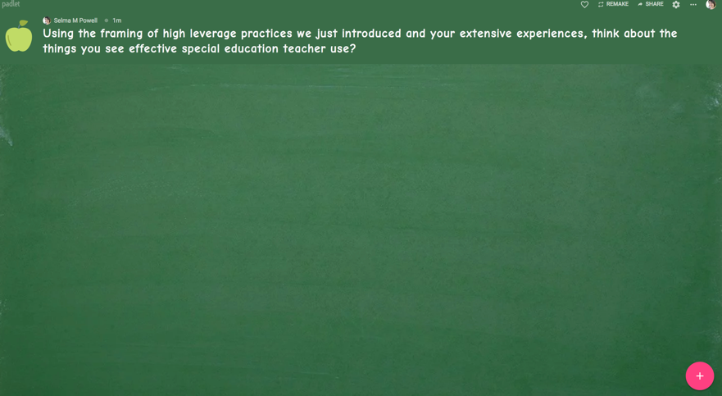
Using the components of high leverage practices we just introduced and your extensive experiences, think about the things you see effective special education teacher use?
4 Components:
Collaboration
Assessment
Social/emotional/behavioral
Instruction
https://padlet.com/selmap/u8wieyxd4l50
Notes:
(Selma)
(10 minutes)
Using the definition we just shared of HLPs and your own experience, work with a shoulder partner and think about the practices you think effective special education teachers use in each component. Make sure to label which component you think that practice falls under…
-Collaboration
-Assessment
-Social/emotional/behavioral
-Instruction
Keep your practices in mind as we read through each of the practices…keep track of areas where there was overlap with your ideas and areas where you were surprised…

Slide 12
Collaboration HLPs
HLP1. Collaborate with professionals to increase student success.
HLP2. Organize and facilitate effective meetings with professionals and families.
HLP3. Collaborate with families to support student learning and secure needed services.
Notes:
(Selma)
Reminder, all of these practices are on the USB you received. We will now take a moment to go read through each of the practices.

Slide 13
Assessment HLPs
HLP4. Use multiple sources of information to develop a comprehensive understanding of a student’s strengths and needs.
HLP5. Interpret and communicate assessment information with stakeholders to collaboratively design and implement educational programs.
HLP6. Use student assessment data, analyze instructional practices, and make necessary adjustments that improve student outcomes.
Notes:
(Carly)

Slide 14
Social/Emotional/Behavioral HLPs
HLP7. Establish a consistent, organized, and respectful learning environment.
HLP8. Provide positive and constructive feedback to guide students’ learning and behavior.
HLP9. Teach social behaviors.
HLP10. Conduct functional behavioral assessments to develop individual student behavior support plans.
Notes:
(Selma)

Slide 15
Instruction HLPs
HLP11. Identify and prioritize long- and short-term learning goals.
HLP12. Systematically design instruction toward a specific learning goal.
HLP13. Adapt curriculum tasks and materials for specific learning goals.
HLP14. Teach cognitive and metacognitive strategies to support learning and independence.
HLP15. Provide scaffolded supports.
HLP16. Use explicit instruction.
Notes:
(Carly)

Slide 16
Instruction HLPs--continued
HLP17. Use flexible grouping.
HLP18. Use strategies to promote active student engagement.
HLP19. Use assistive and instructional technologies.
HLP20. Provide intensive instruction.
HLP21. Teach students to maintain and generalize new learning across time and settings.
HLP22. Provide positive and constructive feedback to guide students’ learning and behavior.
Notes:
(Selma)

Slide 17

What connections can you make from the ideas generated on the padlet to the list of High Leverage Practices?
cc: Serge Saint - https://www.flickr.com/photos/87128770@N00
Notes:
(Carly)
(5 minutes—with shoulder partner or table)
Take 5 minutes with a shoulder partner or with your table. What connections can you make from the ideas generated on the padlet, to the list of HLPs?
-Where do you see overlap?
-Where do you see differences?

Slide 18

cc: C!... - https://www.flickr.com/photos/26399220@N03
Notes:
(Selma)
We want to take this time to share out what you and your shoulder partner. Who would like to go first?

Slide 19
Application Framework
What tools might be used to evaluate or assess this practice?
What tools or resources can be used for implementation?
Where can resources be found?
Notes:
(Carly)
Now that we have introduced the HLPs and their background, we want to spend the bulk of our time unpacking how we would (1) evaluate or assess if a practice is happening, (b) identifying resources to learn more about a practice, and (c) supporting implementation.
We are going to use this framework for the remainder of our time together to support your thinking regarding how to support these practices in your schools.
First, we will walk through the process for four practices, one from each component. We will model what we will be asking you to do later.

Slide 20

Collaboration
cc: jairoagua - https://www.flickr.com/photos/31065898@N08
Notes:
(Selma)

Slide 21
HLP1. Collaborate with professionals to increase student success.
Collaboration with general education teachers, paraprofessionals, and support staff is necessary to support students’ learning toward measurable outcomes and to facilitate students’ social and emotional well-being across all school environments and instructional settings (e.g., co-taught). Collaboration with individuals or teams requires the use of effective collaboration behaviors (e.g., sharing ideas, active listening, questioning, planning, problem solving, negotiating) to develop and adjust instructional or behavioral plans based on student data, and the coordination of expectations, responsibilities, and resources to maximize student learning.
Notes:
(Selma)
We have chosen to highlight HLP1, which focuses on collaboration with professionals. Specifically, we are going to unpack how we would think about supporting special education teacher collaboration with paraprofessionals.

Slide 22
HLP1. What tools might be used to evaluate or assess this practice?
  Paraprofessional Skills Survey
  ParaSkills Inventory
Notes:
(Selma)
We have located two tools that would give us a sense of the type of collaboration taking place between teachers and paraprofessionals…these aren’t comprehensive, these are just examples. You may choose very different tools depending on your context.

Slide 23
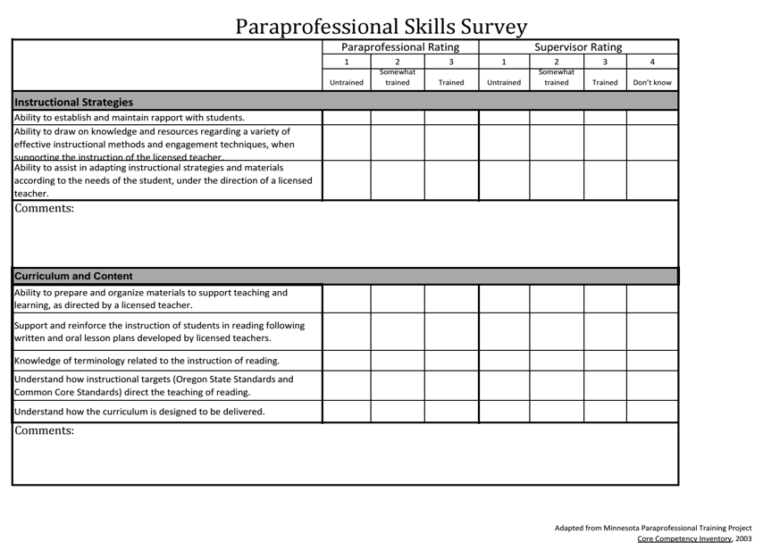
Notes:
This survey is completed by both paras and their supervisors and will provide data regarding how the para feels about instruction and curriculum. Similarly, depending on what your context is, this tool could be used and taken up differently…

Slide 24
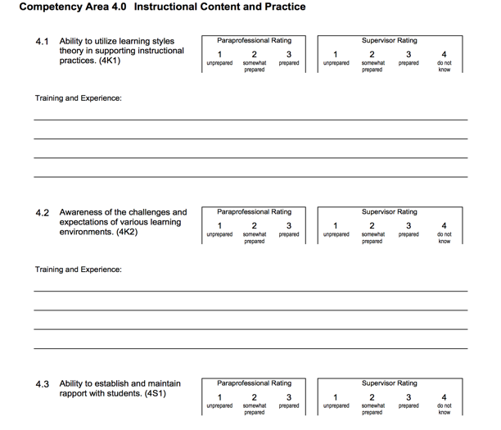
https://ici.umn.edu/para/new/pdf/ParaSkillsIinventory.pdf
Notes:
This skills inventory is similar, but it provides further detail regarding the paras training and experience. Both of these tools would provide insight regarding how well HLP1 was being implemented.

Slide 25
HLP1: Where can resources be found?
Paraeducator Resource and Learning Center University of Vermont (http://www.uvm.edu/~cdci/prlc/ )
A curriculum for job embedded paraprofessional development (http://ici.umn.edu/products/job_embedded_curriculum.pdf )
National Clearinghouse for Paraeducator Resources University of Southern California http://www.usc.edu/dept/education/CMMR/Clearinghouse.html
Paraprofessional Resource and Research Center (www.paracenter.org)
National Resource Center for Paraeducators (http://www.nrcpara.org)
Council for Exceptional Children - Paraeducator Preparation Guidelines (https://www.cec.sped.org/Standards/Paraeducator-Preparation-Guidelines)
Notes:
Part of successful implementation requires identifying where practices need to be improved, and locating the resources you need to learn more about them and support implementation…these are several websites where you can find more information about collaborating with paraeducators…

Slide 26
HLP1: What tools or resources can be used for implementation?
Special Education Paraprofessional Support checklist
Matrix to document the team members’ roles and responsibilities
Paraprofessional Schedule
Notes:
The final step is identifying resources to support implementation. The following three tools can be used to facilitate successful para collaboration…again these aren’t comprehensive, just examples…

Slide 27
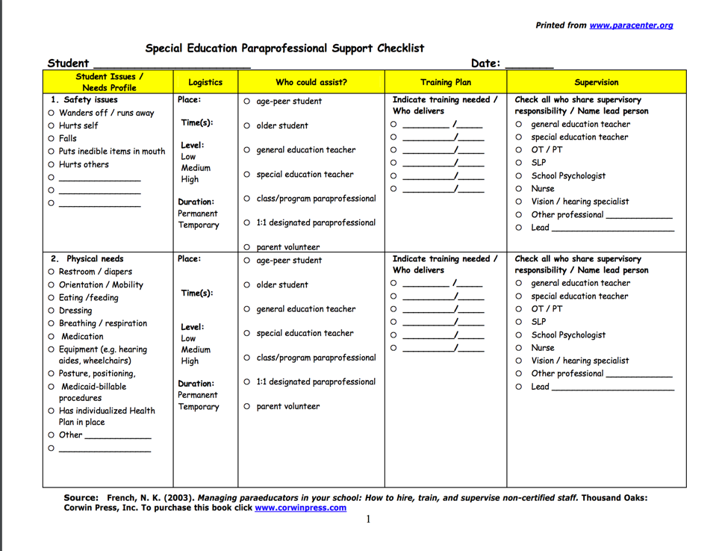
Notes:
This checklist can be used to communicate student needs with paras

Slide 28
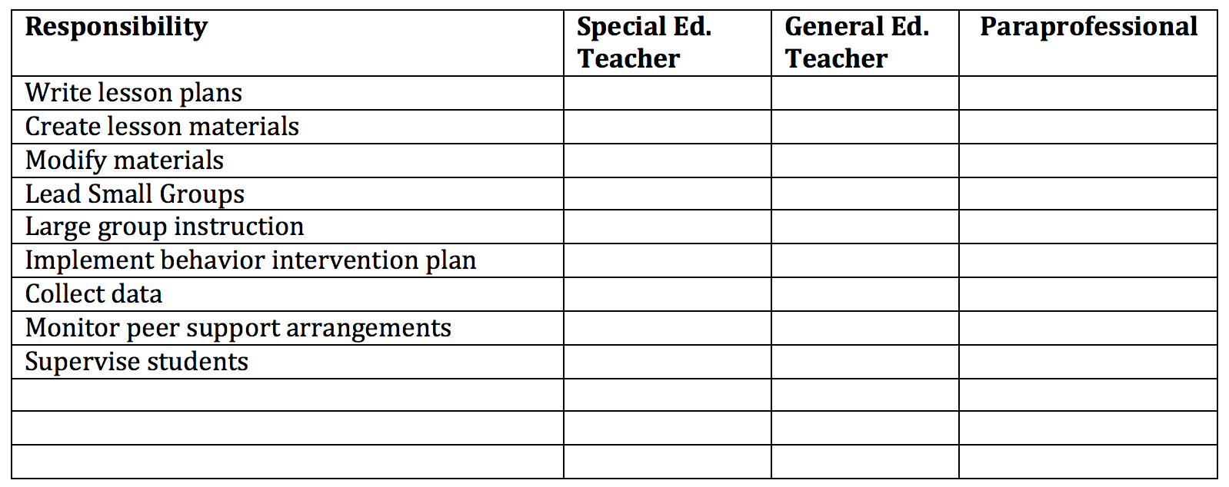
Matrix to document the team members’ roles and responsibilities
Adapted from: Ghere, G., York-Barr, J., Sommerness, J. (2002). Supporting students with disabilities in inclusive schools: A curriculum for job-embedded paraprofessional development facilitator manual. Minneapolis, MN: University of Minnesota Institute on Community Integration
Notes:
This matrix document can help clarify team members’ roles and responsibilities

Slide 29
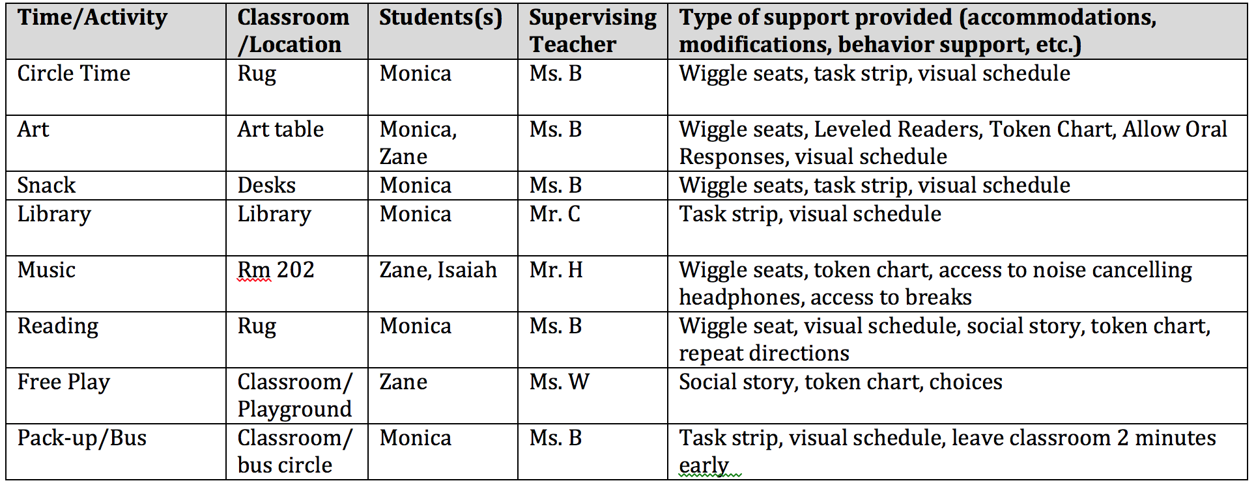
Paraprofessional Schedule
Stewart, E. & Mahoney, M. (2017, April). Supporting paraprofessionals to facilitate student learning and independence in inclusive settings. Council for Exceptional Children Conference, Boston, MA.
Notes:
This sample schedule can establish clear communication regarding where adults are needed and when and what their primary role should be. These forms are all examples and templates are available for you in your provided materials.

Slide 30
Check In
Notes:
(Selma)
Before moving on to the next component, we want to take a moment for a quick check-in…
Who has paras in their building?
Who sees these resources as something that might be valuable to supporting those paras? We are going to leave time at the end for you to situate these practices in the context of your schools, so if this is an area for you to do some work or share your success with this practice, we encourage you to contribute your ideas or resources to the shared folder.
This framework is a way to explicitly name and frame the work you are all already doing in your schools and more systematically monitor their success.

Slide 31

Assessment
cc: Theen ... - https://www.flickr.com/photos/57768536@N05

Slide 32
HLP4. Use multiple sources of information to develop a comprehensive understanding of a student’s strengths and needs.
To develop a deep understanding of a student’s learning needs, special educators compile a comprehensive learner profile through the use of a variety of assessment measures and other sources (e.g., information from parents, general educators, other stakeholders) that are sensitive to language and culture, to (a) analyze and describe students’ strengths and needs and (b) analyze the school based learning environments to determine potential supports and barriers to students’ academic progress. Teachers should collect, aggregate, and interpret data from multiple sources (e.g., informal and formal observations, work samples, curriculum-based measures, functional behavior assessment [FBA], school files, analysis of curriculum, information from families, other data sources). This information is used to create an individualized profile of the student’s strengths and needs.
Notes:
We’ve selected HLP4 to highlight a practice from the assessment component. Specifically, we want to highlight how special educators should use multiple sources of information to understand students’ strengths and needs and guide instruction.

Slide 33
HLP4. What tools might be used to evaluate or assess this practice?
Example Assessments
Screening Tools Chart
Teacher Interview-FBA
Notes:
We will highlight three specific example tools that can be used to determine if multiple sources of information are being collected about each student.

Slide 34
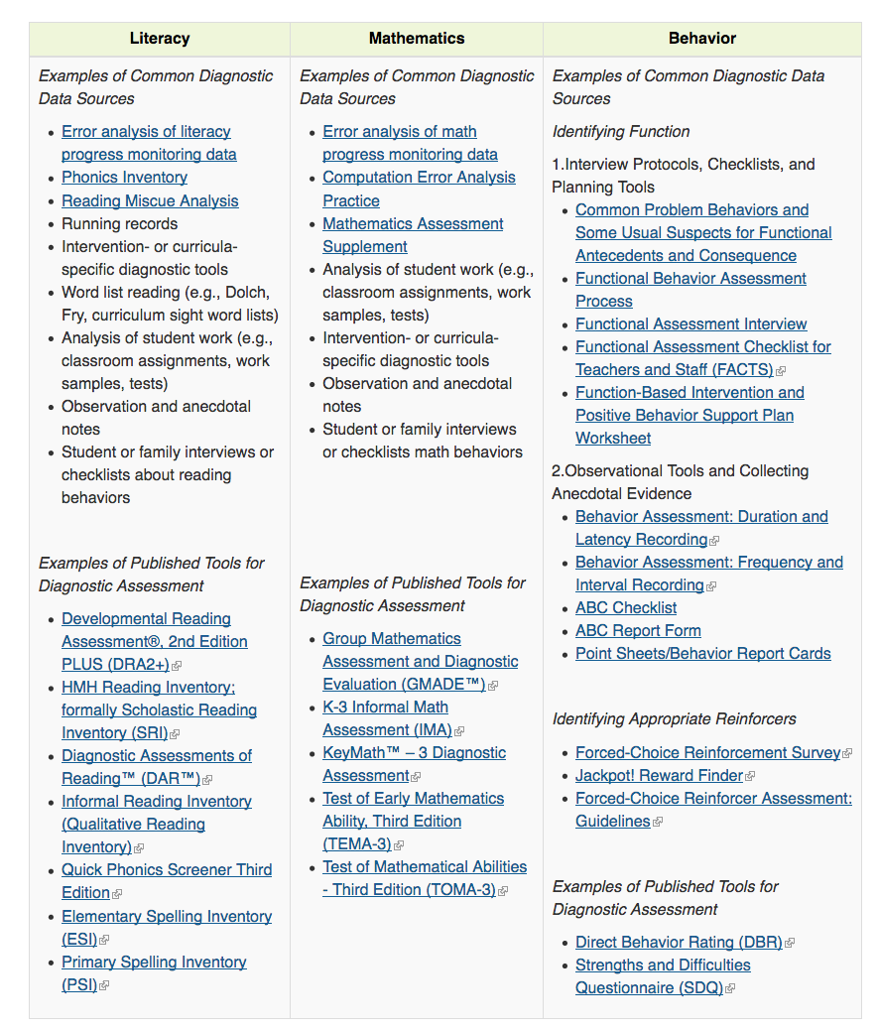
From buildingrti.utexas.org
Notes:
This framework helps schools think about the types of assessments they can use in the different areas of student development and shows how multiple measures can be used across domains.

Slide 35
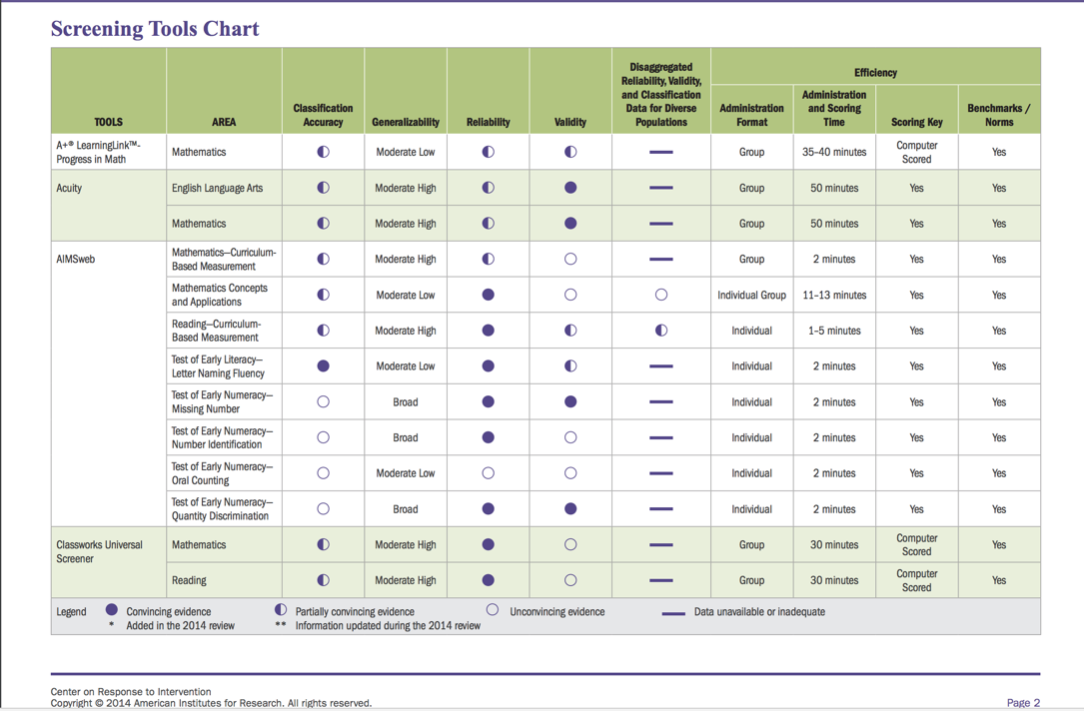
Notes:
Similarly, this tool highlights various assessments and includes information about their technical adequacy and implementation logistics.

Slide 36
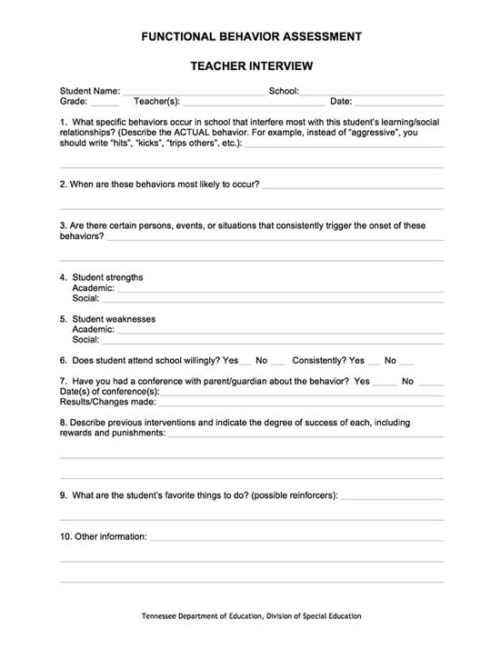
Notes:
This is an example of a different type of data, an interview, to collect information about a student’s behavior instead of just relying on standardized on quantitative or standardized assessments.

Slide 37
HLP4. Where can resources be found?
MAST-East Carolina University
Center on Response to Intervention
SWIFT Education Center
PBIS Center
The Evidence-Based Intervention Network (http://ebi.missouri.edu/)
The National Professional Development Center on Autism Spectrum Disorder (http://autismpdc.fpg.unc.edu/)
IrisCenter
Notes:
There are several high-quality websites that provide resources around assessment. These are just a few of them…again in your folder, you have a comprehensive list with hyperlinks of all of these resources…

Slide 38
HLP4: What tools or resources can be used for implementation?
Data Based Individual Implementation Log
Curriculum Based Measures (CBM)
Observational Notes
Functional Behavior Assessment (FBA)
Notes:
Once a teacher has determined how they are doing in HLP4, they will need support in implementation for using multiple sources of data for assessment.

Slide 39
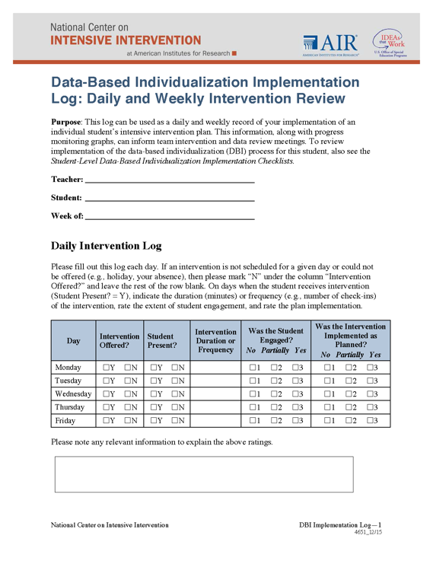
Notes:
This log can help teachers’ monitor and facilitate collection of daily intervention data.

Slide 40
Check In
Notes:
(Carly)
Before moving on to the next component, we want to take a moment for a quick check-in…
Who sees these resources as something that might be valuable to supporting assessment in your schools?
We are going to leave time at the end for you to situate these practices in the context of your schools, so if this is an area for you to do some work or share your success with this practice, we encourage you to contribute your ideas or resources to the shared folder.
This framework is a way to explicitly name and frame the work you are all already doing in your schools and more systematically monitor their success.

Slide 41

Social/Emotional/Behavioral
cc: Leonard J Matthews - https://www.flickr.com/photos/67953162@N00
Notes:
(Selma)

Slide 42
HLP10. Conduct functional behavioral assessments to develop individual student behavior support plans.
Creating individual behavior plans is a central role of all special educators. Key to successful plans is to conduct a functional behavioral assessment (FBA) any time behavior is chronic, intense, or impedes learning. A comprehensive FBA results in a hypothesis about the function of the student’s problem behavior. Once the function is determined, a behavior intervention plan is developed that (a) teaches the student a pro-social replacement behavior that will serve the same or similar function, (b) alters the environment to make the replacement behavior more efficient and effective than the problem behavior, (c) alters the environment to no longer allow the problem behavior to access the previous outcome, and (d) includes ongoing data collection to monitor progress.
Notes:
(Selma)
For the behavior component, we have selected HLP10, which focuses on FBAs, which can be a primary function of special education teachers.

Slide 43
HLP10. What tools might be used to evaluate or assess this practice?
FBA and BIP Checklist
FBA Caseload Summary
Notes:
(Selma)
There are several tools schools and teachers can use to determine if teachers are successful with FBAs.

Slide 44
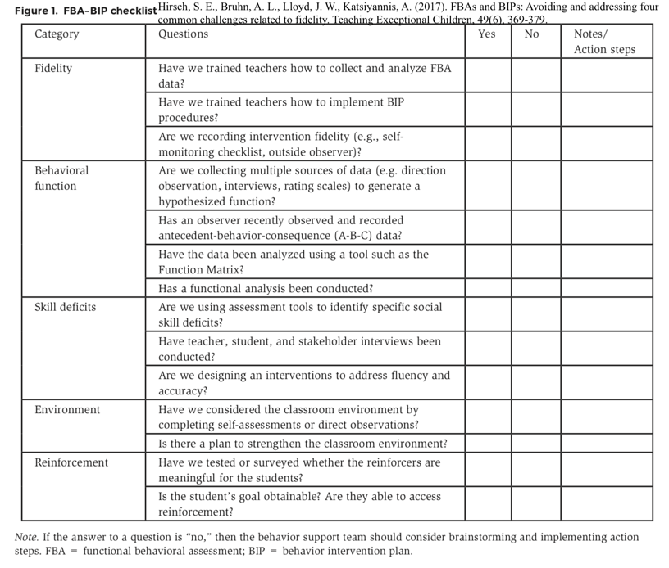
Notes:
(Selma)
This checklist highlights key practices needed fur successful FBA/BIPs.

Slide 45
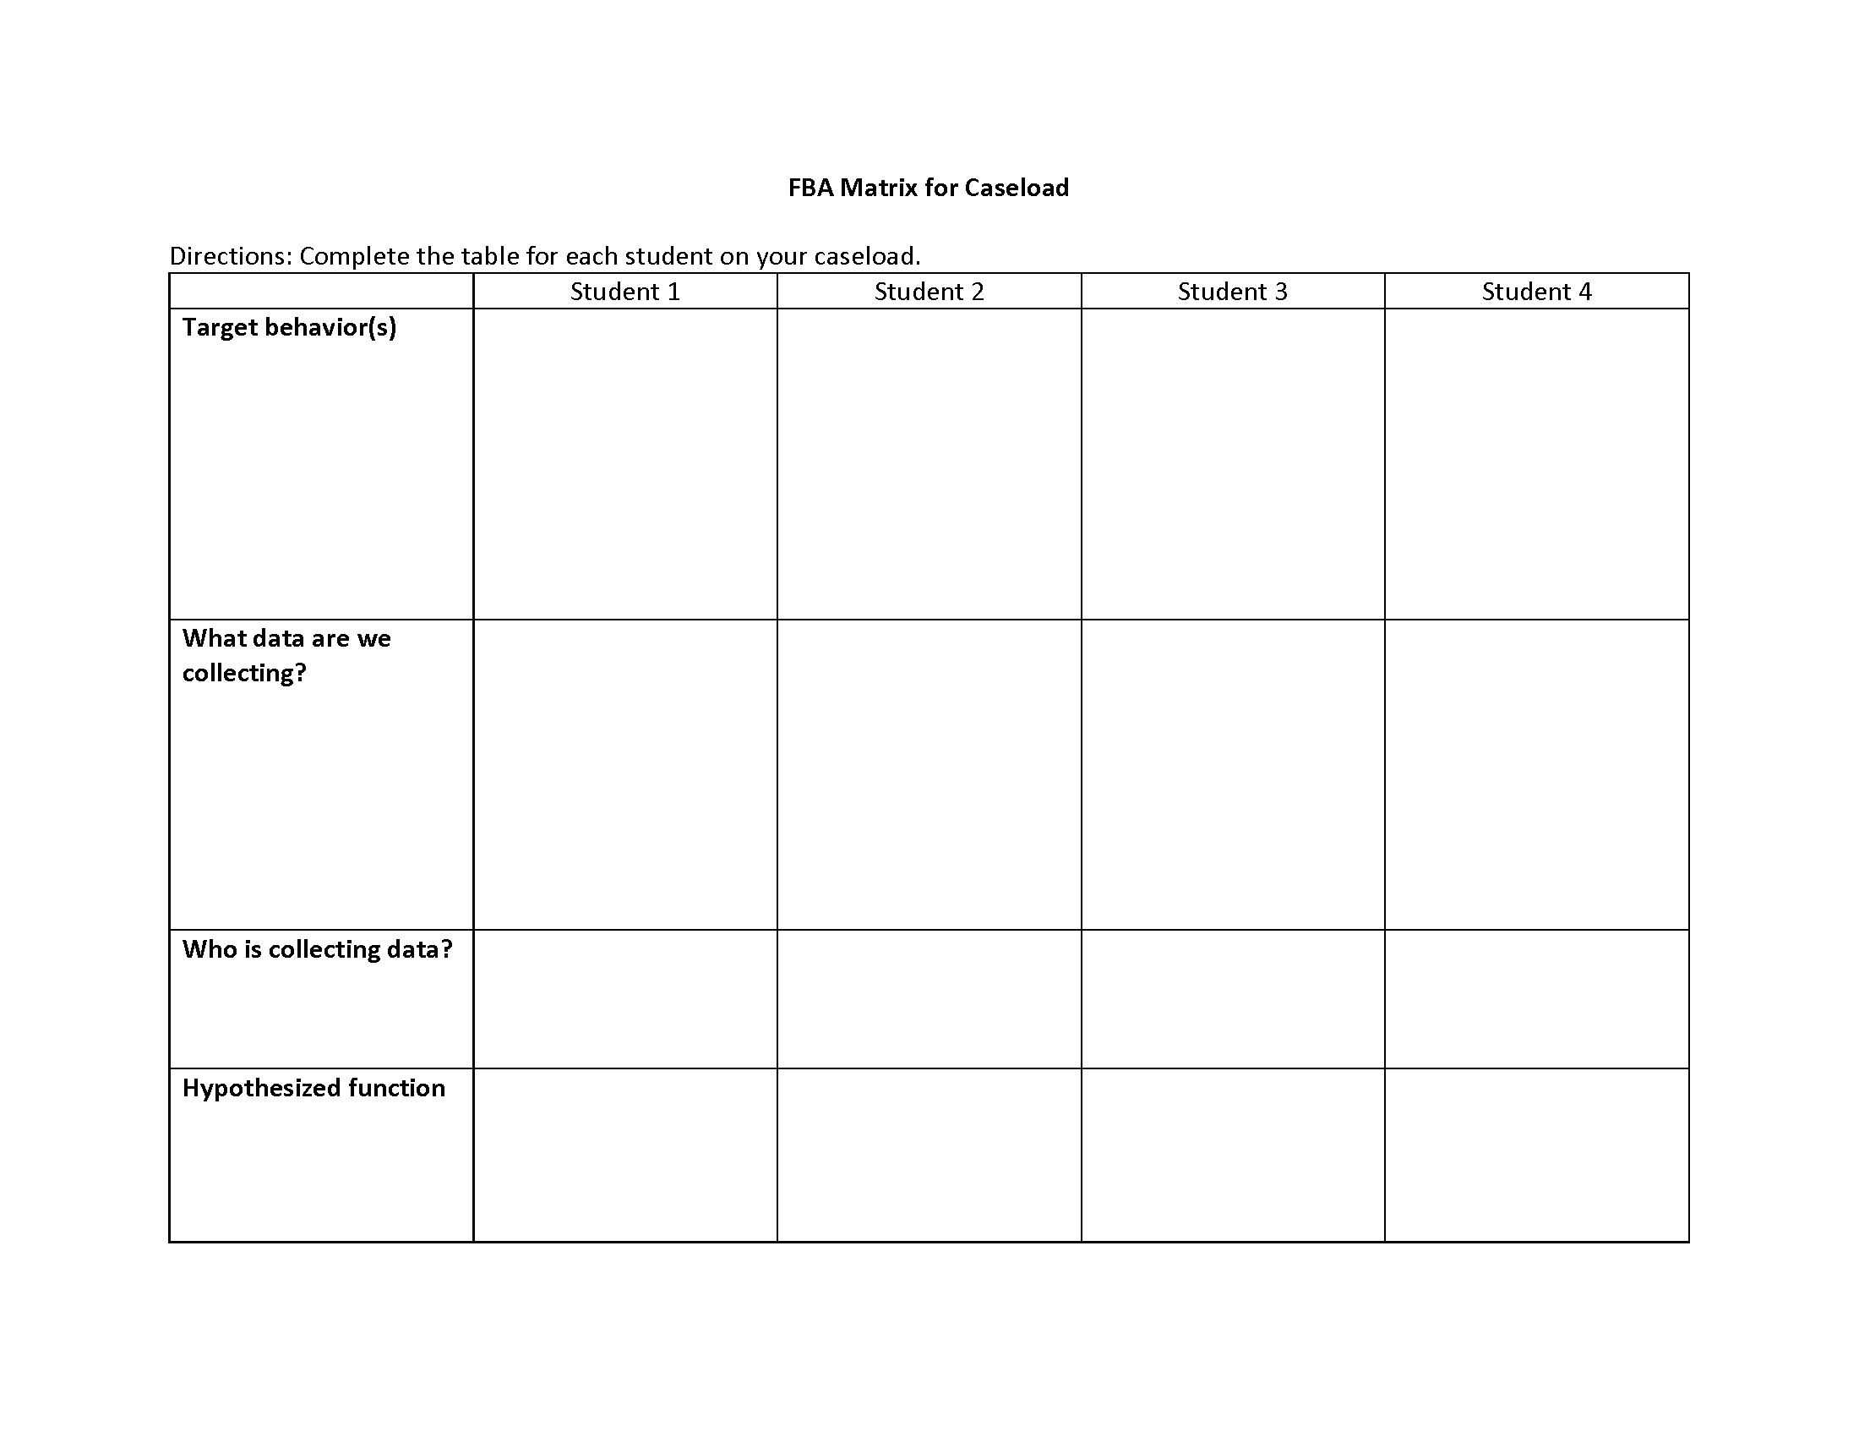
Notes:
(Selma)
This template helps teachers monitor if they are collecting systematic data for each student.

Slide 46
HLP10. Where can resources be found?
PBIS Center
IRIS modules – behavior intervention guides https://iris.peabody.vanderbilt.edu/iris-resource-locator/#content
Missouri EBI – Evidence-based intervention guides http://ebi.missouri.edu/?page_id=227
Intervention Central https://www.interventioncentral.org/behavioral-intervention-modification
Check in/check out Tip Sheet: https://my.vanderbilt.edu/specialeducationinduction/files/2013/07/Tip-Sheet-Check-In-Check-Out.pdf
Notes:
(Selma)
These websites provide extensive resources on the FBA/BIP process…

Slide 47
HLP10. What tools or resources can be used for implementation?
EBP Brief Packet
FBA Preparation Question
ABC Log
Hypothesis Statement Development
Behavior Support Plan
Student check-in
Notes:
(Selma)
We will showcase several tools that can be used to support teacher implementation of the FBA/BIP process…so even if your teacher is not in charge of conducting the FBA, these tools will help them be knowledgeable about the process in order to assist with the development

Slide 48
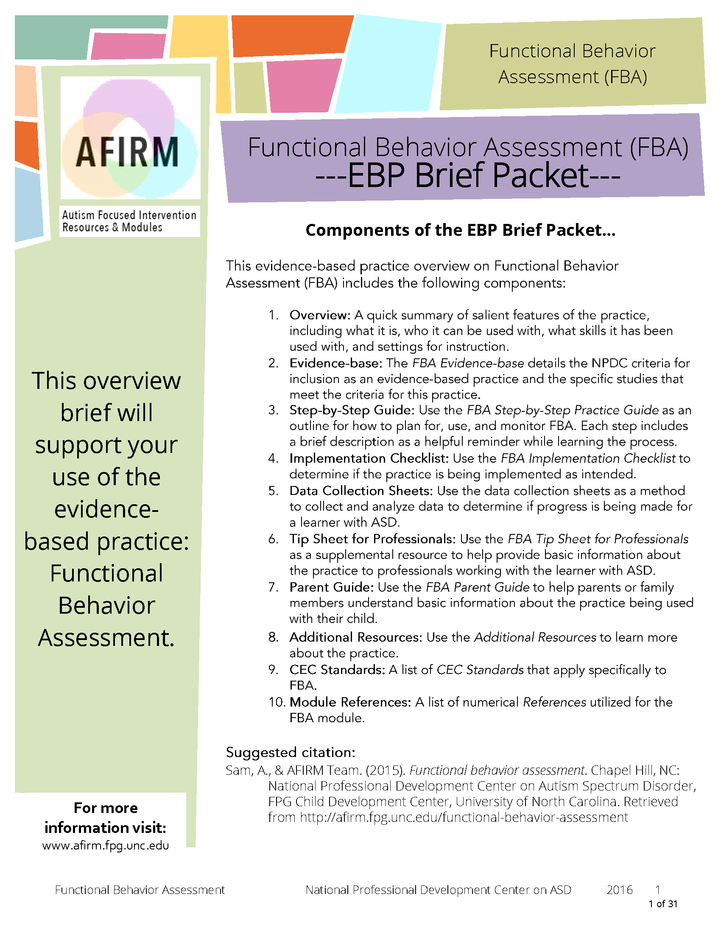
Notes:
(Selma)
This document provides detailed information on the FBA/BIP process for teachers including helpful templates and how-tos.

Slide 49
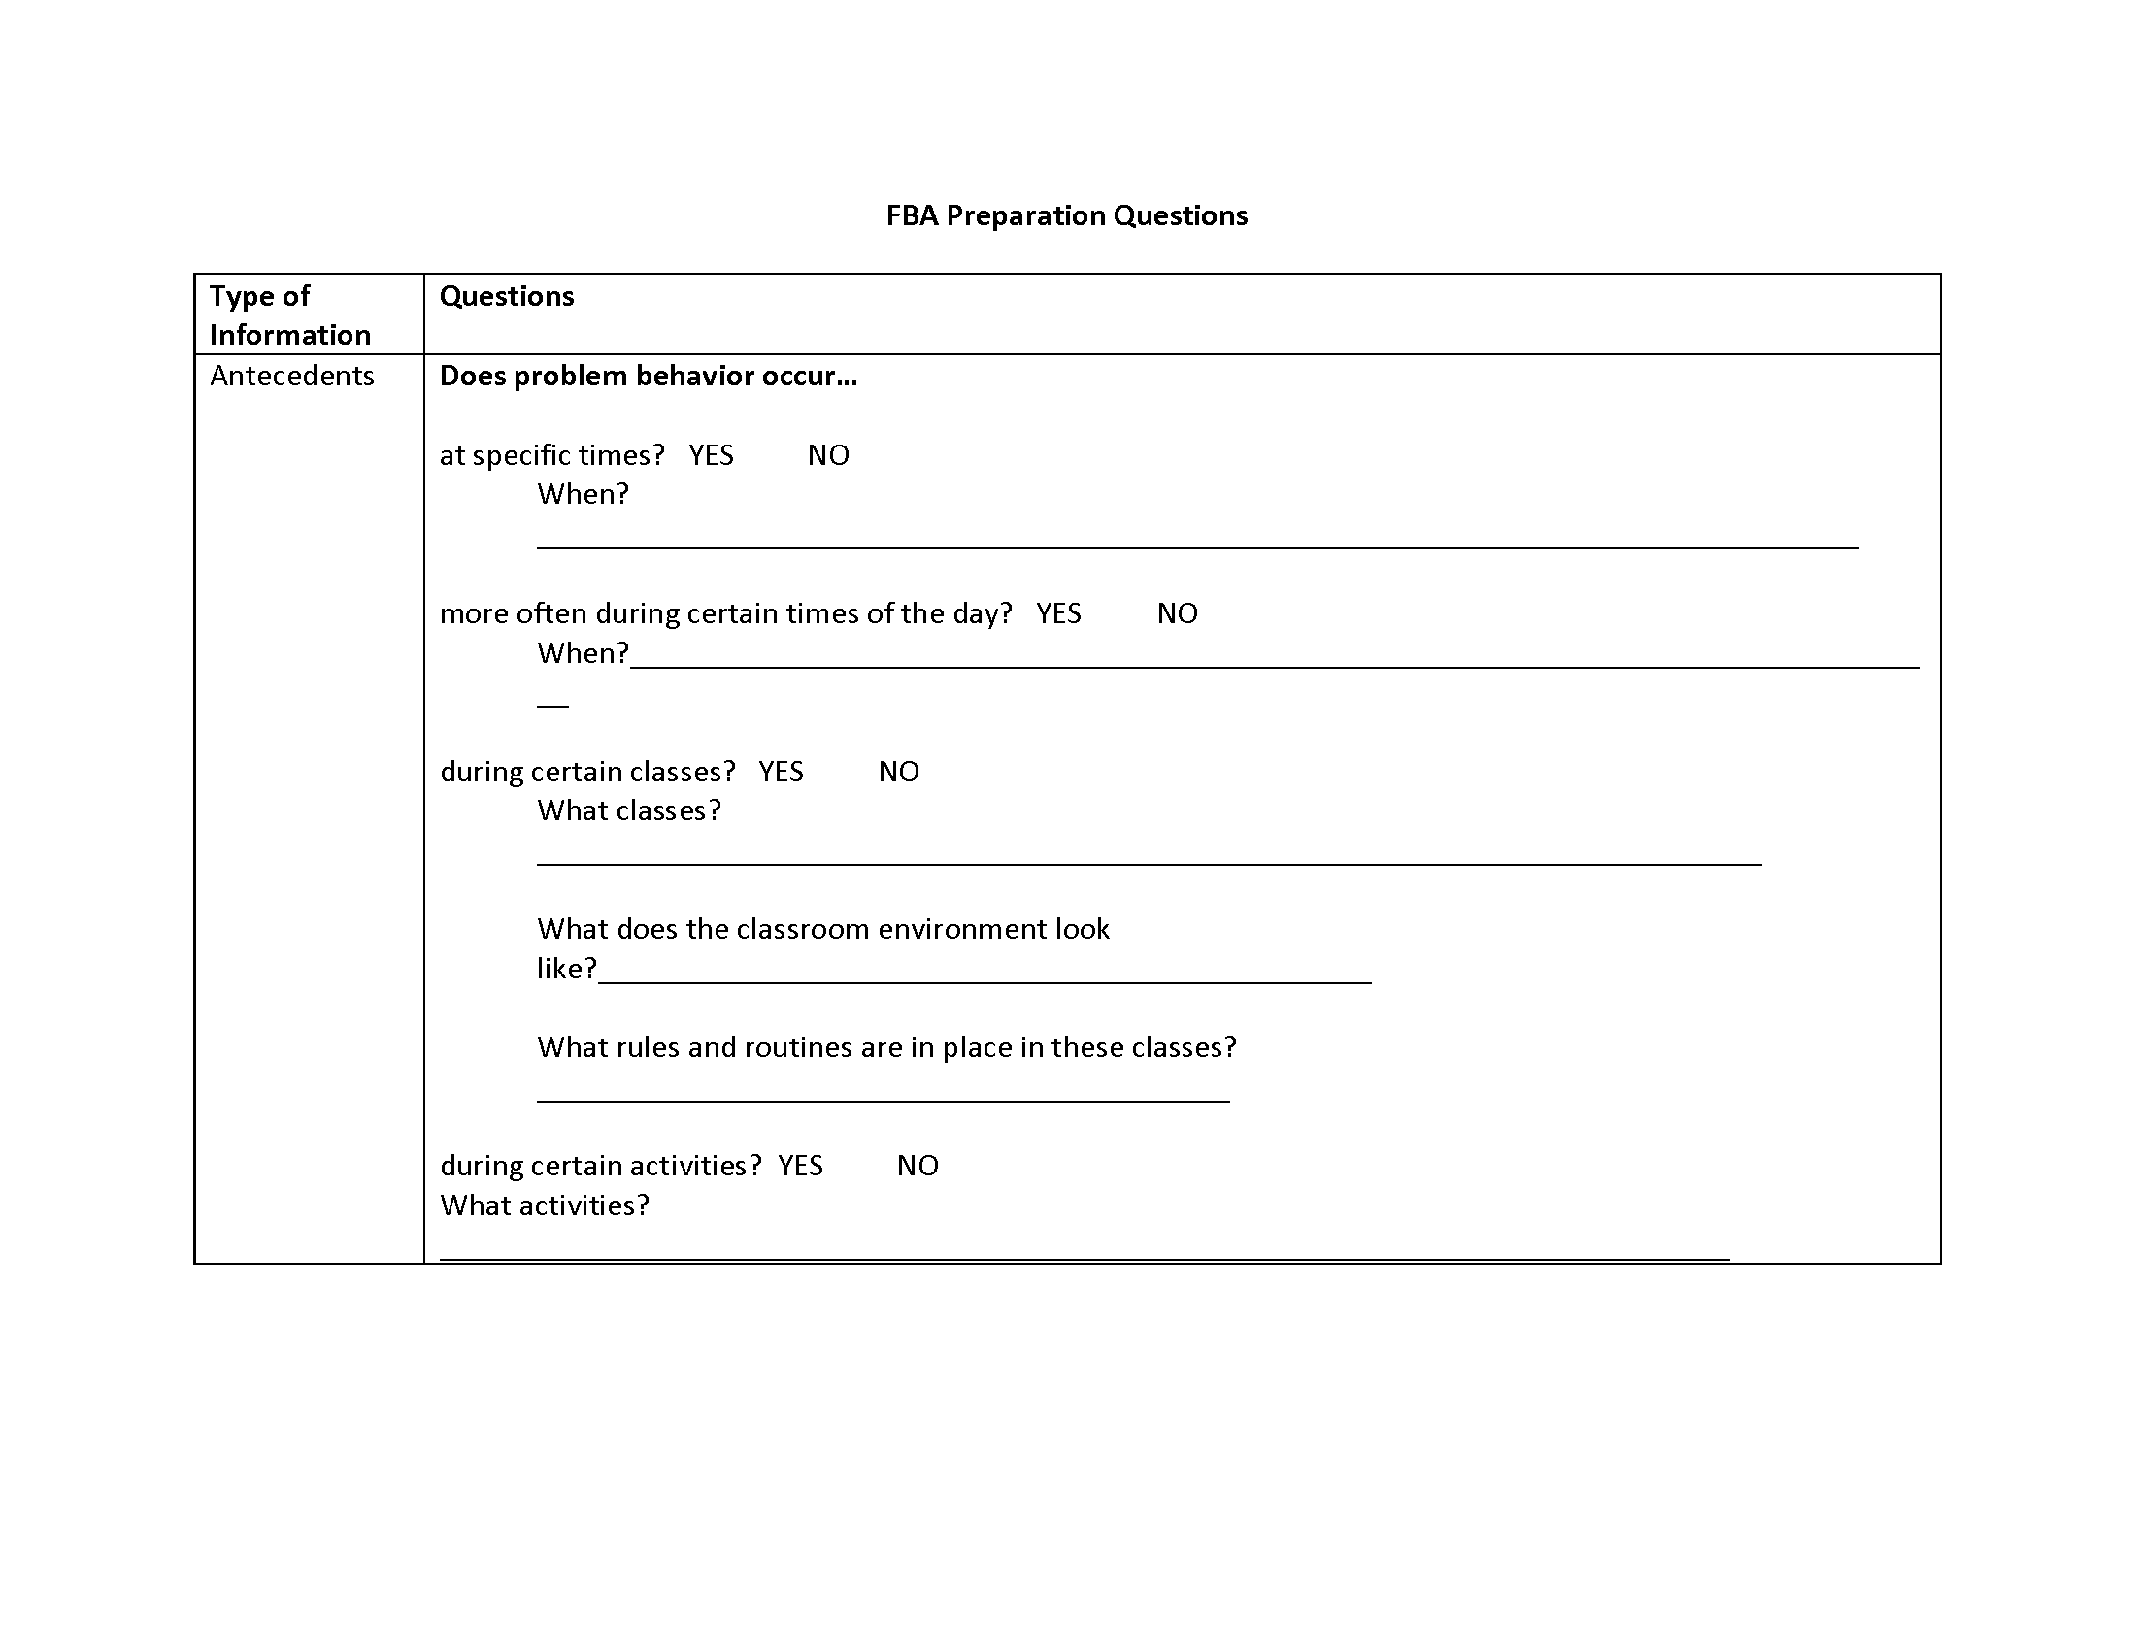
Notes:
(Selma)
This template helps teachers prepare for the FBA process

Slide 50
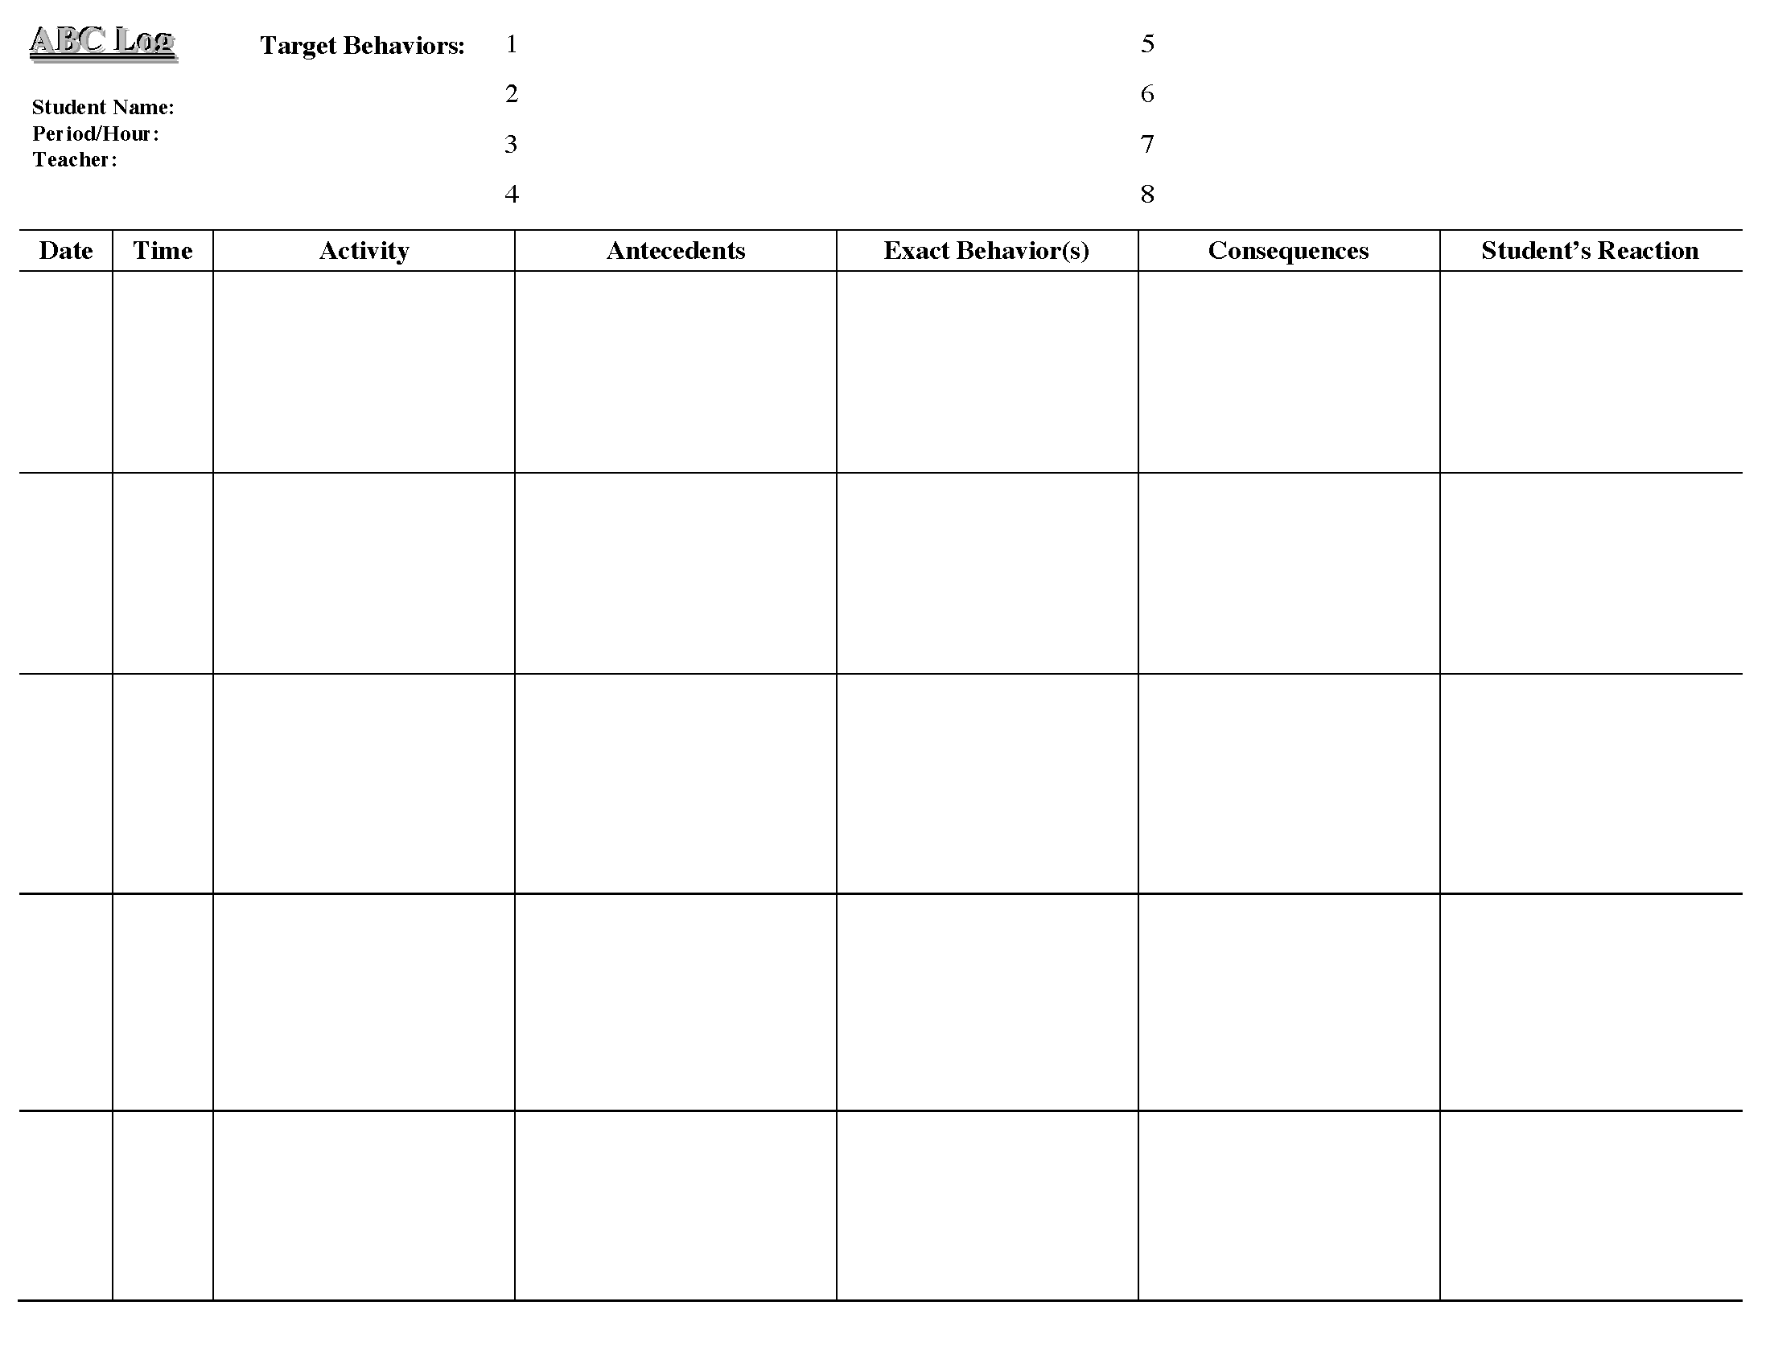
Notes:
(Selma)
This template can be used to facilitate antecedent-behavior-consequence data collection

Slide 51
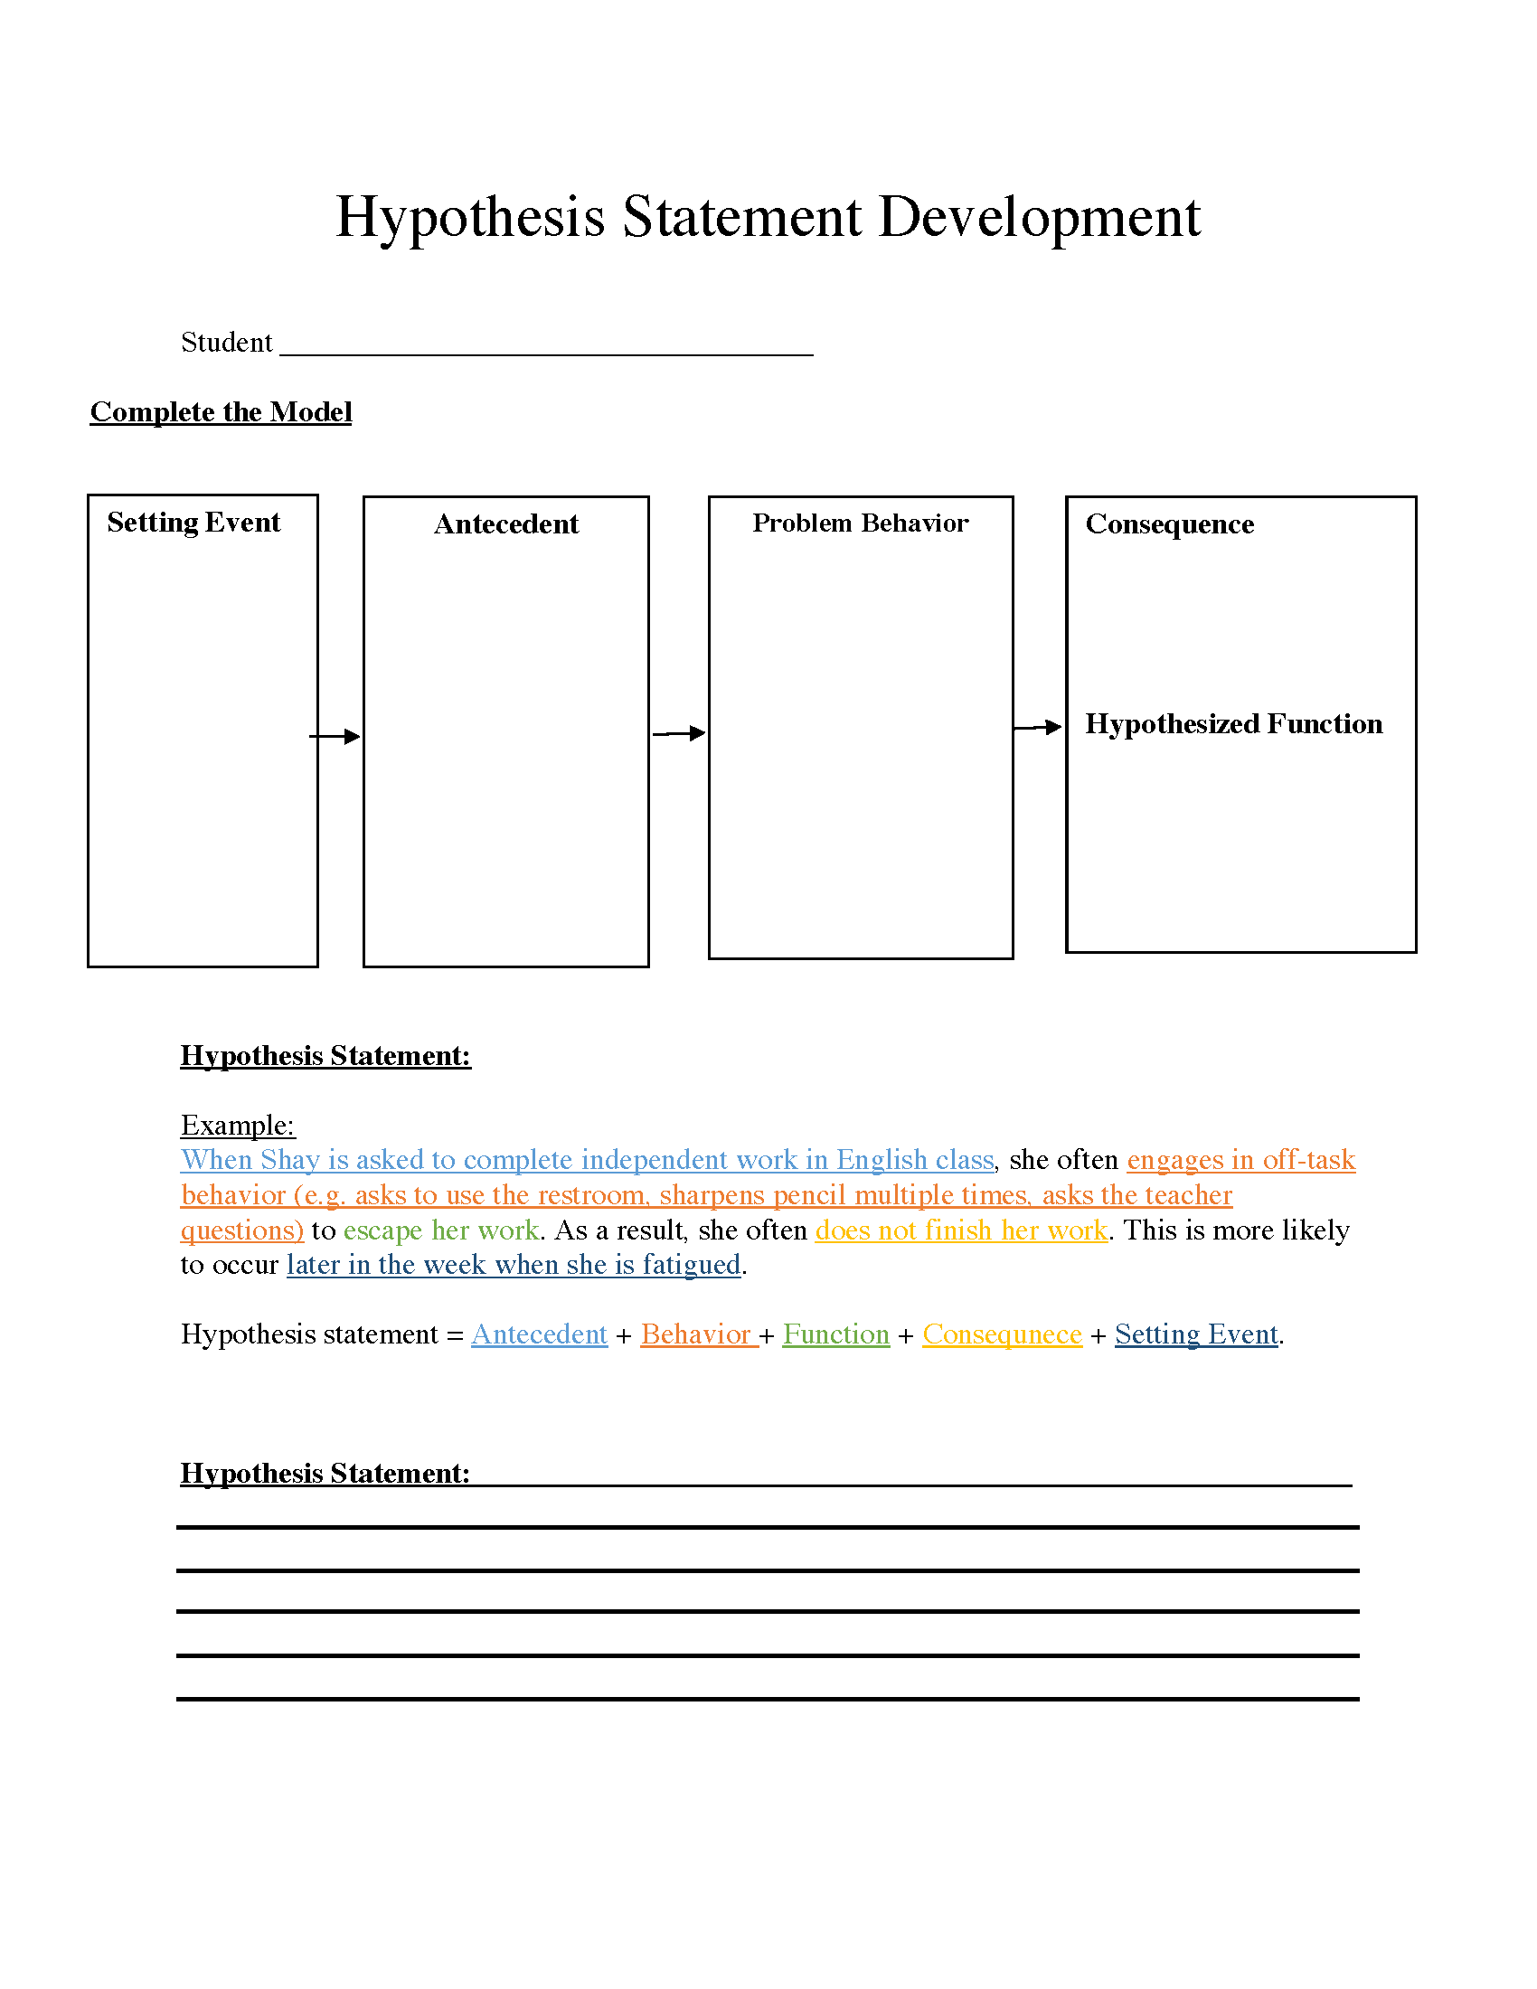
Notes:
(Selma)
Once data has been collected and analyzed, teachers can develop a working hypothesis using this template

Slide 52
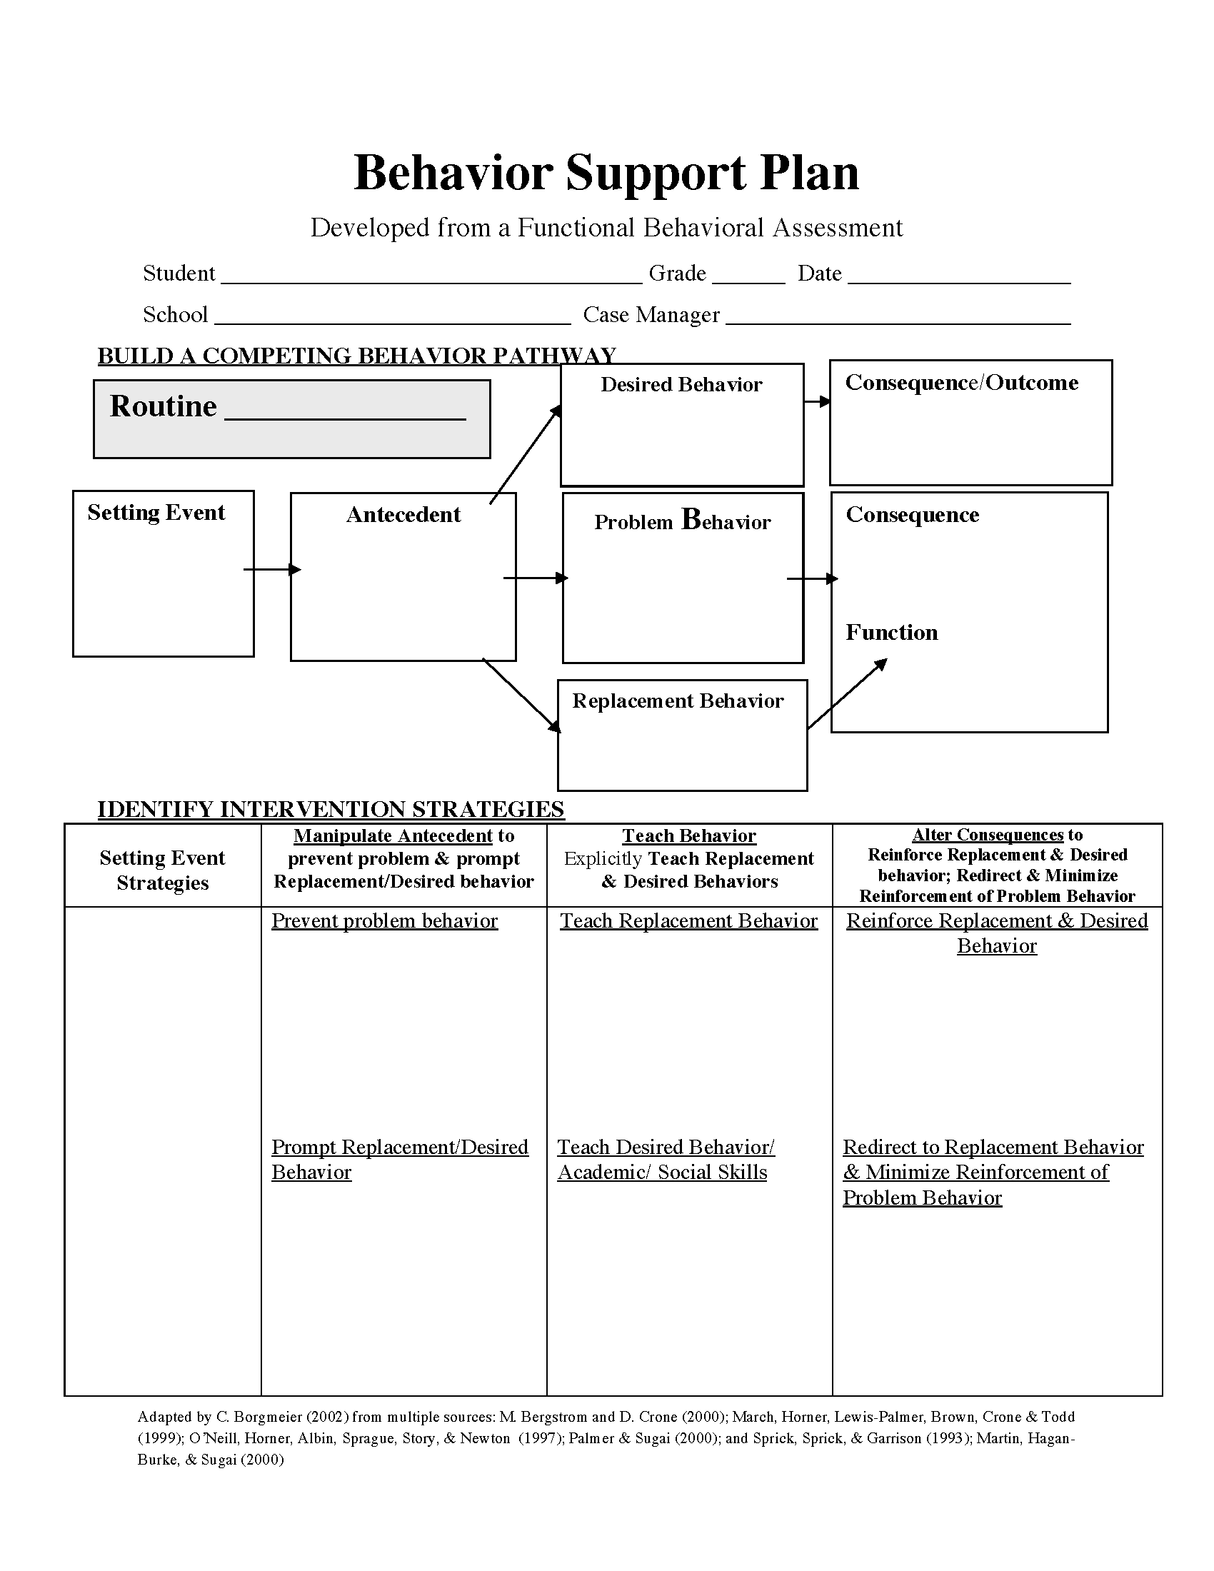
Notes:
(Selma)
Finally, this template can be used in the development of a BIP by the team.

Slide 53
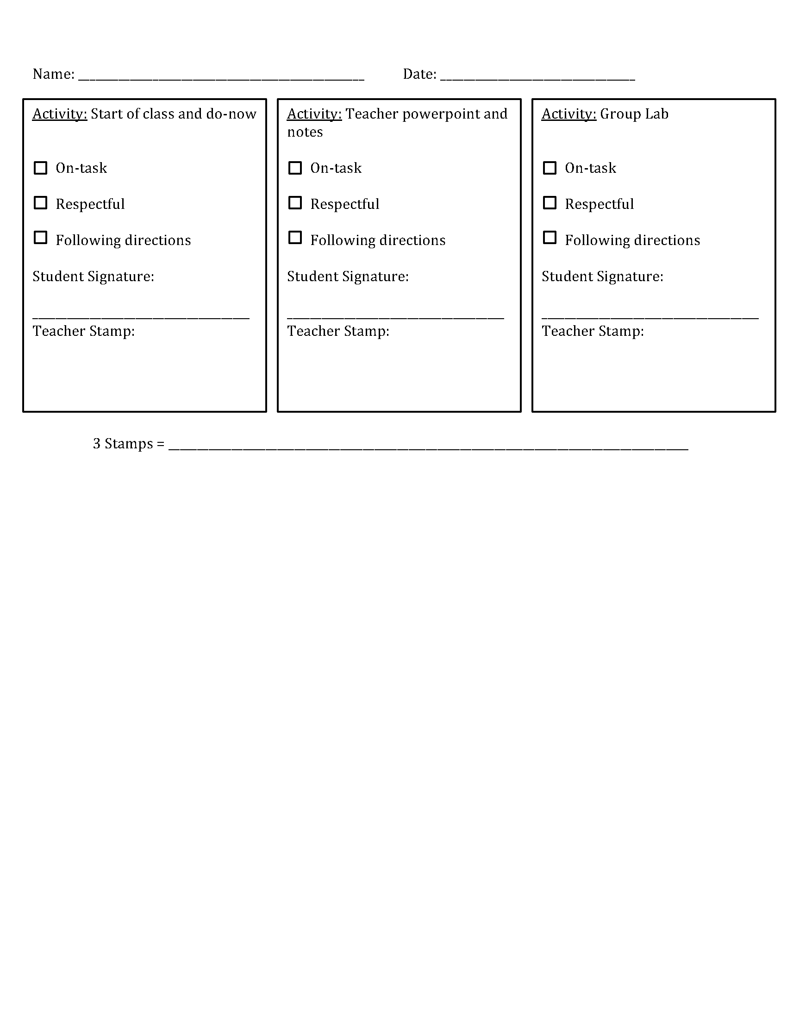
Notes:
(Selma)
Once a behavior plan is in place for a BIP, this check-in form can help students monitor their own positive behavior in order to be successful with their BIP

Slide 54
Check In
Notes:
(Selma)
Before moving on to the next component, we want to take a moment for a quick check-in…
Who has students with FBAs/BIPs in their schools?
Who sees these resources as something that might be valuable to supporting this work? We are going to leave time at the end for you to situate these practices in the context of your schools, so if this is an area for you to do some work or share your success with this practice, we encourage you to contribute your ideas or resources to the shared folder.
This framework is a way to explicitly name and frame the work you are all already doing in your schools and more systematically monitor their success.

Slide 55

Instruction
cc: Anton Sukhinov - https://unsplash.com/@sukhinov?utm_source=haikudeck&utm_medium=referral&utm_campaign=api-credit
Notes:
(Carly)

Slide 56
HLP19. Use assistive and instructional technologies.
Teachers select and implement assistive and instructional technologies to support the needs of students with disabilities. They select and use augmentative and alternative communication devices and assistive and instructional technology products to promote student learning and independence. They evaluate new technology options given student needs; make informed instructional decisions grounded in evidence, professional wisdom, and students’ IEP goals; and advocate for administrative support in technology implementation. Teachers use the universal design for learning (UDL) framework to select, design, implement, and evaluate important student outcomes.
Notes:
(Carly)
Finally, we highlight HLP19 for the instruction component. This HLP focuses on assistive and instructional technologies, specifically universal design for learning.

Slide 57
HLP19. What tools might be used to evaluate or assess this practice?
CAST-UDL Self-Check
Universal Design for Learning Recommendation for Teachers Preparation and Professional Development
Innovative Configuration for Universal Design
Notes:
(Carly)
Several tools can be used to determine if UDL is being utilized in your setting

Slide 58
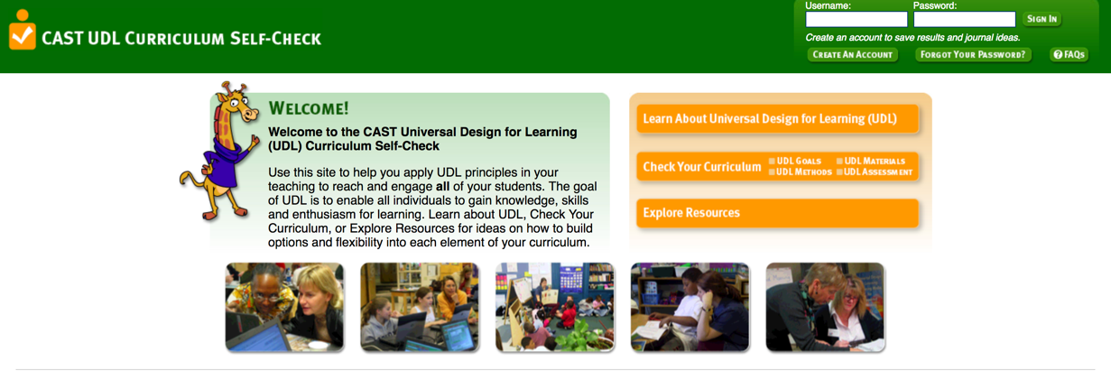
Notes:
(Carly)
This website provides a self-check to determine if UDL principles are in place in your building.

Slide 59
Notes:
(Carly)
This document provides a detailed rubric to identify areas of growth in UDL

Slide 60
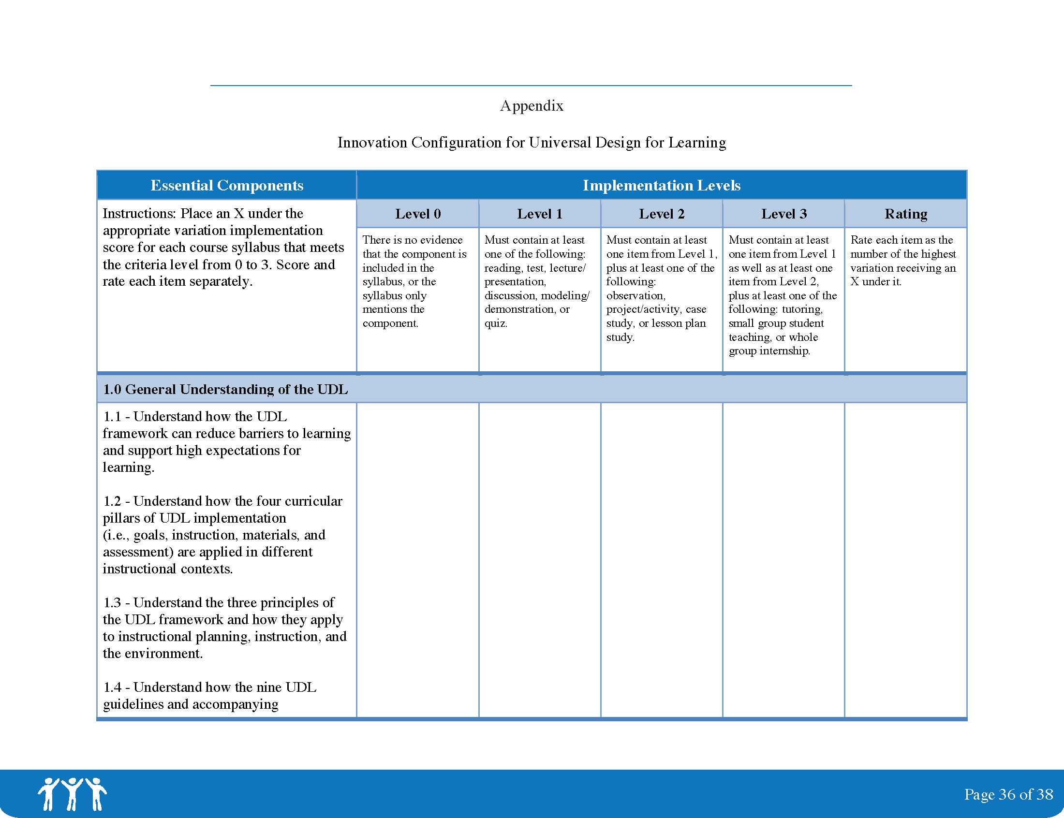
Notes:
(Carly)
Sample rubric

Slide 61
HLP19. Where can resources be found?
The International Society for Technology in Education ITSE
Family Center on Technology and Disability: http://www.fctd.info
Center for Implementing Technology in Education: http://www.cited.org/index.aspx
State Assistive Technology Centers: http://www.resna.org/content/index.php?pid=138
Quality Indicators for Assistive Technology Services https://www.qiat.org/
Notes:
(Carly)
There are several great websites focused on assistive and instructional technology, these are just a sampling of them

Slide 62
HLP19. What tools or resources can be used for implementation?
UDL:
Planning Universal Designed Instruction
UDL Curriculum Toolkit
AT:
Resource: Washington Assistive Technology Act Program
Notes:
(Carly)
Finally, we have three tools to support teacher implementation of HLP19

Slide 63
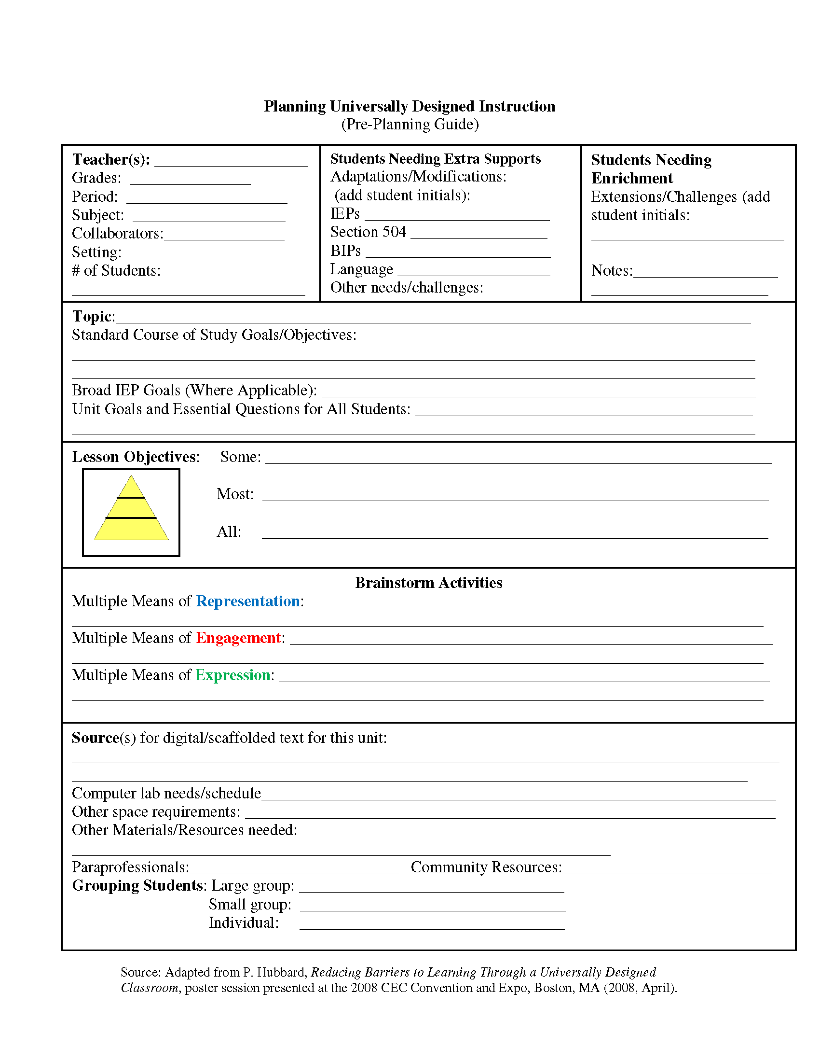
Notes:
(Carly)
This document helps teachers plan lessons with a UDL framework in advance

Slide 64
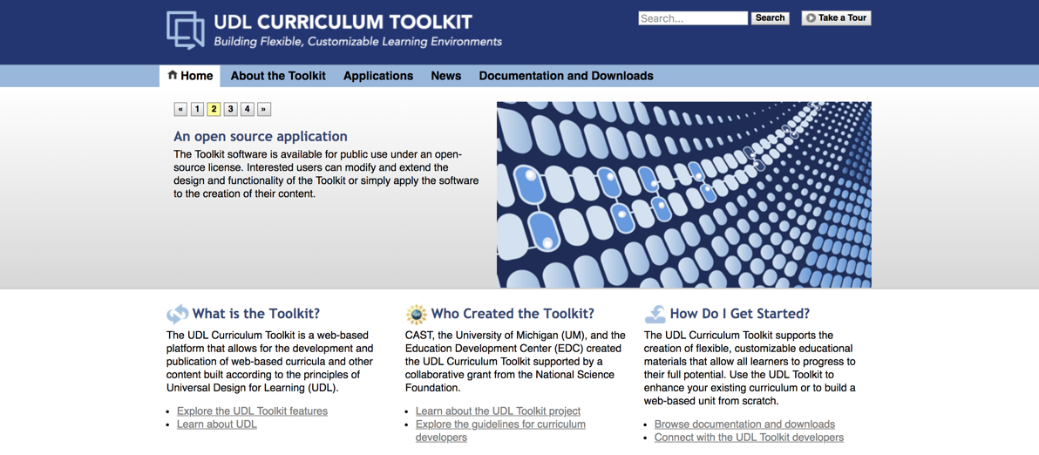
Notes:
(Carly)
This website helps teachers learn about and design lessons using UDL

Slide 65
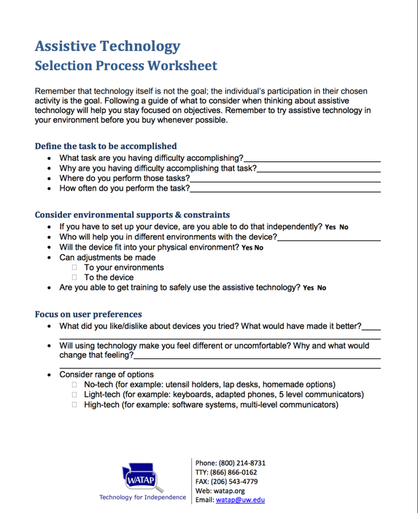
Notes:
(Carly)
This document helps teachers identify assistive technology for their students

Slide 66
Check In
Notes:
(Carly)
Before moving on to the next component, we want to take a moment for a quick check-in…
Who has a need for assistive and instructional technology in their building?
Who sees these resources as something that might be valuable to supporting this work? We are going to leave time at the end for you to situate these practices in the context of your schools, so if this is an area for you to do some work or share your success with this practice, we encourage you to contribute your ideas or resources to the shared folder.
This framework is a way to explicitly name and frame the work you are all already doing in your schools and more systematically monitor their success.

Slide 67

Your Turn
What tools might be used to evaluate or assess this practice?
Where can resources be found?
What tools or resources can be used for implementation?
Use the provided Pp template: https://tinyurl.com/ybguzmg2
cc: Sarah G... - https://www.flickr.com/photos/96526303@N00
Notes:
(Carly)
Now we want you to think through this application framework. With a shoulder partner or small group, pick 1 practice and work through each of the three questions. (20-25 minutes)
We have shared a list of several resources with you in your google folder and on the USB. We have also created a PP template for you to use to put the information you find. Time allowing, we will have people share what they have found. Pick a set of three slides that are the same color and that is how you can organize your information. As you see in the template, you will organize your information for your specific HLP around these three questions. This work will be a part of our shared drive so that you can leave this PD with resources for as many HLPs as possible.

Slide 68

cc: Got Credit - https://www.flickr.com/photos/144008357@N08
Notes:
(Carly)
Tell us what practice you focused on and how you answered the three questions…you can come up and show us your slides as you talk.

Slide 69
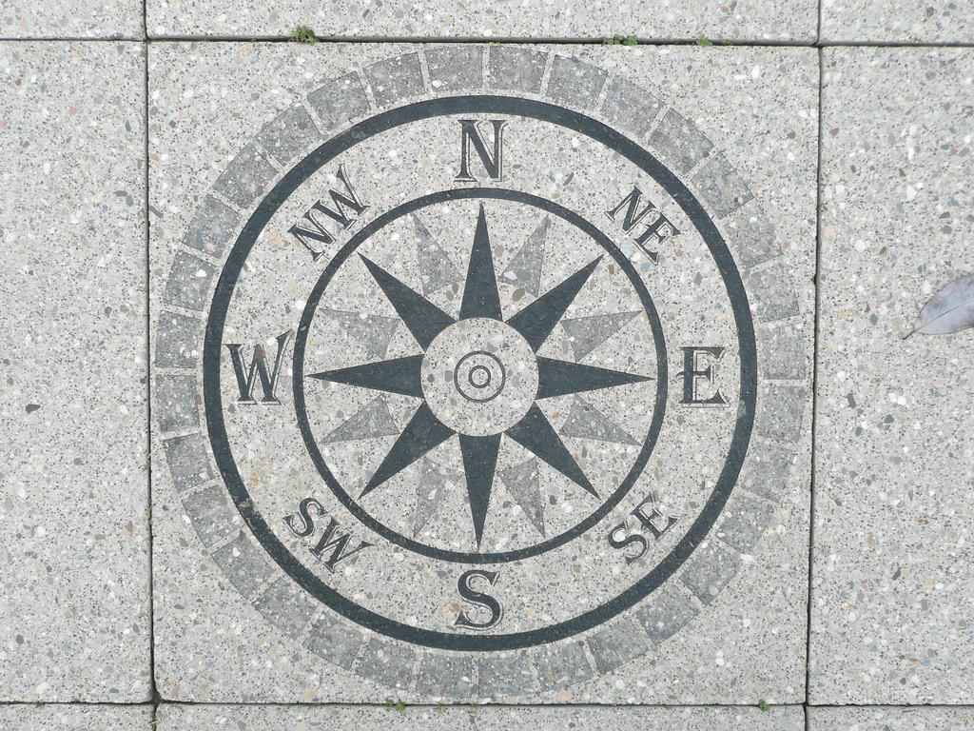
Moving Forward
cc: mwcarruthers - https://www.flickr.com/photos/64167416@N03

Slide 70

selmap@uw.edu
carober1@uw.edu
cc: Orin Zebest - https://www.flickr.com/photos/33917831@N00

