Slide 1
Digging Deeper: Resources to Support 325X Applicants
Sharde Theodore, Ed.S., Ashley Y. Grays, M.Ed.,
Sunyoung Ahn, Ph.D., Camille Catlett, M.A. & Melinda Leko, Ph.D.
Notes:
Ashley

Slide 2
Opening Remarks & Webinar Purpose
Brief overview of the significance of 325X
Share resources to support grant applicants and grantees
Encourage underrepresented institutions to apply
Notes:
Sunyoung

Slide 3
Introduction
Debut of 325X
Diversity in special education programs is critical
Underrepresentation of HBCUs and TCCUs in past grant applications.
Significance of obtaining a 325X grant
Notes:
Sharde
Last 325M grant had 75 applicants 17 HBCUs and 1 TCCU

Slide 4
Impact of HBCUs, TCCUs & MSIs
MSIs house 321 (13%) educator preparation programs across the country
Out of 100 HBCUs:
34 Special Education Programs (including 22 Bachelors and 19 Masters)
4 Alternative/Certification Programs
3 Related Service Programs
2 Professional Degree Programs
Out of 35 TCCUs
3 Special Education or Related Service Programs
23 Early Childhood Programs
Notes:
https://www.educatordiversity.org/wp-content/uploads/2022/12/2021-Primer-user-friendly-FNL_09.15.22.pdf

Slide 5
Overview of 325X
Purpose: Increase the number of HBCUs, TCCUs, and MSIs that offer degree or certification programs in EI, ECSE, SPED, or related services.
Eligibility:
HBCUs, TCCUs, MSIs, and private nonprofit organizations
Must have education department or a related services program
Approx. 16 awards
Max $750,000/60 months
Notes:
Sharde *This info can be found in the program brochure
The Personnel Preparation program helps meet state-identified needs for adequate numbers of fully certified personnel to serve children with disabilities by supporting competitive awards to:
Provide research-based training and professional development to prepare special education, related services, early intervention, and regular education personnel to work with children with disabilities
Ensure that those personnel are fully qualified, and possess the skills and knowledge that are needed to serve children with disabilities; and
Ensure that those personnel are fully qualified, and possess the skills and knowledge that are needed to serve children with disabilities.
Purpose of 325X: The purpose of this priority is to increase the number of programs that prepare personnel who are fully credentialed and licensed to enter the field to serve children with disabilities and their families, including multilingual personnel and personnel from racially and ethnically diverse background.
Expected Outcomes
Within this absolute priority, projects are expected to achieve, at a minimum, the following
expected outcomes:
Increased number of early intervention, early childhood special education, special education, or related services personnel who are multilingual and from racially and ethnically diverse backgrounds
Increased variety of degrees and certifications in early intervention, early childhood special education, special education, and related services
Increased faculty capacity at HBCUs, TCCUs, and MSIs to design and deliver programs of study in early intervention, early childhood special education, special education, and related services

Slide 6
CEEDAR Center
Our mission is to support students with disabilities in achieving college- and career-ready standards by building the capacity of state personnel preparation systems to prepare teachers and leaders to implement evidence-based practices within multi-tiered systems of support.
CEEDAR.org
Notes:
Melinda

Slide 7
CEEDAR
The CEEDAR Center supports students with disabilities by building personnel preparation systems in states. Through the CEEDAR Center’s collaborative work with university educator preparation programs, State Education Agencies, local education agencies and other stakeholder groups, states develop stronger teacher and leader preparation programs.

Slide 8
Roadmap

Slide 9
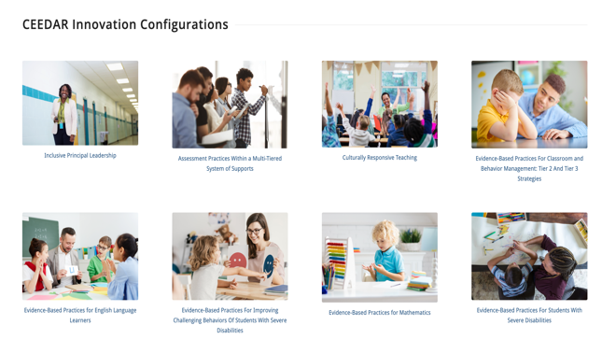
Innovation Configurations (ICs)
Promote the implementation of evidence-based instructional practices in teacher preparation activities. ICs are designed to evaluate current teacher preparation and professional development (PD) by determining the extent to which EBPs are taught, observed, and applied within teacher preparation and PD programs.

Slide 10
Course Enhancement Modules (CEM)
CEMs include usable resources for faculty and PD providers to include in effective opportunities for teachers and leaders to learn about and use EBPs. For example, Learning Resources materials—such as the anchor presentation with speaker notes—can be incorporated into a content course or implemented with a professional learning community.

Slide 11
CEMS include
Description and overview—rationale of the content for ensuring that students with disabilities achieve college and career readiness
Learning Resources
Connections to standards—references to the content standards that will be addressed in the CEM
Anchor presentation—a PowerPoint presentation covering the content
Speaker notes—verbiage the instructor or facilitator can use or adapt to go along with the anchor presentation, including direction on using additional handouts or resources
Sample activities—activities that can be implemented to promote learning or use of the content
Multimedia—audio and video related to the content
Course & PD Outlines—examples of course syllabi and PD that relate to the content
References—a reference list of supporting citations and materials
Suggestions for use:

Slide 12
High-leverage practices (HLPs)
HighLeveragePractices.org

Slide 13
Practice-based Learning Opportunities (PLOs)
Effective PLOs are characterized by several key features. They provide candidates and practicing teachers
models that help candidates understand how to enact specific HLPs,
models of how HLPs can be enacted successfully,
opportunities to use the HLPs in simulated and authentic settings, and
opportunities to receive feedback on and analyze their use of the HLPs.

Slide 14
Teacher Apprenticeship

Slide 15
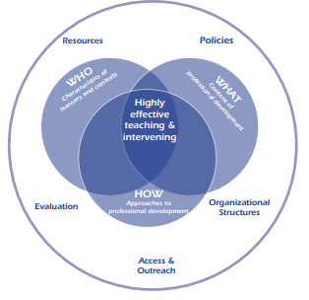
Tools and Strategies to Support Course and Program Design
325N Projects
NPDCI

Slide 16
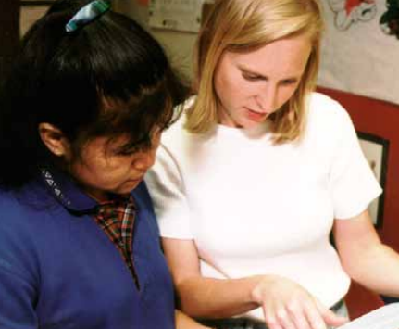
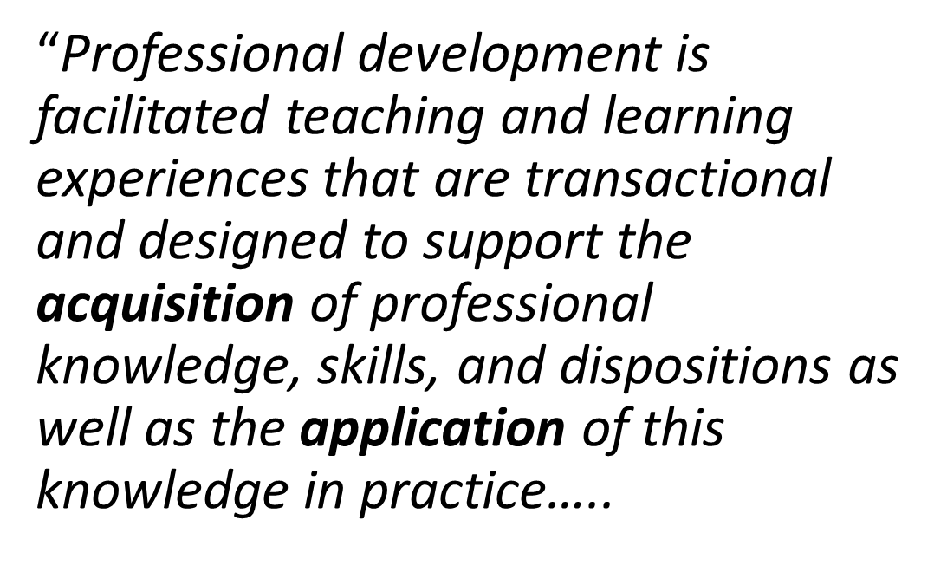
Definition of Professional Development

Slide 17
Definition (continued)
The key components of professional development include:
characteristics and contexts of the learners (i.e., the “who” );
content (i.e., the “what” of professional development); and
organization and facilitation of learning experiences (i.e., the “how”).
Source: National Professional Development Center on Inclusion (NPDCI)
Notes:
Source: National Professional Development Center on Inclusion. (2008). What do we mean by professional development in the early childhood field? Chapel Hill: The University of North Carolina, FPG Child Development Institute, Author.
http://npdci.fpg.unc.edu/sites/npdci.fpg.unc.edu/files/resources/NPDCI_ProfessionalDevelopmentInEC_03-04-08_0.pdf

Slide 18
Crosswalks
Notes:
2004 – 2007 model demonstration project

Slide 19
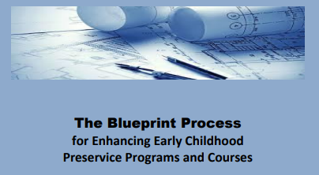
Identify partners Clarify values Program design Course design
Lessons learned from the first group of 325N grantees

Slide 20
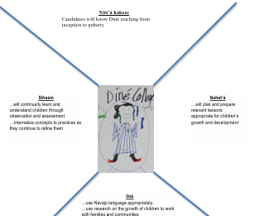
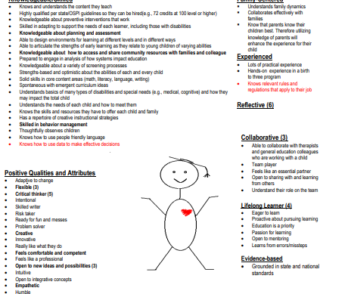
Graduate of the Future

Slide 21
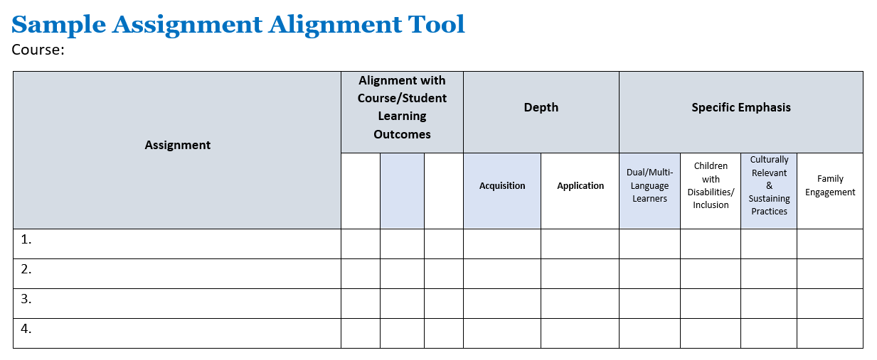
Sample Assignment Alignment Tool

Slide 22
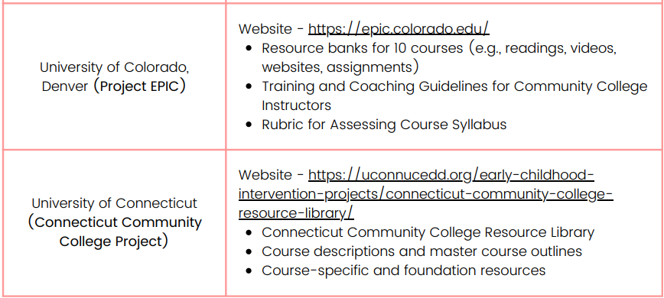
Summary of the Impact of the 325N Projects
Prepared for Julia Martin Eile, 325N Project Officer, OSEP

Slide 23
SCRIPT-NC

Slide 24
Resources for 325X Colleagues
NPDCI Definition of Professional Development
https://npdci.fpg.unc.edu/sites/npdci.fpg.unc.edu/files/resources/NPDCI_ProfessionalDevelopmentInEC_03-04-08_0.pdf
The Blueprint Process for Enhancing Early Childhood Preservice Programs and Courses
https://fpg.unc.edu/publications/blueprint-process-enhancing-early-childhood-preservice-programs-and-courses
Graduate of the Future
Assignment Alignment Tool
SCRIPT-NC: Supporting Change and Reform in Preservice Teaching in North Carolina https://scriptnc.fpg.unc.edu/
Tools – rubrics, personas, assignment alignment examples
Course-Specific Resources
325N Projects
Summary of the Impact of the 325N Projects
https://education2.sdsu.edu/pipelines/325n-impact-2022-final.pdf
Camille Catlett
camille.catlett@unc.edu

Slide 25
Questions & Answers
Frequently Asked Questions
Notes:
Sunyoung

Slide 26
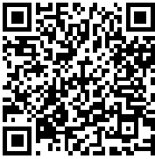
Closing Remarks
Thank you!
Take the first steps toward applying for the OSEP grant!
Contact Sunyoung.Ahn@ed.gov with any additional questions.
Scan the QR code to access additional resources from our presenters:
Notes:
Sunyoung

