Slide 1

Better together

Slide 2
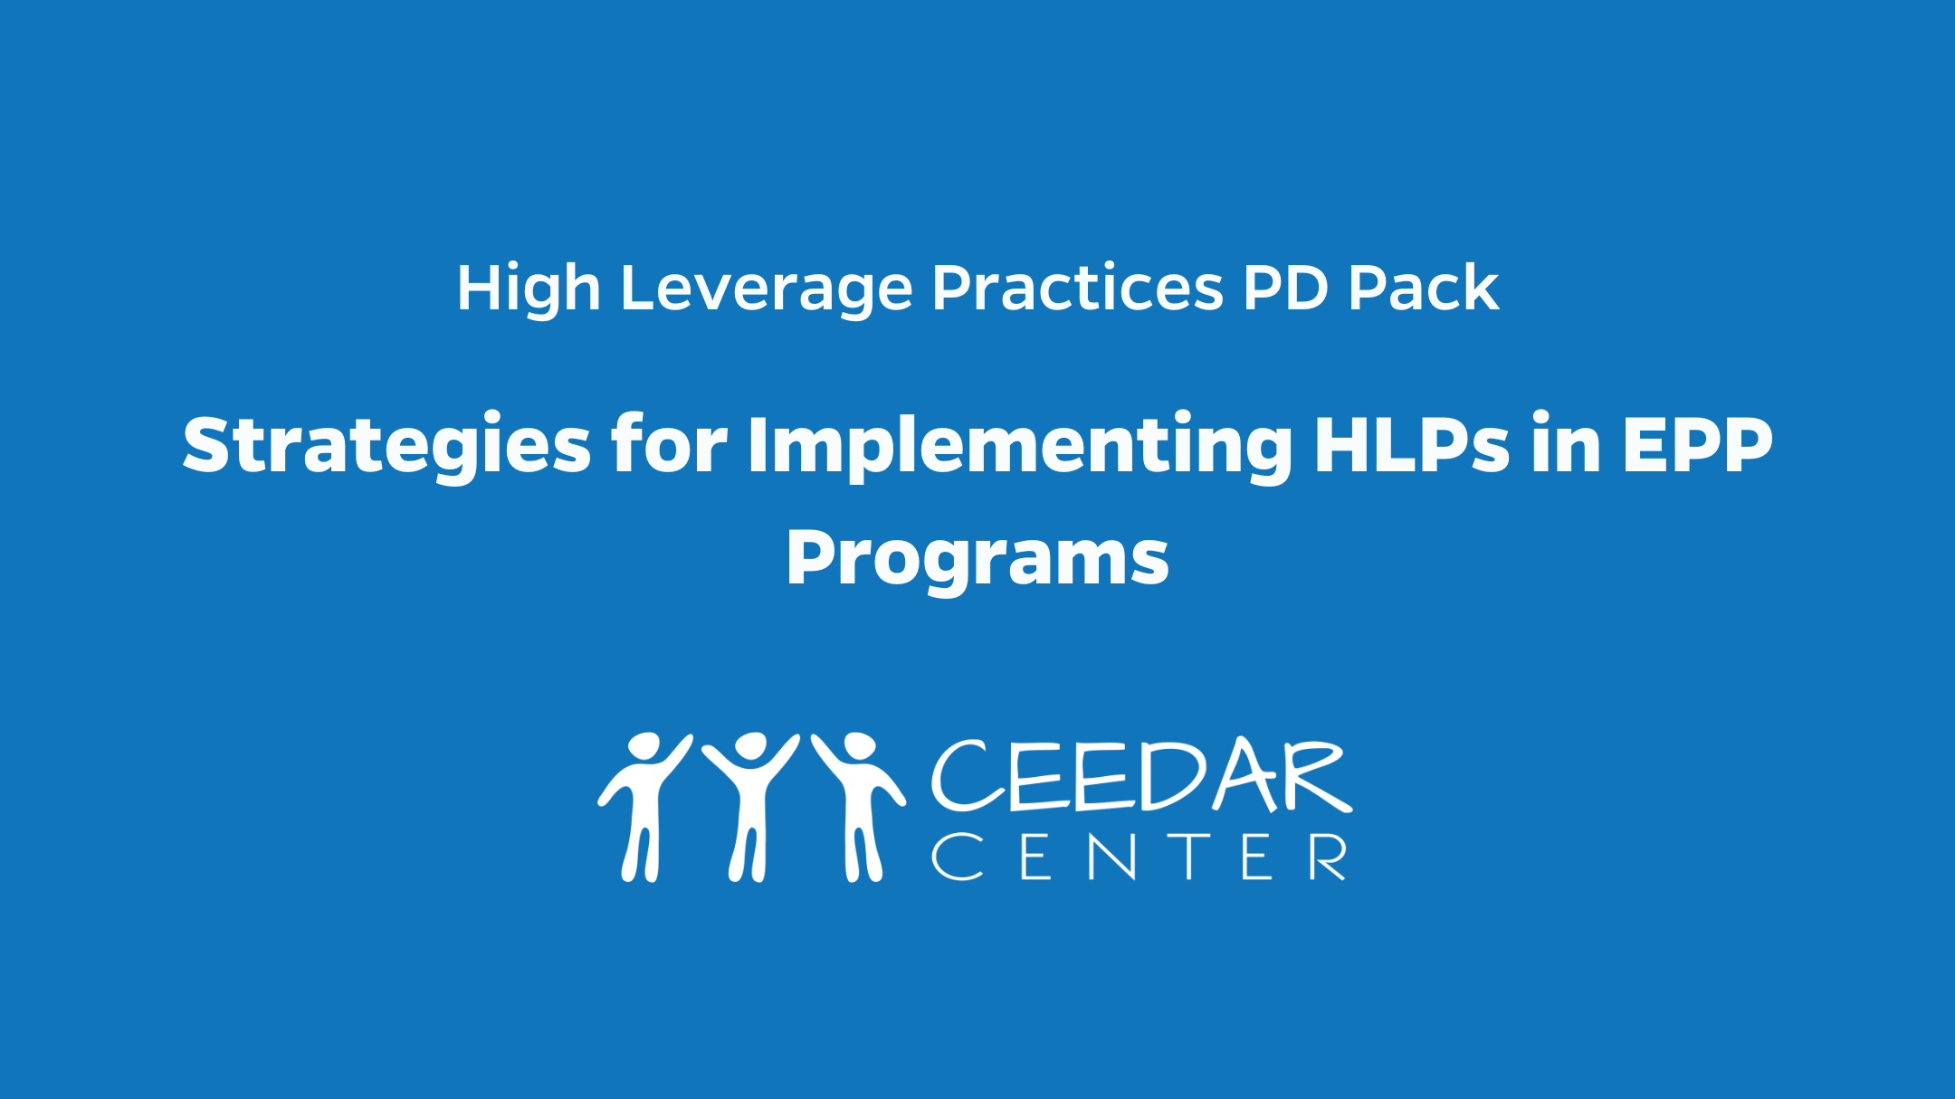
Strategies for implementing hlps in epp programs

Slide 3

Statewide plans and initiatives
Notes:
Day

Slide 4
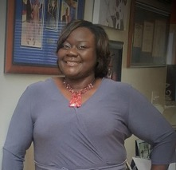


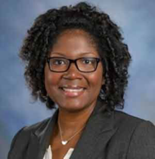
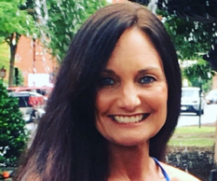
Our Key Players
Zelphine Smith-Dixon, Ed.D
Melissa K. Driver, Ph.D
Kate Zimmer, Ph.D
DaShaunda Patterson, Ph.D
Pam Wetherington, Ed.D
Notes:
day
This team represents the group that led efforts to align efforts, develop content, and begin the process of programmatic changes in the IHE. Many more people have and continue to contribute to this work. But I wanted to give a shout out to the initial team who got the work started in the way that I will describe today.

Slide 5
GA CEEDar Vision for Teacher/Leader Preparation
Vision: Through a multi-system collaboration of powerful and sustainable partnerships, we will prepare teacher and leader candidates with knowledge, skills, and dispositions who consistently provide purposeful instruction, establish and maintain learning environments, and improve student learning and growth. Teachers and leaders will ensure P-12 students succeed and transition into post-secondary lifelong learning leading to an increased workforce capacity.
Notes:
Day

Slide 6




In Partnership with...
CEEDAR CENTER
Georgia Department of Education
Georgia Professional Standards Commission
The University System of Georgia
Columbus State University
Georgia State University
Kennesaw State University
Notes:
Day

Slide 7
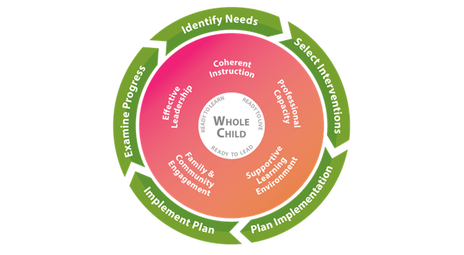
Alignment of Statewide Goals & Initiatives
Notes:
GSCI Systems and Structures Descriptions.pdf (gadoe.org)

Slide 8
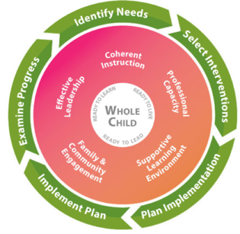


High Leverage Practices
Notes:
day

Slide 9
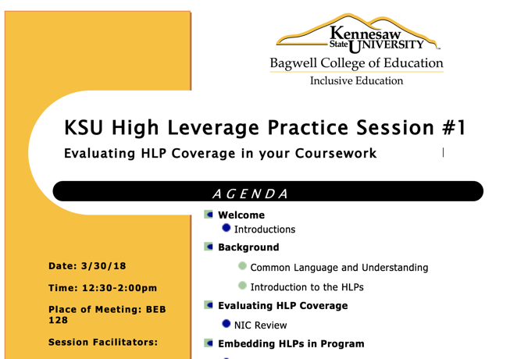
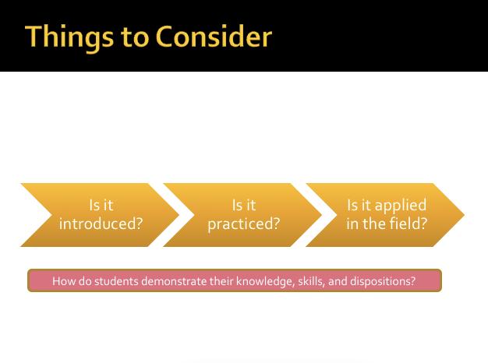
Kennesaw State University Example
Series of HLPs
Notes:
They began their work with introducing HLP and considering how they were covered in the Coursework that their pgraoms currently offered. This meeting essentially allowed for establishing common terms and understanding, "rolling out" the HLPs and explaining their use, evidence base and relevance.
And then the conducting a review of syllbi through the innovation configurations.
Then the discussion turned to embedding HLPs into their programs---This review was based on the questions of How/when are the HLPs introduced, how/when are they practiced in an instructional/developmental manner, and finally how would their candidates observe the use of HLPs in the field during practical experience.

Slide 10
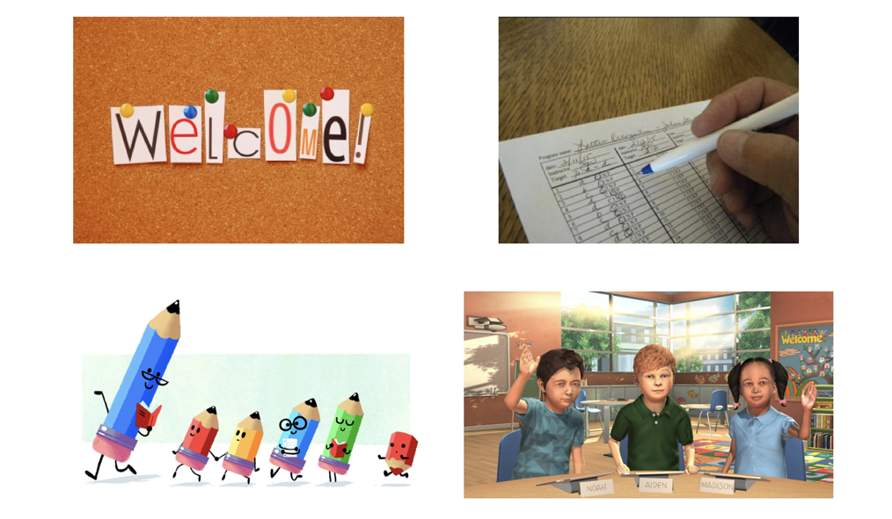
Images
Notes:
This led them to tie these practices and next steps to integrating the HLPs into their MRS (mixed reality simulation) lab. So the introduction and practice of the HLPs were taken up in this context and continues to be supported in this way today. YOu can find more information about their work and it's impact on the HLP.org website.

Slide 11

Examples
Notes:
The first example will be of the starting place for KSU where Dr. Melissa Driver and Kate Zimmer led this work.

Slide 12
CEHD unit structure
College of Education and Human Development
Teacher Preparation
20+ programs (degree and cert only)
Work started with Intro to Spec Ed classes
Professional Service Preparation
Early Childhood Special Education dual
Teacher Preparation programs in the College of Arts and Sciences
(i.e., Music Education, World Languages, etc.)
Notes:
day

Slide 13
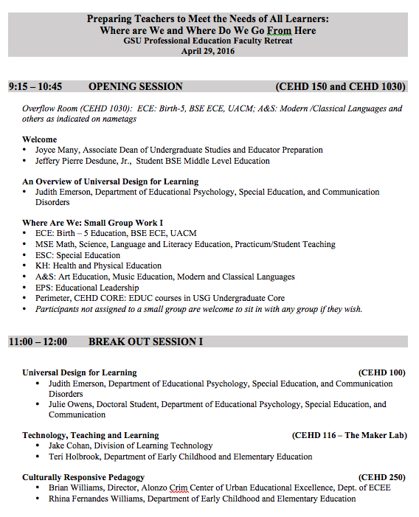
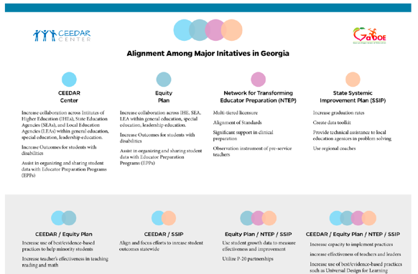
Georgia State University Example
Notes:
day

Slide 14
Beginning the conversation
Needs assessment (innovation configuration)
Prioritized findings
Gathered resources
Incentivized faculty
Refine and revise
Notes:
day

Slide 15
Next Steps
Scale up implementation of HLPs across programs
Responding to legislative changes (e.g., dyslexia mandate)
Evaluating utility of program changes
Notes:
day

Slide 16

GA CEEDAR Leadership Team Takeaways
Start small
Leverage existing resources
Connect needs of all stakeholders
Identify emerging entry points (ie., pending legislation or policy changes)
Notes:
day

Slide 17
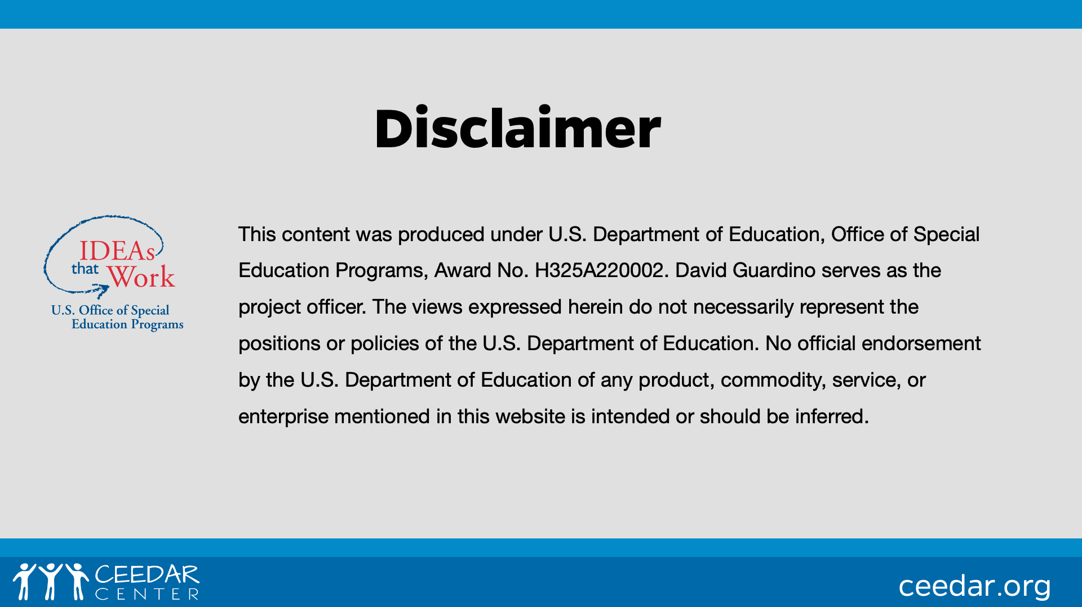
DISCLAIMER
This content was produced under U.S. Department of Education, Office of Special Education Programs, Award No. H325A120003. Bonnie Jones and David Guardino serve as the project officers. The views expressed herein do not necessarily represent the positions or polices of the U.S. Department of Education. No official endorsement by the U.S. Department of Education of any product, commodity, service, or enterprise mentioned in this website is intended or should be inferred.

