Slide 1

Better together

Slide 2
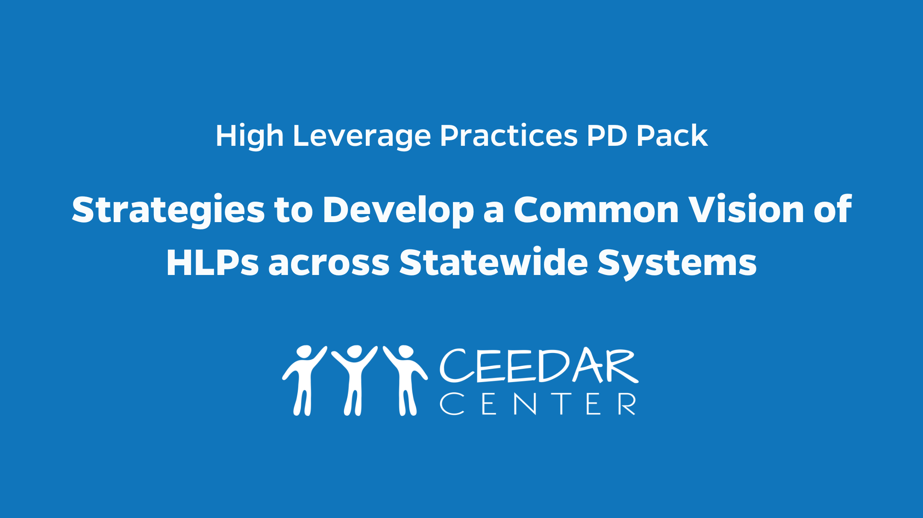
Strategies to develop a common vision of hlps across statewide systems

Slide 3


Arizona Coalition for Educator Preparation and Practice
Moving the Work of HLPs Across Our State
Notes:
Dusty

Slide 4
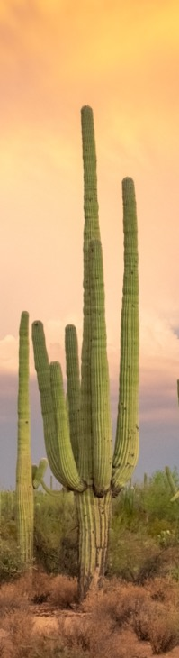



OUR
TEAM
Beth Hoffman
Rio Salado College
Christina Rivera
University of Arizona
Dusty Sanchez
Grand Canyon University
Jessica DeBiase
Arizona State University
Kim Rice
Arizona Department of Education
Notes:
Dusty
We invite you to ask questions comment, take the mic, use the chat box as we go through.

Slide 5
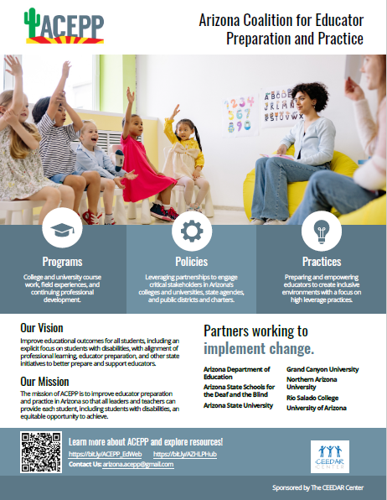
ACEPP FLYER
Notes:
Kim- Drop link in Chat box
Accessible flyer

Slide 6

History of ACEPP
2015
Became a CEEDAR Targeted State
ACEPP VISION:
Improve educational outcomes for all students, including an explicit focus on students with disabilities, with alignment of professional learning, educator preparation, and other state initiatives to better prepare and support educators.
2018
Aligned State Reading Initiatives to HLPs
Created HLP Guidance Document
2019
AZ HLP Hub
NOW
The intersection between knowledge of HLPs and providing effective and repeated PLOs around HLPs.
Notes:
Beth

Slide 7
McDonald’s Learning Cycle
Analyze and revise
Understand
Plan and rehearse
Enact with students
Before entering the cycle, you have to develop knowledge of the HLP.
High Leverage Practices
Notes:
Adapted from The Learning Cycle (McDonald et al. 2013) Reference: McDonald, M., Kelley-Petersen, M., Baeder, A., Danielson, K., Dunleavey, T., Kavanagh, S. S., & Mikolasy, K. (2013, February). Teacher education pedagogy: Developing core practices across the content areas. Presented at the annual meeting of the American Association of Colleges for Teacher Education, Orlando, FL.

Slide 8
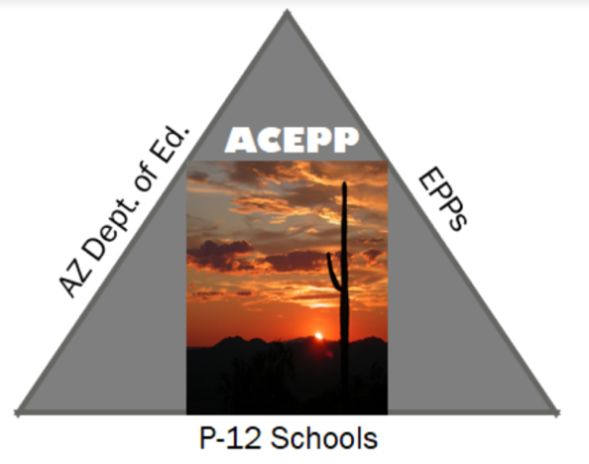
ACEPP’s HLP Goal
Preparing and supporting educators in furthering knowledge and application of best practices for inclusive classrooms.
Notes:
Dusty

Slide 9

Objective
1
Support EPPs to incorporate HLPs and PLOs in coursework and field experiences to impact the learning of teacher candidates.
Create navigational tutorial for using the AZ HLP HUB to help EPPs build HLPs and PLOs into coursework.
Align existing pre-service student teaching evaluation tools (at EPPs) with HLPs
Add resources to the HLP Hub to support the inclusion of practice learning opportunities.
Notes:
Jessica
Create navigational tutorial for using the AZ HLP HUB to help EPPs build HLPs and PLOs into coursework.
Create and disseminate a survey to all faculty
Create and disseminate organization tutorial for AZ HLP Hub
Create and disseminate follow up survey
Align existing pre-service student teaching evaluation tools (at EPPs) with HLPs
Contact program leads/directors, ask if evaluation tools incorporate HLPs.
Collect/Create an alignment tool between HLPs, InTASC, CEC standards and PSEL/NELP standards
Use feedback from survey to develop a plan of supports and resources for revising evaluation tools
Add resources to the HLP Hub to support the inclusion of practice learning opportunities.
Disseminate PLO information
Determine logistics of a statewide, virtual HLP professional learning community around PLOs for EPPs

Slide 10
Objective
2
Develop resources to support districts and charters to incorporate PLOs that support HLPs in professional development and teacher self-evaluation to impact the learning of K-12 students.
Create a selection of resources for administrators to enhance professional learning
Present to administrators to enhance professional learning
Use feedback to develop a plan to disseminate PLO information
Notes:
Jessica
Create a selection of resources for administrators involved in Teacher Empowerment Project to enhance professional learning
Define our administrators (principals? special education directors?)
Review the Hub, the guide, and the crosswalk with the administrators in mind
.Enhance the hub and other resources
Present to administrators from Teacher Empowerment Project to enhance professional learning
Develop presentation.
Present to directors from Teacher Empowerment Project
Use feedback from presentation to inform the HLP resources and dissemination
Use feedback to develop a plan to disseminate PLO information
Create a list of potential audiences
Design an AZ HLP affinity group around PLOs
Explore audience beyond the SLT for dissemination of PLO information/resources

Slide 11
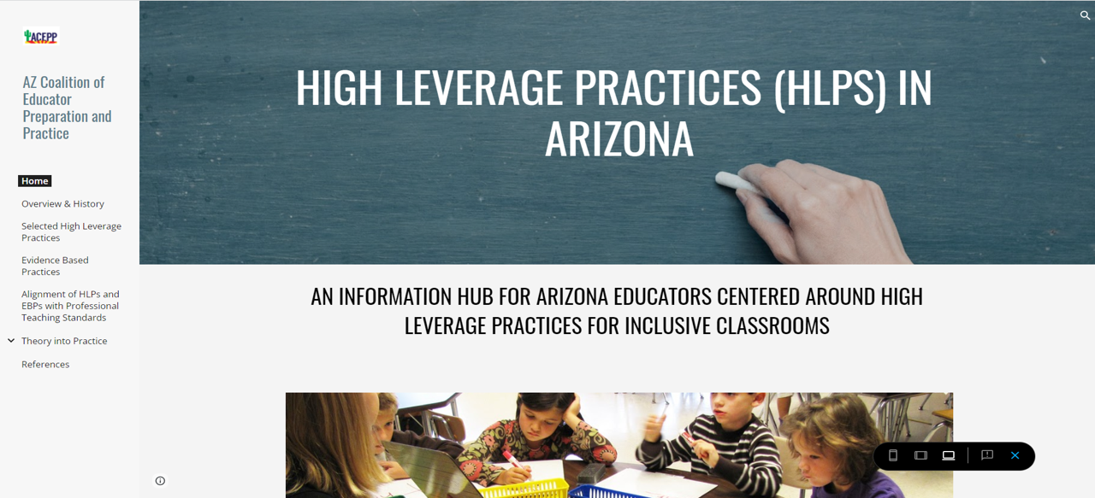
ACEPP HLP Hub https://sites.google.com/view/azhlphub/home

Slide 12
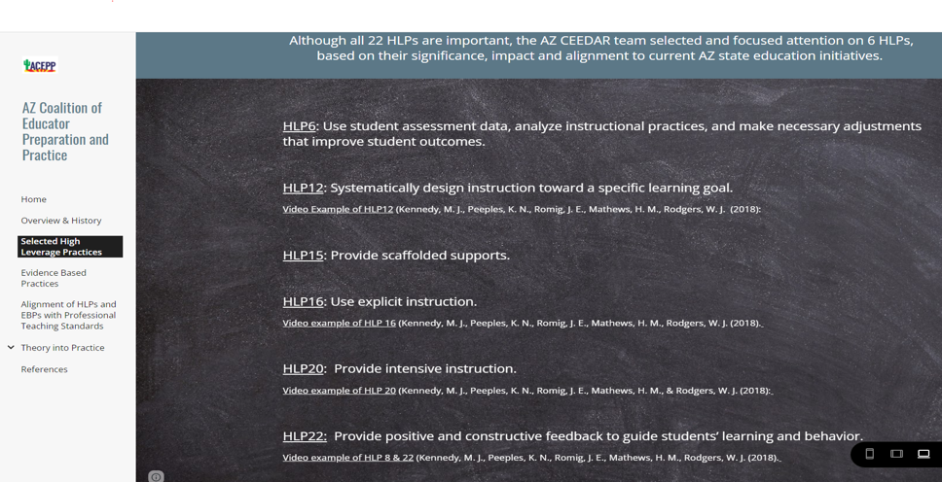
AZ’s Selected High Leverage Practices
Notes:
Beth- screen shot of landing page and highlight key navigation tabs and resources

Slide 13
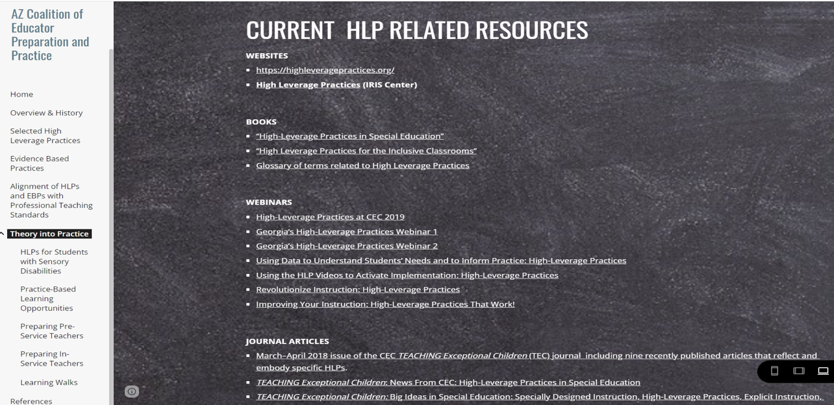


Current HLP-Related Resources

Slide 14
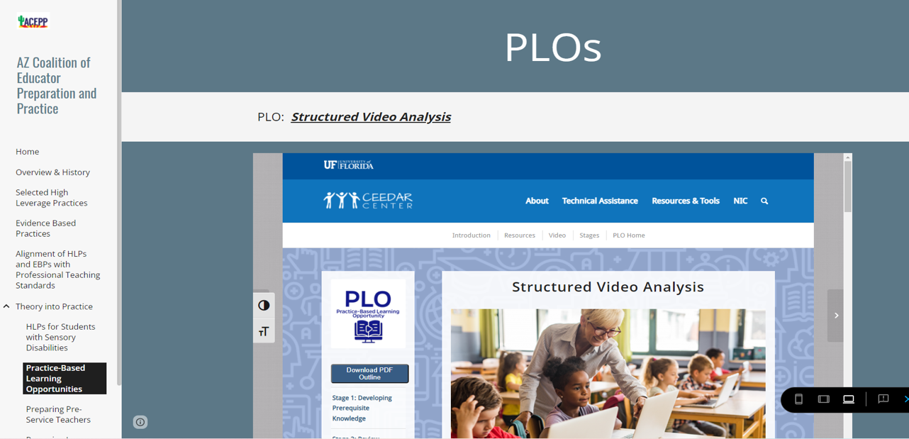
Hub Resources (sites, videos, etc..,)
Access Resources linked through the HLP HUB

Slide 15
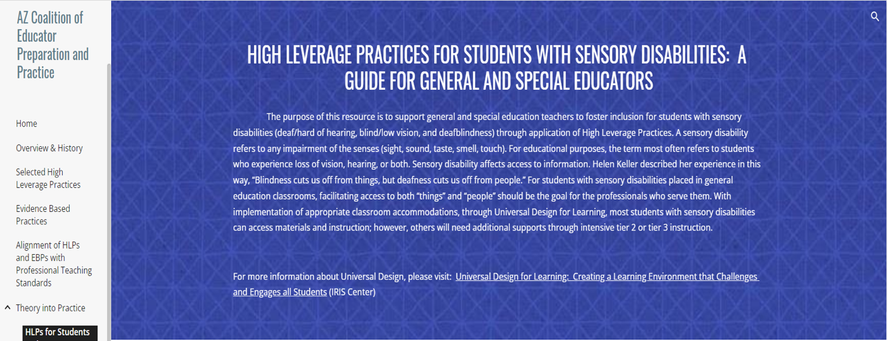
HLPs For Students with Sensory Disabilities
Notes:
Christina
One way we are moving HLPs forward is by starting at our EPPs. This is one example

Slide 16
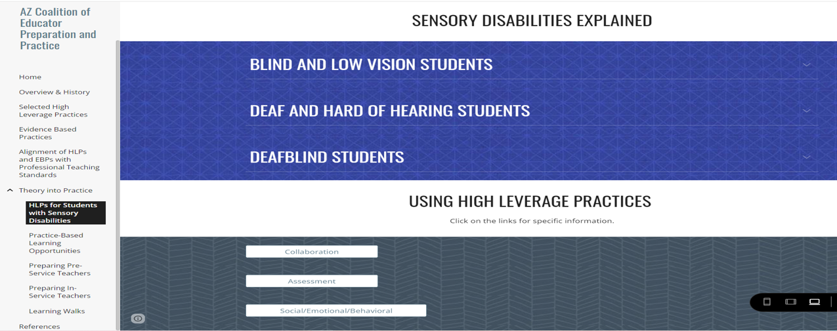
HLPs for Students with Sensory Disabilities, continued
Notes:
Christina

Slide 17
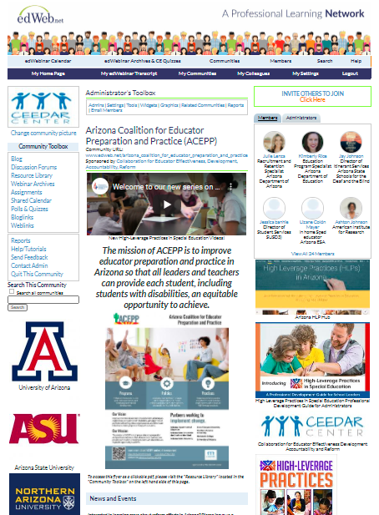
ACEPP edWeb
Notes:
Kim
edWeb.net - Arizona Coalition for Educator Preparation and Practice (ACEPP)

Slide 18
Teacher Empowerment Project
Relationships
Pilot Project
Community of Practice
  Special Education Administrators
  Recruitment and Retention
Retention Survey
Professional Learning

Slide 19

Q/A
Notes:
Christina

Slide 20

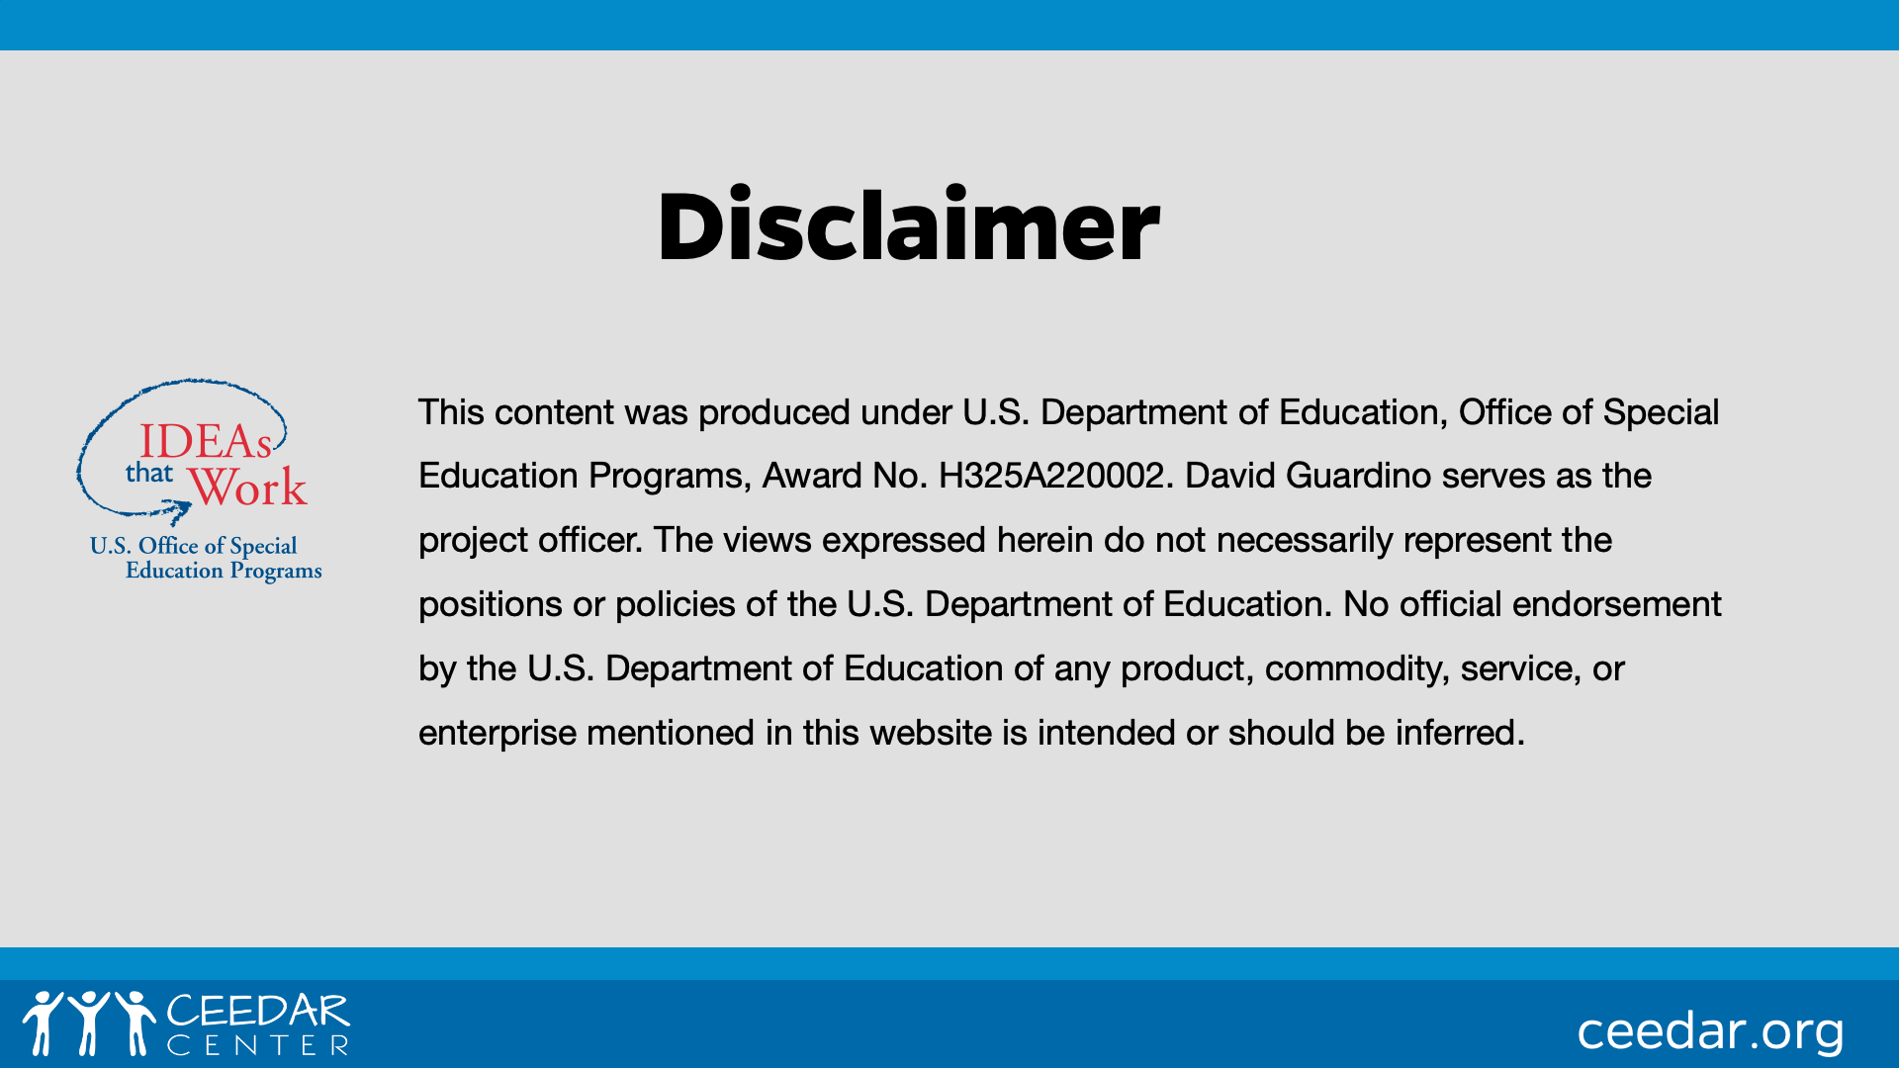
DISCLAIMER
This content was produced under U.S. Department of Education, Office of Special Education Programs, Award No. H325A120003. Bonnie Jones and David Guardino serve as the project officers. The views expressed herein do not necessarily represent the positions or polices of the U.S. Department of Education. No official endorsement by the U.S. Department of Education of any product, commodity, service, or enterprise mentioned in this website is intended or should be inferred.

