Slide 1

Better Together

Slide 2
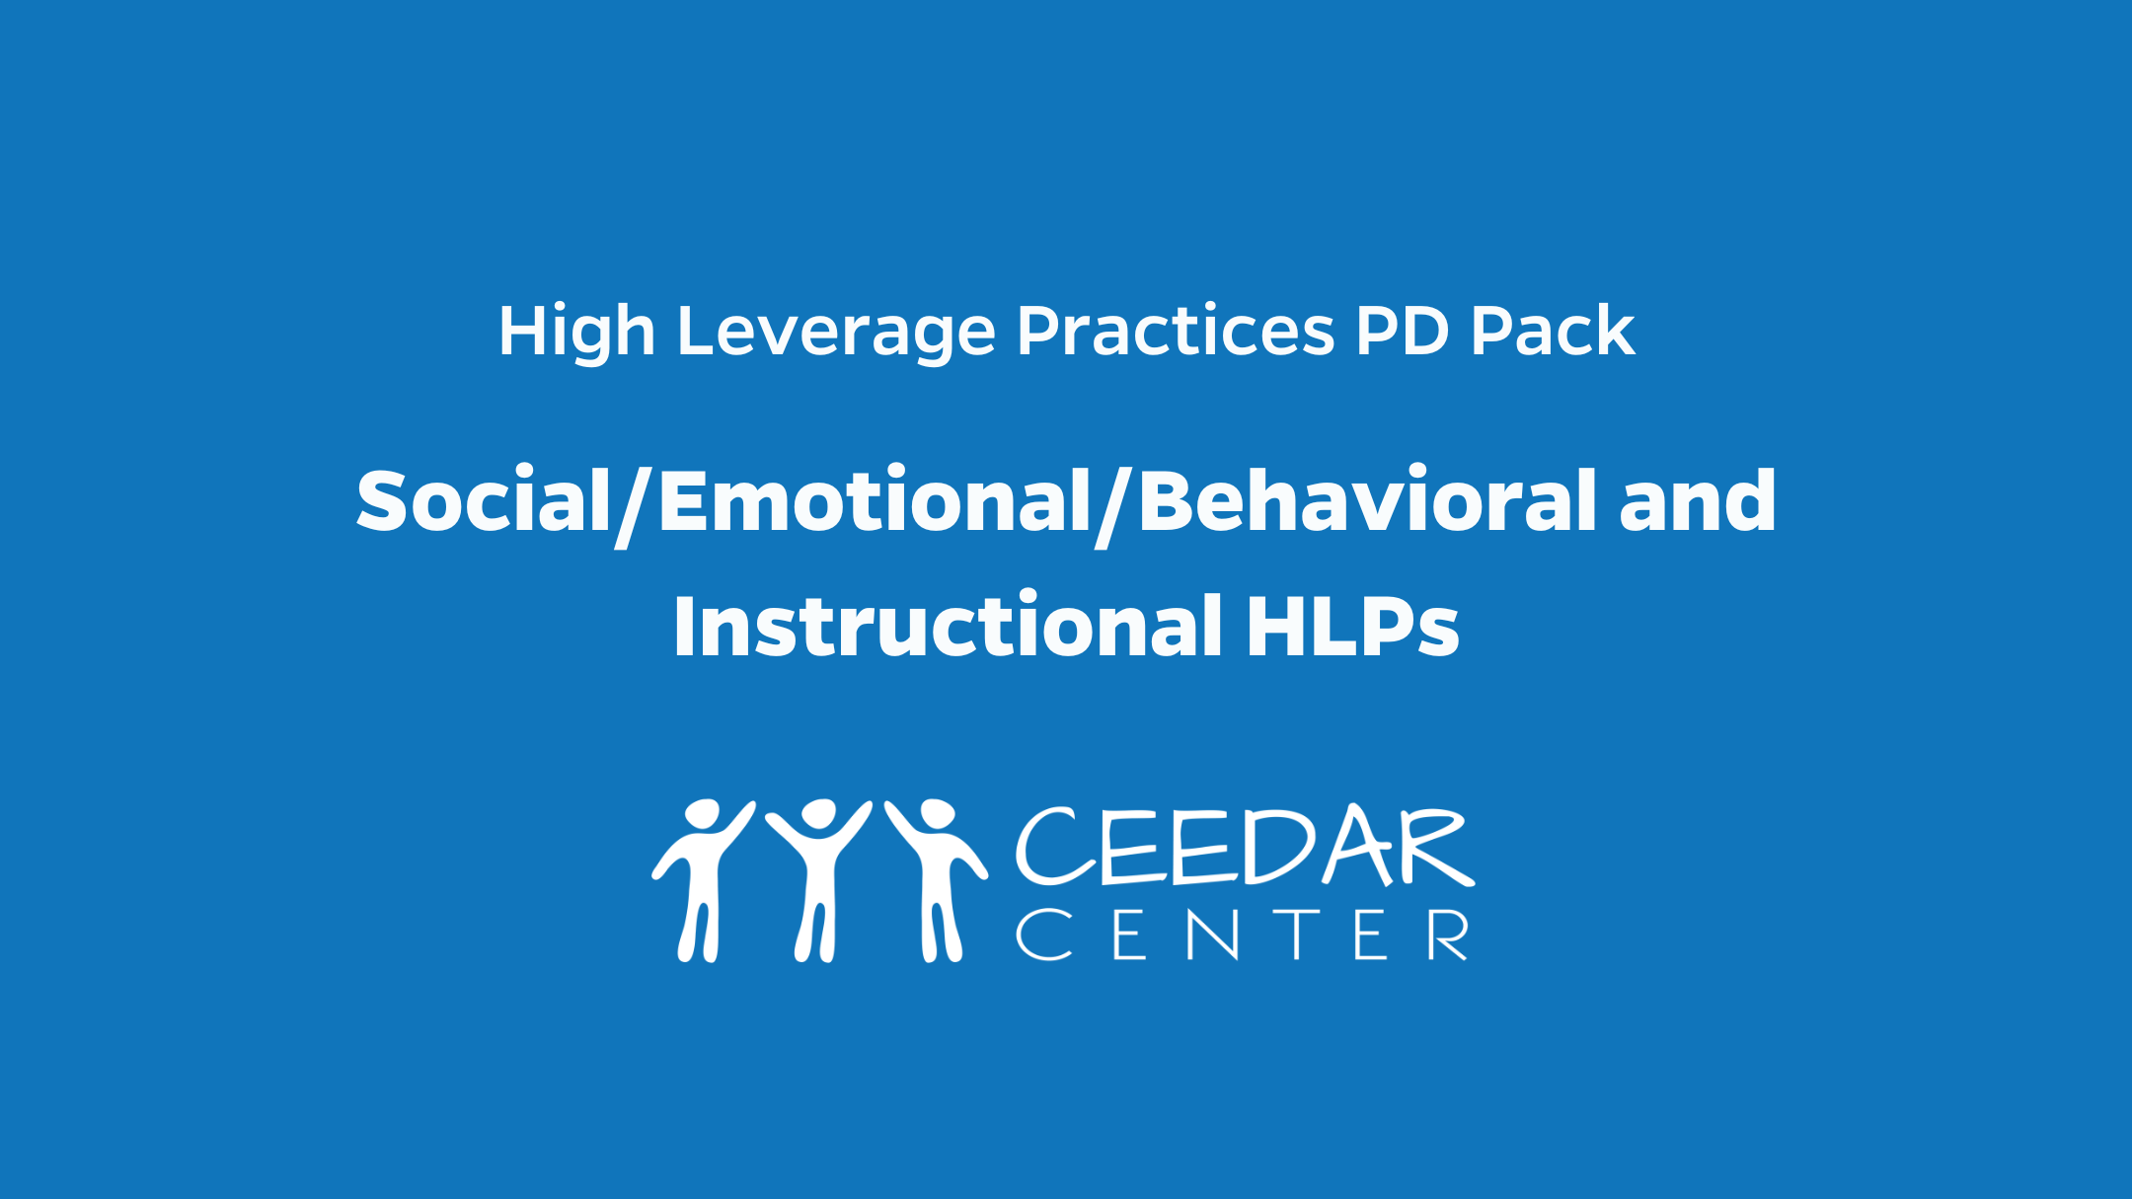
Social/emotional/behavioral and instructional hlps

Slide 3
What are High Leverage Practices?
High-Leverage Practices (HLPs) were developed in partnership between the CEEDAR Center and the Council for Exceptional Children. The HLPs are organized around four areas:
  Collaboration
  Assessment
  Social/Emotional/Behavioral
  Instruction
There are 22 HLPs which have been shown to improve outcomes for students with disabilities in PK-12 schools.
McLeskey, J., Maheady, L., Billingsley, B., Brownell, M. T., & Lewis, T. J. (Eds.). (2019). High leverage practices for inclusive classrooms. Routledge.

Slide 4

HLPs: Social/Emotional/Behavioral
Establish a consistent, organized, and respectful learning environment.
Provide positive and constructive feedback to guide students’ learning and behavior.
Teach social behaviors.
Conduct functional behavioral assessments to develop individual student behavior support plans.
Notes:
Day

Slide 5
HLP 7
HLP 7: Establish a consistent, organized, and respectful learning environment
Overview: Age-appropriate, culturally responsive expectations lead to positive teacher-student relationships, increase engagement, and decrease challenging behaviors.
Strategies: Acknowledge challenges (schedule changes, absences, short-staffed, etc.), then focus on what can be done to cultivate a predictable environment for students. Prioritize expectations and routines from the very beginning. Teach, reinforce, and re-teach after extended breaks from school. Use visual cues, non-verbal cues, proximity, and pre-correction. Create frequent opportunities for students to be positive role models. Collaborate with colleagues - share what works and generate cohesion across settings.
Notes:
Day

Slide 6
HLP 8
HLP 8: Provide positive and constructive feedback to guide students’ learning and behavior.
Overview: Effective feedback relates to students’ goals and guides their learning and behavior, increasing motivation, engagement, and independence.
Strategies: Formula for feedback: acknowledge effort + tell them what you want to see (see examples on next slide). Create coaching opportunities to work with teachers on increasing positive and constructive feedback. Utilize peer support strategies: take frequency counts of feedback and set goals for improvement. Use devices to prompt more frequent feedback (e.g., MotivAider).
Notes:
Day

Slide 7
HLP 9
HLP 9: Teach social behaviors.
Overview: Explicitly teach appropriate interpersonal skills (communication, self-management), then prompt and reinforce.
Strategies: Remember that behavior = communication. Approach behavior challenges with curiosity and view them as a skill deficit that needs to be taught, practiced, and supported. Align social emotional/behavioral goals with school-wide expectations. Embed social skills instruction across academic subjects. Collaborate with key stakeholders (social workers, psychologists, counselors, etc.) to develop and implement social skills groups.
Notes:
Melinda

Slide 8
Steps for Teaching Social Skills
Identify students and define target skills
Break skills into teachable steps
Use and sequence relevant examples (examples, non-examples, role-playing scenarios)
Facilitate student engagement through strategic instruction
Provide performance feedback
Guided practice with scaffolded support
Maintenance and generalization
Notes:
Melinda

Slide 9
HLP 10
HLP 10: Conduct functional behavioral assessments to develop individual student behavior support plans.
Overview: When inappropriate behaviors are chronic, intense, or impede learning, evaluate the function and develop a plan to teach and reinforce replacement behaviors.
Strategies: Create a support team (special education and general education teachers, behavior specialist, social worker, etc.). Regularly collect progress monitoring data to inform plan. Emphasize focus on controllable environment. Recognize and celebrate major and minor successes.
Notes:
Melinda

Slide 10
HLP 11
HLP 11: Identify and prioritize long and short-term learning goals.
Overview: Provide meaningful access to and success in general education curricula.
Strategies: Determine which skills from the general curriculum must be prioritized. Use data from multiple sources (families, students, formal and informal assessments, etc.) to create individualized plans. Take advantage of existing technology to make data collection and analysis easier (see Resources slide). Look for ways to overlap curriculum goals with individual goals to maximize instructional time.

Slide 11
HLP 12
HLP 12: Systematically design instruction toward a specific learning goal
Overview: Develop and sequence lessons that build on each other and activate students’ prior knowledge, making explicit connections in planning and delivery.
Strategies: Determine long- and short-term learning objectives based on individuals and the curriculum. Teach big ideas before details following a logical hierarchy. Teach distinctly different skills to mastery before introducing similar skills that will require discrimination. Focus on frequently encountered concepts first.

Slide 12
HLP 13
HLP 13: Adapt curriculum tasks and materials for specific learning goals
Overview: Assess individual needs, select and adapt materials and tasks to help students meet instructional goals.
Strategies: Types of adaptations: simplifying task directions, altering amount of material, altering difficulty level of material, highlighting relevant material (e.g., important ideas and concepts). Provide guided notes, graphic organizers, and mnemonic devices. Focus on implementing adaptations from IEPs first, then add more as needed Collaborate in grade-level teams to create and share resources. Use assessment data to determine if adaptations are needed or sufficient.

Slide 13
HLP 14
HLP 14: Teach cognitive and metacognitive strategies to support learning and independence
Overview: Integrate explicit instruction on strategies to support memory, attention, and self-regulation into academic content.
Strategies: Pre-teach pre-requisite skills. Explain how, when, why, and where to use the strategy. Break the strategy into chunks. Conduct step-by-step strategy demonstrations while scaffolding supports. Model self-talk when using the strategy. Create multiple opportunities for practice and provide feedback and positive reinforcement. Allow students to practice the strategy in multiple contexts over time.

Slide 14
HLP 15
HLP 15: Provide scaffolded supports
Overview: Provide temporary assistance to students so that they can complete tasks they cannot yet do independently with a high rate of success.
Strategies: Provide visual, verbal, and/or written supports. Use supports flexibly and adjust based on students’ needs. Evaluate the effectiveness of supports and gradually remove them. Pre-planned supports: rubrics, posters, graphic organizers, etc. In-the-moment scaffolding: stepping in to add support or stepping back to reduce support based on the students’ performance.

Slide 15
Hlp 16
HLP 16: Use explicit instruction
Overview: Make content, skills, and concepts explicit by showing and telling students how to think through problems, enact strategies, complete tasks, and clarify concepts.
Strategies: Use instructional transition statements (“Let me see if you remember how to…”, “Watch and listen while I show you…”, “One, two, three, eyes on me!”) Collaborate with grade level teammates to develop a distributed practice schedule (teach a skill, practice it at scheduled intervals). Embed retrieval practice activities to help students commit concepts to memory (exit tickets, flash cards, jeopardy, self-check quizzes).

Slide 16
HLP 17
HLP 17: Use flexible grouping
Overview: Effective teachers assign heterogeneous and homogeneous groups based on explicit learning goals and peer interactions.
Strategies: Use classroom-level assessments to create multiple groupings (e.g., same-level groups, mixed-level groups). Seek/provide professional development opportunities on Kagan strategies. Pair flexible grouping with other HLPs (e.g., strategies for student engagement, intensive instruction, etc.) to maximize student learning.

Slide 17
Hlp 18
HLP 18: Use strategies to promote active student engagement
Overview: Effective teachers build positive teacher-student relationships, connect learning to students’ lives, and use a variety of instructional strategies to motivate and engage students.
Strategies: Increase opportunities to respond using choral response or response cards. Tailor response strategies to meet student needs, use assistive technology, make accommodations to response options (printed response cards vs write-ons). Incorporate other strategies, such as guided notes, classwide peer tutoring, games, digital tools, and group contingencies.

Slide 18
HLP 19
HLP 19: Use assistive and instructional technologies
Overview: Effective teachers select and use assistive and instructional technology to promote student learning and independence.
Strategies: Collaborate with other professionals to learn about and share new technologies for assisting students. Set aside time to explore new technology and reflect on ways to embed it into the school setting. Include the assistive technology (AT) administrator when deciding if students require AT and which AT is most appropriate for their needs.

Slide 19
Hlp 20
HLP 20: Provide intensive instruction
Overview: Effective teachers provide intensive instruction to match students’ learning and behavioral needs.
Strategies: Systematically design instruction that is data driven, matches the intensity of student need, and individualized Implement data-based individualization (DBI), which is designed to support students with intensive needs that are not met in tiers I or II in a multi-tiered system of support. Resources here

Slide 20
HLP 21
HLP 21: Teach students to maintain and generalize new learning across time and settings.
Overview: Teachers design instruction to ensure students apply concepts to multiple settings, systematically use schedules of reinforcement, and teach skills that are naturally reinforced outside of the classroom.
Strategies: Explicitly teach students how to use skills in multiple settings, help them recognize natural reinforcers (e.g., teach them to ask “How am I doing?” to gain feedback), have students monitor their own progress Use various reinforcement schedules (continuous, intermittent, thinning). Avoid assuming generalization will occur naturally - make plans to ensure it happens.

Slide 21
HLP 22
HLP 22: Provide positive and constructive feedback to guide students’ learning and behavior.
Overview: Effective teachers provide feedback to guide student learning and behavior and increase student motivation, engagement, and independence, leading to improved student learning and behavior
Strategies: -Use various modes: verbal, nonverbal, or written -Aim for timely, contingent, genuine, meaningful, age appropriate feedback -Provide feedback at rates commensurate with task and phase of learning (i.e., acquisition, fluency, maintenance). -Provide ongoing feedback until learners reach their established learning goals. -Feedback should strategically delivered and goal directed

Slide 22


CEEDAR Collaborating Centers
  Center on Positive Behavioral
  Interventions and Supports
  National Center on Intensive Interventions
Notes:
Melinda

Slide 23
Resources for Administrators and Teacher Educators:
For unedited examples of teachers’ implementing the HLPs in action, visit: https://highleveragepractices.org/unedited-clips-teachers-implementing-hlps
For guidance on how to incorporate HLPs into teacher preparation and professional development, view this webinar: https://highleveragepractices.org/webinar/using-hlp-videos-activate-implementation
For printable guides designed to help school leaders support staff in implementing HLPs, visit: https://highleveragepractices.org/hlp-leadership-guides
For professional development resources on research-based cognitive strategy instruction, visit: http://cehs.unl.edu/csi or https://iris.peabody.vanderbilt.edu
For resources to incorporate into teacher preparation and professional development: https://ceedar.education.ufl.edu/cems/classroom-and-behavior-management/
Notes:
Melinda

Slide 24
Resources for Teachers:
For engagement, data collection and analysis:
For teaching cognitive and metacognitive:
www.centeroninstruction.org
www.pbis.org
http://ebi.missouri.edu
www.interventioncentral.org
www.achievethecore.org/
www.masteryconnect.com/goodies.html
www.socrative.com/apps.html
https://nearpod.com/
www.plickers.com/
https://kahoot.it/
https://goformative.com/
http://versoapp.com
www.quizsocket.com
www.polleverywhere.com
www.mentimeter.com
Notes:
Melinda

Slide 25

DISCLAIMER
This content was produced under U.S. Department of Education, Office of Special Education Programs, Award No. H325A220002. David Guardino serves as the project officer. The views expressed herein do not necessarily represent the positions or polices of the U.S. Department of Education. No official endorsement by the U.S. Department of Education of any product, commodity, service, or enterprise mentioned in this website is intended or should be inferred.

