Slide 1

Better together

Slide 2
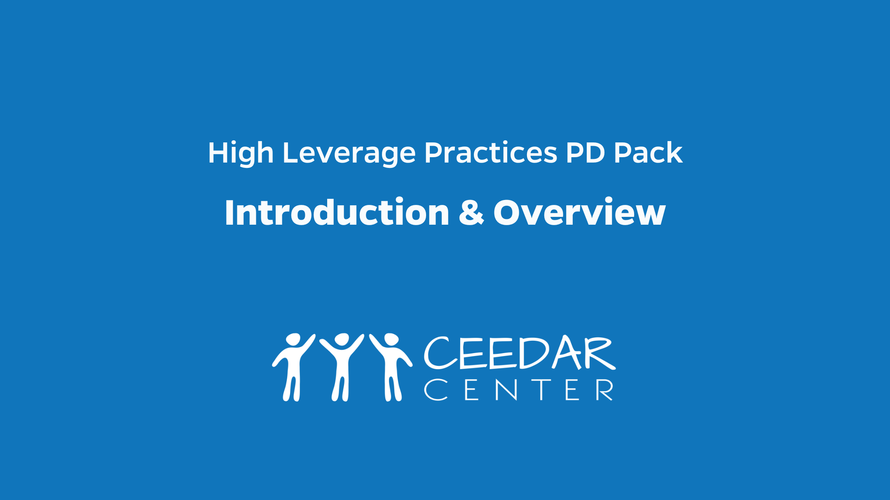
Introduction and overview

Slide 3
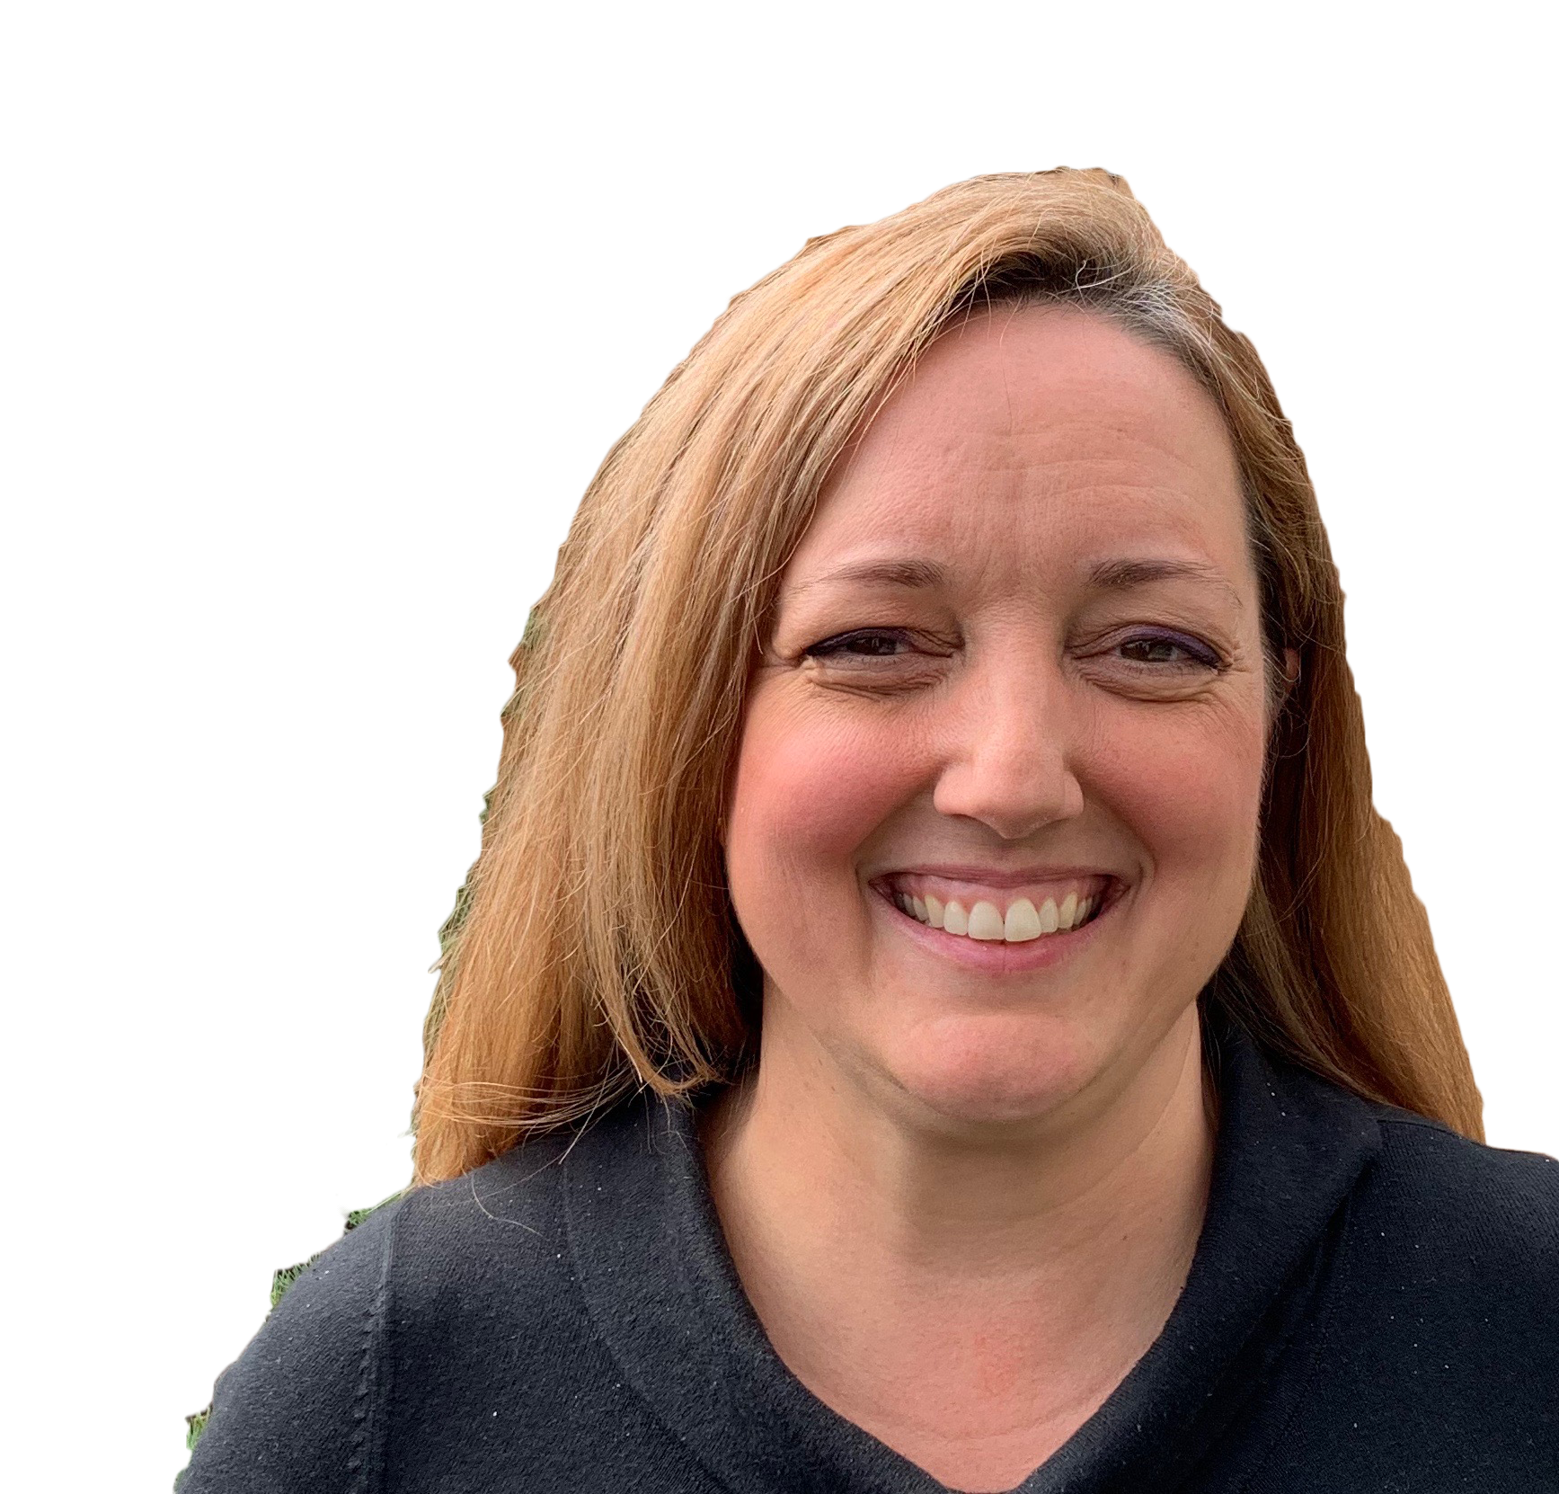
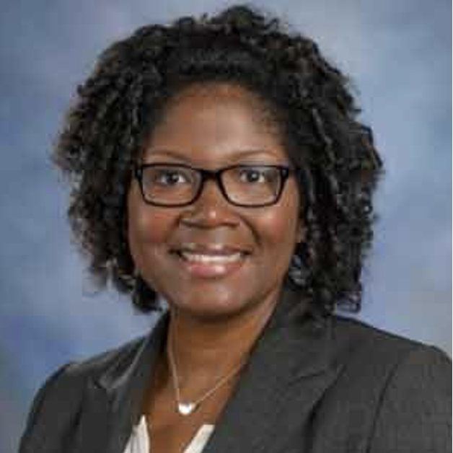
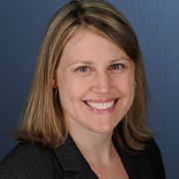
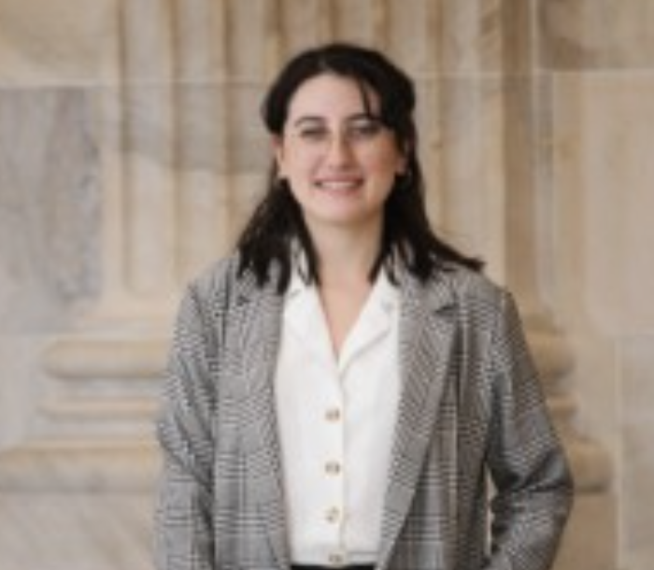
Your Facilitators
Kate Adams
CEEDAR Center
kadams@coe.ufl.edu
Dashaunda Patterson, Ph.D.
Georgia State University
dspatterson@gsu.edu
Melinda Leko, Ph.D.
University of Florida CEEDAR Center
leko@coe.ufl.edu
Cristina Alvarez
AIR (American Institutes for Research)
calvarez@air.org

Slide 4

The CEEDAR CEnter

Slide 5
The CEEDAR Center
Collaboration for Effective Educator Development, Accountability and Reform (CEEDAR)
Notes:
Melinda

Slide 6
The CEEDAR Center
Technical Assistance Center funded by the Office of Special Education Programs (OSEP)
Provides support to 22 states

Slide 7
CEEDAR Center
To create aligned professional learning systems that provide teachers and leaders effective opportunities to learn how to implement core and intensive instruction that enables students with disabilities to achieve college and career ready standards
Every student with a disability has an equitable opportunity to achieve.

Slide 8
High Leverage Practices (HLPs) for students with Disabilities
Notes:
Melinda

Slide 9
High Leverage Practices
HLPs are identified as specific teacher practices that are likely to result in improved student outcomes.
“The HLPs can become the foundation of a cohesive, practice-based teacher education curriculum that incorporates repeated, scaffolded, effective opportunities…” (McLeskey et al., 2017, pg. 9).
Notes:
Melinda
In simplest terms, HLPs are specific teacher practices that are likely to result in improved student outcomes. And this is really why we are all here. We know from decades of educational research and our own in the field experience that there are certain actions, beliefs, and understandings that are beneficial for students (and some that are not). We also know that there are a LOT of quote best practices out there that may or may not have the evidence to back them up. Basically, there is a lot to sort through and decipher for teachers and those who support teachers. Through extensive work done by TeachingWorks out of the University of Michigan, the Council for Exceptional Children, and the CEEDAR center, educators across the nation are narrowing in a set of core practices that are essential for teachers to know and implement. These are high leverage practices.
The hope is by focusing in on these crucial aspects of teaching, we can become even more strategic in our preparation and ongoing support for educators. <CLICK>. HLPs have the potential to become the foundation of a cohesive, practice-based teacher education curriculum that incorporates repeated, scaffolded, and effective opportunities for practice. <CLICK>

Slide 10
HLPs are…
Notes:
Melinda
HLPs include essential <CLICK> skills for teachers to learn and practice. They are not an exhaustive list, and as you review the provided resources you will that they include many non-negotiables for effective teaching. For example, checking student understanding or building respectful relationships with students. We probably all agree that these things should be happening in the classroom.
While there are plenty of beneficial teacher practices out there, having a defined set helps narrow our focus <CLICK> for what teacher educators must introduce and provide purposeful practice <CLICK> for. Like any skill, pre- and in-service teachers must be introduced to the concept, have the opportunity to apply their learning, and regularly practice with meaningful feedback.
You’ll notice that there is a set of general and special education HLPs. We believe all educators need both, and this webinar series will explore how they intersect and complement each other in the areas of collaboration, assessment, social and behavioral supports, and instruction. As you become familiar with these HLPs, remember that the special education set is not exclusively for special educators, but for educators who work with students with disabilities. In our current educational landscape, where students with disabilities are increasingly being served in general education classrooms, this means this set of HLPs is for everybody. Special educators, general educators, academic coaches, teacher leaders, and school and district level administration. <CLICK>

Slide 11
HLPs
HLPs
Collaboration
(3)
Assessment
(3)
Social/
Emotional/
Behavioral (4)
Instruction
(12)
22 HLPs Across Four Domains

Slide 12

HLPS: COLLABORATION
Collaborate with professionals to increase student success.
Organize and facilitate effective meetings with professionals and families.
Collaborate with families to support student learning and secure needed services.

Slide 13

HLPs: Assessment
Use multiple sources of information to develop a comprehensive understanding of a student’s strengths and needs
Interpret and communicate assessment information with stakeholders to collaboratively design and implement educational programs.
Use student assessment data, analyze instructional practices, and make necessary adjustments that improve student outcomes.

Slide 14

HLPs: Social/Emotional/Behavioral
Establish a consistent, organized, and respectful learning environment.
Provide positive and constructive feedback to guide students’ learning and behavior.
Teach social behaviors.
Conduct functional behavioral assessments to develop individual student behavior support plans.

Slide 15

HLPs: Instruction
11. Identify and prioritize long- and short-term learning goals.
12. Systematically design instruction toward specific learning goals.
13. Adapt curriculum tasks and materials for specific learning goals.
14. Teach cognitive and metacognitive strategies to support learning and independence.

Slide 16

HLPs: Instruction (Con't)
Provide scaffolded supports.
Use explicit instruction.
Use flexible grouping.
Use strategies to promote active student engagement.
Use assistive and instructional technologies.

Slide 17

HLPs: Instruction (con’t)
Provide intensive instruction
Teach students to maintain and generalize new learning across time and settings.
Provide positive and constructive feedback to guide students’ learning and behavior.

Slide 18
BENEFITS OF HLPS
Appropriate for ALL Learners
Useful across content and subject area
Established evidence base
Notes:
Melinda
High leverage practices are essential dimensions of instruction. They are teacher practices that are essential to promoting improved outcome and are appropriate for all learners. HLPs are useful across all content areas and grade levels. And are grounded in research and have sufficient evidence to make a positive impact.

Slide 19
Example: Explicit Instruction
Beneficial for all students
Can be used at elementary and secondary levels
Can be used to teach a summarization strategy in reading or long division in mathematics or how to set goals as part of a self-determination program

Slide 20



HLPs Creation: A Collaborative Process
Partnership between:
  Collaboration for Effective Educator
  Development, Accountability and
  Reform (CEEDAR) Center
  Council for Exceptional Children (CEC)
  CEC’s Teacher Education Division (TED)

Slide 21

Part III: Tools
FREE
Notes:
Day lead presenter for tools

Slide 22
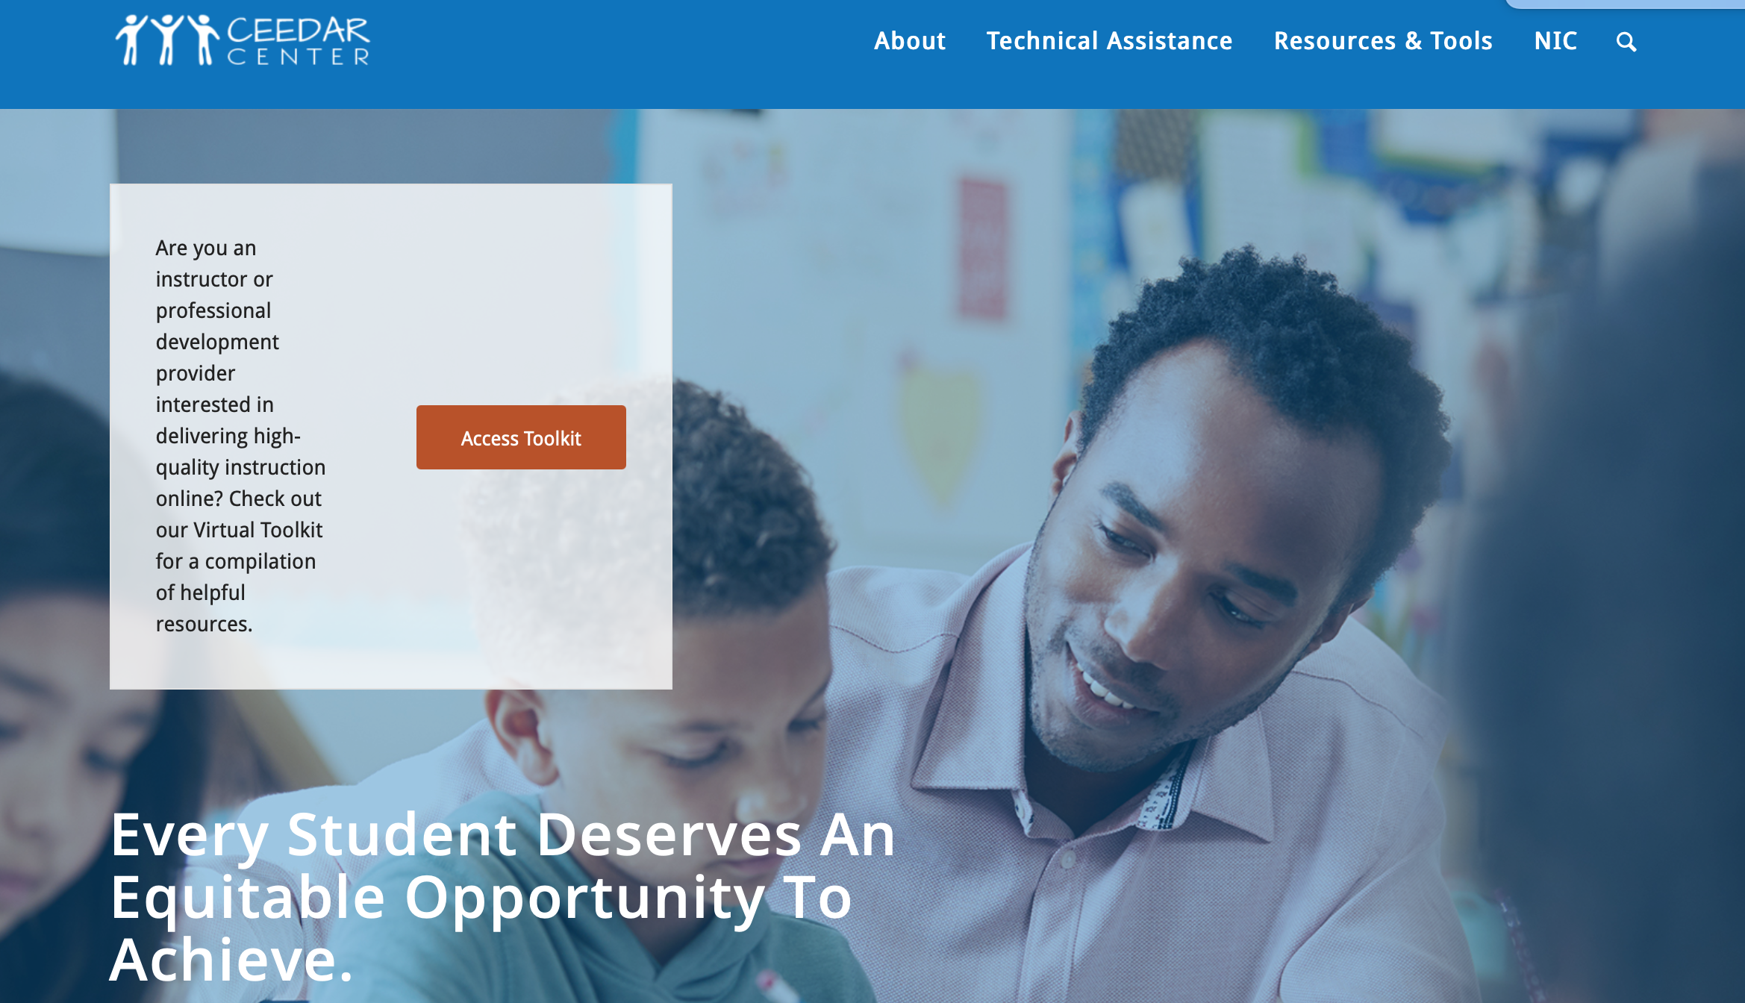
www.ceedar.org
Notes:
Day

Slide 23
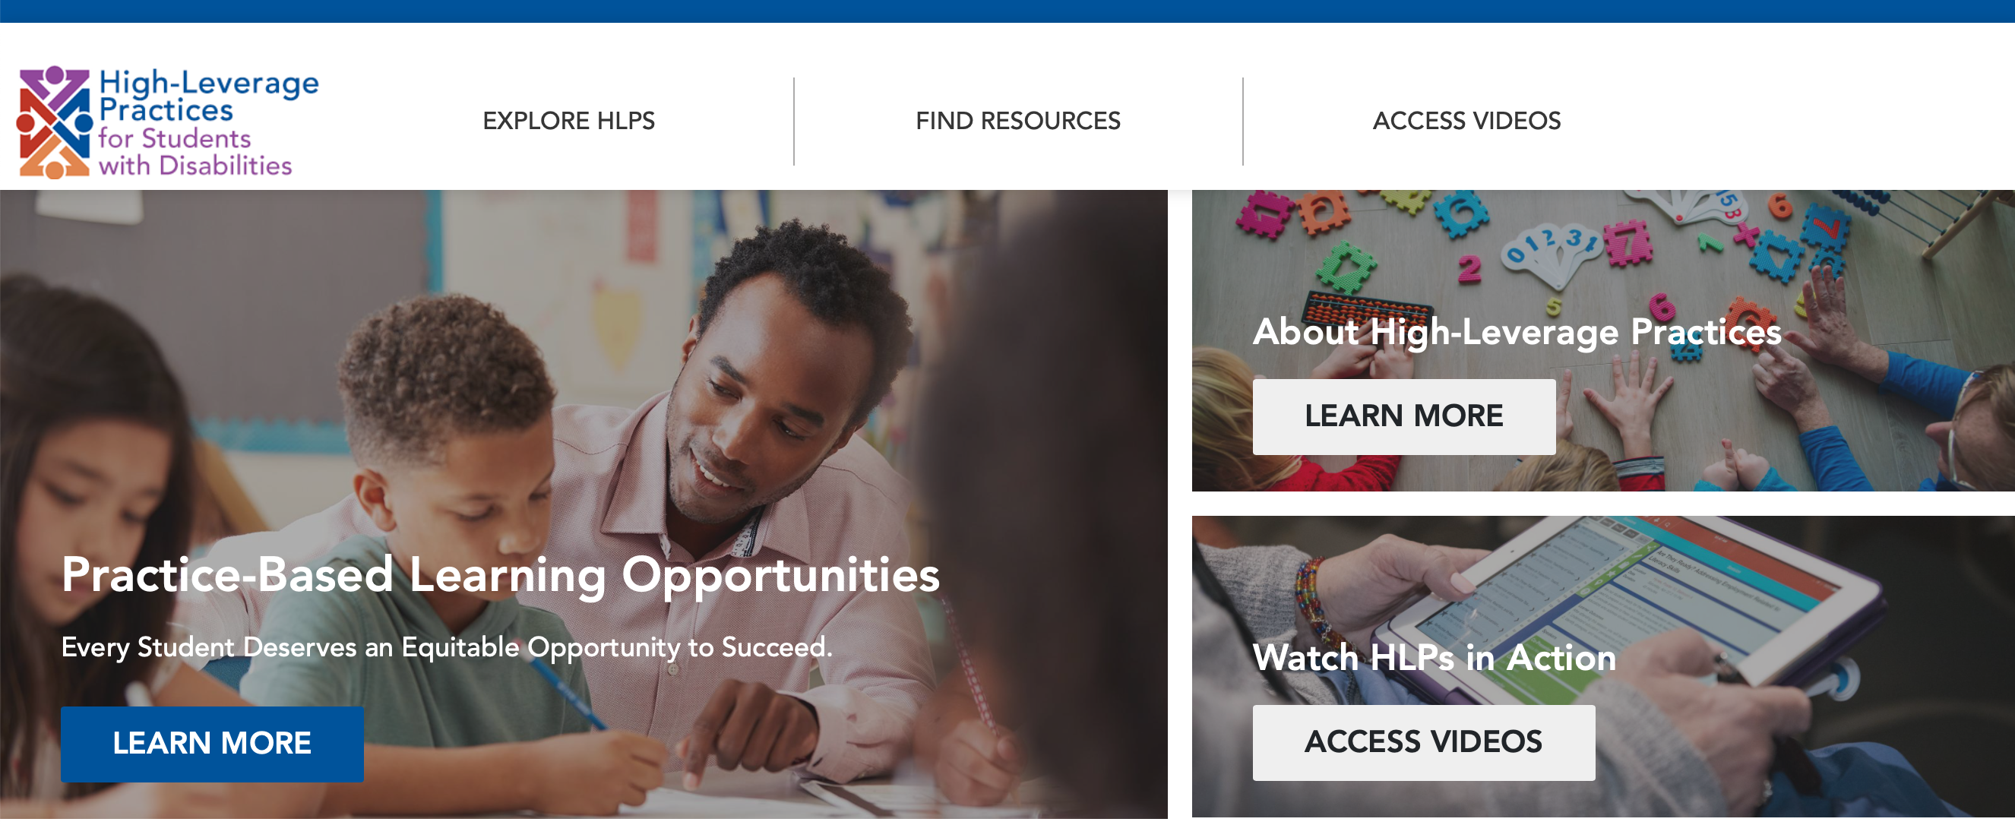
www.HIGHLEVERAGEPRACTICES.org
Notes:
Day- container

Slide 24

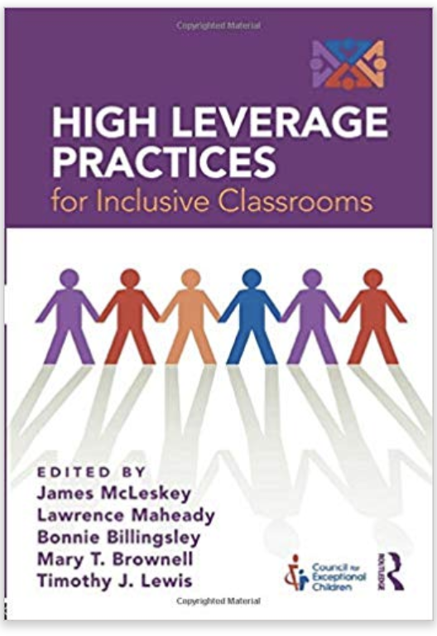

Books/Articles
Notes:
Day

Slide 25
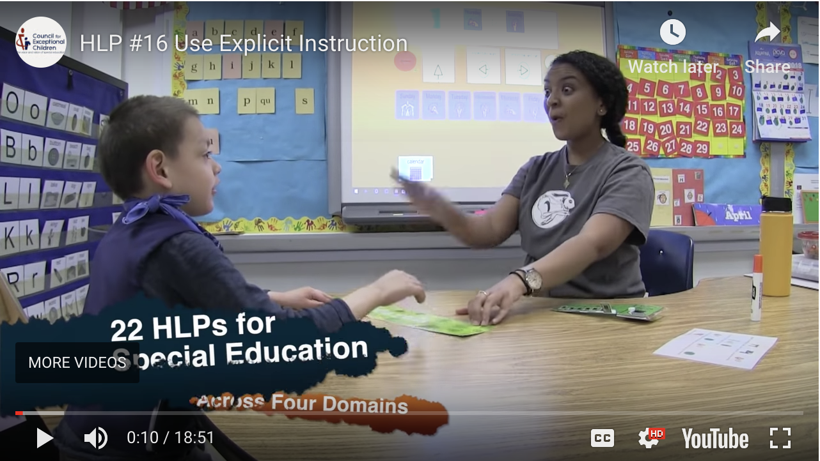
Hlps RESOURCES: vIDEOS
Video Library
Introduction Video
HLPs #8 and #22: Feedback
HLP #12: Systematically Design Instruction
HLP #16: Use Explicit Instruction
HLP #18: Student Engagement
HLP #7: Learning Environment
Notes:
Day

Slide 26
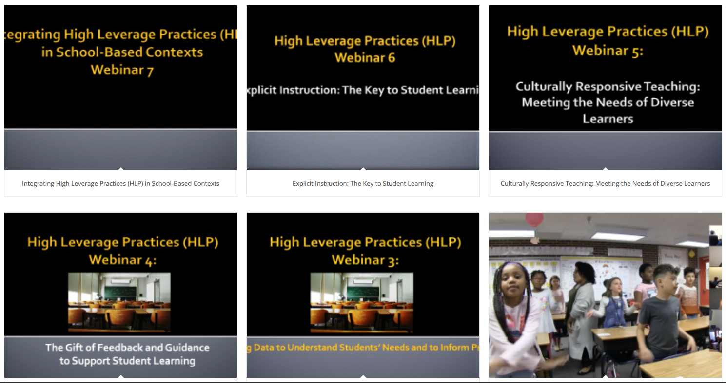
Webinars
www.ceedar.org/archived-webinars/
Notes:
Day

Slide 27
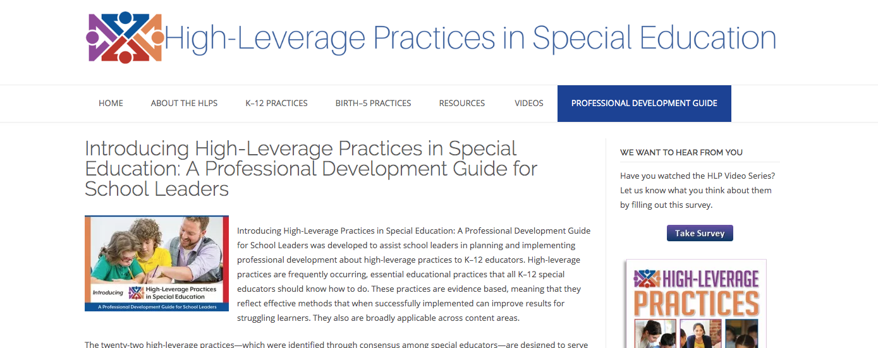
PD Guide
“HLPs in Special Education: A Professional Development Guide for School Leaders”
Notes:
Day

Slide 28

DISCLAIMER
This content was produced under U.S. Department of Education, Office of Special Education Programs, Award No. H325A220002. David Guardino serves as the project officer. The views expressed herein do not necessarily represent the positions or polices of the U.S. Department of Education. No official endorsement by the U.S. Department of Education of any product, commodity, service, or enterprise mentioned in this website is intended or should be inferred.

