Slide 1
Challenges and Innovations in Designing Individualized Scholar Support
OESP & CEEDAR Center
January 22, 2024
Notes:
OSEP- Sunyoung

Slide 2
Purpose
Through this learning community, FY23 PDP grantees will expand their knowledge and strategies in providing scholar support including individualized scholar support that leads to scholar success and retention.
Notes:
Sunyoung

Slide 3
Agenda
Review the 2023 training grants priority requirements for scholar support
Discuss the importance of scholar support for successful completion of the program
Grantee highlights
Breakout learning opportunity
OSEP recommended resources
OSEP updates
Notes:
Sunyoung

Slide 4
OSEP Personnel Grants
Meeting the needs of the field
Notes:
Celia

Slide 5
FY 23 OSEP Personnel Prep Grants
Funding focusing on recruitment and retention at all levels of special education
325D – to support doctoral degree programs to prepare and increase the number of personnel who are well-qualified for, and can act effectively in, leadership positions as researchers and special education/early intervention/related services personnel preparers in IHEs, or as leaders in SEAs, LAs under Part C of IDEA, LEAs, or EIS programs
325K- to prepare scholars in early intervention and special education at the bachelor’s degree, certification, master’s degree, or educational specialist degree levels
325M- to prepare scholars in special education, early intervention, and related services at the bachelor’s degree, certification, master’s degree, educational specialist degree, or clinical doctoral degree levels
325R- to prepare related services personnel at the bachelor’s degree, certification, master’s degree, or clinical doctoral degree levels
Notes:
Celia

Slide 6
Scholar Support
65% or more of the total award must be used for “Scholar Support”.
Scholar budget considerations include mitigating financial burden and based on scholars’ financial needs.
Scholar support does not need to be uniform for all scholars and should be customized for individual scholars based on scholars’ financial needs, including consideration of all costs associated with the cost of attendance, even if that means enrolling fewer scholars.
Scholar support can include support for cost of attendance (i.e., tuition and fees; university student health insurance; an allowance for books, materials, and supplies; an allowance for miscellaneous personal expenses; an allowance for dependent care, such as child care; and/or an allowance for room and board), travel in conjunction with training assignments including conference registration, and stipends to support scholars’ completion of the program.
Projections for scholar support should consider tuition increases and cost of living increases over the project period.
Notes:
Celia
Some additional information has been added to the notice this year related to scholar support so wanted to highlight information.
Scholar support can vary each year of the project but must be at least 65% of the total award.
Scholar budget considerations include mitigating financial burden based on scholar need
Additional information has been provided on what can be considered in scholar support which includes costs related to attendance, such as tuition and stipend but also personal expenses, as well as travel related to training
As you develop your budget projections, consider program attendance costs for scholar over the project period. For example, are scholar support costs going to be the same in the first year, mid-way through the program, and final year? Take that into account in your budget. Consider as well if there may be planned tuition increases as well as cost of living increases

Slide 7
Resources for Supporting Scholars
FY 2023 Grantees were required to demonstrate as part of the project resources how:
Information regarding the types of accommodations and resources available to fully support scholars’ well-being and a work-life balance (e.g., university and community mental health supports, counseling services, health resources, housing resources, child care) will be disseminated and how the project will support scholars to access those accommodations and resources in a timely basis, if needed, while the scholar is in the program;
The types of accommodations and resources provided to support scholars’ well-being and a work-life balance will be individualized based on scholars’ cultural, academic, and social emotional needs with the goal of supporting them to complete the program; and
The budget is adequate for meeting the project objectives and mitigating financial burden to scholars in completing the program of study.
Notes:
Celia
Under the quality of the adequacy of resources, applicants must address how--
Information of accommodations and resources available to fully support scholars’ well-being and a work-life balance will be disseminated and how the project will support scholars to access those if needed;
The types of accommodations and resources provided to support scholars individualized based on scholars’ cultural, academic, and social emotional needs with the goal of supporting them to complete the program; and
- The budget is adequate for meeting the project objectives and mitigating financial burden to scholars.

Slide 8
What Does the Research Tell us?
Meaghan Devlin (Texas A&M University)
Melinda Leko (CEEDAR Center)
Notes:
Celia

Slide 9
Current State of SPED/EI Workforce
Documented shortage throughout IDEA’s history(Boe, 2006; Mason-Williams et al., 2020)
Particularly acute since COVID-19
45% of schools report special education teacher vacancies, the position with the highest percentage of vacancies (DeLaRosa & Elias, 2022)
Majority of school districts do not have enough related services personnel to meet the needs of students with disabilities (National Coalition on Personnel Shortages in Special Education, n.d.).
Part C State coordinators indicate that they had shortages of personnel to work in their system with the top three areas of shortage being speech-language pathologists, physical therapists, and occupational therapists (IDEA Infant and Toddler Coordinators Association, 2021).
Documented shortage throughout IDEA’s history(Boe, 2006; Mason-Williams et al., 2020)
Retaining personnel is key to making improvements in retention

Slide 10
Considerations in Designing Scholar Support
Certification Exams
Job Opportunities
Exam preparation
Provide trainings/funding
Study groups
Tiered supports for scholars who would benefit from targeted or individualized support
Be proactive – monitor scholar progress and respond early
Job fairs and posts
Resume and application support
Interview preparation and practice
Visiting and/or conducting field experiences in high-need districts
Clearly define “high-need” for scholars, provide examples of LEAs who meet criteria

Slide 11
Mentorship
Consistently identified as key factor in supporting early career personnel
Personal support as important as professional support
Important factors to consider
Proximity and availability
Mentor’s experience level
Similar job responsibilities
Individual or group
IHEs uniquely situated to leverage alumni networks here
Formal or informal mentorship opportunities
Billingsley et al., 2009

Slide 12
Research into Practice
Skills-based PD & Coaching
Goal Setting & Progress Monitoring
Training that focuses on improving skills
Content/job responsibility specific
Translate training into practice with in-classroom coaching
Teacher- (or related service provider) driven goals
Specific, observable, measurable
SMART or ABCDE formats
Encourage self-monitoring progress
Consistent, constructive feedback is pivotal throughout!

Slide 13
References
Billingsley, B. S., Bettini E., Mathews, H. M., McLeskey, J. (2020). Improving working conditions to support special educator’s effectiveness: A call for leadership. Teacher Education and Special Education, 43(1), 7-27. https://doi.org/10.1177/0888406419880353
Billingsley, B. S., Griffin, C. C., Smith, S. J., Kamman, M., & Israel, M. (2009). A review of teacher induction in special education: Research, practices, and technology solutions. University of Florida, National Center to Inform Policy in Special Education Professional Development. http://ncipp.education.ufl.edu/files_5/NCIPP%20Induction%20Exc%20Summ.pdf
Boe, E. E. (2006). Long-term trends in the national demand, supply, and shortage of special education teachers. The Journal of Special Education, 40(3), http://doi.org/138-150.10.1177/00224669060400030201
DeLaRosa, J. & Elias, J. (2022). U.S. schools report increased teacher vacancies due to COVID-19 Pandemic, new NCES data show. National Center for Education Statistics, Institute of Institute of Education Science. https://nces.ed.gov/whatsnew/press_releases/3_3_2022.asp
García, E., & Weiss, E. (2019). U.S. schools struggle to hire and retain teachers: The second report in "the perfect storm in the teacher labor market" series. Economic Policy Institute. https://www.epi.org/publication/u-s-schools-struggle-to-hire-and-retain-teachers-the-second-report-in-the-perfect-storm-in-the-teacher-labor-market-series/
Mason-Williams, L, Bettini, E., Peyton, D., Harvey, A., Rosenberg, M., & Sindelar, P. T. (2020). Rethinking shortages in special education: Making good on the promise of an equal opportunity for students with disabilities. Teacher Education and Special Education, 43(1), 45-62. http://doi.org/10.1177/0888406419880352
OSEP. (2019). Retaining personnel: Induction and mentoring. U.S. Department of Education, Office of Special Education Programs. https://osepideasthatwork.org/sites/default/files/R5-InductionMentorship-508.pdf

Slide 14
CEEDAR
Our mission is to support students with disabilities in achieving college- and career-ready standards by building the capacity of state personnel preparation systems to prepare teachers and leaders to implement evidence-based practices within multi-tiered systems of support.
Ceedar.org
Notes:
Melinda

Slide 15
Scholar support: Suggestions from the field
Financial support
living stipend that does not need to be supplemented by part-time work
tuition
fees,
textbooks
childcare
examination fees
Flexible programming and attendance options
evening courses
hybrid formats,
fully online
multiple sections of courses aligned with the needs of various cohorts of teacher candidates
Notes:
Melinda

Slide 16
Scholar support: Additional Suggestions
Cohort problem-solving meetings
Support for program issues, as well as issues arising from the field
Ongoing formative feedback from program scholars with specific questions addressing scholar support
Semi-annual newsletter with resources and program updates to current and past scholars
Example of how scholar support can extend following program completion
Program graduates serving as mentors or ”buddies”
Formalized study groups for any required certification or licensure examinations
Notes:
Melinda

Slide 17
Scholar support: Suggestions from research
Financial support
more robust funding packages
moving expenses
Mentoring
Multiple mentors beyond primary advisor, particularly for scholars of color who report having to find mentors on their own
Internships
Promotes collaboration, expands scholars’ networks
Assessing program/university climate and culture and disaggregating results by race/ethnicity/language
(Maggin et al., 2021; McCorkle et al., 2023)
Notes:
Melinda

Slide 18
Scholar support: Suggestions from research
Scholars with disabilities
Report facing explicit and implicit instances of ableism
“Over-accommodating”
Denial of various field experiences and placements
Lack of or miscommunication between program and partner schools around necessary accommodations for scholars
Reactive “support” meetings
Difficulty with transportation to and from field experiences
Need for
Regular check ins with scholars and soliciting their feedback
Better communication and alignment between EPPs, campus Disability Resource Centers, and field placements
(Strimel et al., 2023)

Slide 19
Resources
TESE special issue "Critical Issues for the Preparation and Workforce Development of Racialized Special Educators” Volume 45(1) 2022
Intersectionally Conscious Collaboration protocol (Boveda & Weinberg)
Critical racial affinity groups (Kulkarni et al.)
Maggin, D. M., Collins, T. A., Foster, J. A., Scott, M. N., Mossing, K. W., & Dorsey, C. M. (2022). Faculty perspectives on the recruitment, retention, and preparation of special education doctoral students of color. Teacher Education and Special Education, 45(3), 227-245.
McCorkle, L. S., Vestal, A., & Diamond, L. L. (2023). Preparing Doctoral Students in Special Education: What Do We Really Know?. Teacher Education and Special Education, 46(3), 185-203.
Strimel, M. M., Nagro, S. A., Baker, P. H., & Thoma, C. A. (2023). The Experiences of Teacher Candidates With Disabilities: A Systematic Literature Review. Teacher Education and Special Education, 08884064231170573.

Slide 20
What FY23 Grantees Proposed
Trends found Across Applications
Notes:
Sunyoung

Slide 21
Areas Proposed to Provide Scholar Support
Notes:
Sunyoung
Other:
monthly stipend for unspecified expenses + \"support fund\" scholars can apply for as needed
Transportation
Funds are made available to scholars on an annual basis (approximately $800) to use for any of the above listed supports
Technology support
Licensure exam
Mentorship
Professional development
discounted tuition rate established for project period“
Accounts to be used per scholar needs."]
Certification exam fees

Slide 22
Cost Increase Projections
Considered cost of living increase over the project period?
Considered tuition increases over the project period?

Slide 23
Availability of Customized/Individualized Scholar Funding Based upon Need

Slide 24
Types of Individualized/Customized Resources Available for Scholars
Notes:
Other:
referrals to appropriate campus- and community-based resources
Food pantry
Mentoring, tutoring, counseling

Slide 25
Dissemination Plan on Available Resources
Notes:
Other:
Student orientation
Quarterly/semester basis and at program enrollment
community outreach through community EC partners
a project handbook with links to a variety of resources
Partnerships with local school districts, including high-need districts"]
No specific plan included
Information shared at orientation. Mentoring and advising, building communities of practice and communities of belonging that span the program of study and project (4 semesters)

Slide 26
Additional Information Related to Scholar Support
Some unique supports proposed by projects include:
IHE offers short term therapy free of charge to help with personal, emotional, or academic difficulties
Supporting scholars access student associations to allow meaningful connections with others with similar lived experiences
Success Coach who will host regular bi-weekly academic support meetings for scholars
Graduates of the program will provide mentorship to current scholars
Providing support for moving costs
Providing an ongoing list of activities in the community to address work/life balance

Slide 27
Let’s Dig Deeper
Grantee Highlights

Slide 28
Coastal Carolina University (325K)
Project Director: Deborah Rooks- Ellis

Slide 29
Florida State University (325D)
Project Director: Carla Wood

Slide 30
Team Science
FSU –UCF
TP-3
Team-Based Research and Teaching to Prepare Experts in Language, Literacy, and Learning

Slide 31
Cross-Site Collaborative Learning
Research Brown-bags
Specialty Seminars
Dissemination
Joint engagement across sites in a research practicum with regular lab meetings using videoconferencing to connect scholars at both sites
3-credit hour specialty graduate seminar with joint participation across sites, alternating lead between FSU and UCF
Engage in presentations at professional conference, professional development for community service providers, publish in peer-reviewed journals

Slide 32
Teaming Boot Camp
Introduction to Team Science
Team
Assembly
Collaboration
PLANS

Slide 33
Graduate Course for Doctoral Scholars
18
5
Doctoral Students
ENROLLED
Disciplinary majors

Slide 34
STUDENT ENGAGEMENT
Students apply the content in writing elevator pitches, mission/vision statements, collaboration plans, and writing a collaborative research proposal
“ONE OF THE ADVANTAGES OF WORKING IN THESE CROSS-DISCIPLINARY TEAMS IS WHAT YOU LEARN OF THOSE VIEWS, PERCEPTIONS, BIASES, BACKGROUNDS, AND HISTORIES THAT COME FROM PEOPLE AND DISCIPLINES THAT ARE DIFFERENT FROM YOUR OWN...ALLOWS EVERYONE TO LEARN, STRETCH, AND BUILD NEW KNOWLEDGE.”

Slide 35
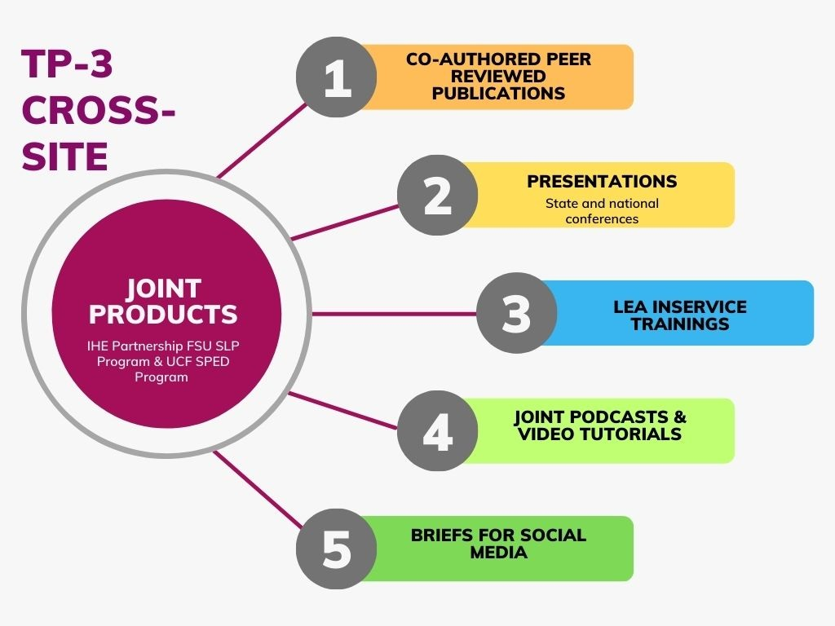

Slide 36
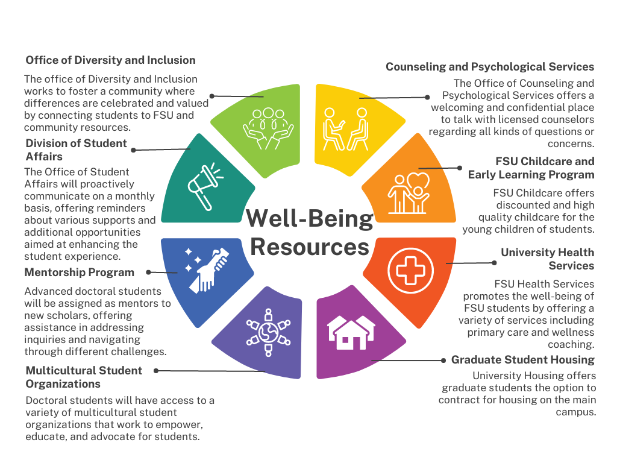
Support for Scholars

Slide 37
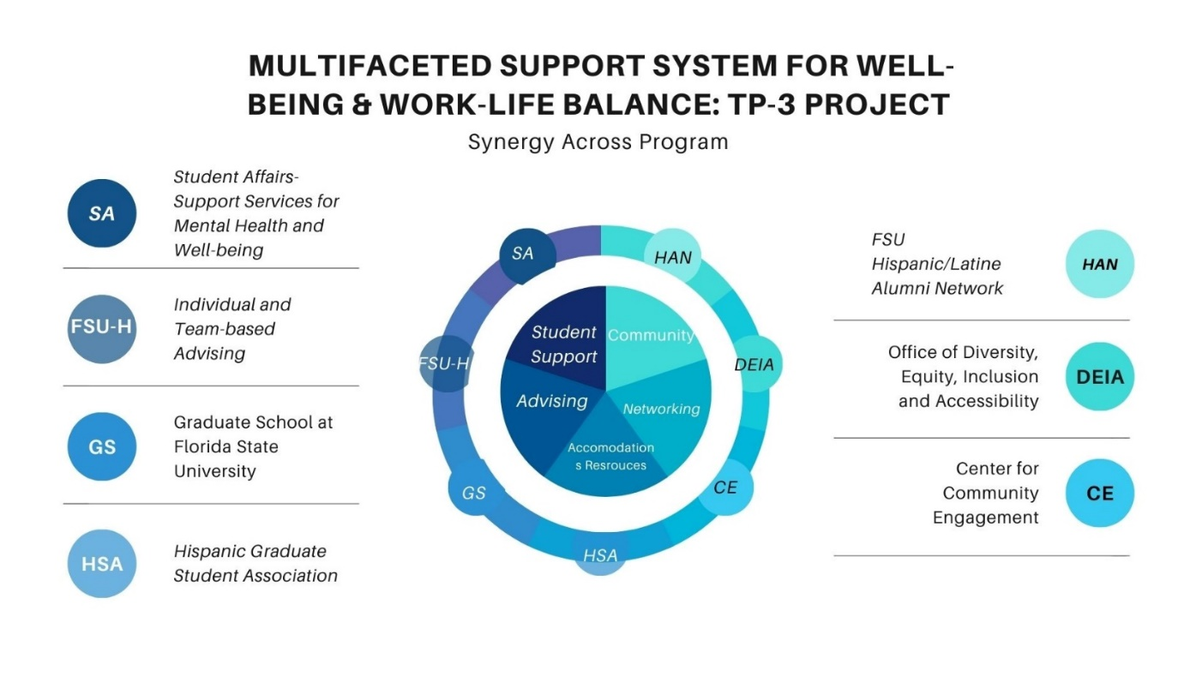
Multifaceted Support

Slide 38
Cross-Site Mentorship Support

Slide 39
Breakout Discussions
- 325D
- 325K
- 325M
- 325R
Notes:
Carlene

Slide 40
Breakout Activities (30 minutes)
Possible facilitation questions
What unique resources does your project provide to support scholars’ well-being?
How do you inform scholar candidates about available resources and funding?
How are scholars supported to access resources?
How do you customize/individualize scholar support based on individual scholar needs?
Any challenges in providing scholar support?
How can OSEP support your project?
Padlet: bit.ly/FY23meeting2
Notes:
Carlene
Each group summarizes challenges and innovations – can we use Padlet for this portion?

Slide 41
Report Out
Share the top three things your group discussed.
Notes:
Carlene

Slide 42
OSEP Updates
Important Reminders
Notes:
Tracie

Slide 43
Things to Remember
APR Due- May 3 (reporting period 10/1/2023- 2/29/2024)
APR support webinar- TBD, March
2024 OSEP combined Leadership and Project Directors’ Conference- August 6 - 8, 2024,
Notes:
Tracie

