Slide 1


Championing Special Educators: Strategies for Recruitment & Retention in Educator Preparation
Session 2 – Making Special Education Degree Affordable
Check-In Question: How did you fund your degree?

Slide 2
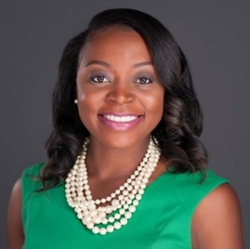
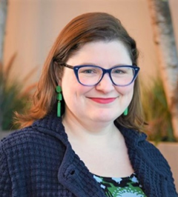
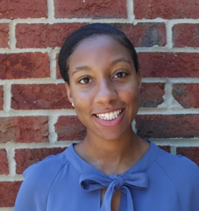

Introductions
Weadé James. Ph.D.
Vice President, Organizational Advancement
AACTE
Brooke Evans, M.A.
Assistant Director,
Research & Practice
AACTE
Sarah Haynes
Engagement Specialist,
AIR/CEEDAR
Notes:
Speaker - Sarah Start and pass over to Weadé and Brooke

Slide 3
Championing Special Educators:
Scope and Sequence
Tues, Oct. 31, 3-4 pm ET | Multiple Pathways Into the Profession
Thurs, Nov. 30, 3-4 pm ET | Making a Special Education Degree Affordable
Tues, Jan. 23, 3-4 pm ET | Clinical Practice Experiences
Thurs, Mar. 28, 3-4 pm ET | Special Education Candidate Wellness
Thurs, Apr. 25, 3-4 pm ET | Benefits of Special Education NIC
Thurs, May 2, 3-4 pm ET | Championing Special Education Through Advocacy
Notes:
Speaker - Weadé
You can register here: Championing Special Educators: Strategies for Recruitment & Retention in Educator Preparation | CEEDAR (ufl.edu)

Slide 4
Teacher Quality Partnership Program (TQP)
Authorized in Title II of the HEA, TQP is designed to strengthen and reform educator preparation at institutions of higher education, and prepare profession-ready teachers for high-need schools and high-need subject areas.
  Grantees are partnerships between IHEs, high-need districts, high-need schools and other eligible entities.
  Grantees are required to provide extensive-year long clinical preparation to candidates and must provide induction supports.
  Candidates are prepared to teach students with disabilities, English Language Learners and literacy strategies.
  Grantees are expected to maintain reforms after federal funding ends and must provide a 100% funding match.

Slide 5
Resource Overview
TQP Applicant Info & Resources
TEACH grants
Teacher Loan Forgiveness
Public Service Loan Forgiveness
Perkins Loan Cancellation
State-Sponsored Student Loan Forgiveness Programs

Slide 6
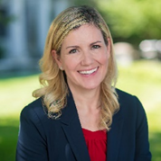
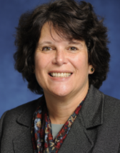
Example/Exemplar
Sarah Irvine Belson, Ph.D.
Professor
School of Education
American University
Carolyn Parker, Ph.D.
Director, Graduate Teacher Education
Acting Director of Academic Programs
School of Education
American University
Notes:
Speaker - Brooke will introduce speakers
Note - Sarah will send time reminders to speakers

Slide 7
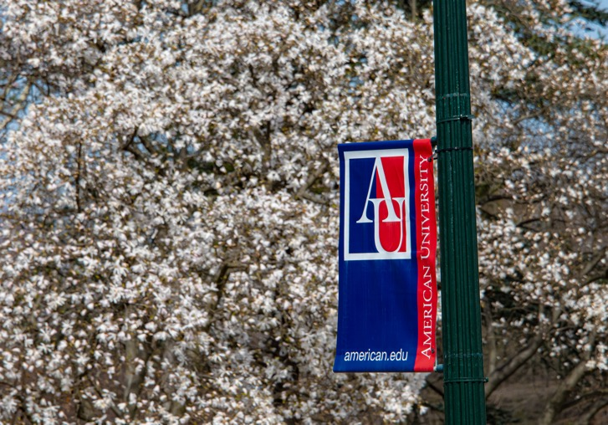
Making Teacher Education Affordable:
American University’s Residency for Excellence in Teaching and Learning (RETL) Project
Dr. Carolyn Parker, Director of Graduate teacher Education
Dr. Sarah Irvine Belson, Professor of Special Education

Slide 8
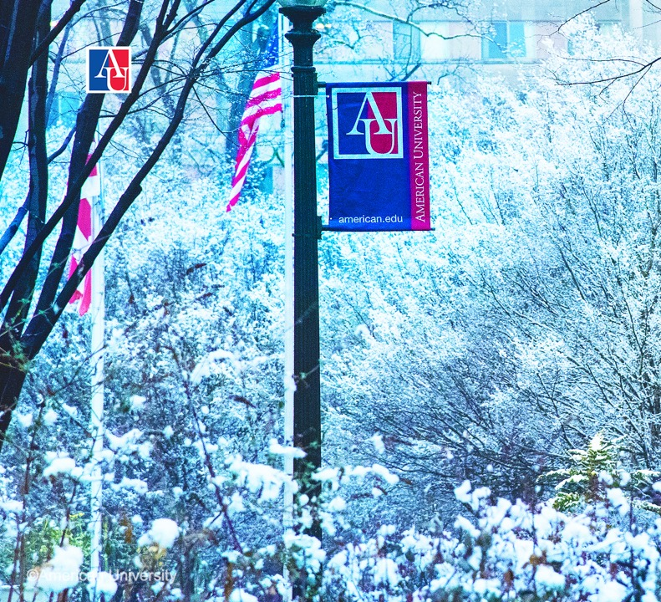
Agenda
American University’s School of Education Vision and Mission
The RETL Partnership
Leveraging our Commitments

Slide 9
on
American University’s School of Education
Programs
Programs mostly at the graduate level in Education Policy and Leadership, International Training and Development, Teacher Education, and Antiracist Supervision and Leadership
Teacher Education
  Undergraduate Degree in Elementary and Secondary Education with a minor in Special Education
  Master in Arts in Teaching and MA in Special Education and Learning Disabilities

Slide 10
on
American University’s School of Education
Vision and Mission
    Vision
    The mission of the School of Education is to create knowledge and prepare students to transform societies through education.
    Mission
    The School of Education aims to be locally, and globally recognized for making a meaningful impact in the field of education through innovative teaching, research, and service. Our impact will be achieved through rigorous scholarship; advocating for equitable and inclusive learning environments; advancing social justice; preparing effective educators; providing leadership in public-policy arenas and collaborating with local, national, and global communities and organizations.

Slide 11
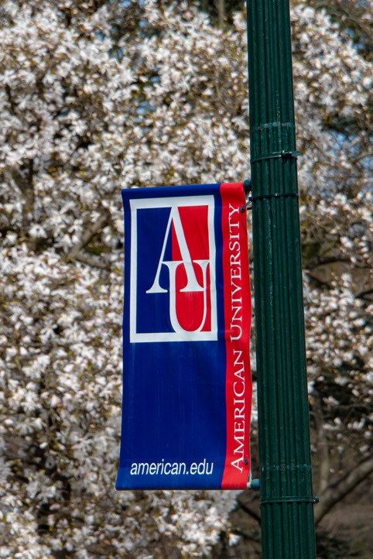
Leveraging Our Commitments to Increase Recruitment of Teacher Candidates
Ongoing Intentional Work in DEI/Community, Justice, and Equity, Inclusive of Faculty, Staff and Students
Teacher Pipeline Initiatives
Residencies and Fellowships
Dual Enrollment in Teacher Education
Child Development Partnership Program
High Impact Tutoring Programs
Notes:
Ongoing spaces for restoration, community building, personal center, equity analysis work
Translate this into ongoing pipeline programs
Representation matters – Ingersoll – TOC are more likely to be asked to engage in invisible labor. Not replaced in the teacher work force.

Slide 12

Residency for Excellence in Teaching and Learning (RETL): Partnership with Friendship Public Charter Schools
Focused on Paraprofessionals and Newly Recruited Residents
Special Education
  Early Literacy
  Language and Speech
Early Childhood
Teacher candidates will spend an academic year in a school under the direction of a master teacher

Slide 13
Residency for Excellence in Teaching and Learning (RETL): Partnership with Friendship Public Charter Schools (FPCS)
Reduced Tuition: $27,000 for Master’s Degree
  Graduate Teacher Education Programs Have Reduced Tuition Model Approved by AU’s Leadership
  Partnership Discount
  Generous and Flexible Financial Aid
      TEACH Grants
      Work Study Awarded for Teaching
  Generous Stipend with benefits from FPCS in the Residency Year
  Summer Teaching Stipend
  Pay Increase with Masters
  $10,500 of Tuition Assistance After Two Years of Employment to repay any remining loans or debt

Slide 14
Philosophy of the Partnership
Supporting the Ongoing Teacher Shortage
Practice --> Research --> Practice --> Research
Explicit Acknowledgement of Race, Class, and Power Dynamics, Unjust Systems
Notes:
Ongoing spaces for restoration, community building, personal center, equity analysis work
Translate this into ongoing pipeline programs
Representation matters – Ingersoll – TOC are more likely to be asked to engage in invisible labor. Not replaced in the teacher work force.

Slide 15
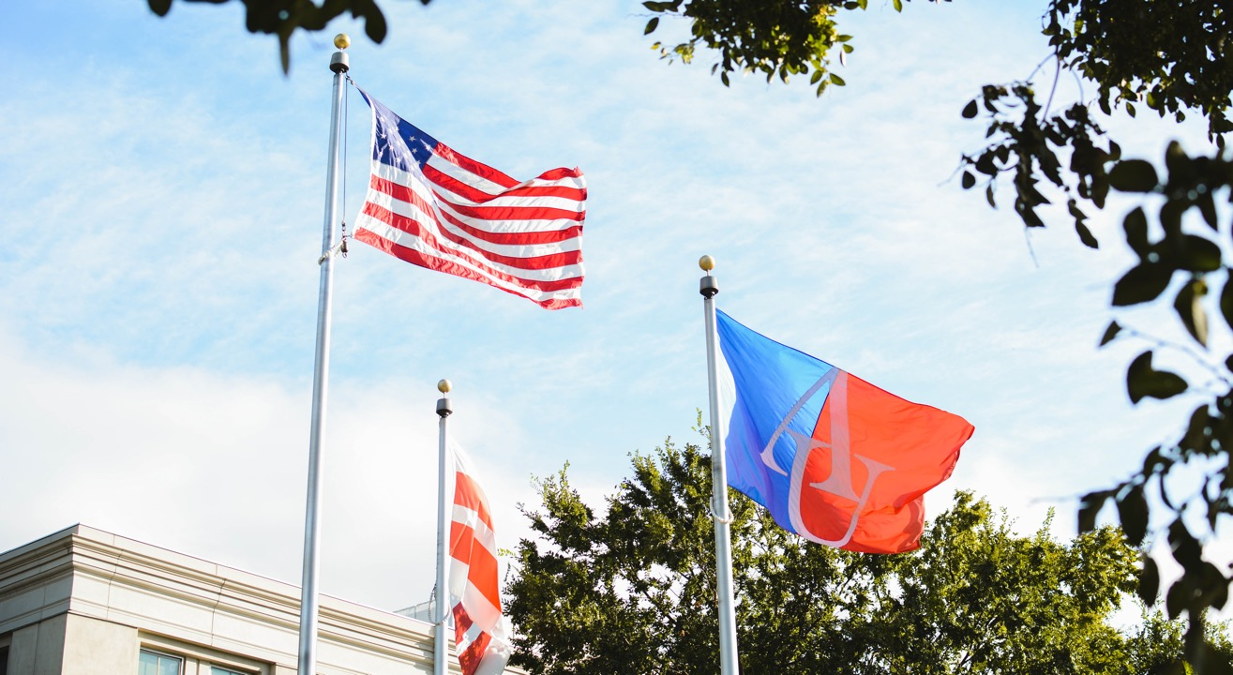


Slide 16
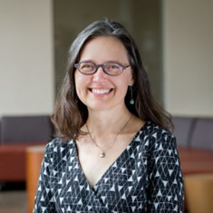
Example/Exemplar
Kimber L. Wilkerson, Ph.D.
Professor of Special Education
Department of Rehabilitation Psychology & Special Education
School of Education
University of Wisconsin-Madison
Notes:
Speaker - Weadé will introduce Kimber

Slide 17
University of Wisconsin-Madison Special Education
Teacher Residency Program
Kimber Wilkerson
Professor of Special Education
klwilkerson@wisc.edu

Slide 18
Challenges
Shortage of well-prepared special educators
Need for special educators in high-need districts and schools
Financial barriers
Attrition, especially among early career educators

Slide 19


UW-Madison TRP
Active and planful recruitment in collaboration with MPS
Full academic year residency in MPS
Generous living stipend of at least $46,500
Eligible for UW-Madison School of Education Wisconsin Teacher Pledge, which covers the cost of tuition
Master’s degree from UW-Madison
Three-year commitment to teach in MPS
Ongoing induction support for two years

Slide 20
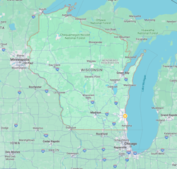
Recruitment
Partnering with MPS’s Senior Director of Talent Management, Michael C. Harris
UW-Madison Teacher Education Center Recruitment Coordinator, Anthony Baxter
Department of Rehabilitation Psychology & Special Education Student Services Coordinator, Kayla Armstrong
Use of Salesforce to share information internally
Communications technical assistance and outreach
Focus on MPS non-instructional employees, recent college graduates, and career changers in the Milwaukee community

Slide 21
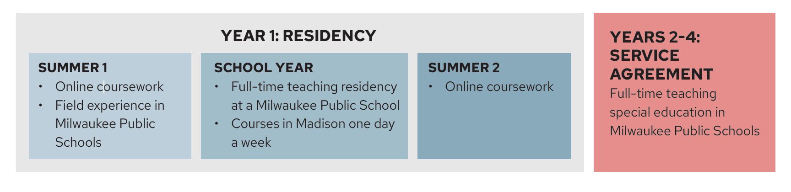
UW-Madison TRP
Recruitment of mentors – with an eye toward sustained relationships
Begin field experiences in first summer
Dedicated TRP liaison

Slide 22
Living Stipend
Funds provided through 2023 grant from the U.S. DoE, Teacher Quality Partnership program
$46,500 in Year 1 of grant
Set at the rate for emergency-certified teachers in MPS
Paid out through MPS over 12 months
Service agreement and expectations related to residency activities (field placements and coursework)

Slide 23

UW-Madison School of Education Wisconsin Teacher Pledge
No interest loan — provides up to the cost of in-state tuition plus testing and licensure fees annually for teacher education students
No payments — loans fully forgiven in exchange for teaching full-time in Wisconsin for three-to-four years

Slide 24

What the Student Pledges
Graduate from their teacher education program.
Get a teaching license from Wisconsin DPI.
Teach at least 75% full-time at a PK-12 Wisconsin school for three-to-four years within five years after graduation.
Verify employment annually via survey with Teacher Pledge Program Manager.

Slide 25

Who is Eligible?
Rising Juniors
Seniors
Graduate Students
Teacher Education Programs
Undergraduate
Art Education
Physical Education
Elementary Education
Special Education
Music Education
Graduate
Secondary Education
Special Education
World Language Education

Slide 26
How to Take the Teacher Pledge
No application – just complete FAFSA!
Enroll – if FAFSA is complete, after enrollment in classes student will receive a Teacher Pledge offer via email.
Three Steps – 1) sign the student agreement, 2) accept the loan, 3) complete the promissory note.

Slide 27
Post-graduation Induction Supports
TRP Liaison continues to act as a resource
Graduates continue to have an MPS mentor, paid by TRP
Ongoing virtual community of practice
Weeklong summer program for early career graduates: UW-Madison School of Education’s Early Career Teaching Institute

Slide 28
Continuous Improvement
Ongoing data collection related to all TRP project goals
Annual reports from an external evaluator
Annual advisory board convenings
Continuous learning from residents, mentors, faculty, principals, alumni – with high-level follow-up and advocacy

Slide 29
Questions?

Slide 30
Breakout Groups
What funding sources support your SpEd candidates?
Alternate ideas/current practices for providing funding for sped candidates?
Notes:
Padlet Link: https://padlet.com/shaynes47/making-a-special-education-degree-affordable-44cp74m8vumb0gnt

Slide 31
Thank You
Next Session
January 23rd, 3PM to 4PM ET
Notes:
Links: Championing Special Educators: Strategies for Recruitment & Retention in Educator Preparation-11.30.23 Meeting (google.com)

Slide 32
Disclaimer
This content was produced under U.S. Department of Education, Office of Special Education Programs, Award No. H325A220002. David Guardino serves as the project officer. The views expressed herein do not necessarily represent the positions or policies of the U.S. Department of Education. No official endorsement by the U.S. Department of Education of any product, commodity, service, or enterprise mentioned in this website is intended or should be inferred.

