Slide 1
Expect, Engage, Empower: Successful Transitions for All
Mary Morningstar
Deanne Unruh
Dawn Rowe
Notes:
Mary

Slide 2

National Technical Assistance Center on Transition: the Collaborative (NTACT:C)
NTACT:C is a Technical Assistance Center co-funded by the U.S. Department of Education’s Office of Special Education Programs (OSEP) and the Rehabilitation Services Administration (RSA).
Purpose: NTACT:C provides information, tools, and supports to assist multiple stakeholders in delivering effective services and instruction for secondary students and out of school youth with disabilities.
NTACT:C builds state agency capacity to:
Use data-driven decision-making processes
Strengthen interagency partnerships
Provide quality professional development
So that ALL students and youth with disabilities experience increased (a) Enrollment in postsecondary education, (b) Graduation, (c) Credential attainment, (d) Competitive integrated employment, and (e) Community engagement
Website: https://transitionta.org/
Notes:
Mary

Slide 3

New Initiative to Improve
Postsecondary Outcomes for Students with Disabilities
3 E: Expect, Engage, Empower
https://osepideasthatwork.org/federal-resources-stakeholders/topical-issues/expect-engage-and-empower-successful-transitions-all#:~:text=This%20initiative%20will%20challenge%20the,with%20disabilities%20and%20their%20families
Notes:
Mary – introducing Dawn
New Initiative To Improve Postsecondary Outcomes for Students With Disabilities
In support of Secretary Cardona’s mission to improve equity across our nation’s schools, OSEP Director Valerie Williams recently announced a new initiative to improve postsecondary outcomes for students with disabilities: Expect, Engage, and Empower: Successful Transitions for All! (May 2023).
The initiative is intended to support successful transitions for all, by beginning with the end in mind
High quality transition services – learn about it early and provide the array of sped interventions – access to general education, related services, experiences, communication, etc. and intensify transition services over time
Challenge students, families, practitioners to ensure they can meet the demands of adulthood
Inspire students, families and practitioners with opportunities to realize dreams for future
Collective action and collaboration, draw on that power

Slide 4

EXPECT
  Believe students with disabilities have potential to achieve their desired postsecondary goals & engage in meaningful community activities
  Ensure students with disabilities have equal access to educational and vocational opportunities & the supports and to participate fully.
  Support students and families to hold high expectations for the future, over the lifespan
Notes:
Dawn

Slide 5

EXPECT
  Expectations lead to parent motivation during transition planning (Hirano et al., 2016)
  Students are more likely to achieve outcomes when parents have high expectations (Carter et al., 2012; Chiang et al., 2012; Doren et al, 2012; Lipscomb et al., 2017; Papay & Bambara, 2013)
  Teachers who expect students to achieve are more likely to support positive outcomes (e.g., sense of belonging, improved academics achievement, motivation; Forian et al., 2012; Hattie, 2008)
Notes:
Dawn

Slide 6

ENGAGE
  Support students with disabilities to be active participants in planning their futures (across the lifespan).
  Collaborate with family members to ensure holistic approaches to planning aligning with student interests
  Work closely with agencies and organizations involved over time and especially during transition
Notes:
Dawn

Slide 7

ENGAGE
  Family engagement in education is a significant contributor to positive outcomes (e.g., attendance, behavior, academic performance; Newman, 2005)
  Parent engagement in education is a predictor of postschool employment, postsecondary education and community engagement (e.g., Carter et a;., 2012; Papay & Bambara, 2013)
Notes:
Dawn

Slide 8

EMPOWER
  Ensure practitioners have a toolbox of effective strategies for assessment, goal-setting, and instructional and curricular engagement.
  Create plans that address unique strengths, preferences, interests and supports of students
  Focus on annual learning and experience goals for students tied to postschool outcomes
  Systems must commit to professional development and support of evolving best practices and research leading to transition outcomes (predictors and practices).
Notes:
Dawn

Slide 9

EMPOWER
  Empowerment promotes autonomy, self-determination, and inclusion among individuals with disabilities (e.g., Farrington et al., 2012; Sparks, 2014)
  Empowerment leads to overall improved quality of life (e.g., better physical health, increased social participation, greater life satisfaction; Wehmeyer, 2020)
Notes:
Dawn

Slide 10


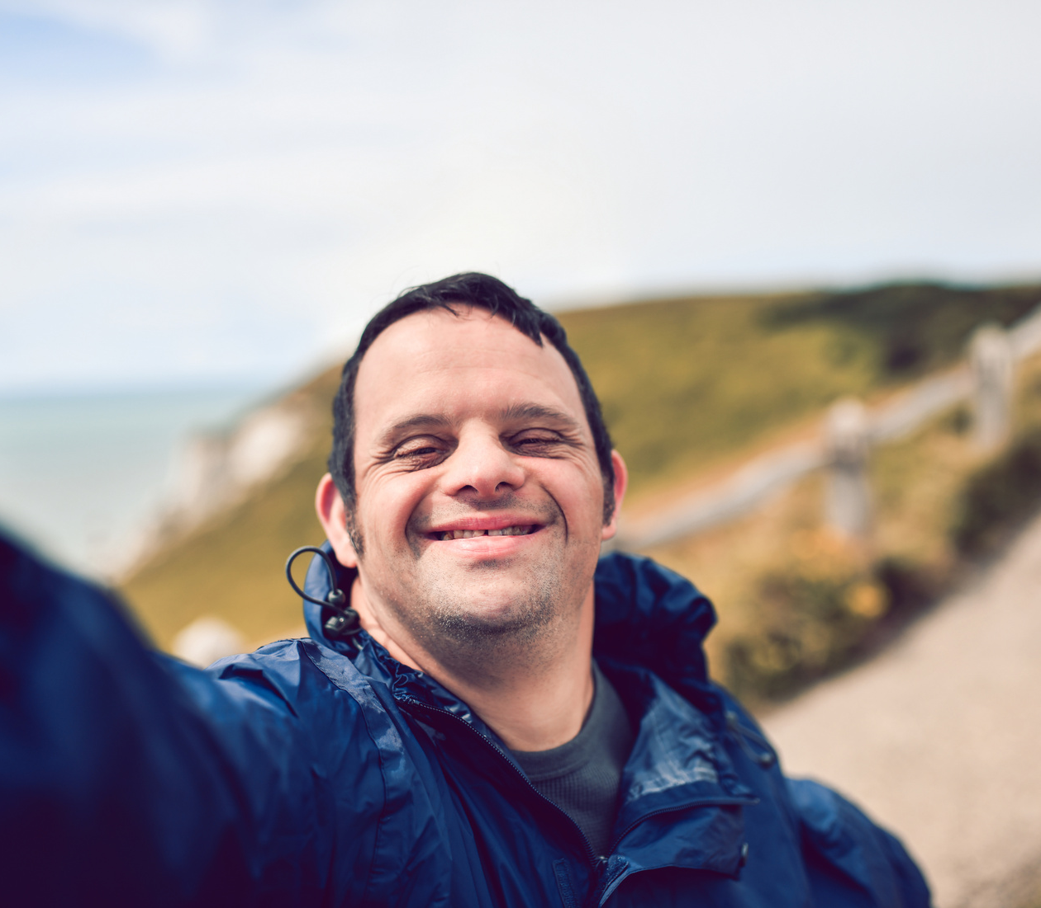
TOWARD SUCCESS FOR ALL
How do we Support Practitioners?
Expect
Engage
Empower
Notes:
Dawn - Transition to what we know about educator preparation Mary

Slide 11



Research Results from Perspectives of Practitioners Training Matters
Secondary Educators are Prepared to Plan but not Act
Are not Sufficiently Prepared with EBPP’s
Formal Training (EPP & PD) Matters the Most
Morningstar, M. E., & Benitez, D. T. (2013). Teacher training matters: The results of a multistate survey of secondary special educators regarding transition from school to adulthood. Teacher Education and Special Education, 36, 51–64.
Notes:
Mary
145 CAEP accredited EPPs
43 states + DC, PR
7 states have a transition credential (CT, DC, FL, IL, IN, NC, OH)
32% rural, 28% suburban, 41% urban
Grad level SPED faculty _ Program Directors/coordinators
30% faculty
Graduate K–12 special education 61 42.1
Undergraduate K–12 special education (initial/entry) 45 31
Blended elementary education and special education (undergraduate) 22 15.2
Blended early childhood education and special education (undergraduate) 2 1.4
Blended secondary education and special education (undergraduate) 2 1.4
General education credential + Special education minor leading to credential
(undergraduate) 2 1.4
General education credential (undergraduate) + Special education credential (graduate) 2 1.4
\
UNDERGRAD: Type of Special Education Program
%
Cross Categorical SPED
43%
High Incidence
44%
Low Incidence
19%
Early Childhood
24%
Other (All, Autism, Gifted, etc.)
3%
GRADUATE: Type of Special Education Program
%
Cross Categorical SPED
45%
High Incidence
39%
Low Incidence
26%
Early Childhood
21%
Other (Autism/BCBA, Generalist, ID, Literacy, LD)
16%

Slide 12

Educator Preparation Programs
How is Transition Being Taught
Less than Half (46%) reported a Stand-alone Transition Course
Most Prepared in Transition & Instructional Planning
Least Prepared in Implementing Transition Practices
Instructional Modalities were Mostly Didactic & Application was Limited
Notes:
Mary
Least Prepared:
Limited courses and sufficient depth of knowledge
Critical Role of faculty specializing in transition
Instructional Modalities
Infusing content across existing courses
Case studies using assessment data to develop PSGoals
Investigating how districts implement transition practices
Action planning and advocating for changes
Personnel Development is recognized as central strategy for systems change and improvement
Single transition course offers greater levels of preparation among program graduates
Lack of growth toward purposeful preparation of teachers over the past 15 years impacting transition
Focus on Transition Across the Lifespan
Embed Content throughout Instructional modalities
Build faculty expertise
Offer full courses

Slide 13
Evidence-Based Practices & Predictors to Support Post-School Success
Positive Post-School Outcomes
In-School Predictors of Post-School Success
Evidence-Based Practices
School, District, & State Level
Student Level
Notes:
Deanne

Slide 14

What Predicted Post-Secondary School Success?
23 Predictors organized alphabetically
EDUCATION
8 Research-based
EMPLOYMENT
1 Evidence-based
INDEPENDENT LIVING
3 Research-based
6 Promising
9 Promising
11 Research-based
10 Promising
A predictor was defined as an in-school experience, typically a program (e.g., a work-based learning experience) that correlated with improved post-school outcomes.
Notes:
Deanne
Definition: A predictor was defined as an in-school experience, typically a program (e.g., a work-based learning experience) that correlated with improved post-school outcomes.
Findings include 23 PREDICTORS organized alphabetically
Education: 8 research-based, 9 promising
Employment: 1 evidence-based, 11 research-based, 10 promising
Independent Living: 3 research-based, 6 promising

Slide 15
In-School Predictors of Post-School Success
X
X
Expect
X
X
Mazzotti, V. L., Rowe, D., Kwiatek, S., Voggt, A., Chang, W., Fowler, C. H., Poppen, M., Sinclair, J., & Test, D. W. (2021). Secondary transition predictors of post-school success: An update for the field. Career Development and Transition for Exceptional Individuals, 44(1), 47-64.
https://doi.org/10.1177/2165143420959793
Notes:
Deanne

Slide 16
In-School Predictors of Post-School Success
X
X
Engage
X
X
Mazzotti, V. L., Rowe, D., Kwiatek, S., Voggt, A., Chang, W., Fowler, C. H., Poppen, M., Sinclair, J., & Test, D. W. (2021). Secondary transition predictors of post-school success: An update for the field. Career Development and Transition for Exceptional Individuals, 44(1), 47-64.
https://doi.org/10.1177/2165143420959793
Notes:
Deanne

Slide 17
In-School Predictors of Post-School Success
X
Empower
X
X
X
Mazzotti, V. L., Rowe, D., Kwiatek, S., Voggt, A., Chang, W., Fowler, C. H., Poppen, M., Sinclair, J., & Test, D. W. (2021). Secondary transition predictors of post-school success: An update for the field. Career Development and Transition for Exceptional Individuals, 44(1), 47-64.
https://doi.org/10.1177/2165143420959793
Notes:
Deanne

Slide 18
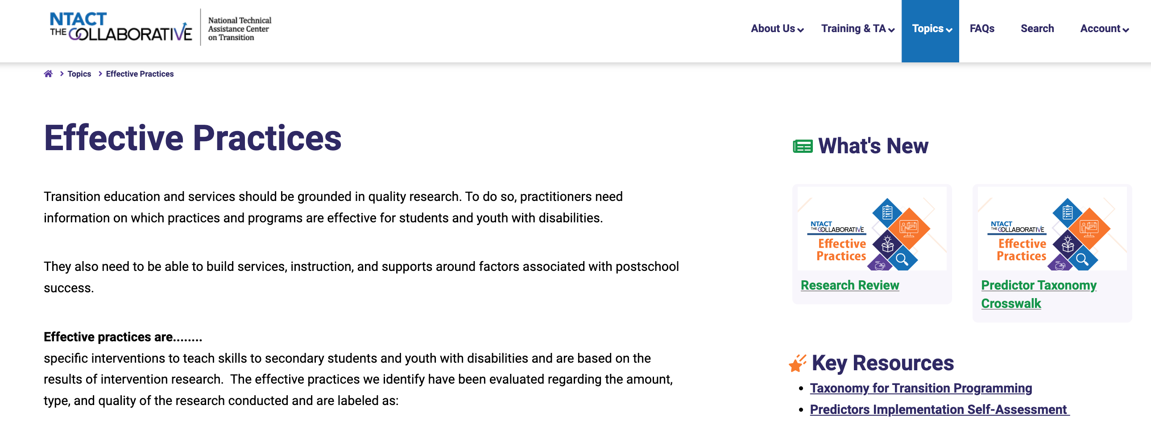
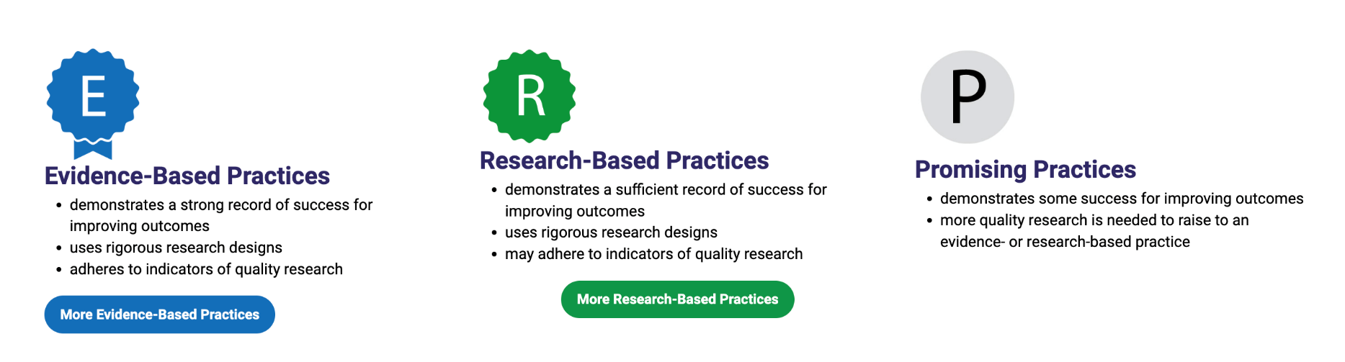
Evidence-Based & Research-Based Practices
Notes:
Deanne

Slide 19
Teaching about Planning & Assessment?
Evidence-Based Practices Resources
Transition Assessment: The BIG Picture Online Training Module – Transition Coalition (transitioncoalition.org)
From Assessment to Practice - NTACT:C (transitionta.org)
Transition Assessment Toolkit - NTACT:C (transitionta.org)
Envision IT (curricula & assessments for STEM skills)
Secondary Education Resources on NTACTC
Postsecondary Education Resources on NTACTC
Pre-Employment Transition Services Resources on NTACTC
Youth Engagement Resources on NTACTC
Notes:
Dawn

Slide 20
Teaching About Family Engagement?
Evidence-Based Practices Resources
Engaging with Families Training Module – Transition Coalition (transitioncoalition.org)
Parent and Family Involvement Annotated Bibliography - NTACT:C (transitionta.org)
Unpacking Assumptions: Equitable Approaches to Re-Engaging Students and Youth in VR Services (webinar)
Notes:
Dawn

Slide 21
Teaching about Collaboration?
Evidence-Based Practices Resources
Interagency Effective Practices (NTACT:C transitionta.org)
Guide for Teachers / Educators on Collaborating with Vocational Rehabilitation Services for Youth with Disabilities - NTACT:C (transitionta.org)
Interagency Collaboration online training module Transition Coalition (transitioncoalition.org)
Lesson Starters: CIRCLES (Communicating Interagency Relationships and Collaborative Linkages for Exceptional Students) (transitionta.org) more at: https://circles.charlotte.edu/
Webinar: Enhancing Collaboration with CTE (transitionta.org)
Notes:
Mary

Slide 22
Teaching Methods/Instructional Strategies?
Evidence-Based Practices Resources
Using Video Modeling for Learners with Autism
Person-centered Planning to Develop Future Expectations
Self-Determined Learning Model of Instruction
Whose Future is it Anyway + Rocket Reader
Student-Directed Transition Planning
Response Prompting to Teach Employment Skills
Go 4 It Now! To teaching Writing Skills
Mentoring to Teach STEM Skills
Self-Directed IEPs to Teach Student Involvement in IEP Meetings
WAGES (Working at Gaining Employment Skills)
Notes:
Mary

Slide 23


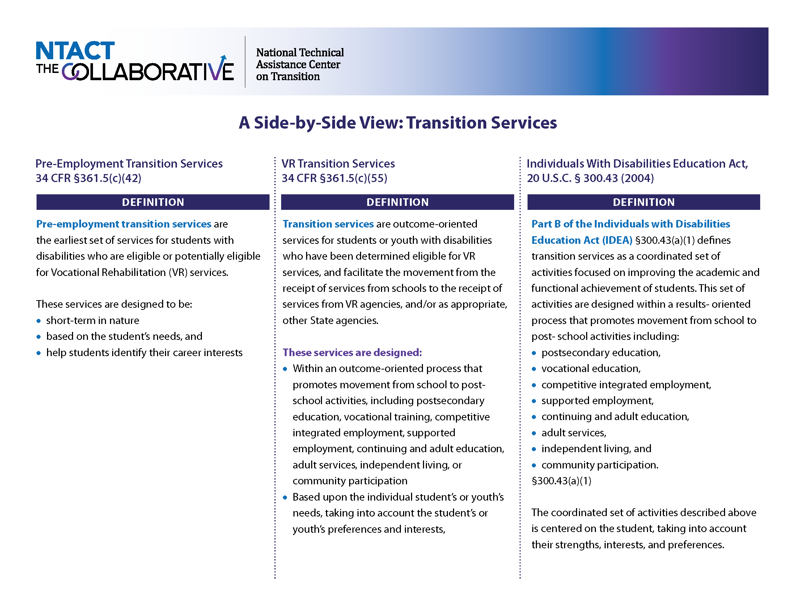
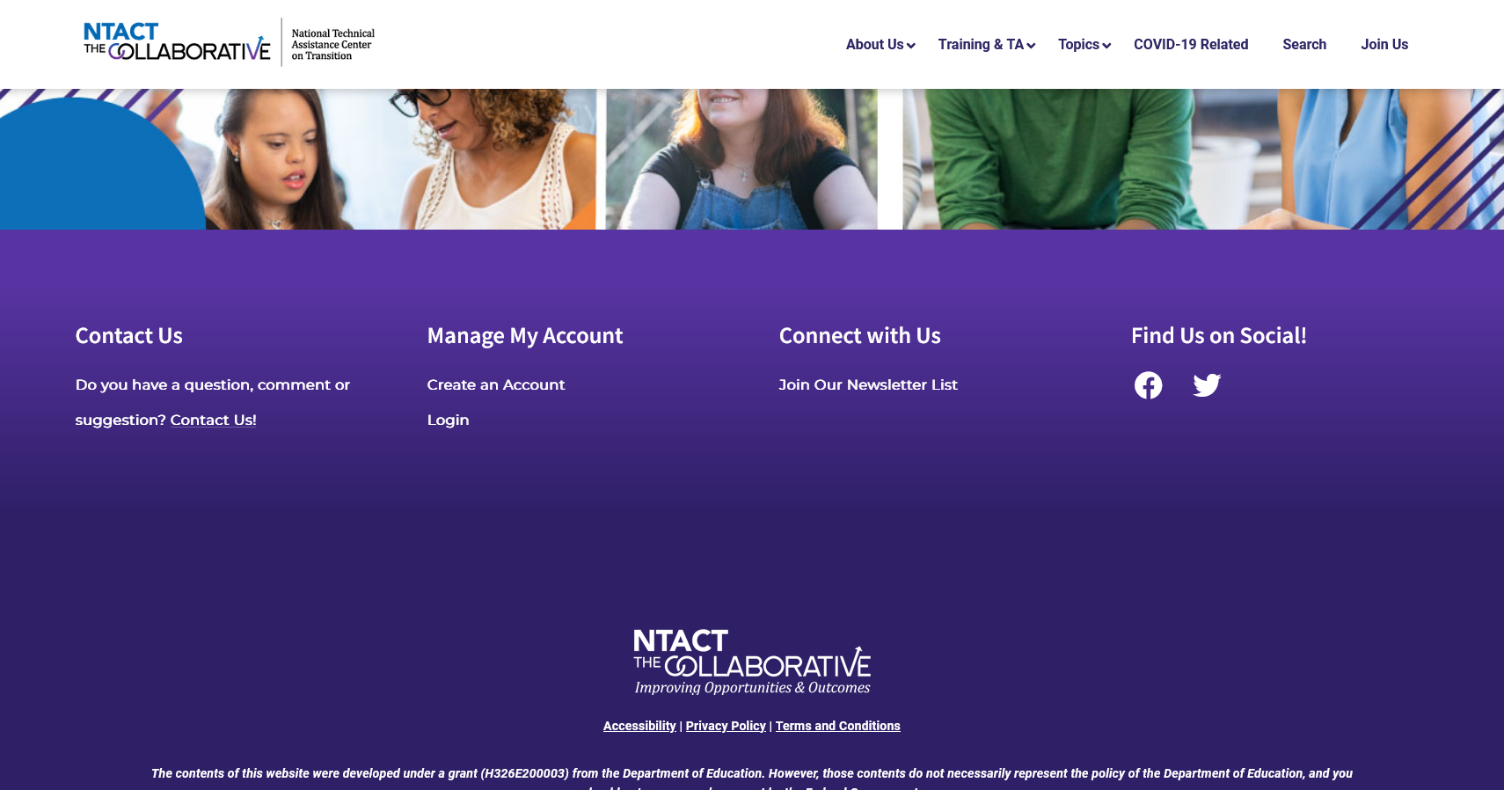
www.transitionta.org
Webinars
Transition Life Hacks
Online Modules
FAQs
Presenter guides, videos, checklists, toolkits, data resources, lesson starters…
Create a FREE account and personalize your dashboard of favorite resources
Notes:
Deanne

Slide 24

Professional Development for Individuals & Teams
Strategies, Tools, & Implementation
Resources & Materials for Educator Preparation
______________ ____ ____________________________________________________________________________________________________________________________________________________________________________________
www.transitioncoalition.org
Notes:
Mary
Professional Development for Individuals & Teams
Strategies, Tools, & Implementation
Resources & Materials for Educator Preparation

Slide 25
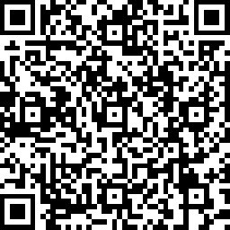
Contact Us
General email for NTACT: C ntact-collab@uncc.edu
Questions/requests-https://transitionta.org/contact/
Presenters:
  Mary Morningstar, mem28@pdx.edu
  Deanne Unruh, dkunruh@uoregon.edu
  Dawn Rowe, roweda@etsu.edu
Evaluation Link

