Slide 1
Preparing Teacher Candidates for Online and Hybrid Instruction
Teaching Methods and Curriculum Part 1
Dr. Sean J. Smith, PhD, CIDDL Center | Dr. Maya Israel, PhD, University of Florida |
Keane Alavi, CEEDAR Center | Rachel Silva, CEEDAR Center

Slide 2





Where are we now?
Emergency remote teaching responding to immediate crisis
Well-planned online
teaching & learning
Flexibility
Notes:
What does this mean for teacher education? What does this mean for methods course? practicum and student teaching? collaboration courses?

Slide 3
Implications for teacher education?
-Courses
-Practica
Executive Function
Supporting SWD in online contexts
Assessment
Engagement
Notes:
How do we think about supporting EF, engagement, and assessment/progress monitoring for students who are in online, hybrid environments

Slide 4
Structured Q & A

Slide 5
Question 1:
How do you plan instruction that does not require a family member to be present with the student during the learning day?

Slide 6



Leveraging the learning management system (LMS)?
Organization
Instructions
Accessibility tools
Linking to additional resources
**But we must model and check for student understanding & use
Notes:
We have the tools in the LMS but we also have to model how to use these tools and check to see whether students are using

Slide 7
Examples
Executive Function | Engagement
-Planning independent tasks -Time management -Sustained effort | -Attention and participation in synchronous & asynchronous activities -Collaboration

Slide 8

Acknowledge the Learning Coach
Empower parents/family members
Engage parents
Ensure the home can support/reinforce
Effective communication
....
Learning Coach 101

Slide 9

Communication - School - Home
Class Directions
Class Expectations
Strategy Applications - Student Empowerment
Tips & Strategies for the Home
Assessment - Determining Progress
Executive Functioning Skills
Social Emotional Supports

Slide 10


Teacher Dev - Impact
Explicit Directions
Step-by-Step Supports
Assignment/Instruction Expectations
How To Information
Instruction
Rinse & Repeat

Slide 11

Communicate - Class Instruction
Tips for Teaching with Video
Explicit Directions
Step-by-Step Supports
Assignment/Instruction Expectations
How To Information
Instruction
Rinse & Repeat
Top Tech Tools for Teachers
Best Screen Recorders - 2021
10 Ways to Use Video for Hybrid Instruction
Understood’s Video Tips
Inclusion through Innovation

Slide 12
Parent-Teacher Communication Tools
Best Family Communication Platforms - With Teachers
Teacher-Parent Communication Strategies
Best Classroom
Messaging Software
12 Ways to Use Social Media for Education
The Secret to Remote Learning Communication with Parents (Includes Podcast)
Webinar: Tips And Tricks For Communicating With Parents Remotely

Slide 13
Question 2:
How do you determine/measure student growth, understanding, and overall development when you don’t regularly meet with students f2f?

Slide 14

Formative Assessment - Online
Helps students identify their strengths - challenges…
Allows students to target areas for work…
Helps US identify when, where, & why students are struggling

Slide 15
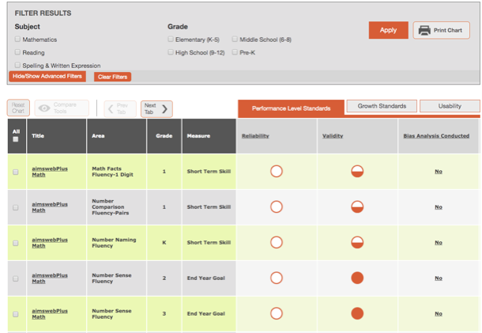
Progress Monitoring Tools
National Center on
Intensive Intervention
Academic Progress
Monitoring Tools Chart

Slide 16

Content Management Systems

Slide 17
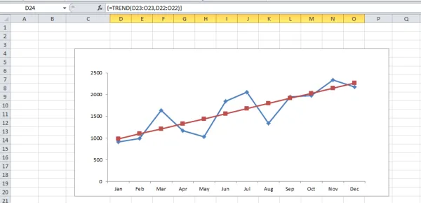
Graph Example
Notes:
When we are thinking of PM though we need that data for the trend line, comparison across time, aimline, class comparisons...

Slide 18
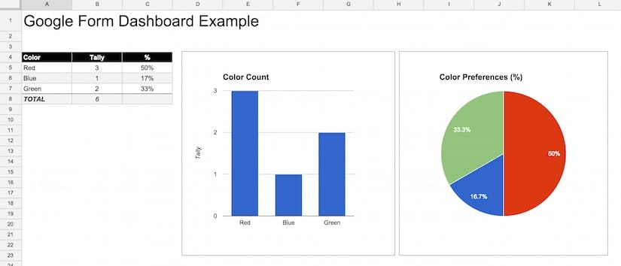
Google Form Dashboard Example

Slide 19
Formative Assessment Resources
Five Formative Assessment Strategies: Special Needs Students and Distance Learning
How-to: Adapt Formative Assessment for Distance Learning
Tips for Formative Assessment in Distance Learning
Tech Tools for Formative Assessment

Slide 20
Technology Tools for Online Assessment
75 Digital Tools and Apps for Online Formative Assessment
30 Of The Best Tools For Remote Teaching And Learning
10 Best Tech Tools for Student Assessment (with Video Explanations)
27 Formative Assessment Tools for Your Classroom

Slide 21

Low stake quizzes and polls
Quizlet
Socrative
Quizalize
Kahoot
Gimkit
Plickers
Flippity
Program for Inclusive Education (PIE)

Slide 22





Other tools to consider
Quizzes
Live Polling
Data Management
Automatic Scoring
Embedded Images, Media
Group students
Database of Quizzes - Questions

Slide 23
Disclaimer
This content was produced under U.S. Department of Education, Office of Special Education Programs, Award No. H325A220002. David Guardino serves as the project officer. The views expressed herein do not necessarily represent the positions or policies of the U.S. Department of Education. No official endorsement by the U.S. Department of Education of any product, commodity, service, or enterprise mentioned in this website is intended or should be inferred.

