Slide 1
Preparing Teacher Candidates for Online and Hybrid Instruction
Introduction
Dr. Sean J. Smith, PhD, CIDDL Center | Dr. Maya Israel, PhD, University of Florida |
Keane Alavi, CEEDAR Center | Rachel Silva, CEEDAR Center

Slide 2

WHAT IS CIDDL?

Slide 3
OUR PURPOSE
Is to engage with stakeholders interested in the preparation of personnel (e.g., preservice teachers) for the preK-12 hybrid or online classroom. Hope to discuss, learn, and address:
Issues related to such preparation and unpacking barriers.
Success stories
Tools, materials, and strategies to consider.
And so much more...

Slide 4
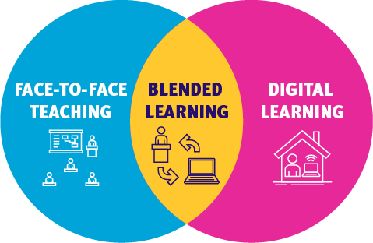
What do we Mean by:
Hybrid
Blended
Virtual
Online
Digital
Remote*

Slide 5

Characteristics of Online Learning:
Fully remote/distance
Personalized pathways for the learner
Digital content
….

Slide 6



How does this Translate to Teacher Preparation?

Slide 7

Voices from the Field
Marcia Riggins - 3rd Grade Educator
Lauren Elkin - HS Math & Physics
Voices from the field

Slide 8
Disclaimer
This content was produced under U.S. Department of Education, Office of Special Education Programs, Award No. H325A220002. David Guardino serves as the project officer. The views expressed herein do not necessarily represent the positions or policies of the U.S. Department of Education. No official endorsement by the U.S. Department of Education of any product, commodity, service, or enterprise mentioned in this website is intended or should be inferred.

