Slide 1
Preparing Teacher Candidates for Online and Hybrid Instruction
Collaboration with Families
Dr. Sean J. Smith, PhD, CIDDL Center | Dr. Maya Israel, PhD, University of Florida |
Keane Alavi, CEEDAR Center | Rachel Silva, CEEDAR Center

Slide 2

The Family

Slide 3

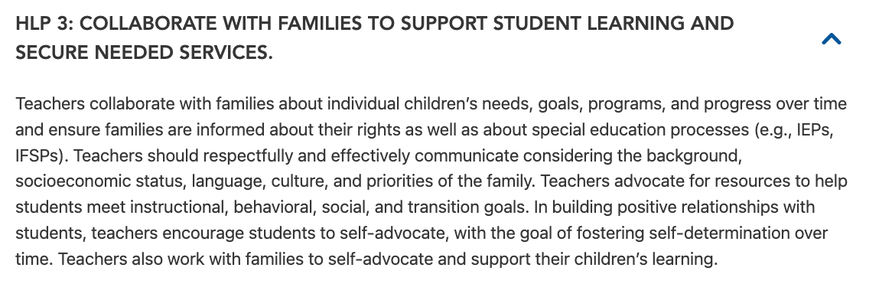
HLP 3

Slide 4


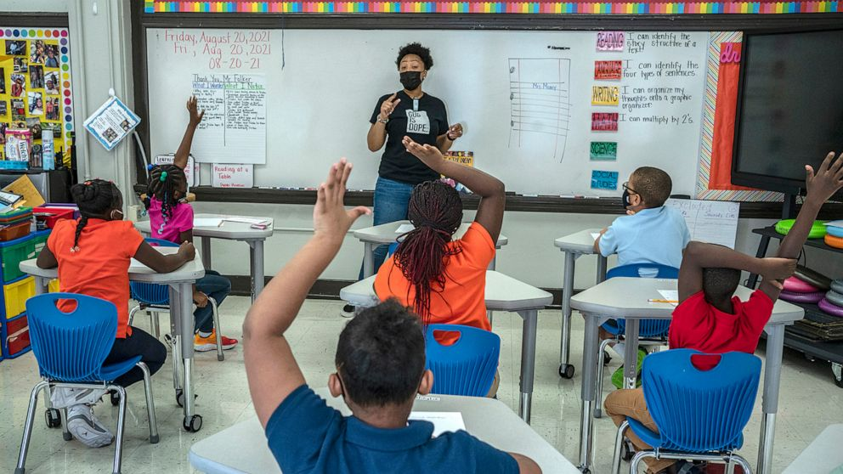
Collaborate - Learning Coach
“It Takes a Village to Raise a Child”
Pandemic - Resulted in Role Changes
Social Emotional Development
Executive Functioning Skills
Technologist
Master Communicator
What about the Parent/Family?

Slide 5

Learning Coach...
Empower parents/family members
Engage parents
Ensure the home can support/reinforce
Effective communication
....

Slide 6

Communicate - Teach Stakeholders
Strategies - In the Home
Strategies - Student Empowerment
Strategies - Engagement
Strategies - Social Emotional
Learning Coach 101

Slide 7

Why Communicate?
Direct/Support/Facilitate Instruction.
Support/Facilitate Learning.
Improve Learner Outcomes.
Engage and Empower (e.g., use of strategies).
Share Information, Resources, Knowledge, & More.
Problem solving.

Slide 8
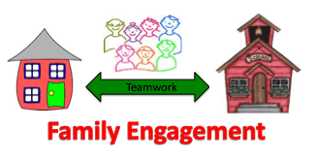
Why Communicate? Continued
Hybrid
Virtual
Periodic F2F disruptions
Reinforcement on School-based learning
Online - extended learning
Online - Catch Up - Drill & Practice
Digital learning is here to STAY

Slide 9

Supporting Families +
https://www.pealcexnter.org/
Designated State Parent Training Center
Personalized to the Needs of PA
Experts in Family Engagement
Identified and proven strategies, processes, etc.
Understood’s - How to Use PTIs

Slide 10

IEP Process
Use School’s Platform (LMS - Suite)
  Send Meeting Announcements
  Safe and Protected
  Shared Information - Connecting Tools
  It’s protected
  It’s familiar
Cloud-based apps - Microsoft Teams - Etc.

Slide 11
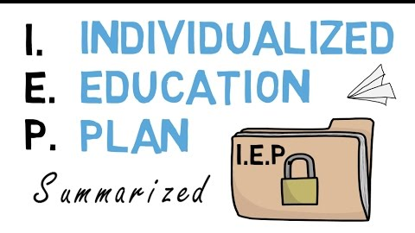
IEP Process Continued
2. Consider varied web-conferencing tools (video, phone, organizing emails and communication)
3. Synchronize calendars (Google Calendar, Doodle, Outlook, etc.)
4. Create a Digital Agenda (organize the meeting, keep folks on track and informed)
5. Use confidentiality features of tech (e.g., email functions)

Slide 12

IEP Process Continued
Maximize the power of Zoom
  Master the tech features
  Ensure accessibility
  Use the various features
  Be creative
  Be collaborative

Slide 13
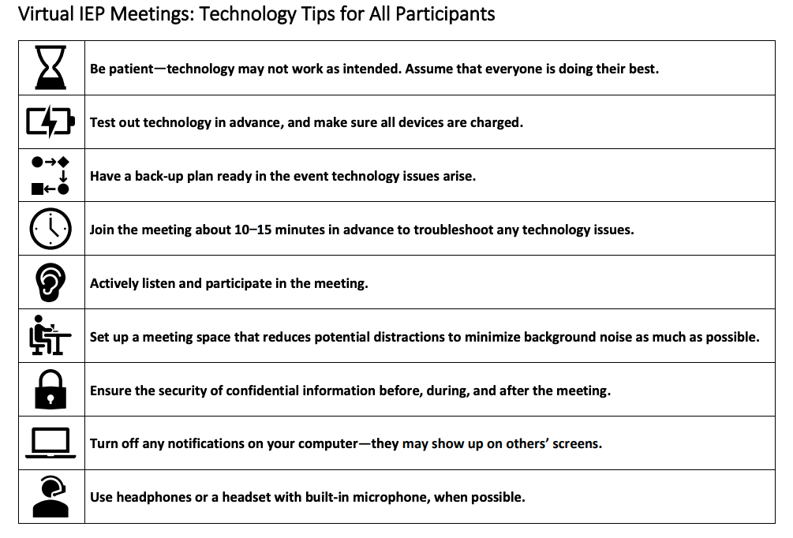
Have the Tech Work for You
WI’s Example

Slide 14
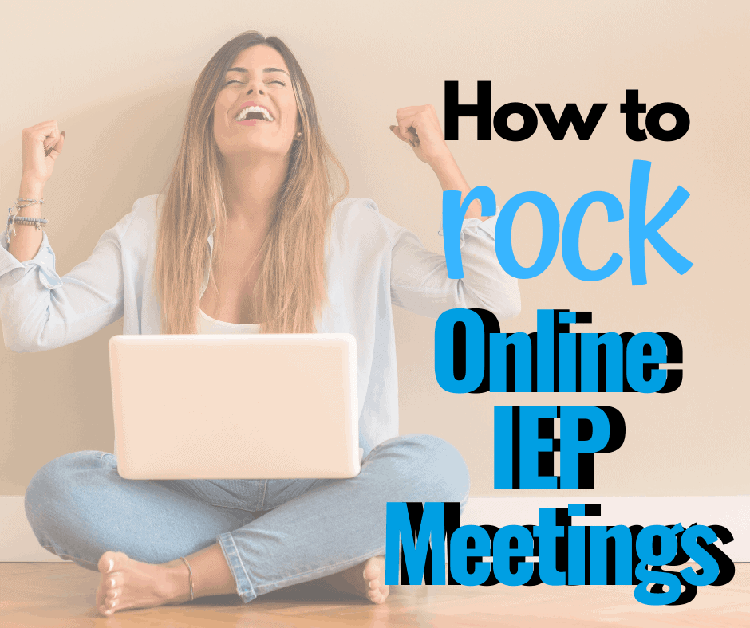
Virtual vs F2F - Future IEPs
Video Overview of Virtual IEP Tips - Special Education Teacher
Virtual IEP Meeting Suggestions - Tip Sheet
OSEP’s TIP Sheet
PATTAN’s Virtual Learning Resources
Podcast - How to Run a Virtual IEP Meeting

Slide 15

Communicate - Instruction +
Class Directions
Class Expectations
Strategy Applications - Student Empowerment
Tips & Strategies for the Home
Assessment - Determining Progress
Executive Functioning Skills
Social Emotional Supports

Slide 16


Communicate - Class Instruction
Explicit Directions
Step-by-Step Supports
Assignment/Instruction Expectations
How To Information
Instruction
Rinse & Repeat

Slide 17

Communicate - Class Instruction Continued
Explicit Directions
Step-by-Step Supports
Assignment/Instruction Expectations
How To Information
Instruction
Rinse & Repeat
Tips for Teaching with Video
Top Tech Tools for Teachers
Best Screen Recorders - 2021
10 Ways to Use Video for Hybrid Instruction
Understood’s Video Tips

Slide 18
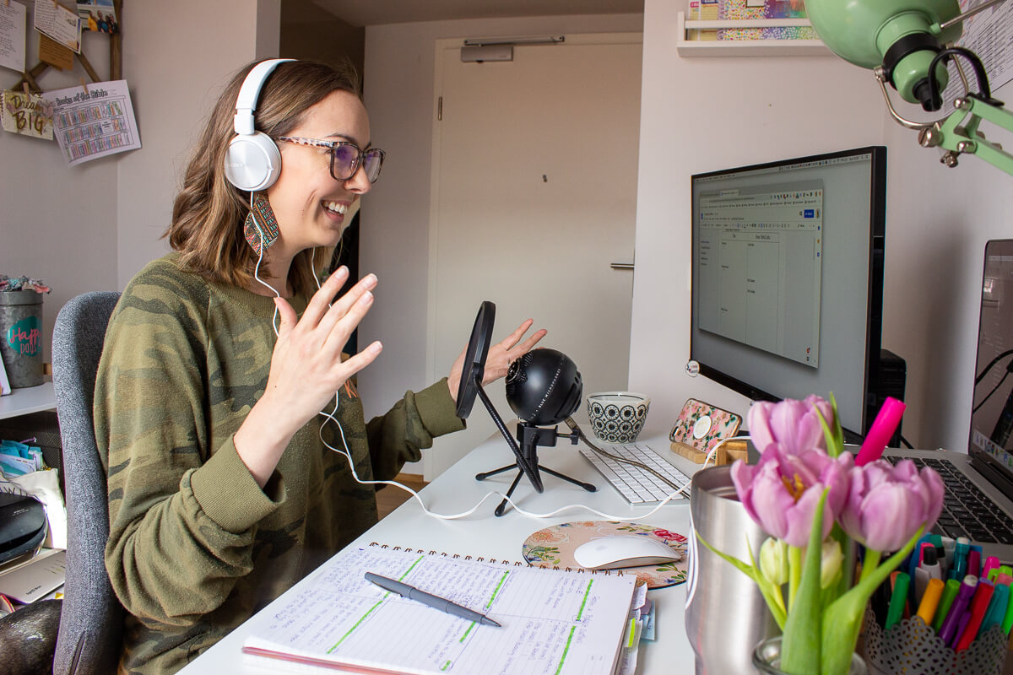
Communicate - Tech we will Use
Audio - Podcast & More
  Step-by-Step Guide
  Podcasts for Instruction
Video Modeling
  Step-by-Step Guides
  Video Modeling 101

Slide 19





Communicate - Podcasts for Teachers

Slide 20
Parent-Teacher Communication Tools
Best Family Communication Platforms - With Teachers
Teacher-Parent Communication Strategies
Best Classroom
Messaging Software
12 Ways to Use Social Media for Education
The Secret to Remote Learning Communication with Parents (Includes Podcast)
Webinar: Tips And Tricks For Communicating With Parents Remotely
Notes:
Bridgette find 2 more resources similar to what I have here..
Tools teachers can use to connect with families and parents

Slide 21
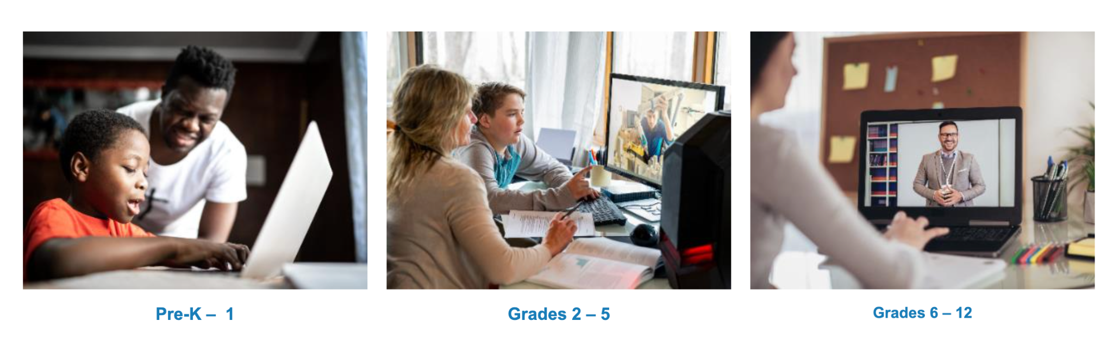

Resource Highlight: Parent University
Parent University: Created by Broward County Public Schools (FL) to help parents with transitioning to remote learning
Includes pre-recorded webinars and slide presentations for e-Learning strategies and best practices for parents, categorized by grade level
Closed captioning for the webinars is available in Spanish, Portuguese, Haitian-Creole, Arabic, Chinese and Vietnamese
Notes:
Bridget could u make this slide pretty
Add a link to Parent University
Find more school based guides that have been created by school districts to further engage and support parent-school interaction
Processes
toolkits

Slide 22
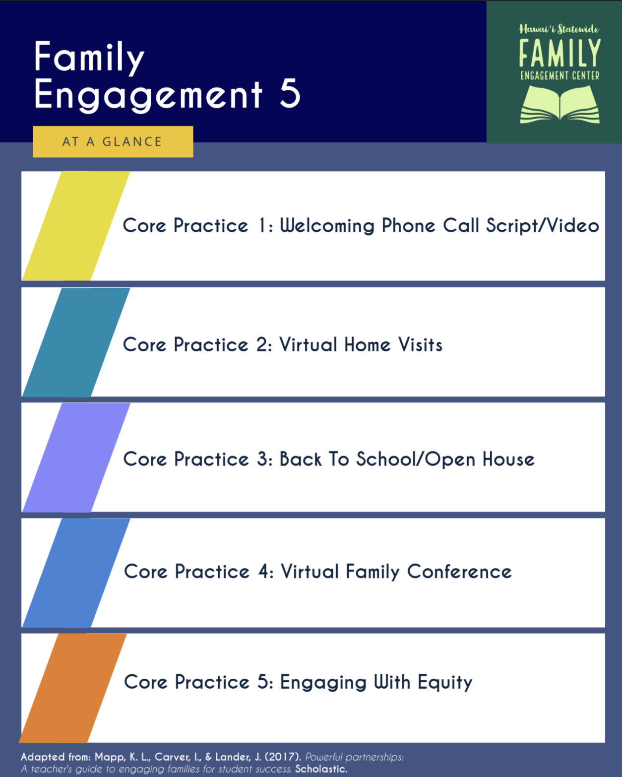
Resource Highlight: Remote Parent Engagement Strategies
Hawai'i Statewide Family Engagement Center: 5 Remote Family Engagement Strategies (Tips, Examples, and Step-By-Step Guides)
Online Tools for Parent Engagement: Resources from Education World, Edutopia, and Common Sense Education,
Creating Virtual Parent-Teacher Events: Resources from ParentSquare and Albert
Notes:
Bridget could u find other resources that suggest tools for parent and school communicate that

Slide 23












Parent-Teacher Communication Tools
Virtual Meeting Platforms
Social Media: Create Classroom Accounts/Pages
Direct, Individual Communication
Create Newsletters/Virtual Handouts

Slide 24
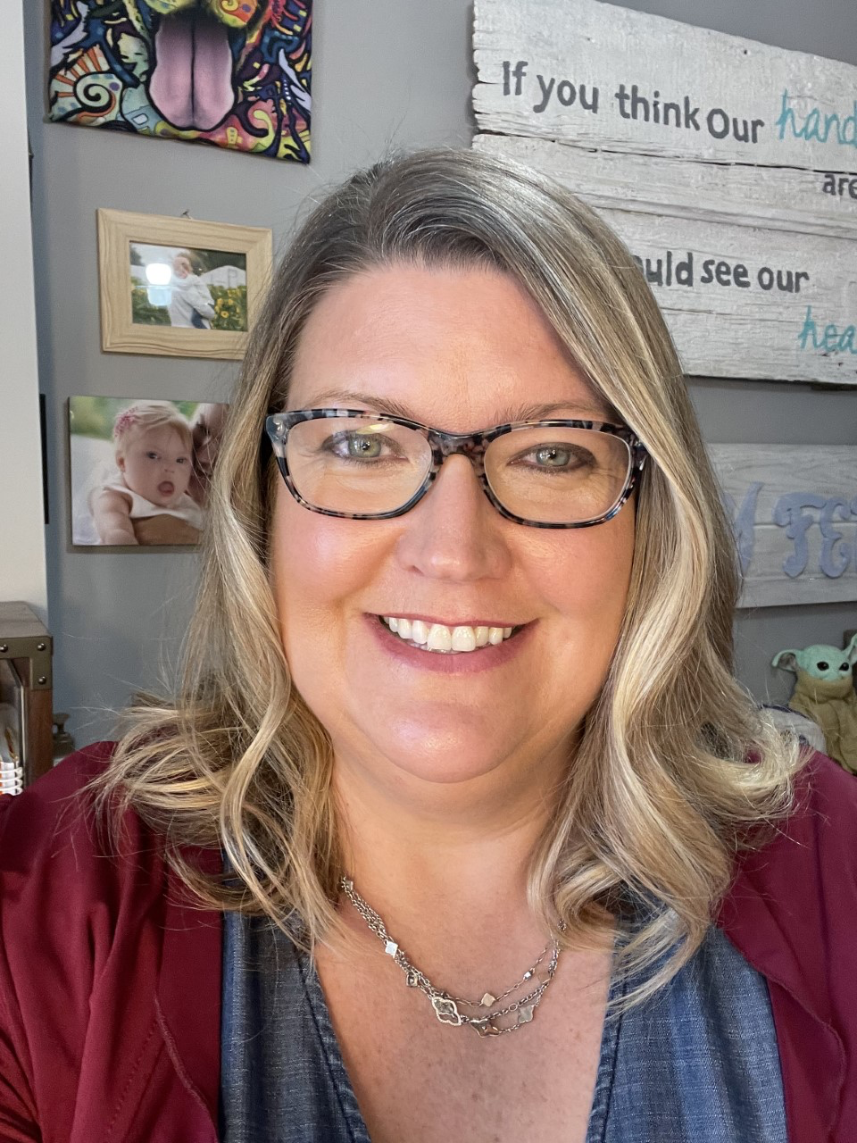
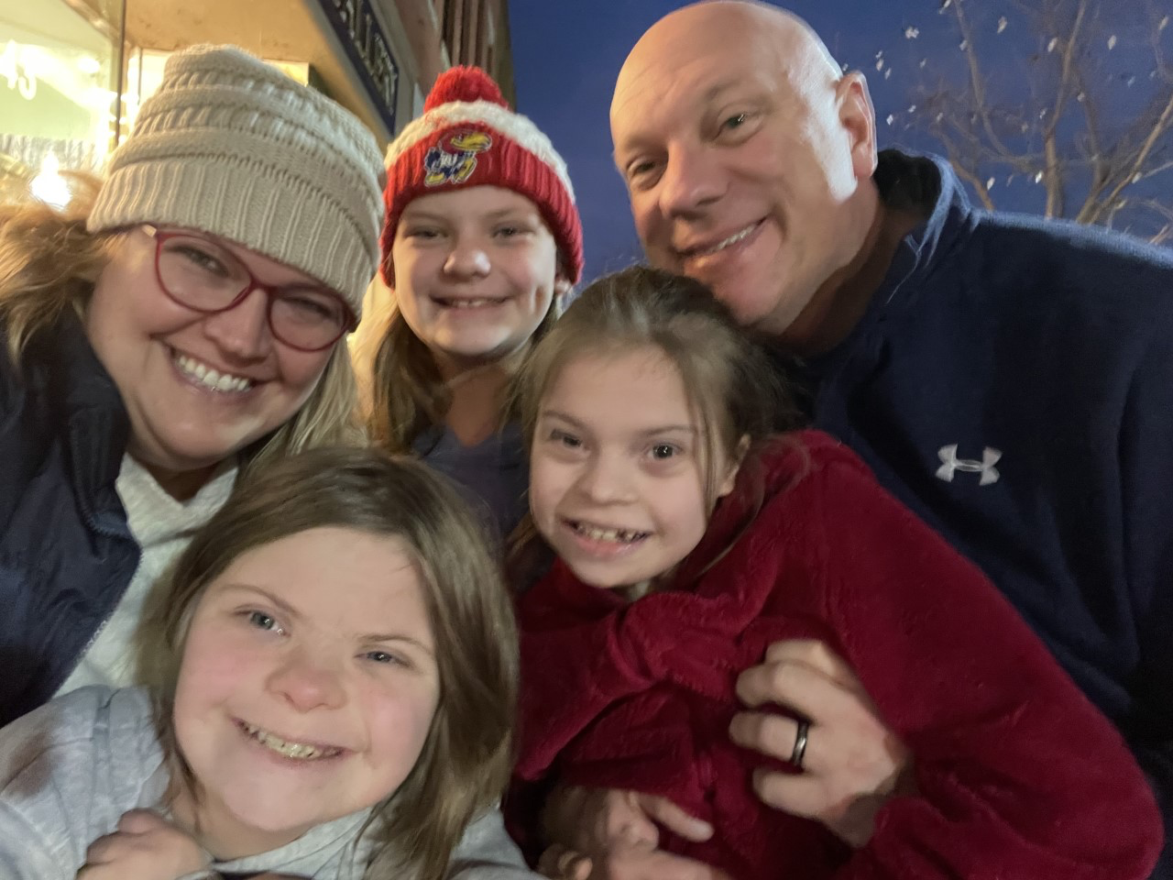
The Parent Perspective:
Jill Reffett

Slide 25
Disclaimer
This content was produced under U.S. Department of Education, Office of Special Education Programs, Award No. H325A220002. David Guardino serves as the project officer. The views expressed herein do not necessarily represent the positions or policies of the U.S. Department of Education. No official endorsement by the U.S. Department of Education of any product, commodity, service, or enterprise mentioned in this website is intended or should be inferred.

