Slide 1
Planting seeds to support scale-up: Implementing mini-grant competitions in Kentucky and Tennessee.
CEEDAR Convening 2023

Slide 2
Scan QR code
to share your ideas

Slide 3
Kentucky
Task 1: Hold mini-grant competition for IHEs to embed HLPs, EBPs, practice-based opportunities or inclusive leadership.

Slide 4
Mini-Grant Awardees
12 projects across 8 Universities/Colleges
Responsibilities/Requirements
Participate in 2-3 check-ins w/KEEP State Leadership Team
Provide evidence of reform
Present on project findings & lessons learned at the 2023 KEEP Summit

Slide 5
Mini-Grant Goals
Goal 1: Embed HLPs, EBPs and inclusive leadership practices in principal preparation programs
Goal 2: Provide opportunities for general education programs to embed MTSS and HLPs in programs
Goal 3: Develop partnerships among IHEs and districts or learning cooperatives to provide more practice-based opportunities (PBO) using HLPs and EBPs
Goal 4: Promote collaboration between special education and general education programs to investigate MTSS and address differentiation in lesson planning and delivery of instruction by using HLPs
Goal 5: Integrate technology within evidence-based practices in the HLPs in special education and general education programs

Slide 6
Institution | Project | Goal
Alice Lloyd College | Preparing Pre-service Teachers to Teach Science in an Inclusive Manner | 3, 4
Bellarmine University | Embedding HLPs in Programs: Administering Universal Screeners | 2
Campbellsville University | Embedding Second-Steps in Teacher Preparation to Address HLP & SEL | 2
Eastern Kentucky University | Using Adaptations in Early Childhood Classrooms | 1-5
Eastern Kentucky University | Integrating Assistive Technology Across EPPs | 5
Murray State University | Increasing PBO’s for 2nd Year Preservice Teachers by Providing Evidence-Based Strategies In A High Need School District | 3
Murray State University | Embedding Technology/HLPs Across Special Education Curriculum | 5
University of Kentucky | Course Revision to Embed HLPs & PBO’s | 4
University of Kentucky | Designing and Implementing Differentiated Lesson Plans Focusing on HLPs and CRT | 4
Western Kentucky University | Bringing HLPs to the Teacher Education Program: Revising the Undergraduate Special Education Curriculum | 4
Western Kentucky University | Embedding HLPs In Principal Preparation Programs | 1

Slide 7
Georgetown College

Slide 8
Western Kentucky University

Slide 9
Western Kentucky University

Slide 10
Tennessee CEEDAR

Slide 11
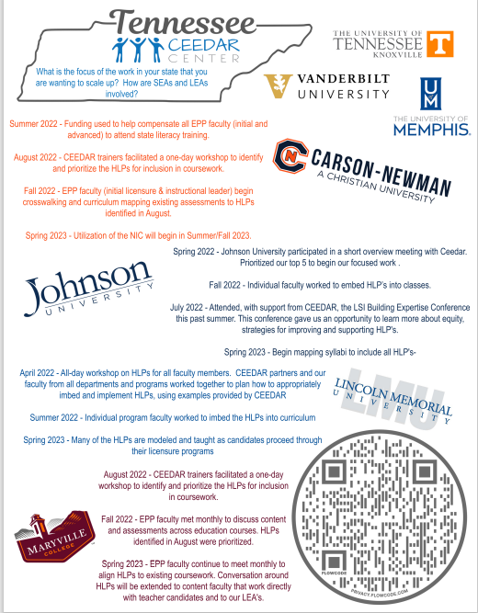

Slide 12
Small Group Breakouts
What does this mean for your work?
How might this affect your work?
What more do you need to know or further explore?
What are some of our strengths and weaknesses – how do they help or hinder us with this situation?
What are the next steps – who will do what by when?

Slide 13
Wrap-Up
What is important to share with my team that helps my context, lessons learned, or things to avoid?
Who should I connect with later? When and what should I follow up?

