Slide 1
Making High Leverage Practices a High Priority: Georgia’s Approach to Scaling Up

Slide 2
Presenters
Meg Kamman: University of Florida & CEEDAR
Kate Zimmer & Melissa Driver: Kennesaw State University
DaShaunda Patterson: Georgia State University

Slide 3
Today
CEEDAR and GA context
Embedding HLPs in coursework and practice opportunities
HLPs as part of the statewide plan for scaling up
Strategies for engaging district partners in professional development
Conversation about HLPs in different contexts

Slide 4
GA- CEEDAR
Applied for Technical Assistance in 2014
Accomplishments in teacher/leader preparation reform, preparation program evaluation and licensure.
New goals added to include HLPs as part of statewide scaleup!

Slide 5
Current Partnership
CEEDAR CENTER
Georgia Department of Education
Georgia Professional Standards Commission
The University System of Georgia
Columbus State University (CSU)
Georgia State University (GSU)
Kennesaw State University (KSU)

Slide 6
PBIS
P-20 Collaboratives
APR
SIMR
HLP
ESSA Plan
CEEDAR
SSIP
MTSS

Slide 7
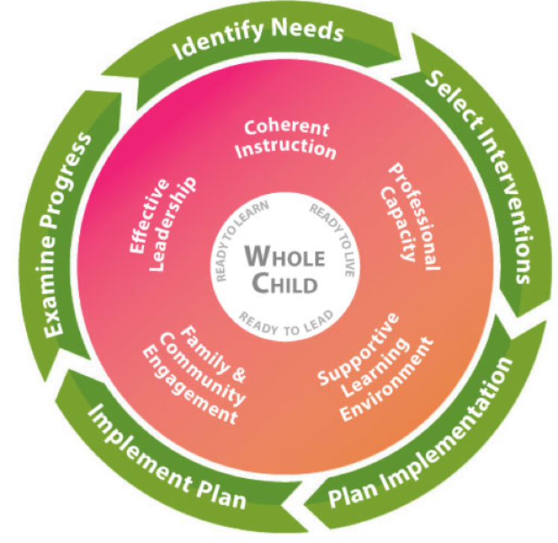
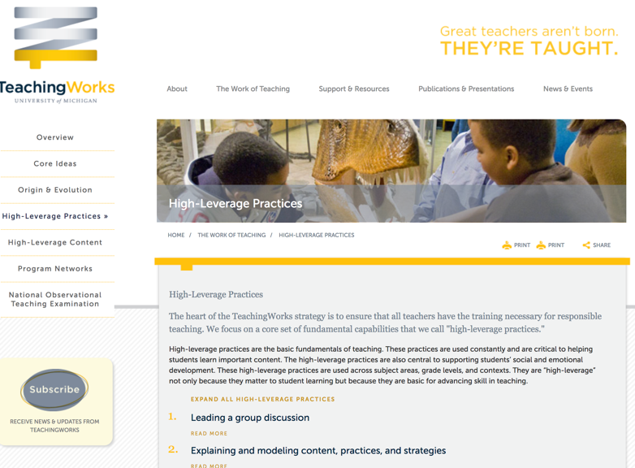
High Leverage Practices

Slide 9
KSU example
Notes:
Melissa –
At Kennesaw State, our focus on HLPs originated through a deep dive analysis of course syllabi through the NIC. Program faculty input course syllabi and assessed how essential knowledge, skills, and understandings were embedded throughout. This first step led to reflective conversations and some course and program revisions. While these conversations continue, one common thread that emerged was the the need to provide purposeful practice for candidates while engaging in coursework and before the application in the field.
Through this process we also found that work on HLPs was siloed in individual faculty members research and teaching. This became abundantly clear through our support courses, which is the course sequence all general education candidates take to learn about teaching students with disabilities. We believe in the importance of authentic collaboration and having a common language for understanding across our EPP to best prepare our candidates to support all learners. Through conversations with our administration and CEEDAR leadership we designed a series of professional learning workshops to scale up HLP understanding and implementation across our university. These workshops began with a kick-off session offered as part of an all day mandatory professional learning day for all preparation programs. We were invited to share how we address and provide practice on HLPs using mixed reality simulation as part of our Project AVATAR lab at Kennesaw State. We felt this was a good place to start, given it guaranteed a touch point and facetime with all faculty to drum up interest. After this kick off session, we offered three follow up sessions to guide faculty thinking on what HLPs are, how they are relevant for their particular content, and an analysis of how HLPs are introduced, practiced, and applied in the field. The focus of the last two sessions really narrowed in on this practice piece, especially practice before working with real live students.

Slide 10
Notes:
Melissa In these workshops we shared examples of how we teach and provide purposeful practice for several HLPs.
Kate - One of the 1st things we talk about with our teacher candidates is creating a welcoming environment and building respectful relationships. Throughout our program we stress to our teacher candidates that they must actively learn about their particular students in order to design instruction that will meet their needs. Programmatically we purposefully embed and model culturally responsive teaching & pedagogy. Furthermore, we explicitly align these conversations and activities with numerous general and special education HLPs.
Melissa – We also discussed how we teach assessment, in particular data collection, progress monitoring, and data-based individualized, to our students through hypothetical case studies for academic skills and mixed reality simulations for behavior to develop aligned interventions for all levels of MTSS. We have found that this middle step has a meaningful impact on our candidates skill and confidence to go out and collect and use data in meaningful ways during their culminating field based assignments.
Kate - Once our teacher candidates have been introduced and practice those skill sets within that course, we build upon them in the next semester within our behavior course. Student expand on those previously learned HLPs and are then introduced to HLPs that have a behavior focus. We highlight these practices and strategies through our Key Assignment called the Behavior Intervention Plan. You can see how we were purposeful introduced, practice, and build upon HLPs throughout our program.
Melissa – We also use our Project AVATAR lab to embed mixed reality simulations into our classes. This allows students to design evidence-based instruction after learning about HLPs, receive instructor feedback on their lesson plans, teach their lesson in a realistic environment that does not involve actual students, and debrief the overall experience with an instructor and/or their peers.

Slide 11
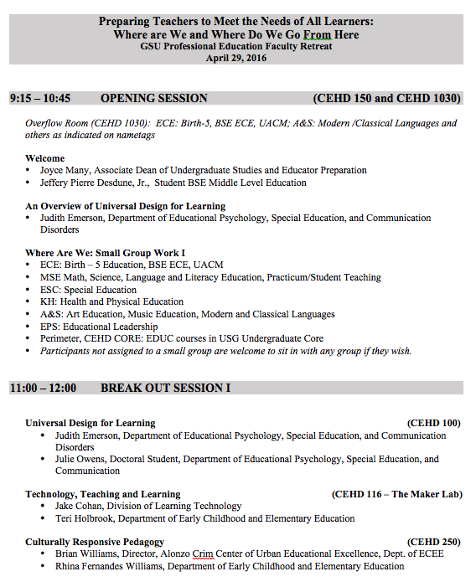
GSU example
Notes:
Day

Slide 12
01
Deans and Chairs recognized value in work
Resources were allocated to support the work
Opportunities were created to sustain efforts
Achieved buy in from Key Stakeholders
02
Professional Education Faculty Retreat
Monthly Faculty Professional Development
Regular sharing of work in formal and informal spaces
Engaged GSU Faculty and LEA partners simultaneously
03
Program leads submitted areas of internally identified needs
Program improvement and development areas were aligned
Documenting changes in program
Established relevance of the efforts to individual programs

Slide 13
Thoughts ?
Notes:
Pam- What thoughts or questions do you have regarding KSU’s and GA State’s implementation of HLPs? Our colleagues are happy to answer your questions or respond to your thoughts.

Slide 14
Scaling Up
HLP Blueprint Goals
Develop and implement a professional development series across general education, special education, and school leadership at SEA, IHE and LEA to:
develop a common understanding of High Leverage Practices
increase opportunities for pre-/in-service teachers to learn and practice strategies for implementing high leverage practices in P-20 settings
embed HLPs in EPP coursework and practice opportunities
in-service teachers implement HLPs in instruction
Notes:
Kate: On this screen we are highlighting our HLP Goal. As we have stated before, CEEDAR provides the opportunity to share the wonderful working going on cross IHEs, SEAs, and LEAs. So when we take a look at our CEEDAR Georgia blueprint, you can see how the current work and initiatives that are going on in the states aligns with our blueprint goals- we are always trying to work smarter and not harder.
Together we decided that we wanted to: develop a common understanding of High Leverage Practices; increase opportunities for pre-/in-service teachers to learn and practice strategies for implementing high leverage practices in P-20 settings; embed HLPs in EPP coursework and practice opportunities; in-service teachers implement HLPs in their instruction

Slide 15
HLP Plans

Slide 16
Phase I: Prep Work & Plan
Goals for this phase:
Create HLP & MTSS Summit Agenda
Identify speakers
Local and national HLP and MTSS experts
Identify participants
Notes:
Melissa: As our state began discussing how to strategically and systematically implement MTSS, it made sense to intentionally include HLPs in this initiative, and we believed the best way to kick-off this off was to develop a statewide convening- an HLP & MTSS Summit. But this takes some work- we wanted to make sure we were purposeful and served multiple purposes: (1) as an opportunity to develop awareness for how the HLPs naturally fit within the framework of MTSS, (2) develop an initial common language and understanding, and (3) provide initial awareness before the 2018-2019 school year. You can see how we are starting to check off stuff in the blueprint! So during this prep work and plan phase, the Project Leads met to create the HLP Kick-Off Convening. We coordinated with CEEDAR, GaDOE, and numerous other key stakeholders. We worked together to create a conference agenda, identify sessions topics, and based on those topics, identified key speakers, and participants.

Slide 17
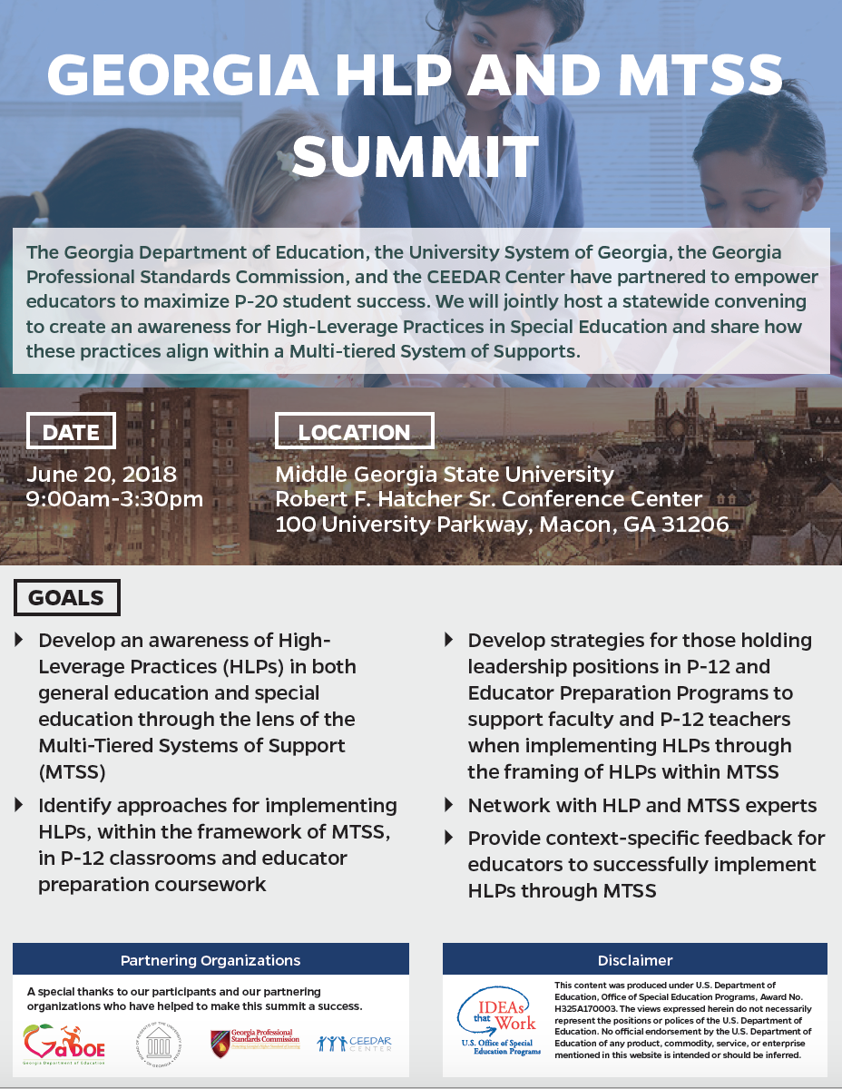
Phase I: Summit’s Participants
Participants
Representatives from all 19 P-20 Collaboratives
Representatives from all 9 RESAs
GaDOE Technical Assistance Personnel
Institutes of Higher Education (IHE) Faculty
Notes:
Pam- In our opinion, one of the most critical aspects of the Summit was our strategic approach for inviting participants. In our state, we have key stakeholders, and we knew their buy-in would increase the delivery of the messaging that included the common language that Kate just spoke about. Let me explain each of the stakeholders and their roles within our state, which will help explain our intentional approach to inviting them.
In Georgia, we have what we refer to as P-20 Collaboratives. P-20 Collaboratives include representatives from school districts, EPPs, BOR, GaDOE, and GaPSC (key stakeholders in education). The initial purposes for developing P20-Collaboratives were to create awareness for what was occurring in school districts and EPPs, to recognize the commonalities, and find ways to work together since we all have the same mission which is to positively affect students’ learning. Now that the awareness has been established and partnerships have strengthened, the Collaboratives meet to discuss current trends, strategies, policy, etc. and find ways to work together.
The next stakeholder is our RESAs, which are Regional Education Service Agencies. The RESA serve several roles within our state, but the primary role is to provide educational services for local school districts to “promote the spread of successful practices to all schools.” They are governed by superintendents, higher education’s faculty members, and representatives within public libraries.
For the Dept of Education’s technical assistance, our state organized a group of personnel to support the implementation of Georgia’s Tiered System of Supports for Students, and their roles are to provide awareness, professional development, answer questions based on the needs within a particular school district. Our state has been thoughtful in terms of who would pilot the implementation of Georgia’s tiered system and strategically selected a group of school districts to begin this work.
And lastly, we invited IHE faculty members working within teacher preparation because we knew how important it was to begin creating awareness for those that work with our pre-service teachers so our state’s new teachers would understand and be able to demonstrate HLPs within the framework of our tiered system of supports.

Slide 18
Phase II: Analyze Summit & State Data
Goal: Create an outline of seven HLP supplemental materials and professional development webinars
How we did this:
State Survey
Analyzed the state data
Summit Survey
Selected targeted HLPs based on both data sets
Considered feedback from other stakeholders
Notes:
Kate: In our next phase, we analyzed the summit and state data.
A survey was given at the end of the Summit & data was reviewed (survey items such as what were some ‘key takeaways from the Summit, what types of resources would be helpful, and which of the HLP categories would participants be interested in learning more about )
The Project Leads met to analyze the state data (provided by Dr. Zelphine Dixon Smith) as well as the feedback provided to select targeted HLPs based on state needs

Slide 19
Phase III & IV: Fall/Spring Webinars & Supplemental Materials
Goal: Increase knowledge of targeted HLPs, show how HLPs can easily be implemented throughout MTSS, and provide materials for purposeful practicing of implementation.
Notes:
Day: HLP Team- Project Leads have planned to implement four virtual targeted professional developments. Invited participants to the convening will be invited to a special pre-view training to learn about the PD training and how to use the accompanying materials. This will allow the selected individuals to also be able to answer questions, provide support, and invite a wider audience to the PD.
First kick-off yesterday (8/29) and provide examples of what we’re talking about for supplemental materials/resources (EPP examples and LEA examples- split slide)

Slide 20
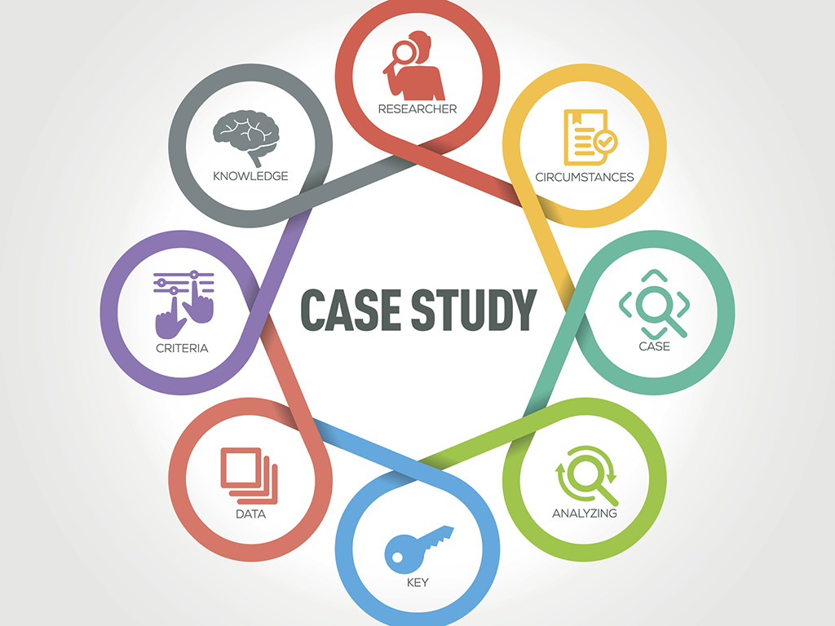
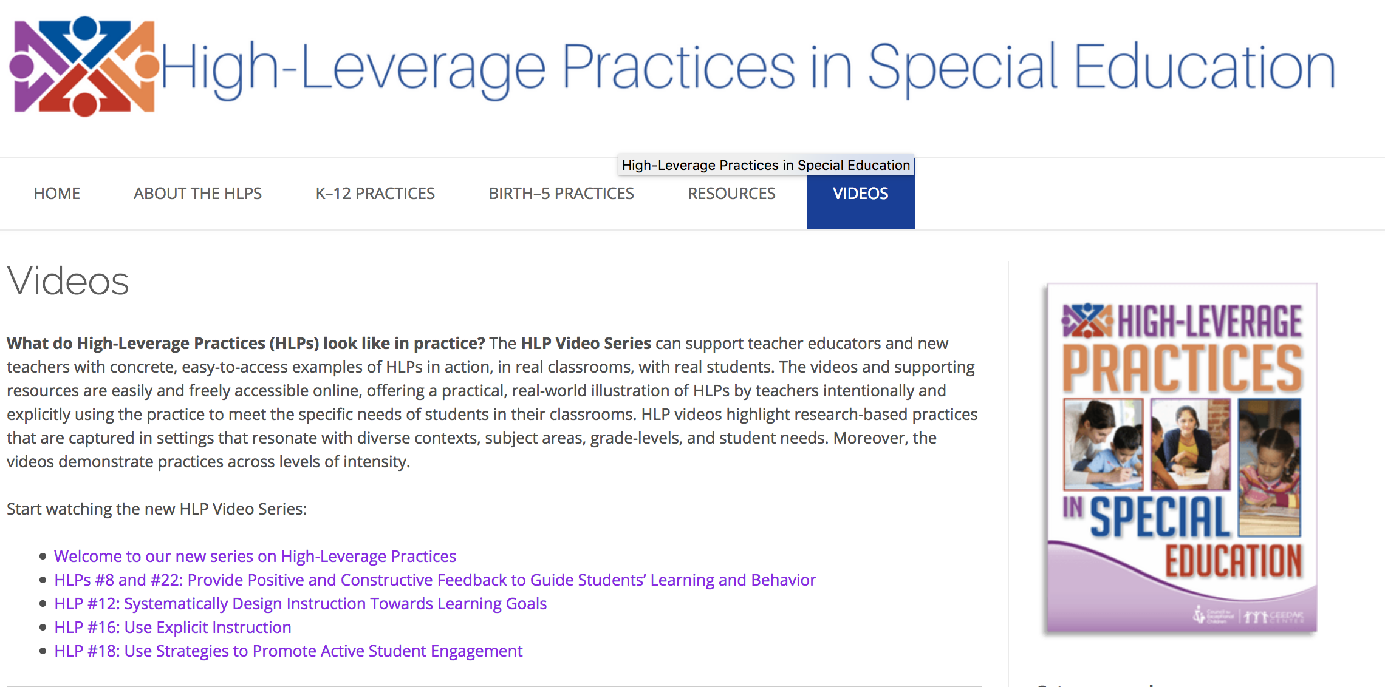
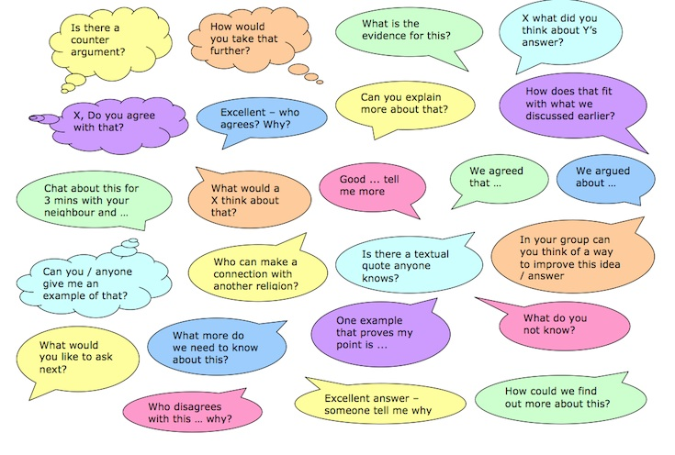
Examples of Supplemental Materials
EPP Examples
LEA Materials
Notes:
Melissa: We are still in the development phase of these supplemental materials, but envision some of the following. In depth case studies that cover strategically paired HLPs along with facilitator guides for use. Resources to accompany the HLP video series produced by CEEDAR including discussion prompts and guiding questions aligned to specific timestamps so viewers can really maximize these videos. We also hope to include some teacher testimonials that can be featured in the webinars and available for later use For example, a pair of general and special education co-teachers talking about how they make the relationship work in their specific context. We are also working on an observation protocol for use in evaluating HLP implementation in the field. We want this to be easy to use and quick, so it can be used to guide coaching conversation immediately after instruction. Some of these resources will be specific for pre-service teachers and some for in-service teachers, but we want to design as much as possible for the continuum of the profession. We want these resources to be applicable for candidates still in their preparation programs, novice teachers in the induction period, all the way to expert teachers looking to continually improve their craft. We are welcome to feedback and suggestions on what resources you think would be helpful for pre- and in-service teacher candidates, which leads us to out next chat box discussion.

Slide 21
Discussion
To support your HLP work, what supplementary materials would be helpful to you?
And/or do you have any supplementary materials that you would like to share?
Notes:
Pam- So, If one said, you know… we have the best HLP materials for you! What do you envision those materials being? OR Have you and/or your colleagues developed HLP materials that you would love to share with others?

Slide 22
Upcoming Webinars
Webinar Date | High Leverage Practices Webinar Topic(s)
January 23, 3:30 P.M. | 18-Use Strategies To Promote Active Student Engagement
February 20, 3:30 P.M. | 16–Use Explicit Instruction
March 20, 3:30 P.M. | 15–Provide Scaffolded Supports
Notes:
Pam

Slide 23
Questions & next Steps
Notes:
Pam- Before we conclude, are there any remaining questions? If so, please use the chat box.

Slide 24
For more information, Please contact
Meg Kamman Ph.D.
University of Florida
Email: mkamman@coe.ufl.edu
DaShaunda (Day) Patterson, Ph.D.
Gerogia State University
Email: dspatterson@gsu.edu
Melissa Driver, Ph.D.
Kennesaw State University
Email: mdriver6@kennesaw.edu
Kate Zimmer, Ph.D.
Kennesaw State University
Email: kzimme10@kennesaw.edu
Notes:
Pam- We want to thank you all for giving us the opportunity to share our state’s story in terms of the implementation of HLPs through the framework of MTSS. If you have any ideas that will help support our work or you’d like more information about our state’s plan, please feel free to contact one of us.
Before we conclude the webinar, are there any final thoughts or questions you’d like to share in the chat box?
Thank you again, and we are looking forward to sharing the results of GA’s implementation with you in the future. We all hope you have a great afternoon!

