Slide 1
EDUCATOR PREPARATION PROGRAMS’ (EPP) PRACTICE-RESPONSE OPPORTUNITIES IN VIRTUAL ENVIRONMENTS
Kathleen Puckett, Arizona State University
Christina Rivera University of Arizona,
Laura Atkinson, Arizona State University
Jessica DeBiase, Arizona State University
Jennifer Gresko, Rio Salado College
Darold Joseph, Northern Arizona University
Pamela Powell, Northern Arizona University

Slide 2
Methodology
Study Focus: Understand the impact of COVID on Educator Preparation Programs
Research Design: Qualitative and quantitative methods of inquiry
Research Questions:
1. What elements, activities, or tools assisted in the transition to online learning environments during the COVID period?
2. What became barriers in the process of transitioning to online learning during this period?
3. What virtual elements, activities, or tools would educators like to see continuing, once K-12 schools and EPPS return to more face-to-face experiences?

Slide 3
Recruitment and selection of participants
Full and part time faculty
Targeted special and general education, but some faculty spanned other programs
Currently employed within 4 Arizona Educator Preparation Programs (EPPs)
EPPs were selected according to availability of representatives on the team

Slide 4
Participant Roles
Tenure track Faculty (all ranks) 11
Clinical faculty (all ranks) 18
Instructors or non-specified faculty 8
Part time faculty (Adjunct or faculty associates) 4
Program Leads (department chair, coordinator, etc.) 7

Slide 5
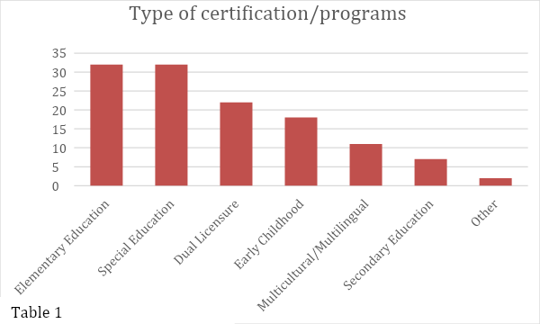
Participation Representation by Program Area

Slide 6
Data Collection
Data Analysis
35-item cross sectional survey using open ended and Likert scale items
Conducted during spring 2022 semester
AZCEEDAR team members shared the survey with prospective participants via email
48 responses received across 4 institutions
Survey responses were analyzed by the AZCEEDAR team members
Coding and tallying processes used
Frequent meetings to triangulate the data
Three themes emerged: Health, Instruction, Technology (HIT)

Slide 7
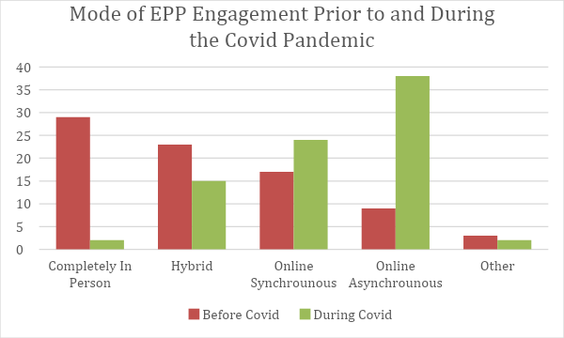
EPP Modes of Instruction
Notes:
as you can see, during COVID, in person instruction shut down-- and went to hybrid, online synchronous and online asynchronous

Slide 8
Field Experience: What shifts were made during COVID restrictions ?
No in person field based instruction/activities.
Asynchronous instruction
Synchronous Instruction
Other:
Notes:
No in person field based instruction/activities.
Asynchronous instruction
Use of video: Observations (recorded), viewed video examples (Internet/ATLAS), candidates developed videos of teaching from home
Synchronous Instruction
Virtual observations, Zoom (etc.) coaching, candidates taught K12 online (K12 LMS/Zoom etc.)
Other:
Hypothetical student scenarios, journaling, modified assignments

Slide 9
College Classroom: What shifts were made to classroom-based instruction during COVID restrictions?
*College classes shifted; opportunities for in-person instruction were lost.
In-person courses shifted to synchronous sessions through Zoom (etc.) for discussion of K-12 changes, wellness checks, continued college course instruction, modified assignment discussion
Online courses modified only field experience assignments
All Modalities
Modified course assignments
Flexible due dates
Wellness checks
Notes:
In-person courses shifted to synchronous sessions through Zoom (etc.) for discussion of K-12 changes, wellness checks, continued college course instruction, modified assignment discussion
Made modification to more asynchronous independent online assignments
Online courses modified only field experience assignments
Field experience assignments modified by methods in previous slide
All Modalities
Modified course assignments
Video based examples
Hypothetical lesson plans
Flexible due dates
Wellness checks

Slide 10
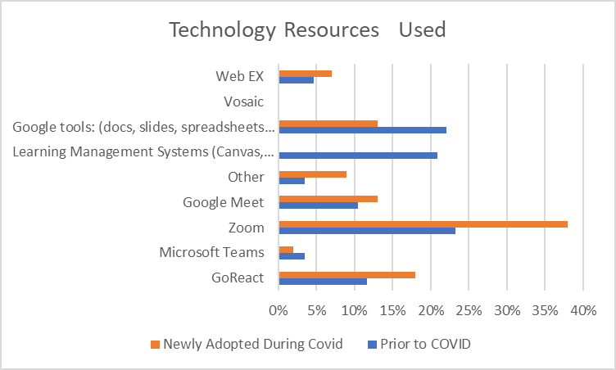
Notes:
Prior to covid, the AZ EPP faculty used google tools, LMS, and zoom for classes-- these were already in place.
During covid, other EPPS reported zoom and google tools in the newly adopted category.
Also newly adopted were go react, web ex.
LMS systems were not listed as newly adopted, meaning they were firmly in place prior to covid.

Slide 11
What barriers/challenges did EPPs experience with the placement of teacher candidates (TCs) due to COVID19 restrictions?
Districts would only place student teachers but not for experiences prior to student teaching | 15%
Finding mentor teachers | 19%
Creating spaces for Teacher Candidates to engage with students | 23%
Access to technology (e.g., wifi, computers, etc.) | 17%
Districts were reluctant to take on a TC for student teaching | 18%
Notes:
Biggest impact: districts were reluctant to have candidates in their schools, and it was very difficult to find students for candidates to work with.
One EPP developed an online tutoring system that K-12 students could join. But the ratio was 4 candidates to 1 or 2 students--not well attended.

Slide 12
What changes were made, overall, within EPP program requirements for TCs during COVID restrictions ?
Changes to the type of activity to fulfill requirements | 33%
Changes in student teaching evaluation modalities | 28%
Changes to required PK-12 classroom time prior to student teaching | 16%
Changes to how student teaching time is calculated to meet certification requirements (to allow for changes in districts’ virtual schedules) | 16%
Modifications for TCs who were student teaching out of Arizona | 4%
Modifications for TCs who are seeking out of state licensure | 2%
Notes:
Most programs made changes to the type of activities required-- instead of in person, they would have hypothetical situations or case studies for the candidates to write or react to.
Evaluation modalities also changed. In the early days, faculty would observe zoom lessons taught by candidates. As things opened up, University supervisors were not allowed in schools, so video observations (go react, etc) were used.
Time also had to be recalculated, as scheduled virtual classes were not the same as the in-person day..

Slide 13
What barriers/challenges were experienced in maintaining the same high expectations of teacher candidates (TCs) during COVID restrictions ?
Engagement:
Attendance and active participation went down.
Mental and physical health:
Candidates were stressed and emotional
Lack of relationship building:
Faculty to candidate interaction: intrinsic motivation was lessened
Notes:
Engagement:
Attendance and active participation went down.
Difficulty establishing presence and immediacy using online observation and evaluation.
Candidates got burnt out on ZOOM and would not show their faces.
Mental and physical health:
Candidates were stressed and emotional…..Took into account when evaluating work. … did not grade as stringently as typically
Tried to convey high expectations by explaining, “If you were in person, this is what it might look like.”
Mentor teachers were asked to substitute or cover other classrooms due to illnesses, candidates didn't have a typical experience
Lack of relationship building:
Faculty to candidate interaction: intrinsic motivation was lessened
Limited K-12 student engagement: Simulations, videos, and video observations were no substitute for face to face

Slide 14
How did EPPs address/respond to those barriers to maintaining same high expectations?
Alternate way of communicating
Flexibility with Assignments
Course materials adjusted
Experimented with technology
Worked with TCs to find best alternatives for their situation
Help from program staff
Emphasized that family and health come first
Notes:
Alternate way of communicating
Individual meetings
More frequent meetings
Extra “virtual” office hours
Reduced group projects
Flexibility with Assignments
Decreased assignments
Alternative assignments
Due date flexibility
Allowing students to earn an “incomplete” or choose P/F grades
Attendance not counted in grade
Considered context/instructional situation when grading
Course materials adjusted
More affordable textbook
Apps/technology for students
Course handouts uploaded to LMS
Created simulations
Experimented with technology
Observations over Zoom
Zoom breakout rooms
Zoom etiquette
Kahoot
Worked with TCs to find best alternatives for their situation
Help from program staff
Emphasized that family and health come first

Slide 15
What issues did TCs experience (and report) as a result of the COVID restrictions?
Health
Anxiety
Exhaustion
Depression
Loss of income
Stress
Loneliness
Illness
Domestic violence
Instruction
Absences
Lack of collaboration
Finding materials
Motivation
Engagement
Changed majors
Cameras off
Technology
Applying new tech
Access to WiFi
Remote instruction
difficult for special education students
Access to K-12 LMS
Notes:
Important to recognize that many faculty were experiencing the same.

Slide 16
What will be sustained?
Our student teachers enter the field of teaching with a much more complete picture of technology and its resources.
Learning management platforms were sustained and have become prominent systems for managing instruction.
Some combination of in person and virtual observations may stay in place.
We may provide training in online learning.
The use of video conferencing tools to meet with students.
Notes:
The pandemic closures afforded the following experiences, which may/should continue
They intimate substantive experiences elevated through the use of technological means.
I'm afraid many schools may find a virtual platform more economically positive and our TIRs (teachers in residence) will have less contact with their students.
Quality Plan B versus quantity. Maybe we focus more on the quality of what and how the TCs are completing things, rather than asking for them to ""collect"" hours for the semester.
The use of technology for classroom observations will continue.
The use of technology for synchronous class sessions for hybrid courses will continue.

Slide 17
What discoveries did COVID restrictions reveal that raised awareness of gaps in teacher training that your program plans to address?
What we need:
Training
Student motivation/engagement in virtual environments
Furthermore:
Better referral systems for mental health.
The use of growth plans early on for struggling students.
Finally:
There was a greater level of inequity highlighted by the pandemic.
Difficult to teach special education students remotely/virtually.
Notes:
Some students thrived in online/remote learning!
What we need:
Technology training - integrating all types of technology into the classroom - even face to face and in person
More emphasis needed to be placed on student engagement and motivation in virtual environments.
Training teachers for online modalities.
Furthermore:
It also revealed a tremendous amount of stress and anxiety in TCs, students and their parents.
Teletherapy for sure
Better referral systems for mental health, the use of growth plans early on for struggling students.
Finally:
There was a greater level of inequity highlighted by the pandemic.
We need to provide high speed internet access to all Arizona communities.
There is no reasonable way to teach special education students virtually. They are not engaged, need support from parents, and there is little feedback on their growth to ensure IEP goals are met.

Slide 18
What skills and/or training did you take advantage of during the shift to remote learning in courses and/or field experiences?
College or university sponsored sessions on how to use specific programs or apps | 38%
Online instructions or videos on how to use program and/or apps | 34%
Conferences or professional development activities outside of the institution | 27%
I did not participate in any sessions on how to use specific programs or apps | 2%
My university did not offer sessions on how to use specific programs or apps | 0%

Slide 19
Considering the shifts/modifications you will sustain/retain, what skills and training do you and other faculty members need to move forward with technology integration in courses and/or field experiences?
Some thoughts included:
Communication and shared resources.
More training on instructional design and ways to creatively use technology for virtual learning experiences.
Connect what's used in k-12 classrooms to university courses.
Learning all of the capabilities of zoom to enhance virtual learning environments.
And finally….
A need for state department to have a teaching certificate specifically for online teaching and/or an online teaching endorsement.
Notes:
Some thoughts included:
Communication and shared resources.
More training on instructional design and ways to creatively use technology for virtual learning experiences.
Connect what's used in k-12 classrooms to university courses
Continued support and funding for external programs.
Designing weekly online modules that are clear and contain all the necessary information for students to be successful working independently.
How to use Zoom cameras in the classroom
Learning all of the capabilities of zoom to enhance virtual learning environments.
More ideas on how to engage our TCs on Zoom sessions.
And finally….
A need for state department to have a teaching certificate specifically for online teaching and/or an online teaching endorsement.

Slide 20
Resources/Centers used to support Faculty and TCs
IRIS Center | 26%
Council for Exceptional Children (CEC) | 20%
CEEDAR Center | 20%
American Association of Colleges for Teacher Education (AACTE) | 5%
Council for the Accreditation of Educator Preparation (CAEP) | 5%

Slide 21
Conclusions
Health: awareness of student need
Instruction: more flexibility
Technology: more and sustained tech and design support

Slide 22
Share your Experience
What were your barriers?
How did you address them?
What will you continue to use?

