Slide 1
Walking the walk: Collaboration across special, general, and leadership education at
Georgia State University
Meg Kamman & Erica McCray
University of Florida
Sheryl Cowart Moss, Carla Tanguay & DaShaunda Patterson
Georgia State University
U.S. Department of Education, H325A120003

Slide 2
Today
We will discuss…
The Georgia-CEEDAR partnership
GSU context
GSU reform process
Results
Next Steps
Special Education
General Education
Leadership

Slide 3
CEEDAR’s Mission
To create aligned professional learning systems that provide teachers and leaders effective opportunities to learn how to improve and support core and specialized instruction in inclusive settings that enable students with disabilities to achieve college and career readiness standards
Notes:
Where does CEEDAR come in? Point out that we are also focusing on leaders, because they are essential to supporting the change process. I focused on teachers today because of time
FIRST, I WILL TALK ABOUT how WE ARE FRAMING OUR WORK

Slide 4
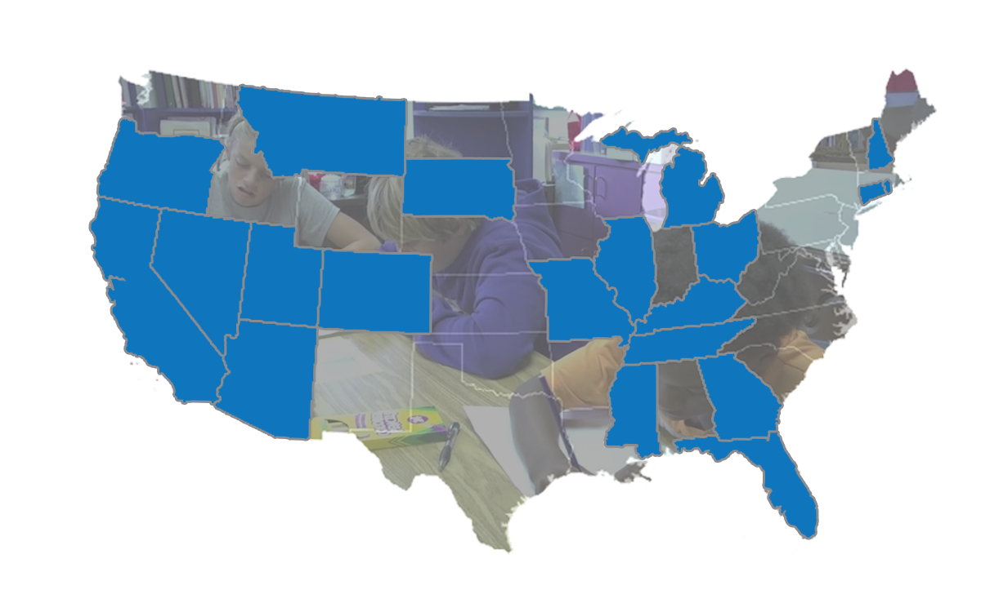
Georgia-CEEDAR Partnership
Intensive in 2014
Department of Education
Professional Standards Commission
Georgia State University
Columbus State University
Kennesaw State University

Slide 5
Georgia Goals
Certification
Teacher and Leader Preparation Reform
Preparation Program Evaluation
Alignment

Slide 6
Teacher and Leader Preparation Reform
The Georgia SLT will establish and nurture multi-system collaboration for teacher and leader preparation.
Objective 1: Increase use of effective/evidence-based practices for multi-tiered systems of support (MTSS).
Objective 2: Create a system for knowledge, dispositions, and practices for co-teaching
Objective 3: Develop a plan for scale up and sustainability of DOE, PSC, LEA collaboration for teacher and leader development

Slide 7
Georgia State University
A structured process:
Determining needs
Faculty retreat
Innovation Configuration training
Syllabi review
Program area analysis
Engage in revision

Slide 8
Who Will Carry Out the Work?
CEEDAR representatives
Associate Dean
Assessment and Accreditation Committee
Faculty

Slide 9
Identifying Needs:
Using relevant data
Aligning with our university/college mission
State and national accreditation

Slide 10
How can existing college/university structures (e.g. Assessment & Accreditation Committee) begin the conversation?
Identification of
KEY AREAS of Interest
Subtitle
Alignment to Modules
Classroom Management & Community Building
Culturally Responsive Pedagogy
Technology
Assessment
Reading/Academic Language
Universal Design for Learning
Align KEY AREAS of interest with CEEDAR modules
Access resources

Slide 11
How to Engage Faculty?
Day long retreat for all faculty working in initial teacher and leader education programs
Key Stakeholders
District representatives from area school systems
Representatives from state agencies and the university system
Breakout sessions led by teacher education faculty from across programs
Speakers included P-12 principal and teacher candidate

Slide 12
What does THAT conversation look like?
Program areas discussed strengths and needs
Participation in breakout sessions
Sharing of information in program areas
Each program area identified 2 Key areas for 2016-2017

Slide 13
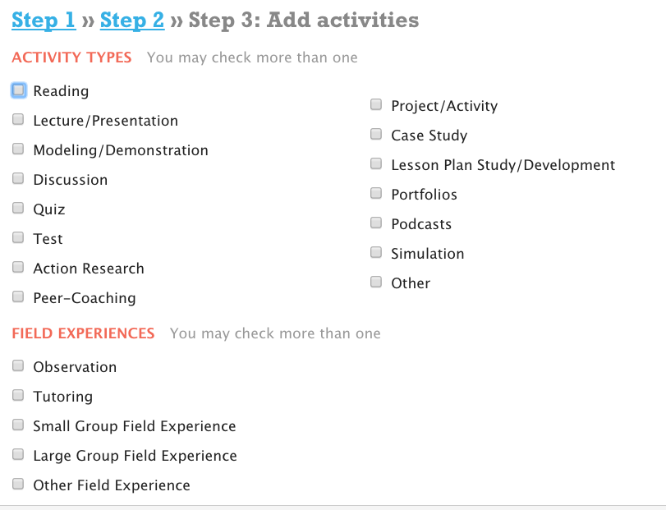
How do you follow up on THAT conversation?
Summer work focusing on syllabi analysis using the Networked Improvement Community.
Programs completed needs analysis for 2 KEY AREAS

Slide 14
How do you support the work?
CEEDAR training in Innovation Configurations with Program Leads
Assistance with Syllabi Analysis
Unit-Level Support during 2016-2017

Slide 15
CEEDAR Training
Led by CEEDAR representatives
Meg Kamman and Erica McCray
Attended by
17 program representatives
Unit Assessment Coordinator
Associate Dean
GSU CEEDAR Representatives

Slide 16
Syllabi Analysis
Faculty representative conducted syllabi analysis independently.
Support provided by dean’s office as needed.
Representative responsible for sharing results of syllabi analysis with program faculty in fall.
Resources from NIC and IRIS to be shared with faculty in programs.

Slide 17
Unit Level Support: 2016-2017
Fall Semester Opening Forum
Faculty learning from syllabi analysis
Assessment and Accreditation Committee review the results of the syllabi analysis
Determine possible unit-level needs.
Monthly professional development forums
Focus on additional professional development and resources for the KEY AREAS.

Slide 18
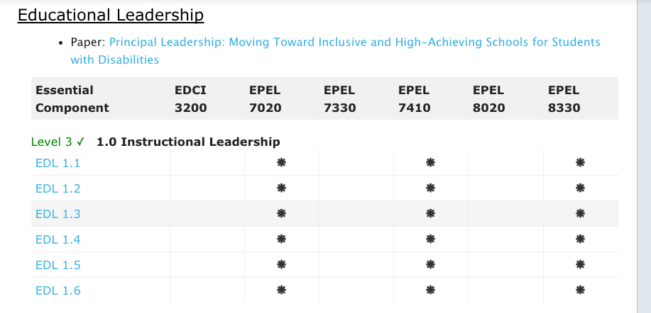
Example Analysis Educational Leadership

Slide 19
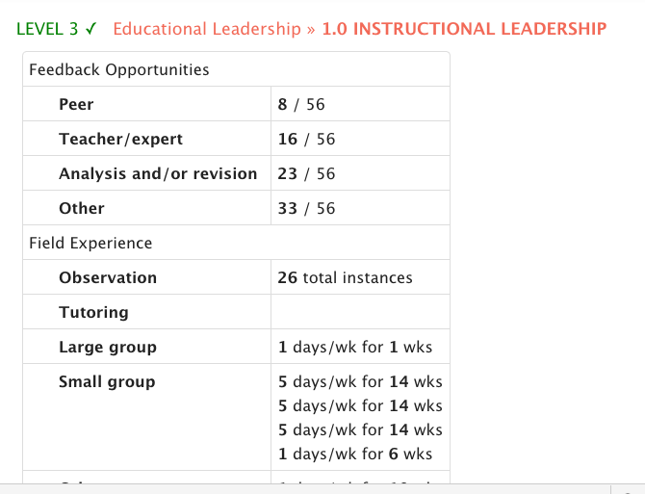

Slide 20
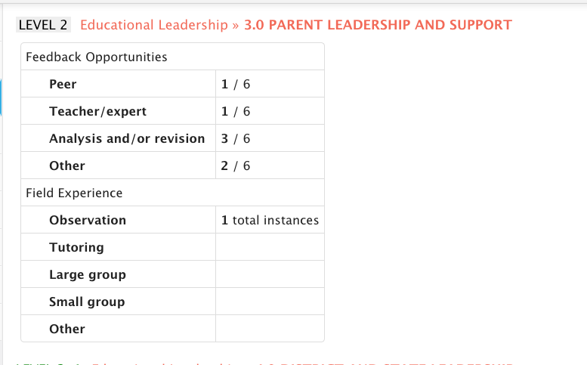

Slide 21
Where are we now?
Educational Policy Studies
Early Childhood & Elementary Education
Middle & Secondary Education
Special Education
Health & Physical Education
Art Education
Music Education
World Language Teacher Education
CORE
Perimeter EDUC Courses

Slide 22
Where are we headed?
Documenting changes
Sharing our work with others
Maintaining Momentum
Developing a formalized mentoring program for our state

Slide 23
Questions

Slide 24
Disclaimer
This presentation was produced under U.S. Department of Education, Office of Special Education Programs, Award No. H325A120003. Bonnie Jones and David Guardino serve as the project officers. The views expressed herein do not necessarily represent the positions or polices of the U.S. Department of Education. No official endorsement by the U.S. Department of Education of any product, commodity, service, or enterprise mentioned in this presentation is intended or should be inferred.

