Slide 1
Are We Paying Enough Attention to Cognitive Load When Designing and Delivering Instruction to
Teacher Candidates?
Michael Kennedy
University of Virginia

Slide 3
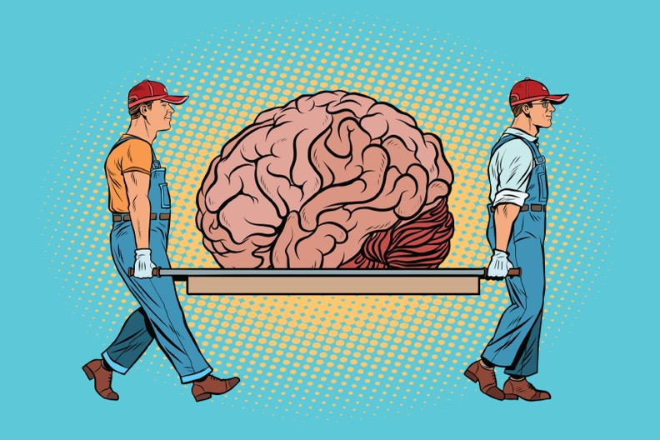
Part I
Are We Paying
Enough Attention
To Cognitive Load?
Implications For
Teacher Preparation &
Classroom Instruction

Slide 4
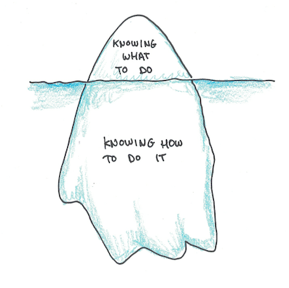
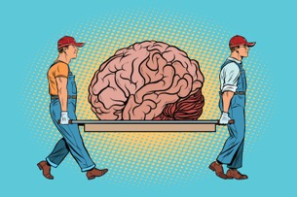
Building
Part II
Declarative
Procedural
Conditional
Knowledge
& The Role of Cognitive Load For Our Teacher Candidates

Slide 5
Are We Paying
Enough Attention
To Cognitive Load?
Implications For
Teacher Preparation &
Classroom Instruction

Slide 6
Are We Paying
Enough Attention
To Cognitive Load?
(P.S. No. The answer is no)
Implications For
Teacher Preparation &
Classroom Instruction

Slide 7
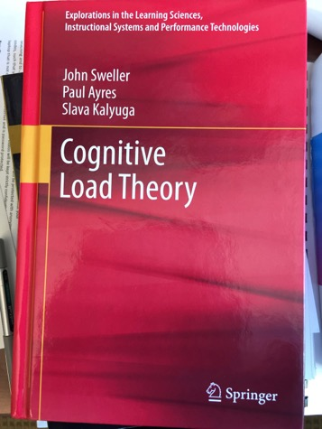
Implications For…
Designing and delivering instruction for teaching adults and students!

Slide 8
I left classroom
teaching to
become a
teacher educator

Slide 9
I left classroom
teaching to
become a
teacher educator
Sadly… The
playbook on how
to become an
effective college
instructor is a
little thin

Slide 10
My First Guest Lecture:
Superbly Prepared

Slide 11
rehearsal was flawless

Slide 12
Who wouldn’t enjoy a
100+ slide PowerPoint
presentation jam packed with 4-5 thorough bullet points per slide on the finer points of special education law crammed into 75 electric minutes???!!!

Slide 18
3 Types of Cognitive Load

Slide 19
3 Types of Cognitive Load
Intrinsic
Extraneous
Germane

Slide 20
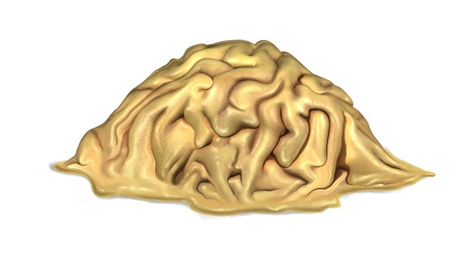
Intrinsic Load
Imposed by the basic structure of information the learner
needs to acquire, regardless of how it is taught.
Sweller, Ayers, & Kalyuga, 2011

Slide 21
Intrinsic Load
Imposed by the basic structure of information the learner
needs to acquire, regardless of how it is taught.
If content is complex, it imposes more intrinsic load than
content that is less/not complex.
Sweller, Ayers, & Kalyuga, 2011

Slide 22
Intrinsic Load
Imposed by the basic structure of information the learner
needs to acquire, regardless of how it is taught.
If content is complex, it imposes more intrinsic load than
content that is less/not complex.
Even if the material isn’t itself complicated, but there is a lot of it,
intrinsic load will be taxed.
Sweller, Ayers, & Kalyuga, 2011

Slide 23
Interactivity Creates Intrinsic Load
Element
Element

Slide 24
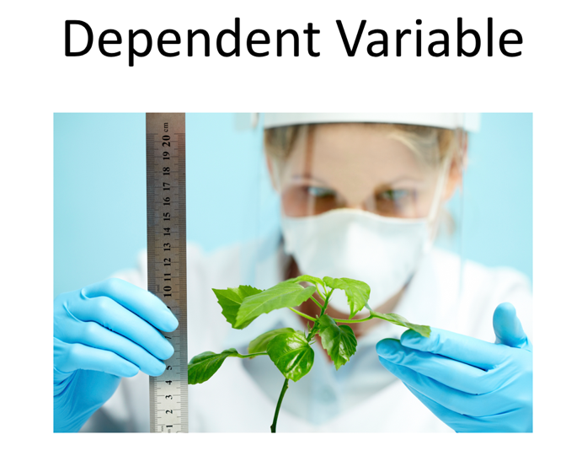

Slide 25
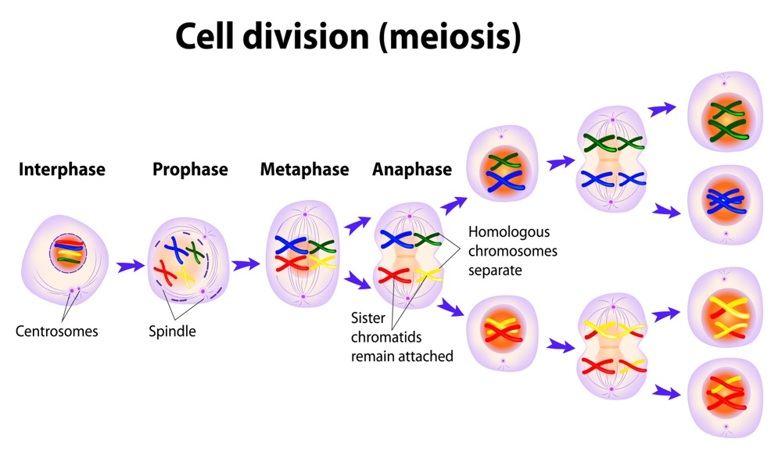
Impacts Students

Slide 26
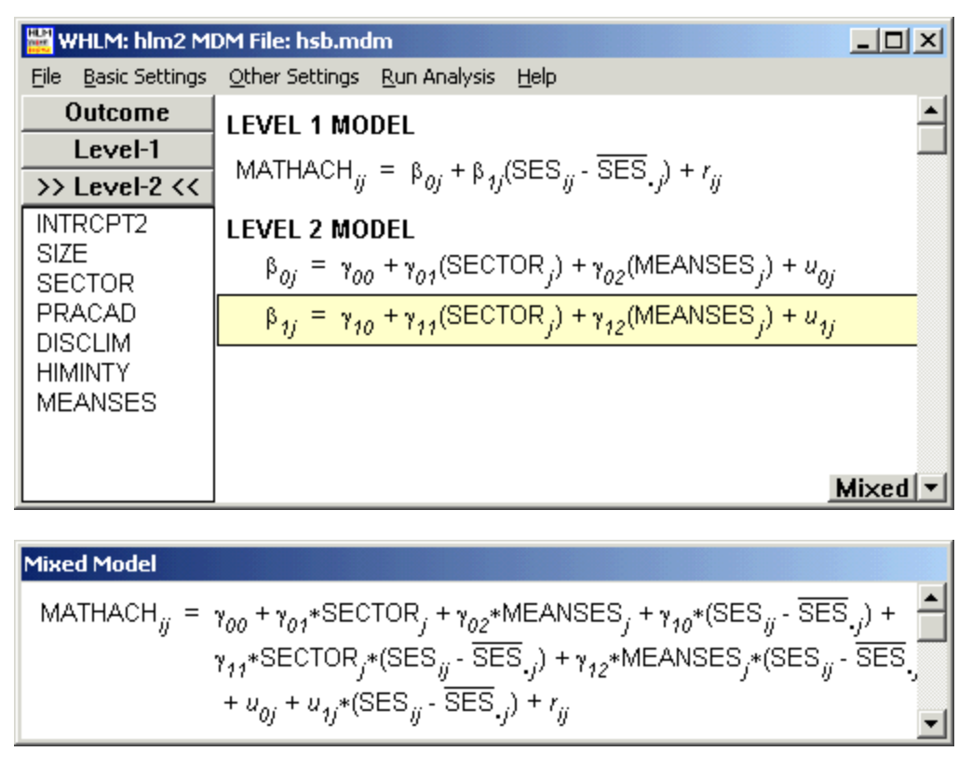
And Adults When Learning

Slide 27
Teacher Candidates Learning and Trying New EBP/HLPs

Slide 28
Prior Knowledge
impacts intrinsic
load
(if you have some,
IL is lower, if not…
not)

Slide 30
Many students
with disabilities
have some
level of
dysfunction in
terms of
cognitive
functionality

Slide 31
Many students
with disabilities
have some
level of
dysfunction in
terms of
cognitive
functionality
IL almost
always higher
for these kids

Slide 32
New teachers
also can
struggle with high amounts of intrinsic load because they’re literally doing things for the first time…

Slide 33
Extraneous Load
Imposed by the method(s) selected to deliver instruction.
Sweller, Ayers, & Kalyuga, 2011

Slide 34
Extraneous Load
Imposed by the method(s) selected to deliver instruction.
Some instruction can cause extremely high amounts of
extraneous load, which interferes with learning.
Other instructional approaches
keep extraneous load to a minimum. It just depends…
Sweller, Ayers, & Kalyuga, 2011

Slide 36
Paradox:
High
extraneous
load for
students…
But can be
low for
teachers

Slide 37
Recipe for high IL and EL: Using EBPs
with fidelity,
collecting data, monitoring behavior, implementing IEPs, collaborating, being observed, etc…

Slide 38
Extraneous Load
Imposed by the method(s) selected to deliver instruction.
Intrinsic load and extraneous load are additive. The sum is the
total cognitive load imposed by content that needs to be learned.
IL + EL = Total Load
Sweller, Ayers, & Kalyuga, 2011

Slide 39
Extraneous Load
Imposed by the method(s) selected to deliver instruction.
Intrinsic load and extraneous load are additive. The sum is the
total cognitive load imposed by content that needs to be learned.
The total cognitive load determines the required working memory
resources needed to process information.
Sweller, Ayers, & Kalyuga, 2011

Slide 40
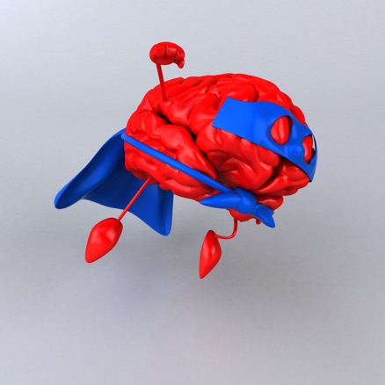
Germane Load
Remaining cognitive resources within working memory devoted to
addressing intrinsic and extraneous load.
Sweller, Ayers, & Kalyuga, 2011

Slide 41
Germane Load
Cognitive resources within working memory devoted to
addressing intrinsic and extraneous load.
If working memory resources required to deal with the combined
intrinsic and extraneous load are exhausted or overwhelmed,
learning is unlikely to occur (no germane load left).
Sweller, Ayers, & Kalyuga, 2011

Slide 42
For teachers:
No germane
load left?
Probably no
EBPs…

Slide 43
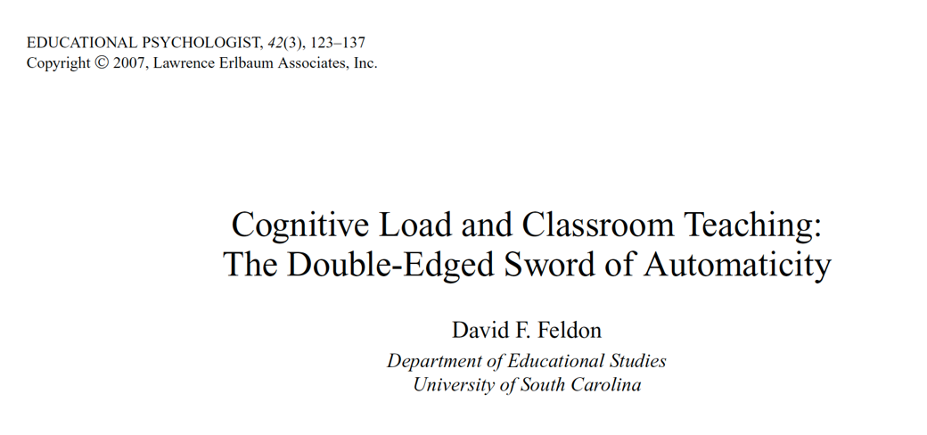

Slide 44
Implications for Teachers???

Slide 45
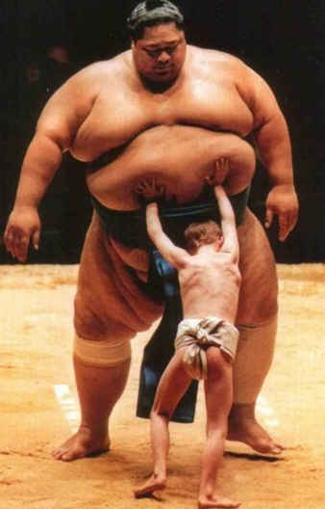
For Many Students
There is a Mismatch
Between Student’s
Learning Needs &
The Demands of the
Curriculum –
Especially in Content
Area Courses
Harbort et al., 2007; King-Sears et al., 2014;
Moin et al., 2009; Mutch-Jones et al., 2012

Slide 46
Demands of Content
Courses
Student’s Learning
Needs
Vannest et al., 2009; Wei et al., 2010; Robinson, 2002

Slide 47
Prevailing Pedagogy
Student’s Learning
Needs
Vannest et al., 2009; Wei et al., 2010; Robinson, 2002

Slide 48
Also a mismatch between everything we need new teachers to learn in a very short amount of time and their cognitive capacity to make sense of it all and become proficient at implementation…
Feldon, 2007

Slide 49
Whoops…
It’s apparently very easy to
overload learner’s limited
cognitive capacity – This
goes for teachers in training, PD,
or students with and without
disabilities.

Slide 50
Whoops…
It’s apparently very easy to
overload learner’s limited
cognitive capacity.
And when that happens…
learning doesn’t.

Slide 51
Also, teachers (at all levels)
are subject to experiencing
cognitive overload. When a
teacher is overwhelmed, they
are likely to stop using practices
they find to be difficult to
implement, and revert to
whatever approach comes
easiest to them (usually
talking/lecturing).

Slide 52
Give thought to how
we structure our approach
for teaching from a
design perspective…

Slide 53
Give thought to how
we structure our approach
for teaching from a
design perspective…
If we know intrinsic load
is going to be high, that’s a
signal to bring our A Game
and manage extraneous
load.

Slide 54
Do the same for designing
and delivering instruction
for students with disabilities
If we know intrinsic load
is going to be high, that’s a
signal to bring our A Game
and manage extraneous
load.

Slide 55
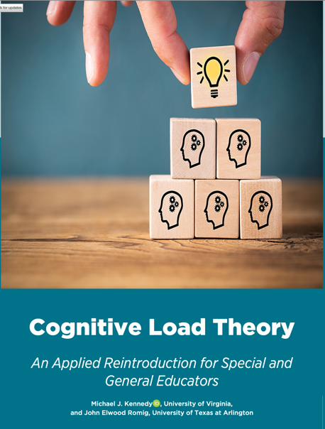
Teaching Exceptional Children
https://journals.sagepub.com/doi/abs/
10.1177/00400599211048214

Slide 56
Building
Part II
Declarative
Procedural
Conditional
Knowledge
& The Role of Cognitive Load For Our Teacher Candidates

Slide 57
Declarative Knowledge
Procedural Knowledge

Slide 58
Intrinsic load for content we teach first as declarative and procedural knowledge to our teacher candidates is usually reasonably low, but technical practices can carry more load to deal with…

Slide 59
As you think about practices associated with evidence-based reading,
they may carry more intrinsic load for some new teachers than others –
may be connected to how they learned (or didn’t) to read and
understand phonics, PA, vocabulary, fluency, comprehension…
For example…

Slide 60
This is especially true because of of our language’s rules and weirdness, and how different students learn at different rates, need combinations of practices, using data, more intensity, etc etc etc.

Slide 61
Many teacher candidates also have it in their head they are “bad at math” which can negatively impact the amount of intrinsic load imposed when learning practices to teach mathematics…

Slide 62
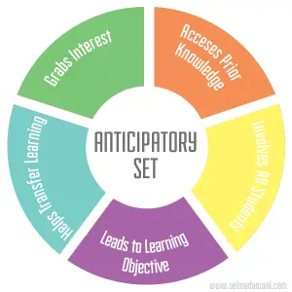
Whereas a practice like anticipatory set is relatively straightforward and easy to
implement, and modifications for different students/situations are minor

Slide 63
(for intrinsic
cognitive load)

Slide 64
Four Domains; Big Implications for Practice
(and big implications for intrinsic cognitive load)
Collaboration
Assessment
Social/Behavioral
Instruction

Slide 65
Learning individual practices is one thing – can create modest amounts of intrinsic load, but in real teaching, multiple practices are often used concurrently, generating unwieldly amounts of load – especially when teachers are new…

Slide 66
Declarative Knowledge
Procedural Knowledge
Issue of Extraneous Load

Slide 67
As uncomfortable as this is: Some instructors are better/more effective than others; some learning environments are better/more conducive for learning than others – In other words, things we do consciously and subconsciously as instructors introduce less or more extraneous load to our students.

Slide 68
Lecture is an important part of any teacher educator’s repertoire, but there’s only so much learning we can expect from this approach.

Slide 69
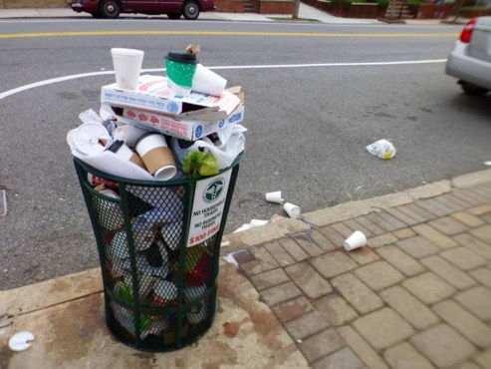
When we are rushing, cramming too much content into one lecture or night of course we are introducing additional extraneous load for students to deal with - And when intrinsic load is already high, results (or the lack thereof) are predictable…

Slide 70
No matter how big or small your courses are, if the main mode of learning about HLPs and EBPs is lecture/hearing about them, development of conditional knowledge is not likely.

Slide 71
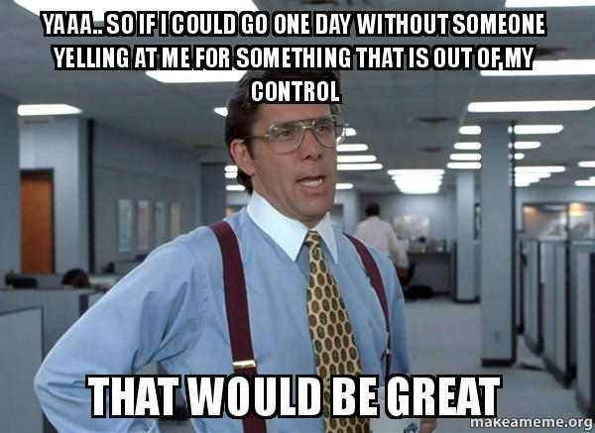
Things out of our control as individual faculty also negatively impact student capacity to successfully learn – like when and where your class is offered, being in placements all day before coming to campus, etc…

Slide 72
For complex practices, or those like HLPs that overlap (and generate a lot of intrinsic load at first exposure, and then again when being implemented by novices), it is important to mix and match how your candidates learn about and practice to distribute extraneous load and help build automaticity.

Slide 73
Diversifying how we present information to our candidates – especially at first exposure – makes a big difference in lowering intrinsic and extraneous load, and sets them up for later success

Slide 74
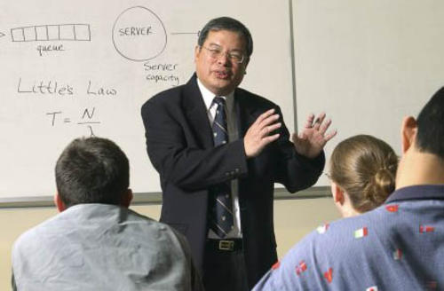
Lecture: Tried, True, Perhaps Overused, but Essential

Slide 75
Use resources like CAPs and other podcasts to reinforce lecture and reading
www.spedintro.com

Slide 77
Great idea to work in discussion

Slide 78
Modeling Videos of HLPs/EBPs being implemented
www.highleveragepractices.org

Slide 79
Watch self and reflect

Slide 80
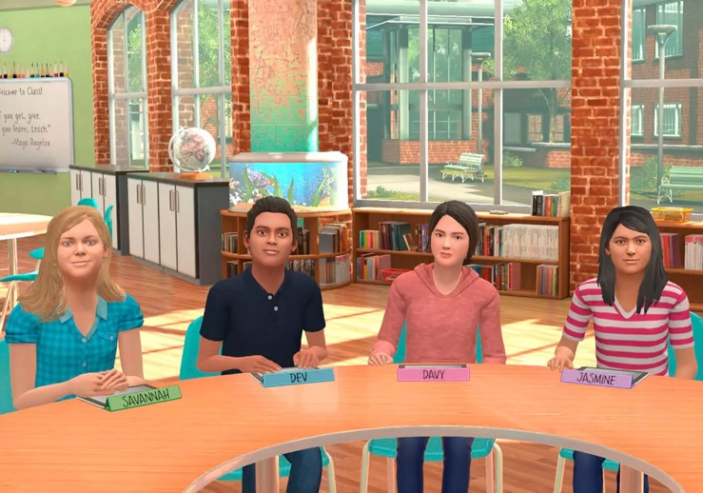
Teach Live/ Mursion mixed reality simuator

Slide 81
Observe teachers in field and reflect/ discuss

Slide 82
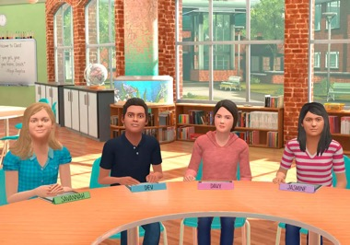
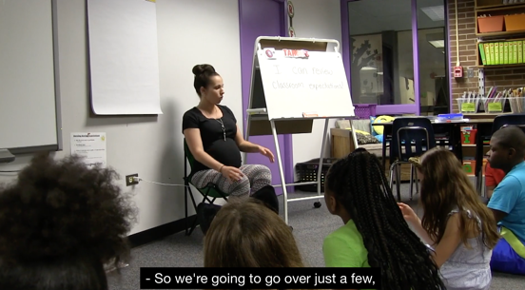
Case studies, podcasts, reflection, simulated
and real practice, watching modeling videos,
discussion, receiving feedback, field visits,
etc… Used in combinations, and repeatedly

Slide 83
What can we get teachers to learn and do well to achieve biggest impact?

Slide 84
Select which practices are most critical, and focus on those…
(for starters, anyway)
Notes:
(a) teaching behaviors that can be used in many different situations, (b) teaching the behavior in several different settings with several different instructors, (c) varying instructions and reinforcers, and (d) programming for common stimuli between the natural and teaching settings.
Effective teachers thoughtfully and carefully choose strategies for maintenance and generalization at the onset of teaching new academic and/or social skills and build them into the instructional program.

Slide 85
We can use a range of instructional approaches to help manage extraneous load, but intrinsic load is still an issue – and if we pack numerous practices into a course/program, we risk overwhelming our novices and they can end up not feeling confident with any or a small number of practices…

Slide 86
Declarative Knowledge
Procedural Knowledge
Conditional Knowledge

Slide 87
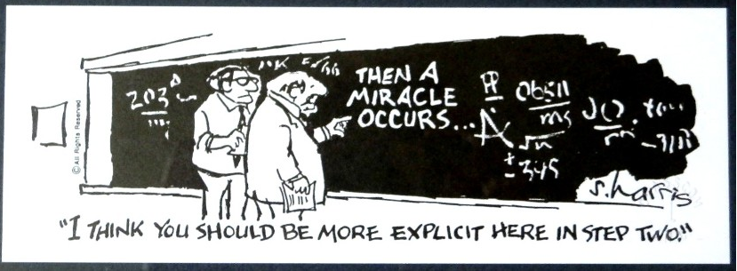

Slide 88
There is sadly no simple button

Slide 89
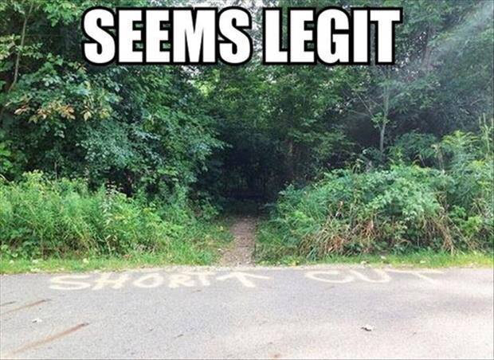

Slide 91
Using COACHED to Support Teacher Candidates’ Knowledge and Implementation of HLPs and EBPs
Michael Kennedy
University of Virginia

Slide 92
mjk3p@virginia.edu
@MJK_PhD

