Slide 1
Inclusive Leadership Breakout SPDG National Meeting
Wednesday, October 14th – 1:30-2:30PM ET
Notes:
Kaylan

Slide 2
Agenda
AIPL State Initiative Overview—Kaylan Connally, CCSSO
The Georgia Story and Case Study—Zelphine Smith-Dixon and Wina Low, Georgia Department of Education
Panel Conversation—Kaylan Connally (moderator), Zelphine Smith-Dixon, and Wina Low
Q&A and Discussion—All
Notes:
Kaylan

Slide 3
Advancing inclusive principal leadership (AIPL) STATE Initiative Overview
Notes:
Kaylan

Slide 4
Advancing Inclusive Principal Leadership (AIPL) State Initiative: Our Goal
Create and implement principal leadership plans focused on
improving outcomes for each student,
with a focus on students with disabilities.
Notes:
Kaylan

Slide 5
AIPL State Initiative: How Did We Get Here?
CCSSO, in partnership with the National Collaborative on Inclusive Principal Leadership (NCIPL), CEEDAR Center, and Oak Foundation believe inclusive principal leaders are vital to supporting students with disabilities and continuously improving schools
Together, we released Supporting Inclusive Schools for the Success of Each Child: A Guide for States on Principal Leadership (www.ccssoinclusiveprincipalsguide.org)
Notes:
Kaylan

Slide 6
AIPL State Initiative – Where We’ve Been (Phase 1)
Arkansas
Georgia
Mississippi
Ohio
Notes:
Kaylan

Slide 7
AIPL State Initiative – Where We Are (Phase 1)
All 4 states are in the process of implementing their plans to advance inclusive principal leadership in policy and practice
In July 2020, CCSSO released two case studies on Georgia’s and Ohio’s work through the AIPL State Initiative
CCSSO also released a policy/practice brief in partnership with the CEEDAR Center and AIR highlighting the work of all four states
Each state presented on a webinar as part of CCSSO’s Inclusive Leadership Webisode Series; a link to the recording can be found here
Notes:
Kaylan

Slide 8
AIPL State Initiative – Where We’re Going (Phase 2)
In Phase 2, CCSSO will support AIPL states in their efforts to:
Continue implementing principal leadership plans focused on improving outcomes for every student, with a focus on students with disabilities
Connect the work with state strategic priorities (e.g., improving literacy outcomes) and adapt plans to support leaders in new learning environments
Re-examine and focus measures of success
Partner with national experts from the Relay Graduate School of Education, Maryland Coalition on Inclusive Education, Lead for Literacy, National TA Center on PBIS, and National Center on Intensive Intervention
Notes:
Kaylan

Slide 9
The Georgia story and case study
Notes:
Kaylan introduces Zelphine and Wina

Slide 10
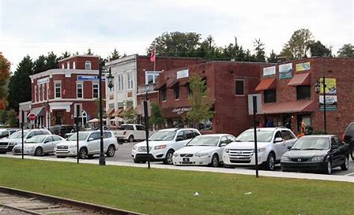

Slide 11
Georgia Advancing Inclusive Principal Leadership (AIPL) Objectives
Objective 1: Create guidance and/or toolkits for local education agencies on how to pursue, develop and retain inclusive leaders.
Objective 2: Develop professional learning opportunities, face-to-face and virtual, to address the behaviors and practices critical to meeting the needs of each learner by race, ethnicity, economic status, ability, and English language learner status.

Slide 12
AIPL Efforts in Georgia
Stocktake Agenda
Realign inclusive leadership focus
Engage a strategic Communication Plan to share what has already been done in Georgia and why inclusive leadership matters
Develop a self-assessment rubric and roadmap for schools/districts to self-evaluate

Slide 13
Why Inclusive Leadership Matters

Slide 14
Inclusive Leadership
Inclusive leaders in education may matter now more than ever. Education leaders are under more pressure to create effective and practical distance learning opportunities to meet the needs of all students during the COVID-19 pandemic. Leaders must prioritize what’s important and inclusion must be at the top of their priority lists.
All district and school staff can benefit when inclusive principals have been established. Inclusive principals distribute leadership across staff and encourage all learners to serve and ensure all students feel safe, supported, and valued.
The GaDOE has developed several resources including an Inclusive Leadership video, graphic, fact sheet and communications plan to help school systems address the behaviors and practices critical to inclusive leadership and meeting the needs of ALL learners.
Visit Inclusive Leadership Matters for more information.

Slide 15
AIPL Efforts in Georgia
Excited to look to the future
Building the toolkit around “Georgia’s System of Continuous Improvement”
Continue sharing the stories of successful leadership in schools throughout Georgia
Continue to leverage the momentum of our efforts
Stocktake Agenda

Slide 16
Contact Information for State Lead
Dr. Zelphine Smith-Dixon
State Director of Special Education Services and Supports
Georgia Department of Education
zsmith@doe.k12.ga.us

Slide 17
Panel discussion
Notes:
Kaylan

Slide 18
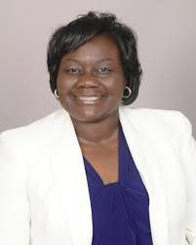
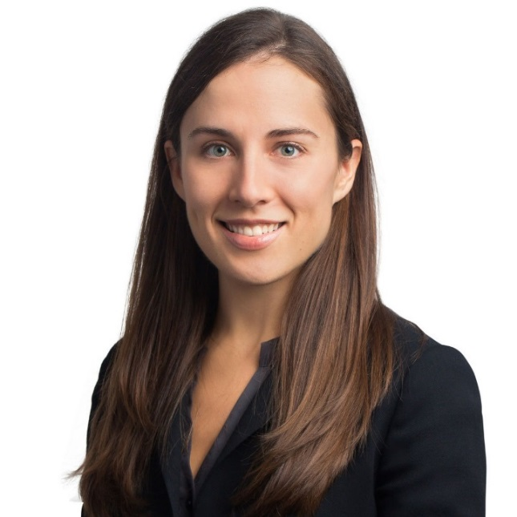
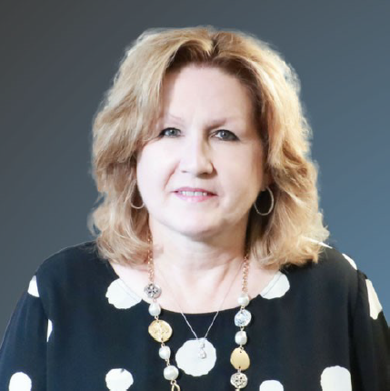
Panel Discussion: Inclusive Leadership
Moderator:
Kaylan Connally
Program Manager, Student Expectations, CCSSO
Zelphine Smith-Dixon
State Director, Special Education Services and Supports
Georgia Department of Education
Wina Low
Senior Program Manager, Special Education Services and Supports
Georgia Department of Education
Notes:
Kaylan moderates panel conversation with Zelphine and Wina

Slide 19
Q&A and Discussion
Notes:
Kaylan

Slide 20
Q&A and Discussion
What questions or comments do you have for Zelphine and Wina?
What additional questions do their presentations and conversation spark for you?
How could the work and resources shared be applied in your context?
Notes:
Kaylan opens the panel up for Q&A from audience

Slide 21
Notes:
Kaylan

Slide 22
Messenger
Thank you!
Notes:
Kaylan

