Slide 1
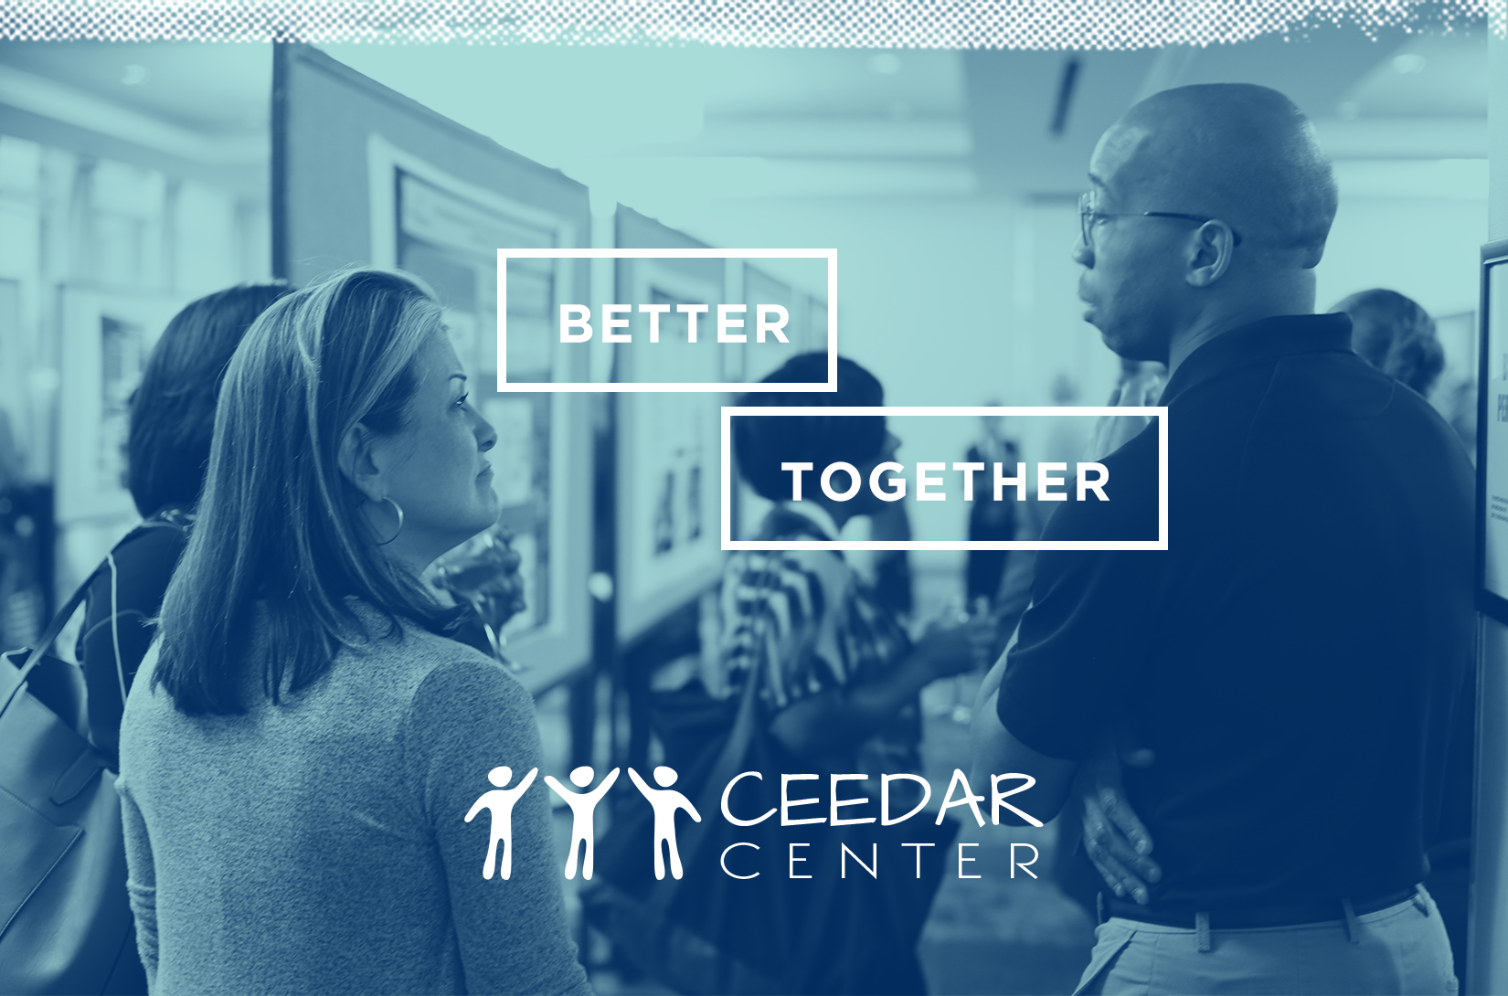
Working with Principals to Develop Inclusive School Programs

Slide 2
Topics:
Background information on developing inclusive schools, from 1980s to 2000s
Research on effective inclusive schools from 2000 to the present

Slide 3
Background Information – 1980s to early 2000s
Late 1980s through early 2000s – Worked with teams of teachers and administrators from about 40 elementary, middle, and high schools to develop inclusive schools
Systematic approach to school change based primarily on the work of Fullen (2001) and Sarason (1990)
One semester planning, and that semester and summer to provide professional development, with implementation in the fall
Description of this change process found in book titled Inclusive schools in action: Making differences ordinary

Slide 4
Background Information (Continued)
Assumption that inclusion would improve academic outcomes
For the most part, no school-wide data were available to document this assumption during this time
Students with disabilities were often not part of the accountability system in general education

Slide 5
Developing Inclusive Schools - Lessons Learned
School-wide change (school improvement) is required to develop and sustain an inclusive school
Most students with disabilities can e included for much of the school day in general education classrooms
Academic outcomes improved for some students with disabilities, but not others (e.g., those with more severe learning (reading) disabilities) (McLeskey & Waldron, 1998)
Overall, improved academic outcomes were not sufficiently improved

Slide 6
Developing Inclusive Schools - Lessons Learned (Cont.)
“Schools that function inclusively do so for a reason…the principals in these schools were the reason” (Salisbury, 2006, p. 79)

Slide 7
Background Information – 2000s to Present
NCLB (2002) accountability mandate changed things…
School-wide data were available to monitor student progress overall in disaggregated groups (including students with disabilities)
Principals and teachers were much more motivated to improve instruction and academic outcomes for students with disabilities
Continued our school improvement work, but focused much more on improving instruction and academic improvement

Slide 8
Research on Effective Inclusive Schools
Case studies of effective inclusive schools
Students with disabilities meeting benchmarks for achievements well above average (for students with disabilities)
Students with disabilities included in general education classrooms performed well above average
Research is limited to a handful of schools
Most of this work in elementary schools

Slide 9
Research on Effective Inclusive Schools (Cont.)
Effective inclusive schools require even stronger principal support than previously
School wide change (school improvement) is required to develop and sustain and effective inclusive school
What are must-haves that require active principal engagement as school improvement occurs and schools become effective and inclusive?

Slide 10
Research on Effective Inclusive Schools (Cont.)
All PSEL Standards are important… But the must-haves for effective inclusive schools relate to:
  Standard 1 | Mission, Vision, Core Values
  Standard 4 | Curriculum, Instruction, and Assessment
  Standard 6 | Professional Capacity of School Personnel

Slide 11
Standard 1 | Mission, Vision, Core Values
What does this mean for an effective inclusive school?
Example:
  Include all students as valued members of the community
  Students with disabilities belong to the school community and are accepted by all
  They actively participate in the academic and social community of the school
  They are provided supports that give them an opportunity to succeed

Slide 12
How do Principals Get There?
From the beginning, principals had strong core values regarding inclusion
One principal was described as “adamant and uncompromising” about core values, which included “meeting the needs of all students in the school, not just a particular group”, and “ensuring that students with disabilities were included as a natural part of this vision and were educated as much as possible with typical peers” (Waldron et al., 2011, p. 24)

Slide 13
How do Principals Get There? (Cont.)
In another setting, across three schools, the shared vision did not “bubble up from the bottom”
Core values came from the principals, who were “clear about their school’s fundamental missions…to them, inclusion was a non-negotiable grounded in civil rights” (Hehis & Katzmann, 2012, p. 33)

Slide 14
How do Principals Get There? (Cont.)
Principals knew they could not mandate this vision and ensure commitment (and thus motivation) of teachers
Teachers were taking big risks, and often had a “this too shall pass” perspective on change
Teachers need to be highly motivated to develop and enact instructional skills needed
Key – what principals did to gain support from teachers for this vision

Slide 15
How do Principals Get There? (Cont.)
Had to develop a trusting, supportive relationship with teachers
Teachers could depend on the principal, who engaged in a range of behaviors to demonstrate support for teachers
Principals shared decision making, shared control over all aspects of change, and distributed leadership (teacher leaders)
In one school, the principal was described by a teacher as someone who “shared decision-making power and remained flexible, open-minded, and ready to learn from others” (Waldron et al., 2011, p. 54)

Slide 16
How do Principals Get There? (Cont.)
Top-down pressure (value and support all students) and bottom-up support for teachers and others involved in school improvement to enact the vision
Culture of trust and collaboration that was developed in these schools
One principal said “the degree to which we trust each other determines the degree to which we can actually get together and solve problems and work things out” (Hoppey & McLeskey, 2013, p. 249)

Slide 17
How do Principals Get There? (Cont.)
Principals also built trusting relationships with teachers by:
  Hiring teachers and paraeducators who were a good fit for the school
  Redesigning the school day so adequate time and resources were available to ensure teachers were successful
  Obtaining and providing sufficient resources to support teachers
  A willingness by the principal to make difficult decisions
Building trust and collaboratively engaging teachers was thus used to gain teacher support (and motivation) for the vision

Slide 18
Standard 4 | Curriculum, Instruction, & Assessment
Elmore (2005) recommends developing an internal accountability system that complements and supports external accountability
All effective inclusive schools recognized that teachers needed data for monitoring student progress and making instructional decisions
Must be a system that teachers value and support (i.e., it is viewed as a reflection of the content and outcomes of their instruction)
Teachers, administrators, and others worked collaboratively to develop data systems

Slide 19
Standard 4 | Curriculum, Instruction, & Assessment (Cont.)
One principal said he and his teachers developed their own measures for accountability that were intended to describe what was important to them so they would know when they were doing a good job
“Using these data led to many changes in the school, including more use of evidence-based practices to address the needs of struggling students, and reorganizing the school day” (Hoppey & McLeskey, 2013, p. 251)

Slide 20
Standard 4 | Curriculum, Instruction, & Assessment (Cont.)
“How can I have a conversation with teachers about their students if I don’t know how they’re progressing, how well they’re teaching, without individual data about students? So we had to come up with ways to monitor students. We [use these data to] have good conversations about how kids are doing, how we can get them moving, what resources you need, and all that information” (Waldron et al., 2011, p. 58)
In this school, data drove ALL decisions about resources, professional development, how the school day was organized, etc.

Slide 21
Standard 6 | Professional Capacity of School Personnel
About 70% of general education teachers feel they lack the knowledge and skills to meet the needs of students with disabilities in their classrooms (Scruggs & Mastropieri, 1996; Waldron, 2007)
Most PD/PL provided by local districts is not sufficiently intensive or focused on individual teacher practice to meet the needs of effective inclusive schools
High quality PD/PL is teacher-directed, often involves collective participation, and actively engages teachers in learning through opportunities for observing, receiving feedback and coaching. It also must be job-embedded and intensive to support learning of new skills (Desimone, 2010)

Slide 22
Standard 6 | Professional Capacity of School Personnel (Cont.)
Principals in effective inclusive schools played a critical role in ensuring teachers were provided learner-centered PD/PL
Some schools provided a large group of its teachers with intensive professional development over several months to plan the transition into becoming an effective inclusive school, and to develop the expertise to support students’ needs in their classrooms
One principal redefined a major part of his role to be more of a mentor & coach for his teachers (Hoppey & McLeskey, 2013)
Another principal developed teacher experts in her school, who then shared their expertise with others

Slide 23
Standard 6 | Professional Capacity of School Personnel (Cont.)
Principals viewed the provision of high-quality PD/PL as one of their main responsibilities
Principals immersed faculty in opportunities for high-quality PD, available at multiple times during the school day/year (e.g., faculty meetings that provided PD)
Strategies included use of grade-level or problem-solving teams, study groups and book studies addressing topics that were of particular importance, coaches, professional learning communities, etc.

Slide 24
Must-Haves to Develop & Support Effective Inclusive Schools (based on Case Studies)
Systematic School Improvement
Active and Knowledgeable Support of the Principal
  Vision and Teacher motivation
  Assessment Data to Monitor Student Progress and Make Decisions
  Building Professional Capacity – Improving Instruction in Classrooms

Slide 25
DISCLAIMER
This content was produced under U.S. Department of Education, Office of Special Education Programs, Award No. H325A170003. David Guardino serves as the project officer. The views expressed herein do not necessarily represent the positions or polices of the U.S. Department of Education. No official endorsement by the U.S. Department of Education of any product, commodity, service, or enterprise mentioned in this website is intended or should be inferred.

