Slide 1

Tools for Success with Inclusive Principal Leadership

Slide 2
Today’s Objectives
We will explore and discuss the following three resources around inclusive leadership:
  The State Evaluation of Principal Preparation Programs from UCEA and New Leaders
  An Inclusive Principal Leadership Self-Assessment Tool from the State of Massachusetts
  Promises to Keep from CCSSO and CEEDAR

Slide 3
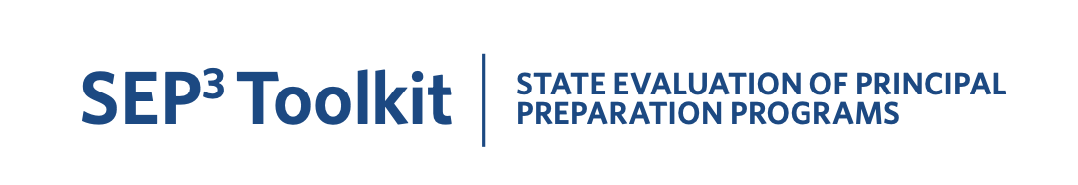
SEP3 Toolkit: State Evaluation of
Principal Preparation Programs
The readiness assessment rubric includes information in two broad areas:
  A) Focus, alignment, and positioning of state leadership
  B) Technical capabilities of the state education agency
The rubric gives examples of state actions and ideal lenses used by state leaders to assess their current state’s effectiveness around prioritization of inclusive leadership.
Click here to access the SEP 3 Toolkit.

Slide 4
IPL Self-Assessment Tool from Massachusetts DOE
This tool, adapted from Massachusetts ESE’s Model System, allows administrators to conduct a self-assessment with an emphasis on inclusive practice.
Building administrators and district administrators can use this tool in the process of conducting self-assessments.
Click here to access the Principal Self-Assessment Tool.

Slide 5
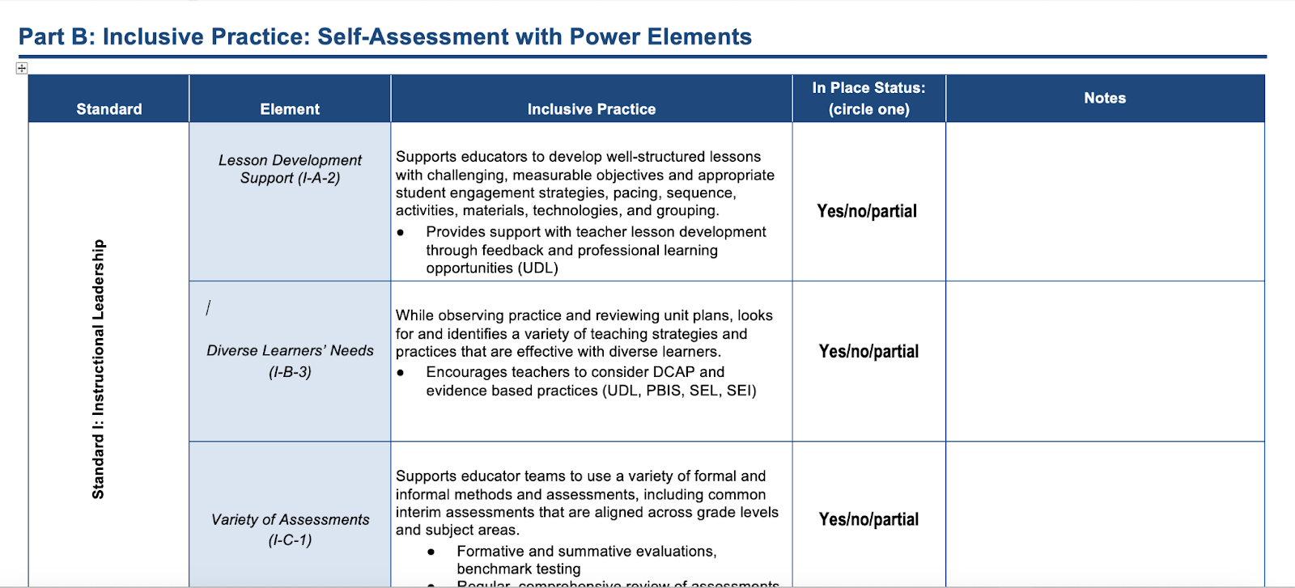
IPL Self-Assessment Tool from Massachusetts DOE

Slide 6
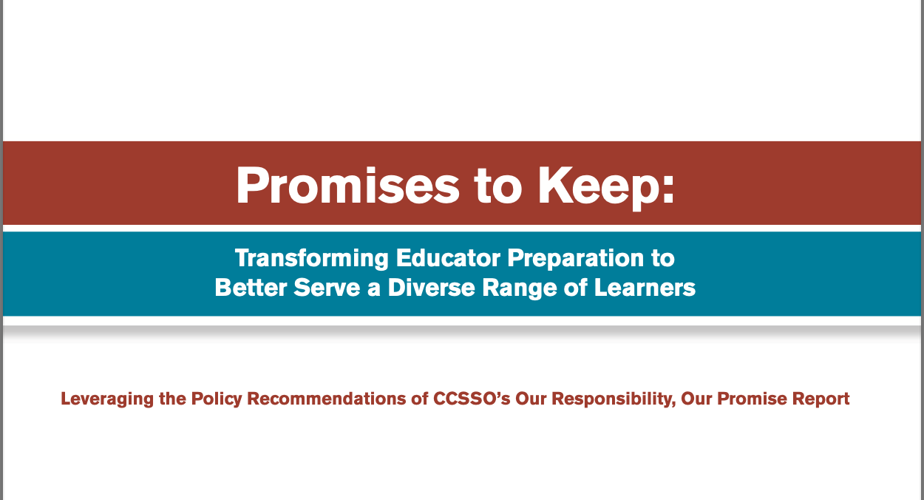


Promises to Keep
Promises to Keep is a document created in conjunction with Our Responsibilities, Our Promise, by CCSSO’s Network for Transforming Educator Preparation (NTEP)
Click here to access Promises to Keep.

Slide 7
DISCLAIMER
This content was produced under U.S. Department of Education, Office of Special Education Programs, Award No. H325A170003. David Guardino serves as the project officer. The views expressed herein do not necessarily represent the positions or polices of the U.S. Department of Education. No official endorsement by the U.S. Department of Education of any product, commodity, service, or enterprise mentioned in this website is intended or should be inferred.

