Slide 1

Supporting Inclusive Schools for the Success of Each Child

Slide 2

Inclusive Principal Leadership: Where We’ve Been
In January 2017, CCSSO and the Collaboration for Effective Educator Development, Accountability, and Reform (CEEDAR) Center released a supplementary guidance document for students with learning differences
  Developed by an Advisory Group of principals, leaders from state and local education agencies, the higher education community, and professional associations
Outlines key steps every state can take to ensure all school principals are prepared and supported to lead learning environments that meet the needs of students with disabilities and others who struggle to learn in school

Slide 3






















National Collaborative on Inclusive Principal Leadership (NCIPL)

Slide 4

NCIPL: Where We Are
We released Supporting Inclusive Schools for the Success of Each Child!
(https://ccssoinclusiveprincipalsguide.org)

Slide 5
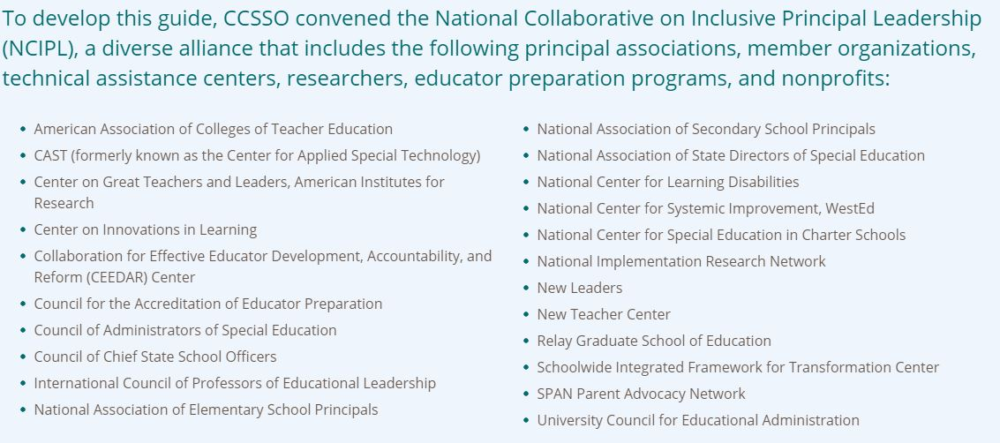
NCIPL: Where We Are

Slide 6
NCIPL: Where We Are
Supporting Inclusive Schools for the Success of Each Child: A Guide for States on Principal Leadership contains 8 key strategies to support states in integrating inclusive principal leadership in policy and practice:
  Strategy 1: Set a Vision and Plan for Inclusive Principal Leadership
  Strategy 2: Cultivate Coherence and Collaboration
  Strategy 3: Transform Principal Preparation and Licensure
  Strategy 4: Promote Principal Development on Inclusive Practices
  Strategy 5: Provide Targeted Supports to Districts and Schools
  Strategy 6: Connect School Improvement and Principal Development Initiatives
  Strategy 7: Meaningfully Engage Stakeholders as Partners in the Work
  Strategy 8: Adopt Processes and Supports for Continuous Improvement
Please Answer the Poll

Slide 7
Exploring the Microsite
Please visit https://ccssoinclusiveprincipalsguide.org/
We will explore the Where to Start Questions, State Strategies, and Aligned Resources sections
  And we encourage you to continue to do so after this presentation

Slide 8
DISCLAIMER
This content was produced under U.S. Department of Education, Office of Special Education Programs, Award No. H325A170003. David Guardino serves as the project officer. The views expressed herein do not necessarily represent the positions or polices of the U.S. Department of Education. No official endorsement by the U.S. Department of Education of any product, commodity, service, or enterprise mentioned in this website is intended or should be inferred.

