Slide 1
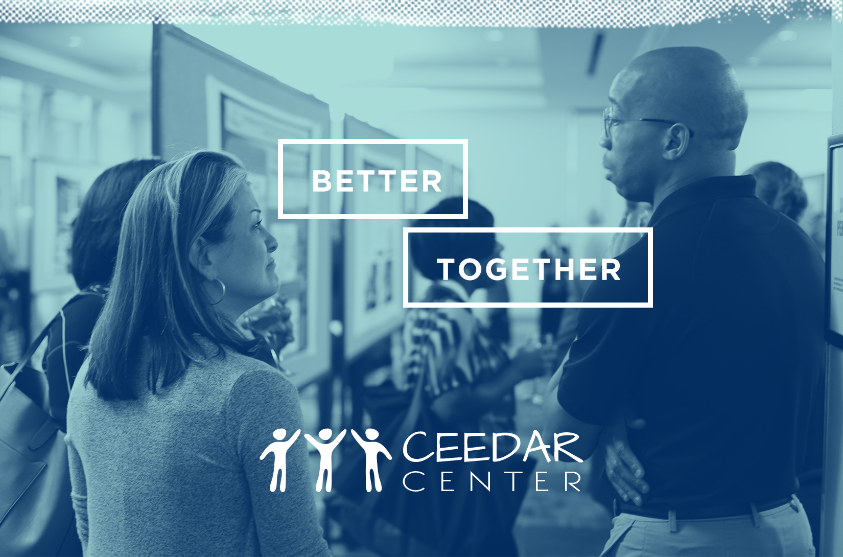
Supporting Implementation of High-Leverage Practices

Slide 2

HLPs for Teaching Students with Disabilities
Focus on instructional practice
High-frequency use
Research-supported for student engagement and learning
Broad applicability across content and settings
Skillful implementation is foundational
https://highleveragepractices.org

Slide 3
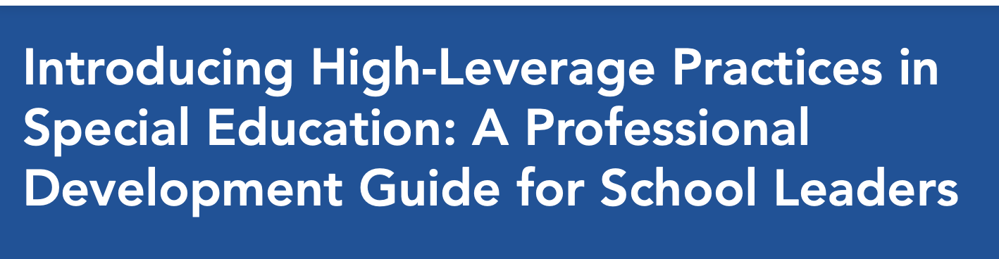
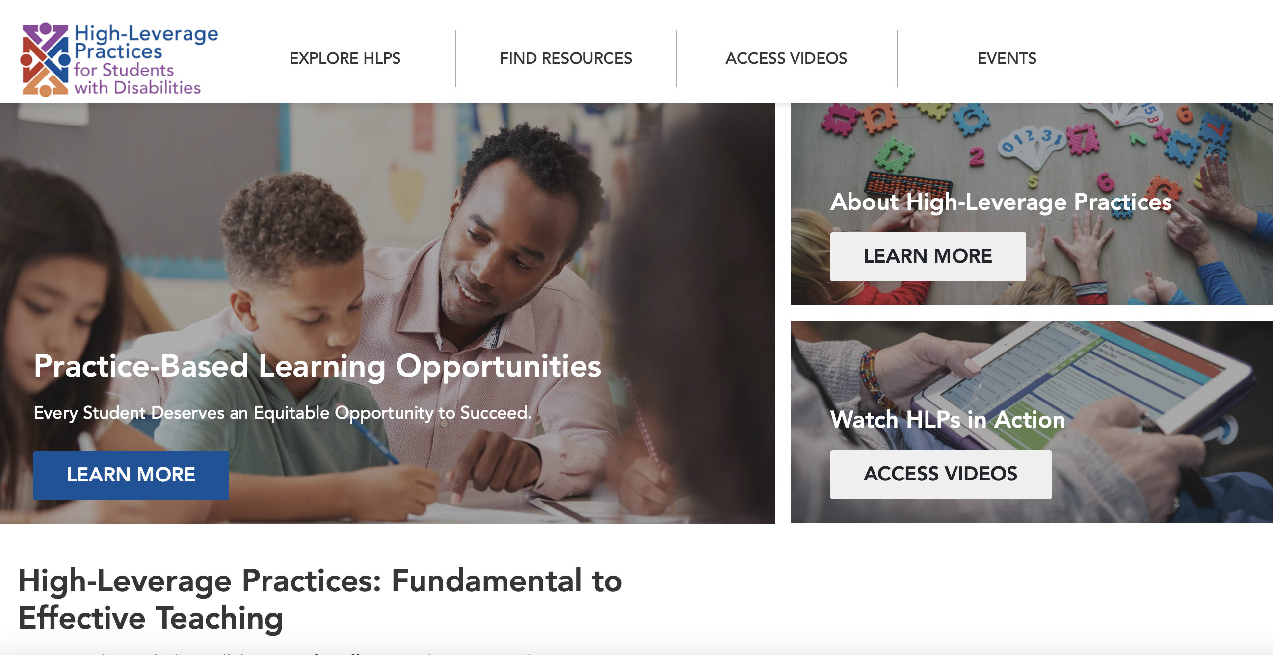
HLPs in Action

Slide 4
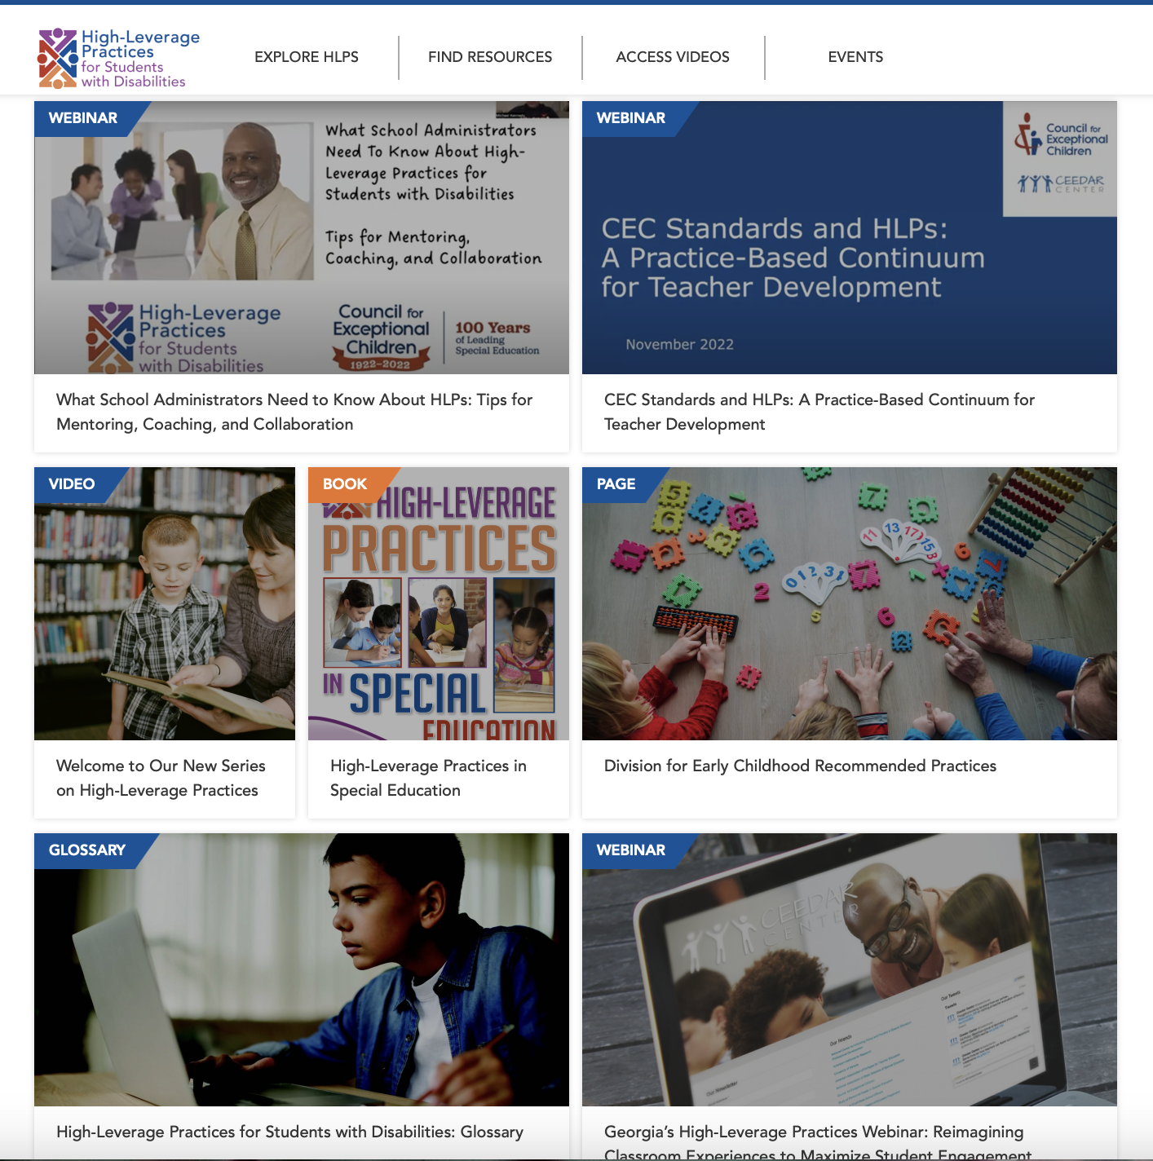
HLP Resources

Slide 5
What’s Included?
Getting to know High-Leverage Practices
Sharing High-Leverage Practices
Reflecting on High-Leverage Practices

Slide 6
Getting to know High-Leverage Practices
Section 1: Getting to know High-Leverage Practices
  Overview
  Collaboration
  Assessment
  Social / Emotional / Behavioral
  Instruction
  Bibliography of Resources
  Resources You Can Trust!

Slide 7
Sharing High-Leverage Practices
Section 2: Sharing High-Leverage Practices
  Professional Development Tools
  A Leader’s Guide to Agendas: Presentation Materials
  Professional Development Engagement Tools

Slide 8
Reflecting on High-Leverage Practices
Section 3: Reflecting on High-Leverage Practices
  Professional Development Tools
  Professional Development Reflection

Slide 9
Innovation K-8 School
Principal Wise and Assistant Principal Noble have established a vision for inclusion and equitable outcomes. All faculty, staff, students, and families are clear about the desired outcomes and are working towards them. Mrs. Wise and Mr. Noble are using resources from the CEEDAR Center, CEC, CCSSO, and the IRIS Center to inform their leadership and their lesson study groups. They are committed to inclusive leadership and that all teachers are knowledgeable and effectively implementing High-Leverage Practices and Evidence-Based Practices to deliver instruction leading toward IEP goal attainment.

Slide 10
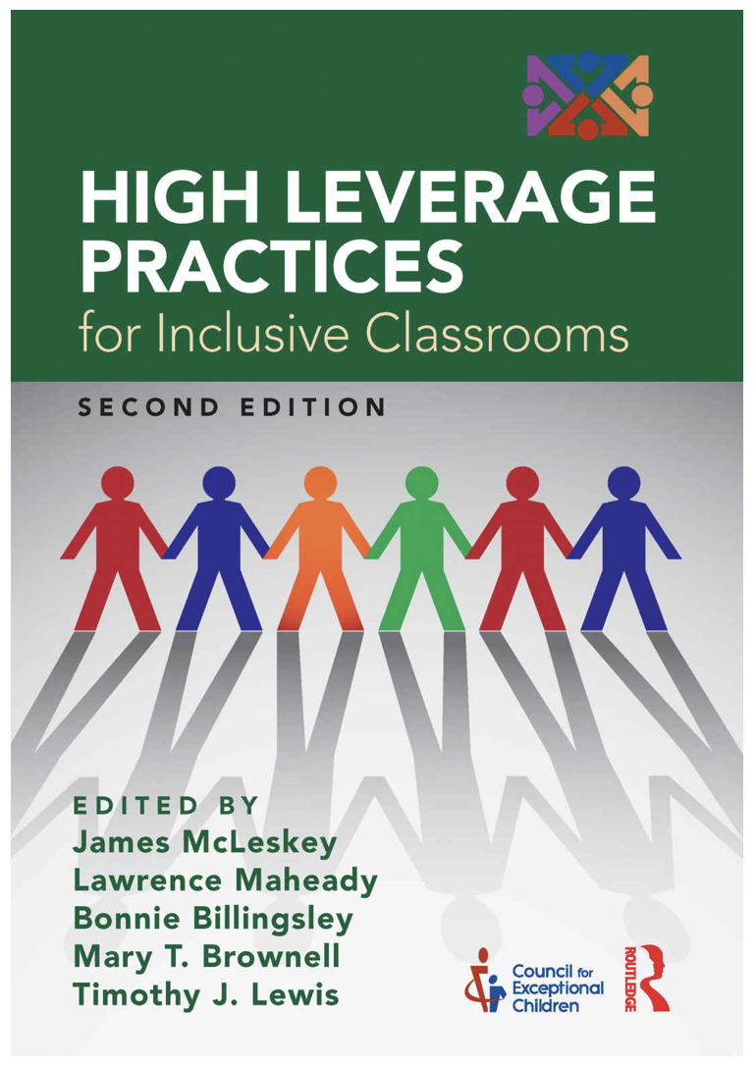

Innovation K-8 School
The school, as a collective community of practice, set priorities based on their reading of HLPs in Inclusive Schools. The leadership team set complementary goals based on guidance from the NCIPL and the HLP PD Guide for School Leaders.

Slide 11
Innovation K-8 School
The school leadership team and partner educator preparation provider used CEEDAR Center Innovation Configurations and Course Enhancement Modules to ensure alignment between preparation, professional development, and practice. Grade-level teams including interns regularly reviewed students’ IEPs and targeted specific High-Leverage Practices and Evidence-Based Practices throughout the year. HLPs and EPBs became common language and practice.

Slide 12
Innovation Configurations
ICs provide a structure for identifying strengths and gaps in professional learning opportunities in a specific content or focus area to increase use of Evidence-Based Practices

Slide 13
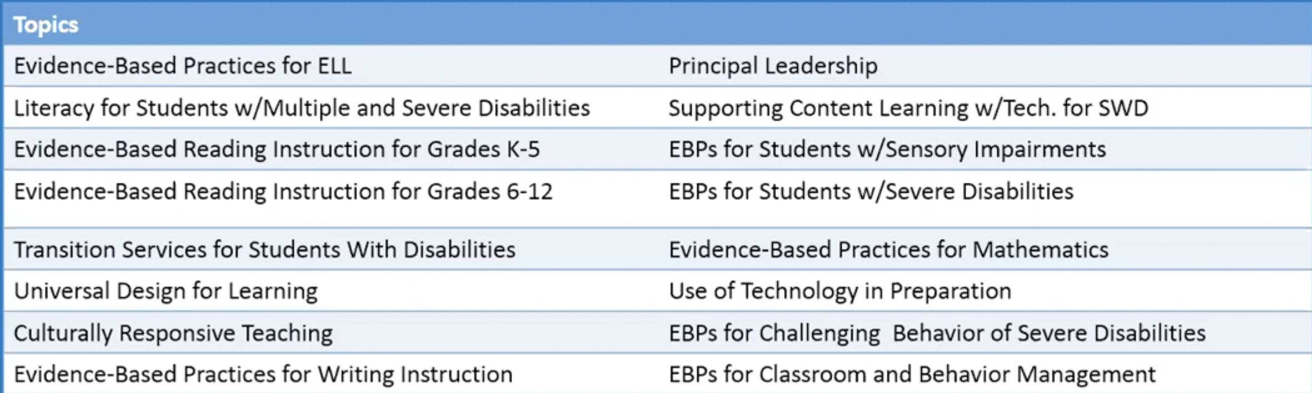
Innovation Configuration (IC) Topics

Slide 14
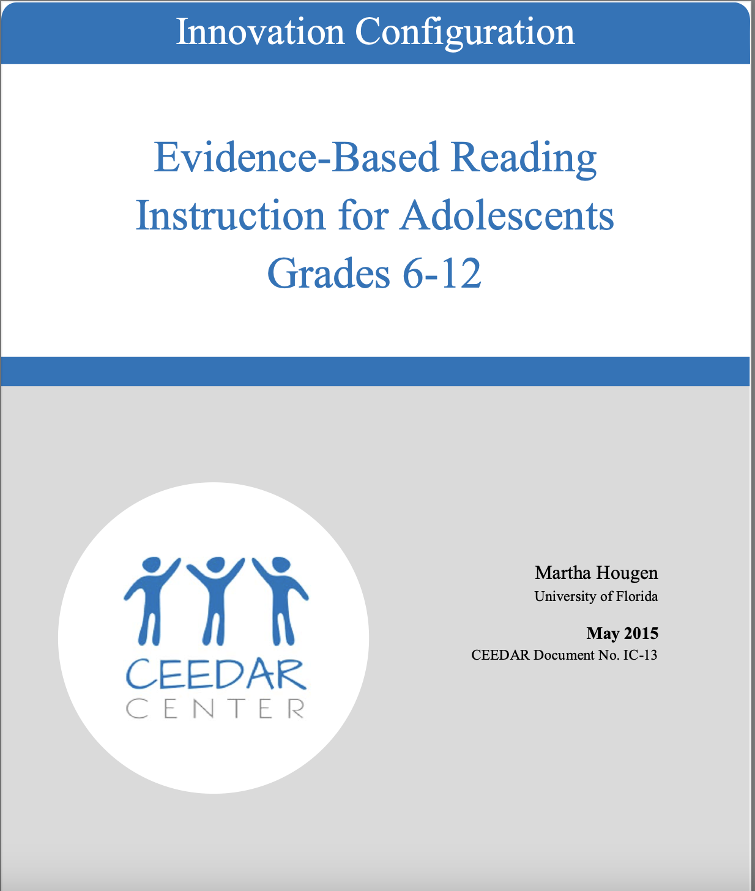
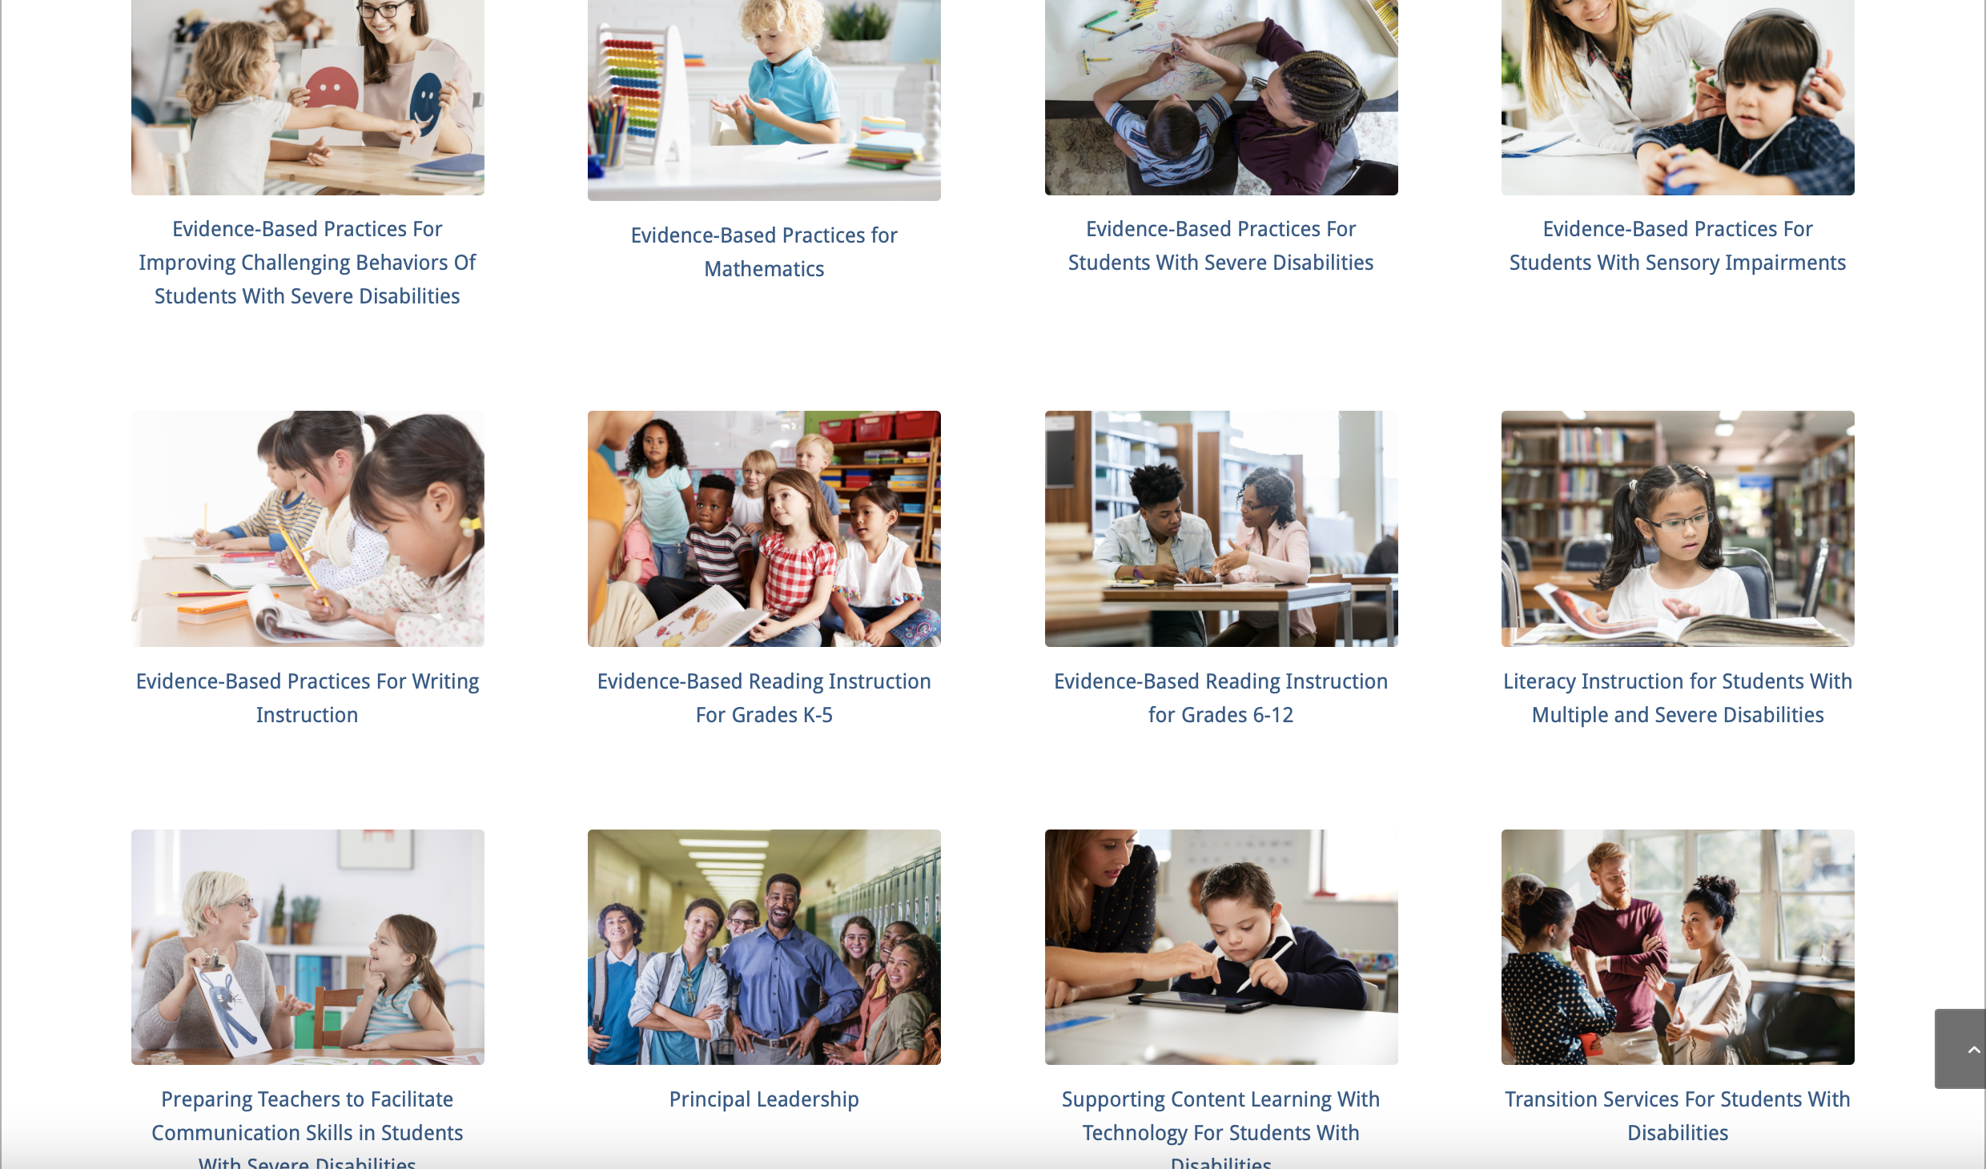
IC: Reading Instruction for Grades 6-12
Notes:
OLYMPIA

Slide 15
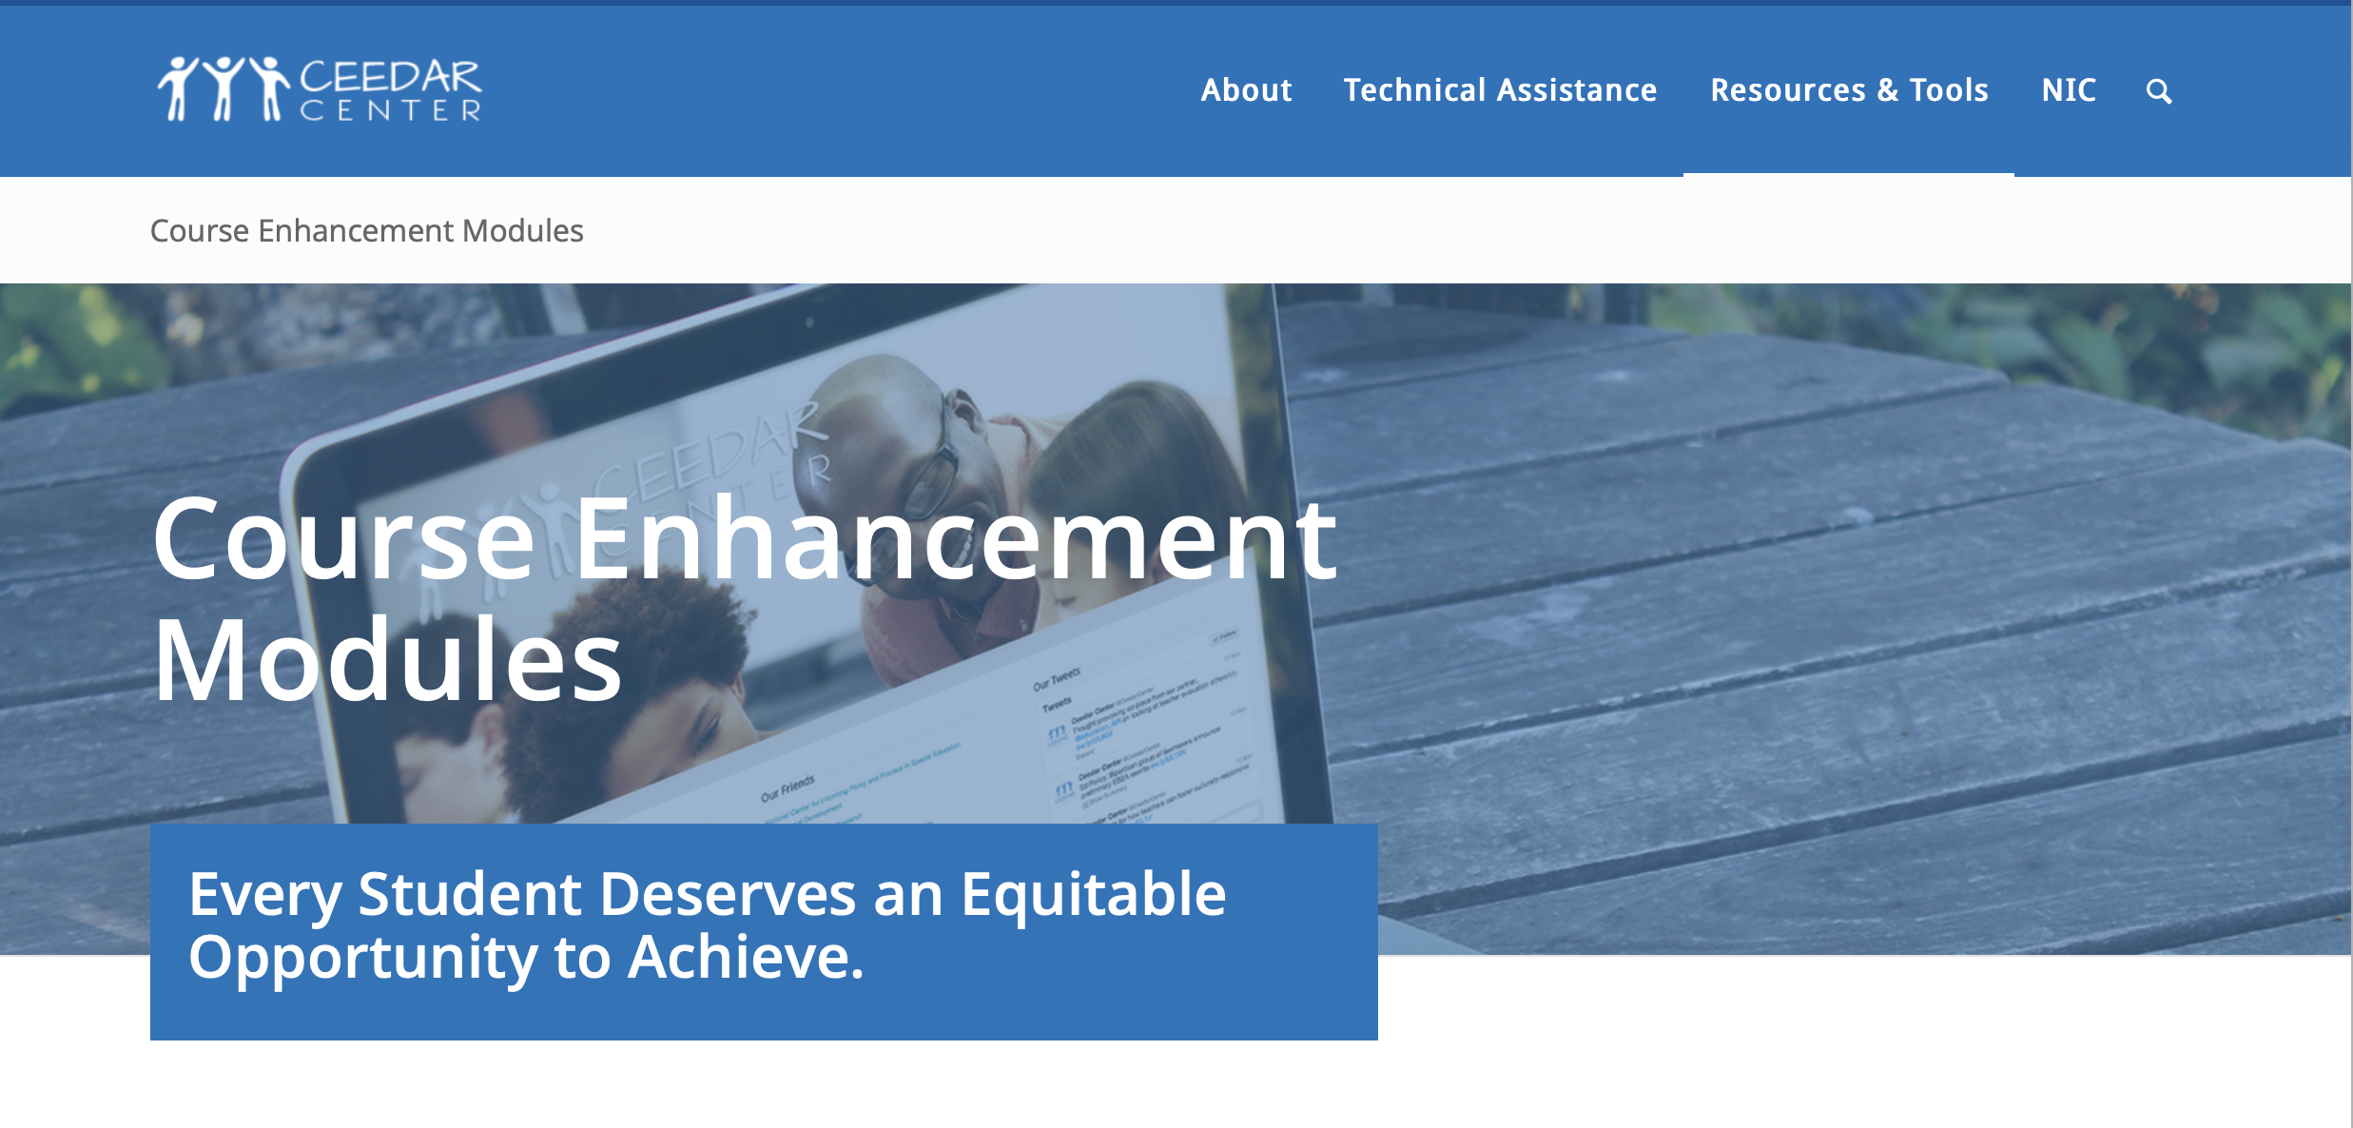
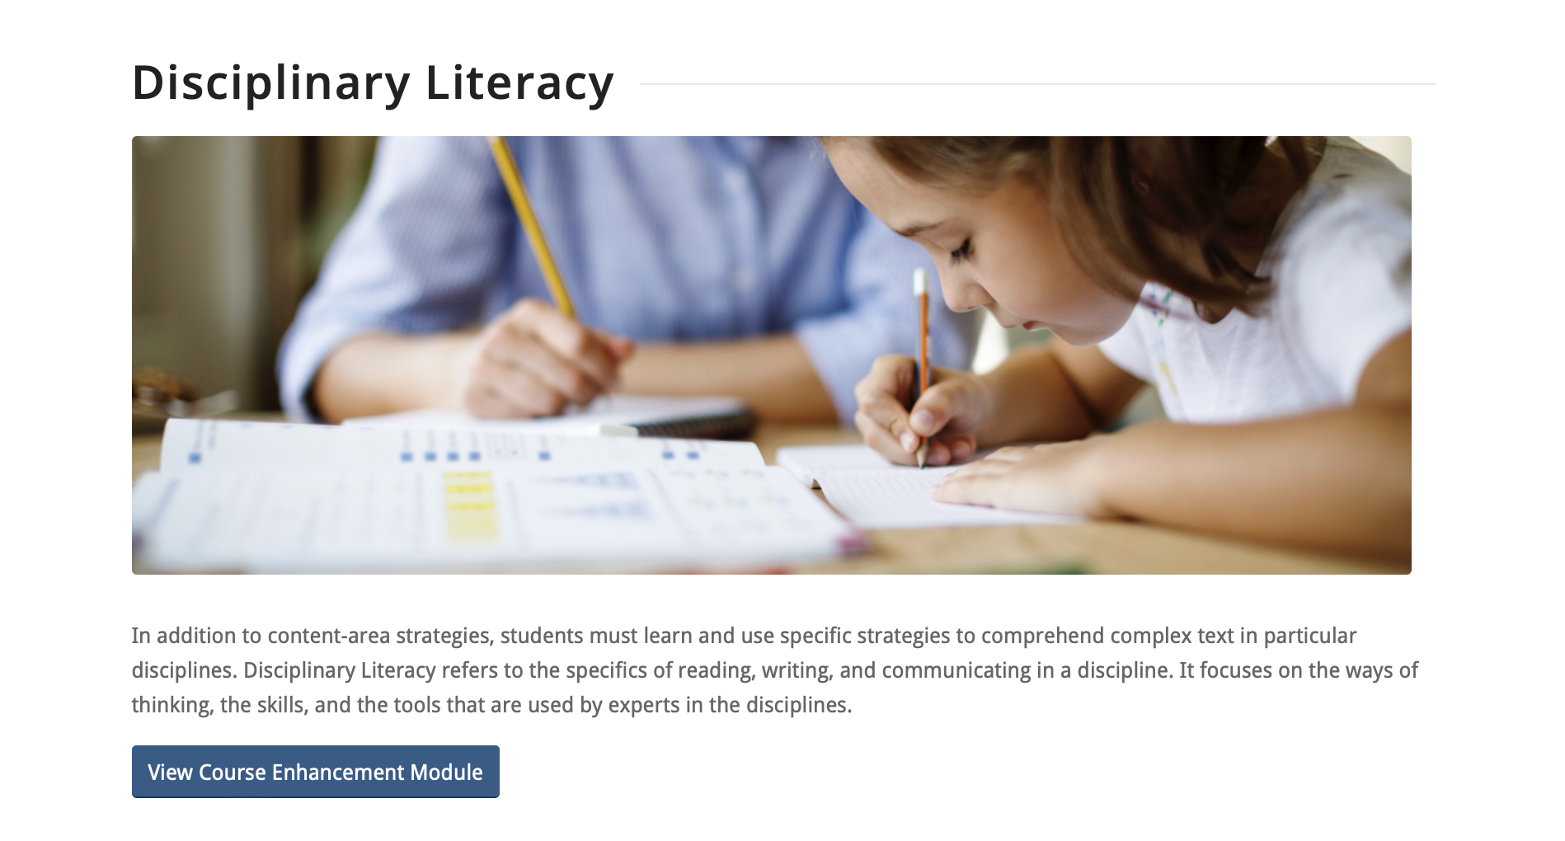
CEM: Reading Instruction for Grades 6-12
Notes:
OLYMPIA

Slide 16
Innovation K-8 School
As the year progressed, teachers formed lesson study teams as suggested in the Learning to Teach practice brief. This process allowed teachers to get substantive feedback on their selection and implementation of EBPs and HLPs to ensure they were meeting each students’ needs with an emphasis on IEP goal attainment.

Slide 17
Learning to Teach Framework
Identifying critical content and pedagogy (HLP, literacy)
Considering approach for creating high-quality, practice-based opportunities (PD and strategy alignment)
Analyzing practice-based opportunities (lesson study)
Strengthening efforts (continued PD and PIP)

Slide 18
DISCLAIMER
This content was produced under U.S. Department of Education, Office of Special Education Programs, Award No. H325A170003. David Guardino serves as the project officer. The views expressed herein do not necessarily represent the positions or polices of the U.S. Department of Education. No official endorsement by the U.S. Department of Education of any product, commodity, service, or enterprise mentioned in this website is intended or should be inferred.

