Slide 1

Promoting Principal Leadership for Student Success

Slide 2

Inclusive Principal Leadership: Where We’ve Been
In January 2017, CCSSO and the Collaboration for Effective Educator Development, Accountability, and Reform (CEEDAR) Center released a supplementary guidance document for students with learning differences
  Developed by an Advisory Group of principals, leaders from state and local education agencies, the higher education community, and professional associations
Outlines key steps every state can take to ensure all school principals are prepared and supported to lead learning environments that meet the needs of students with disabilities and others who struggle to learn in school

Slide 3
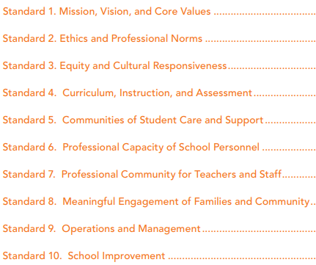
Inclusive Principal Leadership: Where We’ve Been
Our work on Inclusive Principal Leadership is rooted in the PSEL standards and the PSEL 2015 and Promoting Principal Leadership for the Success of Students with Disabilities
In going through the process of putting together the follow-up document, we realized more was needed to support states as they promote inclusive school leadership

Slide 4
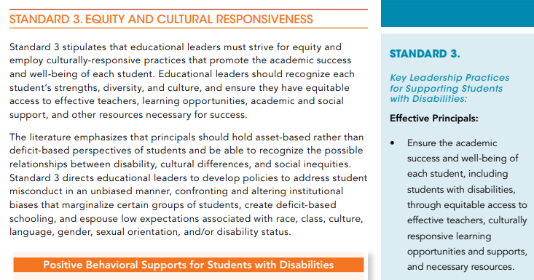
PSEL and Inclusive Principal Leadership

Slide 5
Equity and Cultural Responsiveness
Exclusionary Discipline: All Time High
School to Jail Pipeline: 73% of youth with emotional behavioral disabilities who drop out of school are arrested within five years
Mental Health: 30% of students in need receive services
PSEL 2015
Standard 3

Slide 6
Wisconsin Urgency
  Students with Dis/Abilities:
    Suspended: 3 times more likely
    Expelled: 2 times more likely
  Students with Emotional Behavioral Dis/Abilities:
    Suspended or Expelled: 10 times ore likely
PSEL 2015
Standard 3

Slide 7
Wisconsin Urgency
  African American Students: 10 times
  Native American Students: 3.5 times
  Hispanic Students: 2.4 times

Slide 8
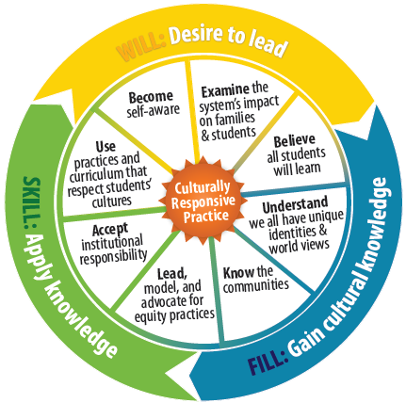
Equity and Cultural Responsiveness
  Engage staff in discussions of the terms “Fair”, “Equal” and “Equity”
  Ensure IEPs reflect individualized supports and services that promote “Access” and “Engagement” in general education curriculum and environment
PSEL 2015
Standard 3

Slide 9
Equity and Cultural Responsiveness
Model strength based language . . .
  Promote differences versus deficits
  Discuss “opportunity gap” versus “achievement gap”
  Develop, model, and highlight positive relationships with students with differing abilities and lived experiences
PSEL 2015
Standard 3

Slide 10
SEA Strategy Disaggregation of Data
SEA Strategy
Disaggregation of Data
National Study Disaggregating Predictive Reasons for Office Referrals
White Students
Smoking
Vandalism
Leaving without Permission
Obscene Language
Black Students
Disrespect
Excessive Noise
Threat
Loitering
Skiba, R.J., Michael, R.S., Nardo, A.C. & Peterson, R. (2002).
The color of discipline: Sources of racial and gender disproportionality in school punishment. Urban Review, 34, 317-342.

Slide 11
Meaningful Engagement of Families and Community
Understanding the Unique Experience and Culture of Parents and Family Members of Students with Dis/Abilities
“Hurt People” “Hurt People” Rick Lavoie
Designate a location in the school for information and resources for families
  State and regional organizations and peer supports, IEP resources, web links on school/district page
PSEL 2015
Standard 8

Slide 12
SEA Supports of Family and Community Engagement
Cross Division Family Engagement Workgroup
WI FACETS
Grants and partnerships with Wisconsin Parent Training and Information Center (PTI)
Collaborative trainings, webinars, support of special education advisory council, focus group and stakeholder input
WSPEI (Wisconsin Statewide Parent Educator Initiative)
IDEA Discretionary Grant
CESA Family Engagement Coordinators
District Family Engagement Liaisons
PSEL 2015
Standard 8

Slide 13
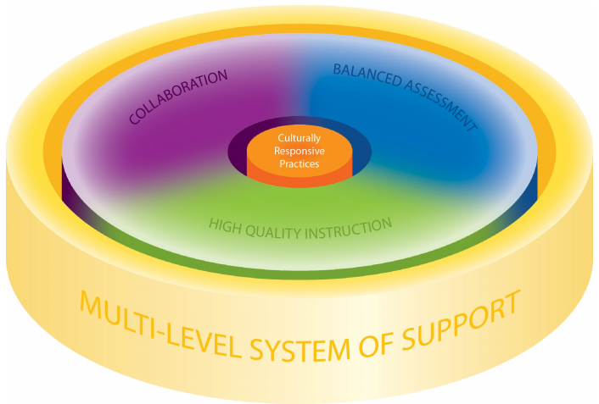


School Improvement
Remember What We Want to Accomplish
PSEL 2015
Standard 10

Slide 14
College and Career Readiness
All Students Graduate from High School
Academically Prepared and
Socially Emotionally Competent
by Possessing and Demonstrating . . .
Knowledge
Proficient in Academic Content
Skills
Critical Thinking, Communication, Collaboration, Creativity, Community
Habits
Perseverance, Responsibility, Adaptability, Leadership

Slide 15
School Improvement
Focus discussions on “Why” and “How” when updating systems that support the needs of students with IEPs
Disaggregate student data and look at your students with IEPs
  Disciplinary removals, shorter school days, referrals, suspensions
  Academic achievement, participation in assessment
  Attendance, graduation
  Access to curriculum, instruction, and environments
PSEL 2015
Standard 10

Slide 16
SEA Level Supports
Principals as a required team member in statewide systems change initiatives focusing on students with IEPs
SPDG – Principals as part of PLCs that focus on students with IEPs
Using SPDG as example of framing other IDEA Discretionary Grants

Slide 17
School Improvement
Federal Identifications
IDEA
LEA Determinations
Disproportionality
ESSA
Targeted Support
Comprehensive Support
Additional Targeted Support

Slide 18
School Improvement
Special Education and Title I: Leveraging Overlaps
Equity at the heart of both laws
Coordinated/unified:
    Notification package
    reporting requirements
    reporting platform (WISEgrants)
    supports (WISExplore, WISElearn, region and statewide support system)
Improvement planning resources rooted in implementation science
Statewide system to support continuous improvement efforts
Flexibility in continuous improvement approaches and supports
PSEL 2015
Standard 10

Slide 19
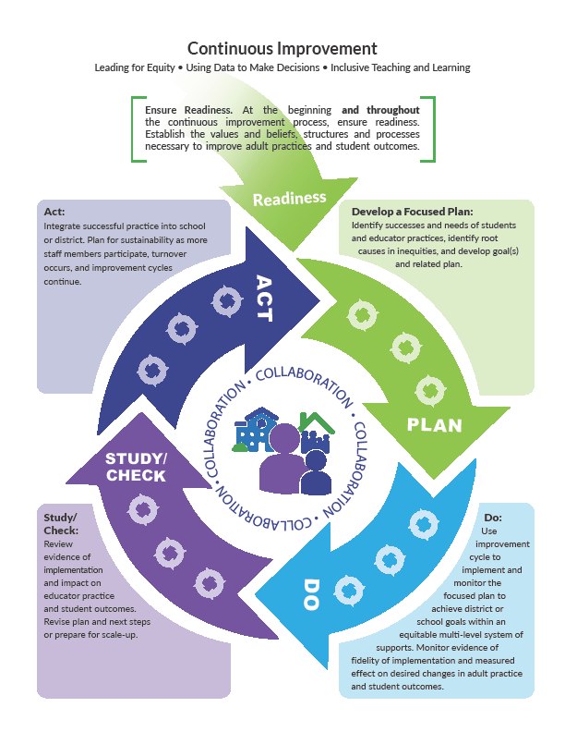
Continuous Improvement Process

Slide 20
DISCLAIMER
This content was produced under U.S. Department of Education, Office of Special Education Programs, Award No. H325A170003. David Guardino serves as the project officer. The views expressed herein do not necessarily represent the positions or polices of the U.S. Department of Education. No official endorsement by the U.S. Department of Education of any product, commodity, service, or enterprise mentioned in this website is intended or should be inferred.

