Slide 1

Leadership for Effective Inclusive Schools

Slide 2
Leadership for Inclusive Schools
What is inclusion?
Where is inclusive reform initiated and supported?
Why is principal leadership important?
What do inclusive principals do?
What do we know about principal preparation for inclusive schools?
What resources are available to support leaders in learning about inclusive schools?

Slide 3
What is Inclusion?
Physical placement in inclusive schools and classrooms
Valued member of class, part of class routines and activities; relevant extracurricular activities
Accessible curriculum
S
U
P
P
O
R
T
S
+
e.g., Booth, 2011; Hehir et al., 2016; Pitonyak, 2017

Slide 4
Where is Inclusive Reform Initiated & Supported? (Billingsley, 2019)
Office of Special Education
States
Universities
Courts
Districts
School
Principals, Teacher Leaders, Others
Parents
Classrooms
Teachers, Paraprofessionals

Slide 5
Why is principal leadership important?
“Schools that function inclusively do so for a reason. … [and] the principals in these schools were the reason” (Salisbury, 2006, p. 79)
Principals play important roles in creating the culture and supports necessary for inclusive programs for students with disabilities

Slide 6
What do inclusive principals do?
Support a shared vision for inclusion
  Articulate support to varied constituents
  Help others see why inclusion is important
2. Foster a culture of high expectations and collective responsibility
3. Share decision-making with others
  Solicit broad input from others
  Create planning teams
    Teacher leaders, parents, critical friends, others
Support professional learning

Slide 7
What do inclusive principals do? (cont.)
4. Support teacher learning
  Help staff understand what inclusion means and looks like
  Focus on instructional practices
  Formal and informal learning (e.g., Professional Learning Communities)
5. Create working conditions and structures that support inclusion
  Teachers’ roles
  Supporting teacher collaboration/co-teaching
  Schedules & resources

Slide 8
What do inclusive principals do? (cont.)
6. Monitor progress
  Progress toward inclusion
  Student progress (e.g., RTI, MTSS)
  Problem-solve and celebrate successes
7. Plan for sustaining inclusion over time
  New hires
  On-going PD
8. Encourage questions, expect resistance, listen to concerns, &
problem-solve

Slide 9
What do we know about principal preparation for inclusive schools?
(Billingsley, McLeskey & Crockett, 2017)
  Coursework typically addresses the legal aspects of special education
  Minimal preparation about inclusion and effective programs
  Principals are often uncertain about what special education teachers do
  Have concerns about general educators’ readiness to teach students with disabilities
  In summary, there is a lot of work to do in preparing principals for inclusive schools

Slide 10
Resources that Support Leadership Development
Professional learning
Coursework
Micro-credentialing
Self-study

Slide 11
Guidance Document for Inclusive Leadership:
Elaborating on the PSEL Standards
Council of Chief State School Officers & Collaboration for Effective Educator Evaluation, Development, and Reform (2017). PSEL 2015 and promoting principal leadership for the success of students with disabilities. Retrieved on February 18, 2017 from http://www.ccsso.org/Documents/2017/PSELforSWDs01252017.pdf

Slide 12
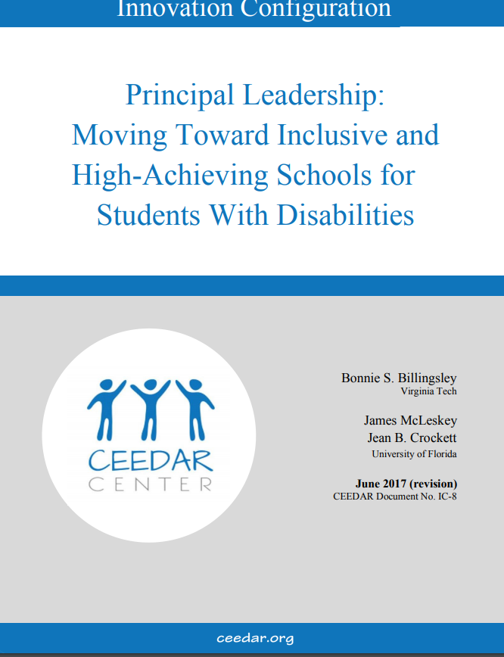
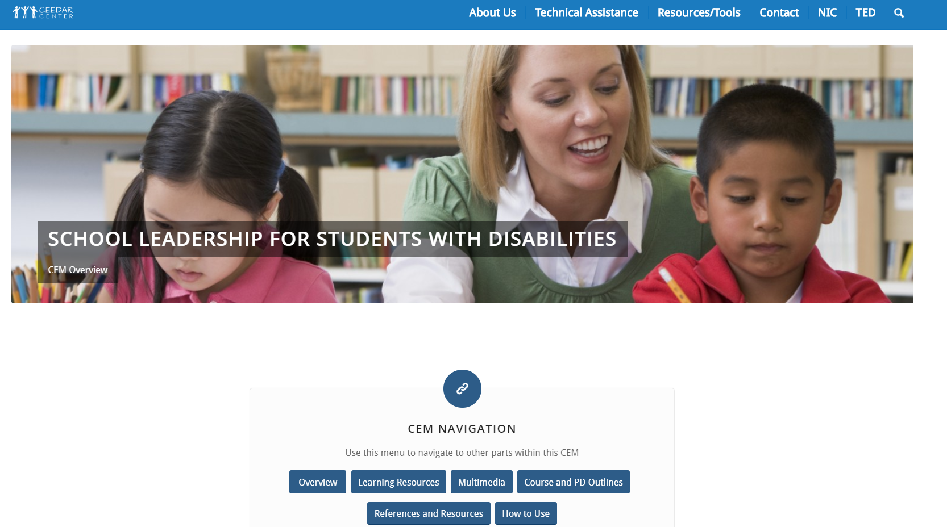
CEEDAR Principal Resources http://ceedar.education.ufl.edu/cems/leadership/
This CEM provides a syllabus and 7 lectures,
with activities and resources for 21 hours of instruction

Slide 13
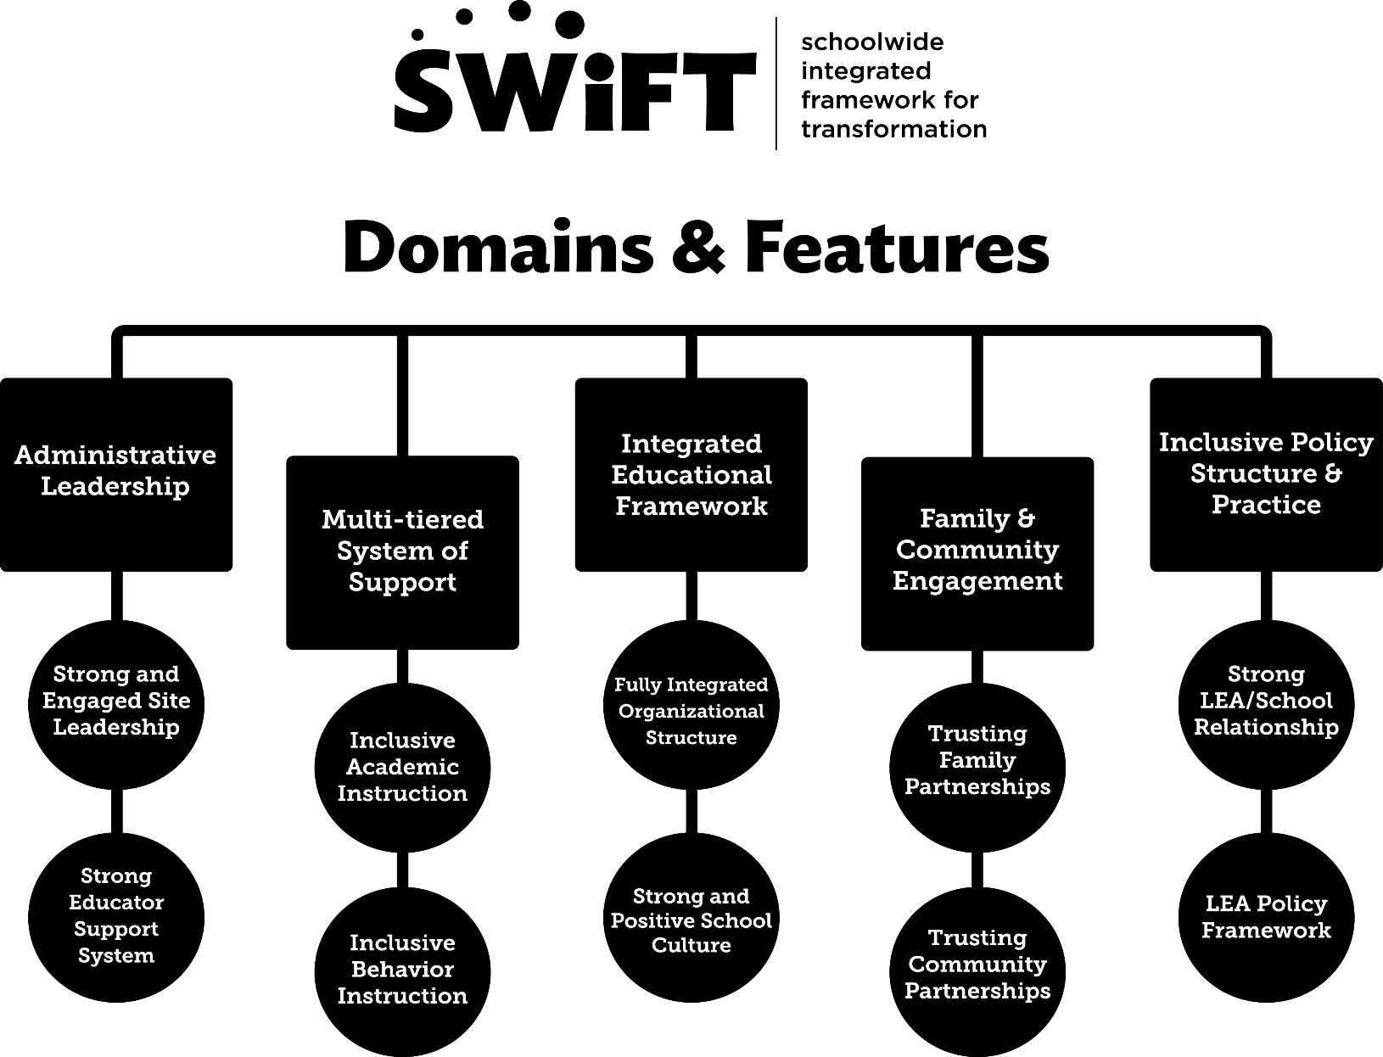
SWIFT Schools
Includes:
Guides
Podcasts
Webinars
Videos
Blogs
Tools
Web resources
And more…
http://guide.swiftschools.org/

Slide 14
IRIS Resources: School Improvement/Leadership
Examples of Modules
  IEPs: How administrators can support the development and implementation of high-quality IEPs
  RTI: Considerations for school leaders
  Teacher retention: Reducing the attrition of special educators
  Differentiated instruction: Maximizing the learning of all students
  Effective school practices: promoting collaboration and monitoring students’ academic achievement
https://iris.peabody.vanderbilt.edu/resources/iris-resource-locator/

Slide 15
Case Studies of Inclusive Leadership Reviewed
(Billingsley & Banks, 2019)
Examples of state and district leadership
Examples of exemplary principals in pre-K or elementary schools
Examples in secondary schools
Examples of inclusive efforts sustained or not, over time
Examples of stalled or failed efforts

Slide 16
Research and practitioner books about inclusion

Slide 17
DISCLAIMER
This content was produced under U.S. Department of Education, Office of Special Education Programs, Award No. H325A170003. David Guardino serves as the project officer. The views expressed herein do not necessarily represent the positions or polices of the U.S. Department of Education. No official endorsement by the U.S. Department of Education of any product, commodity, service, or enterprise mentioned in this website is intended or should be inferred.

