Slide 1

Introduction to Inclusive Principal Leadership

Slide 2

Inclusive Principal Leadership: Where We’ve Been
In 2015, the National Policy Board for Educational Administration (NPBEA) released the Professional Standards for Educational Leaders (PSEL)
  PSEL better reflects the role of leaders today, both as building managers and instructional leaders who advance learning for an increasingly diverse group of students
CCSSO worked with NPBEA and educational leaders in the field to update the standards
Notes:
Refresh of the Interstate School Leaders Licensure Consortium Standards

Slide 3

Inclusive Principal Leadership: Where We’ve Been
In January 2017, CCSSO and the Collaboration for Effective Educator Development, Accountability, and Reform (CEEDAR) Center released a supplementary guidance document for students with learning differences
  Developed by an Advisory Group of principals, leaders from state and local education agencies, the higher education community, and professional associations
Outlines key steps every state can take to ensure all school principals are prepared and supported to lead learning environments that meet the needs of students with disabilities and others who struggle to learn in school

Slide 4
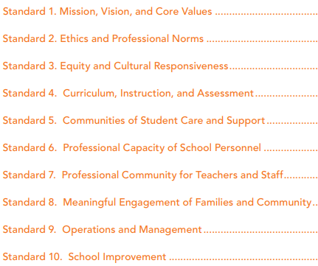
Inclusive Principal Leadership: Where We’ve Been
Our work on Inclusive Principal Leadership is rooted in the PSEL standards and the PSEL 2015 and Promoting Principal Leadership for the Success of Students with Disabilities
In going through the process of putting together the follow-up document, we realized more was needed to support states as they promote inclusive school leadership

Slide 5
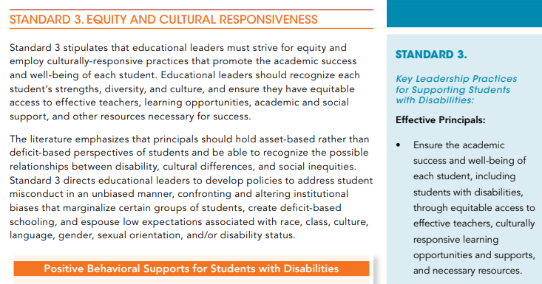
PSEL and Inclusive Principal Leadership

Slide 6
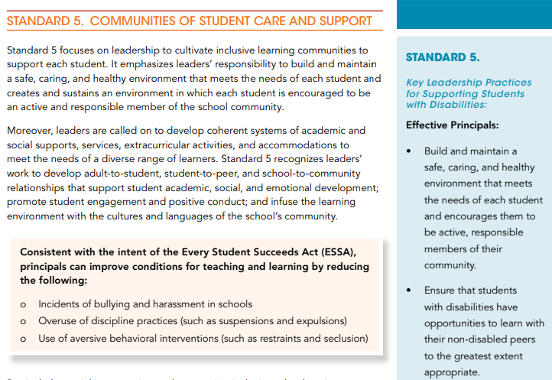
PSEL and Inclusive Principal Leadership

Slide 7
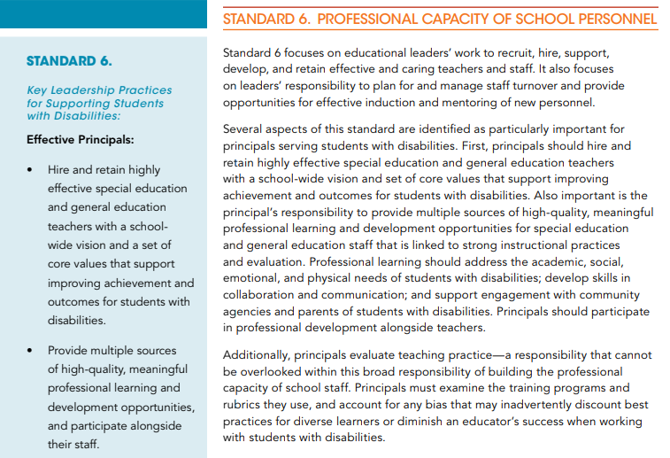
PSEL and Inclusive Principal Leadership

Slide 8






















National Collaborative on Inclusive Principal Leadership (NCIPL)

Slide 9

NCIPL: Where We Are
We released Supporting Inclusive Schools for the Success of Each Child!
(https://ccssoinclusiveprincipalsguide.org)

Slide 10
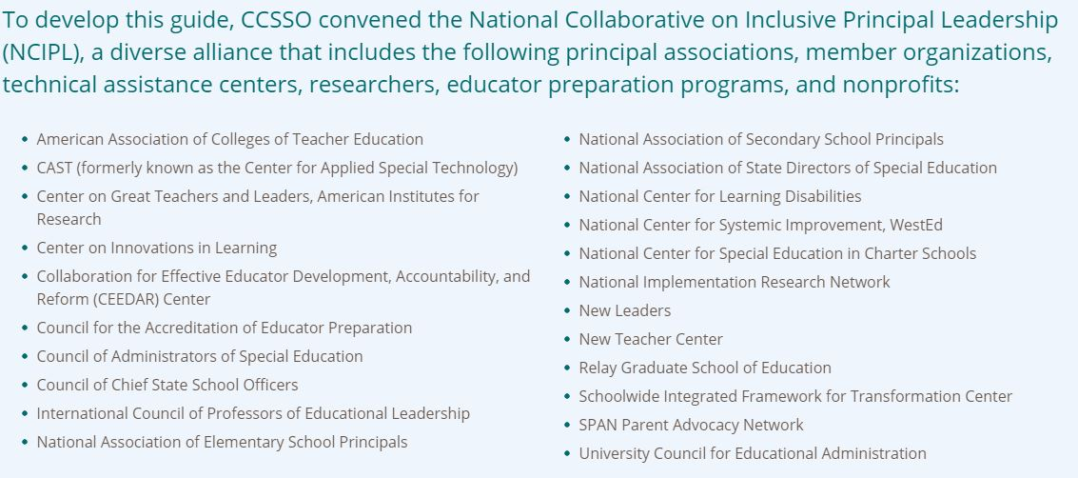
NCIPL: Where We Are

Slide 11
DISCLAIMER
This content was produced under U.S. Department of Education, Office of Special Education Programs, Award No. H325A170003. David Guardino serves as the project officer. The views expressed herein do not necessarily represent the positions or polices of the U.S. Department of Education. No official endorsement by the U.S. Department of Education of any product, commodity, service, or enterprise mentioned in this website is intended or should be inferred.

