Slide 1
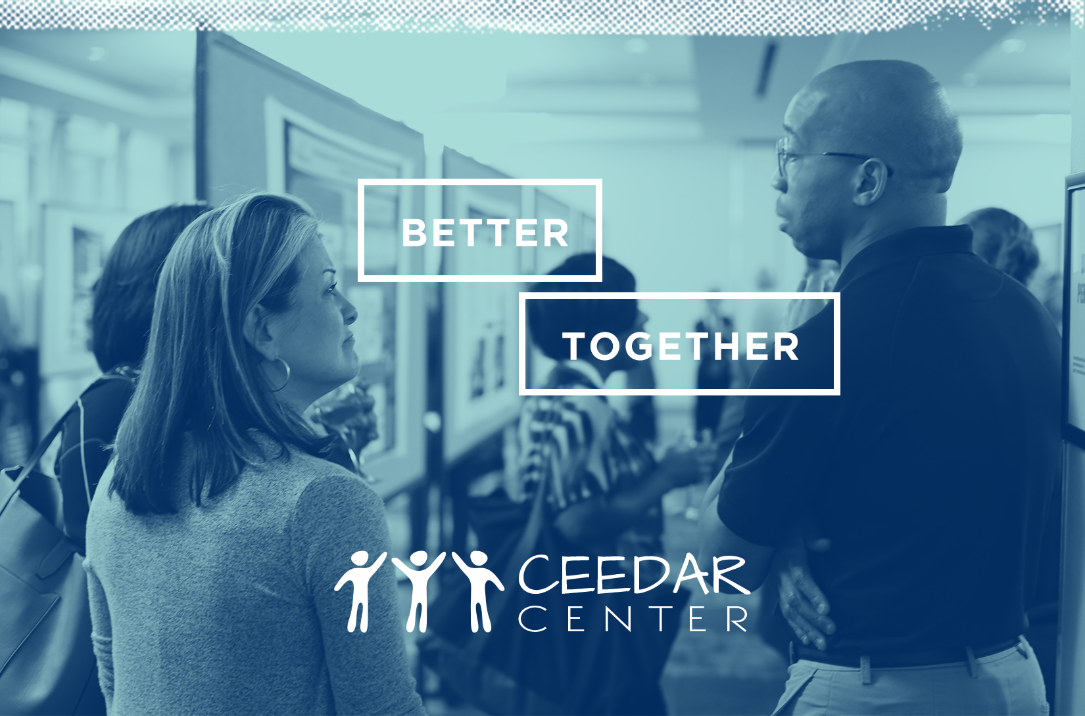
IPL in Action: Oregon Case Study

Slide 2
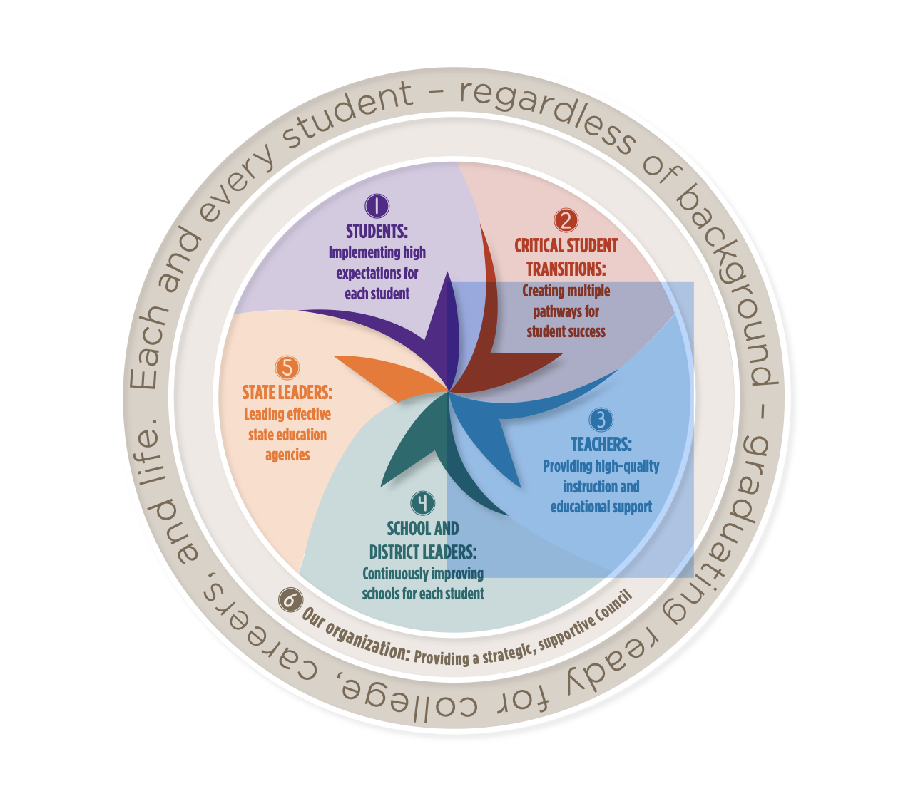
Overview of CCSSO’s 2017-2020 Strategic Plan

Slide 3

Goal 1: Students
Each student deserves an education that prepares them for lifelong learning and success in the world today.

Slide 4
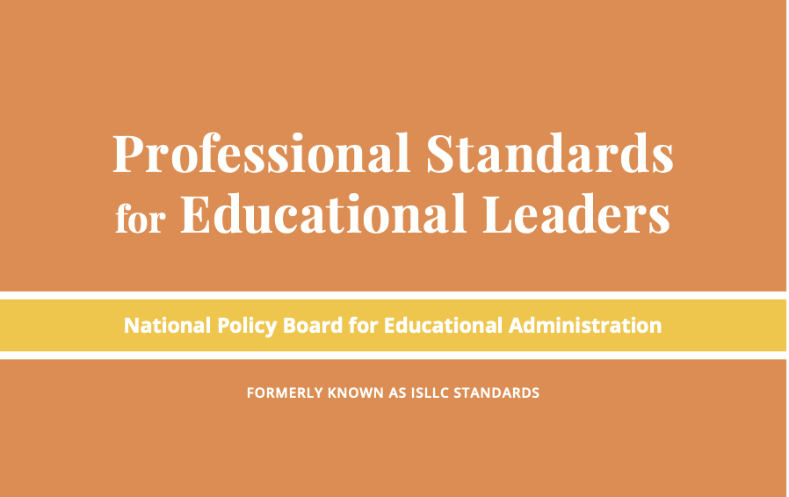
Inclusive Principal Leadership: Where We’ve Been
In 2015, the National Policy Board for Educational Administration (NPBEA) released the Professional Standards for Educational Leaders (PSEL)
  PSEL better reflects the role of leaders today, both as building managers and instructional leaders who advance learning for an increasingly diverse group of students
CCSSO worked with NPBEA and educational leaders in the field to update the standards

Slide 5

Inclusive Principal Leadership: Where We’ve Been
In January 2017, CCSSO and the Collaborations for Effective Educator Development, Accountability, and Reform (CEEDAR) Center release a supplementary guidance document for students with learning differences
  Developed by an Advisory Group of principals, leaders, from state and local education agencies, the higher ed. community, and professional associations
Outlines key steps every state can take to ensure all school principals are prepares and supported to lead learning environments that meet the needs of students with disabilities and others who struggle to learn in school

Slide 6



Inclusive Principal Leadership: Where We’ve Been
  In February 2017, CCSSO held, in collaboration with CEEDAR and Center on Great Teachers and Leaders (GTL Center), a meeting of 32 individuals representing federal TA centers and national organizations to discuss the role of principals in supporting students with learning differences.
    PSEL 2015 and Promoting Principal Leadership for the Success of Students with Disabilities grounded the discussion
  The NCIPL committed to…
    Communicate and disseminate information to key stakeholders
    Contribute to cross-organizational collaboration and strategic planning
    Integrate new strategies into and align current work

Slide 7

NCIPL: Where We Are
  Together, we released:
  Supporting Inclusive Schools for the Success of Each Child!

Slide 8
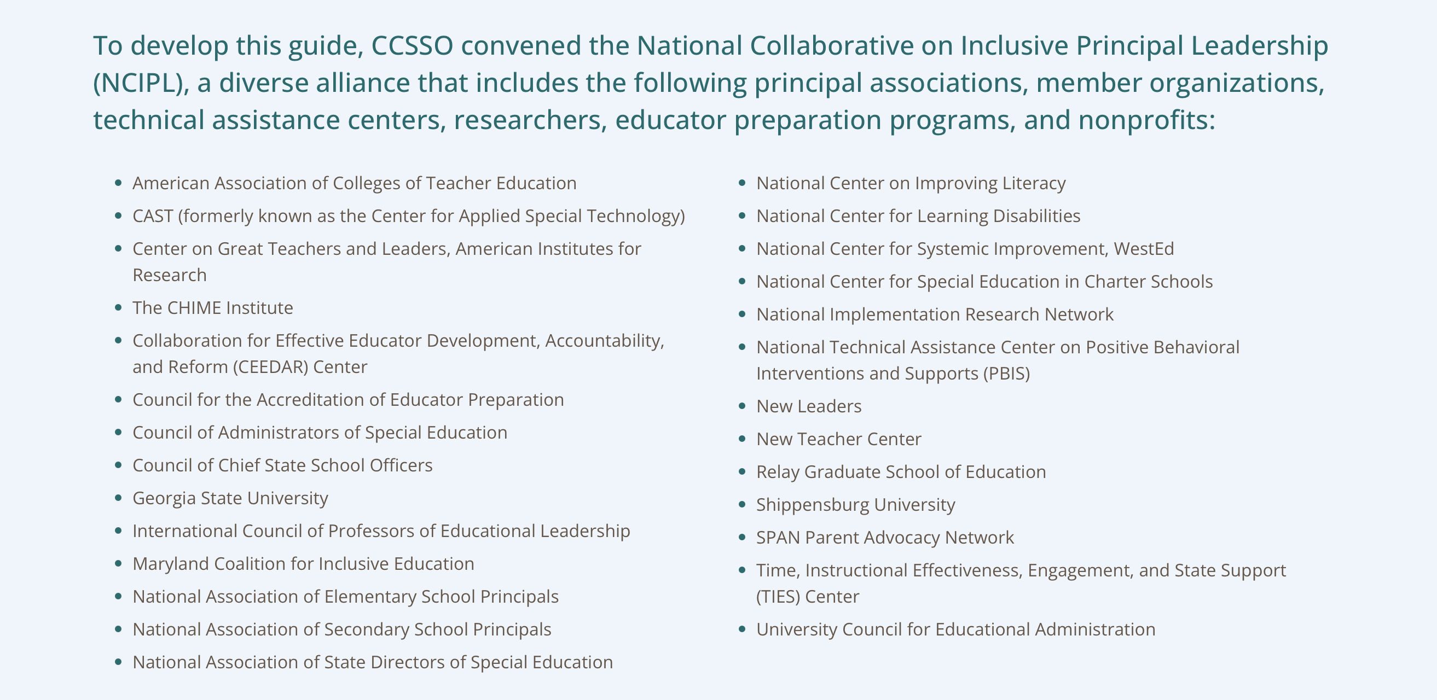
NCIPL: Where We Are

Slide 9
NCIPL: Where We Are
Supporting Inclusive Principal Leadership for the Success of Each Child contains 8 key strategies to support states in integrating inclusive principal leadership in policy and practice:
  Strategy 1: Set a Vision and Plan for Inclusive Principal Leadership
  Strategy 2: Cultivate Coherence and Collaboration
  Strategy 3: Transform Principal Preparation and Licensure
  Strategy 4: Promote Principal Development on Inclusive Practices
  Strategy 5: Provide Targeted Supports to Districts and Schools
  Strategy 6: Connect School Improvement and Principal Development Initiatives
  Strategy 7: Meaningfully Engage Stakeholders as Partners in the Work
  Strategy 8: Adopt Processes and Supports for Continuous Improvement

Slide 10
  Strategy 3: Transform Principal Preparation and Licensure
Analyze assessments used for licensure and program approval to determine leader capacity to establish inclusive buildings and classrooms
Create or adapt leadership performance assessments to measure the degree to which leaders foster productive collaboration among special education and general education teachers, and related service providers
Establish and/or implement principal preparation program approval requirements to include the context, coursework, and the length and quality of field experiences necessary for effective inclusive principal leadership
Review CAEP requirements to assess alignment with inclusive leadership practices

Slide 11
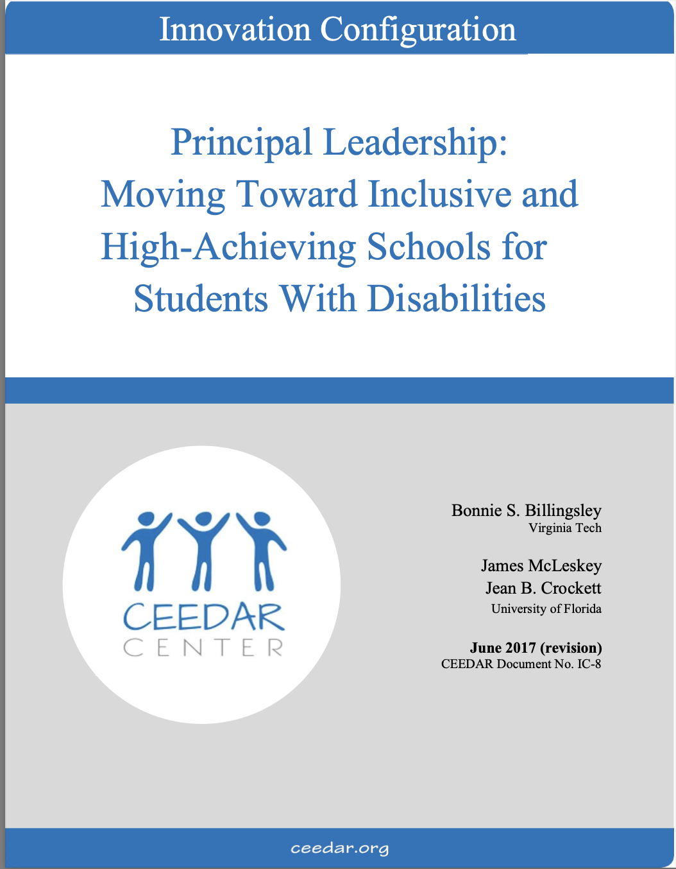
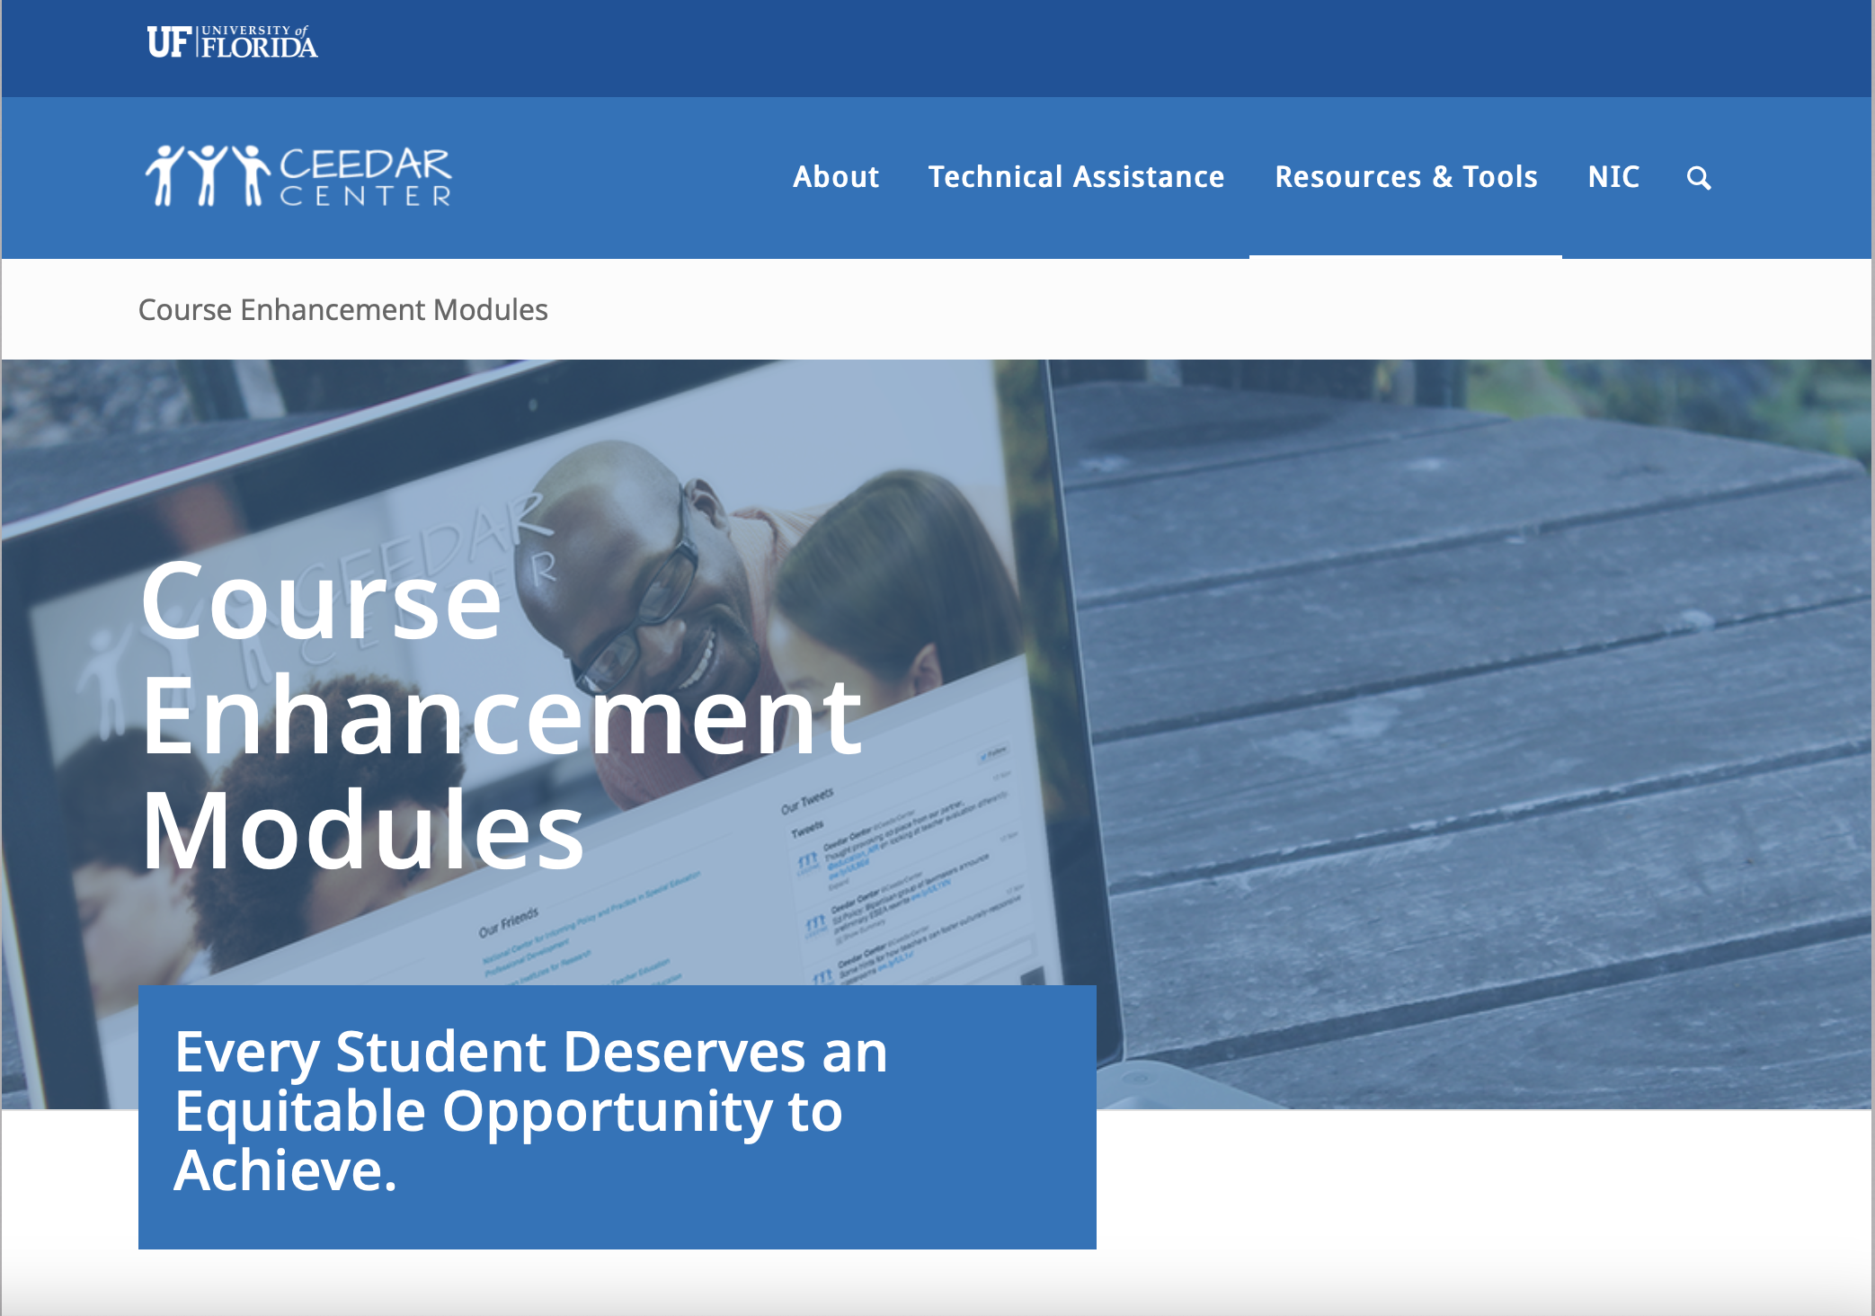
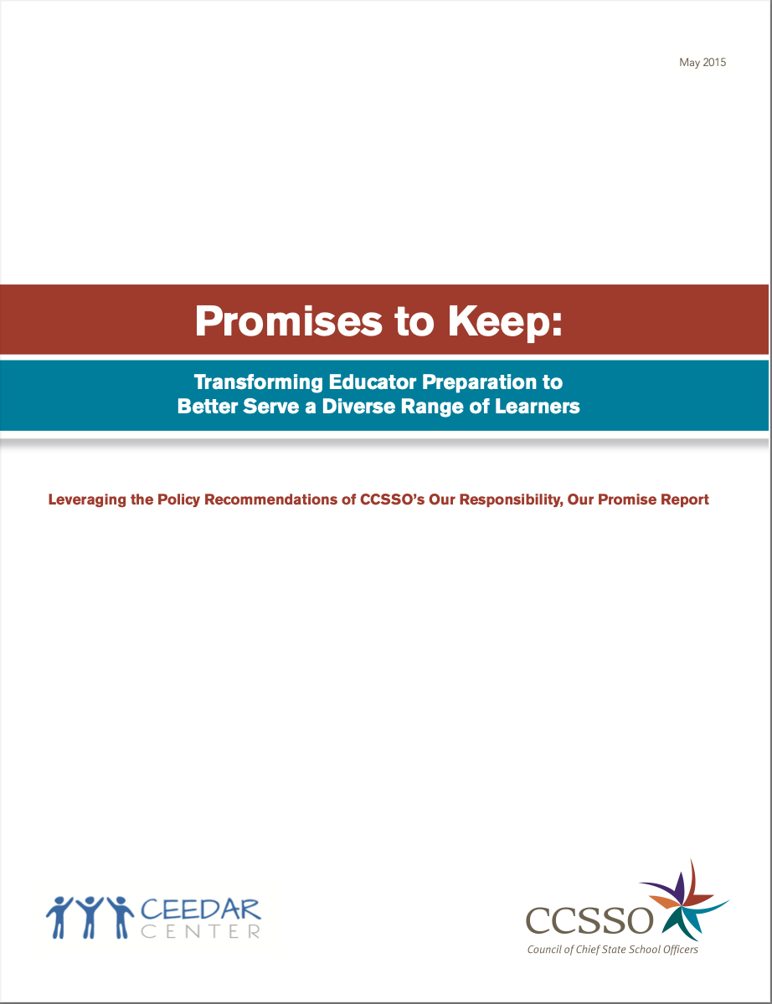
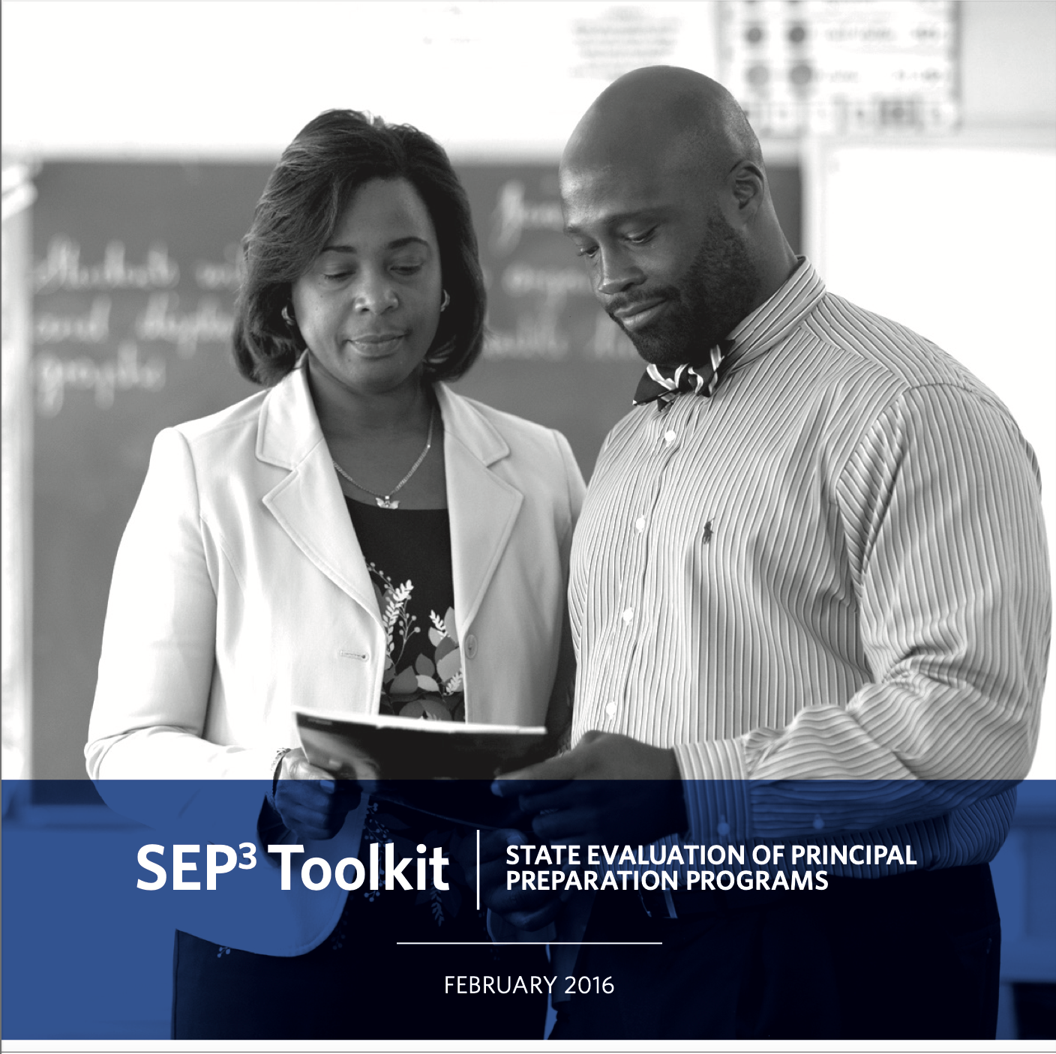
Related Resources for Strategy 3
Innovation Configuration: Principal Leadership
CEEDAR Course Enhancement Module
SEP3 Toolkit – State Evaluation of Principal Preparation Programs
Promises to Keep: Transforming Educator Preparation to Better Serve a Diverse Range of Learners

Slide 12
NCIPL: Where We’re Going
CCSSO is committed to providing short- and longer-term support to states, in partnership with the CEEDAR Center, focused on developing school principals who are well-prepared and supported to lead inclusive environments that meet the needs of students with disabilities
  To support states in building upon, deepening, and refining current work on school leadership to have a greater focus on inclusive leadership practices

Slide 13
The Oregon Context
Oregon Professors’ Collaboration
  7 universities (2 public / 5 private)
  Includes OR Principal’s Association
ORPEA’s seat at OR Policy Table
Principal Preparation Rule Refresh
  Goal for 2017-2018
  Integrate PSEL 2015 and NELP 2018

Slide 14
The Oregon / CEEDAR Timeline
OR joins CEEDAR’s 2015 Cohort
  Intensive Technical Assistance
  Administrator License Redesign
Principal Prep joins Teacher Prep
  Focused Leadership / Clinical Practice
  New modules for Preliminary Admin
October 2018 (CEEDAR 2.0)
  Shift embedded modules to ORPEA
  Intrastate Partnerships with ICPEL

Slide 15
The Oregon Plan
Pilot module development SU17
  Portland State / GFU / Uoregon
Use foundational CEEDAR tools
  Course Enhancement Module (CEM)
  Innovation Configuration Model
Implement principal modules 2017-2018
  Behavior / Discipline – FAPE
  Network / Transition - LRE
Implement district-level 2018-2019

Slide 16
DISCLAIMER
This content was produced under U.S. Department of Education, Office of Special Education Programs, Award No. H325A170003. David Guardino serves as the project officer. The views expressed herein do not necessarily represent the positions or polices of the U.S. Department of Education. No official endorsement by the U.S. Department of Education of any product, commodity, service, or enterprise mentioned in this website is intended or should be inferred.

