Slide 1
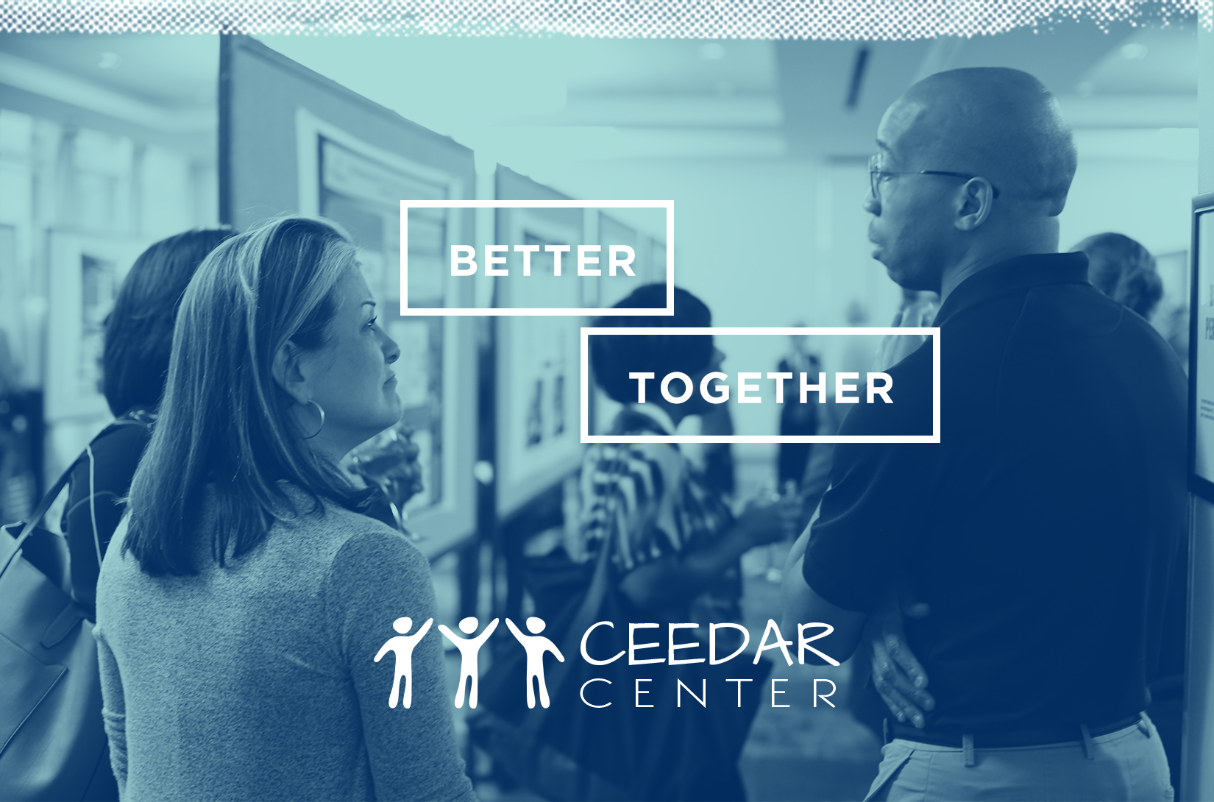
Defining IPL and School Improvement

Slide 2
Agenda
Attributes of Effective Inclusive Leaders
Practices of Effective Inclusive Leaders
Sustainability, Burnout, and Turnover

Slide 3
Research Sites
Urban districts in Mid-Atlantic
Urban and rural districts in Central Texas
Urban, suburban, and rural districts on the U.S.-Mexico border

Slide 4
Identifying Schools and School Leaders
Review District-Level Data
Schools that narrowed achievement gaps
Changes to special education delivery
Principals with more than 2-3 years on campus
Interview and Observe
Initial interviews with principal, assistant principal, and teachers
Conduct walkthroughs and observations of classrooms and meetings

Slide 5
Attributes of Effective Inclusive Leaders
Professional experiences in special education and/or personal experiences with disability or segregation
Oriented toward action, not just “winning hearts and minds”
Intersectional understanding of marginalizing conditions
Able to collaboratively learn, prioritize, plan, lead, and adapt appropriately

Slide 6
Practices of Effective Inclusive Leaders
Establishing and conveying the vision
Facilitating a high-quality learning experience for students
Building professional capacity
Creating a supportive organization for learning
Connecting with external partners

Slide 7
Establishing and Conveying the Vision
Principals also formed planning teams to support visioning, including those serving in varied roles (e.g., school psychologists, special and general educators, parents, critical friends) (DeMatthews & Mawhinney, 2014; Causton-Theoharis et al., 2011)
Principals worked with school staff to: (1) provide a rationale for inclusion by outlining problems with segregation and explaining what might be accomplished via greater inclusion, (2) gain clarity about the meaning of inclusion (why it is important) and what it looks like in practice, seeking stakeholders’ ideas, questions and concerns, (3) address resistance to inclusion, by listening, problem-solving, and (4) sustain efforts toward enacting the vision over time (Billingsley & Banks, 2019)

Slide 8
Building Professional Capacity
Trust-building by principals is critical to the success of these programs (Hoppey and McLeskey, 2013)
Effective inclusive leaders take effort to understand the working conditions required to support student learning, which allows them to be dependent sources of PD and assistance for teachers
PD is supported by activities such as meetings of grade level/content area teams, study groups, and embedded learning opportunities (e.g., coaching) in teachers’ classrooms (e.g., Billingsley and Banks, 2019). Principals also provide leadership for the development of professional learning communities to support teacher learning (e.g., Hoppey and McLeskey, 2013)

Slide 9
Sustainability, Burnout, and Turnover
Effective inclusive leaders often make immediate changes when they are on their campuses, but systemic improvement requires several years longer
Under-studied, under-prepared, lack of attention on principal burnout
Burnout has been described as a “psychological phenomenon in which a syndrome of emotional exhaustion, depersonalization, and reduced sense of accomplishment can occur among individuals who do ‘people work’ of any kind” (Maslach & Jackson, 1986, p.1)
  Emotional exhaustion describes feeling drained, overextended, and a sense of depleted emotional resources that can impact job performance
  Personal accomplishments refers to one’s feelings of competence and a tendency to evaluate oneself positively concerning one’s work with others

Slide 10
Turnover
Among all U.S. public school principals in school year 2015-2016, about 82% remained at the same school in the next year (Goldring & Taie, 2018)
The average principal has just 4 years at their current campus (Goldring & Taie, 2018)
Across urban, suburban, and rural contexts, schools serving larger percentages of low-income students, students of color, and low-achieving students are led by less qualified, less effective principals (Grissom, Bartanen, & Mitani, 2019)
Principal turnover increased the likelihood of teacher turnover (DeMatthews, Knight, & Shin, 2022), lowered math and reading achievements, and made it more likely that teachers left for multiple years after the principal exited (Bartanen, Grissom, & Rodgers, 2019)

Slide 11
Final Thoughts
Principals are critical to inclusive education reforms because of who they are and the actions they take
We know a good amount about the leadership attributes and practices of effective inclusive leaders
However, less attention has been paid to building for sustainability, the impact of principal turnover and inclusive efforts, and principal burnout
Professional and philanthropic organizations, government agencies, and principal preparation programs are increasingly focusing attention and resources on the development of principals who are knowledgeable about special education and ready to lead inclusive schools, but we are not sufficiently addressing principal turnover and its impact on sustaining inclusive reforms

Slide 12
DISCLAIMER
This content was produced under U.S. Department of Education, Office of Special Education Programs, Award No. H325A170003. David Guardino serves as the project officer. The views expressed herein do not necessarily represent the positions or polices of the U.S. Department of Education. No official endorsement by the U.S. Department of Education of any product, commodity, service, or enterprise mentioned in this website is intended or should be inferred.

