Slide 1

CDSE resource guide for new administrators

Slide 2
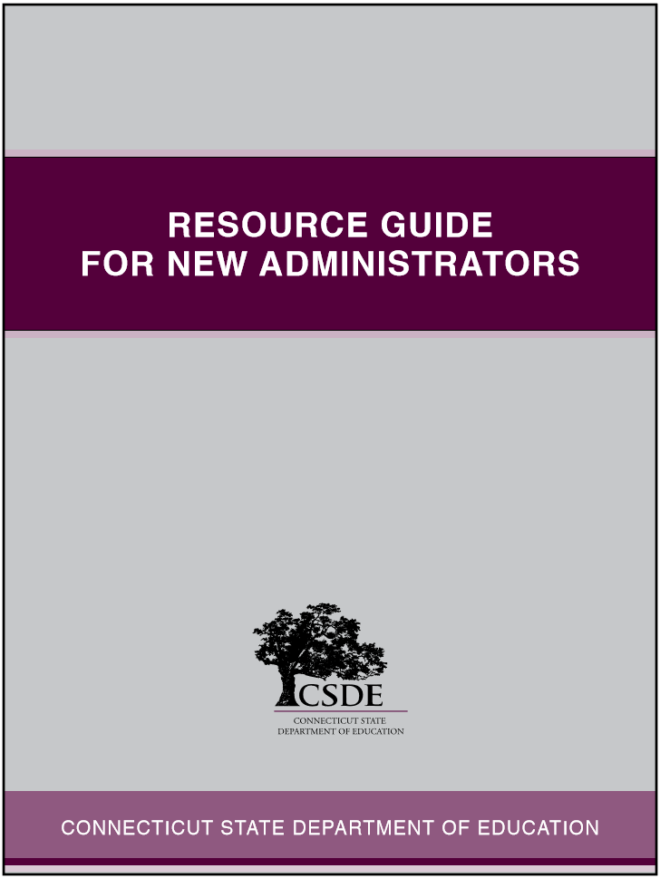

Resource Guide for New Administrators
CONNECTICUT STATE DEPARTMENT OF EDUCATION

Slide 3
Context and Purpose
Support for New Administrators
Communication about CSDE Resources
User-Friendly Tool to Support Leadership Practice
CONNECTICUT STATE DEPARTMENT OF EDUCATION

Slide 4
User-Friendly Format
Reference to state and/or federal legislation
Brief overview of the topic
“Must know” information about the topic
Electronic links to additional resources
Description of observable leadership practice related to each topic
CONNECTICUT STATE DEPARTMENT OF EDUCATION

Slide 5
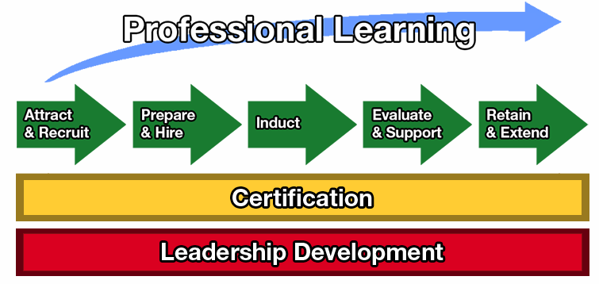
Talent Management Continuum
CONNECTICUT STATE DEPARTMENT OF EDUCATION

Slide 6
Administrator Induction
Build upon theory, content and clinical practice experience from preparation program
User-friendly resources for practical situations
Identify area for growth:
  New Learning
  Apply New Learning
  Put into Practice
CONNECTICUT STATE DEPARTMENT OF EDUCATION

Slide 7
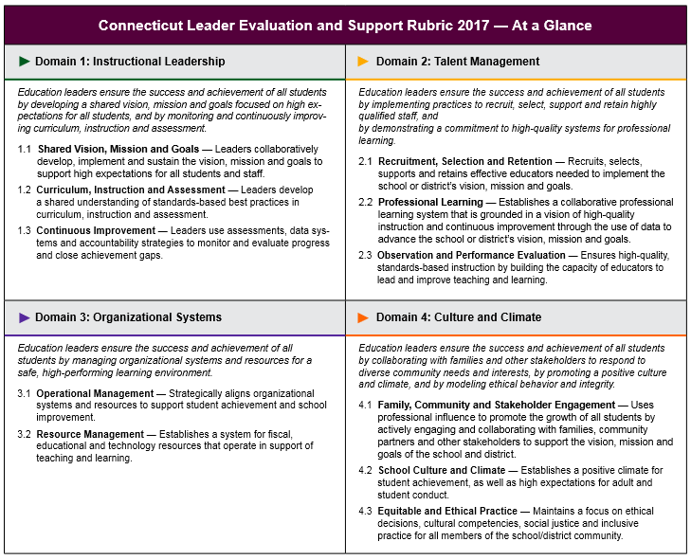
Evaluate and Support
CONNECTICUT STATE DEPARTMENT OF EDUCATION

Slide 8
Evaluate and Support
Description of Observable Leadership Practice and Performance
Support Attainment of Student Learning Indicators
Professional Learning for Identified Areas of Focus
CONNECTICUT STATE DEPARTMENT OF EDUCATION

Slide 9
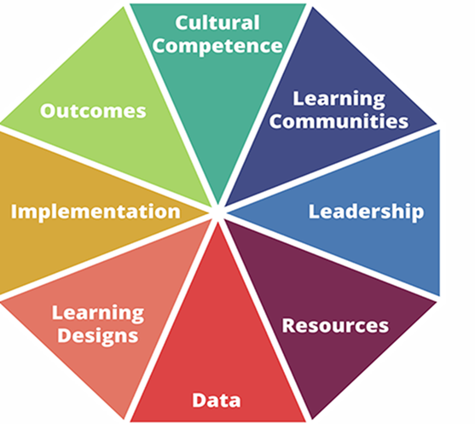
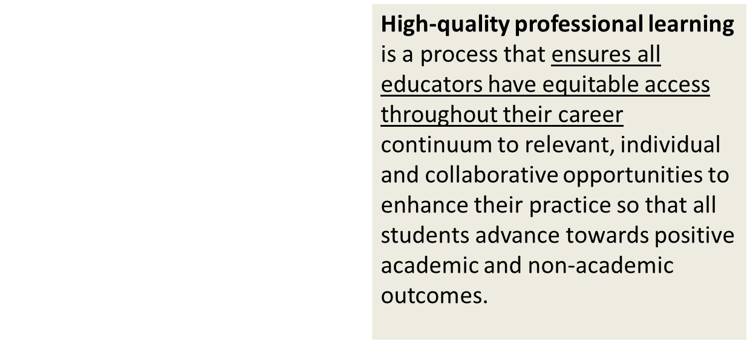
Professional Learning
CONNECTICUT STATE DEPARTMENT OF EDUCATION

Slide 10
Professional Learning
Individual, School or District Areas of Focus
Coaching Tool for Administrator Practice and Performance
Resource for Teacher Professional Learning
CONNECTICUT STATE DEPARTMENT OF EDUCATION

Slide 11
Professional Learning
The Standard
Professional learning that enhances both educator practice and outcomes for each and every student requires and develops leadership capacity at all levels to advocate for and create systems for professional learning.
Leadership Defined
Leadership is the act of motivating and guiding others toward a specific outcome. In professional learning, the goal of leadership is:
to create, sustain, and advance significant school and district growth that enhances educator practice so that each and every student will advance towards positive academic and non-academic outcomes.
CONNECTICUT STATE DEPARTMENT OF EDUCATION

Slide 12
Leadership Development
Establish a Common Language
“What Does This Look Like in Practice?”
Collegial Support Among School/District Administrators
Continuous Improvement of Leadership Practice
CONNECTICUT STATE DEPARTMENT OF EDUCATION

Slide 13
Discussion
What follow-up questions do you have for the presenter?
  What clarifying questions do you have?
  What are you curious to learn more about? OR…
  What probing or deep-dive questions do you have?

Slide 14
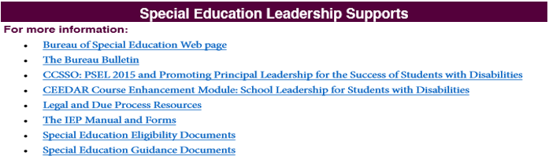
Special Education Leadership Supports
Found on pp. 51-52 in the CSDE Resource Guide for New Administrators
Did you know the following supports are available?
•Special Education Professional Learning Modules:
•Training in Special Education Administration for
Principals and Other Administrators
•Enhancing Instructional Programs Within Schools
(aka: 7-Day Series)
•Planning and Placement Team (PPT) Chairperson Training
•Improving Outcomes for Students with Disabilities:
A Three-Day Series for Principals.
•The Bureau of Special Education web page
•The Bureau Bulletin
•Each Connecticut school district has assigned Bureau
consultant contact ready to assist you!.
• Leadership Forums:
• The Bureau’s Annual Back to School Meeting:
CONNECTICUT STATE DEPARTMENT OF EDUCATION

Slide 15
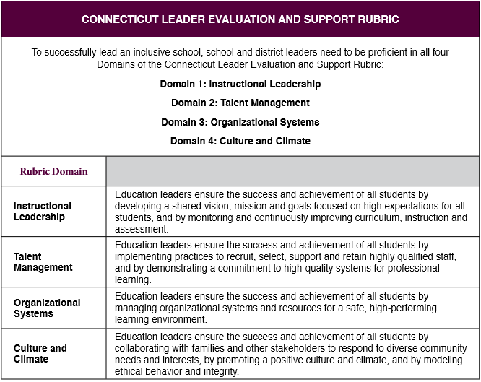
Connecticut Leader Evaluation and Support
CONNECTICUT STATE DEPARTMENT OF EDUCATION

Slide 16
DISCLAIMER
This content was produced under U.S. Department of Education, Office of Special Education Programs, Award No. H325A170003. David Guardino serves as the project officer. The views expressed herein do not necessarily represent the positions or polices of the U.S. Department of Education. No official endorsement by the U.S. Department of Education of any product, commodity, service, or enterprise mentioned in this website is intended or should be inferred.

