Slide 1

Advancing IPL Through Stakeholder Engagement

Slide 2
Engaging others in your work
Know your audience
Tailor your message to them
  A new state chief or SEA leadership? District superintendents?
Make it clear and compelling
The “why” of the work
Timing is important
Notes:
OLYMPIA

Slide 3
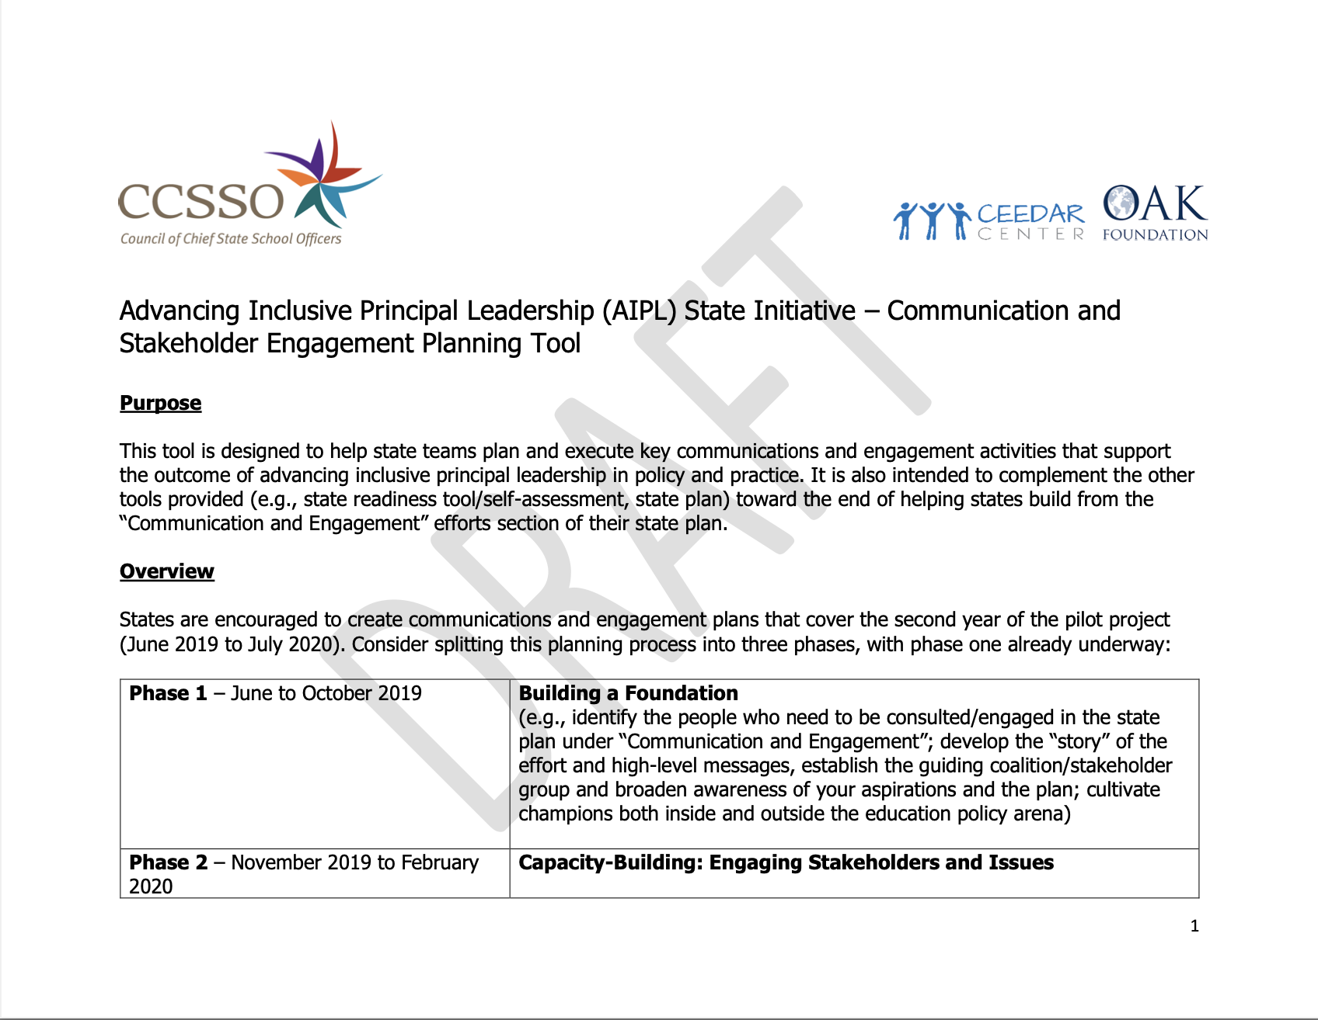
Advancing Inclusive Principal Leadership 1

Slide 4
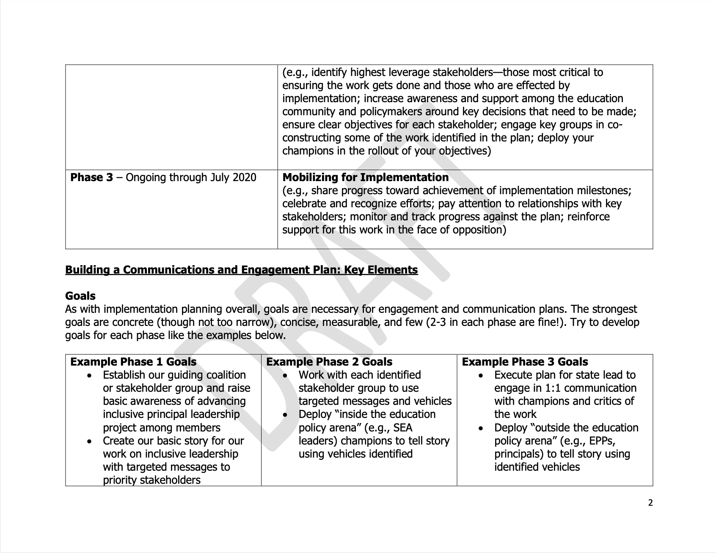
Advancing Inclusive Principal Leadership 2

Slide 5
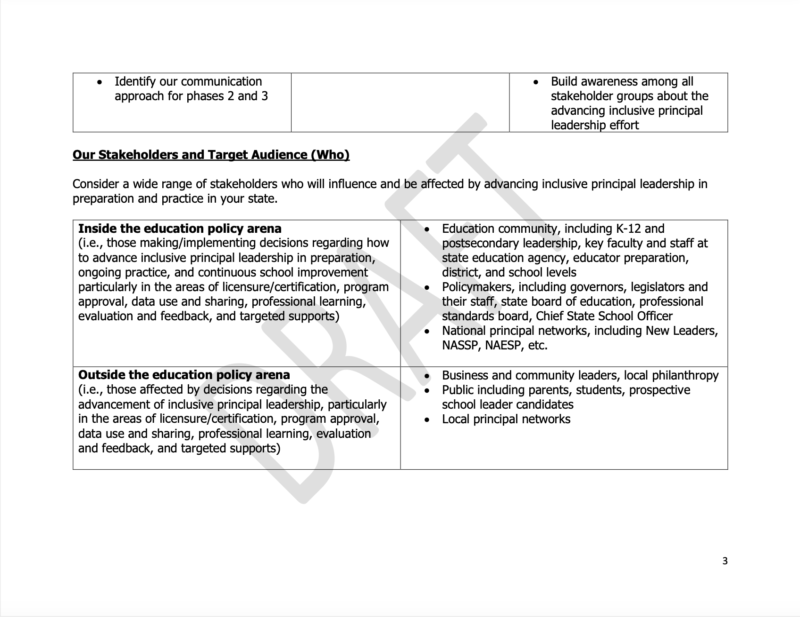
Advancing Inclusive Principal Leadership 3

Slide 6
Communications and Engagement Resources
Key message template
Communication and Stakeholder Engagement Tool
Talking points template
  Overall message
  Story grounded in the work
  Frame your key points and your supporting points. Think about how to succinctly present the challenge you are trying to tackle and how.
Notes:
OLYMPIA

Slide 7
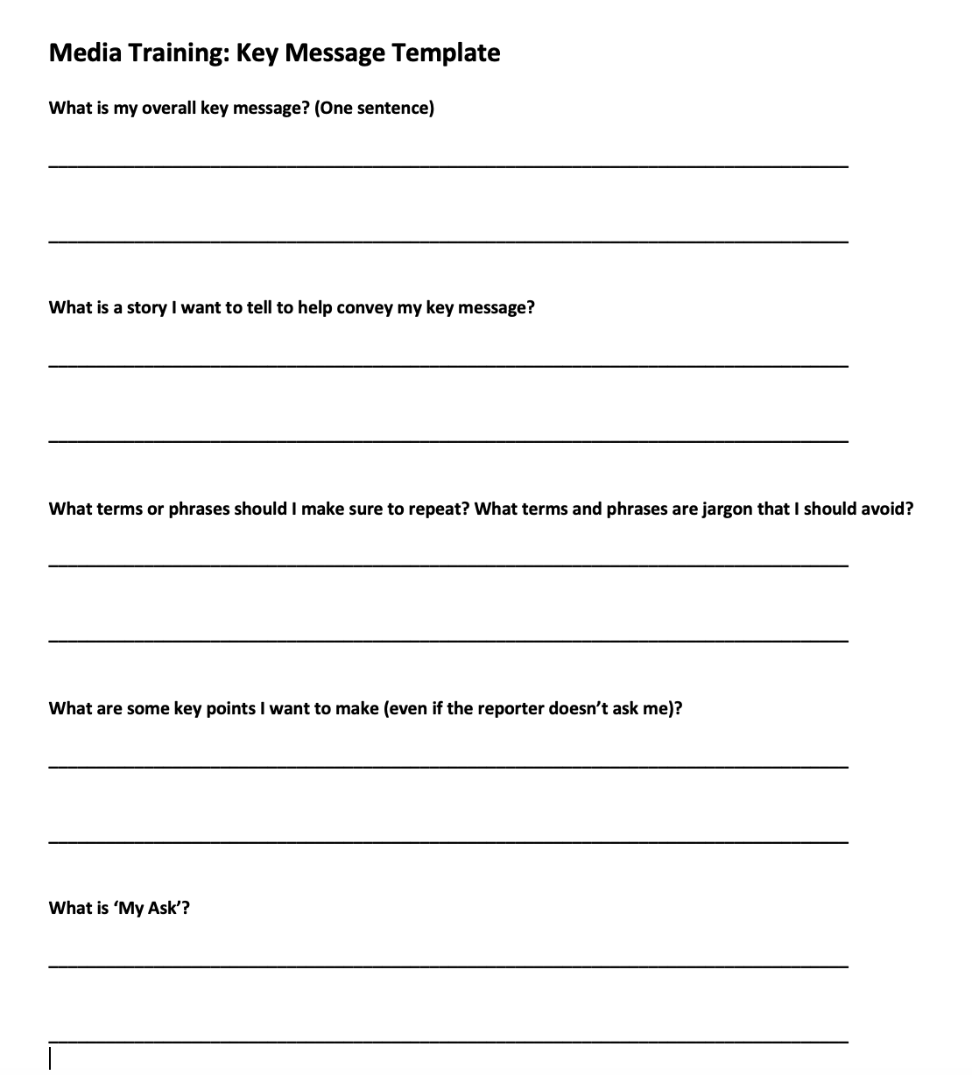
Media Training: Key Message Template

Slide 8

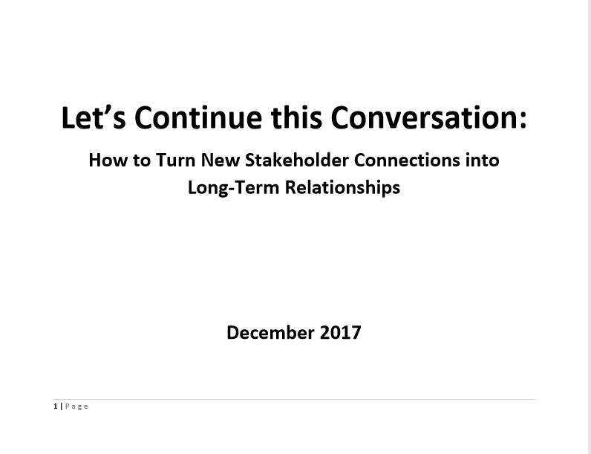
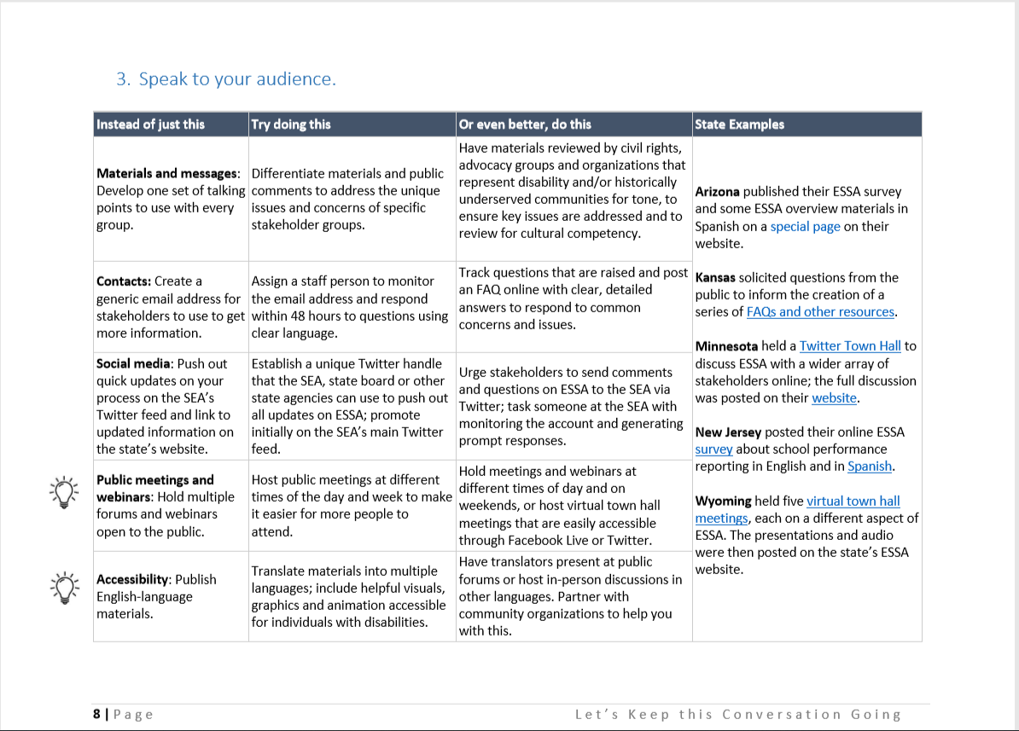
Resources
Notes:
OLYMPIA

Slide 9
DISCLAIMER
This content was produced under U.S. Department of Education, Office of Special Education Programs, Award No. H325A170003. David Guardino serves as the project officer. The views expressed herein do not necessarily represent the positions or polices of the U.S. Department of Education. No official endorsement by the U.S. Department of Education of any product, commodity, service, or enterprise mentioned in this website is intended or should be inferred.

