Slide 1
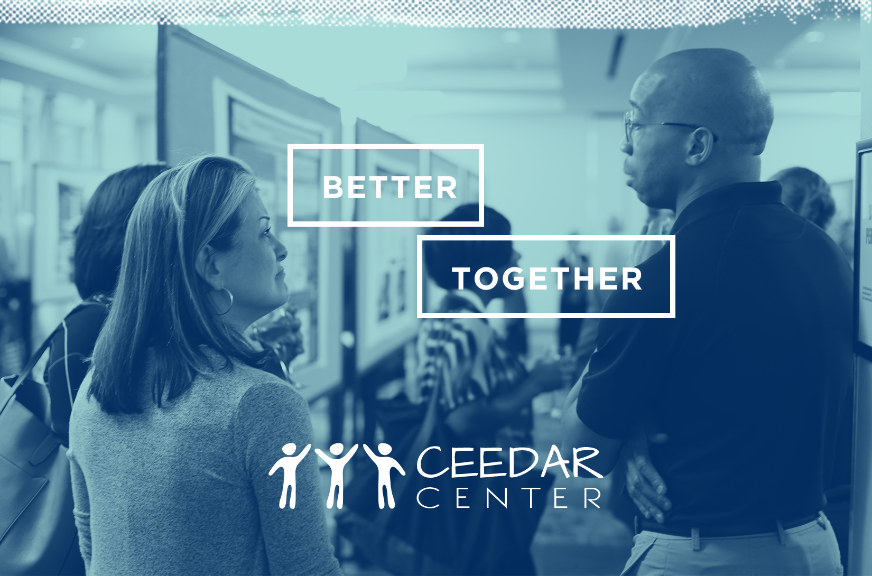
Culturally Relevant Literacy & Education

Slide 2
Goal
To share Arizona Department of Education, Exceptional Student Services, Professional Learning and Sustainability Goals, alignment/implementation, data collected, and reporting related to culturally responsive literacy education.
Notes:
ESS/PLS

Slide 3
Mission
To increase the literacy knowledge and skills of education professionals serving students with disabilities in Arizona.
Notes:
ESS/PLS

Slide 4
Vision
To provide culturally inclusive professional learning across Arizona that promotes active engagement, focuses on increasing educator effectiveness, and applies learning theories and research into classroom practice.
Notes:
ESS/PLS

Slide 5
Our Students
1,141,694
480,035
  living in poverty
144,152
  with disabilities
73,410
  English learners
9,540
  both disability/EL

Slide 6
Our Students cont.
520,900 Hispanic/Latino
431,146 White
62,596 African American
51,063 Native American
37,768 Multi Racial
33,659 Asian

Slide 7
State Systemic Improvement Plan
(SSIP)
Targeted sites will increase the performance of students with disabilities in grades 3-5 on the English Language Arts (ELA) state assessment from 6.4% to 12.99% by FFY 2019 to meet the state proficiency average for students with disabilities in grades 3-5.
Notes:
See Hand-out-
Our mission and work for the last two years.

Slide 8
Definition of Culturally Responsive Education
Teachers who utilize culturally responsive practices value students’ cultural and linguistic resources and view this knowledge as capital to build upon rather than as a barrier to learning. These teachers use this capital (i.e., personal experiences and interests) as the basis for instructional connections to facilitate student learning and development.
Gay (2010), Nieto, Bode, Kang, and Raible (2008), and Ladson-Billings (2009).
Notes:
https://ceedar.education.ufl.edu/wp-content/uploads/2014/08/culturally-responsive.pdf
EBPs; e.g., Harlin & Souto-Manning, 2009; Hersi & Watkinson, 2012; Nieto et al., 2008; Santamaria, 2009).

Slide 9

Learning Walks
Purpose, Process, and Tool
Notes:
Share the link to Purpose, Process, and Tool
(15 min)
Introduce: Learning Walks; big picture; set of possibilities of what high performing schools practice everyday with all students.
image courtesy of https://pixabay.com/en/glasses-read-learn-book-text-272399/

Slide 10
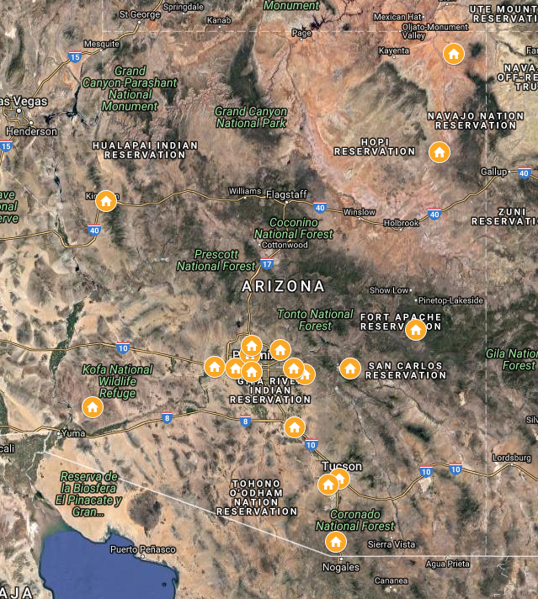
Professional Learning
SSIP Trend Data (LW)
Connecting and Applying Literacy Learning (CALL)
  8 Districts
  14 Principals
  14 Special Education Directors
  28 Exemplary Teachers
  5708 Students
Notes:
CALL is a professional learning series, focused on culturally inclusive Reading/Writing Connection practices for school leaders with their teachers; by the end of the pd. they walk away with a deep understanding of how to teach (Thinking, Listening, Speaking, Writing, Reading) in all content areas with authenticity, with ease, and in a manner that engages and challenges all students (Especially students with disabilities and student who struggle to become literate).

Slide 11
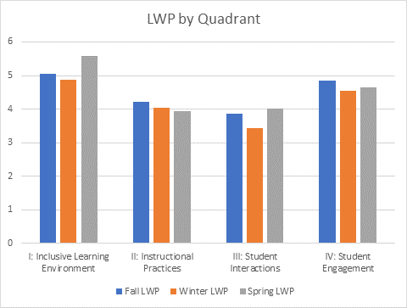
2018-2019 Learning Walks Data
Notes:
Closure (5 min.)
8 Districts
14 Principals
14 Sped. Directors
28 Exemplary Teachers
5708 Students

Slide 12
Essential Questions
What evidence do you have that your professional learning is focused on culturally inclusive literacy practices?
What evidence do you have that these literacy practices are making a positive difference in your students’ achievement?
Notes:
Chat/Break out room guiding questions

Slide 13
DISCLAIMER
This content was produced under U.S. Department of Education, Office of Special Education Programs, Award No. H325A170003. David Guardino serves as the project officer. The views expressed herein do not necessarily represent the positions or polices of the U.S. Department of Education. No official endorsement by the U.S. Department of Education of any product, commodity, service, or enterprise mentioned in this website is intended or should be inferred.

