Slide 1
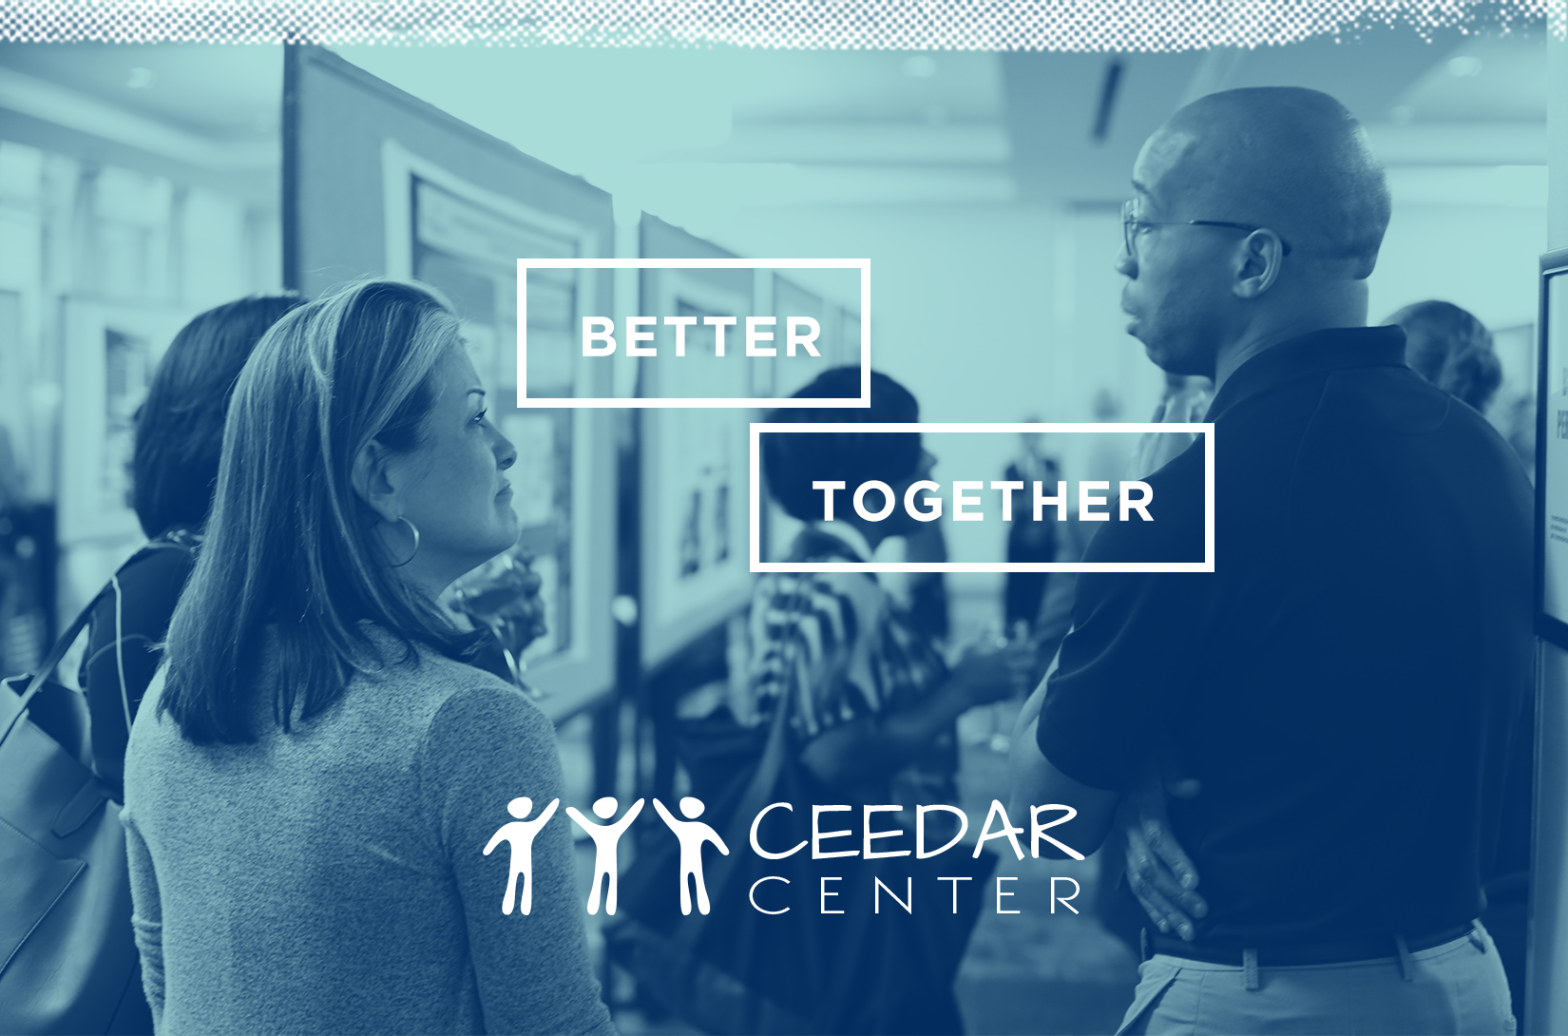
INTRODUCTION TO CULTURALLY RELEVANT EDUCATION

Slide 2

Centering thoughts
Children are indigenous to classrooms
Willingness to change children, coupled with an unwillingness to change schools
  (Shalaby, 2017)

Slide 3
Ceedar center priority areas for sustainability and scale up
Focus Areas
Preparation Program Reform
General Education
Special Education
Preparation Program Evaluation
Standards, Licensure, and Program Accreditation
Leadership
Alignment
Data Collection & Use
Equity & Access

Slide 4
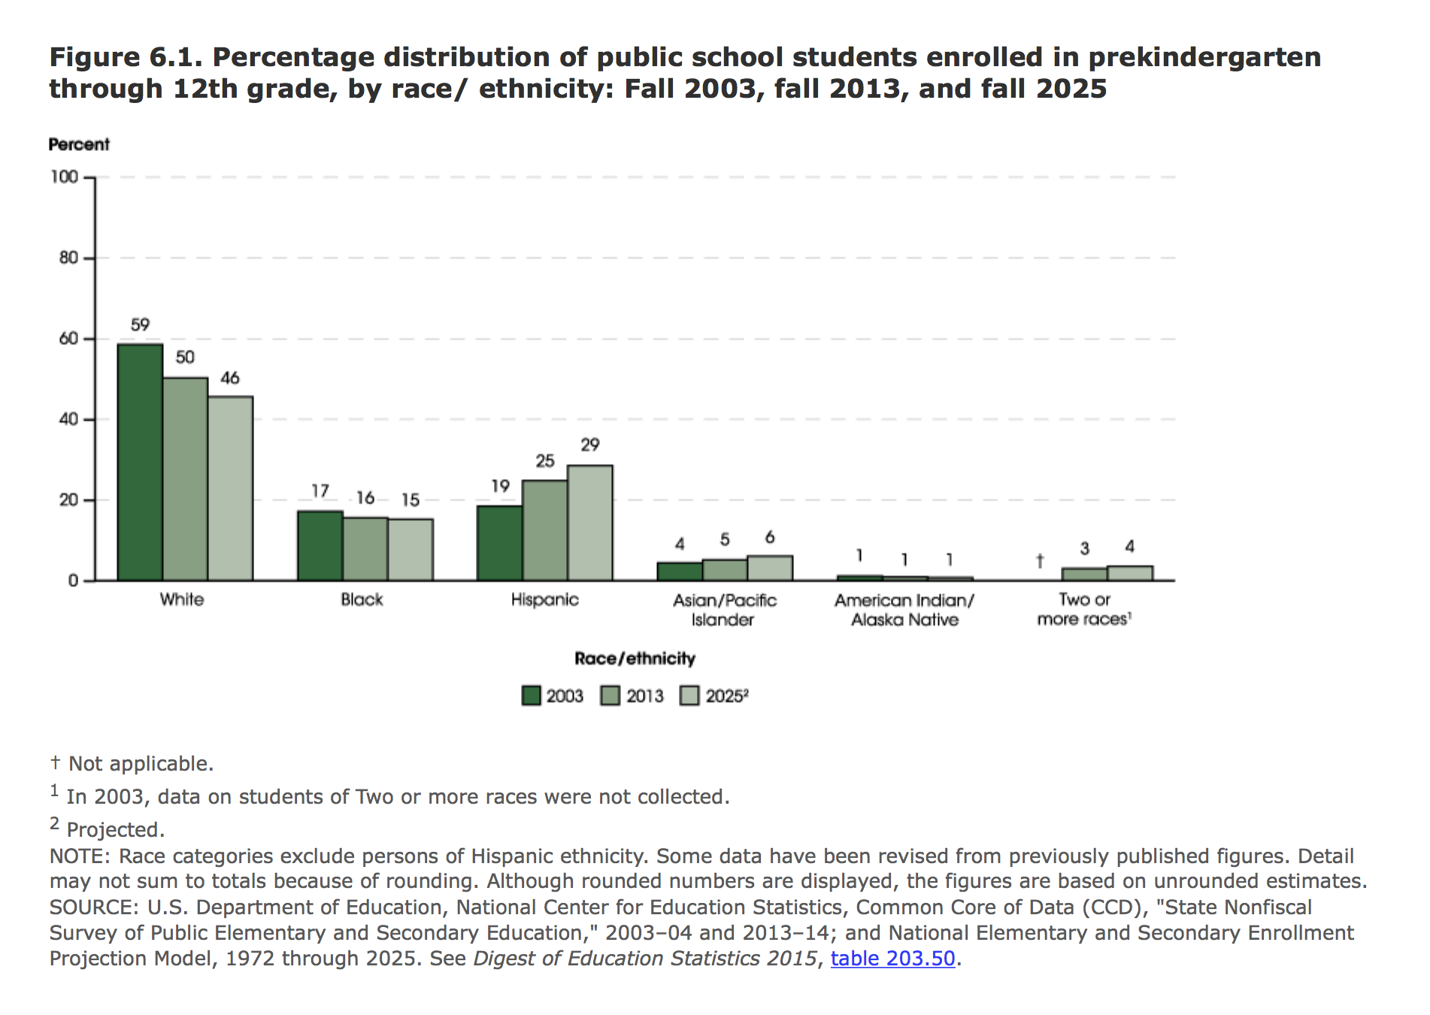
Why this focus and approach?

Slide 5
Why this focus and approach?
SOURCE: U.S. Department of Education, National Center for Education Statistics, Schools and Staffing Survey (SASS), "Public School Teacher Data File," 1987-88 through 2011-12; "Private School Teacher Data File," 1987-88 through 2011-12; and "Charter School Teacher Data File," 1999-2000; and National Teacher and Principal Survey (NTPS), “Public School Teacher Data File,” 2015-16. (This table was prepared September 2017.)

Slide 6
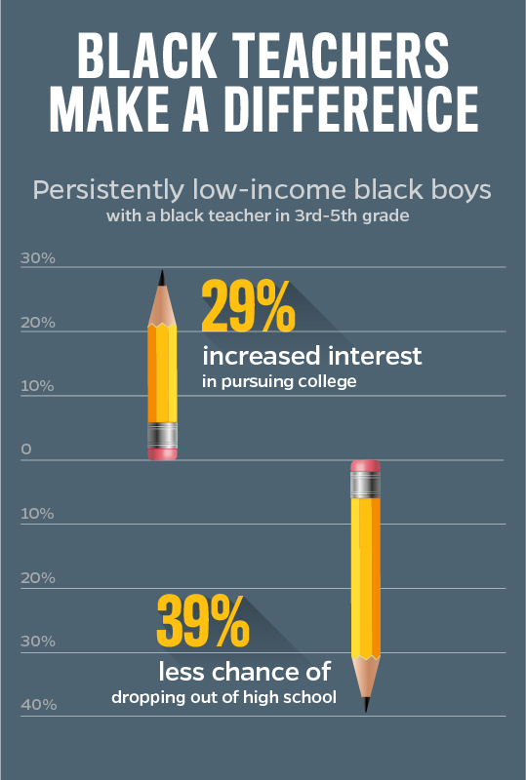
Why this focus and approach?
Effect of teacher bias on student achievement
  Expectations
  Interactions
Race-congruence/role model effects and student achievement
Diverse perspectives and representation are enriching

Slide 7
Overview of culturally responsive pedagogy: policy & Practice
ESSA guidance
  Completers demonstrate cultural competency
  Provide ongoing PD in cultural competency and responsiveness and equity coaching
IDEA
  Culturally relevant instructional principles (e.g., focus on representation in instructional environment, family-friendly practices)
Notes:
ESSA
Establishing outcome-oriented performance metrics to facilitate oversight by the authorizer and provide common expectations and standards for academies. This may include developing rigorous qualifications for teacher and/or principal candidates to successfully complete the program, such as demonstration of cultural competency, classroom management skills, subject area and content- specific knowledge, and the ability to use standards-based, data-driven and differentiated instruction (p. 6).
Providing ongoing professional development aimed at cultural competency and responsiveness and equity coaching, designed to improve conditions for all educators and students, including educators and students from underrepresented minority groups, diverse national origins, English language competencies, and varying genders and sexual orientations (p. 19)
IDEA
Link assessments of student progress directly to the instructional curricula rather than to abstract norms for standardized tests.
Examine not only the individual child but also his or her instructional environment, using direct observational data.
Create classroom environments that reflect different cultural heritages and accommodate different styles of communication and learning.
Develop and implement family-friendly practices to establish collaborative partnerships with parents and other caregivers, including those who do not speak English.

Slide 8
Overview of culturally responsive pedagogy: policy & Practice
Diverse educator workforce
Culturally relevant policy
Culturally relevant education
Equity and access

Slide 9
DISCLAIMER
This content was produced under U.S. Department of Education, Office of Special Education Programs, Award No. H325A170003. David Guardino serves as the project officer. The views expressed herein do not necessarily represent the positions or polices of the U.S. Department of Education. No official endorsement by the U.S. Department of Education of any product, commodity, service, or enterprise mentioned in this website is intended or should be inferred.

