Slide 1
Teacher Candidate Recruitment and Retention in Small Programs: Increasing Enrollment & Interest
Dr. Ben Burnett, PhD
TED SSPEC Keynote
Thursday, November 10th
1:15-1:30pm EST

Slide 2

outline
CEEDAR & MS Partnership
About Dr. Ben Burnett
About William Carey University
William Carey Initiatives

Slide 3
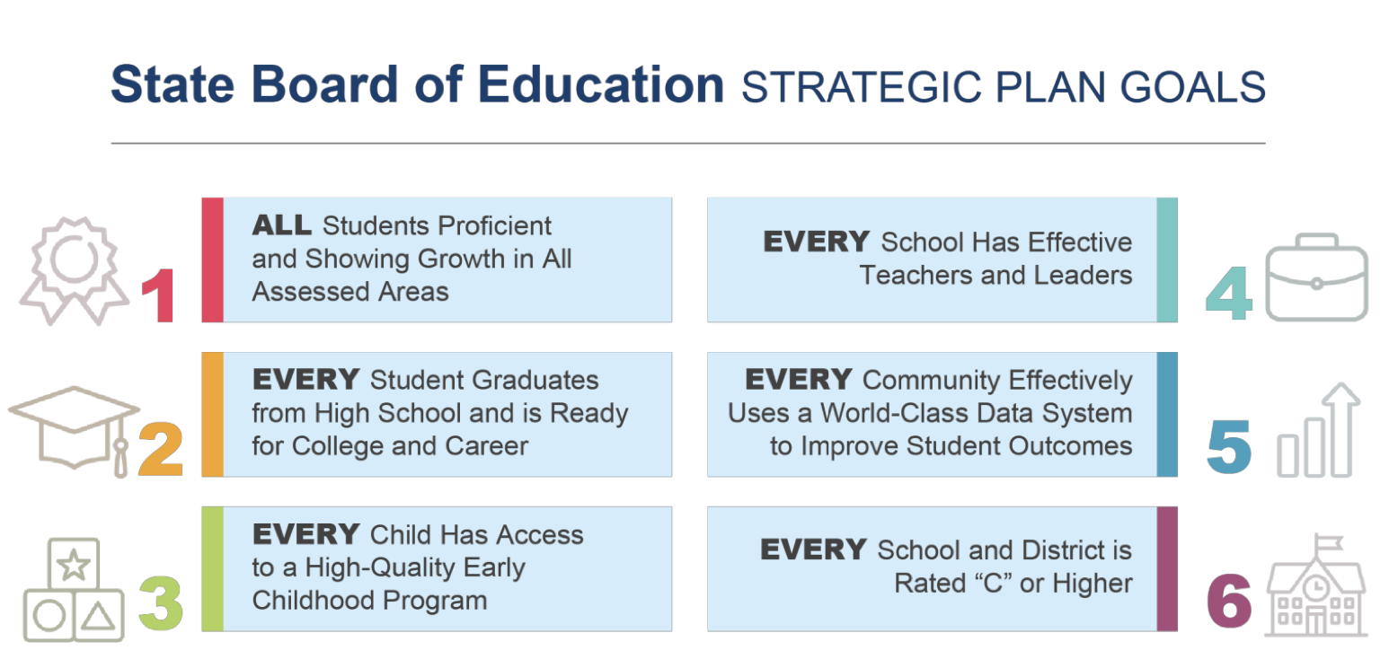
The CEEDAR center & the Teaching Leading and solutions group (TLSG)
Delta State University
Tougaloo College
University of Mississippi
University of Southern Mississippi
William Carey University
Since 2016

Slide 4

Ceedar-mississippi

Slide 5

Find your calling

Slide 6
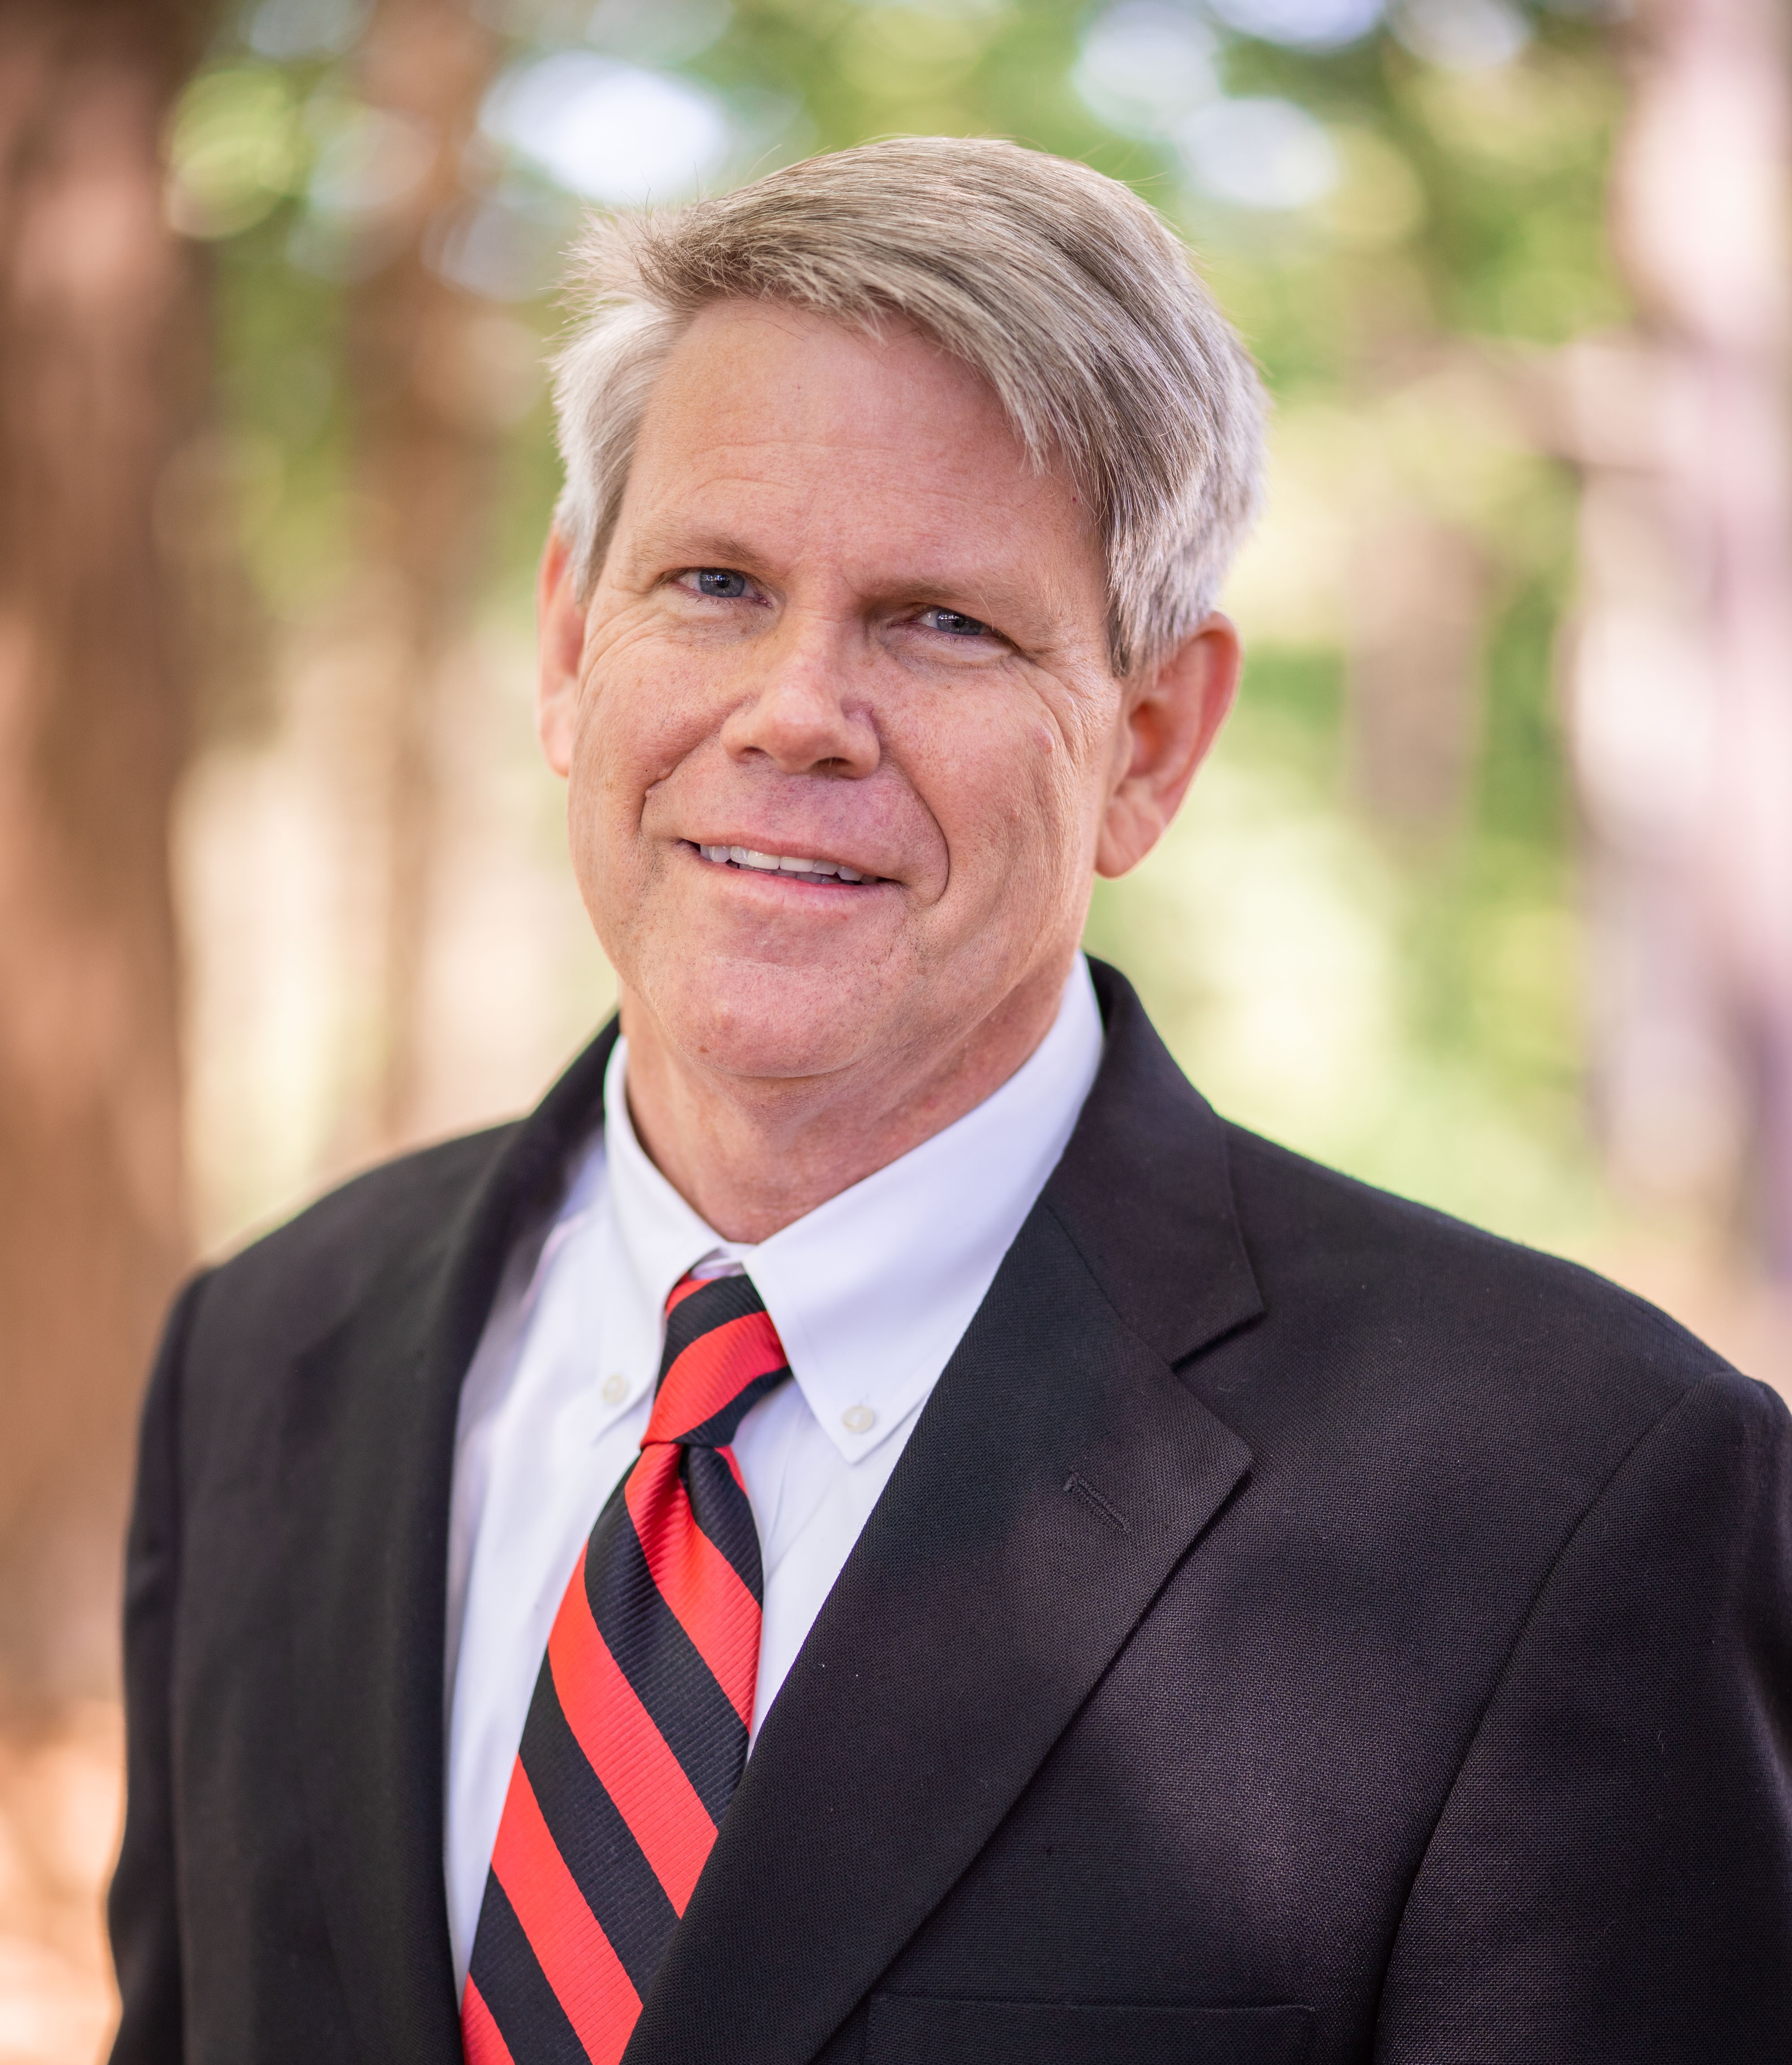
Dr. Ben Burnett
President of William Carey: 2022 – present
Dean College of Education: 2014-2020
Executive Vice-President 2020-2022
Former HS Band Director, Middle School Principal and Superintendent

Slide 7
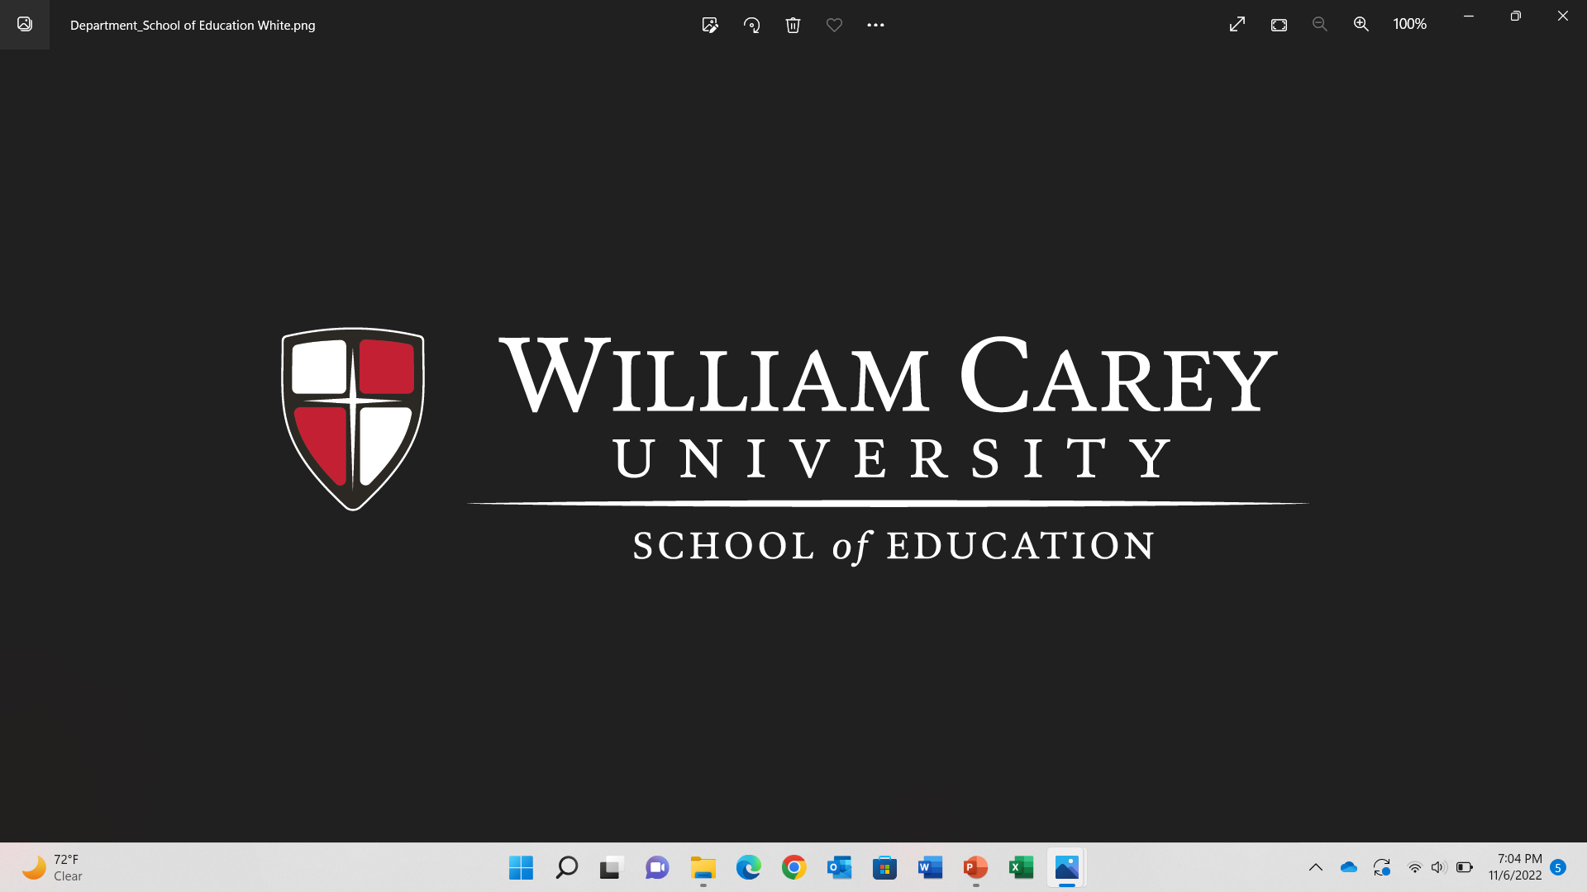
William Carey University

Slide 8
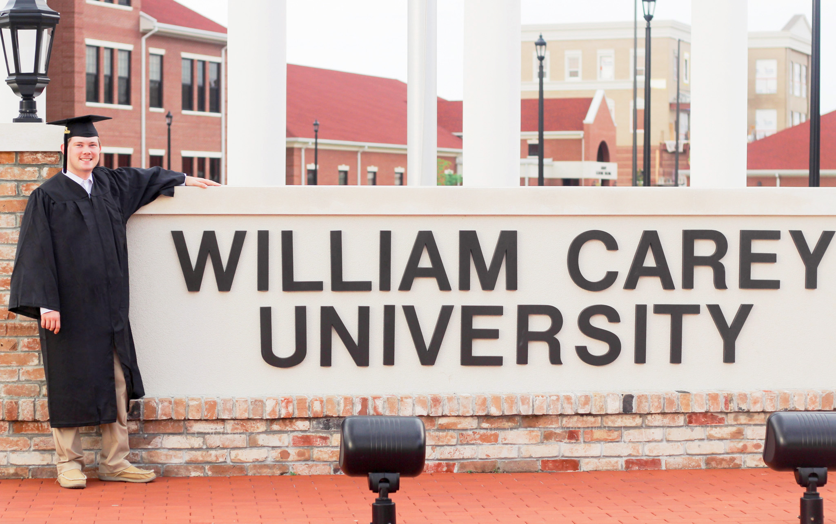
About William Carey university
Private, Christian University
Enrollment of 5,600 for Fall 2022
School of Education-Graduated 632 in 2022-Largest in state
Medical School, Pharmacy School, Physical Therapy School
Special Education numbers

Slide 9
Education programs offered at WCU School of Education
MS Teacher Residency
College credits for high school students who complete Educator’s Rising/Teacher Academy coursework
Tuition free courses for current teachers to support licensure renewal
Partnership with Pearl River Community College
Online Degree programs

Slide 10
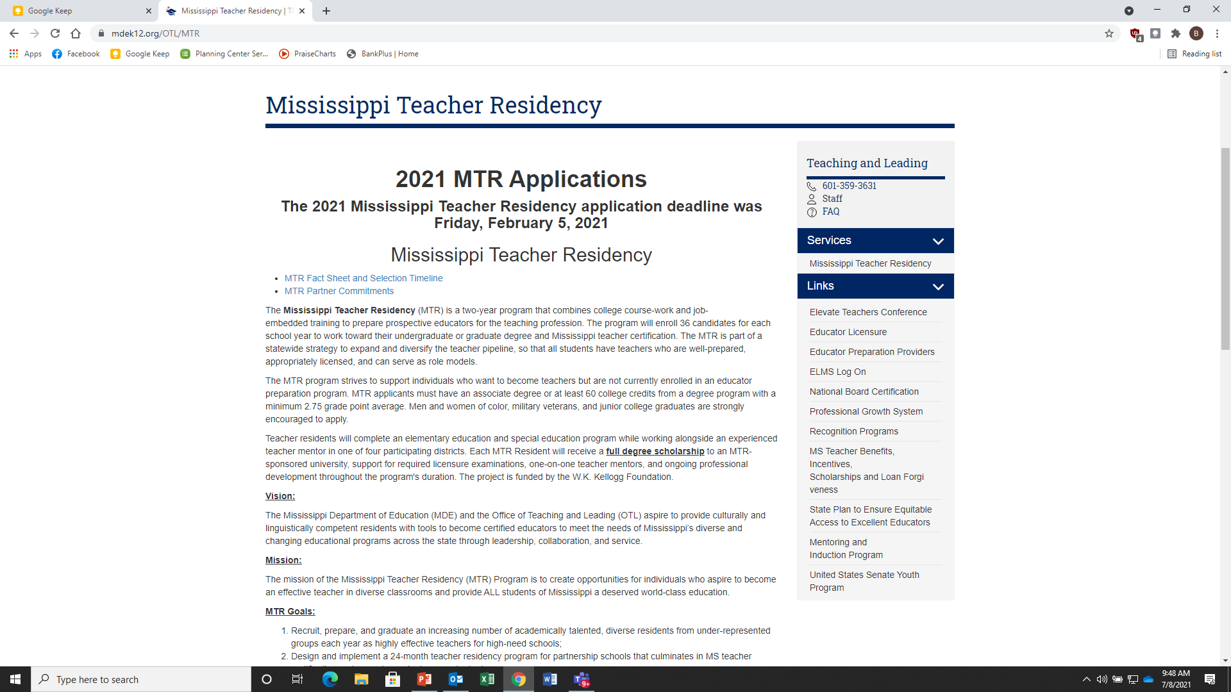
Teacher Residency Programs

Slide 11

Grow Your own
Notes:
TP-what we are doing to encourage districts to partner with us to create a pipeline in your own district

Slide 12

Teacher Academy Scholarship
Notes:
Ben-this is what we do to attract teacher academy teachers at Carey-based on recommendation from Task Force report

Slide 13
3,036 Certified Teacher
Vacancies
5,503 Educator Workforce Vacancies
Notes:
TP-here is the real data for state-wide openings this year after school started-also notice that it’s not just teachers we are needing

Slide 14
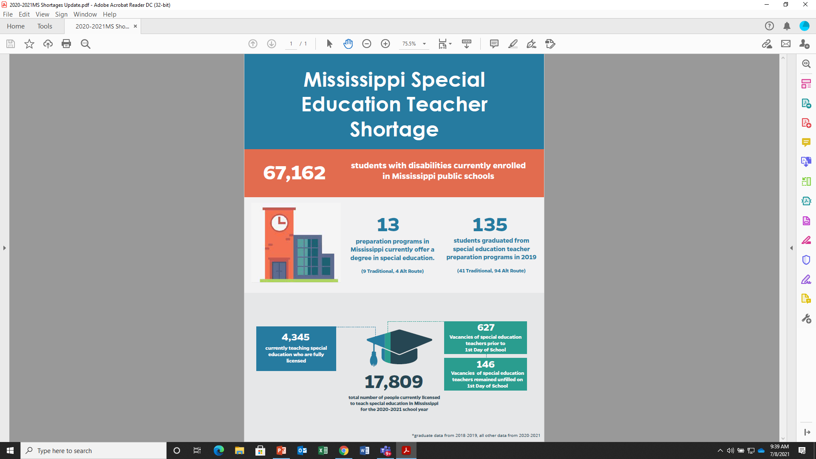
MS Infographic

Slide 15
William Carey University Teacher Shortage Programs
Grow Your Own
Teacher Assistant Waiver (Traditional and Alternate Route)
School District Partnership Cohort (Alternate Route)
Teacher Academy Scholarship
Community College Partnerships
Grants( Mississippi Teacher Residency and Black Educator Initiative)
Teacher Shortage Conference "Think Tank“
MPE
Help support this conference in North Mississippi Could be a pre-conference.
Feature EPP’s in your newsletters.

Slide 16
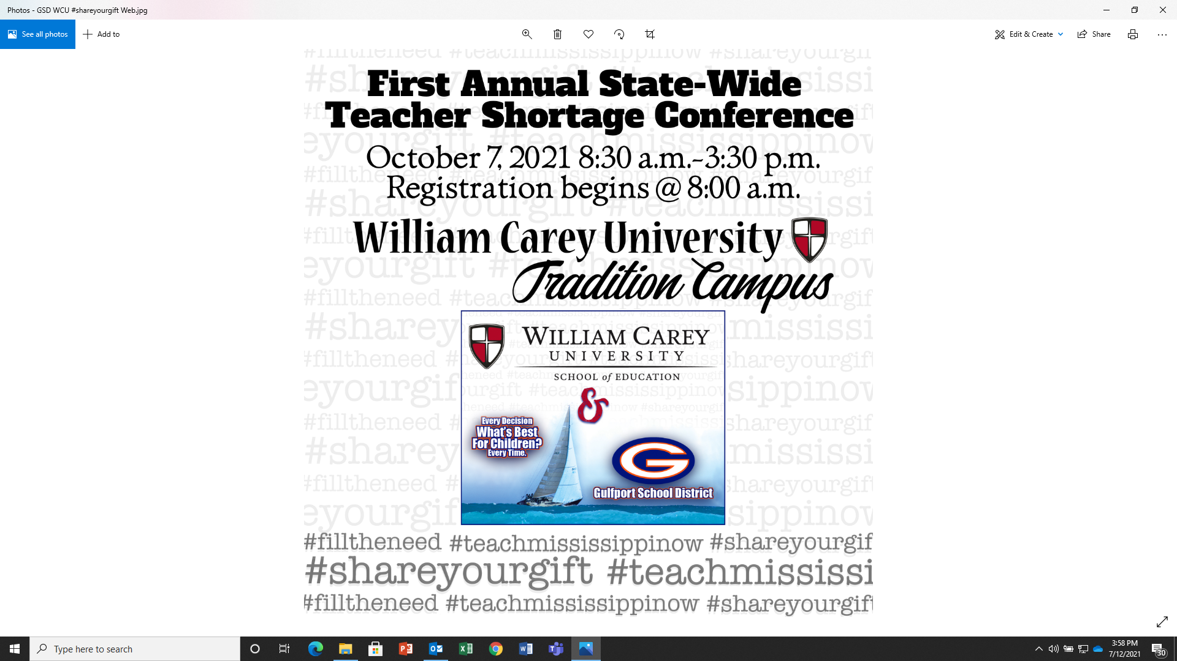
conference
Notes:
Ben-The first ever Teachers shortage conference was held in Biloxi this fall. Dr. Peasant will highlight the findings from the 4 different breakout groups. You have handouts for these findings.

Slide 17
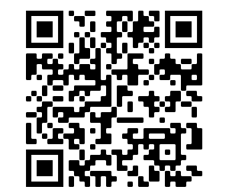
Resource for Mississippi Stakeholders
Notes:
Ben-Give out QR code cards. “We have developed a webpage on the WCU website to house all of the documents from all of the task forces and work groups. In addition, we are posting all teacher shortage related articles and presentations there as a resource. (pull up webpage and show to everyone). Please email me at bburnett@wmcarey.edu for any resource you would like us to add to this. –it is also lined from the title at the top of the page-click on it to show the webpage

Slide 18
Ensuring high quality programs
Revised reading coursework and programs to align with the science of reading; provided reading training to faculty and teachers (2016-2017)
Added BCBA certification
Added special education director’s coursework
Infused High-leverage practices into coursework

Slide 19
Disclaimer
This content was produced under U.S. Department of Education, Office of Special Education Programs, Award No. H325A120003. David Guardino serves as the project officer. The views expressed herein do not necessarily represent the positions or polices of the U.S. Department of Education. No official endorsement by the U.S. Department of Education of any product, commodity, service, or enterprise mentioned in this website is intended or should be inferred.

