Slide 1
Building Blocks for Culturally Relevant Education: Policy, Preparation, Practice, and Partnerships
Meg Kamman, Will Hunter, Corlis Snow & Rachel Silva

Slide 2
Today
CEEDAR’s Equity Efforts and Topical Action Group
Overview of 4 briefs

Slide 3
CEEDAR’s Winning Aspiration
Every student with a disability has an
equitable opportunity to achieve.

Slide 4
Students of color
53% public school students
48% of students served under IDEA
2017 National Assessment of Educational Programs
 | ELA | Math
White | 232 | 248
Black | 206 | 223
Hispanic | 209 | 229
Notes:
National Center for Education Statistics (2021)
Current educational data shows continued disparities in academic outcomes among student subgroups

Slide 5
Educator Workforce
Predominantly White, middle class, and monolingual
TPP faculty have varied knowledge and skill for meeting the needs of diverse learners
Supporting Special Education Teachers of Color (18%)
Provide culturally responsive teaching and evidence-based interventions
Advocate against biased practices and policies
Create a sense of belonging
Notes:
Teachers and leaders are essential for providing an equitable education for all students and that our nations’ schools cannot accomplish this goal without a diverse and culturally responsive workforce.
Children from culturally and linguistically diverse backgrounds continue to experience schools and society differently than their White peers (NCES, 2019).
Teachers of color tend to have higher academic expectations (Gershenson et al., 2016), are generally prepared to respond to mental health needs (Cormier et al., 2021), and are less likely to use exclusionary discipline with students from racially and linguistically diverse backgrounds (Lindsay & Hart, 2017).
SETOC threatens the quality of education for students of color with disabilities
Essential partners in providing culturally responsive teaching and evidence-based transition interventions to students of color with disabilities
Advocate against biased practices and policies that disproportionately affect students of color with disabilities (e.g., exclusionary discipline)
Create a sense of belonging (Scott et al., 2021).

Slide 6
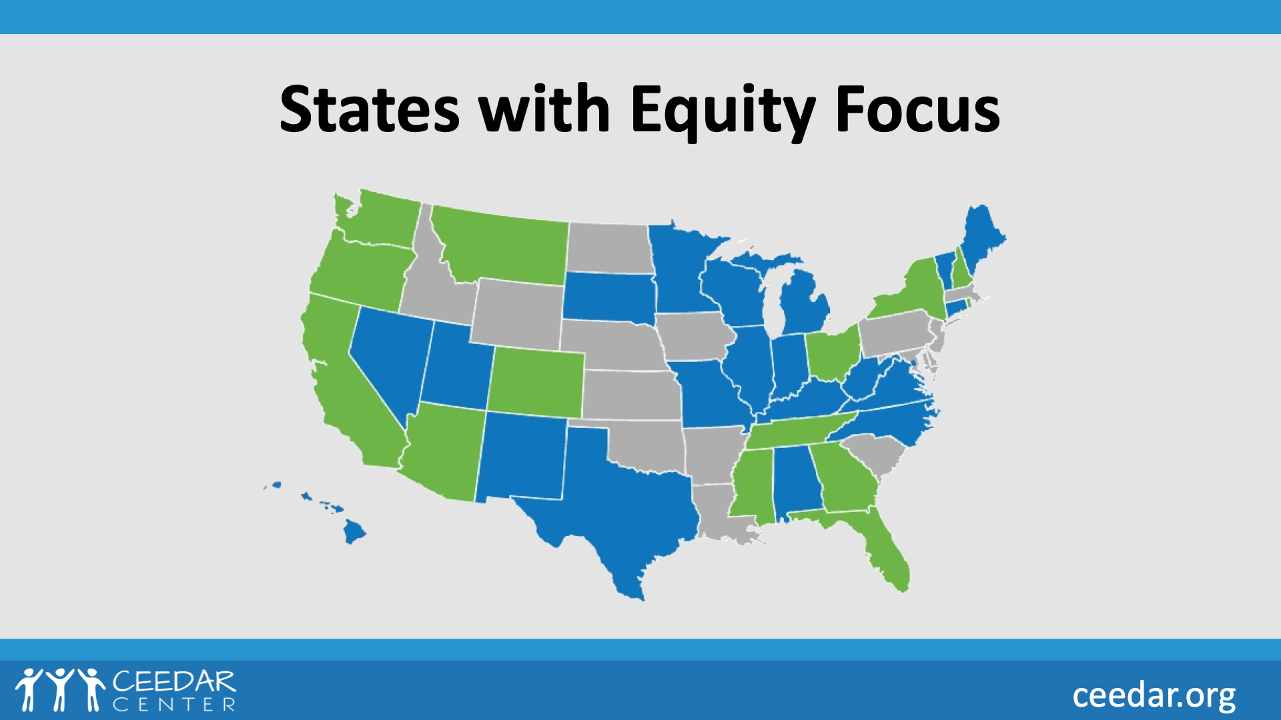
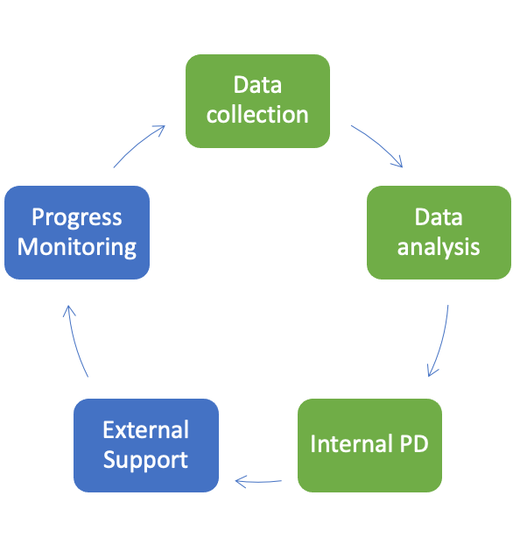
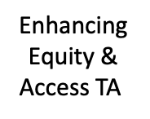
CEEDAR
The CEEDAR Center, a technical assistance Center funded to improve educator professional learning systems to support students with disabilities, is partnering with states and educator preparation programs to reform their policies and practices with a focus on equity and access.
Notes:
65% of ceedar states have a focus on equity and access. The Center has a stronger focus on helping states look at data and provides supports to states in areas of need.

Slide 7
CRE Topical Action Group
9 states
SEA and EPP approaches to CRE in preparation, partnerships, and policy
Leverage state efforts in a common focus area
Facilitate discussions
Develop resources
Recommend policy action
Two Committees
Professional Development
Infrastructure Supports
Notes:
Example: CEEDAR states are working to revise program review standards to incorporate opportunities for candidates to gain knowledge and skills in this area in field experiences through strong partnerships with districts
CEEDAR’s CSLG model is influenced by research on networked improvement communities. Like cross-state learning groups, networked improvement communities provide a structure to organize collaborative efforts to tackle shared problems of practice (Russell et al., 2017).
provide a structure to leverage the collective knowledge and resources of the CEEDAR network
build relationships between state-level leadership teams, partner organizations, and individual team members.
Topical Action Groups (TAGs) are one level of CSLG.

Slide 8
Four Briefs
Brief #1
A Call to Action: Supporting Faculty Development for Culturally Responsive Teacher Preparation Programs
Brief #2
Supporting Equity Focused Preparation through Policy
Brief #3
Utilizing Strategies to Embed Culturally Relevant Education in Principal Preparation
Brief #4 (in progress)
Family and Community Advocacy to Influence Policy

Slide 9
Brief #1
A Call to Action: Supporting Faculty Development for Culturally Responsive Teacher Preparation Programs
Notes:
CEEDAR has approximately 35 regular staff that provide direct TA. We also utlize content experts when needed to assist states. We have more than a hundred implementation specialists that can also assist. These are a cadre of folks from our state teams, SEA and LEA faculty who have successfully implemented reform efforts and can assist in other states with their experience and expertise.

Slide 10
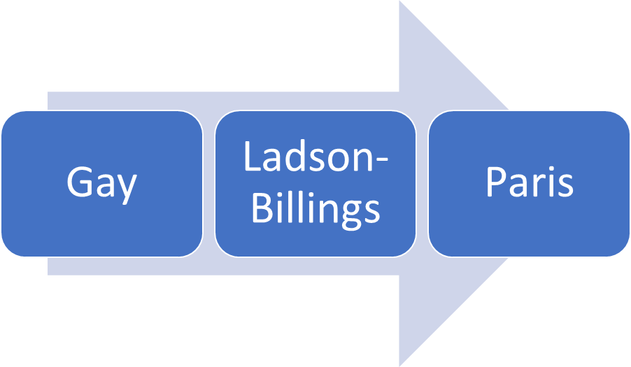
Our Foundations

Slide 11
We realize the definition is constantly evolving to encompass new contexts. For the purpose of this brief, we define culturally responsive teaching as:
instructional practices and interactions that acknowledge sociopolitical, historical, and social contexts of education while promoting equity for all.

Slide 12
Professional develop begins with self-reflection and a willingness to grow
Resources offered rather than mandated.
Notes:
CEEDAR has approximately 35 regular staff that provide direct TA. We also utlize content experts when needed to assist states. We have more than a hundred implementation specialists that can also assist. These are a cadre of folks from our state teams, SEA and LEA faculty who have successfully implemented reform efforts and can assist in other states with their experience and expertise.

Slide 13
Delta State University
College of Education & Human Sciences
Yearly Survey of Student Identities
Cultural Competence Professional Development Module
Cultural Competence link on the College of Education & Human Sciences webpage

Slide 14
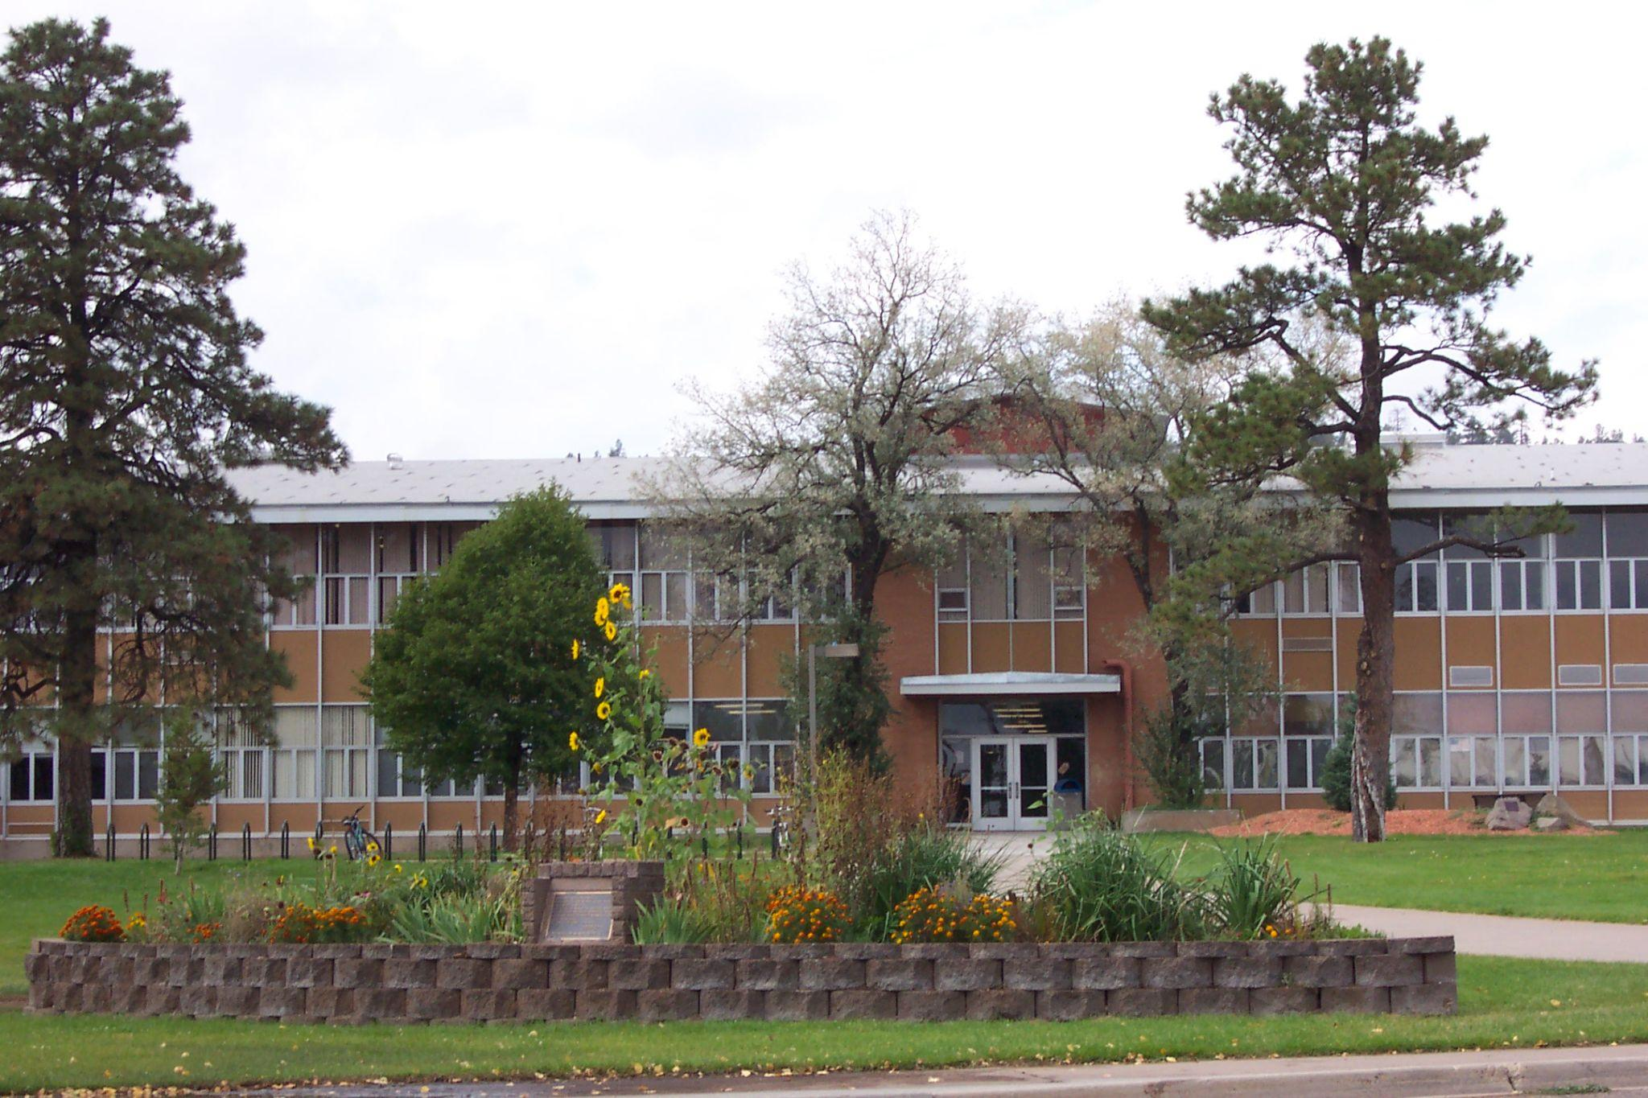
Northern Arizona University
Substantive efforts to revise course syllabi and programs of study to reflect culturally responsive pedagogy.
Tribal Nation partnerships:
Building Capacity in Early Childhood on Tribal Nations
Native School Administrator education
Universal Design for Learning

Slide 15
What are you doing within your context around cultural competence awareness and development?

Slide 16
How would the approaches from Delta State and Northern Arizona University fit your context?

Slide 17
Brief #2 Supporting Equity Focused Preparation through Policy
Notes:
CEEDAR has approximately 35 regular staff that provide direct TA. We also utlize content experts when needed to assist states. We have more than a hundred implementation specialists that can also assist. These are a cadre of folks from our state teams, SEA and LEA faculty who have successfully implemented reform efforts and can assist in other states with their experience and expertise.

Slide 18
Guiding Questions Over the past few years, has educational policy affected students with exceptionalities and students from marginalized populations? Are there examples of parents leveraging educational policies historically? Topics to Consider: Racial Educational Policies LGBTQ+ COVID-19

Slide 19
Racial Educational Policies
From a historical perspective the foundation of special education law (Public Law 94-142, later evolving to IDEA) was based on the Brown vs. Board of Education of Topeka 1954 Supreme Court Case (Yell, 1998).
Interestingly in 2022, at the state level, policies are being enacted for K-12 educators not to discuss concepts associated with race. Currently there are 28 states that have successfully banned or are considering banning concepts associated with race in public school curriculums.

Slide 20
Racial Educational Policies

Slide 21
LGBTQ+
In 2016, the U.S. departments of Education and Justice released guidance clarifying transgender students were protected under Title IX; yet, in 2017, the guidance was rescinded.
In 2021, 32 state legislatures had proposed bills to authorize discrimination against LGBTQ+ students (Temkin, 2021).
As of May 2021, twenty-nine state have no legislation that affirms non-discrimination for LBGTQ+students.

Slide 22
LGBTQ+

Slide 23
COVID 19
Being those most likely to deal with the possibility of COVID loss and job loss, left students of color with a higher likelihood of trauma during and coming out of the pandemic.
In many cases schools were not able to continue providing students with disabilities the same Individualized Education program (IEP) that they were able to receive in person and, in some cases, schools could not accommodate a student with a disability at all (Office of Civil Rights, 2021).

Slide 24
COVID-19

Slide 25
Over the past few years, has educational policy affected students with exceptionalities and students from marginalized populations?
Are there examples of parents leveraging educational policies historically?

Slide 26
Brief #3
Utilizing Strategies to Embed Culturally Relevant Education in Principal Preparation

Slide 27
Student Leader Data
Huge gaps in achievement
Overrepresentation in special education
Higher referral and suspension rates
Higher dropout rates
Slow changes in demographics of leaders
Overall, administrators have less experience
High needs schools have least experienced administrators
Notes:
For example, in 1988, 87% of principals were white (Grissom, Egalite & Lindsey, 2021). Thirty four years later, 78% of principals are white and 22% principals of color (NCES, 2020).

Slide 28
Recommendations for Leader Learning
Use Modeling
Apply a Systems Approach
Encourage Shared Leadership
Provide a Learning School Example

Slide 29
Leader Role
Host Leader
Conditions for Learning
Self-Reflection
Heart

Slide 30
Syracuse Example
Embedding Culturally Responsive Pedagogy
Simulation related to CRP misunderstandings
Aligned with NY framework in coursework

Slide 31
Resources
Culturally Relevant Education Innovation Configuration
Inclusive Leadership Innovation Configuration
EXPLORING EQUITY ISSUES: Culturally Responsive Leaders
University Council for Educational Administration

Slide 32
Do you collaborate with your Educational Leadership Program?

Slide 33
Brief #4 (in progress)
Family and Community Advocacy to Influence Policy
Notes:
CEEDAR has approximately 35 regular staff that provide direct TA. We also utlize content experts when needed to assist states. We have more than a hundred implementation specialists that can also assist. These are a cadre of folks from our state teams, SEA and LEA faculty who have successfully implemented reform efforts and can assist in other states with their experience and expertise.

Slide 34
How do you connect with family and community advocacy groups in your role?

Slide 35
Questions?

Slide 36
Disclaimer
This content was produced under U.S. Department of Education, Office of Special Education Programs, Award No. H325A220002. David Guardino serves as the project officer. The views expressed herein do not necessarily represent the positions or policies of the U.S. Department of Education. No official endorsement by the U.S. Department of Education of any product, commodity, service, or enterprise mentioned in this website is intended or should be inferred.

