Slide 1
Title
Learning to Teach: Re-Envisioning Practice Based Approaches in Virtual Settings
How Do We Ensure that our Teacher Candidates are Learner Ready?

Slide 2
Presenters:
Dr. Amber Benedict, Arizona State University
Dr. Amy M Papacek, Arizona State University
Germaine Koziarski (soon-to-be Dr.), Arizona State University
Robby Robinson (soon-to-be Dr.), University of Las Vegas, Nevada
Dr. Wendy Rodgers, University of Las Vegas, Nevada
Notes:
Amber

Slide 3
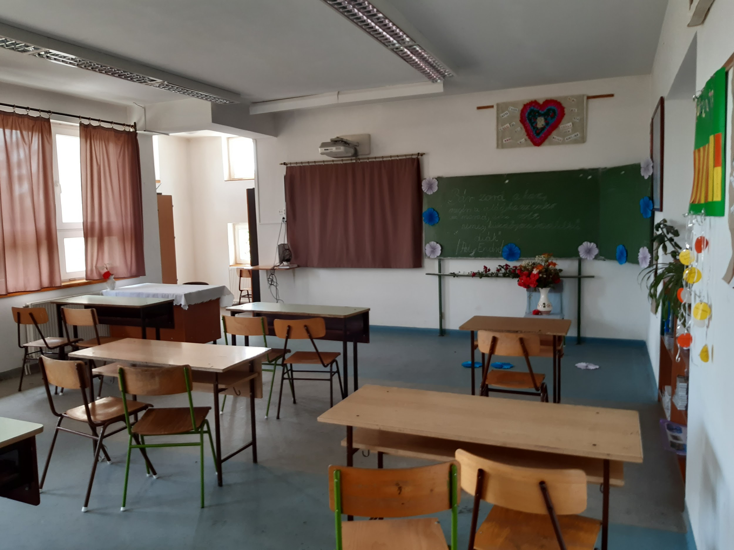
The Challenge
How to practice?
Notes:
Amber
As a result of Covid-19, teacher preparation institutions have scrambled to mobilize face-to-face coursework to be delivered remotely via various online approaches (e.g., synchronous, asynchronous). In addition to not knowing how long this pandemic will last, many of these programs may choose to remain in this virtual space. Therefore, it is necessary to support teacher educators in making decisions during this precarious time and in future ones about how practice-based experiences can be enacted within virtual spaces.

Slide 4
What are Practice-Based Opportunities and Why are They Important?
Modeling
Spacing
Variation
Coaching & Feedback
Analysis & Reflection
Scaffolding
Notes:
Amber
Learning to teach is complex.
Effective educators must draw upon knowledge and practices in ways that are both intentional and responsive to students.
This type of knowledge and skill integration does not occur from observations or reading about teaching alone; it is developed through careful practice coupled with feedback.
But how might this be structured when the usual spaces for teaching and learning are no longer accessible?
In this research we examined just this question. In the midst of Covid, we looked to our peers at neighboring Educator Preparation Programs to learn how practice-based experiences might be re-imagined within online spaces.
Using the science on learning as a framework, we asked teacher educators to tell us the ways they were designing practice-based experiences within online coursework and environments that:
· Modeled, or provided candidates examples of what expert performance looked like;
· Are spaced over a period of time;
· Were varied in contexts, with a range of student groups, and differing degrees of support;
· Provided candidates explicit coaching and constructive feedback;
· Created opportunities for candidates to engage in analysis and reflection upon their practice;
· And were scaffolded to gradually increase in complexity as the candidate deepens their knowledge and skill for effective instruction.

Slide 5
Study framework: Research Design
Semi-structured interviews with teacher educators engaged in innovative work
Increasing depth of inquiry, analysis and reflection
Literature Review: team read > 160 articles, only 20 in teacher education
Online survey & individual interview
COVID
Notes:
Robby
Our research design was born out of necessity. Each of us on this team, like you, were forced to immediately adapt our face-to-face courses into online instruction and practicum experiences. Despite this rapid change we still had the responsibility to ensure our teachers were and are learner ready on day one upon graduating from our program.
While we made these adjustments, we looked to the literature to understand what best practice for learning to teach within online environments might look like.
We assembled a national survey that was disseminated via AACTE and the CEEDAR Center to learn teacher educator’s experiences and approaches.
We facilitated a literature review examining online learning and practice-based experiences of professions, similar to education, that are applied fields, such as nursing or dentistry. Of 718 empirical, peer review articles found in our search, 61 met the inclusion criteria, and 20 directly related to teacher education.
Finally, drawing from the pool of participants who completed our national survey, we selected teacher educators who were operationalizing practice-based experiences within online platforms in especially innovative ways and were also adhering to the features of well-defined practice-based experiences, that we mentioned on the previous slide.

Slide 6
Our Findings
Practice-based experiences can be developed within virtual spaces.
What we found?
6 Practice-Based Experiences + 1 New Approach
Notes:
Robby
Our Findings.
What we found were 6 examples of practice-based experiences that were previously supported in the literature and one new approach re-defined within virtual spaces
In the slides that follow, we will share about each of these practice-based experiences, as well as tips we have learned from the teacher educators interviewed about how to operationalize the approach within an online space.

Slide 7
Online Lesson Study
Dr. Kristen Arnold
Faculty
Whitworth University
Spokane, WA
Master in Teaching Program
&
Director of Education
Adaptive Training Academy (ATA)
Analyze student data
Small groups to present LP
Teach & record their lesson
Watch videos & reflect/rubric
Whole class debrief led by a facilitator
Notes:
Robby
“Online Lesson Study is a backward-design practice-based approach which starts with the instructional endpoint and design to meet the lesson goals. A five-step process using an e-Workbook TM (Google.drive) as a framework in which the strategy is based upon. The steps are featured each week dependent upon the type of content. There is a focus of one or more HLPs per step. The five-step process being utilized by practitioners increases the candidates understanding of why reflection is essential to their practice as well as how to refine their own practice of self-reflection. First, candidates identify the needs of the students and develop the practise-based instructional approach. Step 2 Builds collaboration, confidence, trust and vulnerability. Next, candidates teach the recorded lesson in an online synchronous format while being observed by their peers. Additionally, candidates watch their peers and their recordings while marking a rubric on performance. Lastly, a facilitator provides direction during a whole class debiref of the feedback. Executed at a deliberate and appropriate point during the candidate program, this strategy provides critical skills in the areas of collaboration, confidence, trust and vulnerability to peers, and self-reflection on instructional practice.”
Teacher-educators use this method in order to advance their teacher-candidates reflective instructional planning and analysis to promote more knowledge about how students learn and think as well as to how the teacher’s instruction affects their student’s thinking.
To a greater extent, candidates were able to hone in on explicit instruction, increasing what they have not previously witnessed in their teaching videos. As teacher-educators, we can utilize this strategy to see that they are understanding the practice of providing knowledge to learners.

Slide 8
Peer Tutoring
Steps:
Tutor training
Synchronous online sessions b/w PST & student with a trained observer
Feedback on performance
Benefits:
Practice with reading instruction
Learn LP building & strategy implementation
Student access to tutoring
Dr. Timothy Houge
Professor
Northern State University
Aberdeen, SD
School of Education
&
Director
NSU Reading Clinic
Notes:
Robby
“Online Peer Tutoring provides teacher candidates practice in writing and delivering literacy lessons under the direct supervision of a reading specialist. Candidates are paired with students with literacy difficulties and provide tutoring via synchronous online sessions.Teacher candidates in the program gain valuable skills in lesson preparation, reading methodology, and working with students with literacy difficulties. Students in the program averaged a whole grade level of increased performance in literacy. Two procedures which increased student engagement were providing headsets to student participants to limit outside distraction and require signed adult contracts to provide conducive environments during the tutoring sessions. This program also provides tutoring access to a population of disadvantaged students which would otherwise be left-out.”
Tutorial context for teacher candidates which allows them to practice writing and delivering literacy lessons under the direct supervision of a reading specialist. Existing research literature makes it clear that preservice teachers benefit from instruction about reading processes and opportunities to practice teaching in a tutorial environment. Furthermore, three essential components for successful implementation are evident: 1) maintain a coordinator—preferably one with a literacy background; 2) require lesson plans; 3) provide training prior to and during the clinical experience. When technology operated as expected, the instructional environment was ideal, and the children were engaged, distance instruction emulated face-to-face instruction. It became a viable means of granting access to literacy instruction for children who were geographically distributed or those who found it difficult or impossible to attend tutoring in person. Data comparing face-to-face instruction with distance tutoring showed very little difference. The preliminary analysis for the children instructed via face-to-face showed an average growth in comprehension of 1.06 grade levels. Tips for improving student engagement; Provide headsets to students and require contract with adult in the home to provide conducive space for tutoring.
Identify students for program: Local School District or rural schools because of online sessions. Scale: Run by NSU Reading Clinic but could be organized at any level. Tutors: preservice teachers are good candidates but current teachers could also be used. Lesson Plan: Standardized lesson plan helps to maintain predictability for the student and the tutor. NSU uses a scripted lesson plan that can be used for multiple strategies but always follows the same pattern of learning. Synchronous sessions: provide flexibility on time and location for tutors and students. Parents or guardians need to be involved to ensure sessions are productive. NSU provides a trained professional to monitor the sessions and provide feedback. This could be accomplished asynchronously to facilitate alack of resources.

Slide 9
Case Learning
Dossier of materials
Analyze documents to interpret student understanding & progress
Decide if an instructional program is effective
Design lessons aligned with student need
Dr. Abigail Allen
Assistant Professor of Special Education
Clemson University Greenville, South Carolina
Department of Education and Human Development
https://youtu.be/vlgbbX3tEYU
(e.g., Kennedy et al., 2012)
Notes:
Germaine
Case learning can be an effective tool to support candidates in developing their problem solving skills and can be analyzed independently, or in collaboration with peers (Brownell et al., 2019). It is important that materials provided for analysis are specific and provide students specific details of student characteristics and performance (Shulman, 1992).
Dr. Allen used videos so that students could contextualize the case study. For example, when analyzing student data, she shares videos of an educator implementing an oral reading fluency probe so that candidates can see the way the data were collected. Case Learning can be used with other approaches too. Educator preparation programs with access to a virtual reality software could have candidates apply their learning activity to an avatar that fits the profile of the learner in the case study.
Another important aspect of this practice-based approach is the use of rubrics. They can be used to provide candidates feedback on the depth and quality of their analysis (e.g., Gunn, Peterson, & Welsh, 2015); however, in order for this feedback to be useful in improving candidate future performance teacher educators must hold candidates accountable for integrating proposed changes into future case analyses.

Slide 10
Rehearsal
Teach a practice or skill
Peers play P-12 students
Teacher educator plays the role of the coach, providing feedback .
Dr. DaShaunda Patterson
Associate Dean for Faculty Development and Equity
Georgia State University
Atlanta, GA
Department of Learning Sciences
(Lampert et al., 2013)
Notes:
Germaine
In order to optimize the rehearsal’s potential for effectiveness, it is important for the teacher educator to first model a rehearsal, showing students the underlying thinking involved in planning and assessment that informed the design of the lesson that the teacher educator enacts (Tyminski et al., 2014).
Rehearsal is enriched with a classwide debriefing session following observation of the rehearsal.
Within the online-environment, the use of breakout sessions or flipgrid can support candidates in
For Dr. Patterson’s students, they record their mini-lessons in advance. During class, candidates play their videos and peer observers can provide feedback and give a collective debriefing in small groups via breakout sessions. A benefit of having recordings is that the candidates delivering the lesson can watch themselves and partake in the same analysis.

Slide 11
Video Analysis
Used in a “flipped” structure
Read about a core practice
Watch a video showcasing that practice in class
After class, watch video independently & provide feedback
Dr. Adria Hoffman
Professor
Virginia Commonwealth University (VCU)
Richmond, VA
School of Education
&
Anna Lou Schaberg Professor of
Practice, Teaching And Learning
Notes:
Germaine
Dr. Hoffman currently uses video analysis with her teacher candidates. Many of the videos she chooses for her students to analyze are based on High Leverage Practices. Activities used in conjunction with these videos included creating lesson plans, with a focus on what adaptations they would use for teaching the whole class.
Dr. Hoffman created a “flipped” structure by having teacher candidates read about a core practice. Then, during synchronous class time, students watch a video showcasing that practice. After class, they watch the video again, independently, and complete their analysis. Then feedback is provided to the teacher candidate students.
She emphasized the importance of providing feedback to help pre-service teachers develop their analysis skills. Additionally, she noted that she shows her candidates the distinctions between inferences and observations. To help teacher candidates with their analysis, Dr. Hoffman notes the importance of asking questions that will foster their analytical skills. Those questions might sound like “What did you see the teacher do?” and “What did the student do in response?”

Slide 12
Virtual Simulation
Dr. Driver
Dr. Zimmer
Dr. Melissa Driver - Associate Professor
Dr. Kate Zimmer - Associate Professor & Director of Avatar Lab
Kennesaw State University
Kennesaw, GA
Inclusive Education Department
AVATAR Lab = mixed-reality simulation for practicing skills
Allows for immediate feedback in a safe space
Notes:
Germaine
Virtual simulation is a mixed-reality simulation that creates an immersive environment for participants to practice and master skills. One of our interviewees described their use of The AVATAR Lab. Utilizing this approach allows teacher candidates to receive immediate feedback in a space that is safe to make mistakes. The AVATAR Lab has an extensive amount of scenarios that have already been developed, but teacher educators are able to create their own too.
Drs. Driver and Zimmer utilize the Avatar Lab with their teacher candidates. They can assign the same scenario and environment to each candidate (grade, content area, student behaviors, etc), or they can assign individual scenarios based on candidates’ needs. Peers are able to view the lessons and provide feedback. Additionally, the sessions are recorded, so students have the benefit of rewatching their lessons. Prior to COVID, the candidates taught within a mixed reality, meaning that the classroom and its features existed within a physical space and the avatars were within a simulation. After COVID, teacher educators learned to operationalize the entire lab within a virtual space.
Unfortunately, one downside to utilizing this practice-based approach is the very high cost of adopting one of these virtual labs.

Slide 13
Aligned Virtual Placement
(E Learning)
Practicum in virtual classrooms
Observe live lessons w/ lead teacher
Micro-teach students
Evaluated w/ TAP Rubric: Instruction, Environment, Planning, Professionalism
Different focus each week
Key: Partnership between teachers’ college & Prep Digital for information sharing
Ashley Katikos
Assistant Division Director, Professional Experiences
Arizona State University
Tempe, AZ
ASU Prep Digital
Notes:
Germaine
Ashley spoke with us about ASU Prep Digital, the aligned virtual placement at Arizona State University. ASU Prep Digital is used with teacher candidates who are in their first semester of practicum, although there is some opportunity for students who are further along in their program to take part as well.
Candidates are provided the opportunity to witness modeling by observing live lessons. Some candidates are paired with a lead teacher to engage in modeling, spaced learning opportunities, and scaffolding. Spaced learning opportunities allows candidates to strengthen their understanding of effective teaching practices over time by moving from observation, to one-on-one or small group tutoring, to finally planning and delivering a micro-teach with students.
ASU Prep Digital allows teacher candidates to complete their practicum experience through the use of classrooms that are already existing in virtual spaces. ASU Prep Digital utilizes this approach to support teacher candidates with the skills and knowledge they need to thrive in online, hybrid, and flex model instructional settings.
Important aspect for the success of this practice-based approach: establish partnerships
Establish partnerships! To ensure teacher candidates are successful, the teacher’s college at ASU meets regularly with Prep Digital. They request weekly feedback from the students in order to drive change that will benefit the candidates and improve their experience.

Slide 14
Future research and steps
Post-pandemic, many programs may remain virtual
Are special education candidates prepared when they step into their classroom?
Can they use culturally sustaining practices?
How do we teach teacher educators to use these virtual practice-based experiences ?
Notes:
Amy
One thing that we have found…. At the beginning of COVID; most universities has scrambled to meet the needs of our TC to continue to have authentic experience while learning to teach
We are really being Reactive instead of preparing our programs to be proactively knowing how we to move effective, appropriate instruction for our students - -especially our students with exceptional needs
We need to keep researching and we hope that you are interested in this information and our research. We would love to hear from you about your experiences during this pandemic and how we can work towards having our teacher-prep programs include more

Slide 15
Our contact information
Amber Benedict - Amber.Benedict@asu.edu
Amy Papacek - amy.papacek@asu.edu
Germaine Koziarski - gkoziars@asu.edu
Robby Robinson - robby.robinson@unlv.edu
Notes:
Amy

Slide 16
Disclaimer
Disclaimer
This content was produced under U.S. Department of Education, Office of Special Education Programs, Award No. H325A220002. David Guardino serves as the project officer. The views expressed herein do not necessarily represent the positions or policies of the U.S. Department of Education. No official endorsement by the U.S. Department of Education of any product, commodity, service, or enterprise mentioned in this website is intended or should be inferred.

