Slide 1
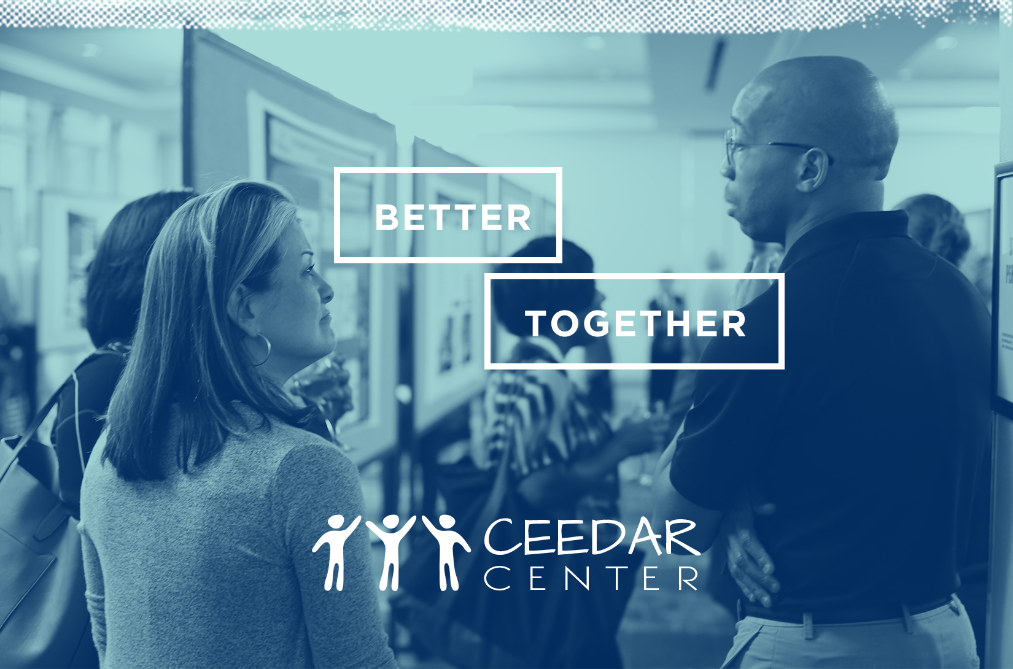
Promoting Learner Engagement

Slide 2

Effective Online Instruction to Enhance Engagement
Corey d. pierce Ph.D. & Lori Peterson Ph.D.
University of Colorado
School of Special education
Corey.pierce@unco.edu
Lori.Peterson@unco.edu

Slide 3

Effective Course Development
Common Course Template
Development vs. Actual Course Shells
Course Flow
Course Settings and Expectations
This Photo by Unknown Author is licensed under CC BY

Slide 4

Ensure Program Quality
National Standards for Quality Online Learning: https://www.nsqol.org/
Quality Matter Standards focus on:
  Course Overview and Introduction
  Learning Objectives (Competencies)
  Assessment and Measurement
  Instructional Materials
  Learning Activities and Learner Interaction
  Course Technology
  Learner Support
  Accessibility and Usability
Learning Management System
Faculty/Instructors ability to advise in program
This Photo by Unknown Author is licensed under CC BY

Slide 5
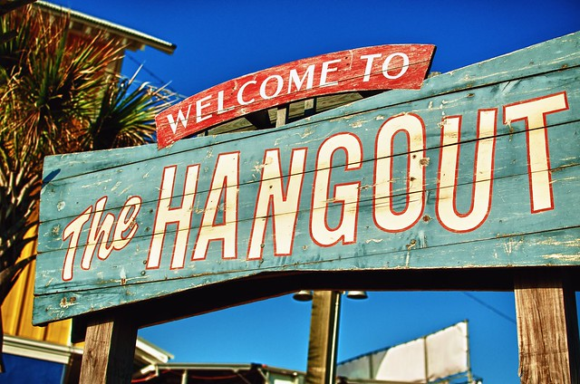
Give students multiple spaces to interact
This Photo by Unknown Author is licensed under CC BY-SA-NC

Slide 6

If you build it, will they come?

Slide 7

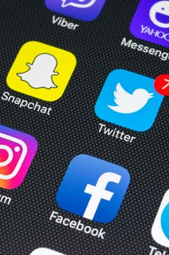
Communication
This Photo by Unknown Author is licensed under CC BY-SA-NC

Slide 8

Scaffold the Transition
This Photo by Unknown Author is licensed under CC BY
“Meet them where they are at and bring them along.”
Notes:
.

Slide 9

Strategies
Create Tone of Community
Introductory Videos or Messages
Synchronous Overview Meetings
Getting To Know You Activities
Letting Your Personality Show
Be Real
Use Collegial Language
Provide Consistency and Routine

Slide 10

Strategies
Facilitate Faculty to Student Communication
You are Available
Ways to Get in Touch
Weekly Announcements
Reach Out to Check In or Provide Reinforcement
Connect with the Quiet Ones

Slide 11

Strategies
Use Content Related Discussions
Prompt Individual Answers or Thoughts
Provide a Variety of Response Opportunities
Monitor Your Role in the Discussion
Set Participation Opportunities and Guidelines for Synchronous Meetings

Slide 12

Strategies
Use Collaborative Activities
Discussion Forums
Wiki Pages
Google Docs
LMS Peer Review
LMS Groups

Slide 13

Strategies
Provide Opportunities for Student Collegiality
Faculty Guided Socials
Course Boards to Share Good News
Non-Sponsored Social Media Group Recommendations (when appropriate)

Slide 14

Community
Feeling Inclusion
Feeling Acceptance
Feeling Support
Feeling Comfortable
Willingness to Engage
This Photo by Unknown Author is licensed under CC BY-SA-NC

Slide 15
Interaction and Engagement Framework
Learner-to-content
Learner-to-instructor
Learner-to-student

Slide 16
Interaction and Engagement Framework
Learner-to-content
  interactions are how the learner interacts with the instructional materials in a course.
2. Learner-to-instructor
  interactions are how students and instructors connect at numerous and timely points throughout the course.
3. Learner-to-learner
  interactions are how learners connect with their peers in the context of the course.

Slide 17
DISCLAIMER
This content was produced under U.S. Department of Education, Office of Special Education Programs, Award No. H325A170003. David Guardino serves as the project officer. The views expressed herein do not necessarily represent the positions or polices of the U.S. Department of Education. No official endorsement by the U.S. Department of Education of any product, commodity, service, or enterprise mentioned in this website is intended or should be inferred.

