Slide 1

.

Slide 2


.
  Effective Remote Instruction 101

Slide 3

Effective Remote Instruction 101

Slide 4
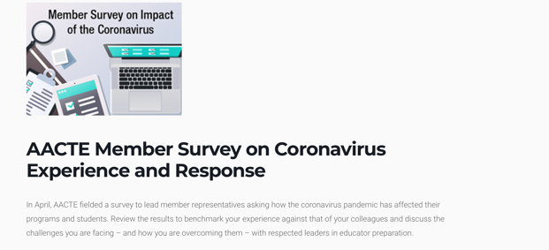
AACTE Member Survey April 2020
https://aacte.org/events/aacte-member-survey-on-coronavirus-experience-and-response/

Slide 5
Survey Methodology
Links to an online survey were distributed to the lead representatives for 700 AACTE member institutions on April 9, 2020
188 usable responses were submitted by the deadline of April 24, 2020 for a response rate of 27%
Responses were received from at least one institution per state, except Arizona, New Mexico, and Wyoming

Slide 6
Has your college/school/department of education transitioned to online learning as a result of the coronavirus pandemic?
Note: Respondents had the option to select that their institution was still in a planning phase or was continuing face-to-face instruction, but no institutions selected those responses.

Slide 7
Which formats are you using for online instruction?
Note: Respondents could select more than one option.

Slide 8
Do you know these terms?
Module
F2F
Asynchronous
Online
LMS
Hybrid
Remote
Blended
Synchronous
Face-to-Face

Slide 9


Basic Terminology
Fully Face-to-Face (F2F)
Blended
Hybrid
Fully Online/
Remote

Slide 10
Basic Terminology
Fully Face-to-Face (F2F)
Blended
Hybrid
Fully Online/
Remote
Synchronous/ Asynchronous

Slide 11
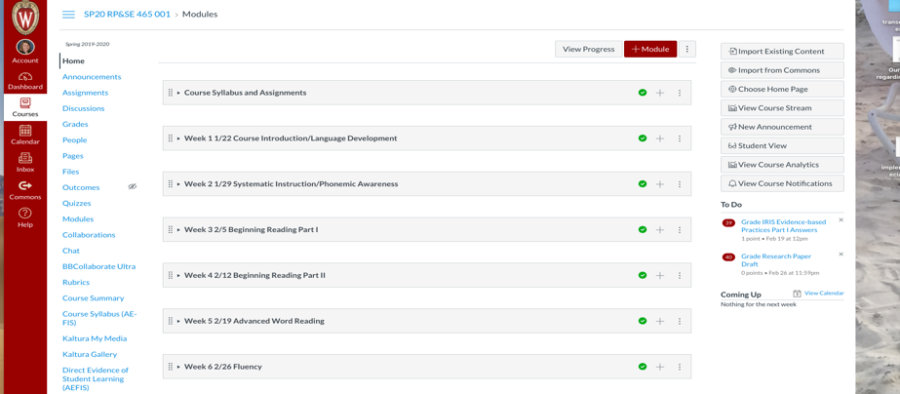
Basic Terminology
LMS: Learning Management System

Slide 12
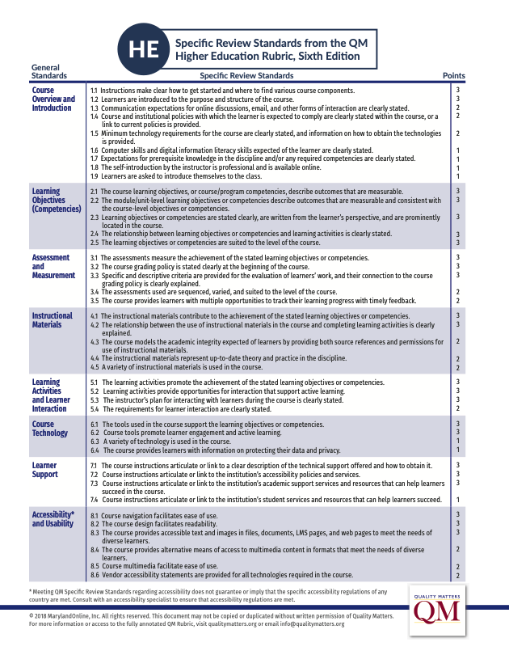
Quality Indicators https://www.qualitymatters.org

Slide 13
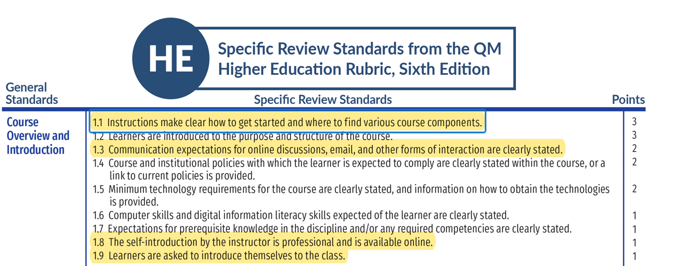
Quality Indicators

Slide 14
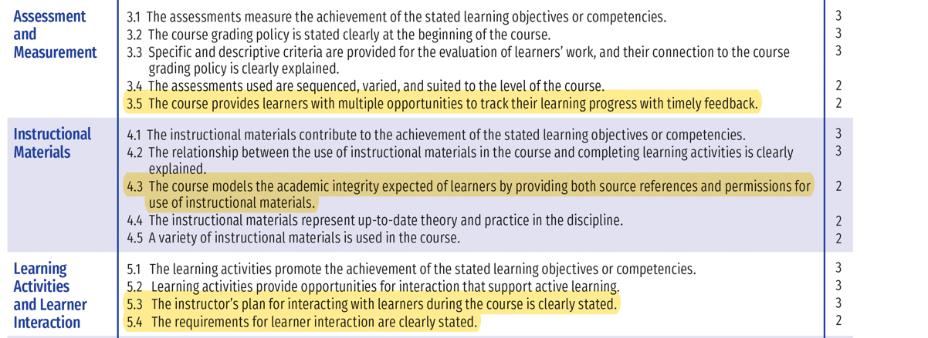
Quality Indicators

Slide 15
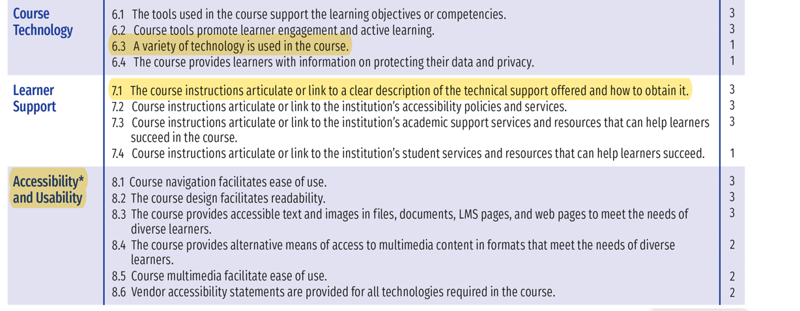
Quality Indicators

Slide 16
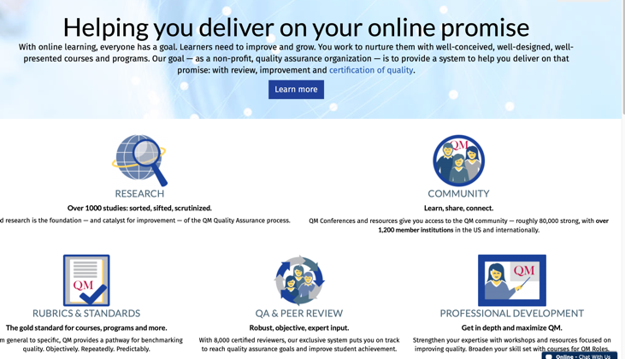
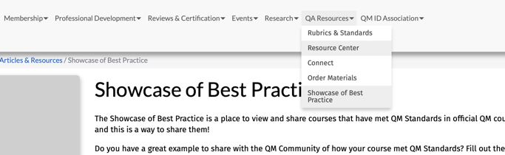
Quality Matters

Slide 17
9 Principles for Excellence in Web-based Teaching
(Henry & Meadows, 2008)
The online world is a medium unto itself.
In the online world content is a verb.
Technology is a vehicle, not a destination.
Great online courses are defined by teaching, not technology.
Sense of community and social presence are essential to online excellence.
Excellence requires multiple areas of expertise.
A great web interface will not save a poor course; but a poor web interface will destroy a potentially great course.
Excellence comes from ongoing assessment and refinement.
Sometimes the little extras go a long way.

Slide 18
Quick Tips
Consistency is Key
Have a predictable rhythm and structure for each module
Less is More
Limit the number of “new” tools and apps
Explain, explain, examples, examples
The more explicit and detailed your course is, the fewer questions you will receive
Time is of the Essence
Be prepared to check email, discussion boards, etc. frequently
Consider having a discussion post for students to ask course questions
Break lectures apart into briefer segments

Slide 19
DISCLAIMER
This content was produced under U.S. Department of Education, Office of Special Education Programs, Award No. H325A170003. David Guardino serves as the project officer. The views expressed herein do not necessarily represent the positions or polices of the U.S. Department of Education. No official endorsement by the U.S. Department of Education of any product, commodity, service, or enterprise mentioned in this website is intended or should be inferred.

