Slide 1

DEVELOP, SUPPORT, & RETAIN – MENTORING & INDUCTION

Slide 2
Advance Organizer
Alternative Route Programs (ARPs): Background and Context
What We Know About ARPs in General and Special Education
Considerations For Effective Program Design and Implementation

Slide 3
Background and Context 1
Background and Context
Approaching ARPs
    Context
    Challenges
        Clarifying Goals
        General Education/Special Education Differences
        Minimizing Entrenched Thinking
        Influencing The Nature of Professionalization
        Difficulty Assessing Efficacy; Few Agreed Upon Outcome Measures

Slide 4
Background and Context
    Opportunities for Special Education
        Addressing Shortages and Disproportionate Distribution of Highly Effective Teachers
        Innovative Program Designs
        Emphasis on Clinically Rich Preparation
        Enhancing and Institutionalizing the P-20 Partnership

Slide 5
What We Know About ARPs
Proliferation, Diversity, and Research (Connelly et al., 2014; Feistreitzer, 2010; Rosenberg et al., 2007, 2009; Sindelar et al., 2012)
    One-Third of All Teachers Participated in Some Type of ARP with the Majority Being in Large Urban Centers
    Lack of Empirical Evidence of Major Differences Between ARPs and Traditional Programs May Be a Function of:
        Variability Among AR Programs (e.g., Time of Entry to Classroom, Placement Factors, etc.)
        Blurring of Programmatic Lines of Demarcation (Shared Program Features)
    Special Education Differs From General Education Programs
        Vast Majority of Special Education ARPs Designed and Implemented By IHEs in Partnership with LEAS and SEAs
        Program Types Include Internship, Distance, Step-Up, and Local (Sindelar et al., 2012)
        Not as fast or Streamlined like GE programs; Most (69%) provide Considerable Time (>18 months) For Instructional Activities
        Evaluations Indicate that Programs Tend to be Structurally Similar to Traditional Programs but Differ in Populations Served; Step-Up Programs Appear to Be Best Fit for Special Education

Slide 6
Considerations For Effective Program Design and Implementation
Engage in Productive Partnerships (Rosenberg et al., 2009)
    School Context Where ARP participants Working has the Strongest Impact on Outcome Measures
    Successful ARP Partnerships have Time Allocated for Collaborative Activities
Integrate Best Practices In Program Components (Wasburn-Moses & Rosenberg, 2008)
    Promote Classroom Survival
    Emphasize Skills to Improve Practice
    Integrate Instructor and Student Topics
    Require Collaboration and Teaming
    Build on the Strengths of a Cohort Model
    Model and Promote a Professional Orientation To Teaching

Slide 7
Considerations For Effective Program Design and Implementation
Address Challenges Associated With Internal and External Approvals and Governance
    Program Approval Standards
    Internal Faculty Buy-In and Governance
    Issues of “Level Playing Fields”
Going To Scale
    Cost of Quality Programming
    Developing New Infrastructure
    Institutionalizing Partnerships Through Formal EP Roles

Slide 8

Fresno State
Established in 1911
Part of the California State University system
25,000 students
Hispanic Serving Institution
Kremen School of Education and Human Development
1911 first grads were teachers
NCATE accredited since 1953
400 Credentials in 2017/18
430 Graduate Degrees in 2017/18
2014 McAuliffe Program Awardee

Slide 9
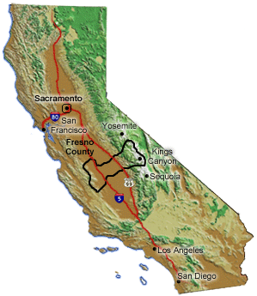
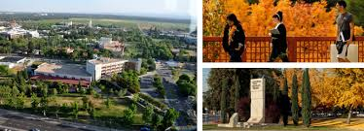

Map of California
FRESNO COUNTY
CALIFORNIA STATE UNIVERSITY, FRESNO
“FRESNO STATE”

Slide 10
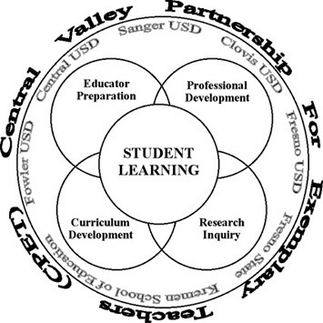
Partnerships to Residencies
2006 - present
This work :
is about a common vision and goal (TK-12 student growth)
is based on strong relationships
requires leadership both at the university and district (especially site principals)
serves our region and community
is Win-Win districts have a pool of candidates who are like 2nd year teachers and universities have access and opportunities, as well as meeting their mission
Primary work in Elementary and Secondary preparation – ONE COHORT for SPED and Elementary authorization when market was different (not as high a need as the last few years in California.

Slide 11
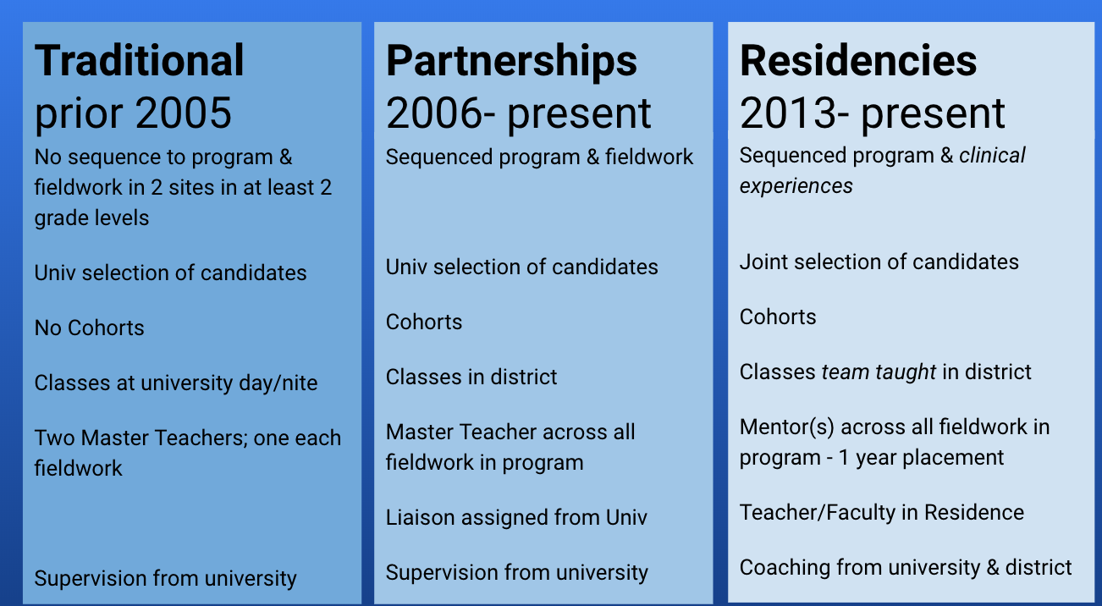
Progression to residencies

Slide 12
Rosenberg (2008) & Fresno State Residencies
    Promote Classroom Survival - Placed prior to school start in Aug, determine schedule & supports (text, email, phone to problem solve); residency calendars and PD
    Build on the Strengths of a Cohort Model Use of cohort members’ strengths such as bilingual skills, represent candidates at conferences, candidate with ADHD presented to peers; mix up the group (BUT… cohort effect)
    Model and Promote a Professional Orientation To Teaching - Professional Orientation To Teaching from day 1 – expectations, professional development attendance; dress; attendance, punctuality…beginning; full year; CHAMPS training…
    Emphasize Skills to Improve Practice - Formative assessments built thru and use of CREATe observation protocol
    Integrate Instructor and Student Topics - assignment focus and application to placement; Meetings with mentor to explain; K-12 student topic choice for inquiry work
    Require Collaboration and Teaming - Levels of meetings; meet often; text, call to immediately problem solve

Slide 13
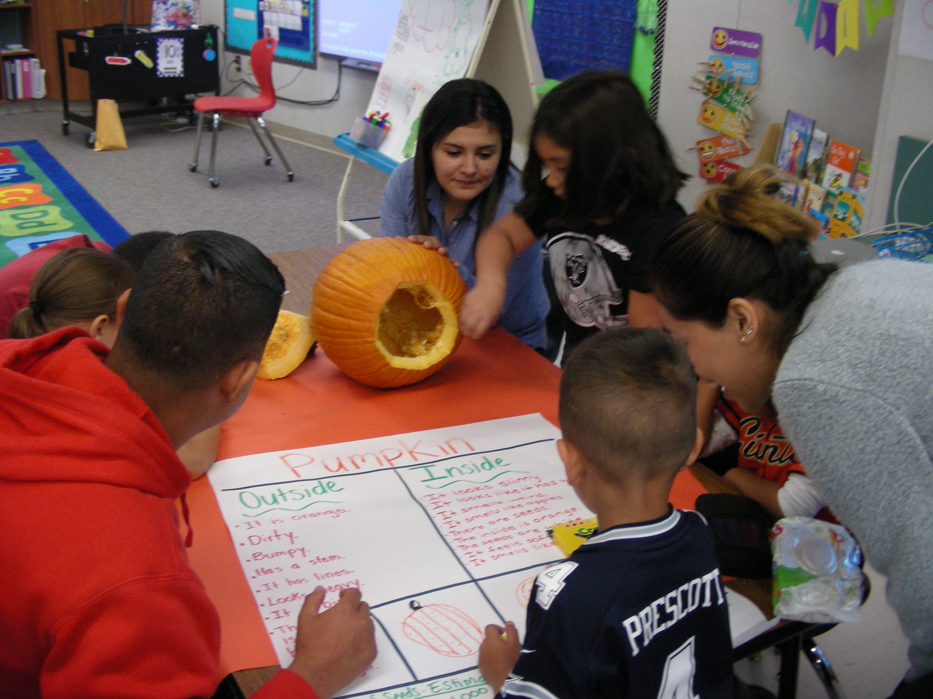
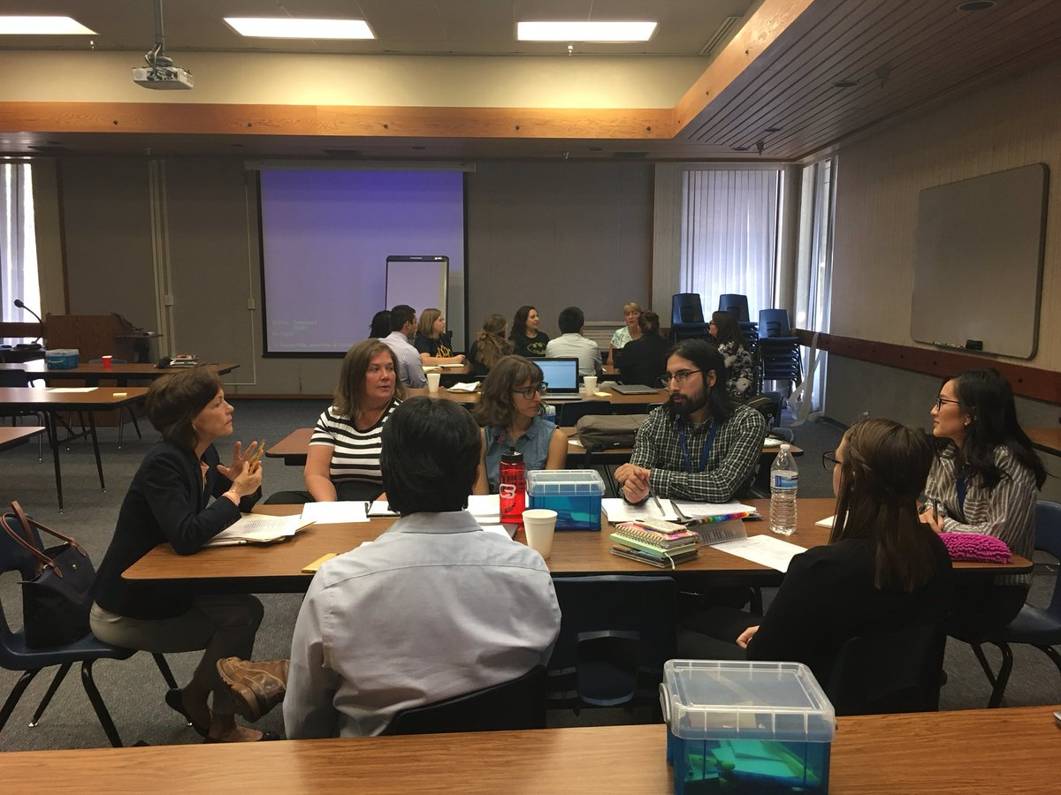
Residency Decisions
Special Education prep issues
1. Grade span and lens; type of SPED credential
2. School site availability, inclusive characteristics and leadership
3. Schedule (time & semester) of courses and clinical hours – SPED courses after 4 PM which does not fit typical description of residency
4. Process for joint selection of candidates, mentors, and coaches Mentors often spread over many sites which can make PDS model more difficult
5. Faculty and District pairs to Team Teach Use of Teachers on Special Assignment or Curr Specialists - some districts stipend
6. Selection of Teacher In Residence & Faculty In Residency (Release time costs – grant covered -TQP )
7. Dress code, parking, food on campus, lanyards, fingerprinting…

Slide 14
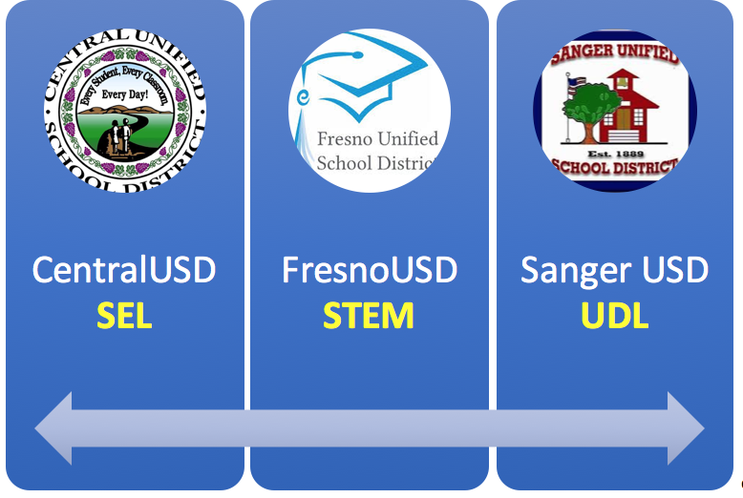
District determined lens
University accreditation, new TPEs, required credential courses, and clinical experiences with emphasis on CLSP, UDL, DAP and Inquiry. The lens is used as a focus to make a difference and develop the residency as a resource. (FUSD also has an MA infused due to TQP requirement – Use MA in CI for elementary and secondary)

Slide 15
Special Education unique issues
Candidates hired prior to certification – 95% of FS SPED candidates
Time to completion of credential SPED same as Elem but with new Calif TPEs will be more difficult
How to schedule a residency Be creative – use late afternoons and evenings but is that intent of residency? 4 day week – class one day – district pay sub?
Finding mentors with inclusive mindsets who are skillful teachers District partners should assist to identify mentors… use of principal recommendation; scores; observations
Finding school sites with inclusive values and practices (both GE and SPED) District partners should assist to identify sites… Leadership, inclusive practices; scores; faculty interest
Fatigue so SPED candidates do not complete a Masters degrees Calif is a post-bac state and FS has infused SPED graduate courses at the end of our SPED teacher prep - it adds rigor and candidates like the shortened timeline to MA

Slide 16

CHALLENGES (EXTERNAL & INTERNAL)
Much like UDL if we had a barrier we looked for solutions.

Slide 17
Overcoming challenges
Program Approval – We used our same approval process; for certain cohorts we have used PD for meeting some standards
Governance – Use existing committees for programs and have open meetings with districts; District representatives on committees; Present at School Board mtgs; Passion & Leadership critical
Faculty Buy-In – Open meetings; Interview of new faculty and take to visit when interviewing; Chairs manage assignments; Faculty not forced to participate; CSU is the CFA union – collective bargaining agreement all 23 CSUs
Level Playing Field – ARP has same course requirements and hrs; residency often exceed hours in clinical placement
District Requests/Expectations – Work through trust relationship; Understanding for our diffused authority and not line authority; Differences (scripted curr…); Dispositional characteristics to come to agreement

Slide 18
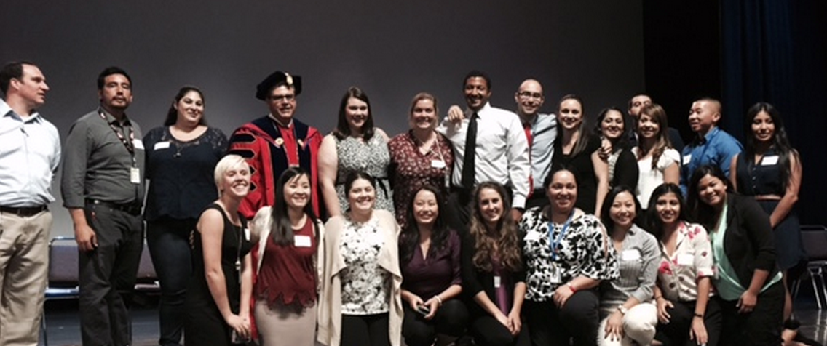


Going to Scale
Other Partners have included:
NCTR
Bechtel Foundation
Dept of ED
BRANCH Alliance for Educator Diversity

Slide 19
Scaling 1
Going to Scale
Cost of Quality Programming
Fresno State has residencies in three districts:
Fresno USD – large urban for six years and we have prepared 12 cohorts – 2 cohorts a year
Sanger USD – small, rural in second year - 1 cohort a year
Central USD – small, suburban in first year- 1 cohort a year
Requests from Clovis USD and Madera USD
Partnership Coordinator position – buyout of some workload
Faculty-in-Residence position for each cohort – buyout of some workload
Mileage to drive to districts
TIME - for relationships, coordinating, planning, improving, team class planning …
Leadership, Leadership, Leadership investment

Slide 20
Scaling
Developing New Infrastructure
Institutionalizing Partnerships
Website changes (we have not devoted enough time to this)
Joint interview processes
Development of course/cohort schedules to include districts
Team teaching structures – onboarding the teams
New positions – Faculty In Residence
New faculty interviews – Dean asks about their work or interest in residency work
Support staff professional development –Advisors and Dept Assistants
Leadership, Leadership, Leadership (Dean – Provost – President) ** President’s Commission for Teacher Education
Expectation that all candidates interested be offered opportunity
Developed & funded faculty positions
Used data for statistical evidence of improved preparation/student effect Shared data agreements
Agreed meeting structures
MOU ??

Slide 21
DISCLAIMER
This content was produced under U.S. Department of Education, Office of Special Education Programs, Award No. H325A170003. David Guardino serves as the project officer. The views expressed herein do not necessarily represent the positions or polices of the U.S. Department of Education. No official endorsement by the U.S. Department of Education of any product, commodity, service, or enterprise mentioned in this website is intended or should be inferred.

