Slide 1

Choosing your channel

Slide 2
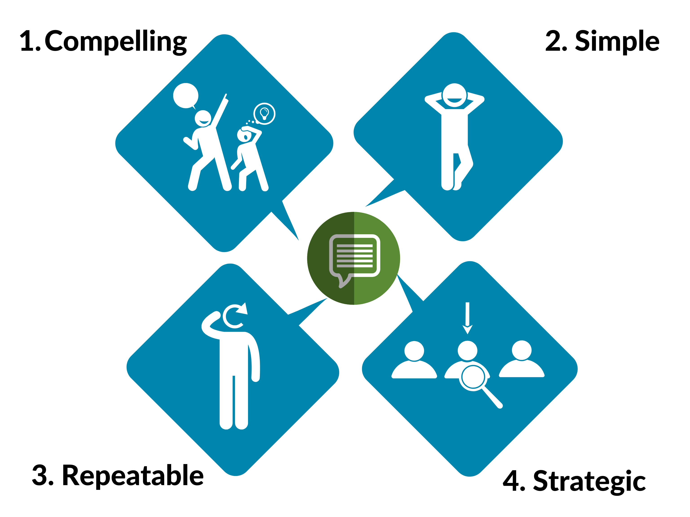
Anatomy of a Good Key Message

Slide 3
Anatomy of a Good Key Message

Slide 4
Anatomy of a Good Key Message

Slide 5
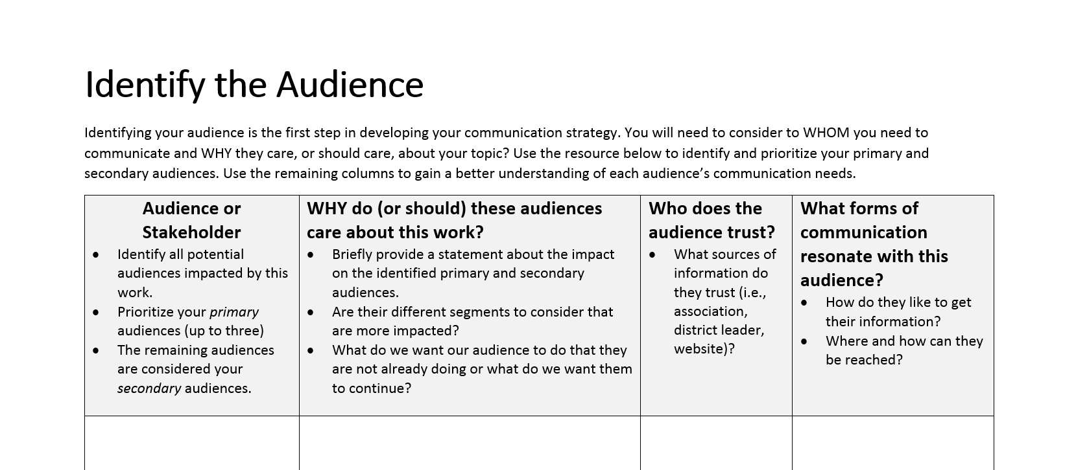
Reminder:

Slide 6
Resource: signetwork marketing toolkit
A resource on marketing for non-marketers. Has great, free guidelines for internal and external communications, marketing, and social media.
http://www.signetwork.org/content_pages/190-resource-library

Slide 7

edTPA Implementation:
Georgia’s Story
Anne Marie Fenton
Director, Rules Management and Educator Assessment
Georgia Professional Standards Commission annemarie.fenton@gapsc.com
7
Notes:
7

Slide 8

Five Steps
Recruitment
Preparation
Induction
Retention
Renewal

Slide 9
Working Together
Working Together:
edTPA as a Lever to Forge Meaningful Partnerships

Slide 10

Early Implementation Timeline
Spring 2012 – National Field Test (8 EPPs in GA)
2012-13 Tiered Certification Task Force
2012-13 Introductory/Exploratory year for providers
Spring 2013-Fall 2013 Finalize policy incorporating edTPA
2013-14 Exploratory/Scaling Up year for providers
10
Notes:
10

Slide 11
Early Implementation Timeline
2014-15 Partial Implementation (each provider implements edTPA with a subset/all of programs, but not consequential yet)
2015-16 Full Implementation (each provider implements edTPA for all programs, consequential)
11
Notes:
11

Slide 12
Georgia’s Passing Standard
 | 13 Rubric Fields (65 Possible) | 15 Rubric Fields (75 Possible) | 18 Rubric Fields (90 Possible)
9/1/2015-8/31/2016 | 29 | 35 | 42
9/1/2016-8/31/2017 | 29 | 35 | 42
9/1/2017-8/31/2018 | 32 | 38 | 45

Slide 13
Capacity Building
Capacity Building
Recruitment
Preparation
Induction
Retention
Renewal
So how can we work together?

Slide 14

Communication Structures of Support
edTPA Coordinators (for each EPP)
edTPA Regional Coordinators
Surveys
Statewide edTPA Conferences
Statewide Convenings (HR, Leaders, Ed. Leadership, EPP Heads, Faculty)
Communications Targeted to Various Audiences (WIFM)
edTPA Policy and Implementation Advisory Committee, including Data Retreat and Focus Groups
edTPA Virtual Professional Learning Community (edTPA VPLC)
Ongoing Sharing of Data and Experiences (Commission Meeting; Statewide Convenings; Conferences; VPLC)

Slide 15
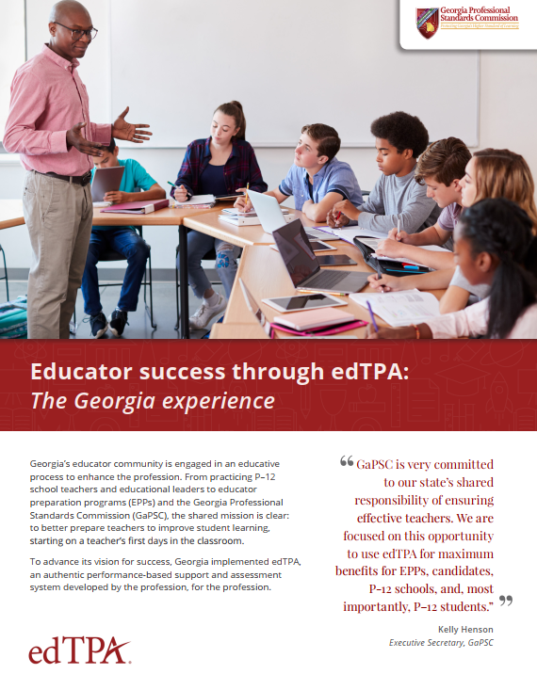
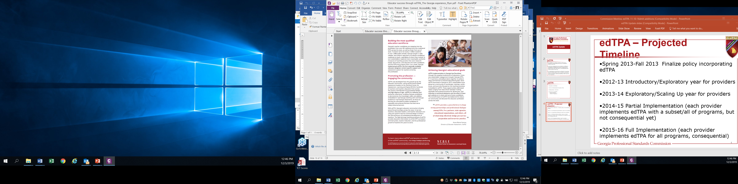
Educator Success Through edTPA

Slide 16
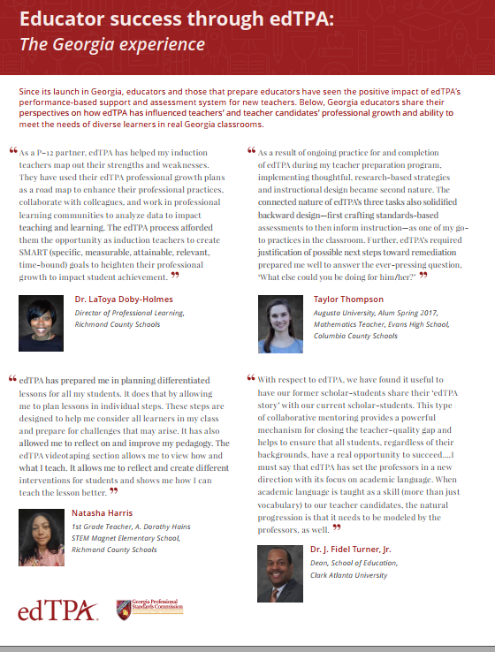
Educator Success Through edTPA

Slide 17
Forging Partnerships
Forging Partnerships
Determining alignment of edTPA and the local or state in-service evaluation assessment
Examining school goals/mission/priorities
Teacher Candidate Evaluation System
P20 Collaboratives
Virtual Professional Learning Communities
Individualized Professional Learning Plans
Differentiated Induction
Professional Learning Communities led by Teacher Leaders

Slide 18
Working Together: Takeaways
Working Together: Takeaways
edTPA as a lever to bridge pre-service preparation and in-service practice
edTPA can forge strong partnerships across EPPs,
P-12, state agencies, educational organizations
Multiple collaborative structures of support can provide avenues for meaningful dialogue about not only the art and skill of teaching, but also about practice and problems of practice in preparation, induction, and retention, all while strengthening partnerships
Must span boundaries
Collaboration builds capacity

Slide 19
Making it Count
Making it Count
Share about the work
Keep the focus on the educative value with the “So What?” in mind
Foster conversations with your partners about successes and needs
Seek ways to work together
Keep the focus on doing what is best for P-12 students

Slide 20
So what?
Recruitment
Preparation
Licensure
Induction
Retention
Renewal
So What?
Excellence in Preparation
Collaborative Partnerships
Powerful Individualized Professional Learning informed by Pre-service Data and Experiences
Strengthened Teacher Effectiveness
Equity in Schools
Increased Retention
Continuous Improvement Across the Professional Continuum
Positive Impact on P-12 Learning

Slide 21


We Are Working Together!

Slide 22
edTPA Implementation:
Georgia’s Story
Anne Marie Fenton
Director, Rules Management and Educator Assessment
Georgia Professional Standards Commission annemarie.fenton@gapsc.com
22
Notes:
22

Slide 23
DISCLAIMER
This content was produced under U.S. Department of Education, Office of Special Education Programs, Award No. H325A170003. David Guardino serves as the project officer. The views expressed herein do not necessarily represent the positions or polices of the U.S. Department of Education. No official endorsement by the U.S. Department of Education of any product, commodity, service, or enterprise mentioned in this website is intended or should be inferred.

