Slide 1
NH CEEDAR Research Initiative: The State of Clinical Practice and Preparation in New Hampshire
2019 CEEDAR Cross-State Convening Meeting
Denver, CO
Steve Bigaj
Keene State College
Keene, NH
Other members of the Partnership Research Team:
Megan Birch, Plymouth State College
Vince Connelly, University of New Hampshire
Laura Wasielewski, Saint. Anslem College

Slide 2
New Hampshire: CEEDAR Goal #2
Goal #2 : To determine the extent and nature of partnerships between NH Educator Preparation Programs (EPPs) and P-12 to demonstrate positive impact on all P-12 student learning and educator development
Collect and collate the landscape and context of current practice around partnerships based upon the goal area’s conceptual frame.
Establish a common language and understanding with respect to P-20 partnerships based on the conceptual framework
Expand the volume and quality of partnerships in place in NH
Notes:
Integration of professional learning practices:
(e.g., educator rounds, coaching, research, mentoring, communities of practice)

Slide 3
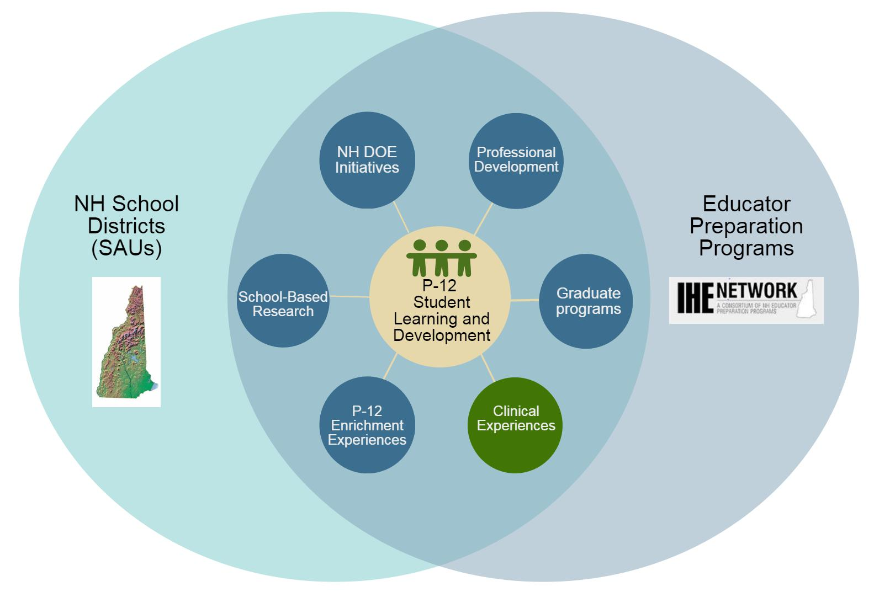
P-12 School- EPP Partnerships
Notes:
Make sure to mention the NTEP, IHE Network, NH DOE, CEEDAR collaboration here

Slide 4
Conceptual Framework: The Nature of EPP/IHE Partnerships and Clinical Practice
Immersive Clinical Experiences
I
IV
Placement Relationship
Partnership Relationship
II
III
Early
Field Experiences
Figure 1: Nature of IHE Partnerships with P-12 Schools (IHE Network Partnership Subcommittee, 2016)

Slide 5
Conceptual Framework: Guiding Principles
Partnerships improve pupil learning
Partnerships are bidirectional and mutually beneficial
P-12 School – EPP/IHE Partnerships
Partnerships foster culture of adult lifelong learning

Slide 6
Principle 1: Partnerships are centered on P-12 student learning and development
Student learning at the core of our work
Build capacity for collaborative learning
Connect theory to practice
Support diverse needs of all learners
Notes:
Integration of professional learning practices:
(e.g., educator rounds, coaching, research, mentoring, communities of practice)

Slide 7
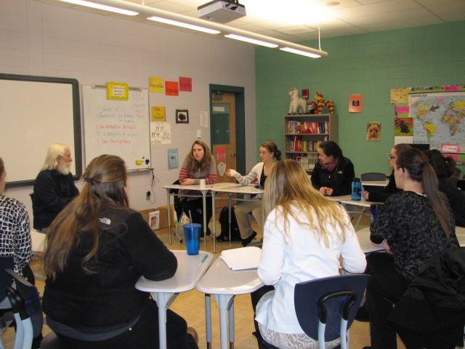
Principle 2: Partnerships foster a culture of adult learning
Teaching as a profession, promoting lifelong learning
Collaborative professional learning
Integration of professional learning practices
Notes:
Integration of professional learning practices:
(e.g., educator rounds, coaching, research, mentoring, communities of practice)

Slide 8
Principle 3: Partnerships are bidirectional and mutually beneficial
Shared vision, values, and decision-making
Establishment of communication between and among school partners
Shared responsibility for teaching and learning of teacher candidates and P-12 students
Co-construction of experiences (e.g., clinical, professional learning)
Notes:
Co-construction of experiences-- (e.g., clinical, professional learning)

Slide 9
Research Purpose and Question
Purpose: To examine the scope and sequence of clinical experiences in educator preparation programs in our state and explore the nature and strength of the partnerships between EPPs and P-12 schools.
What is the current status of clinical practice and
EPP - P-12 school partnerships in our state?
Notes:
Share Definitions CAEP for Clinical Practice and Partnerships

Slide 10
Survey Instrument and Participants
Development of the survey including stakeholder feedback
Close-ended and open-ended items, completed online
-Part I: Clinical Practice (early, middle, capstone)
-Part II: School – IHE Partnerships
Participants:
Educator Preparation Administrators and Program Coordinators (8 of 13 institutions completed with 48 unique responses)
Notes:
Possible handout the survey add logo

Slide 11
General Findings: What We Learned
Current status of Clinical Practice: Characteristics at early, middle, and capstone clinical experiences
Selection of clinical experiences
Activities engaged in at various levels
Characteristics of supervision and evaluation
Placement Centered or Partnership Centered
Notes:
General findings include in each: for example primarily placement focused at all levels

Slide 12
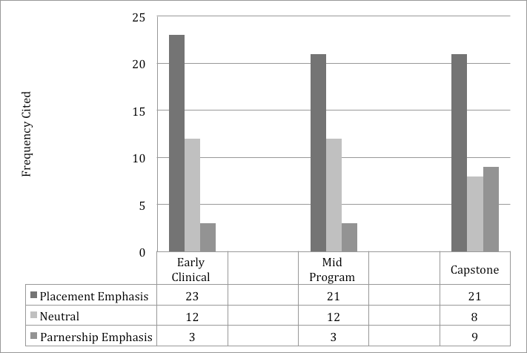
Placement vs Partnership Emphasis

Slide 13
General Findings: What We Learned
Current status of P-12 School and EPP Partnerships
All are shifting towards partnerships, with the most formal relationships reported in connection to culminating experiences.
Programs also described relationships, “organic,” often short-term, coordinated by individual faculty and teachers or for specific courses or projects, which were ripe but had not yet developed into a formal partnership.
Most programs expressed an aspiration to strengthen, extend, and formalize existing relationships with schools.
The Inventory also revealed several hurdles faced by by IHEs: financial, geographic, systematic.

Slide 14
Sharing of Results
IHE Network
AERA, ATE, CEEDAR, NERRO, CEC, ACRES, NAPDS
Publications

Slide 15
Upcoming Research Activities
Follow up focus-group and/or interviews with EPP administration/representatives
P-12 Administrator Survey
Identification of design elements
Notes:
Share idea of writing and edited book of examples in NH

