Slide 1
Supporting Inclusion with HLPs: Pathways to Equity and Access
WACTE
October 28-29, 2020
Presenters:
Cyndi Caniglia, Ph.D. Whitworth University
Jen Cole, M.A.
Washington PAVE
Equity
Access
HLPs
"Every student deserves the opportunity to be successful regardless of their zip code, the color of their skin, the language they speak, their sexual and/or gender identity, and whether or not they have a disability."
  Chardin, M. & Novak, K. 2020
Notes:
Use of HLPs as a pathway to equity and access
We will spend our time today discussing:
A call to action for addressing issues of equity and access to meaningful academic and social opportunities in general education settings for our p-12 students: Information on our current status related to inclusive practices in Washington State
Engage in conversation around our individual identity and how that influences our role related to teacher preparation and affecting outcomes for students and families.
The HLPs and their role in impacting inclusive, equity-based pedagogy, when combined with culturally responsive practices
CEEDAR and the role of CEEDAR in supporting us in this work at both state and national levels through collaboration across stakeholders, resources, and multiple venues of support
We will have a total of 3 breakout sessions with opportunity to discuss and debrief…

Slide 2
Land Acknowledgement
I would like to acknowledge that we are on indigenous lands, and in Everett from where I reside, I am on the traditional territory of the Coast Salish People, specifically the Tulalip Tribes, successors in interest to the Snohomish, Snoqualmie, Skykomish, and other allied bands signatory to the 1855 Treaty to Point Elliott. They, and many other indigenous people are still here, surviving and thriving Since Time Immemorial. I honor their strength and resilience.
What traditional territory is your city on? https://native-land.ca/
Notes:
It is important to note that this kind of acknowledgement is not a new practice developed by colonial institutions. Land acknowledgement is a traditional custom dating back centuries for many Native communities and nations. For non-Indigenous communities, land acknowledgement is a powerful way of showing respect and honoring the Indigenous Peoples of the land on which we work and live. Acknowledgement is a simple way of resisting the erasure of Indigenous histories and working towards honoring and inviting the truth. “ – Duwamish Indian Tribe

Slide 3
Washington Association of Colleges for Teacher Education (WACTE)
Statement on Racism
“WACTE preparation programs pledge to redouble their efforts to create a more inclusive teaching corps, address systemic racism within their own programs and the broader education system, examine their own implicit biases, and do their best to prepare teachers who can and will teach children the ways that they, and we, can create a society where we don’t have to mourn the deaths of people such as George Floyd or Philando Castile or Botham Jean or Breonna Taylor or Eric Garner or Michael Brown or hundreds of other black people who have died because of the ways police and our governments view and treat black people.”
- Keith A Lambert, Ed.D. WACTE President
Notes:
Adopted from OSPI, Puget Sound ESD. We acknowledge the pain and trauma resulting from the past few weeks and over 400 years of racism in the Unite States. We stand with our communities of color, especially those who identify as and/or are categorized as African American. We are committed to centering our work to dismantle structural racism.
We offer a comment of silence and honor the space for people from communities of color to speak first, if inclined to do so. We encourage people to use the chat box, if needed. Also, we will include resources in the chat for those who might need more support or want more information.
The Black Lives Matter Movement explained – a good baseline understand of one of the major organizing groups of the protest
75 things you can do for racial justice -- This article is particularly targeted at what white people can do, which is a very US-centric lens, but still offers very useful information to all. These recommendations can be viewed as being for anyone coming at this conversation from a lens other than being black.
On The Media’s Breaking News Consumer Handbook – There is a lot of content being released right now. This can help you remember how to analyze what you read with a critical lens
A podcast on intersectionality -- another great place to learn more about the place race holds in social justice movements in the US.
Above all be safe, be kind, and be good to yourselves and others.
(Adopted by Aaron Jorgensen, Northeastern University)

Slide 4
Inclusion is the belief and practice that all students have the right to meaningfully access academic and social opportunities in general education settings.
Approximately 143,000 eligible students in Washington state receive special education and related services.
Only 57 .7% of students receiving special education services are included in general education settings for 80-100% of the school day.
For students of color with a disability, this drops to 47.7%.
For students with intellectual disability, this drops to 5%.
Washington is currently one of the least inclusive states, ranking 44 out of 50.
A Call to Action for Teacher Educators:
Equity and Access Matters

Slide 5
A Call to Action for Teacher Educators:
Equity and Access Matters
SB 5091 - created a 2-tier multiplier system beginning in 2020-2021 that differentiates special education funding based on the amount of time students spend in the general education setting (more funding for 80% or more time in general education settings than for students less than 80% of time in general education setting)
2019 – Legislators committed $25 million-dollar one-time investment In PD for educators on inclusion practices (leading to the IP Grants)

Slide 6
A Call to Action for Teacher Educators:
Equity and Access Matters
The U.S. Department of Education’s Office of Special Education and Rehabilitative Services released State determinations on implementation of the Individuals with Disabilities Education Act (IDEA) for Part B and Part C for fiscal year 2018.
Washington has been determined to need assistance in implementing the requirements of Part B for more than two consecutive years.
Washington continues to meet Part C requirements of the IDEA.

Slide 7
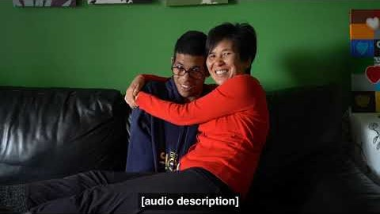
Disability History and Pride Month
Kenassa
12th Grade, Shoreline
Link
Notes:
Disability History and Awareness Month (RCW 28A. 230.158) takes place during October to increase awareness, respect, and acceptance for people with disabilities, and to bring a greater sense of pride to people with disabilities.

Slide 8
A Shared Responsibility
“A story matrix connects all of us. There are rules, processes, and circles of responsibility in this world. And the story begins exactly where it is supposed to begin. We cannot skip any part.”
-Joy Harjo, First Native American Poet Laurate

Slide 9
What role does your identity play in your approach to teacher preparation and ultimately, in outcomes for students and families?
Are we looking at intersectionality?
Do we have diverse representation?
Does this work relate (in a real way) to marginalization?
How has the urgency in this work redefine it?
The” specialness of special education” an inherent fear is addressing race issues
Are we doing anti-racist teacher preparation?
How do we un-learn some of our perspectives and behaviors?
Are we willing to have the uncomfortable conversations around racism, and are we allowing space for those conversations….and having patience with the “messiness” of this work?
Threat=fear of losing something, how does this relate to teacher education and “othering”?
Notes:
Our role as Teacher Educators…

Slide 10
Breakout 1
In your group, discuss one or more of the following:
What are your reflections about Washington's ranking as 44th in the nation for inclusion of the students with disabilities ?
Does your teacher preparation program incorporate anti-racist and anti-ableist curriculum and pedagogy to address issues of equity and access?
Does your teacher preparation faculty include diverse representation (race, ethnicity, and ability)? Pre-service candidates?
Notes:
The current environment has unveiled inequity more than ever before and provided opportunity to change the way we do things.
As we approach issues of equity and access in teacher preparation, it is important to acknowledge our identities and biases and how they may influence our approach to this work.
Please discuss one or more of the following questions in your group. (Ask group to take a picture of questions before going into rooms and/or paste questions in chat box)
We will discuss for 10 minutes and then come back to the group to share out. Please identify a member of your group to share out.

Slide 11
A Call to Action for Teacher Educators from Our Colleagues:
(Ball & Forzani, 2011; McLeskey & Brownell, 2015)
A set of essential teaching practices
This work is essential to improve student learning and behavior
These practices must have a demonstrated impact on student achievement
Taught in teacher preparation coursework
Practiced deliberately and generalized into field experiences
A call for: “a common core of professional knowledge and skils that can be taught to aspiring teachers across all types of programs and pathways” (Ball & Forzani, 2011, p. 19).
Notes:
Given these and other inequities that exist and the need for adequate preparation and training to support preservice and in-service teachers to be able to address these inequities…
The authors of HLPs and HLPs in Special Education call each of us in TPPs to action:
Infuse in teacher preparation and in-service teacher practice:
practices that research has demonstrated can impact student achievement and be used across different content areas and grade levels.
Practices teacher candidates can learn through practice and feedback.
A “common core of professional knowledge and skill that can be taught to aspiring teachers across all types of programs and pathways” (Ball & Forzani, 2011, p. 19)

Slide 12
HLPs for Inclusive Classrooms
Extend the HLPs by Ball and colleagues
Developed by CEEDAR Center, CEC, and TED of CEC
4 domains, 22 Practices:
  Collaboration
  Assessment
  Social/emotional and behavioral support
  Instruction
Notes:
What are HLPs?
Practices that extend the work of Ball and colleagues (HLPs from Teaching Works) – on next slide
Practices, specifically HLPs for inclusive classrooms.
22 practices across 4 domains….

Slide 13
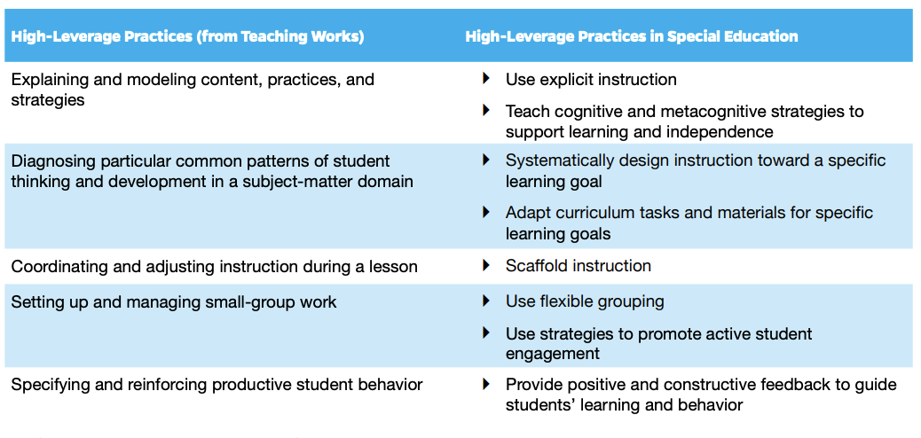
Commonalities and Distinctions Across HLPs
McCray, et al. 2017 https://ceedar.education.ufl.edu/wp-content/uploads/2017/12/HLPs-and-EBPs-A-Promising-Pair.pdf
Notes:
Comparison of Ball and colleagues HLPs to HLPs for inclusive classrooms and also special education.
Practices are appropriate for all teachers
HLPs identified for special education vary only in intensity and focus (McLeskey & Brownell, 2015)
HLPs may offer a pathway to equity-based instruction for students when combined with an equity-based lens and culturally responsive pedagogy.
Intentional training of faculty as well as in-service and preservice teachers helps to infuse practices that will provide students equitable access to instruction in general education and special education settings.

Slide 14
“…HLPs are a set of practices that are necessary to support student learning and that should be learned and implemented by all preservice and in-service teachers. HLPs provide precision and clarity to teaching.” (p.5)
represent the “fundamentals of teaching” when used intentionally based on students’ needs
can be used with ALL students across ALL educators across all subjects and grade levels; shared ownership of student learning and progress
practices both novice and effective teachers implement frequently
high quality instruction and access to general education curriculum at the core
practices embedded across tiers in an MTSS framework
combined with an equity-based lens, culturally responsive pedagogy, and an awareness that additional tools and pedagogy are also necessary
Pathways to Equity and Access
Herberger, Holdheide, & Sacco, 2020
McCray, Kamman, & Brownell, 2017

Slide 15
HLPs, Equity, and Access in Our Current Environment
An example of HLPs as a pathway to equitable learning environment
CEEDAR Brief:
  Removing Barriers to Distance Learning by Applying HLPs.
  Herberger, Holdheide, & Sacco 2020
Notes:
Highlights HLPs as a pathways to equity-based instruction for students in distance llearning
An example of resources provided by CEEDAR.
Improve preparation programs, preparing preservice candidates even now in current environment
Provide resources to P-12 inservice teachers and educators
Provides opportunity for us to partner with families/support family engagement through resources such as this and many others

Slide 16
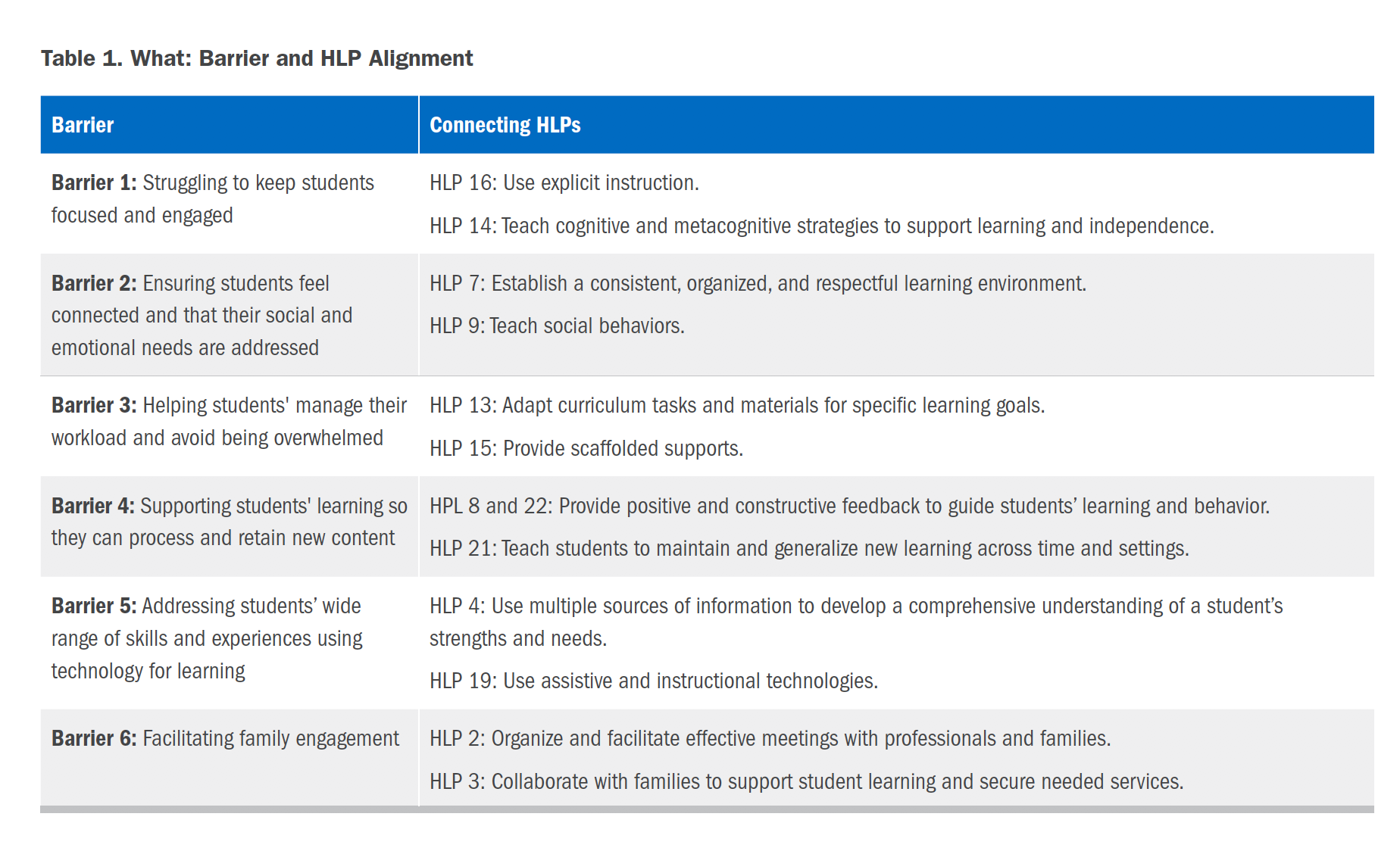
Removing Barriers to Distance Learning by Applying HLPs.
Herberger, Holdheide, & Sacco 2020
Notes:
Example of HLPs as a pathway to remove barriers and establish an equitable learning environment
Support all teachers who are striving to ensure students of all backgrounds and abilities are provided equitable access to high-quality instruction in distance learning environments by:
identifying several common barriers that impede effective distance learning;
strengthening educators’ understanding and use of HLPs to address common barriers;
identifying potential strategies that teachers can apply to improve equitable access to content and learning; and
providing resources for teachers to further develop their knowledge and skill in implementing HLPs.
From CEEDAR Brief: Removing Barriers to Distance Learning by Applying HLPs. Herberger, Holdheide, & Sacco 2020

Slide 17
Pathways to Equity Based Instruction
HLP 3: Collaborate with families to support student learning and secure needed services.
HLP 5: Interpret and communicate assessment information with stakeholders to collaboratively design and implement educational programs
HLP 7: Establish a consistent, respectful, and organized learning environment.
HLP 18: Use strategies to promote active student engagement.
Notes:
Highlight current environment – how these practices provide opportunity for us to partner with families/support family engagement in providing instruction in a distance learning environment!
HLPs implemented along with culturally responsive practices create a pathway to equity-based instruction for ALL students.
Training of faculty and in-service and preservice teachers infuse practices that will provide ALL students equitable access to instruction in inclusive environments and/or across settings.
Examples of HLPs:
HLP 3: Collaborate with families to support student learning and secure needed services. Teachers collaborate with families about individual children’s needs, goals, programs, and progress over time and ensure families are informed about their rights as well as about special education processes (e.g., IEPs, IFSPs). Teachers should respectfully and effectively communicate considering the background, socioeconomic status, language, culture, and priorities of the family. Teachers advocate for resources to help students meet instructional, behavioral, social, and transition goals. In building positive relationships with students, teachers encourage students to self-advocate, with the goal of fostering self-determination over time. Teachers also work with families to self-advocate and support their children’s learning.
HLP 5: Interpret and communicate assessment information with stakeholders to collaboratively design and implement educational programs. Teachers interpret assessment information for stakeholders (i.e., other professionals, families, students) and involve them in the assessment, goal development, and goal implementation process.”] Special educators must understand each assessment’s purpose, help key stakeholders understand how culture and language influence interpretation of data generated, and use data to collaboratively develop and implement individualized education and transition plans that include goals that are standards-based, appropriate accommodations and modifications, and fair grading practices, and transition goals that are aligned with student need
HLP 7: Establish a consistent, organized, and respectful learning environment.To build and foster positive relationships, teachers should establish age-appropriate and culturally responsive expectations, routines, and procedures within their classrooms that are positively stated and explicitly taught and practiced across the school year. When students demonstrate mastery and follow established rules and routines, teachers should provide age-appropriate specific performance feedback in meaningful and caring ways. By establishing, following, and reinforcing expectations of all students within the classroom, teachers will reduce the potential for challenging behavior and increase student engagement. When establishing learning environments, teachers should build mutually respectful relationships with students and engage them in setting the classroom climate (e.g., rules and routines); be respectful; and value ethnic, cultural, contextual, and linguistic diversity to foster student engagement across learning environments.
HLP 18: Use strategies to promote active student engagement. Teachers use a variety of instructional strategies that result in active student responding. Active student engagement is critical to academic success.
Teachers must initially build positive student–teacher relationships to foster engagement and motivate reluctant learners. They promote engagement by connecting learning to students’ lives (e. g., knowing students’ academic and cultural backgrounds) and using a variety of teacher-led (e.g., choral responding and response cards), peer-assisted (e. g., cooperative learning and peer tutoring), student-regulated (e.g., self-management), and technology-supported strategies shown empirically to increase student engagement. They monitor student engagement and provide positive and constructive feedback to sustain performance.

Slide 18
Resources for HLPs
View an HLP in Action (Distance Learning Example):
HLP 14 Use Cognitive and Metac0gnitive Strategies https://highleveragepractices.org/701-2-4-3-3-2/
CEEDAR Center: Publications, Videos, Presentations, Webinars https://ceedar.education.ufl.edu/high-leverage-practices/
HLPs.org: 0-5, K-12 HLP Books, Videos, PD Guides, Webinars
https://highleveragepractices.org
Text: High Leverage Practices for Inclusive Classrooms: http://pubs.cec.sped.org/p6298/
Practice Learning Opportunity Resources: Implementing HLPs (CEEDAR TAG groups): Coming Soon

Slide 19
Breakout 2
The current environment has unveiled inequity in unprecedented ways, creating opportunities for us to change the way we do things in teacher preparation.
Discuss this idea…
  Thoughts?
  Possibilities?
  Barriers?
Notes:
Please discuss one or more of the following questions in your group. (Ask group to take a picture of questions before going into rooms and/or paste questions in chat box)

Slide 20
CEEDAR Partnership with Washington State https://ceedar.education.ufl.edu/
Partnership with Washington State since 2018
  Alignment with OSPI, PESB, WACTE, Higher Education Entities,
  Pre K-21 Educators, Govenor’s Office of the Education Ombuds, Community Partners (PAVE)
National Connections with others doing similar work:
  TAG Groups (Culturally Responsive Education, High Leverage Practices, etc.)
  Affinity Groups
Resources, Support, Research
  Faculty, Educators P-21, Families
Inclusionary Practices Project
  Inclusion Practices Handbook Draft (Feedback Requested)
Notes:
Opportunities with CEEDAR as our partner in TPP work…
Provides the opportunity for us to partner with TPPs nationally and statewide, statewide stakeholders including agencies and schools and engage in collaborative relationships, professional development opportunities, and critical conversations about how TPPs can respond
Put in chatbox:
IPH Draft:
https://www.k12.wa.us/sites/default/files/public/specialed/inclusion/Inclusionary%20Practices%20Handbook_DRAFT_10.12.20.pdf
We are seeking feedback. You can email it to me at ccaniglia@whitworth.edu

Slide 21
Washington State CEEDAR Leadership Team:
Goal #4: Equity and Access
Ensure equity in the development of Goals, 1, 2, 3, and 5 in WA’s CEEDAR work
Racial equity, intersectionality, and disability justice (Curriculum Tools and PD)
Authentic Family Engagement and School partnership
Collaborative, transformative relationships as equal participants in the process Including restorative, healing ways.
Recruitment and Retention of educators of color, disability
Other goals:
Goal # 1: Community-Centered Redesign
Goal # 2: Outcomes alignment (Pre-service and PK-21)
Goal # 3: Knowledge Mobilization
Goal # 5: Educator workforce redesign
Notes:
State level team work: 5 goal areas, goal 4 Equity and access
CEEDAR goals make all of this more equitable and connected

Slide 22
Break Out 3
Discuss:
  How might what we have discussed today have implications for your teacher preparation program?
  What are promising things that are happening in our state that you learned of today or want to share with the group?
  What research opportunities to you see to improve equity and access for K-12 students through quality teacher preparation?
Notes:
Please discuss one or more of the following questions in your group. (Ask group to take a picture of questions before going into rooms and/or paste questions in chat box)

Slide 23
With Gratitude
“And the day came when the risk to remain tight in a bud was more painful than the risk it took to blossom.”
Anaïs Nin
Notes:
We have potential to move systems to be more responsive for all kids. This is the one thing…THE thing. We have the opportunity to be aligned in partnership with CEEDAR, Coordination of systems/entities, embedding HLPs across TPPs and P-21, and including families and communities in the work. This is work that cannot be done in isolation…

Slide 24
Resources
View an HLP in Action (Distance Learning Example):
HLP 14 Use Cognitive and Metac0gnitive Strategies https://highleveragepractices.org/701-2-4-3-3-2/
CEEDAR Center: Publications, Videos, Presentations, Webinars https://ceedar.education.ufl.edu/high-leverage-practices/
HLPs.org: 0-5, K-12 HLP Books, Videos, PD Guides, Webinars
https://highleveragepractices.org
Text: High Leverage Practices for Inclusive Classrooms: http://pubs.cec.sped.org/p6298/
Practice Learning Opportunity Resources: Implementing HLPs (CEEDAR TAG groups): Coming Soon
CEEDAR Brief:
Removing Barriers to Distance Learning by Applying HLPs.
Herberger, Holdheide, & Sacco 2020

