Slide 1


Slide 2
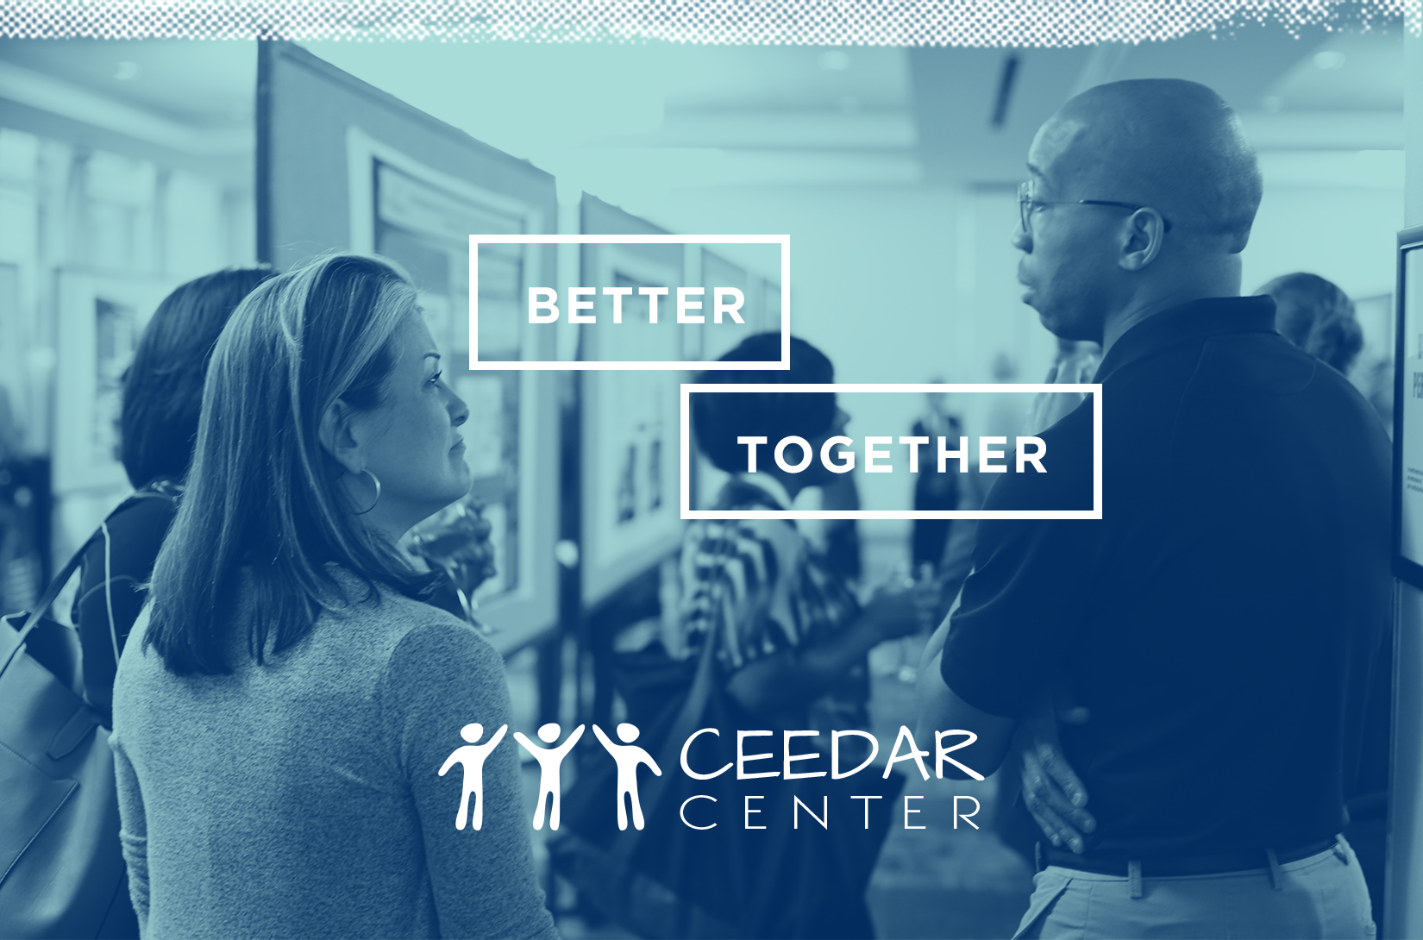

Slide 3

HLP alignment with Program curriculum
Dr. Carrie Chapman, DR. Mark Savignano, & Dr. Rick Lybeck
Minnesota State University, Mankato
Notes:
On this slide you may enter the title of your mini-grant project, your name, and your institution

Slide 4
Purpose of Project
Our department's focus for general education pre-service teachers is on the professional education core - to advance towards their teaching licenses. This process is achieved through four levels of coursework and school-based experiences:
Level 1 - Educational theory, racial and social context understanding of learners/schools
Level 2 – Planning, instruction, assessment
Level 3 – Literacy and differentiation
Level 4 - Student teaching
One of our department goals for this project is to align content goals and objectives across the levels. This alignment will help ensure students understand high-leverage practices with an emphasis on social justice/racial equity to address the wide variation of student learning, and understand how personal and systemic bias influence learners' success
Notes:
On this slide, you can provide some general background on the project. What was the purpose or goal? Why did you decide to focus on this project? How does it fulfill a need at within your educator preparation program or district?

Slide 5
Project Activities
Meet with faculty of the department to present project and gain feedback.
Meet with a subgroup to develop a chart that adds a social justice emphasis to the high-leveraged practices.
Align each HLP to a level of our teacher education program.
Present chart to department to gain feedback.
Refine chart.
Use chart to help align the new PELSB teaching standards across the program, assessing/evaluating for possible core changes.
Ask faculty to teach HLPs with a social justice/racial equity emphasis.
Notes:
On this slide you can share more about what you did for the project. You might include a list of project activities or tasks, a project timeline, any collaborators who contributed to the project.

Slide 6
Project Products, tools, and/or services
Alignment chart
Notes:
On this slide you can share more about new or revised products or service that resulted from your project. For example, you might talk about and share a revised course syllabi, assessment, PD materials, and etc.

Slide 7
Next Steps
Continue to add to, refine, and complete chart with expanded social justice/racial equity information.
Present new chart to department for feedback.
Use chart along with new PELSB standards as the guides for program assessment/evaluation in determining adjustments or changes in any program part.
  Since HLPs w/emphasis on social justice will be used in aligning new standards to program, HLPs will be built into coursework
Notes:
On this slide you can share what you plan to do in the future. Are there more project activities you would like to complete? Will this project lead to a second scope of work? Would you like to gather feedback from teacher candidates or colleagues? Are you hoping to pilot a new product or tool?

Slide 8
Questions?
carrie.chapman@mnsu.edu
mark.savignano@mnsu.edu
Rick.lybeck@mnsu.edu
Notes:
We would like everyone to have a few minutes at the end of the presentation to allow audience members to ask questions and make connections across projects. If you feel comfortable, include your contact information so people can reach out to you in the future ☺

Slide 9

DISCLAIMER
This content was produced under U.S. Department of Education, Office of Special Education Programs, Award No. H325A170003. David Guardino serves as the project officer. The views expressed herein do not necessarily represent the positions or polices of the U.S. Department of Education. No official endorsement by the U.S. Department of Education of any product, commodity, service, or enterprise mentioned in this website is intended or should be inferred.

