Slide 1
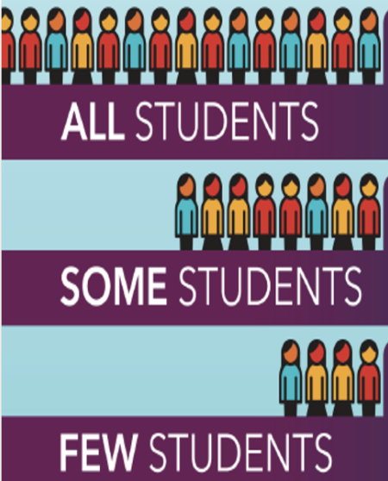
MTSS: From Coursework to Classroom Practice
A CA CEEDAR and CA MTSS Collaboration
Creating Alignment with Credential Program Transition

Slide 2
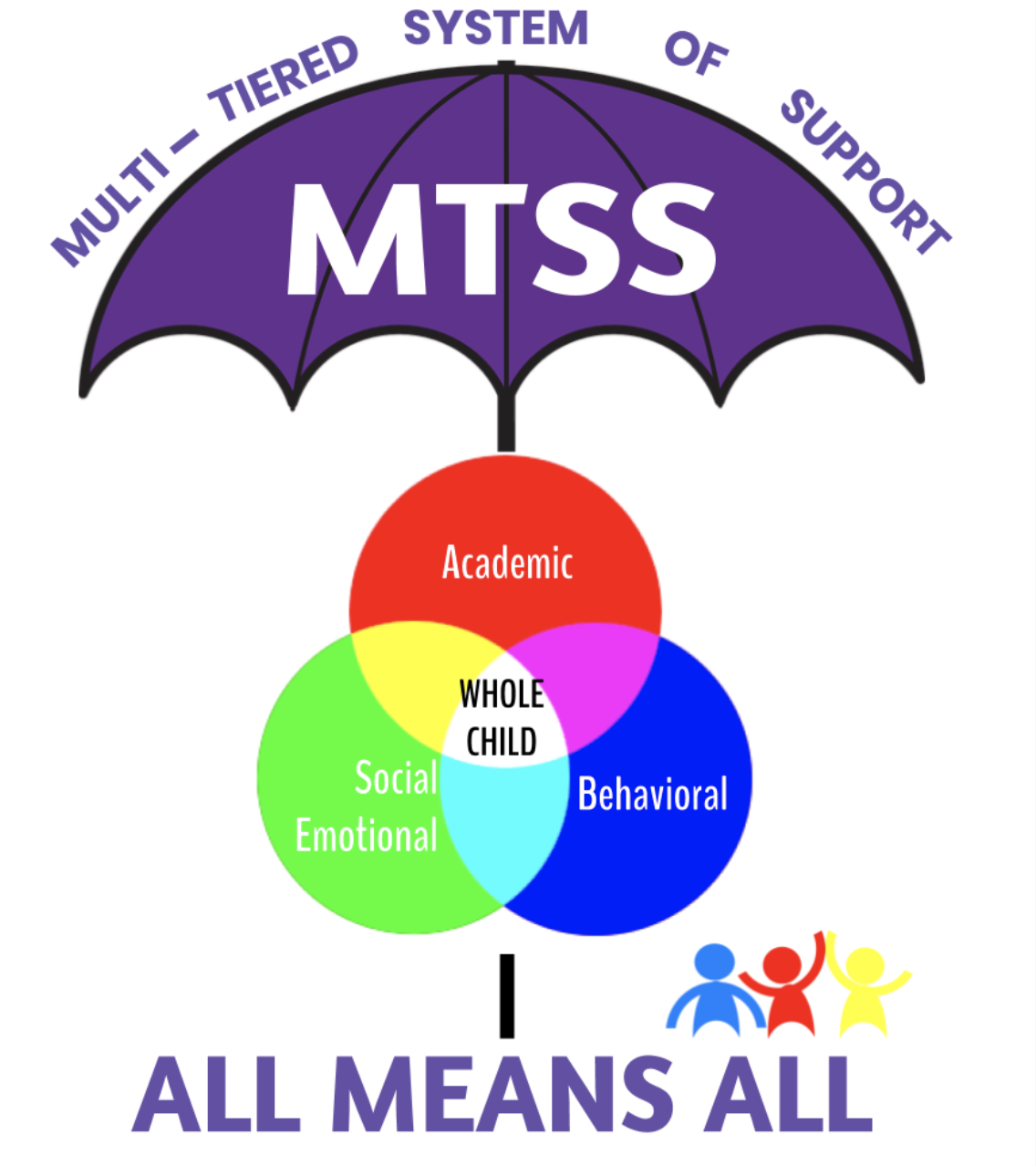
Introductions
Dr. Nicole Schneider, UMass Global
Dr. Victoria Graf, Loyola Marymount University
Dr. Rebecca Harrison, Coordinator of Academic Interventions, OCDE
Notes:
3 mins
Each panelist will introduce themselves

Slide 3
CEEDAR Center Collaboration for Effective Educator Development, Accountability, and Reform
Notes:
Vicki

Slide 4
DISCLAIMER
This content was produced under U.S. Department of Education, Office of Special Education Programs, Award No. H325A170003. David Guardino serves as the project officer. The views expressed herein do not necessarily represent the positions or policies of the U.S. Department of Education. No official endorsement by the U.S. Department of Education of any product, commodity, service, or enterprise mentioned in this website is intended or should be inferred.
Notes:
Vicki The views expressed here do no represent the positions or policies of the U S Dept of Ed, our funder.

Slide 5
About the Center
TA Center funded by the US Department of Education Office
Of Special Education Programs (OSEP)
Housed at the University of Florida,
which partners with AIR and CCSSO
Mary Brownell, Ph.D., Director
Notes:
Vicki

Slide 6
CEEDAR’s Mission
To create aligned professional learning systems that provide teachers and leaders effective opportunities to learn how to improve and support core and specialized instruction in inclusive settings that enable students with disabilities to achieve college and career readiness standards
Notes:
Vicki Where does CEEDAR come in? Point out that we are also focusing on leaders, because they are essential to supporting the change process. I focused on teachers today because of time
FIRST, I WILL TALK ABOUT how WE ARE FRAMING OUR WORK

Slide 7
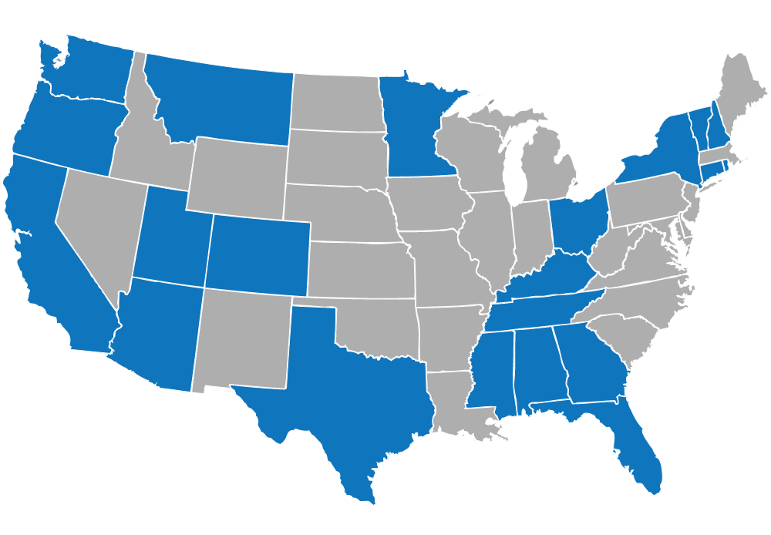
CEEDAR CENTER STATES
Notes:
Now in 21 states, with more joining on even at this 11th hour. We also worked in NV, SD, and IL.

Slide 8
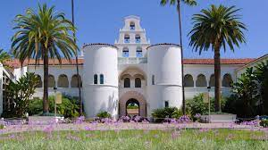
California Participants
Commission on Teacher Credentialing
California Department of Education
Nine IHEs:
UMass Global
Cal Poly Pomona
Cal State East Bay
Cal State Long Beach
Cal State LA
For more information: lindablanton@coe.ufl.edu
Cal State Northridge
Loyola Marymount
San Francisco State
University of San Diego
Notes:
Vicki California was in our first cohort of states, and CEEDAR has been working with CA since October 2013

Slide 9
Current Initiatives
Collaboration with CA-MTSS
Conducting this workshop series and developing modules for teacher educators
Collaboration with CSU System
Developed this clinical practice content for CSU website
Collaboration with CCTE
Offering a webinar series on collaborative and integrative co-teaching
Collaboration with the CA Alliance for Inclusive Schooling
Working with CAIS’s Inclusive Leadership Subcommittee and collaborating with CAST
Notes:
https://inclusive.calstate.edu/hpl-tpe-alignment-resource.html
Need to include link for CSU website, CCTE, and CAIS

Slide 10
CEEDAR Resources
CEEDAR CENTER- Home Page
Innovation Configurations
Course Enhancement Modules
Notes:
Nicole?? Video and Resources

Slide 11
Objectives for the Workshop
Develop familiarity with the
MTSS IC Essential Components for Educator Prep Programs
How these Essential Components align with the Universal and Ed Specialist Teaching Performance Expectations
MTSS Resource Guide
Begin to analyze your course or program using the IC
Generate ideas and plan for integrating the MTSS Essential Components into your program/coursework for:
Educator Specialist Program
General Education Coursework to address the universal TPEs
Literacy Program Standard
Notes:
Paul will discuss the “modified version” and the “full version” as the focus is on Teacher Prep
Nicole

Slide 12
MTSS and TPEs
TPE U1.4 Use a variety of developmentally and ability-appropriate instructional strategies, resources, and assistive technology, including principles of Universal Design of Learning (UDL) and Multi-Tiered System of Supports (MTSS) to support access to the curriculum for a wide range of learners within the general education classroom and environment.
TPE U4.4 Use a variety of developmentally and ability-appropriate instructional strategies, resources, and assistive technology, including principles of Universal Design of Learning (UDL) and Multi-Tiered System of Supports (MTSS) to support access to the curriculum for a wide range of learners within the general education classroom and environment.
Notes:
Nicole?

Slide 13
On the horizon…
In the draft of the forthcoming Literacy Program Standard…
“Coursework includes the study of high-quality literacy instruction that incorporates a) California’s Multi-Tiered System of Support Framework, including best first instruction, universal support for all students, and supplemental support for students who are not progressing;”
Notes:
Nicole?

Slide 14
Discussion
Where does special education fit within MTSS?
Notes:
Vicki - Add content from colleagues

Slide 15
Overview of Innovation Configurations (ICs)
MTSS Innovation Configuration
Catalogs MTSS evidence-based practices (EBPs) that increase student learning and achievement
Use it to:
Analyze EBP coverage for a course/a set of courses/curriculum/program
Identify strengths, gaps, and redundancies
Address types of instruction and experiences your students receive
Focus on instruction and experiences that promote the use EBP
Preparing Teacher Educators for Statewide Scale-up of Multi-tiered System of Support (Sailor, Skrtic, Cohn, & Olmstead, 2020) Abstract
Notes:
Nicole? - Show overview, the process and the original IC
Unpack the differences between the two original/modified

Slide 16
Unpack the Modified Innovation Configuration
Introduction to the Modified MTSS for Teacher Prep IC
The MTSS Components---Modified MTSS IC
Components/levels on the rubrics
Comments? Questions?
Notes:
Let’s discuss.
Kathy-Intros the Modified IC
Rationale and lens of modified IC
Kathy: 3 mins
Show the components, rubrics and levels

Slide 17
Breakout Group: Evidence
What would evidence look like that meets an essential component?
What do you already do?
The teacher preparation program promotes the importance of creating collaboration opportunities among stakeholders (e.g. With families, GED/SPED teachers, paras, related service staff, etc.) | The teacher preparation program promotes the belief that all students need a continuum of supports (universal, supplemental, intensified) to meet the needs of the whole child (academic, behavior, and social-emotional)
Notes:
Nicole 5 mins.

Slide 18
Share-out:
What evidence did you come up with?
Notes:
Nicole 5 mins

Slide 19
Sample Syllabi/IC
Final outcome of how this can be implemented across your curricula/program
MTSS Sample
Syllabus Sample
Notes:
5 mins
Purpose to look thru syllabus and where they are addressed.
Sample IC and syllabus

Slide 20
Program Analysis
Time to think about your own program
Points to Consider…
Where in your special and general education programs is MTSS content taught? Or should be taught?
What alignment is already in your program and what needs to be addressed?
How will you apply what you have learned?
Who will you share this out with at your affiliation?
Notes:
what do you notice what you currently have/need to do?
Share out in chat/a loud
Think about program level of implementing MTSS
What stands out?
What alignment is already in your program and what needs to be addressed?
How will you apply what you have learned?
Who will you share this out with at your affiliation?

Slide 21
Partners/Triads Share-out for Program Analysis:
Introduce yourself (name, affiliation, role, goal(s) for being here)
Share your initial thoughts and ideas about your program/course:
What did you notice?
What is working?
What needs to be addressed?
What ideas do you have?
Notes:
Jody-5 min

Slide 22
Data Collection
3 Types of Data
Student outcome data
Implementation data
Capacity
Notes:
Rebecca

Slide 23
Next Steps
Complete syllabi/program analysis
Share results and get feedback from team
Find resources to fill in the gaps
Revise syllabi/program
Notes:
Nicole
5 mins

Slide 24
Resources
We have aligned our MTSS Resource Guide with the Essential Components
Resource Guide
MTSS Resource from Session 1
Notes:
Nicole 10 mins
Resource Guide: Highlight the UDL Course Enhancement Module and SWIFT resource show link and resource page

Slide 25
SWIFT Schools
SWIFT Guide

Slide 26
Additional Support Available
Questions?
For Additional Support Contact
Vicki Graf (Victoria.Graf@lmu.edu)
Nicole Schneider (nschneid@umassglobal.edu)
Rebecca Harrison (rharrison@ocde.us)
Notes:
20 mins
Nicole
Survey
Request for Support
Paul
Stipend; original syllabus/revised and IC matrix

