Slide 1

Hip-Hop Critical Pedagogy

Slide 2


Hip-Hop Critical Pedagogy
Thursday, May 14th, 2020
Dr. William Hunter

Slide 3
Table of Contents
Introduction
What the Literature Says-Teacher Prep Programs/Educational Systems
What is Hip-Hop?
Hip Hop as a Critical Pedagogy
Placing it into Action
Example of the Process
Concluding Thoughts
Questions
Stay in Your Lane/Figure out Your Lane

Slide 4
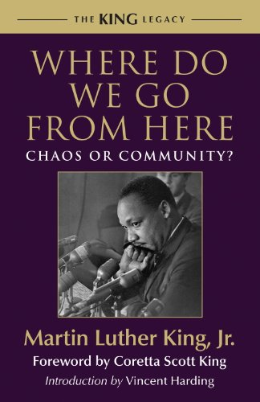
What the Literature Says
It is essential for an emphasis be placed on instructional practices based in teacher education that are designed to improve student (academic and behavioral) outcomes in P-12 classrooms (McDonald, Kazemi, & Kavanaugh, 2013).
There is an emergence of teacher based practices being emphasized in general and special education pre-service special education programs (Leko, Brownell, Sindelar, & Kiely, 2015).
Research has highlighted the importance of “collaborative and collegial learning environments that help develop communities of practice able to promote school change beyond individual classrooms” (Darling, Hammond & McLaughlin, 1995)
The Educational System functions as a system of exclusion (King, 1967).

Slide 5


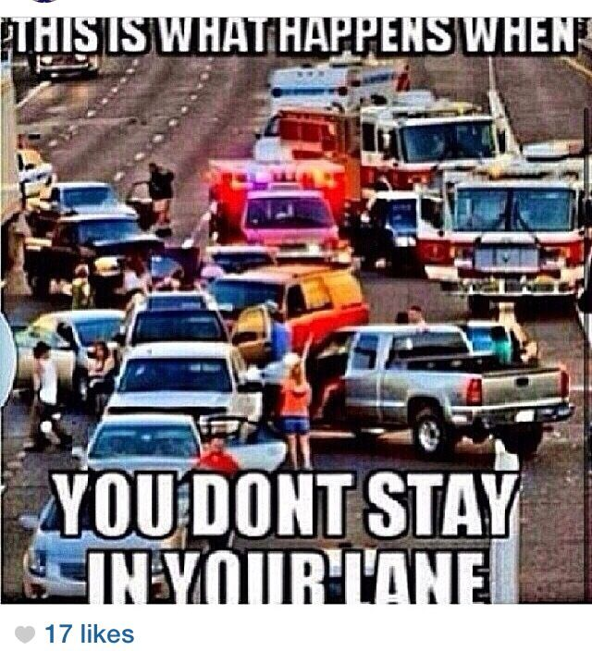

Stay in Your Lane/Figure Out your Lane-Respect the Movement
Different Interpretations with “Staying In Your Lane”
Become a Student of Hip-Hop, but how?
*Dr. Christopher Emdin’s Work
*Dr. Bettina L. Love’s Work
*Explore Hip-Hop Music….

Slide 6


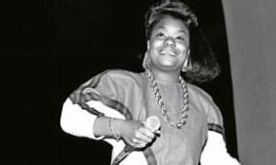
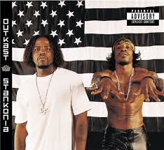
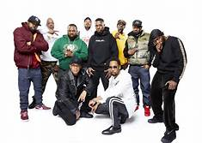
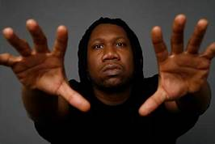
Let’s Figure Out what Hip-Hop Is..
Let’s take a journey through Hip-Hop History-

Slide 7

What is Hip-Hop?
Hip-Hop is a cultural movement that started by black, Latino, afro-Caribbean People in New York City in the 1970’s.
Hip-Hop Vs. Rap?
DJ Kool Herc
“In terms of a distinction in quality, there are MCs creating art and contributing to the culture and then there are rappers who are packaged products of record labels who are contributing to their own coffers with little regard for progress or contributing to the artform and its evolution”.
*Shaka Shaw, September 19, 2013, Ebony Magazine

Slide 8

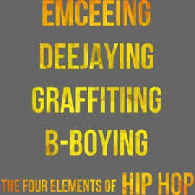
What is Hip-Hop?
There are 4 Major Elements of Hip-Hop

Slide 9
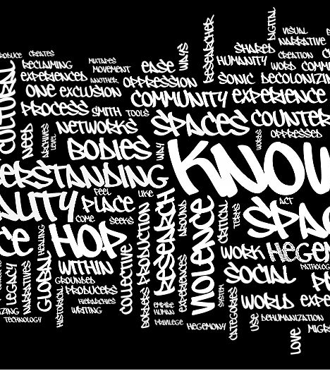
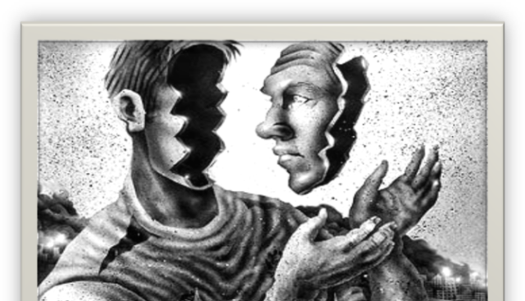
What is Hip-Hop?
The Fifth Element of Hip-Hop
-Knowledge of Self-

Slide 10
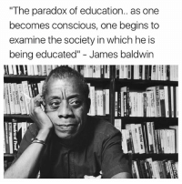
Hip Hop as a Critical Pedagogy
The Connection to The Culturally relevant Pedagogy
3-Tenants of Culturally Relevant Pedagogy (CRP)-Ladson-Billings, 2018.
-A Focus on Student Learning-”Intellectual Growth”
-Developing Students Cultural Competence “ is beyond artifacts, foods, and customs but expanded to include thought, perceptions, feelings, and attitudes”. All students have culture and should be able to develop fluency in another culture”
As educators, it is essential to assist students with recognizing and appreciating their cultural of origin.
-Developing Students Critical Consciousness-“So What Factor”
History and knowledge of current times is essential here.

Slide 11
Hip-Hop as a Critical Pedagogy
Hip-Hop Pedagogy is designed to create a forum for hip-hop to be understood as a means to expose and critique social inequities specifically access to opportunities within education (Akom, 2009, Rose, 2018).
Courtney Rose (2018)-Framework for Critical Hip-Hop Teacher Education (CHHTE)
(Four Tenants)
1-Hip-Hop As a Lived Experience
2 Dialogic Problem-Posing Curriculum-”Turns teacher into a facilitator”
3 Curriculum as a (De) Colonizer-Cultural Competence
4 Development of Critical Consciousness-Connection to CRP

Slide 12



Placing it into Action
The process-
*Brainstorm about the class with co-instructor, Dr. Derrick Robinson
*University Protocol….

Slide 13

Placing it into Action
The process-
*Planning Team-Dr. Gina Tillis (Community Based Project/Spoken Word), Ms. Keishana Barnes (Research Considerations)
*Street Team
*Hybrid Course Initially-
Mondays 1-4pm/With the Pandemic, there was a transition to Online Instruction
Zoom Sessions/Instagram Live
*12 Students-Different Majors-
African American Studies, English, Youth Services

Slide 14
Course Objective
This introductory course will examine the phenomena of the genera of hip-hop/rap and its impact on education and potential to be a driving force in maximizing the education of youth enrolled within urban school settings. Through several theoretical framework lens including cultural relevant pedagogy and critical media pedagogy, an analysis on the art of hip-hop: art, dance, dee-jaying, and rap (lyricism) will be the foundational themes of the course. The main focus of the course will prioritize the interpretation of hip-hop/rap lyrics (lyricism) and the ways it speaks to the youth. An exploration on how hip-hop brings to the light topics such as oppression, violence, identity, culture, power, and activism toward social justice will be also serve as a foundational component within the course. There will be specified moments of discussion and reflection on how hip-hop is a voice for those from marginalized backgrounds setting the stage for a revolution of ideas that can impact urban education. The summative project of the course will provide the forum for students to present on the force and movement of hip-hop from a past, present and/or future perspective.

Slide 15
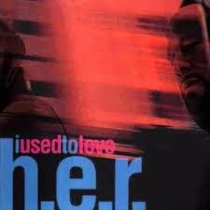
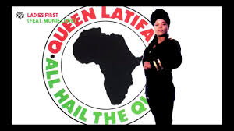
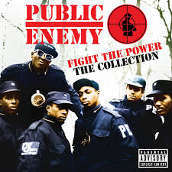
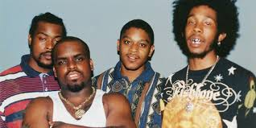
Placing it into Action
Teaching The Course-
Analysis of Songs/Lyrics
*Guest Speakers-WebbStar
*Student Performance/University of Memphis Campus School
*Lunch Fellowship Central Barbeque/National Civil Rights Museum
*Zoom/Instagram Live
*Final Project-Zoom

Slide 16

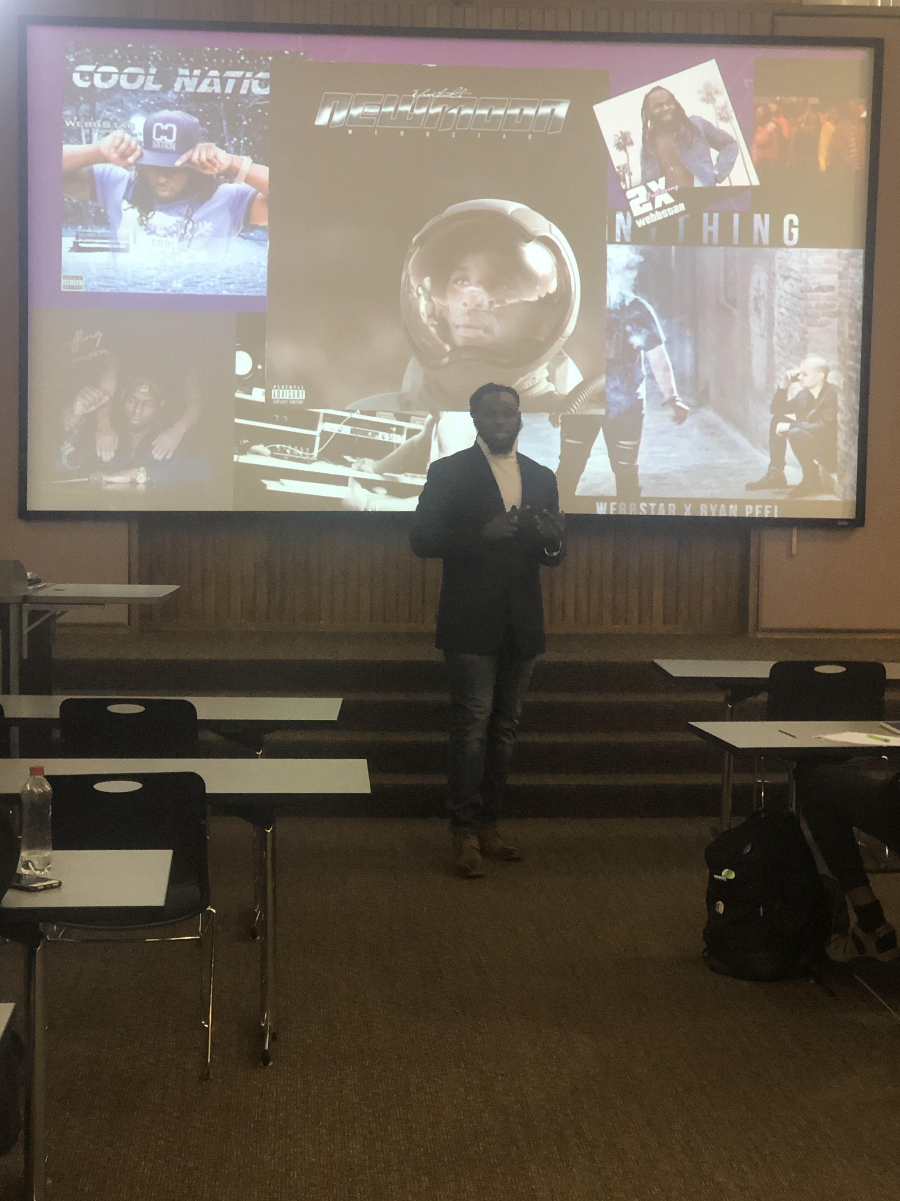
Place it Into Action-
Guest Speaker
Guest Speaker-Local/National Recording Artist-WebbStar
Rap Vs. Hip Hop Discussion
*Local Special Educator within Shelby County Schools, Memphis, Tennessee

Slide 17
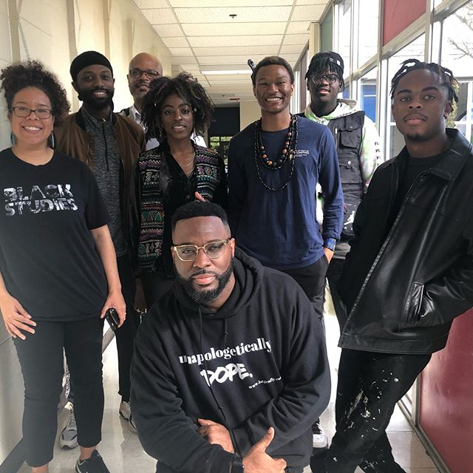
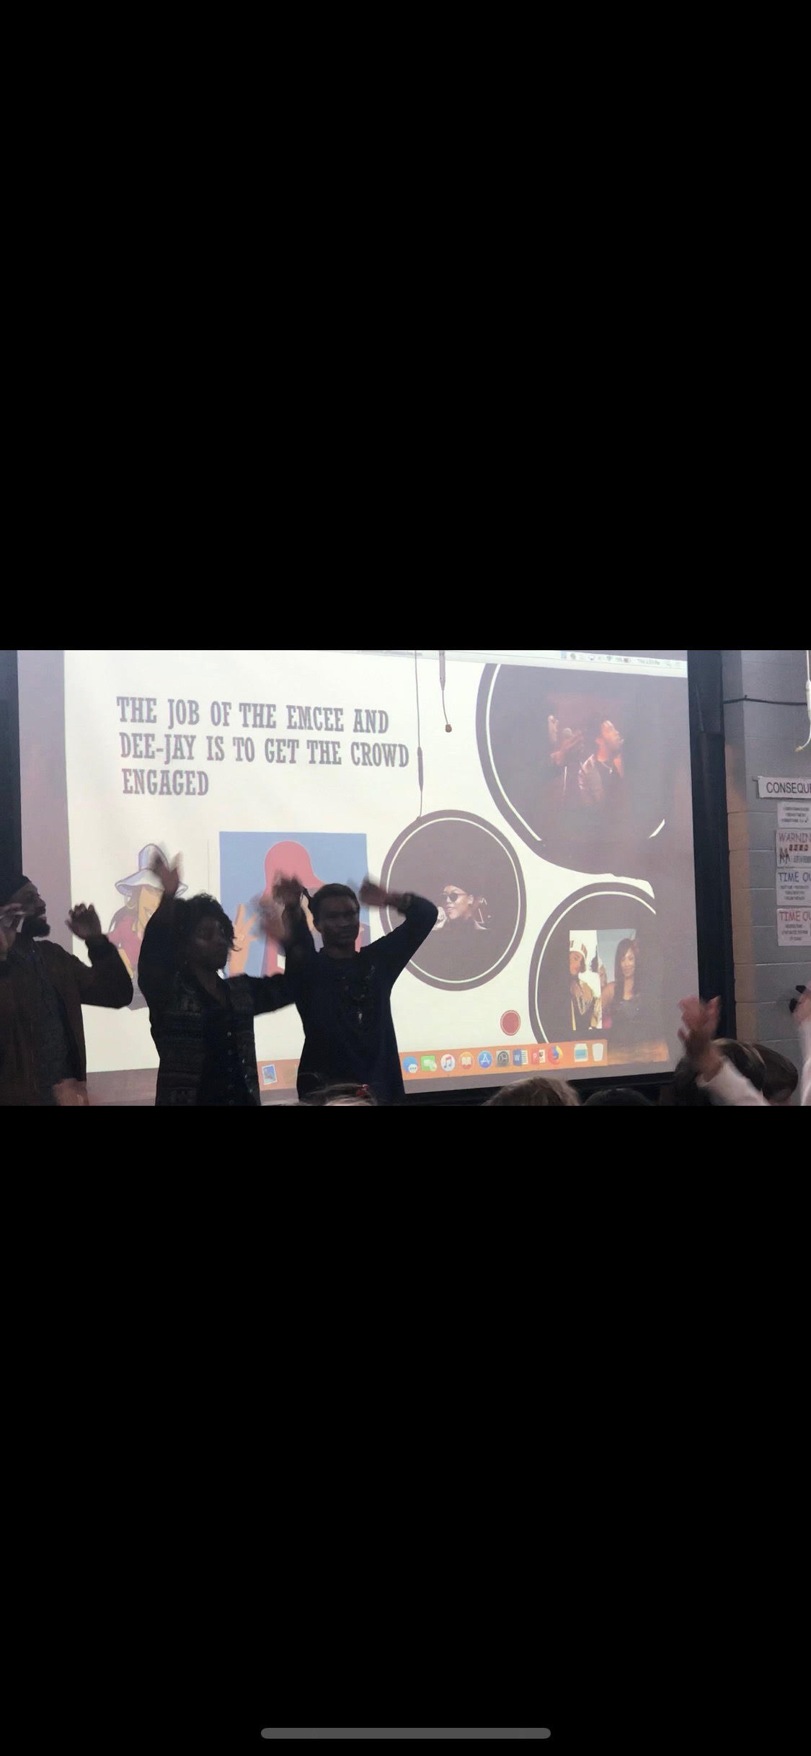
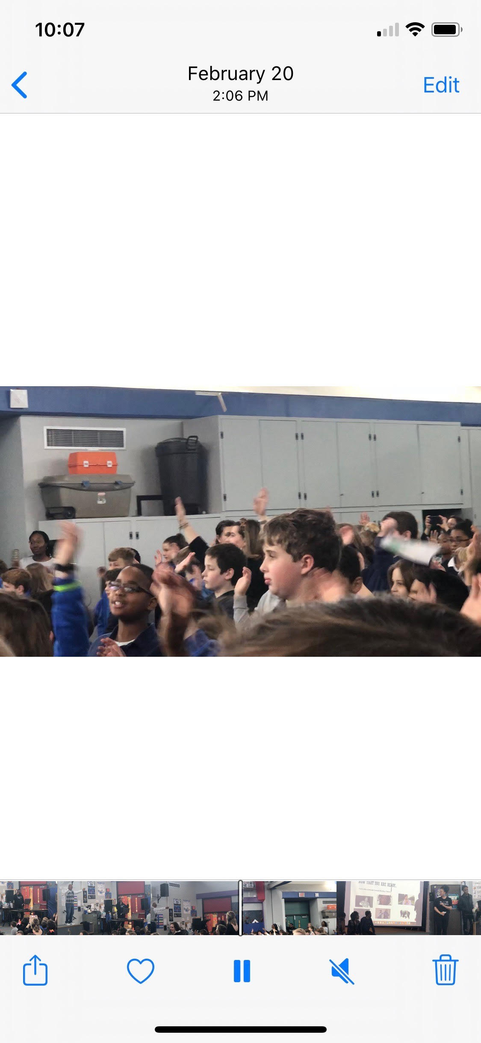
Place it Into Action Campus School Presentation-Link-https://drive.google.com/drive/folders/1M8iHaLk_ASMuHlCWX6VTm1L70AS_OmVJ

Slide 18
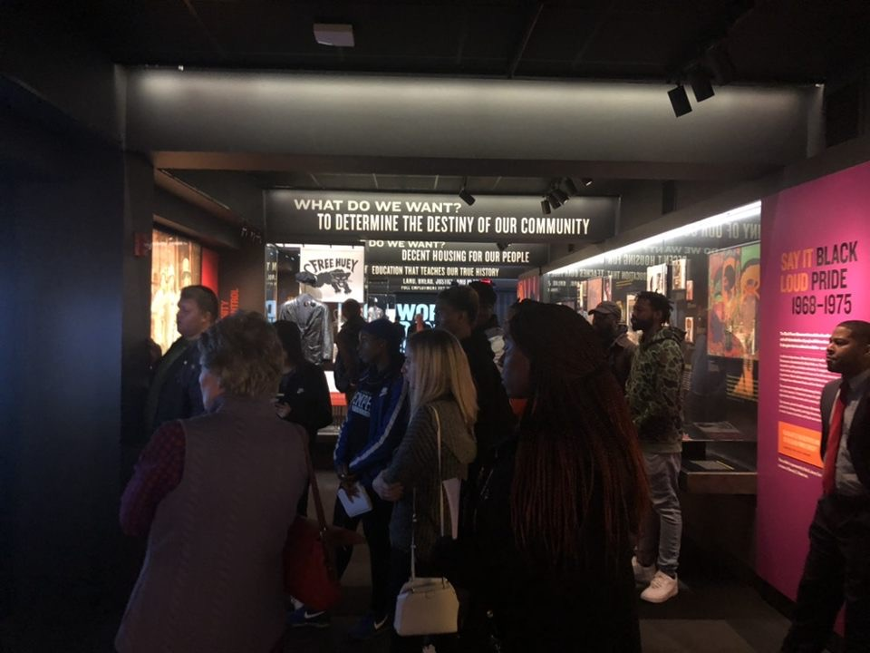

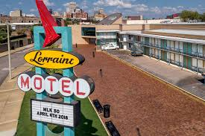
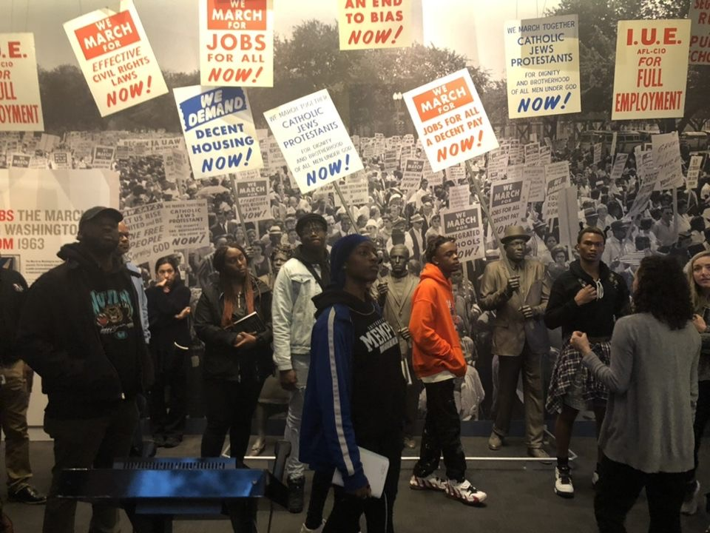
Place it Into Action Civil Rights Museum -

Slide 19
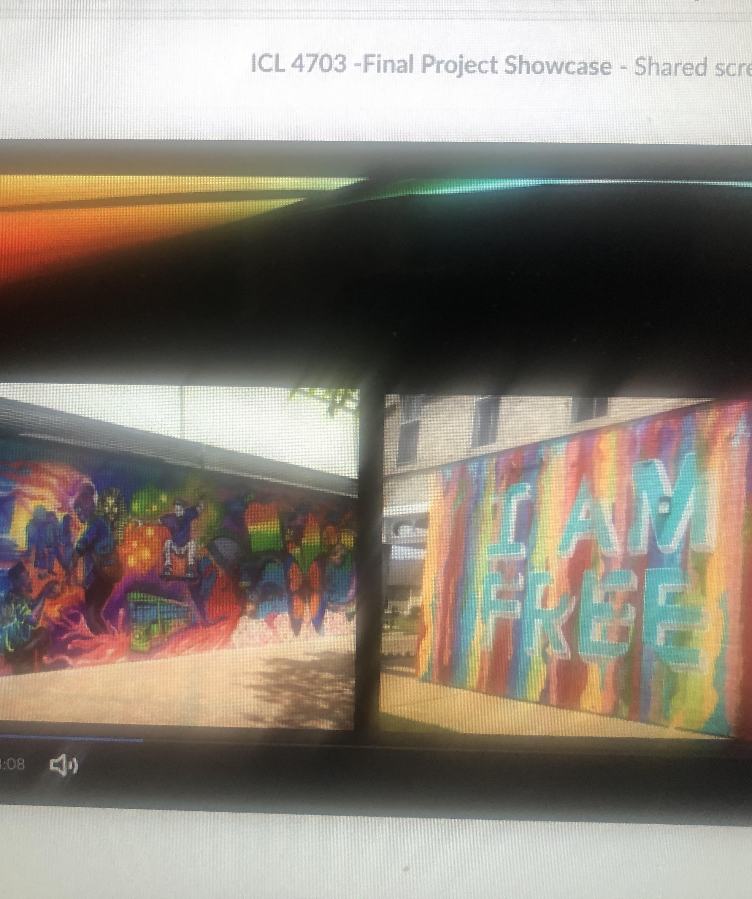
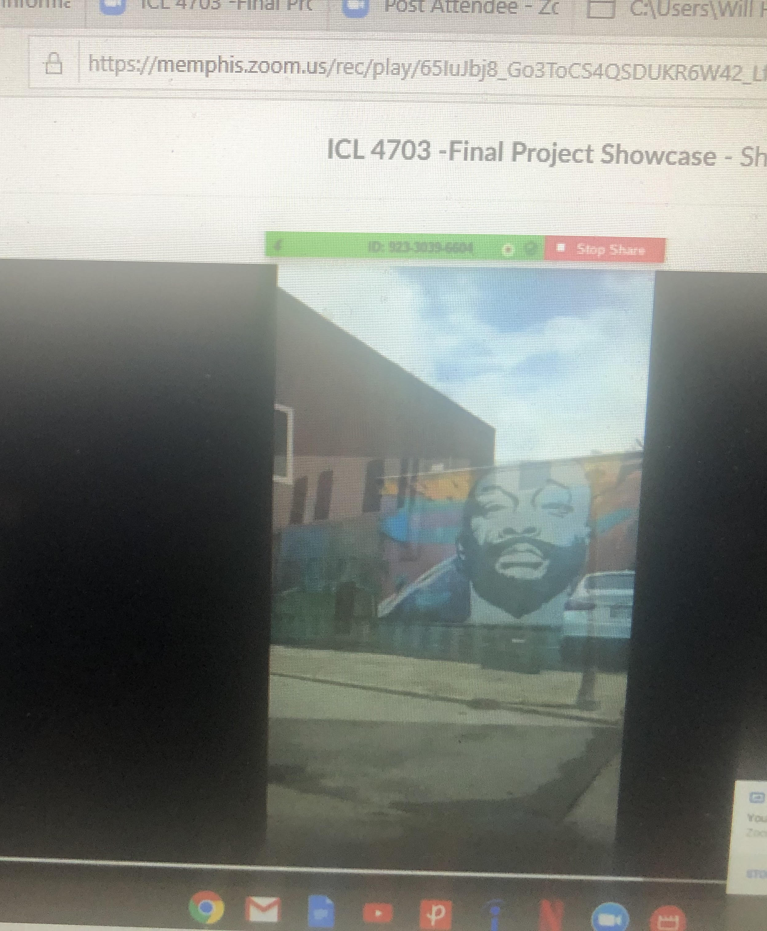


Placing it Into Action
ICL 4703 Final Project/Dee-Jay Presentations
Online Presentations

Slide 20
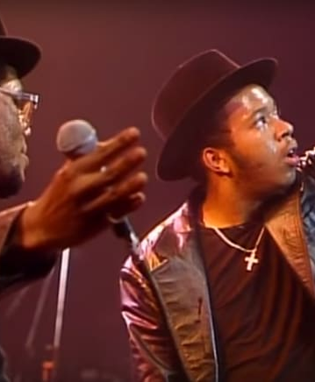


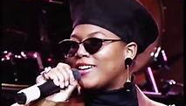
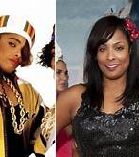
The Job of The EmCee and Dee-Jay is to get the Crowd Engaged

Slide 21


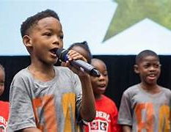

Conclusion-
Hip-Hop Can Be used as an Educational Tool

Slide 22

Conclusion
Questions & Answers

Slide 23
Bibliography

Slide 24
DISCLAIMER
This content was produced under U.S. Department of Education, Office of Special Education Programs, Award No. H325A170003. David Guardino serves as the project officer. The views expressed herein do not necessarily represent the positions or polices of the U.S. Department of Education. No official endorsement by the U.S. Department of Education of any product, commodity, service, or enterprise mentioned in this website is intended or should be inferred.

