Slide 1
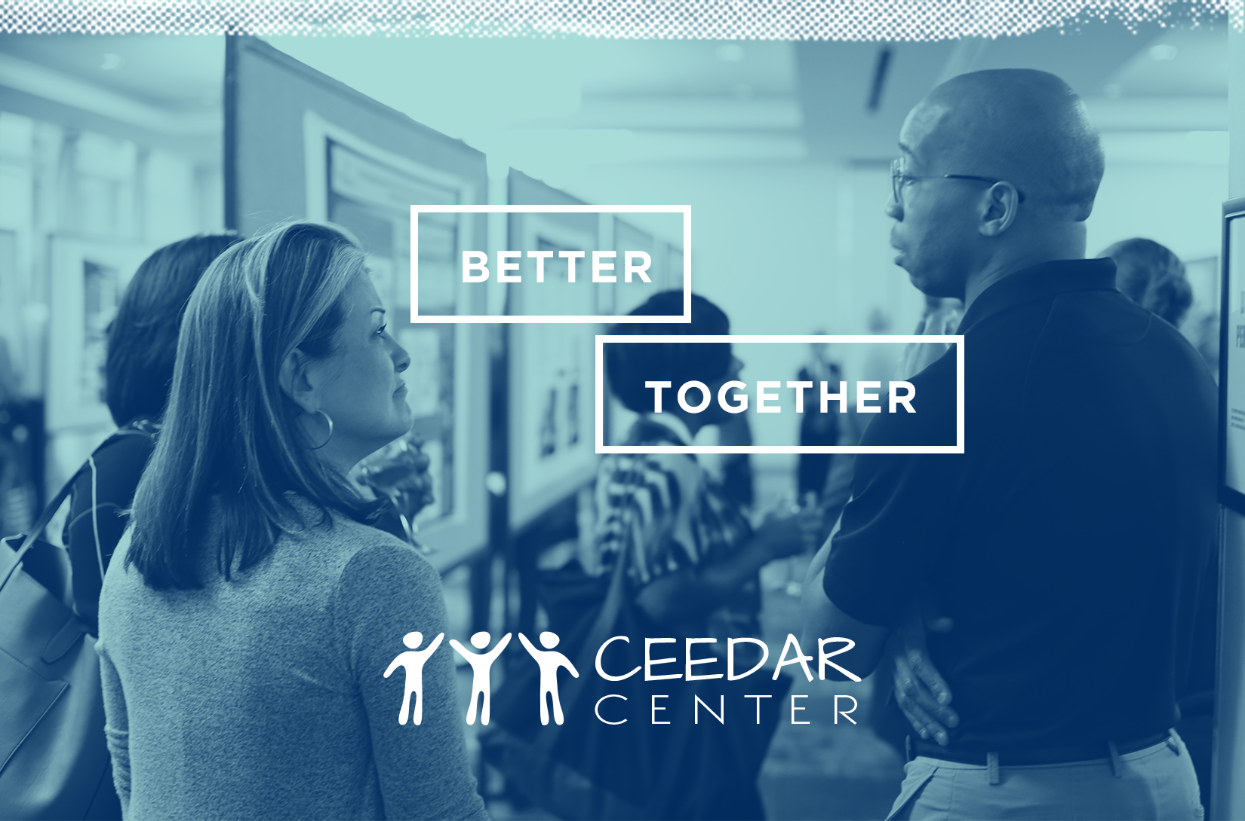
SOCIAL JUSTICE & CULTURALLY RELEVANT EDUCATION

Slide 2
Frameworks for pedagogy

Slide 3
Sleeter’s three needs

Slide 4

Whole groups discussion and q&a

Slide 5
DISCLAIMER
This content was produced under U.S. Department of Education, Office of Special Education Programs, Award No. H325A170003. David Guardino serves as the project officer. The views expressed herein do not necessarily represent the positions or polices of the U.S. Department of Education. No official endorsement by the U.S. Department of Education of any product, commodity, service, or enterprise mentioned in this website is intended or should be inferred.

